Slide 1
The Whole is Greater Than the Sum of the Parts: Client-Side Multi-Spectral Imagery in Alaska
Eric Stevens, Carl Dierking, Tom Heinrichs, and Jessie Cherry
Geographic Information Network of Alaska (GINA)

Slide 2
Outline
Definition of Terms
Advantages of “On the Fly” generation in AWIPS
Examples from Alaska
Closing Thoughts

Slide 3
Not Every Rectangle is a Square
Mutli-spectral Product: any product made from more than one single-channel image
Thus the classic 11µm-3.9µm channel difference “fog product” is multi-spectral
RGB: a multi-spectral product that contains single-channel or multi-spectral products in each of the red, green, and blue components of a color image
Thus all RGBs are multi-spectral, but not all multi-spectral products are RGBs

Slide 4
The Multi-spectral Advantage
The Whole is Greater Than The Sum of the Parts
Some meteorological and terrain features only become obvious in multi-spectral products
A more time-efficient way to evaluate all the new channels available from JPSS and GOES-R
Can combat data sprawl with data density: multispectral products are “more dense”

Slide 5
Talkin’ Bout My Generation
Server-side generation: multi-spectral products are generated by Cooperative Institute upstream of the user, http://feeder.gina.alaska.edu
Client-side generation: multi-spectral products are generated on AWIPS at the local NWS office
Greater bit depth
More informative roll-over sampling
Provides dialog for modifying color levels
Cooperative Institute delivers only the single channel imagery to the NWS field office
Less demand on bandwidth into AWIPS
Less demand on storage within AWIPS

Slide 6
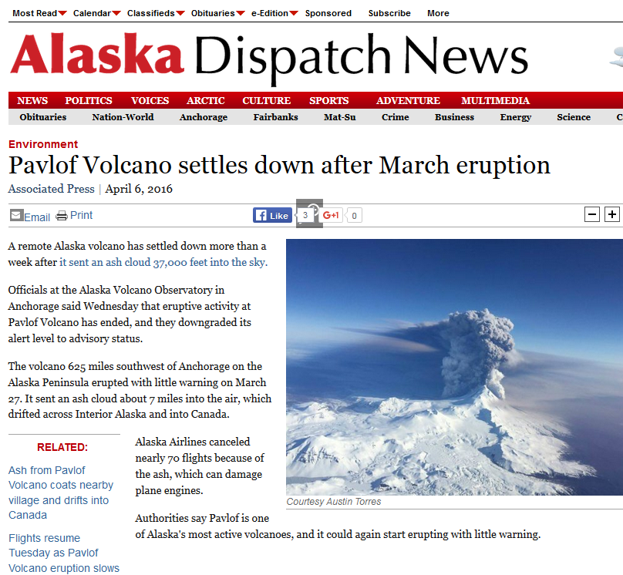

Slide 7
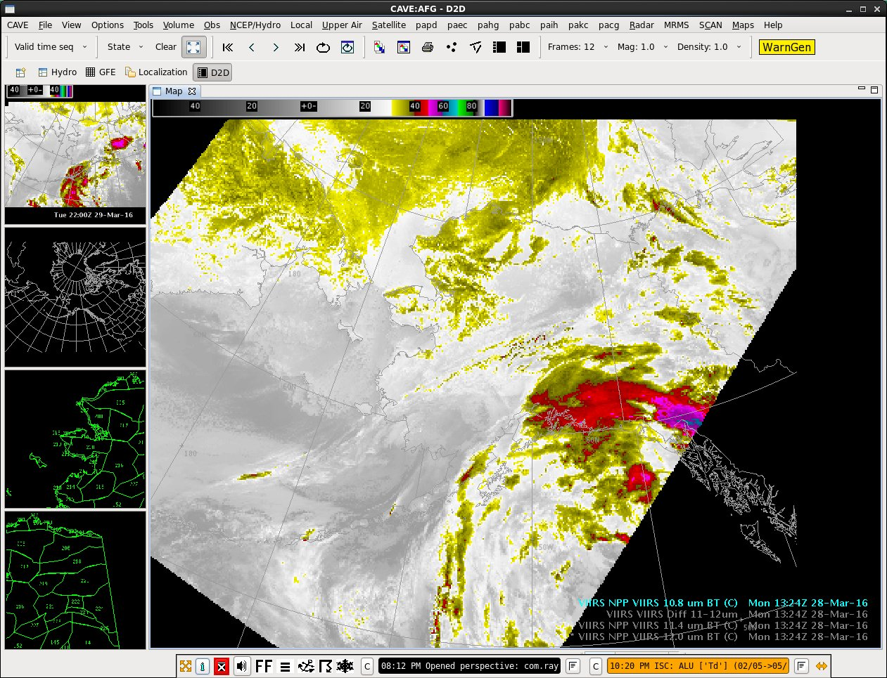

Slide 8
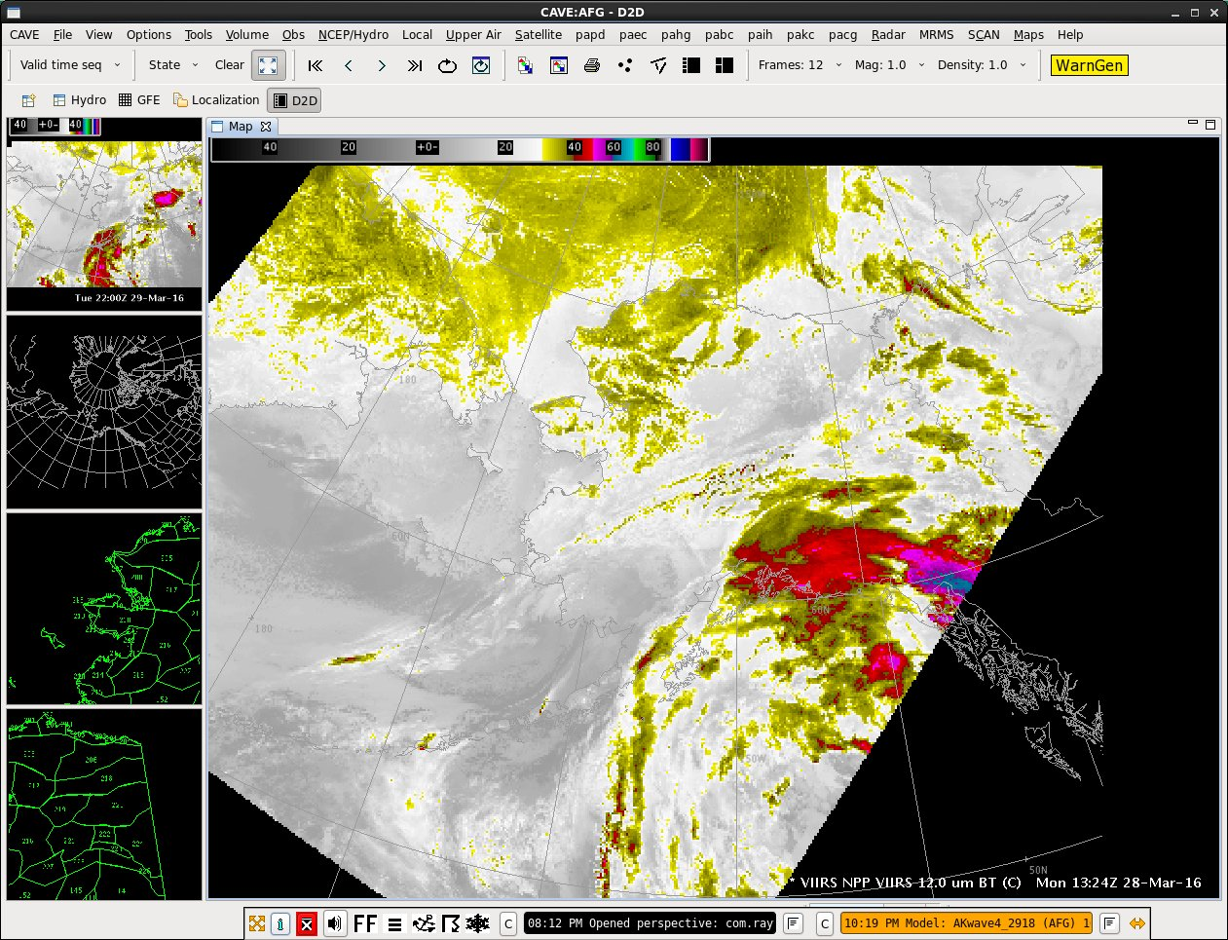

Slide 9
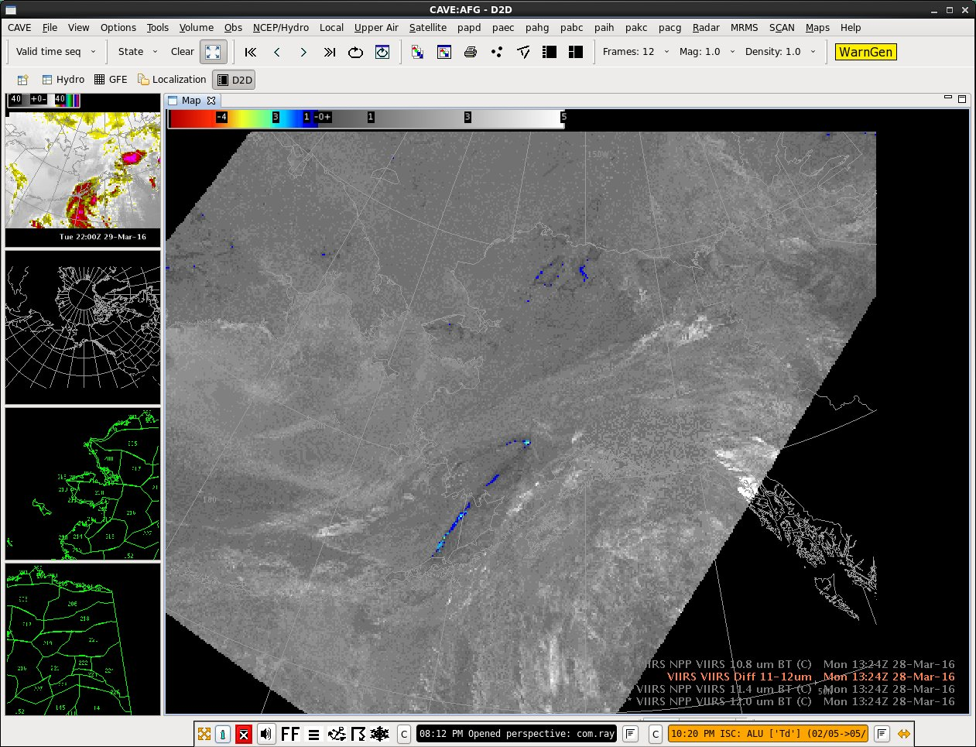

Slide 10
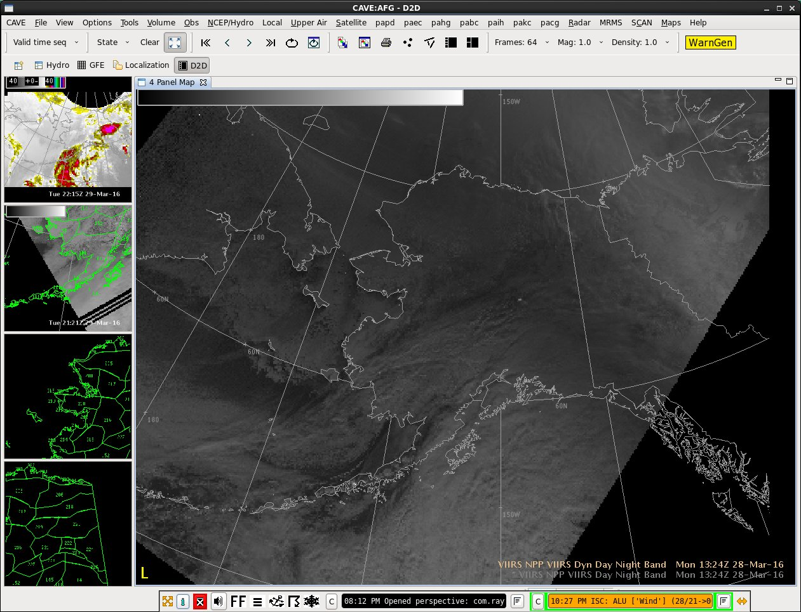

Slide 11
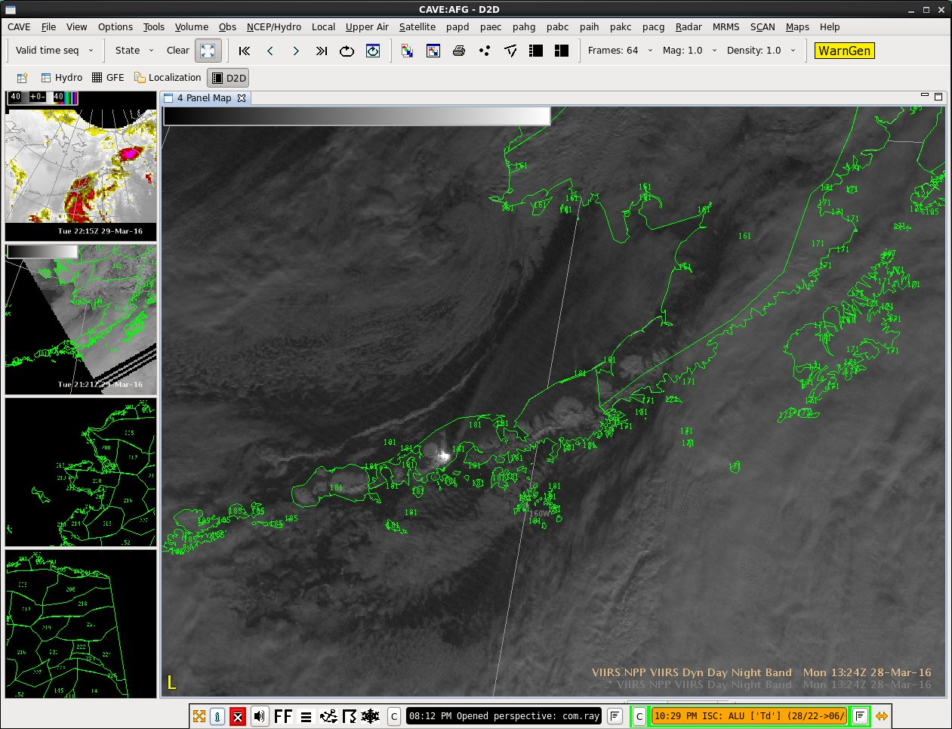

Slide 12
The “Natural Color” RGB
The Recipe:
Red: VIIRS I3 band 1.61µm
Green: VIIRS I2 band 0.86µm
Blue: VIIRS I1 band 0.64µm
The Use:
Very useful in discriminating cloudy areas from clear areas that have a snow or ice-covered surface
Bonus Complication, Known by several names: Natural Color, Land Cover, False Color,.. More?

Slide 13
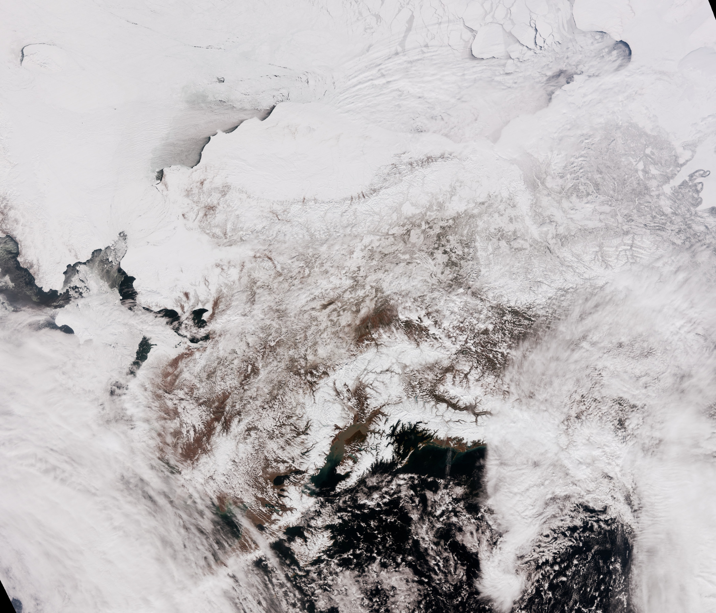
Notes:
This image, as well as the following few, is from April 17, 2016 at 2205Z, or 205pm local time.

Slide 14
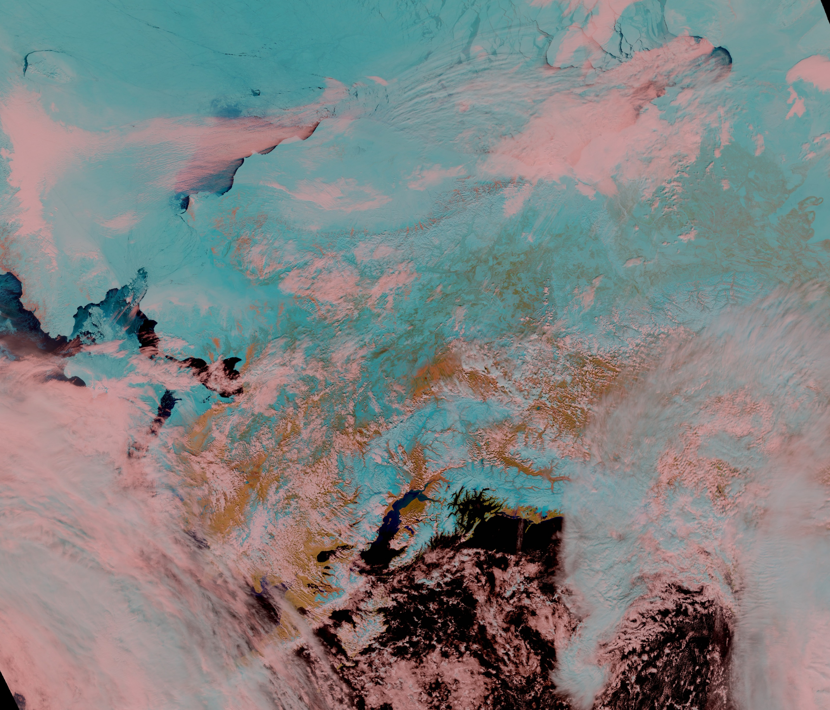

Slide 15
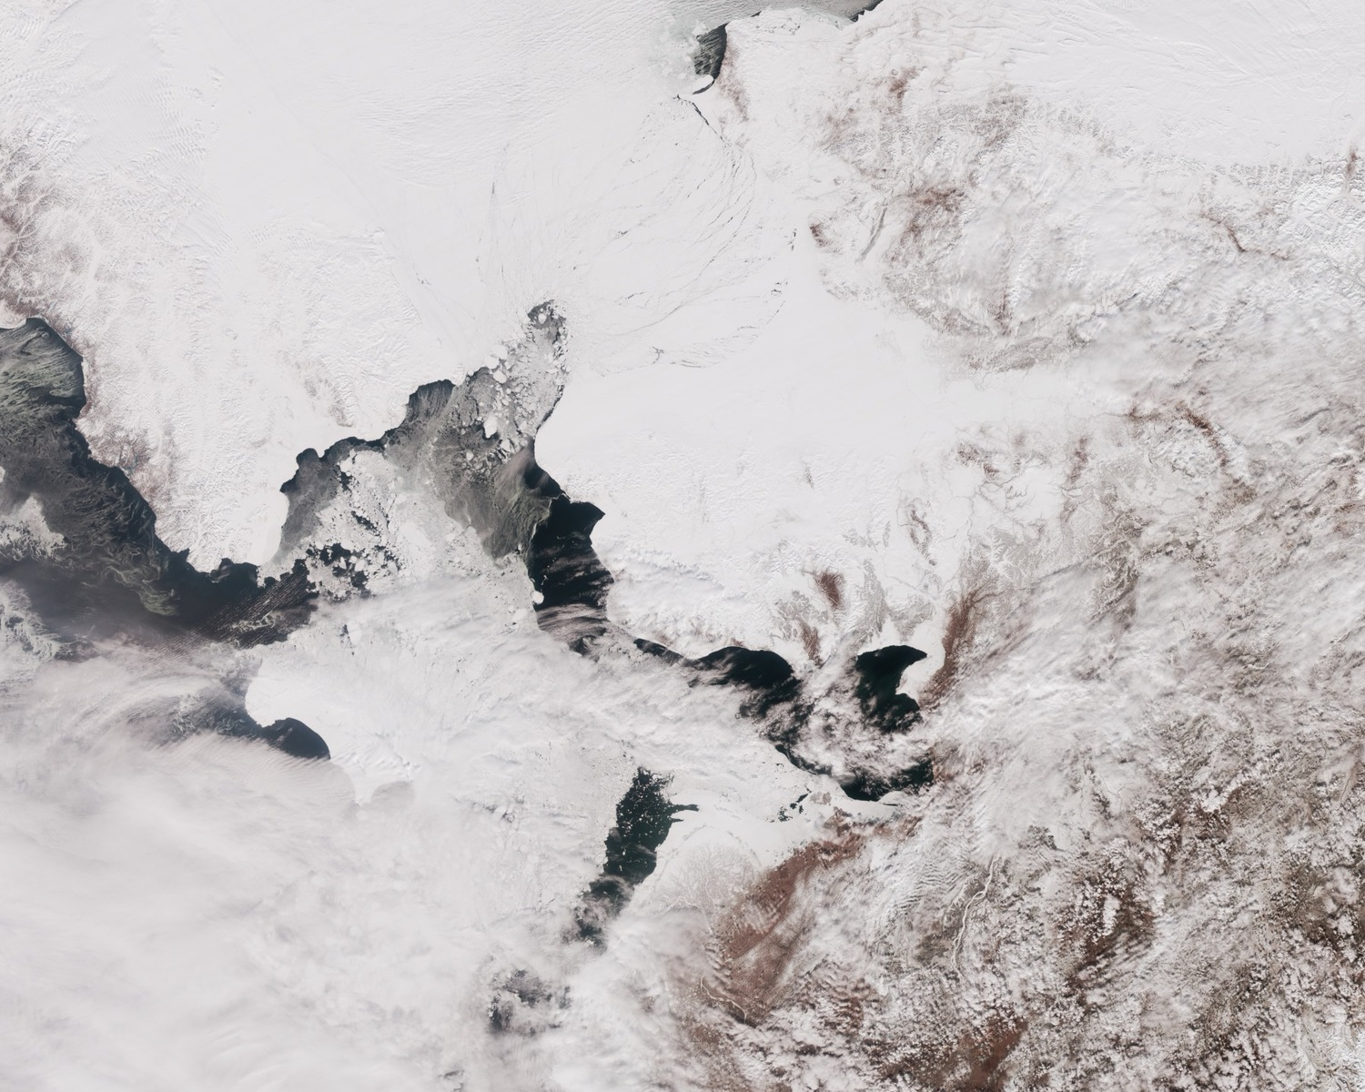

Slide 16
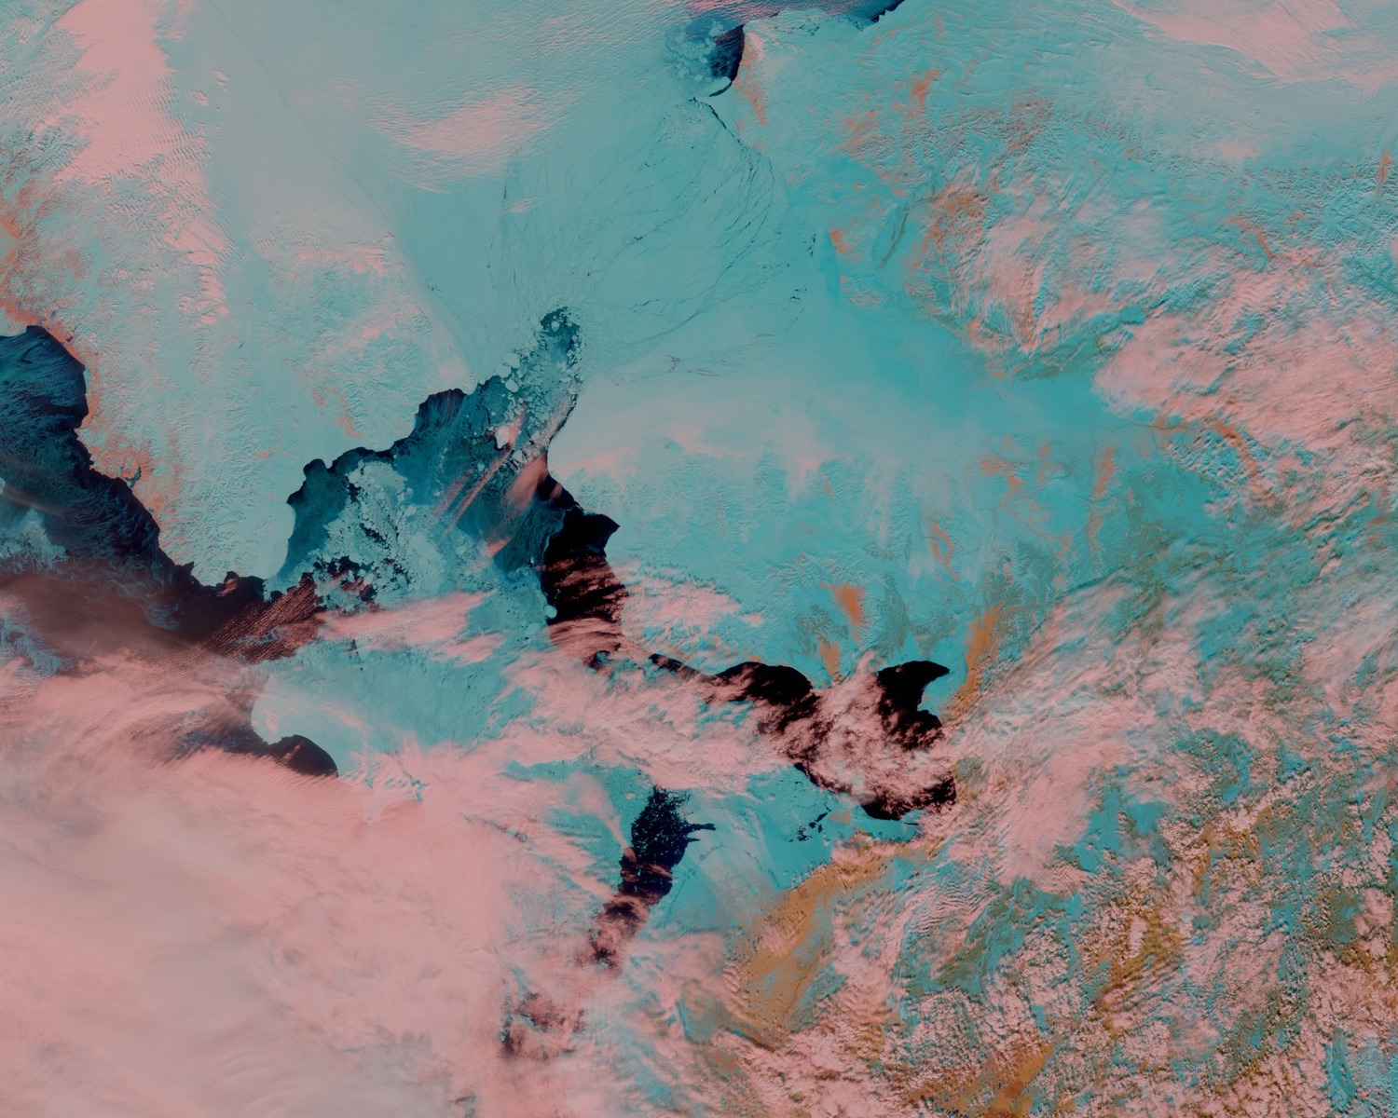

Slide 17
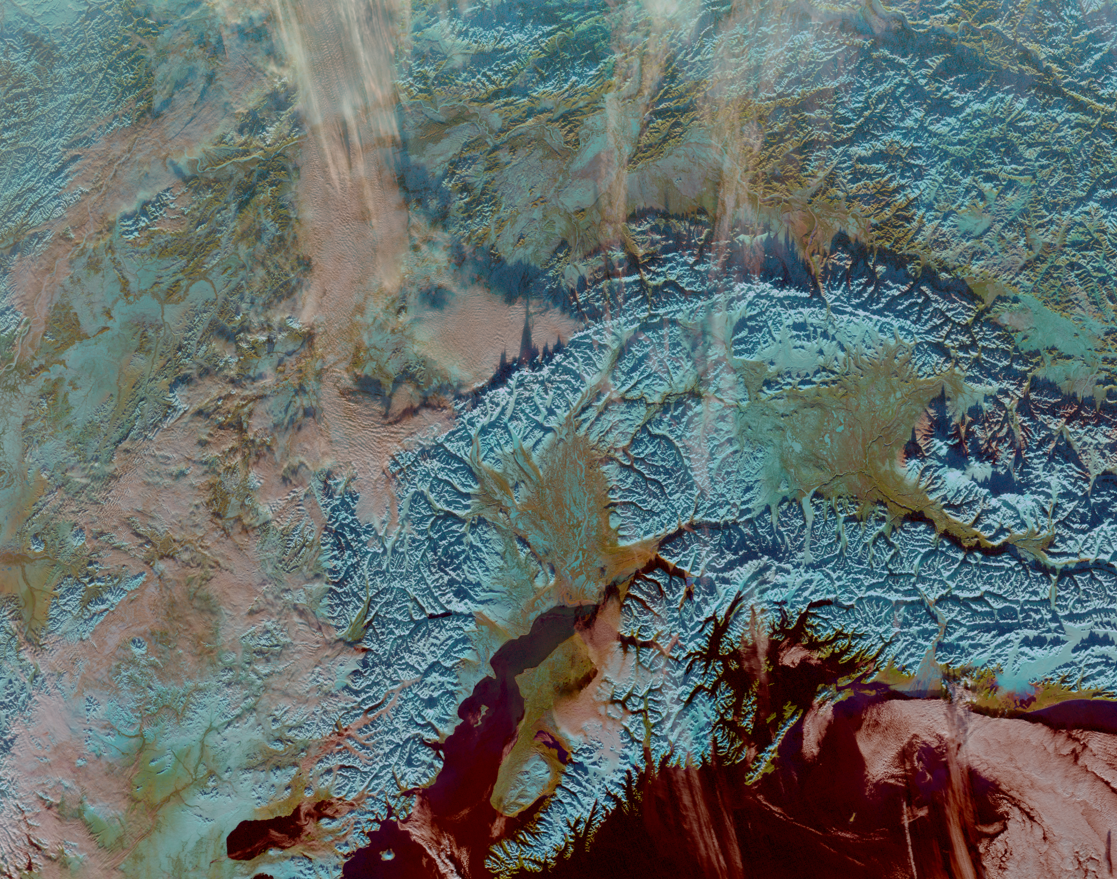

Slide 18
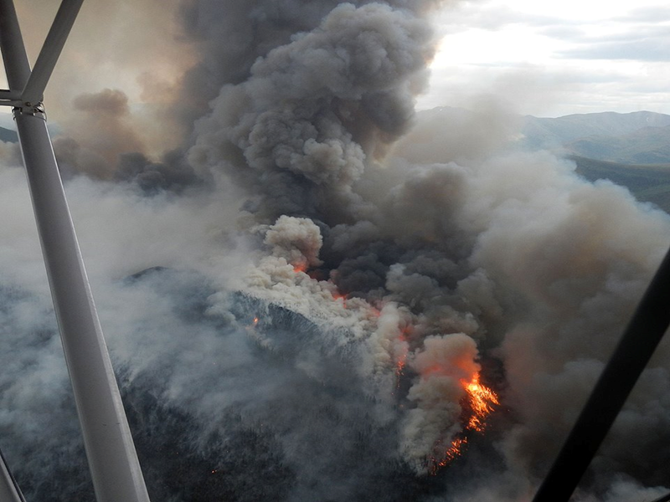
Notes:
June 22, 2015, Willow Creek fire in BLM White Mountains, AK. Wildfires burned over 5 million acres in Alaska in 2015.

Slide 19
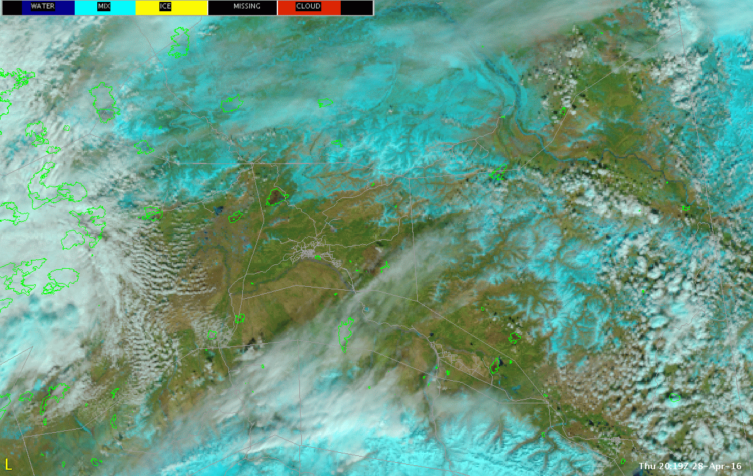
Notes:
Interior Alaska on April 29, 2016. RGB Naturual Color based on VIIRS data delivered by GINA NWS Alaska, this product made “on the fly” on AWIPS by Ed Townsend. The big takeaway here is that this RGB uses the 0.86micron veggie band as a component…this band will highlight the damaged vegetation in the burn areas, as less incoming sunlight is reflected at 0.86micron and shows up here as a deficit in the green gun.

Slide 20
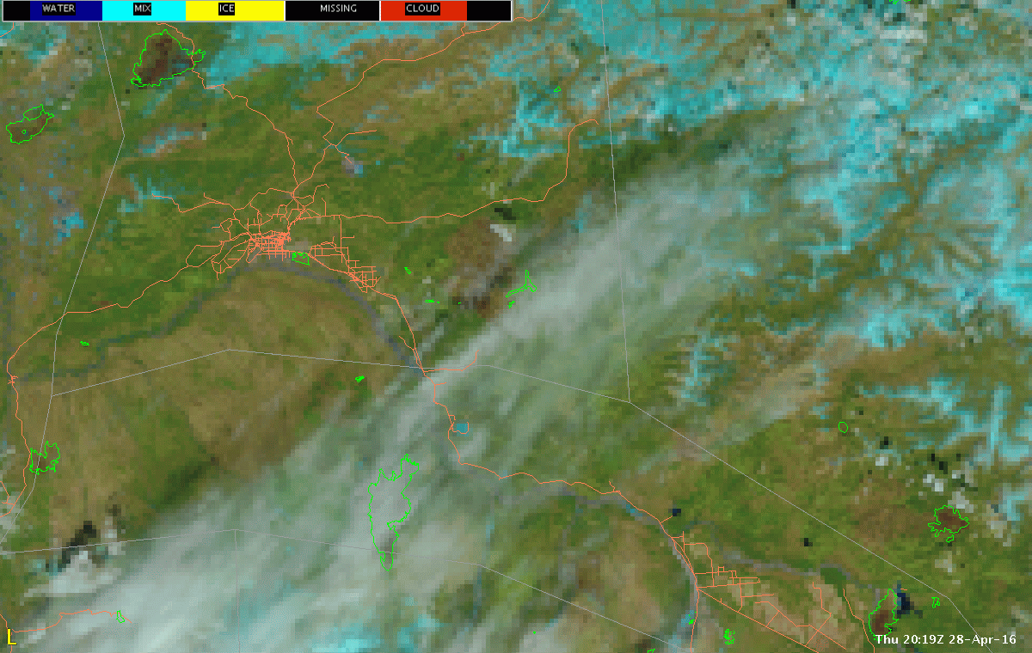
Notes:
Zoom in, same image as in previous slide

Slide 21
Closing Thought 1: The Definition of Expertise Regarding Multi-Spectral Imagery
The Users’ Levels of Understanding:
Good: Awareness of the Product: “What’s this new RGB?”
Better: Basic Use of the Product: “In this RGB, the greenish-yellow clouds often indicate IFR ceilings.”
Best: Expertise with the Product: “The sea ice appears blue in this image because the 1.61µm channel is in the red gun, and at this wavelength incoming sunlight is not well reflected by snow and ice-covered surfaces”
One role of the Cooperative Institutes is to help forecasters achieve this “Level 3” of understanding

Slide 22
Closing Thought 2: New Opportunities for the Cooperative Institutes?
If the “client-side” approach to the generation of multi-spectral imagery is embraced at the NWS, then…
There will be a need at the NWS for training on how to do basic construction of multi-spectral imagery on AWIPS, fundamental do’s and dont’s
Potential for collaboration with NWS WFOs and Regions in developing new multi-spectral products to address WFO and Regional-level challenges: the “Arctic Testbed” in Alaska
There will still be non-NWS users who can’t make their own multi-spectral products on the fly

Slide 23
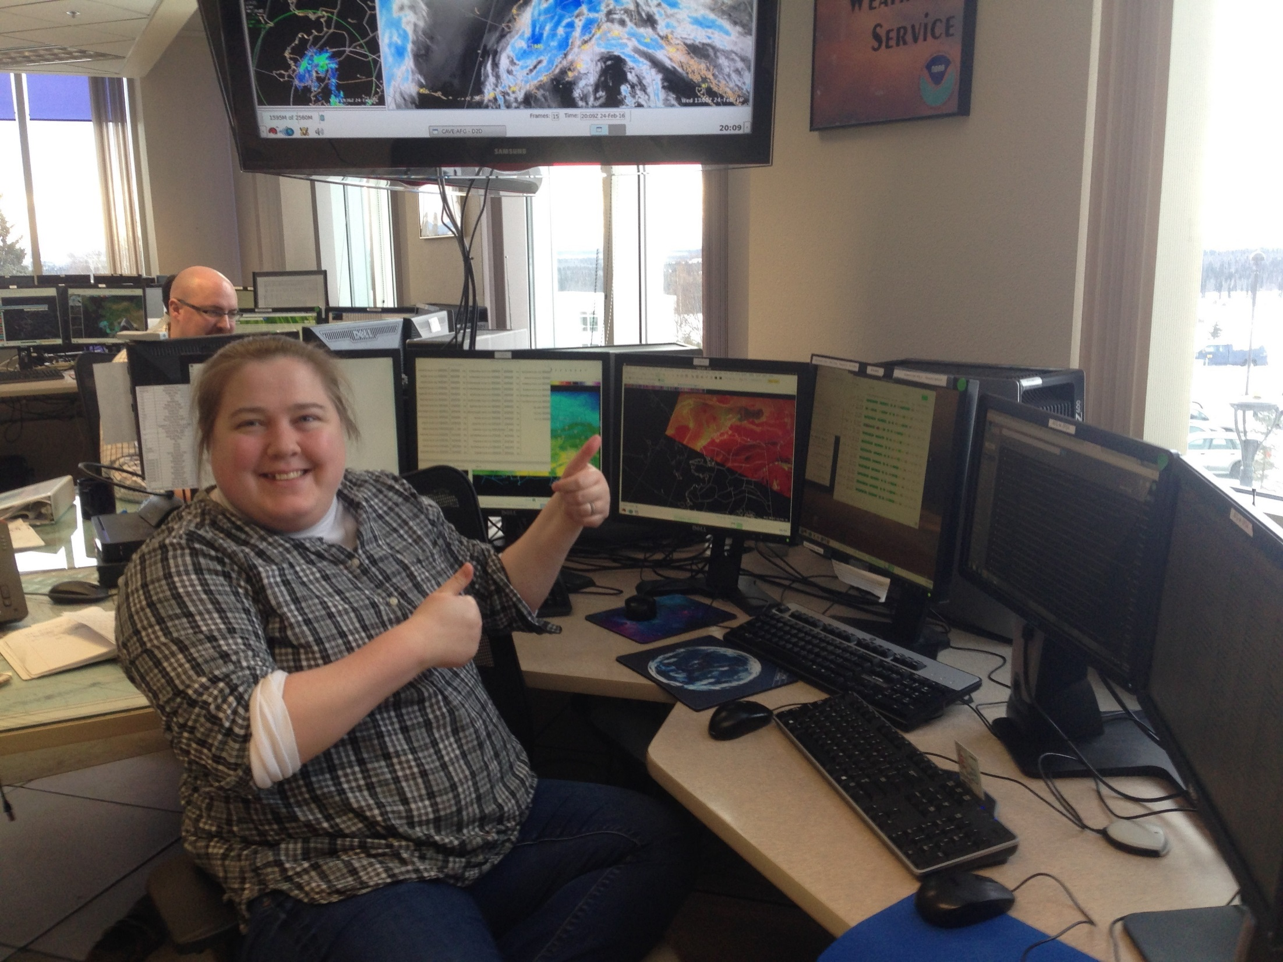
Notes:
Our goal: NWS forecasters are fluent and demonstrate expertise with multi-spectral imagery, routinely use this imagery in the forecast process, and thereby the quality of their forecasts improves. Lindsey Tardif-Huber and Ryan Metzger at WFO Fairbanks, March 2016.

Slide 24
Bonus Slides: the GMU River Flood and Ice Product Rides Again
Thanksgiving Day, 2015: Inelegant power hit at GINA killed the machine generating the product
March, 2016
Product back in routine generation and delivery to NWS Alaska: Whew!
COMET module hits the streets/rivers, “JPSS River Ice and Flood Products”
April, 2016
GMU’s Dr. Sanmei Li in Alaska as visiting scientist
Corresponding airborne photography now in SSEC’s Real Earth

Slide 25
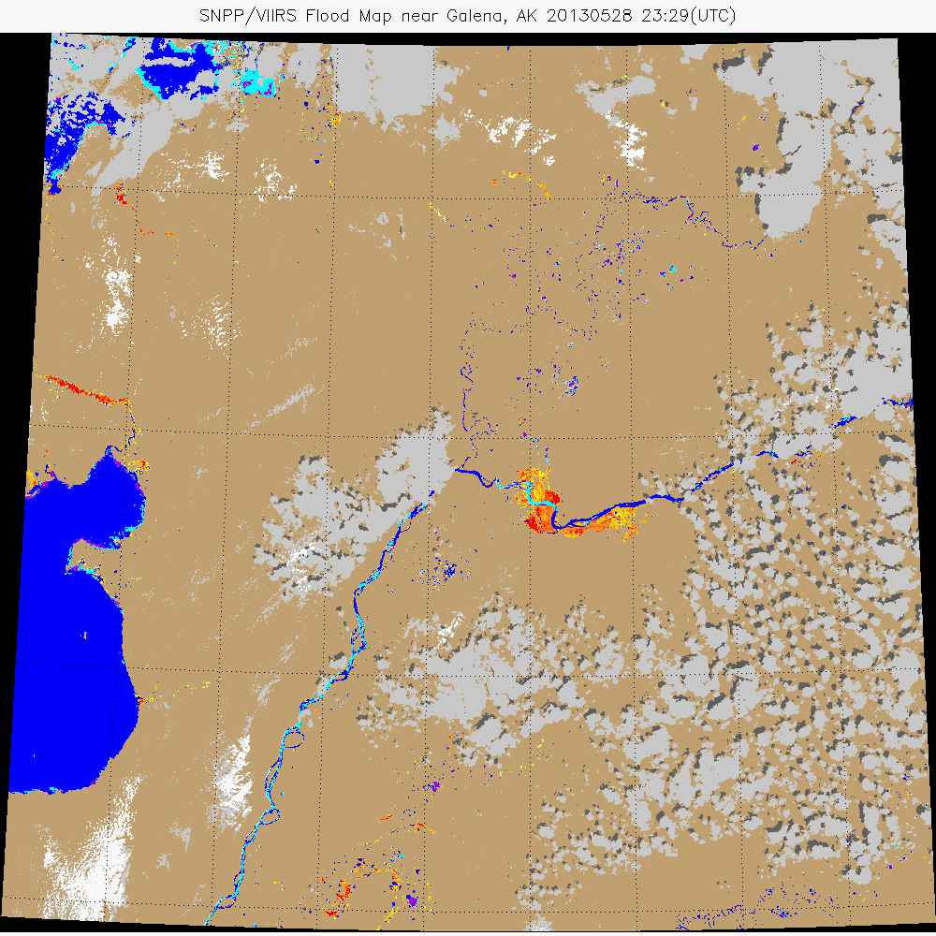

Slide 26
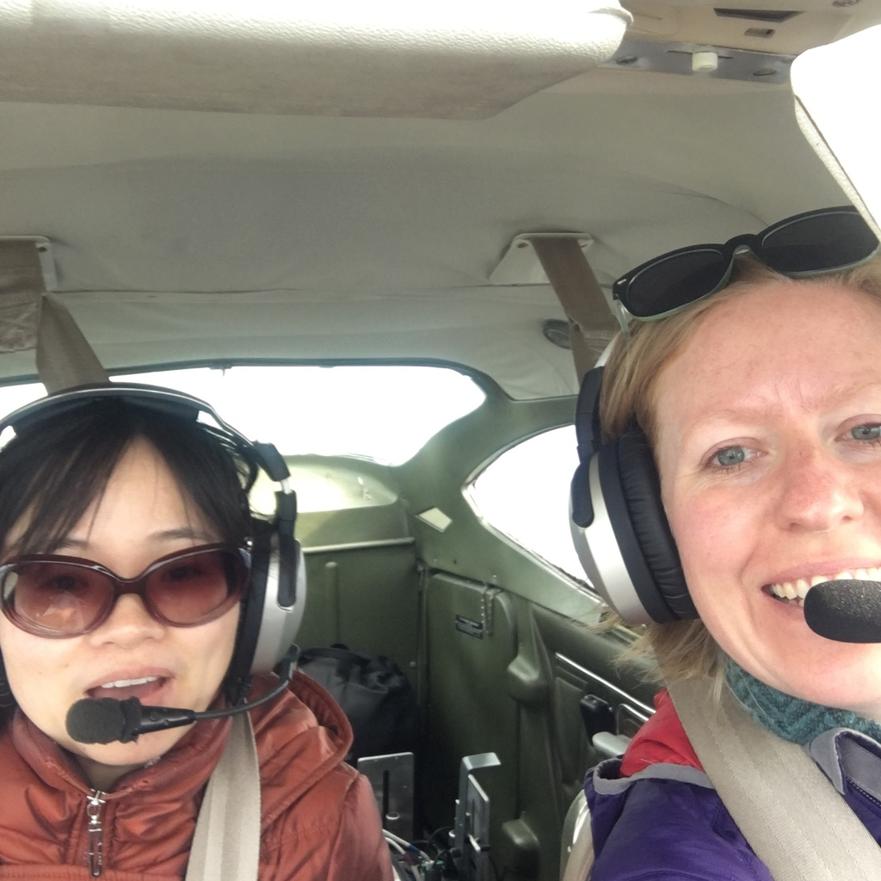

Slide 27
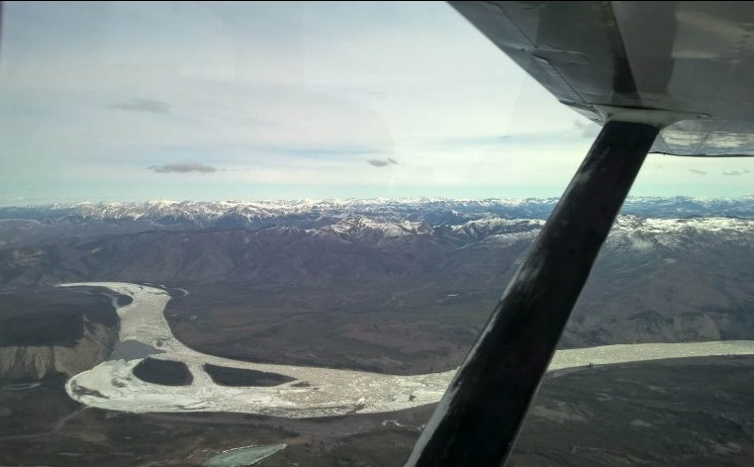

Slide 28
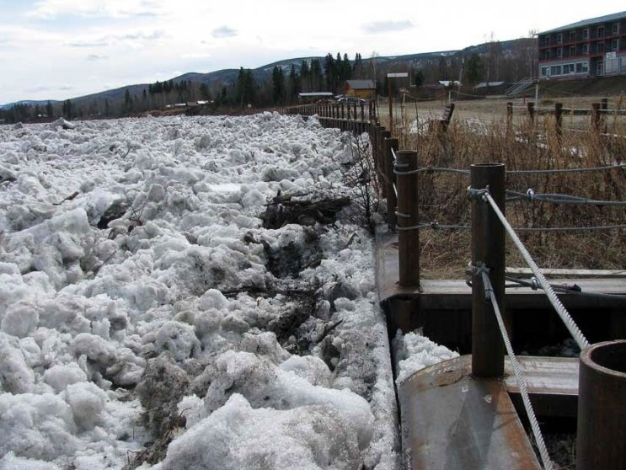

Slide 29
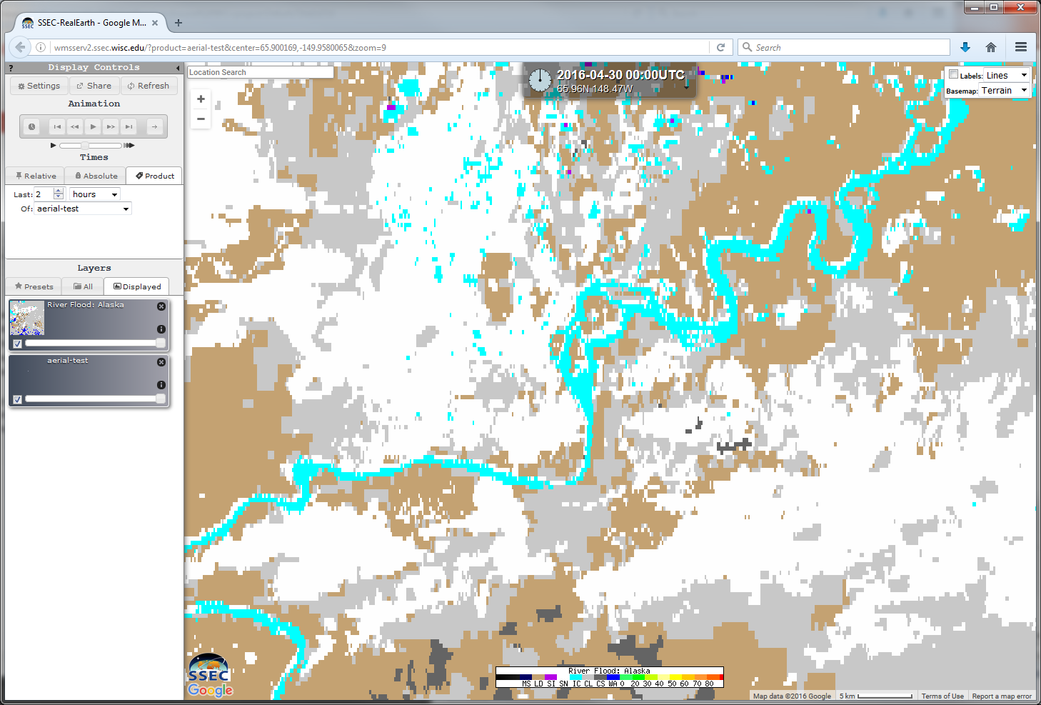

Slide 30
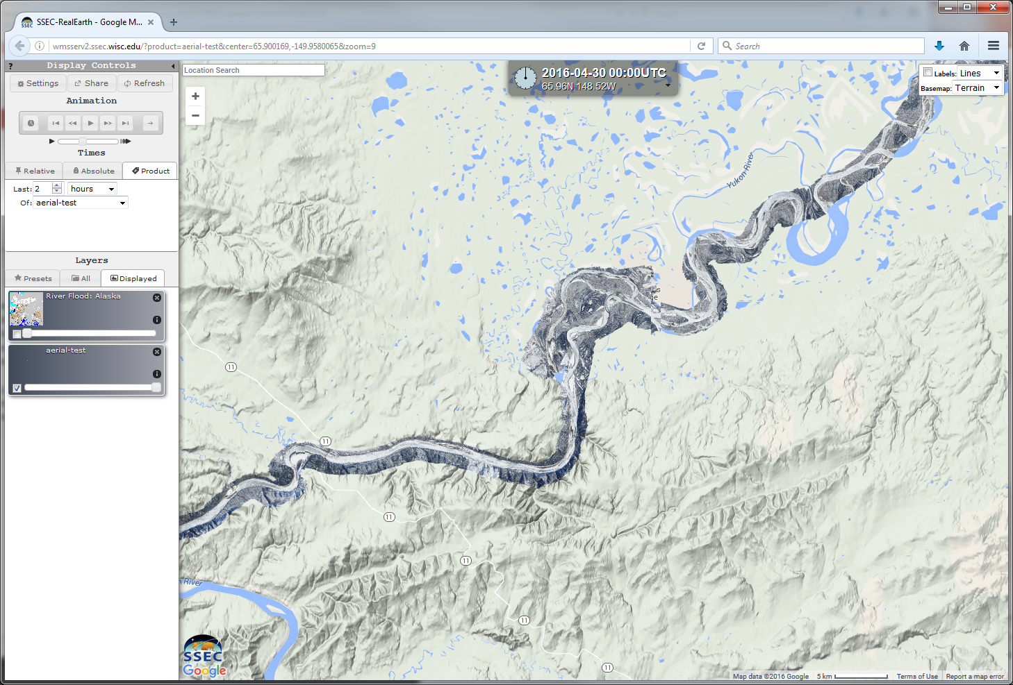

Slide 31
eric@gina.alaska.edu

