Slide 1
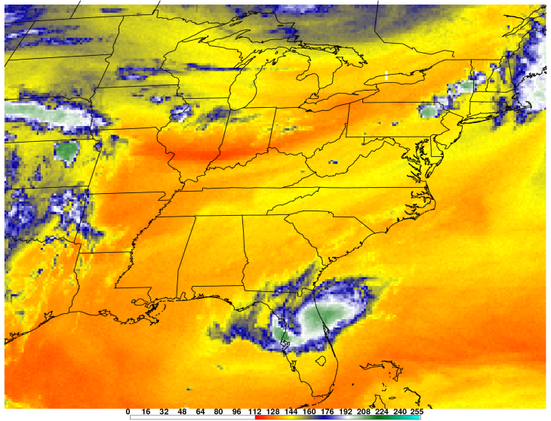
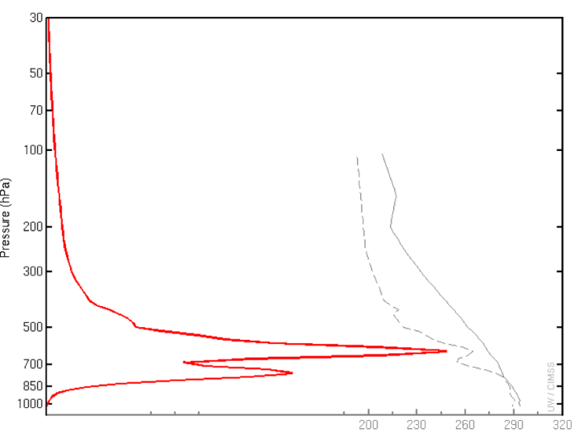
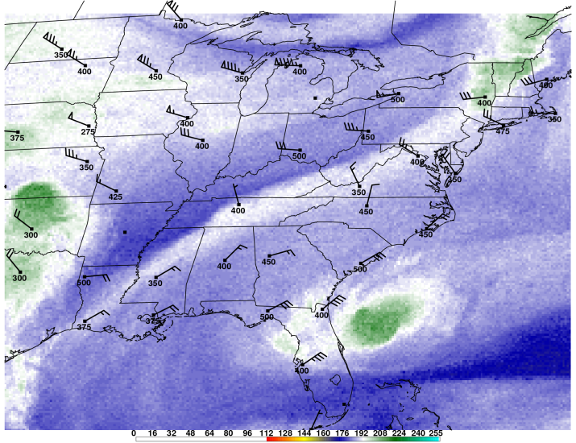
The Use of Multiple GOES Sounder Water Vapor Channels to Monitor the Evolution of Mid-level Dry Air in Convective Events
Christopher M. Gitro
NOAA/NWS Kansas City/Pleasant Hill Weather Forecast Office

Slide 2
Motivation
NWS provides only limited satellite interpretation training
SHyMet (Satellite Hydrology and Meteorology)
Taken as Interns (“most” anyways)
Little to no training in Severe and Winter AWOC
Many times an underutilized and underappreciated tool
Increased EML discussion on AFDs and Severe Wx Outlooks
RAOB network provides soundings only twice/day
Real-time upper-air analysis needed during rapidly developing severe events

Slide 3
Background
All NWS BGM forecasters completed VISIT training session on using 7.4 µm GOES Sounder Channel for severe weather detection
10-km resolution; 1-hr temporal resolution
Available in AWIPS under the satellite menu
Main advantages:
Detects broader window of the atmosphere
Better ability to resolve mid/upper-level moisture contributions
Great tool for tracking mid-level dry air (convective instability) in real-time
Northeastern U.S. has long history of significant severe weather events associated with remnant elevated mixed layers (EMLs)
Ability to track mid-level dry air plumes in real time is highly beneficial to NWS severe weather ops!

Slide 4
Current/Future Water Vapor Bands
Three GOES Sounder Water Vapor channels currently available to all NWS offices in AWIPS:
Band 10, 7.45 µm → low to mid-level moisture
Band 11, 7.02 µm → mid to upper-level moisture
Band 12, 6.52 µm → upper-level moisture
Currently seen at 10-km resolution with an update interval of 1-hr
Future GOES-R Water Vapor Bands
Band 10, 7.4 µm → low to mid-level moisture
Band 9, 7.0 µm → mid to upper-level moisture
Band 8, 6.2 µm → upper-level moisture
Advanced Baseline Imager: 2 km resolution and update interval 60s!
Current GOES Sounder water vapor bands can be used as a proxy for future GOES-R water vapor bands!

Slide 5
Real-time Weighting Functions
Ability to see exactly where GOES Sounder is sampling
Desperately needed in AWIPS for analysis!
http://cimss.ssec.wisc.edu/goes/wf/viewwf.php?day=T0&time=00&sat=GE&band=wv&stn=

Slide 6
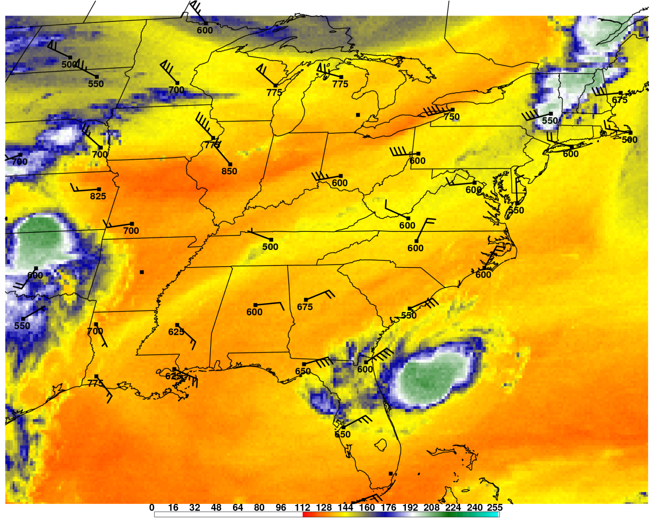
Winds/Pressure Levels at Peak of Weighting Function
Forecasters think of water vapor as a plan view (i.e. 600 mb)
Actually an isosurface that slopes with time
Horizontal distribution of moisture much more variable in lower portions of the atmosphere 7.45 µm channel
Much better at tracking low/mid-level boundaries than the standard mid/upper-level water vapor band currently utilized by most forecasters
GOES Sounder Band 10, 7.45 µm

Slide 7
Review
Despite crude resolution, current GOES Sounder serves as proxy for future GOES-R water vapor channels
Ability to detect broader portions of the atmosphere
Three distinct channels detect moisture contributions at specified levels of the atmosphere
Variable moisture distribution in the horizontal allows the 7.45 µm Sounder channel to track low/mid-level boundaries much more efficiently than the current standard water vapor channel
Real-time weighting functions give forecasters vital knowledge on exactly where in the atmosphere the Sounder channels are sampling
Needed in AWIPS!

Slide 8
June 1, 2011 Case Study

Slide 9
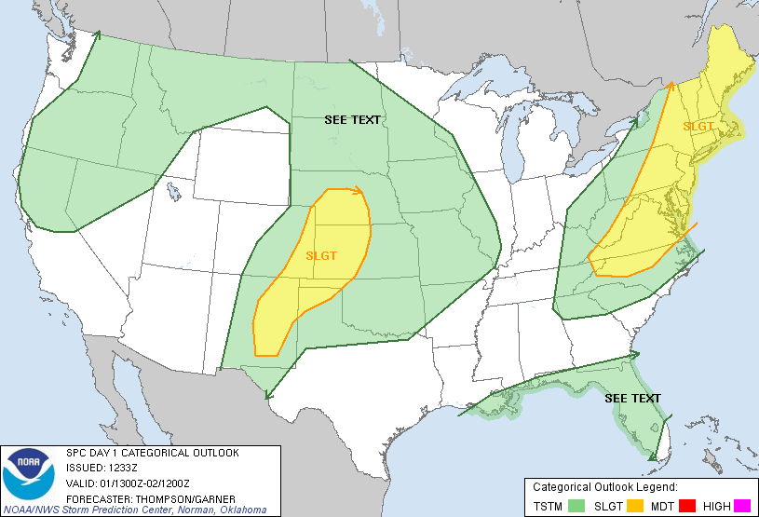
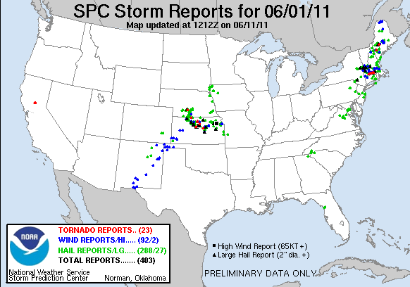
Event Overview
Large long tracked tornado in western MA
63 km long path length (through Springfield)
200+ injuries
3 confirmed fatalities

Slide 10
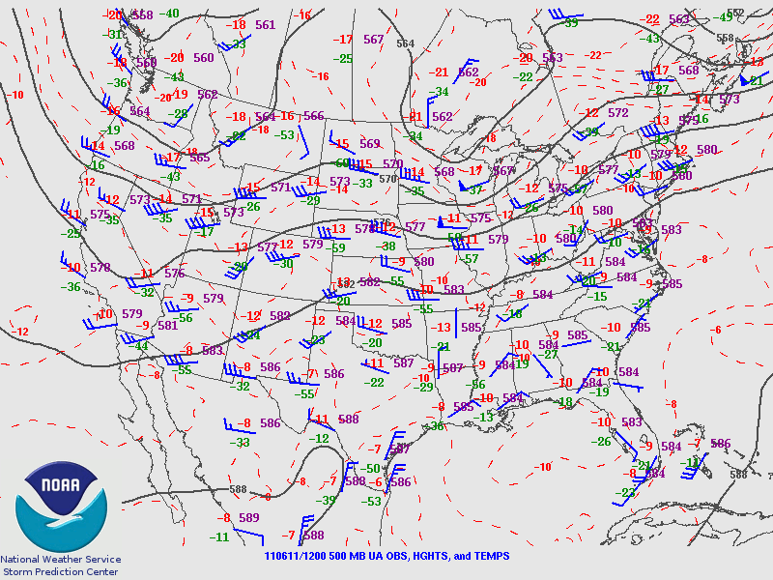
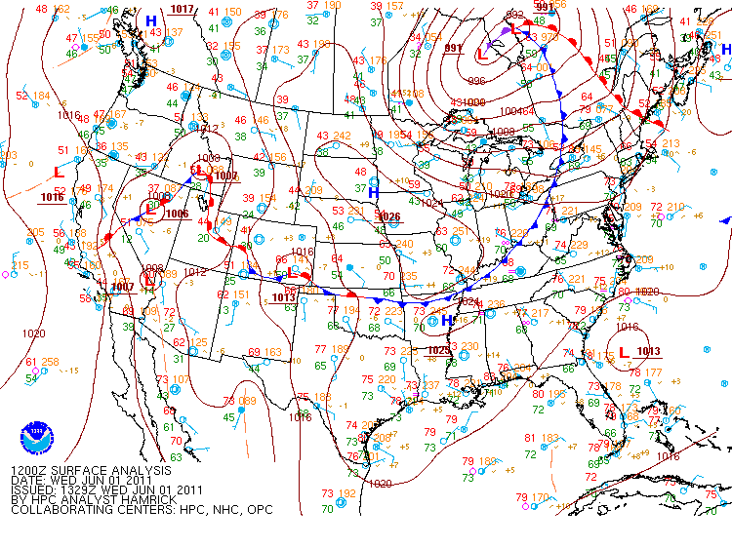
Synoptic Setup

Slide 11
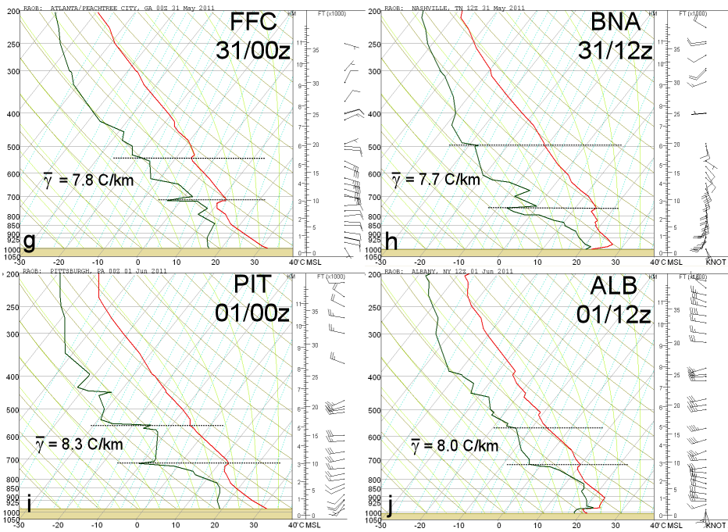
Elevated Mixed Layer
Image from Banacos et al. 2012, their Fig. 8
Used with permission

Slide 12
700-500 hPa Lapse Rates
6 hourly time steps from 0000 UTC 28 May – 1800 UTC 01 June
Image from Banacos et al. 2012, their Fig. 5
Used with permission

Slide 13
1600 UTC Surface Analysis
Prefrontal trough located across eastern NY with dewpoint gradient located further west
Convection initially develops in between dewpoint gradient and prefrontal trough
Image from Banacos et al. 2012, their Fig. 10
Used with permission

Slide 14
The Rest of the Story
Elevated mixed layer was moving out of eastern NY/western New England by afternoon on 1 June 2011
Cross section shows elevated cold front moving in during the afternoon → Focus for convection east of dewpoint gradient
Operational experience indicates upper cold fronts are often overlooked
Previous research (Locatelli et al. 2002) suggests cold fronts aloft common east of Rockies → major severe wx producer
Big question: How can an operational forecaster track these features in real-time?
Image from Banacos et al. 2012, their Fig. 11
Used with permission

Slide 15
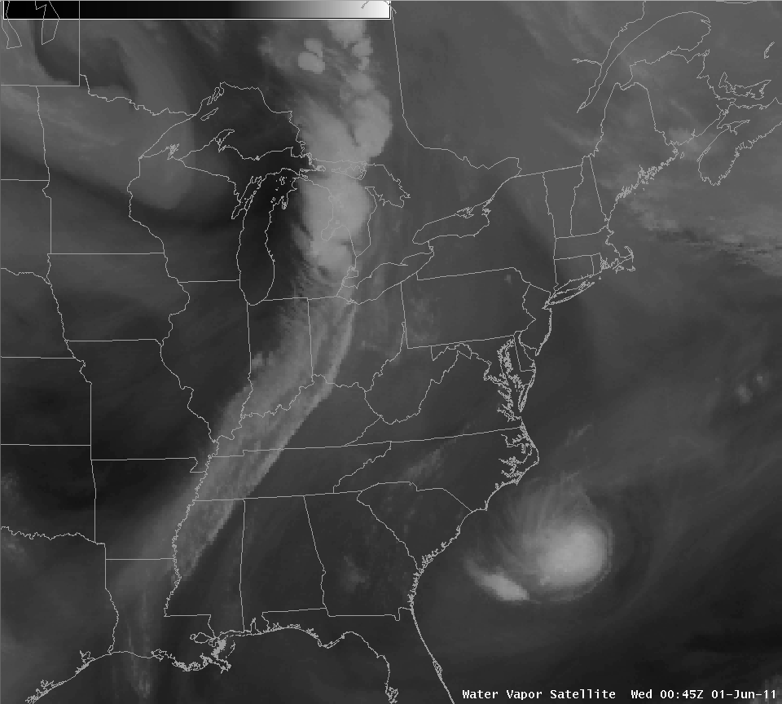
Conventional Water Vapor

Slide 16
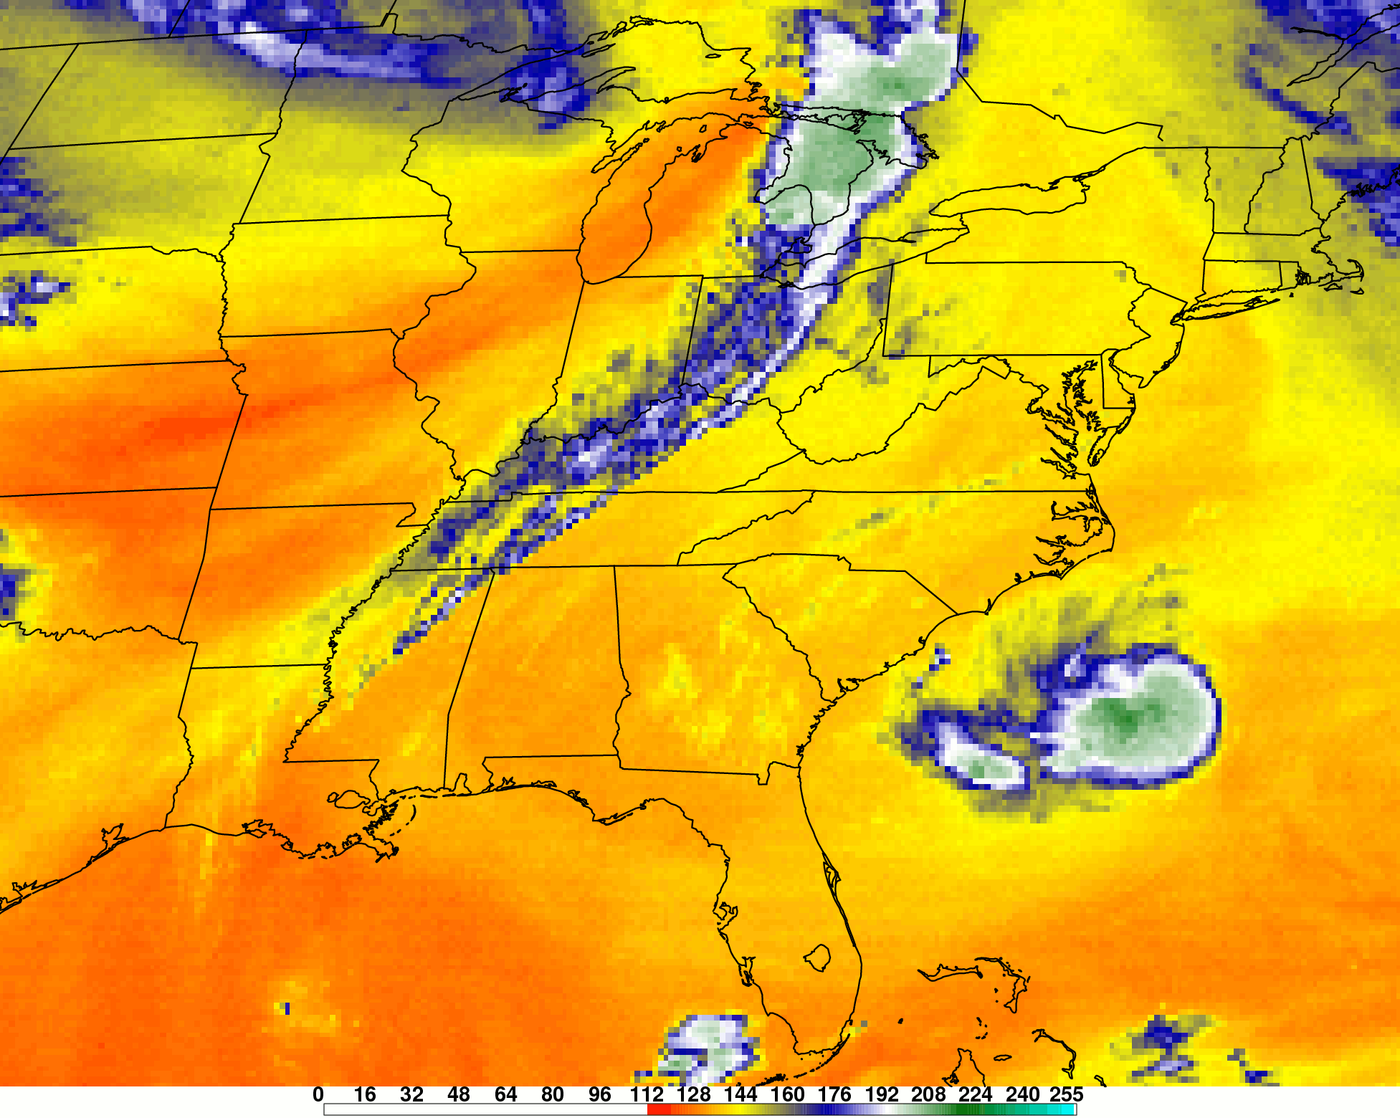
GOES Sounder 7.45 µm Imagery

Slide 17
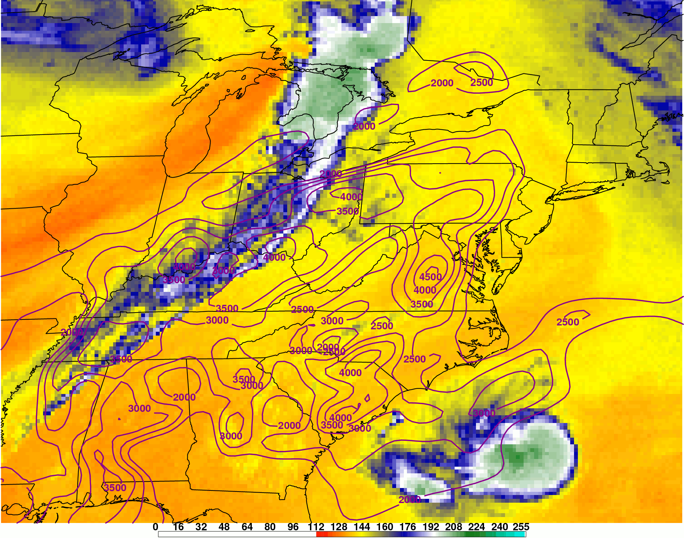
GOES Sounder 7.45 µm with SBCAPE
Overlaid with HRRR or Rapid-Refresh data
→ more complete picture at current atmospheric process

Slide 18
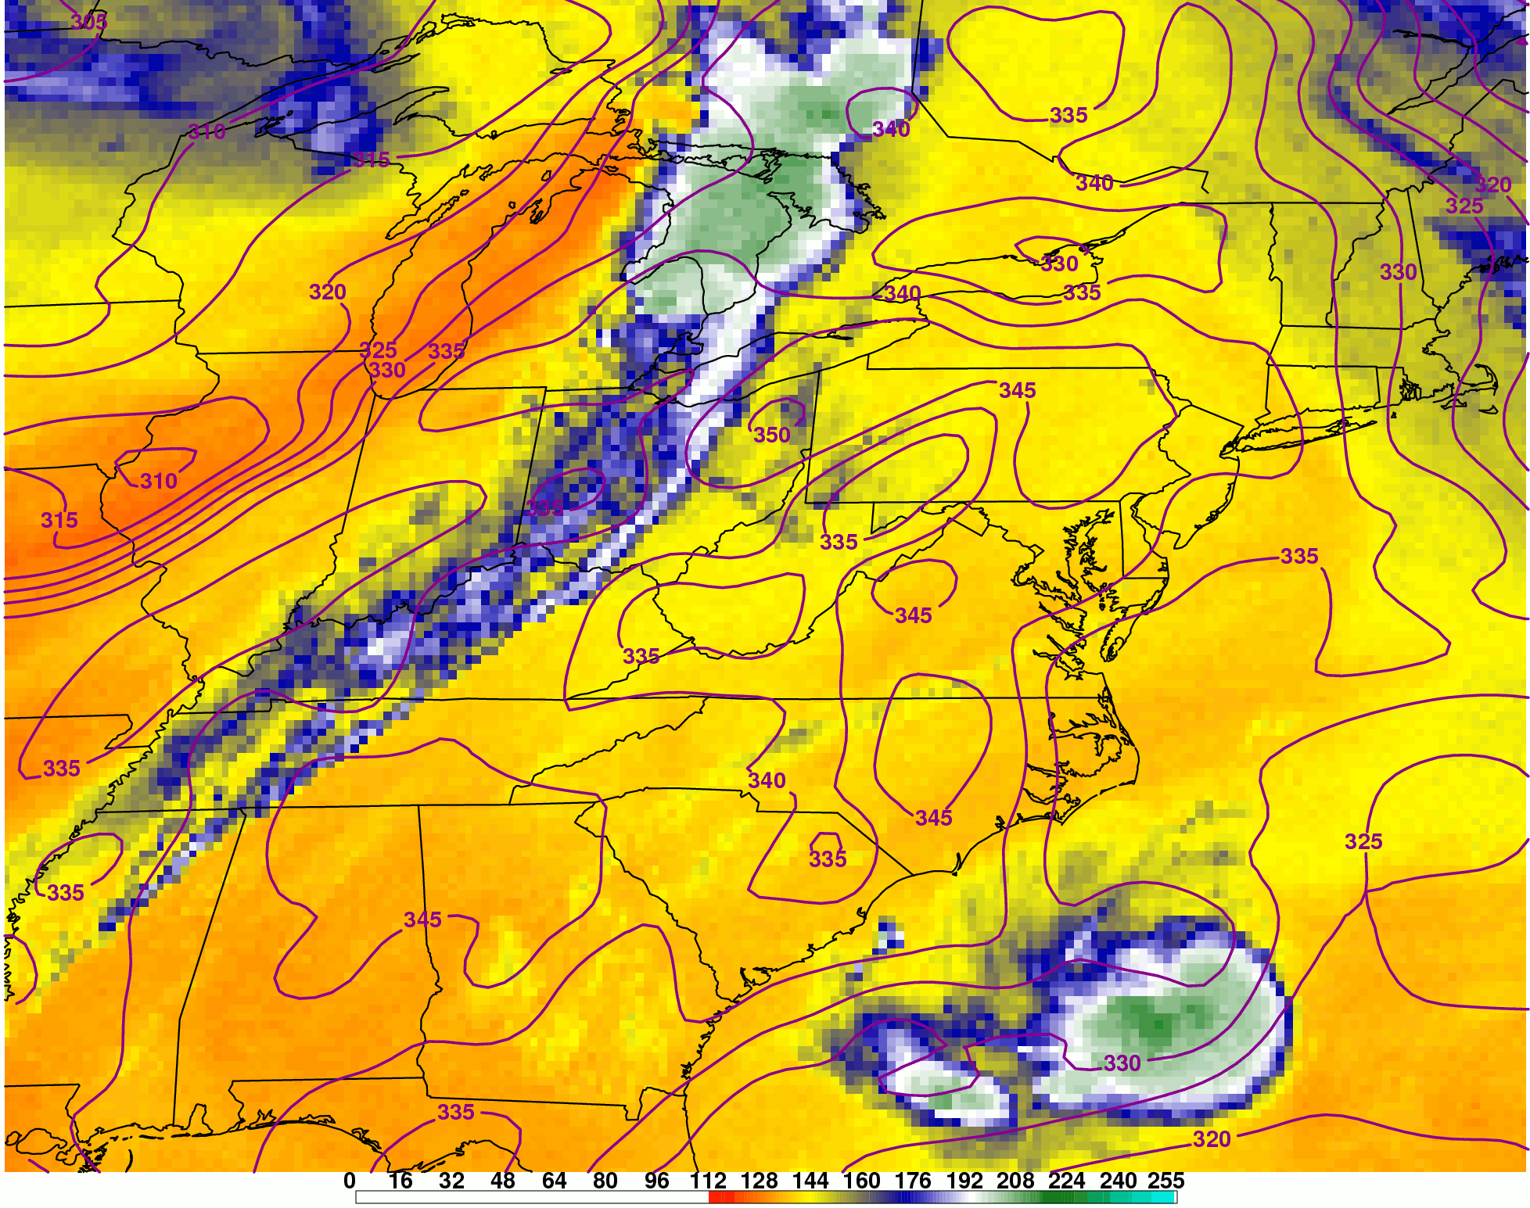
GOES Sounder 7.45 µm w/850 θ_{e}
Overlaid with HRRR or Rapid-Refresh data
→ more complete picture at current atmospheric process

Slide 19
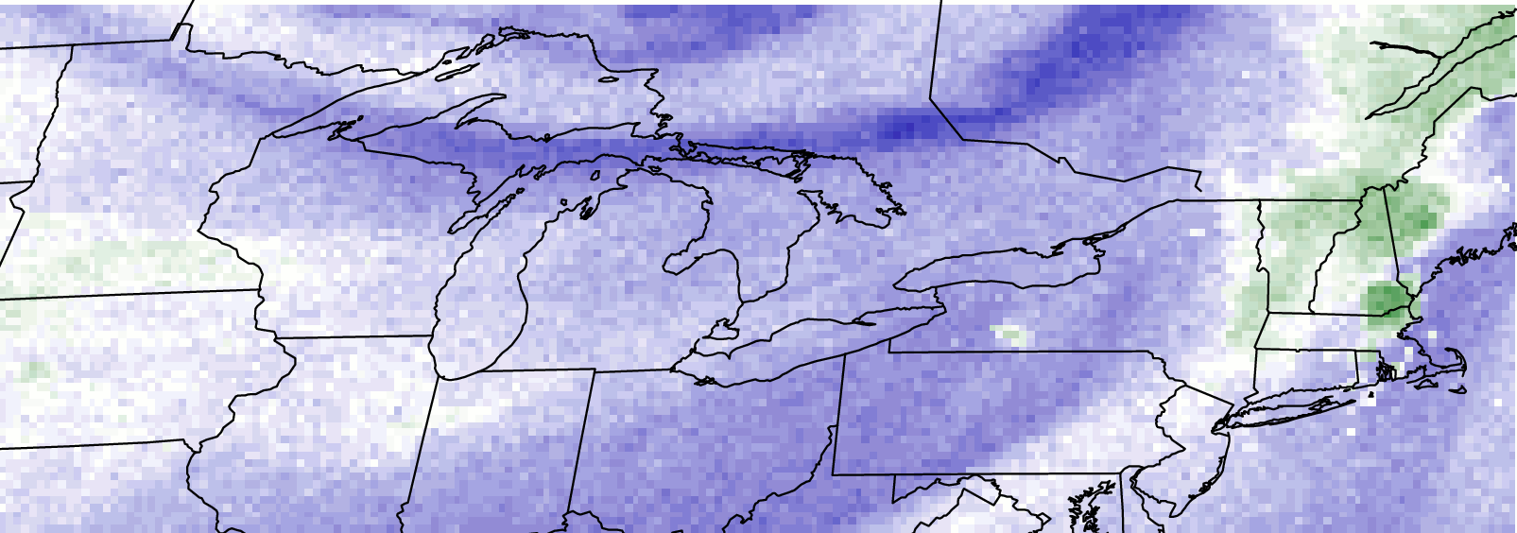
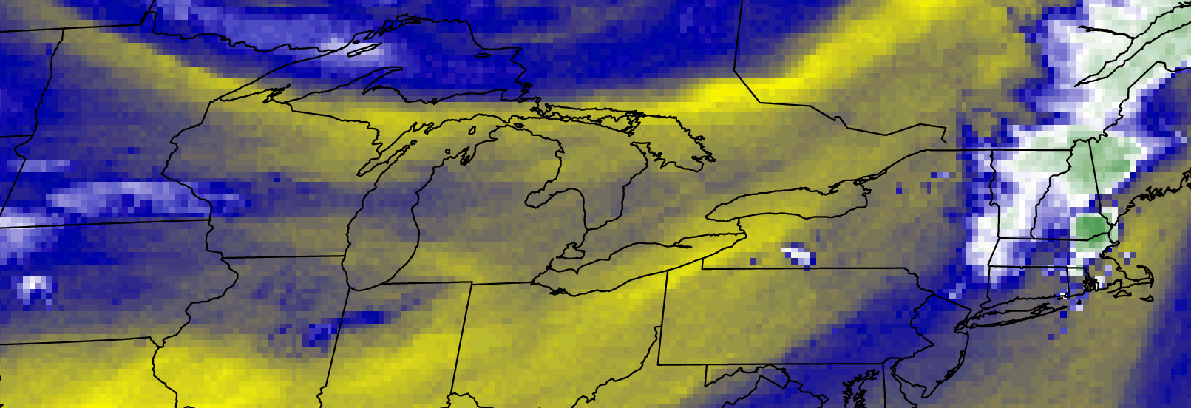
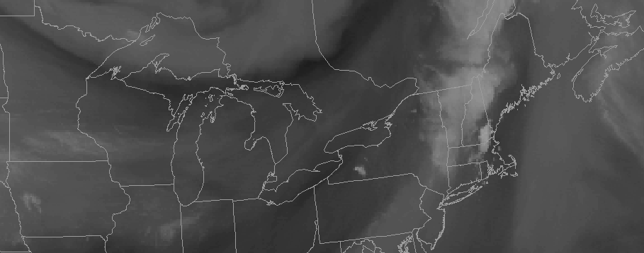
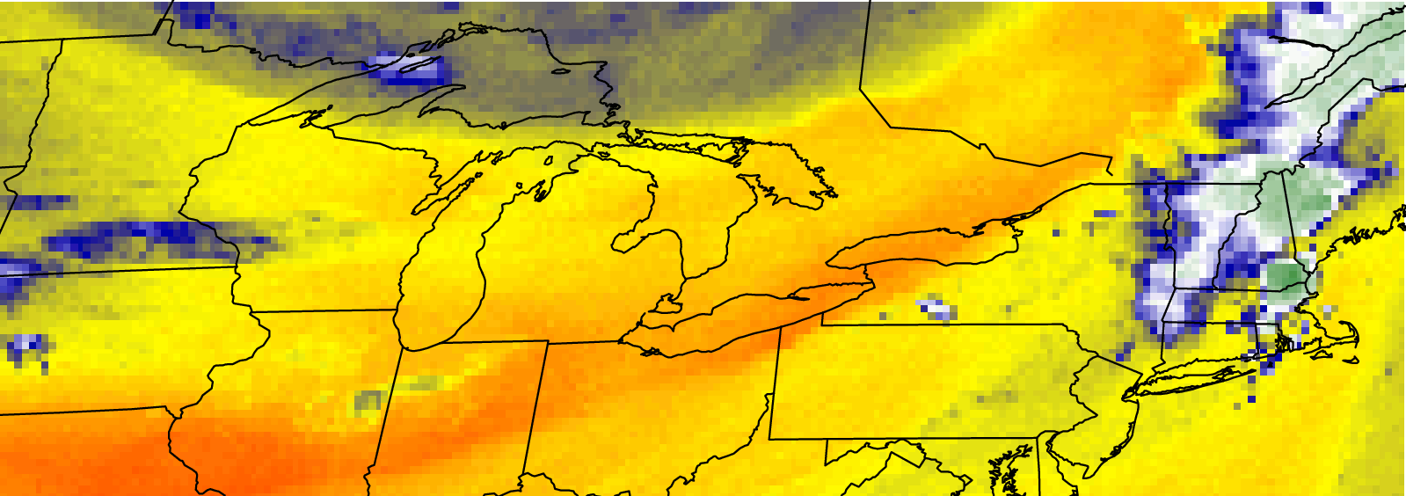
Convective Initiation 4-Panel
Band 12
Band 11
Band 10
Conventional Water Vapor
Location and movement of elevated cold front most clearly seen on GOES Sounder Band 10 Imagery

Slide 20
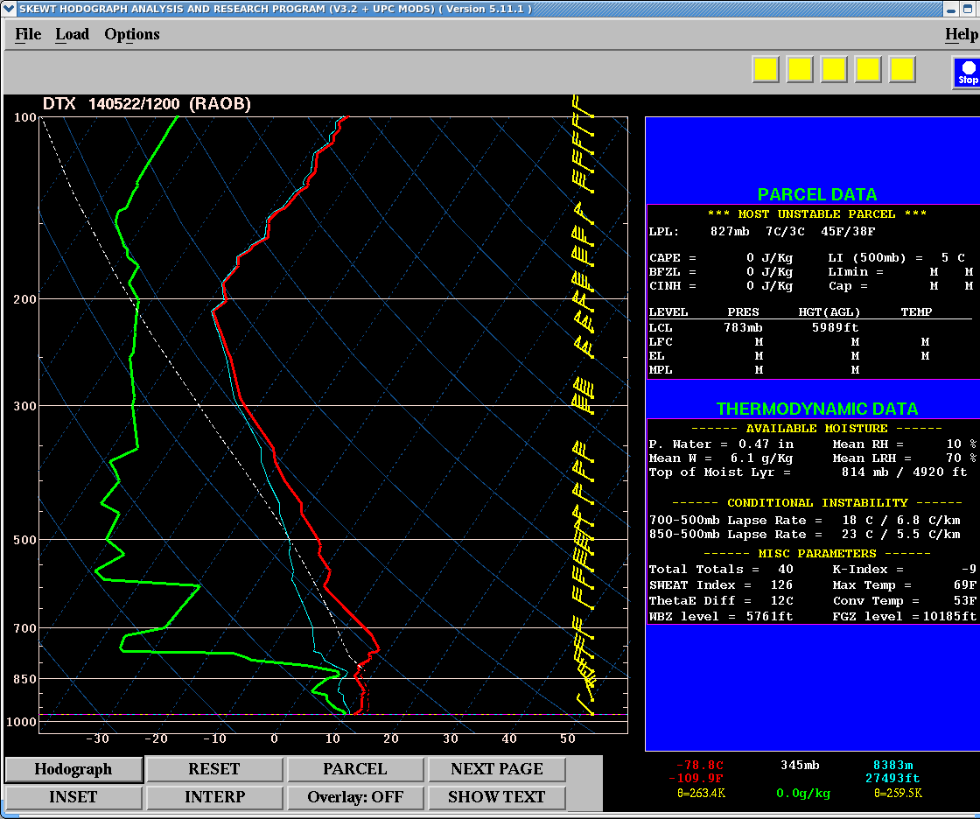
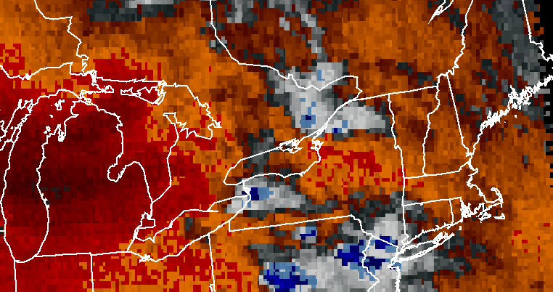
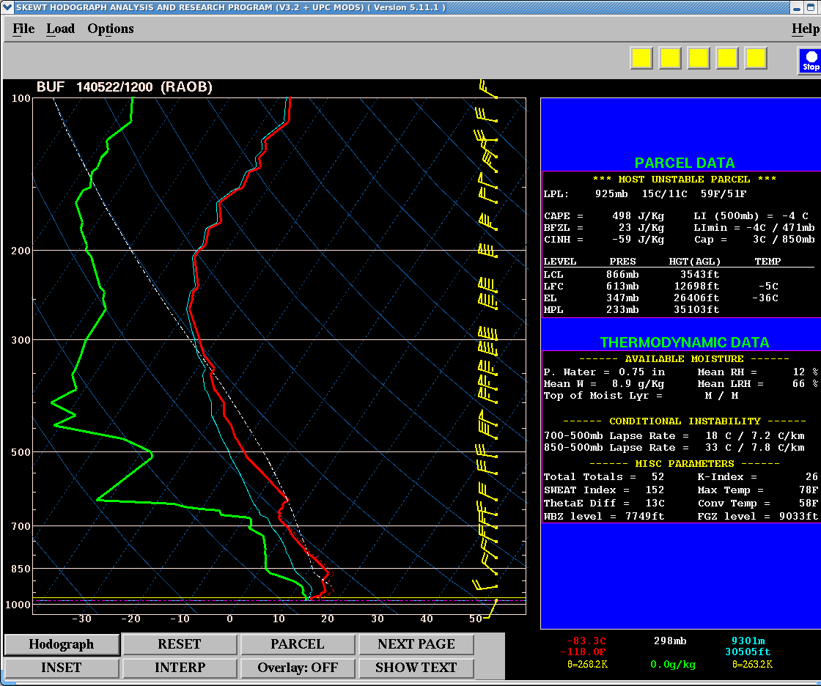
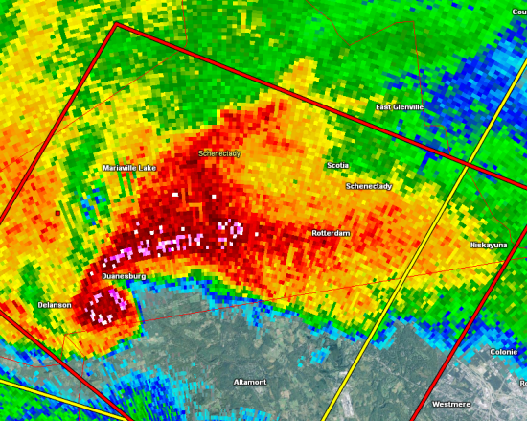
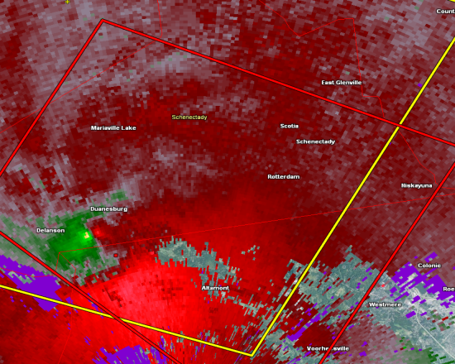
Other Examples
22 May 2014
GOES Sounder Band 10: 0647 – 2047 UTC 22 May 2014
KENX 0.5° Reflectivity and SRM @ 1951 UTC
EF-3 Tornado with 7 mile path length in Schenectady and Albany Counties in eastern New York

Slide 21
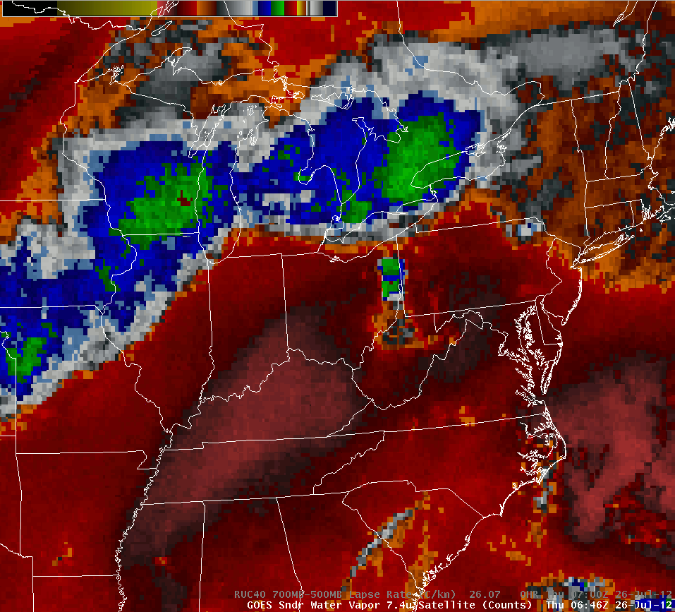
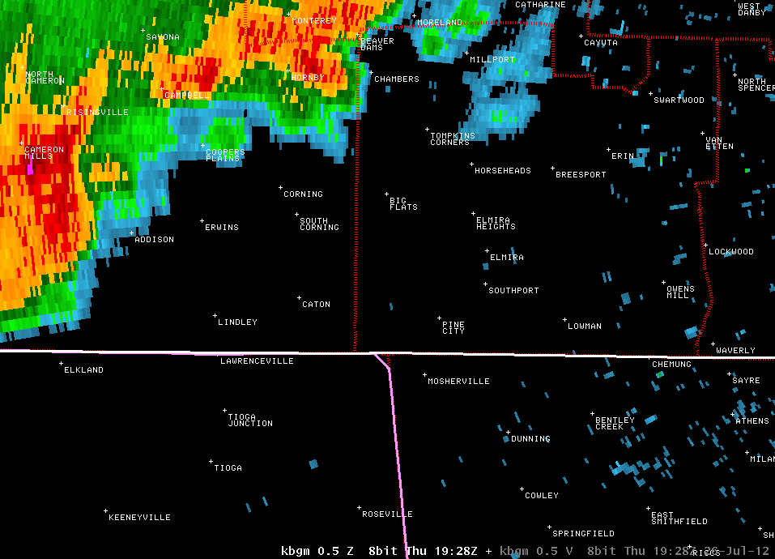
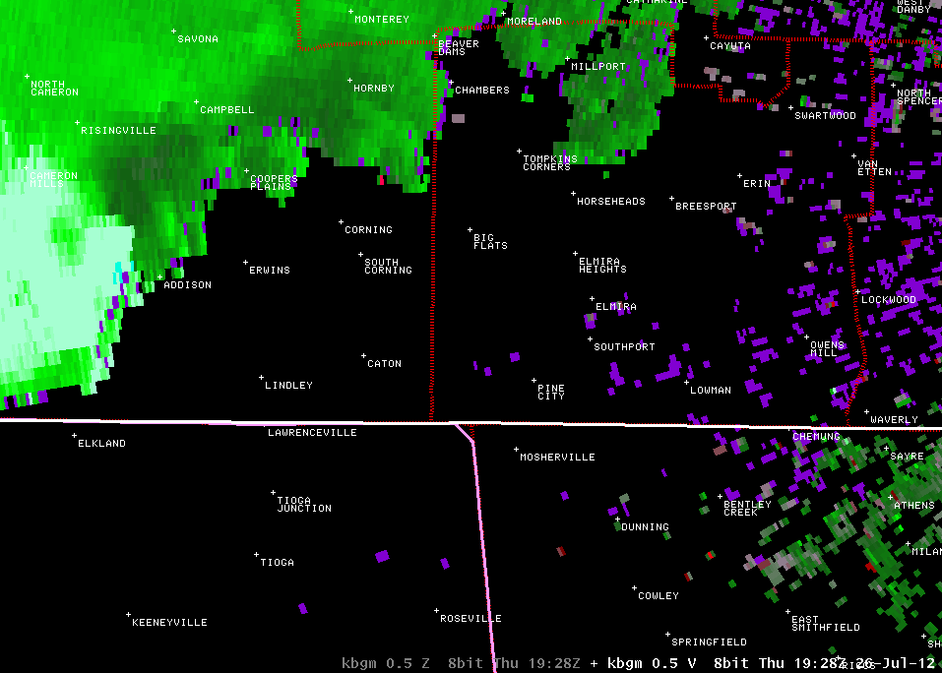
Other Examples
26 July 2012
EF-1 Tornado in downtown Elmira, NY

Slide 22
Conclusions
Current GOES Sounder Bands currently serve as proxy for future GOES-R ABI products
Despite limited spatial and temporal scale, current GOES Sounder products should be used to develop GOES-R familiarity
Sounder Band’s ability to track low-level dry air and boundaries is paramount for severe wx operations
No other real-time data source has this ability
GOES-R ABI products will have update frequency of no greater than a 5 min interval!
Much improved understanding of four-dimensional atmospheric processes

Slide 23
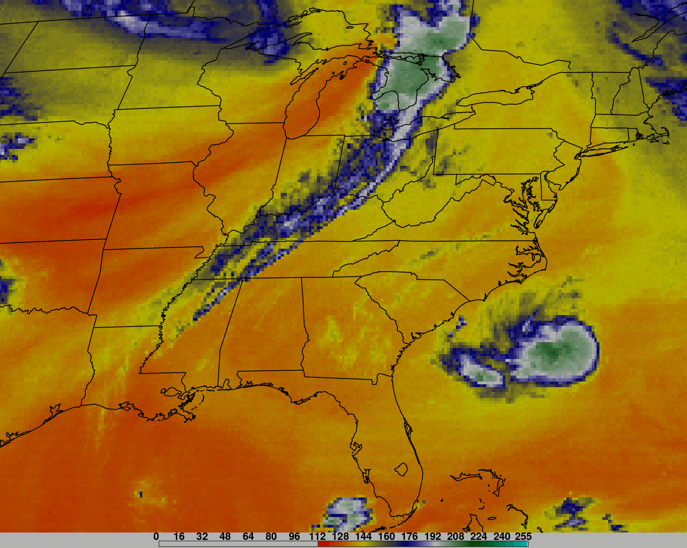
Questions???
christopher.gitro@noaa.gov

