Slide 1
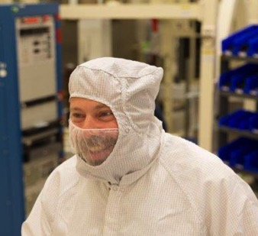
The Advanced Baseline Imager (ABI) on the GOES-R Series
Timothy J. Schmit (tim.j.schmit@noaa.gov) (“GOESguy”)
NOAA/NESDIS/Satellite Applications and Research
Advanced Satellite Products Branch (ASPB)
Madison, WI
Plus many, many more…
GOES-R Teachers Workshop
Cape Canaveral, FL
November 2016
UW-Madison

Slide 2
Thanks to…
Jordan Gerth
Scott Lindstrom
Kathleen Strabala
Bill Line
SSEC data center
Mat Gunshor
Scott Bachmeier
Kaba Bah
Steve Miller
Dan Lindsey
Steve Goodman
Chris Schmidt
Chad Gravelle
JMA
SSEC Real Earth team
ITT / Harris
Lockheed-Martin
Entire GOES-R team!
Dave Jones
COMET
You.

Slide 3
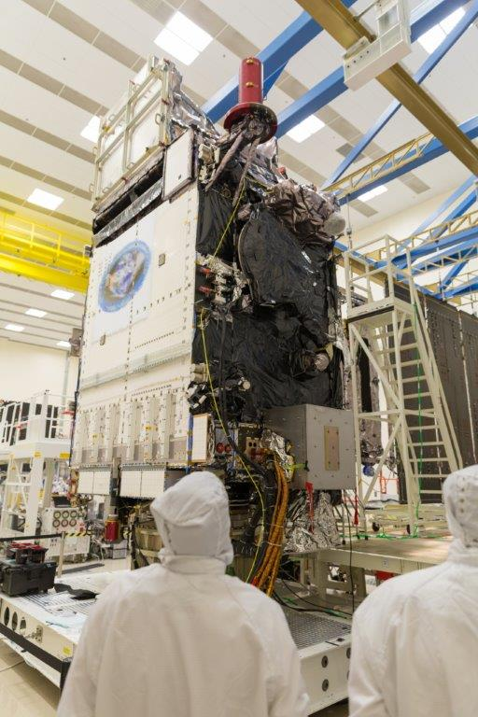
Outline
Introduction
GOES and AHI
GOES-R ABI
Spectral
Spatial
Temporal
Derived Products
Summary
Lockheed Martin

Slide 4
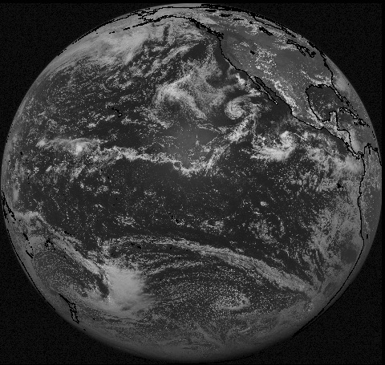
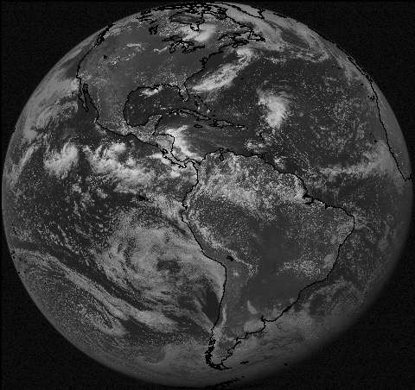
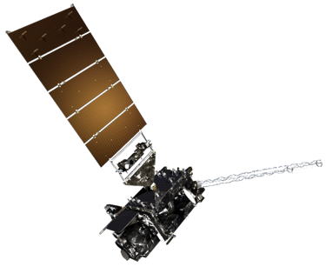
NOAA GOES Constellation
GOES-16 or -17
(137W)
GOES-16 or -17
(75W)
After GOES-R and -S are launched, checked out & operational.
Notes:
Template footer obscured. Fixed.
Estimate during mid-2010.

Slide 5
Advanced Himawari Imagery (AHI)
Japan’s AHI launched:
7 October 2014
Operational:
02 UTC on 7 July 2015
Very similar to the ABI
15 of the 16 spectral bands
Imager built by same company:
Harris Corporation, Space and Intelligence Systems
Image is courtesy of Mitsubishi Electric.

Slide 6
Advanced Himawari Imager (AHI)
Advanced Baseline Imager Bands
AHI Band | AHI Approximate Central Wavelength (μm) | ABI Approximate Central Wavelength (μm) | ABI Band | Type | Nickname
1 | 0.47 | 0.47 | 1 | Visible | Blue
2 | 0.51 |  |  | Visible | Green
3 | 0.64 | 0.64 | 2 | Visible | Red
4 | 0.86 | 0.86 | 3 | Near-Infrared | Veggie
 |  | 1.4 | 4 | Near-Infrared | Cirrus
5 | 1.6 | 1.6 | 5 | Near-Infrared | Snow/Ice
6 | 2.3 | 2.2 | 6 | Near-Infrared | Cloud Particle Size
7 | 3.9 | 3.9 | 7 | Infrared | Shortwave Window
8 | 6.2 | 6.2 | 8 | Infrared | Upper-level Water Vapor
9 | 6.9 | 6.9 | 9 | Infrared | Mid-level Water Vapor
10 | 7.3 | 7.3 | 10 | Infrared | Lower-level Water Vapor
11 | 8.6 | 8.4 | 11 | Infrared | Cloud-Top Phase
12 | 9.6 | 9.6 | 12 | Infrared | Ozone
13 | 10.4 | 10.3 | 13 | Infrared | “Clean” Longwave Window
14 | 11.2 | 11.2 | 14 | Infrared | Longwave Window
15 | 12.4 | 12.3 | 15 | Infrared | “Dirty” Longwave Window
16 | 13.3 | 13.3 | 16 | Infrared | CO₂ Longwave

Slide 7
AHI: Champi
(spectral bands)
Notes:
Animation.

Slide 8
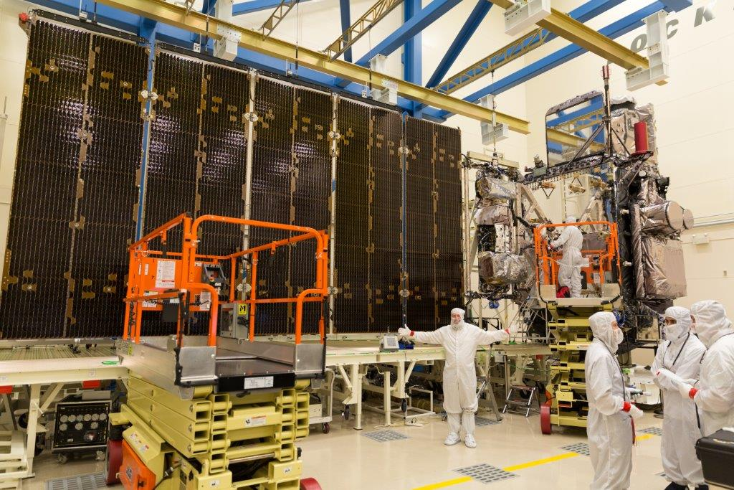
GOES-R Advanced Baseline Imager (ABI)
Spectral
Improved!
Spatial
Improved!
Temporal
Improved!
Lockheed Martin

Slide 9
ABI: Bands 1-6 (Visible / NearIR)
ABI Band | Wavelength (µm) | Wavelength range (µm) | Sub-point pixel spacing (km) | Descriptive Name
1 | 0.47 | 0.45 - 0.49 | 1 | “Blue”
2 | 0.64 | 0.60 - 0.68 | 0.5 | “Red”
3 | 0.864 | 0.847 - 0.882 | 1 | “Veggie”
4 | 1.373 | 1.366 - 1.380 | 2 | “Cirrus”
5 | 1.61 | 1.59 - 1.63 | 1 | “Snow/Ice”
6 | 2.24 | 2.22 -2.27 | 2 | “Cloud Particle Size”
Six visible or near visible bands on ABI, one on heritage imager
Notes:
Based on Schmit et al, 2017. stars = today’s imager band.

Slide 10
ABI: Bands 7-16 (Infrared)
ABI Band | Wavelength (µm) | Wavelength range (µm) | Sub-point pixel spacing (km) | Descriptive Name
7 | 3.90 | 3.80 - 3.99 | 2 | “Shortwave window”
8 | 6.19 | 5.79 - 6.59 | 2 | “Upper-level Water Vapor”
9 | 6.93 | 6.72 - 7.14 | 2 | “Mid-Level Water Vapor”
10 | 7.34 | 7.24 - 7.43 | 2 | “Lower/Mid-level Water Vapor”
11 | 8.44 | 8.23 - 8.66 | 2 | “Cloud-top Phase”
12 | 9.61 | 9.42 - 9.80 | 2 | “Ozone”
13 | 10.33 | 10.18 - 10.48 | 2 | “Clean longwave window”
14 | 11.21 | 10.82 - 11.60 | 2 | “Longwave window”
15 | 12.29 | 11.83 - 12.75 | 2 | “Dirty longwave window”
16 | 13.28 | 12.99 - 13.56 | 2 | “CO₂”
10 infrared bands on the ABI, four on heritage imager
Notes:
Based on Schmit et al, 2017. stars = today’s imager band.

Slide 11
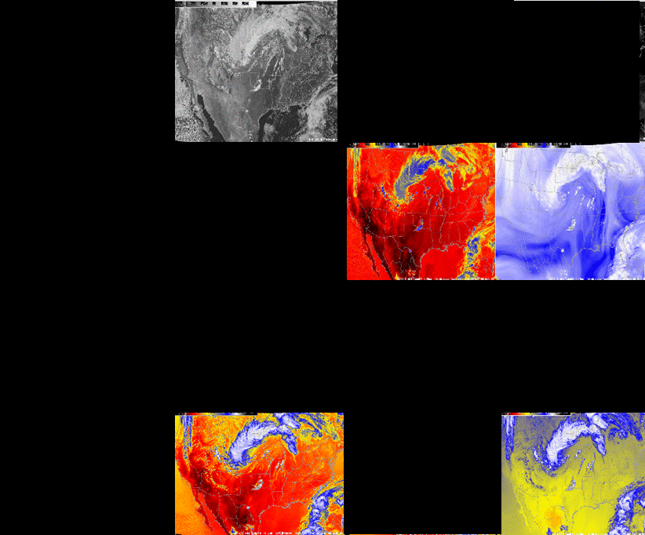
Current GOES Spectral Bands (5)
VIS
1 Visible
0 Near-IR
4 IR
NIR
WV
IRW
CO2

Slide 12
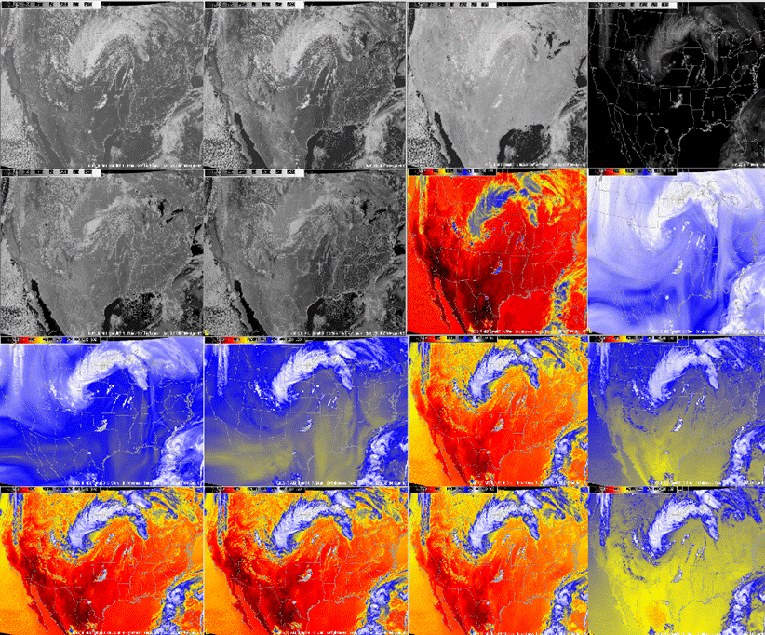
ABI Spectral Bands (16)
0.47 μm
0.64 μm
0.86 μm
1.38 μm
2 Visible
4 Near-IR
10 IR
1.61 μm
2.26 μm
3.9 μm
6.19 μm
6.95 μm
7.34 μm
8.5 μm
9.61 μm
10.35 μm
11.2 μm
12.3 μm
13.3 μm

Slide 13
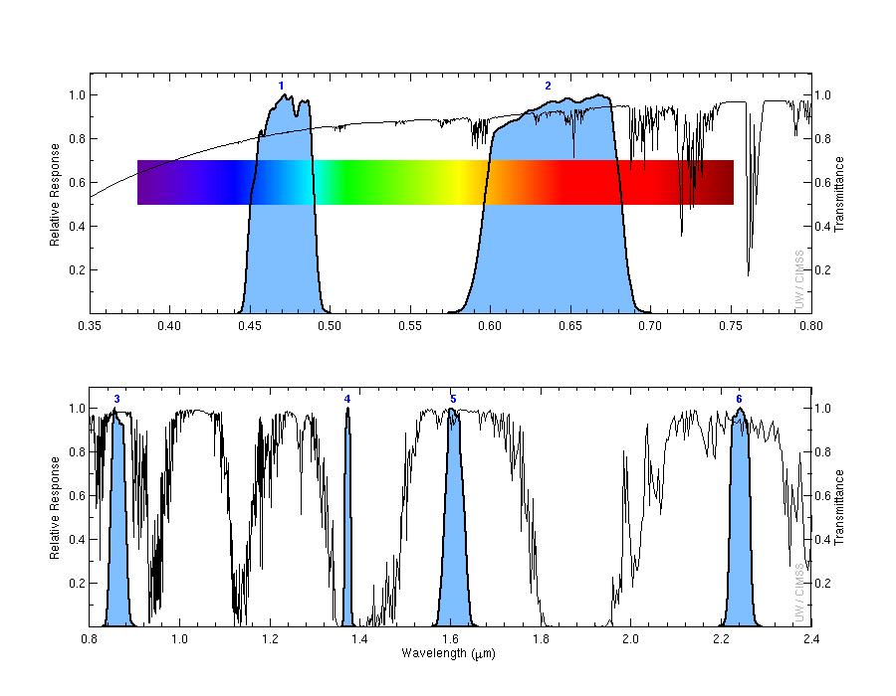
ABI Spectral Bands
Visible
Near-IR

Slide 14
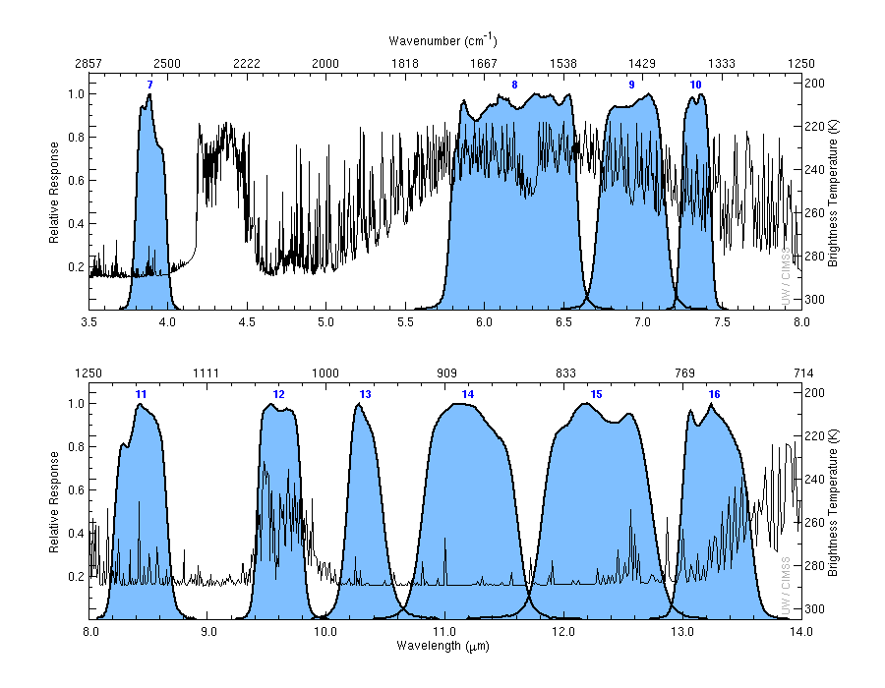
ABI Spectral Bands (IR)

Slide 15
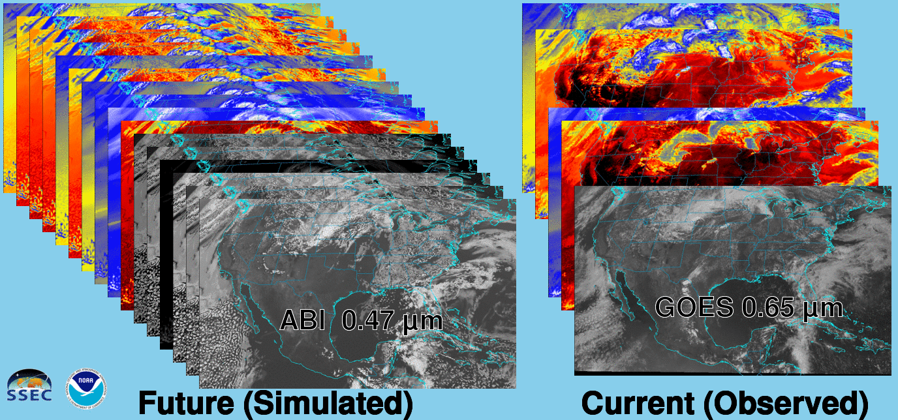
Future vs. Current Spectral Bands
The current GOES (right) has 5 spectral bands, while the GOES-R series ABI (left) will have 16 spectral bands.
Notes:
Animation.

Slide 16
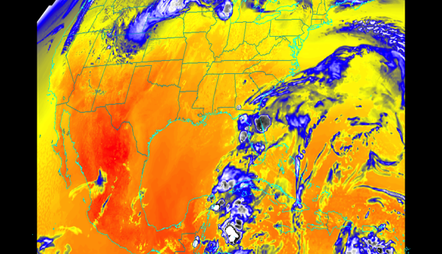
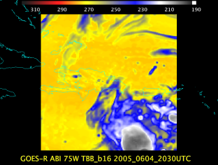
Baseline ABI Scan Modes
Scan mode (3) or ‘flex mode’ for the ABI:
- Full disk 15 minutes + 5 min CONUS + 1-min mesoscales (2 locations).
[Scan mode (4) or ‘Continuous Full Disk’ (CFD) is a full disk every 5 min]
Notes:
CONUS image is the shifted center point.

Slide 17
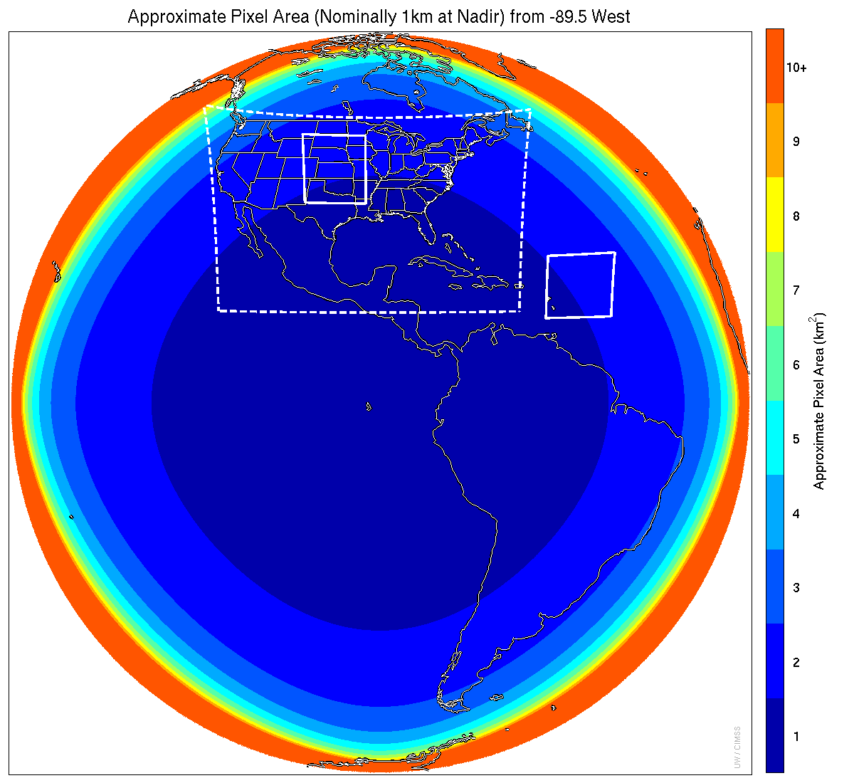
Meso-scale box locations are movable
1 min
5 min
1 min
15 min
Central
Notes:
1-km² spatial resolution at satellite nadir. Pixel Areas are approximate. Each bin is rounded to the nearest 1km² until we get to 9.5km² and then all are binned into the red 10+ area. So the first, dark blue, ring covers pixel areas from 1 to 1.49km² and is labeled “1”, above 1.5 to below 2.5km² goes into the next ring and is called “2”, etc. GOES-Test location. PUG CONUS sector. Two meso-scale image sectors shown; these are selectable. The same central lat/lon used for these mesoscales produces a different sized and shaped area for different satellite locations.

Slide 18
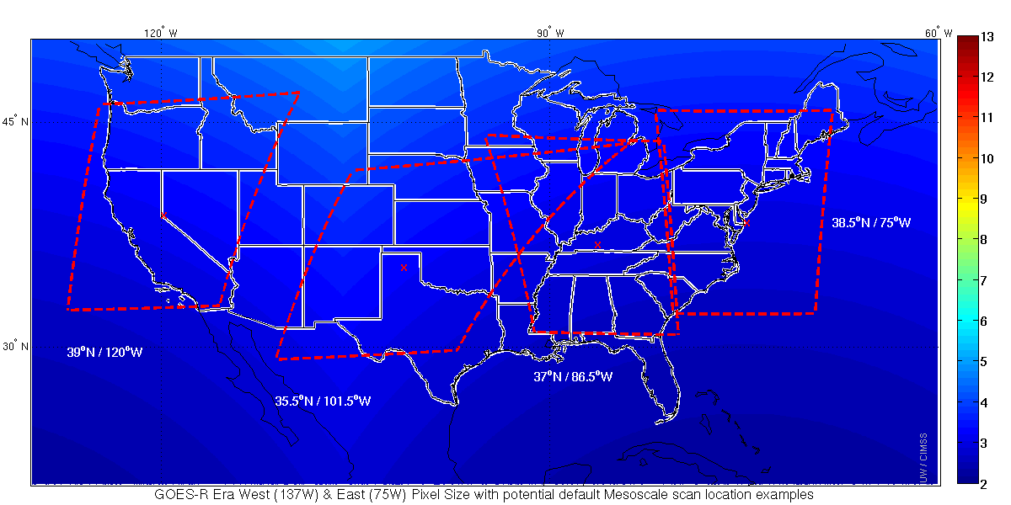
Proposed Default Meso Locations
For both West and East satellite locations

Slide 19
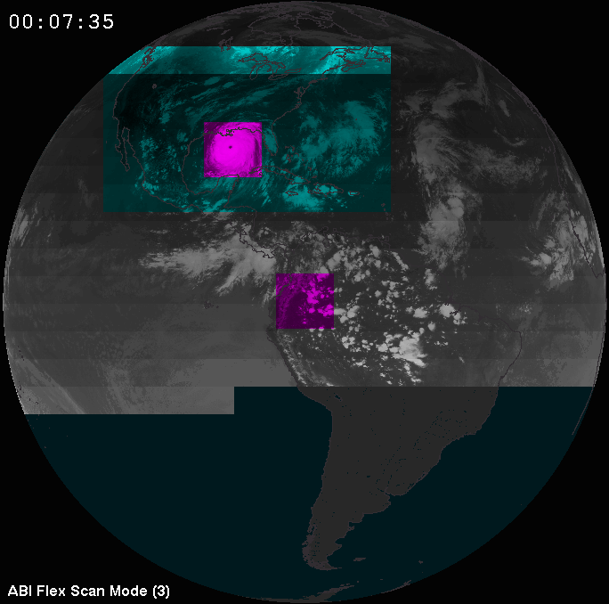
ABI Scan Strategy
Time->
CONUS
Meso
Meso
Full
Disk
Concept of the ABI “flex mode” diagram
(image fades with time)

Slide 20
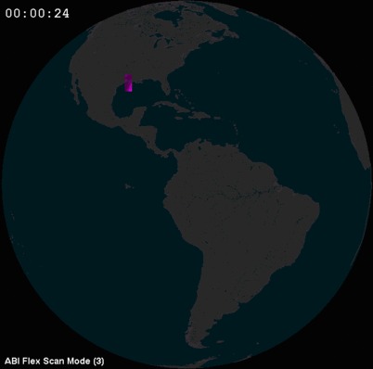
Flex Mode Concept
Notes:
Animation.

Slide 21
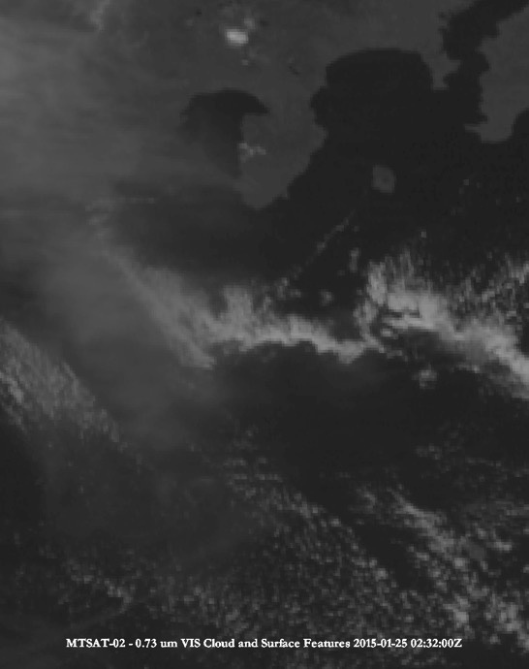
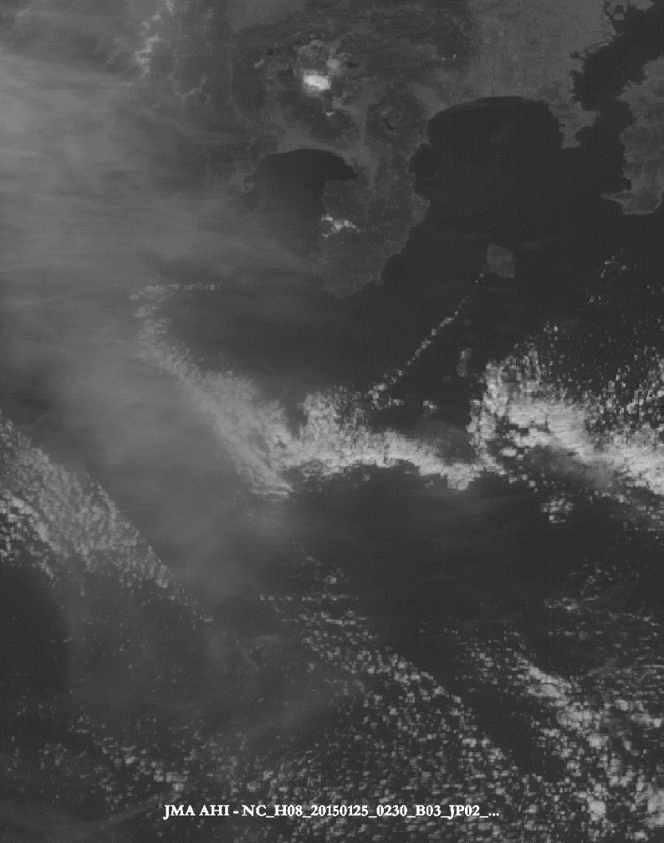
MTSAT and AHI (visible band)
Approximate spatial resolution: 1 km
Approximate spatial resolution: 0.5 km
Notes:
Images made with McIDAS-V by M. Gunshor, using a ‘square root’ enhancement. McIDAS-V

Slide 22
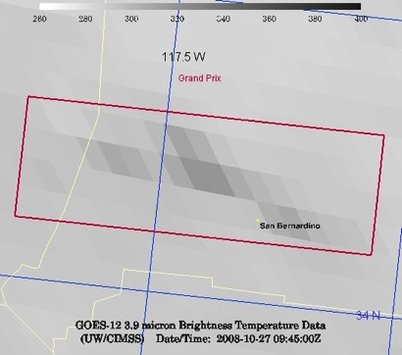
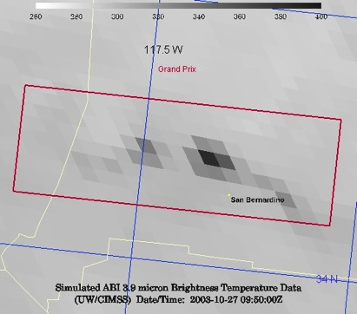
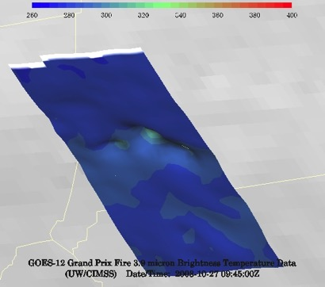
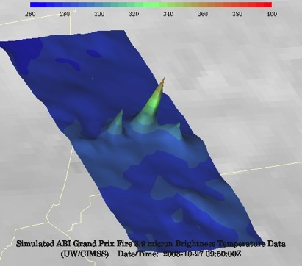
Current GOES and GOES-R ABI
Simulation of Grand Prix Fire/Southern California
GOES-12
GOES-R ABI
GOES-12
GOES-R ABI
Notes:
Here are two different fires from J. Feltz of CIMSS (using mcidas-v). What we can see is a more defined peak in the higher resolution data and it is easier to pick out individual hotspots. In addition, the higher saturation temperature of the ABI allows us to see that the fire is around 370K. ABI is simulated from MODIS.

Slide 23
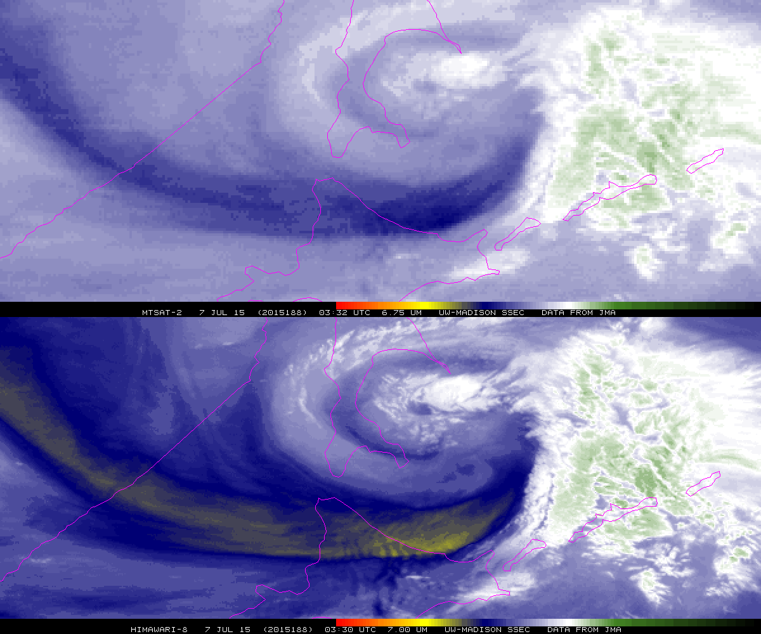
MTSAT vapor band
JMA’s AHI water vapor band centered at 7.0 μm
Note the improved spatial resolution from the AHI. There is evidence of waves over northern Japan in the AHI image, but not in the MTSAT image.
Notes:
native projection. Both images are from July 7, 2015 at approximately 0330 UTC.

Slide 24
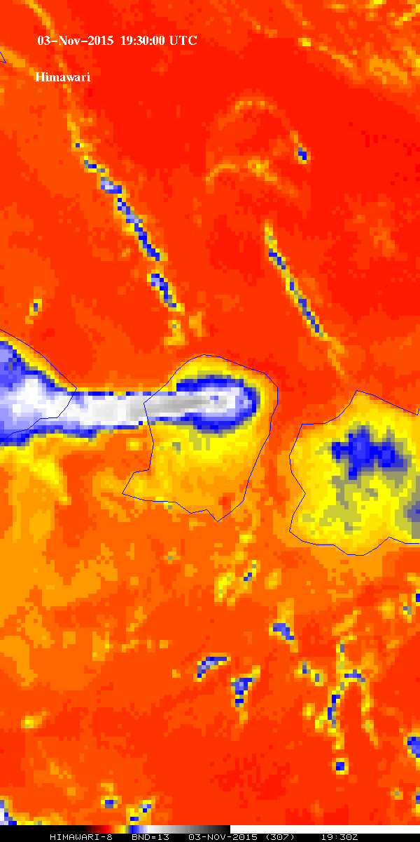
?
Arc clouds
?
Clouds
What’s this infrared image showing?
?
?
?
Plume
Hot spot
Land
?
Cooler
MTSAT
(older generation)
AHI
(new generation)
Improved spatial resolution of an advanced imager
Rinjani
Notes:
MTSAT vs AHI (Spatial) Plume is volcanic ash from Rinjani. Data from JMA, via STAR and the SSEC Data Center.

Slide 25
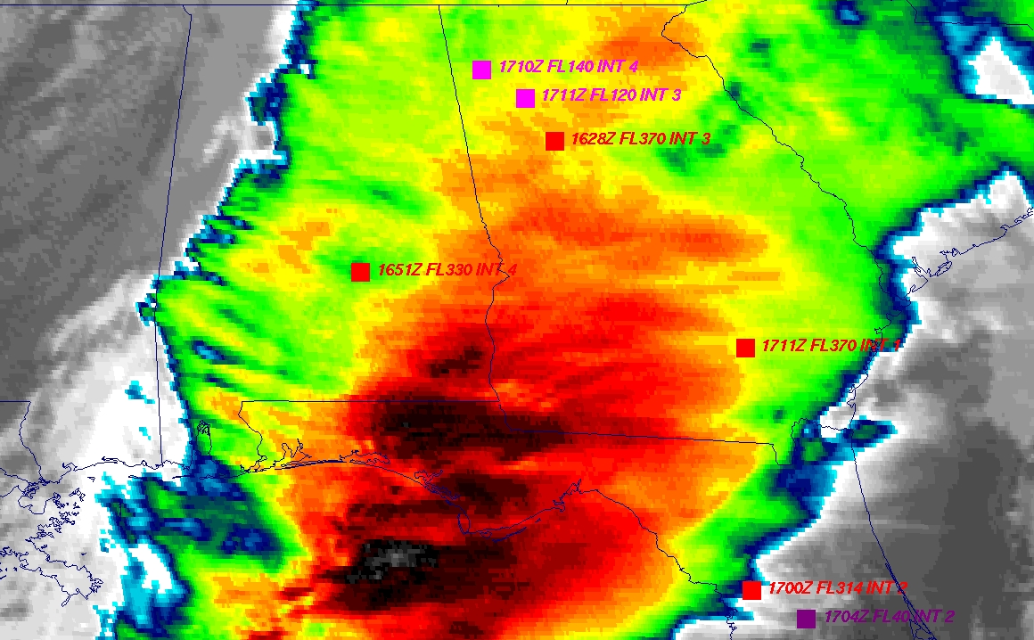
GOES
Figure courtesy of K. Bedka and W. Feltz

Slide 26
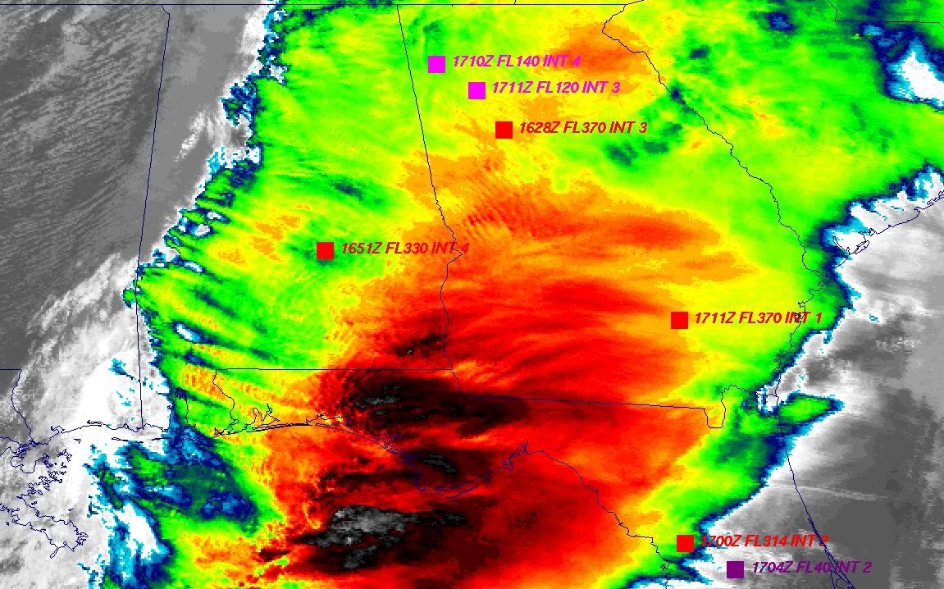
“ABI” from MODIS
Figure courtesy of K. Bedka and W. Feltz

Slide 27
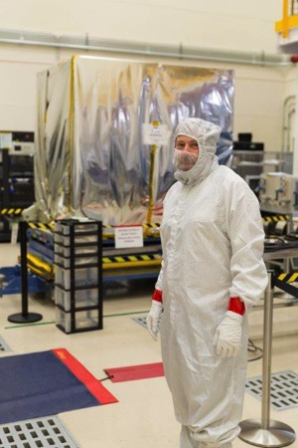
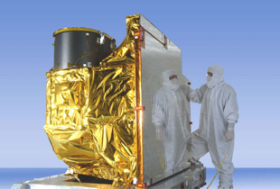
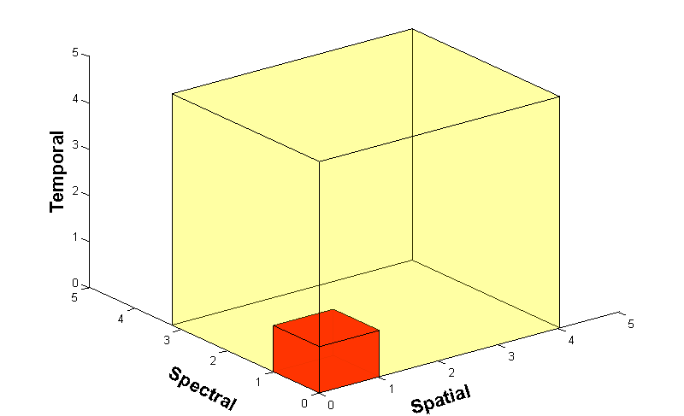
Advanced Baseline Imager (ABI)
ABI on GOES-S
5
4
3
X
Faster coverage (5-minute full disk vs. 25-minute)
X
Improved spatial resolution
(2 km IR vs. 4 km)
X
More spectral bands (16 on ABI vs. 5 on the current imager)
Notes:
Slide from J. Gerth, CIMSS.

Slide 28
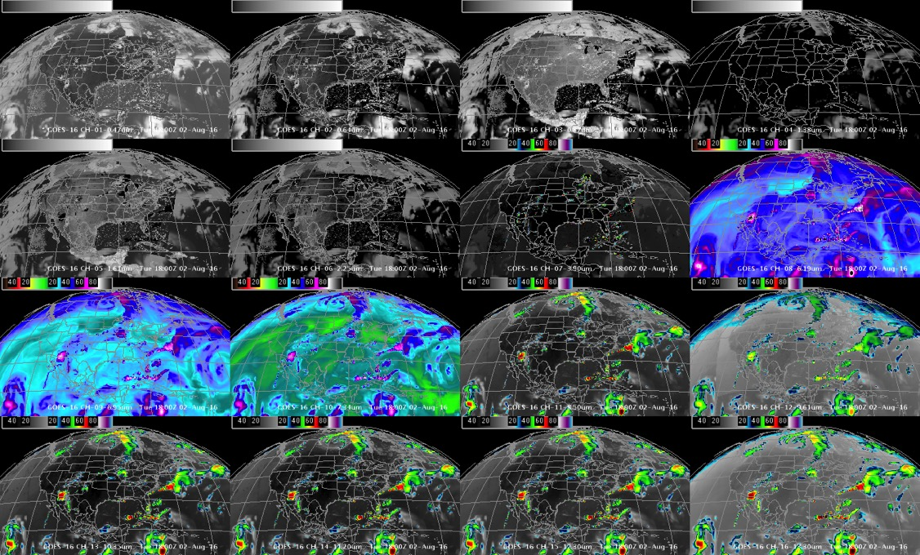
Simulated ABI Spectral bands during testing
0.47 μm
0.64 μm
0.86 μm
1.37 μm
1.6 μm
2.2 μm
3.9 μm
6.2 μm
6.9 μm
7.3 μm
8.4 μm
9.6 μm
10.3 μm
11.2 μm
12.3 μm
13.3 μm
GOES-R ABI Imagery simulated at UW-Madison via AWG Proxy, processed via the Ground System, acquired via NOAAPort, shown in AWIPS-II (default enhancements)
Notes:
DOE-4

