Slide 1
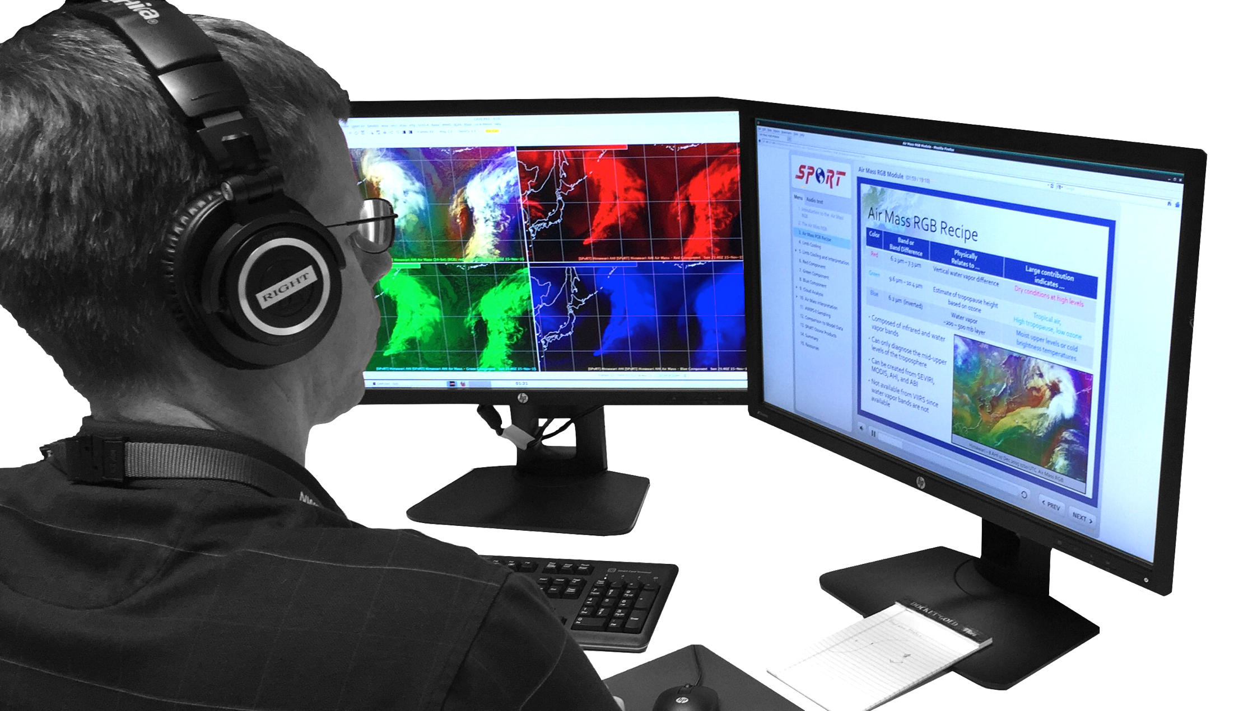
Evaluating the Integrated Training AWIPS Plugin at the Operations Proving Ground
Chad M. Gravelle, PhD GOES-R Satellite Liaison NWS Operations Proving Ground University of Wisconsin - CIMSS Kansas City, MO
Jason Burks Research Scientist
NASA SPoRT Huntsville, AL
Satellite User-Readiness Meeting
12 May 2016

Slide 2
Integrated Training AWIPS Plugin
2015 Satellite User Readiness Meeting action item that was endorsed by the NOAT, funded by the GOES-R Program, developed by NASA SPoRT.
Notes:
Evaluate new tools, techniques, and capabilities by NWS forecasters in realistic, yet focused and controlled, evaluations.

Slide 3
Integrated Training AWIPS Plugin
2015 Satellite User Readiness Meeting action item that was endorsed by the NOAT, funded by the GOES-R Program, developed by NASA SPoRT.
Road to the Operations Proving Ground Evaluation...
June and July 2015: Plugin Development
August and September 2015: Demonstrations of Prototype Plugin
November 2015 – January 2015: Plugin Refinement
February 2015: AWIPS Test Authorization Note Approval and Plugin Installation at the OPG
March 2015: OPG Evaluation on Operational Applications of Multiple Spectral Bands for the GOES-R Era
Notes:
Evaluate new tools, techniques, and capabilities by NWS forecasters in realistic, yet focused and controlled, evaluations.

Slide 4
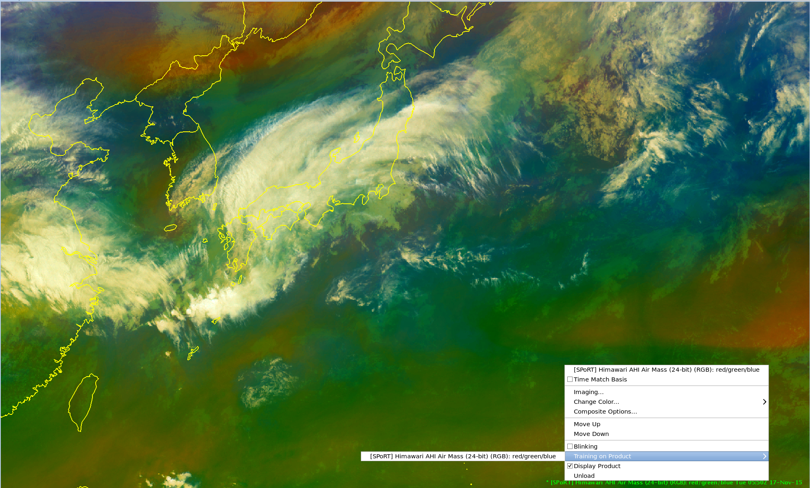
Integrated Training AWIPS Plugin
Notes:
Evaluate new tools, techniques, and capabilities by NWS forecasters in realistic, yet focused and controlled, evaluations.

Slide 5
Integrated Training AWIPS Plugin
Notes:
Evaluate new tools, techniques, and capabilities by NWS forecasters in realistic, yet focused and controlled, evaluations.

Slide 6
Integrated Training AWIPS Plugin
Notes:
Evaluate new tools, techniques, and capabilities by NWS forecasters in realistic, yet focused and controlled, evaluations.

Slide 7
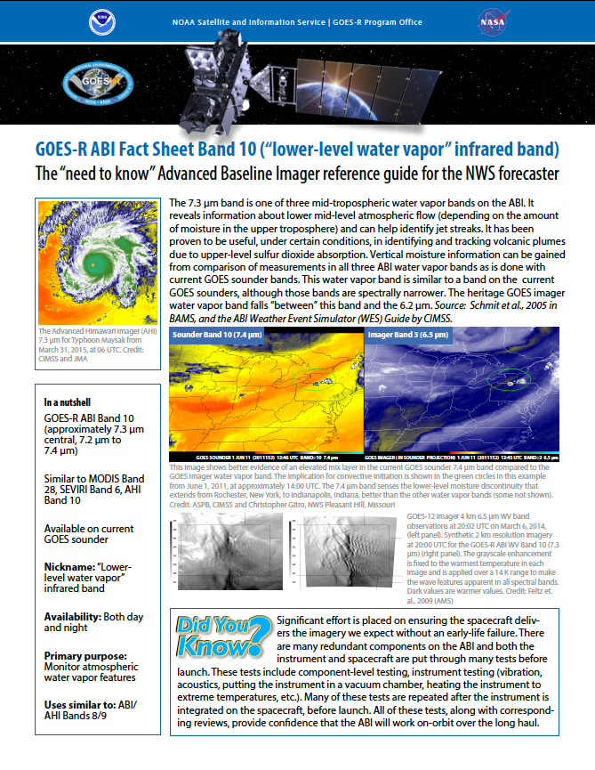
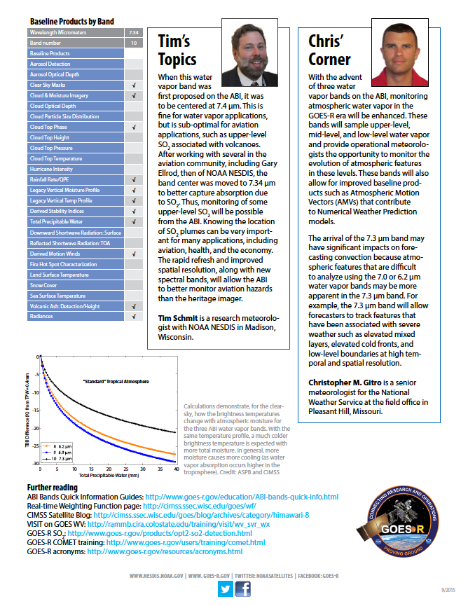
Available OPG Evaluation Resources: ABI Fact Sheets
Available for Bands 1-14
Notes:
Evaluate new tools, techniques, and capabilities by NWS forecasters in realistic, yet focused and controlled, evaluations.

Slide 8
Available OPG Evaluation Resources: Interactive Quick Guides
Available for True Color, Natural Color, GeoColor, Airmass, and Nighttime Microphysics RGBs
Notes:
Evaluate new tools, techniques, and capabilities by NWS forecasters in realistic, yet focused and controlled, evaluations.

Slide 9
Available OPG Evaluation Resources: Articulate Modules
Available for Airmass and Nighttime Microphysics RGBs
Notes:
Evaluate new tools, techniques, and capabilities by NWS forecasters in realistic, yet focused and controlled, evaluations.

Slide 10
OPG Evaluation Exercises
* Integrated Training AWIPS Plugin was available for every exercise. *
Monday Afternoon: OPG and H8 Familiarization
Tuesday Morning: Multiple Hazards
Tuesday Afternoon: Multiple Hazards
Wednesday Morning: Mid-Latitude Cyclone
Wednesday Afternoon: Mid-Latitude Cyclone Analysis
Thursday Morning: Nighttime Fog and Low Stratus
Thursday Afternoon: Developing 4-Panel Displays
Notes:
Evaluate new tools, techniques, and capabilities by NWS forecasters in realistic, yet focused and controlled, evaluations.

Slide 11
OPG Evaluation: Guided Mid-Latitude Cyclone Exercise
Wednesday Mornings…
Part 1: 14/15 November 2015 2200-0300 UTC
8:30 AM - 0.64 µm
8:45 AM - 0.64 µm, 11.2 µm, 6.9 µm, and True Color RGB
9:00 AM - 0.64 µm, 11.2 µm, True Color RGB, and Natural Color RGB
9:10 AM - 7.3 µm (comparing WV color curves)
9:10 AM - 6.2 µm, 6.9 µm, 7.3 µm, and 11.2 µm
9:40 AM - Break
Notes:
Evaluate new tools, techniques, and capabilities by NWS forecasters in realistic, yet focused and controlled, evaluations.

Slide 12
OPG Evaluation: Guided Mid-Latitude Cyclone Exercise
Wednesday Mornings…
Part 1: 14/15 November 2015 2200-0300 UTC
8:30 AM - 0.64 µm
8:45 AM - 0.64 µm, 11.2 µm, 6.9 µm, and True Color RGB
9:00 AM - 0.64 µm, 11.2 µm, True Color RGB, and Natural Color RGB
9:10 AM - 7.3 µm (comparing WV color curves)
9:10 AM - 6.2 µm, 6.9 µm, 7.3 µm, and 11.2 µm
9:40 AM - Break
Part 2: 15/16 November 2015 2200-0300 UTC
10:00 AM - 0.64 µm, 11.2 µm, 6.9 µm, and True Color RGB
10:15 AM - Integrated Training AWIPS Plugin (Airmass RGB Articulate Module)
Notes:
Evaluate new tools, techniques, and capabilities by NWS forecasters in realistic, yet focused and controlled, evaluations.

Slide 13
OPG Evaluation: Guided Mid-Latitude Cyclone Exercise
Wednesday Mornings…
Part 1: 14/15 November 2015 2200-0300 UTC
8:30 AM - 0.64 µm
8:45 AM - 0.64 µm, 11.2 µm, 6.9 µm, and True Color RGB
9:00 AM - 0.64 µm, 11.2 µm, True Color RGB, and Natural Color RGB
9:10 AM - 7.3 µm (comparing WV color curves)
9:10 AM - 6.2 µm, 6.9 µm, 7.3 µm, and 11.2 µm
9:40 AM - Break
Part 2: 15/16 November 2015 2200-0300 UTC
10:00 AM - 0.64 µm, 11.2 µm, 6.9 µm, and True Color RGB
10:15 AM - Integrated Training AWIPS Plugin (Airmass RGB Articulate Module)
10:45 AM - Airmass RGB, R Input, G Input, and B Input
11:00 AM - Integrated Training AWIPS Plugin (Airmass RGB Quick Guide)
11:00 AM - Airmass RGB, 6.2 µm, 6.9 µm, and 7.3 µm
11:20 AM - Break
11:30 AM - Airmass RGB, 6.2 µm, 6.9 µm, and 7.3 µm with GFS 300-200-mb PV
11:45 AM - Airmass RGB, 6.2 µm, 6.9 µm, and 7.3 µm with GFS 300-mb Isotachs
12:00 PM - Airmass RGB, 6.2 µm, 6.9 µm, and 7.3 µm with GFS 700-500-mb Theta-E
Notes:
Evaluate new tools, techniques, and capabilities by NWS forecasters in realistic, yet focused and controlled, evaluations.

Slide 14
Forecaster Feedback During Mid-Latitude Cyclone Exercises
On a scale of 1-10, when learning how to interpret the Airmass RGB imagery, how valuable was it to view the Airmass RGB Articulate Module and Interactive Quick Guide in AWIPS during this exercise to reinforce foundational RGB concepts learned before arriving at the evaluation?
10 (Extremely Valuable): 6 forecasters
9: 1 forecaster
8: 1 forecaster
7:
6: 1 forecaster
5:
4:
3:
2:
1 (Not Valuable):
Notes:
Evaluate new tools, techniques, and capabilities by NWS forecasters in realistic, yet focused and controlled, evaluations.

Slide 15
Forecaster Feedback During Mid-Latitude Cyclone Exercises
“Without the training I would have been totally lost. In fact, I likely will need to view it a few more times, which is why having it incorporated within the AWIPS environment is ideal.”
“To be honest, I would have been lost without having the Interactive Quick Guide to refer to! The RGB Airmass imagery is new to me in an [simulated] operational setting.”
“I thought the Articulate Module was useful to get a reinforcement of the RGB concepts, but I felt it was a bit long. During the module I found myself looking at the [displaced real-time] Airmass RGB imagery to see if I could spot similar features.”
“I think this is great to have integrated right into the AWIPS workstation. However, the module can take some time to go through and may not be good to do during a busy shift or when there is the potential for high impact weather. This is why I think quick guides are crucial to have as a resource.”
Notes:
Evaluate new tools, techniques, and capabilities by NWS forecasters in realistic, yet focused and controlled, evaluations.

Slide 16
OPG Evaluation: Guided Night Fog and Low Stratus Exercise
Thursday Mornings…
Part 1: 2 September 2015 0900-1400 UTC
8:30 AM - GeoColor RGB
8:45 AM - Integrated Training AWIPS Plugin (Nighttime Microphysics RGB
Articulate Module)
9:15 AM - Nighttime Microphysics RGB, R Input, G Input, and B Input
9:25 AM - Integrated Training AWIPS Plugin (Airmass RGB Quick Guide)
9:25 AM - GeoColor RGB, Nighttime Microphysics RGB, 10.3 µm, 3.9 µm
9:40 AM - Break
Notes:
Evaluate new tools, techniques, and capabilities by NWS forecasters in realistic, yet focused and controlled, evaluations.

Slide 17
OPG Evaluation: Guided Night Fog and Low Stratus Exercise
Thursday Mornings…
Part 1: 2 September 2015 0900-1400 UTC
8:30 AM - GeoColor RGB
8:45 AM - Integrated Training AWIPS Plugin (Nighttime Microphysics RGB
Articulate Module)
9:15 AM - Nighttime Microphysics RGB, R Input, G Input, and B Input
9:25 AM - Integrated Training AWIPS Plugin (Airmass RGB Quick Guide)
9:25 AM - GeoColor RGB, Nighttime Microphysics RGB, 10.3 µm, 3.9 µm
9:40 AM - Break
Part 2: 20/21 September 2015 2000-0030 UTC
10:00 AM - GeoColor RGB
10:15 AM - Integrated Training AWIPS Plugin (Nighttime Microphysics RGB
Articulate Case Study)
10:45 AM - Nighttime Microphysics RGB, R Input, G Input, and B Input
10:50 AM - Integrated Training AWIPS Plugin (Airmass RGB Quick Guide)
10:50 AM - GeoColor RGB, Nighttime Microphysics RGB, 10.3 µm, 3.9 µm
Notes:
Evaluate new tools, techniques, and capabilities by NWS forecasters in realistic, yet focused and controlled, evaluations.

Slide 18
Forecaster Feedback During Night Fog and Low Stratus Exercise
On a scale of 1-10, when learning how to interpret the Nighttime Microphysics RGB imagery in this exercise, how valuable was it to view the Nighttime Microphysics RGB Articulate Module, Interactive Quick Guide, and Case Study Module in AWIPS to reinforce foundational RGB concepts learned before arriving at the evaluation?
10 (Extremely Valuable): 3 forecasters
9: 2 forecasters
8: 2 forecasters
7: 1 forecaster
6:
5:
4:
3:
2:
1 (Not Valuable):
Notes:
Evaluate new tools, techniques, and capabilities by NWS forecasters in realistic, yet focused and controlled, evaluations.

Slide 19
Forecaster Feedback During Night Fog and Low Stratus Exercise
On a scale of 1-10, when learning how to interpret the Nighttime Microphysics RGB imagery in this exercise, how valuable was it to view the Nighttime Microphysics RGB Articulate Module, Interactive Quick Guide, and Case Study Module in AWIPS to reinforce foundational RGB concepts learned before arriving at the evaluation?
10 (Extremely Valuable): 3 forecasters 5 forecasters
9: 2 forecasters
8: 2 forecasters 2 forecasters
7: 1 forecaster
6: 1 forecaster
5:
4:
3:
2:
1 (Not Valuable):
Notes:
Evaluate new tools, techniques, and capabilities by NWS forecasters in realistic, yet focused and controlled, evaluations.

Slide 20
Forecaster Feedback During Night Fog and Low Stratus Exercise
On a scale of 1-10, when learning how to interpret the Nighttime Microphysics RGB imagery in this exercise, how valuable was it to view the Nighttime Microphysics RGB Articulate Module, Interactive Quick Guide, and Case Study Module in AWIPS to reinforce foundational RGB concepts learned before arriving at the evaluation?
10 (Extremely Valuable): 3 forecasters 5 forecasters 6 forecasters
9: 2 forecasters 1 forecaster
8: 2 forecasters 2 forecasters
7: 1 forecaster
6: 1 forecaster 1 forecaster
5:
4:
3:
2:
1 (Not Valuable):
Notes:
Evaluate new tools, techniques, and capabilities by NWS forecasters in realistic, yet focused and controlled, evaluations.

Slide 21
Overall Forecaster Feedback on Available Training Resources
”These are really excellent resources. The PDF Fact Sheets are great for a quick glance at everything on one page and the “in a nutshell” sections were spot-on. The Interactive Quick Guides help since they are well organized and if you have the time to dive in for a more detailed review the info is there. The Articulate Modules are great and should be viewed once for foundational training. However, I don't think you need to reference the Articulate Modules again if you have the other resources.”
“I really liked the PDF Fact Sheets. I liked the Interactive Quick Guides the least, mainly because they are not as easy to scan and more clicking is involved. The Articulate Models are great too, especially if they tie in forecast applications.”
“I liked the Interactive Quick Guides the best, which provide more detailed information, but aren't overwhelmingly hard to use.”
Notes:
Evaluate new tools, techniques, and capabilities by NWS forecasters in realistic, yet focused and controlled, evaluations.

Slide 22
Overall Forecaster Feedback on Integrated Training Plugin
”On a scale of 1-10....a 100. Integrated training ensures that training does not fall on the floor once foundational training is completed. It’s a way for forecasters to continually be able to reference the building blocks and apply those building blocks to applications and the forecast process…continue to build on the knowledge they've gained!”
“Very valuable - a must have. I explained before that I have found myself fumbling around with papers/binders/laminations on shift just looking for a quick reference that I would not have to do if the Fact Sheets or Interactive Quick Guides were available to me with a click of a button.”
“I like it having it there. It would be nice to have this type of training built into AWIPS for all the radar products too. There are so many, so it's hard to remember a lot of the nitty gritty detail [with the radar products].”
“Having to sift through hundreds of pages on our internal wiki/Google sites page at my office can get time consuming, so having this option to quickly pull up training right within AWIPS and have it right next to what you are viewing is something very valuable and beneficial in my opinion.”
Notes:
Evaluate new tools, techniques, and capabilities by NWS forecasters in realistic, yet focused and controlled, evaluations.

Slide 23
OPG Recommendations Based on Forecaster Feedback
For the NWS Central Processing Portfolio and AWIPS Program Office:
“Leveraging NASA SPoRT's successful prototype design, OPG recommends implementing the Integrated Training AWIPS Plugin into a future AWIPS baseline build.”
For the NWS Office of the Chief Learning Officer:
“OPG recommends support for the development of focused, application-oriented training resources, with direct impact on interpretation, that are integrated into the AWIPS platform.”
For the NWS Central Processing Portfolio and AWIPS Program Office:
“Once baseline, OPG recommends the Integrated Training AWIPS Plugin rating system database be configured for accessibility across the entire NWS AWIPS network to facilitate the communication of information about the quality and practicality of training resources.”

