Slide 1
The success story of Himawari-8: Does R2O really mean “Risks to Overcome”?
A Presentation
Satellite Proving Ground / User Readiness Meeting, 12 May 2016
Jordan J. Gerth Assistant Researcher, Liaison to NWS Pacific Region Cooperative Institute for Meteorological Satellite Studies University of Wisconsin at Madison
Bill D. Ward Environmental and Scientific Services Division Chief National Weather Service Pacific Region Headquarters

Slide 2
Where America’s Day Begins
Guam’s “day one” was 4 December 2015.
The NWS Guam forecast office was ready on “day one” due to foresight at NWS Pacific Region Headquarters earlier in the year.
This presentation will outline the challenge, discuss risks and solutions, highlight ongoing issues, and make recommendations for upcoming new generation satellites based on the experience.

Slide 3
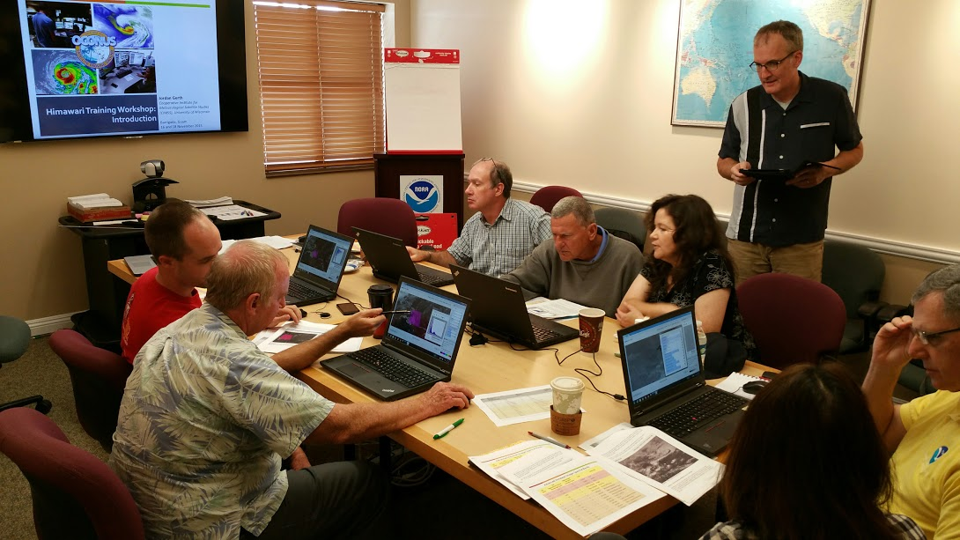
The challenge is to prepare operational meteorologists for new generation weather satellites.

Slide 4
The Challenge
Practically, this means building capacity.
Ensuring technical systems are capable of delivering and displaying imagery and products at the full spatial, spectral, and temporal resolution
Infusing imagery and products into the operational forecast process
Integrating new satellite data into predictive models (numerical weather prediction and otherwise)

Slide 5
Value of Observations
Value =
Quality of Actionable Information (Statements) –
Amount of Factual Information (Data)

Slide 6
Value of Observations
Value decreases when data increases without impacting a decision process.
In this era of “big data”, the amount of data is endlessly increasing.
Unfortunately, the time duration allocated to make a decision is generally fixed.
Modernizing weather forecast services hinges on the practitioner leveraging the right data at the right time.

Slide 7
Risk
Ensure consistency and reliability of Himawari imagery data flow to the forecast offices in Pacific Region.
Provide derived satellite products to the field offices in Pacific Region.

Slide 8
Solution
Procure a satellite processing server to handle incoming Himawari imagery from multiple sources and convert to necessary formats.
HimawariCast (antenna delivery)
HimawariCloud (terrestrial delivery)
Use real-time imagery coupled with CSPP Geo to create quantitative products for operations.

Slide 9
There are two sources for Himawari imagery that enters the Honolulu forecast office.

Slide 10
Solution
To decrease the impact of an interrupted data feed to operations, an AWIPS bundle was configured to display the lesser-resolution HimawariCast imagery behind the full-resolution HimawariCloud tile imagery.
Notes:
AWIPS is Advanced Weather Interactive Processing System

Slide 11
Unresolved Risk
There is inadequate AWIPS performance to support loading, panning, and zooming of large loops, especially at full resolution.

Slide 12
Risk
There was little validation of the AWIPS data-to-display value mapping and geostationary map projection prior to operational use.
We are hampered by our ability to innovate on AWIPS for accommodating features that would improve the forecaster experience.

Slide 13
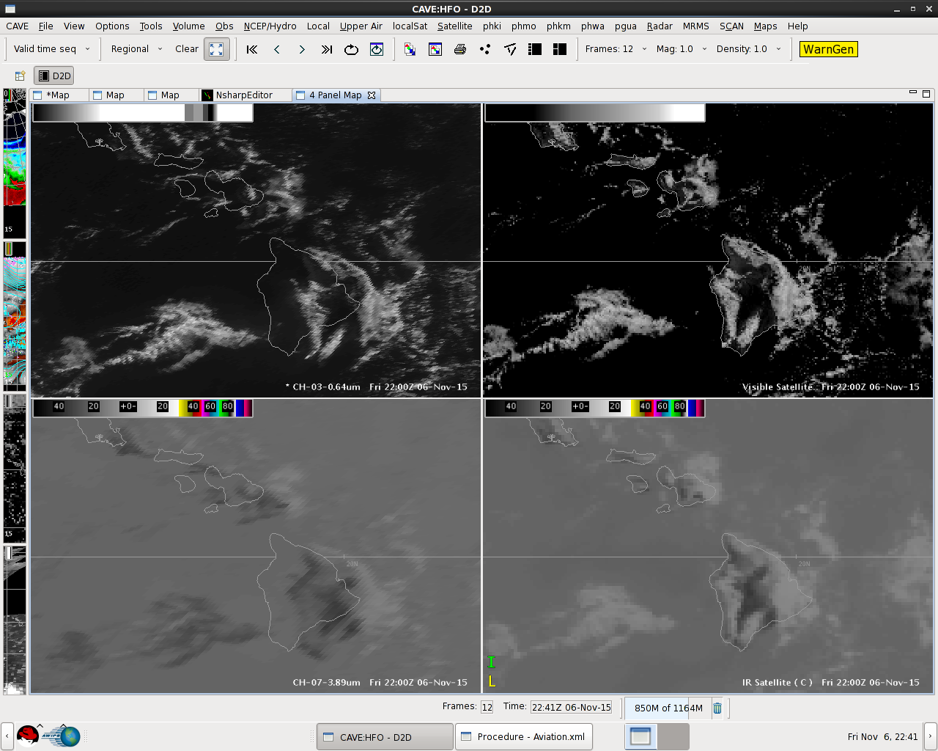
Source: Leigh Anne Eaton

Slide 14
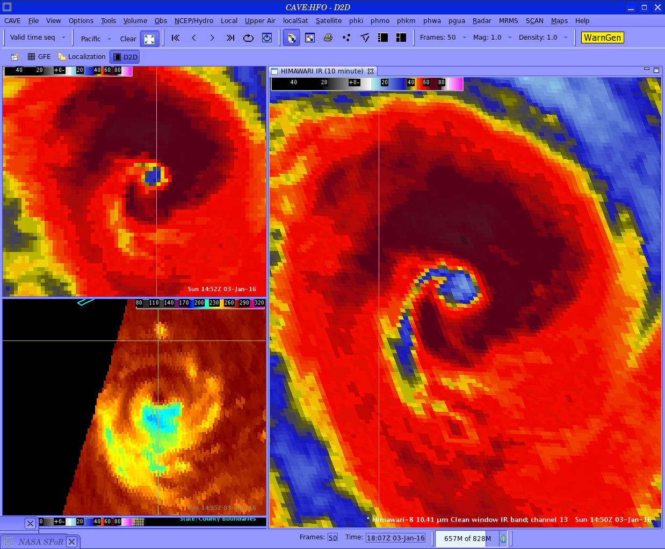
Source: Tom Birchard

Slide 15
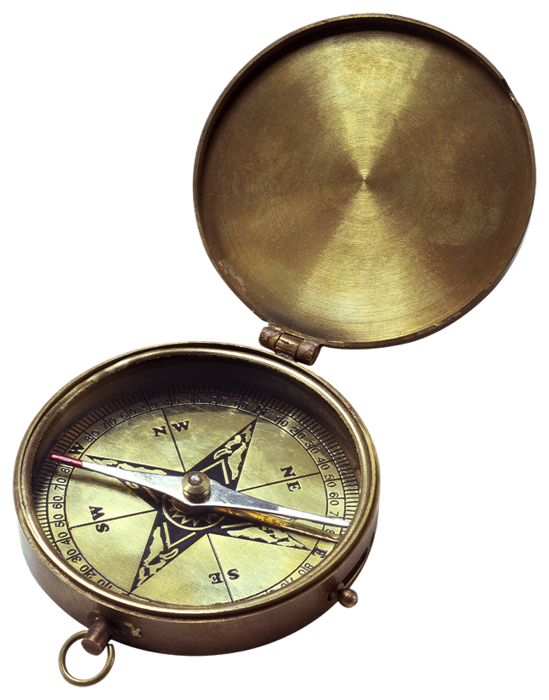
Solution/Workaround
Remap imagery to conventional projections with McIDAS and provide it to AWIPS and N-AWIPS for location-sensitive applications.
Notes:
McIDAS is Man computer Interactive Data Access System

Slide 16
Risk
There was not suitable or tailored training for Himawari-8 imagery immediately available.

Slide 17
Solution
CIMSS developed a new two-day workshop on the Advanced Himawari Imager (AHI) with learning experiences specifically tailored to the operational forecaster.
Some of the workflows that forecasters envision during the workshop are translated to the operational environment.

Slide 18
Training vs. Conveying
We train on… | We need to convey…
The spectral differences between the infrared window channels | How these differences may lead to a different storm characterization during the application of the Dvorak technique
The result of increasing zenith angle on brightness temperatures | How to identify strong jets and synoptic features near the edge of the scan
The reflectance of certain atmospheric and surface properties at varying visible and near-infrared wavelengths | How to discriminate clouds based on phase and composition
How spectral bands are composited to form a Red-Green-Blue (RGB) image | How to use RGBs in certain situations and in such a manner that yields dividends to the forecaster workflow

Slide 19
In Practice
“Seeing Amos accelerating toward Samoa-up to 12-18 hours faster than current forecasts indicated. Viewing 10 minute Himawari clean and legacy IR bands really aided in center fixing and tracking. Was tracking overshooting tops in final RGB convective cloud product of day then meshed right into IR & lightning data to aid in confidence.”
Tom Birchard Hurricane Specialist Central Pacific Hurricane Center

Slide 20
Remaining Issues
Different bit depths of legacy band imagery complicates compositing Himawari-8 full disk imagery with adjacent GOES-15 for AWIPS.
No GOES-R baseline products are available for demonstration in NWS Pacific Region with Himawari-8 input to date.
ESPC does not support Himawari-8 operationally despite NWS use.
There is an inconsistent training experience for users beyond NWS Pacific Region.

Slide 21
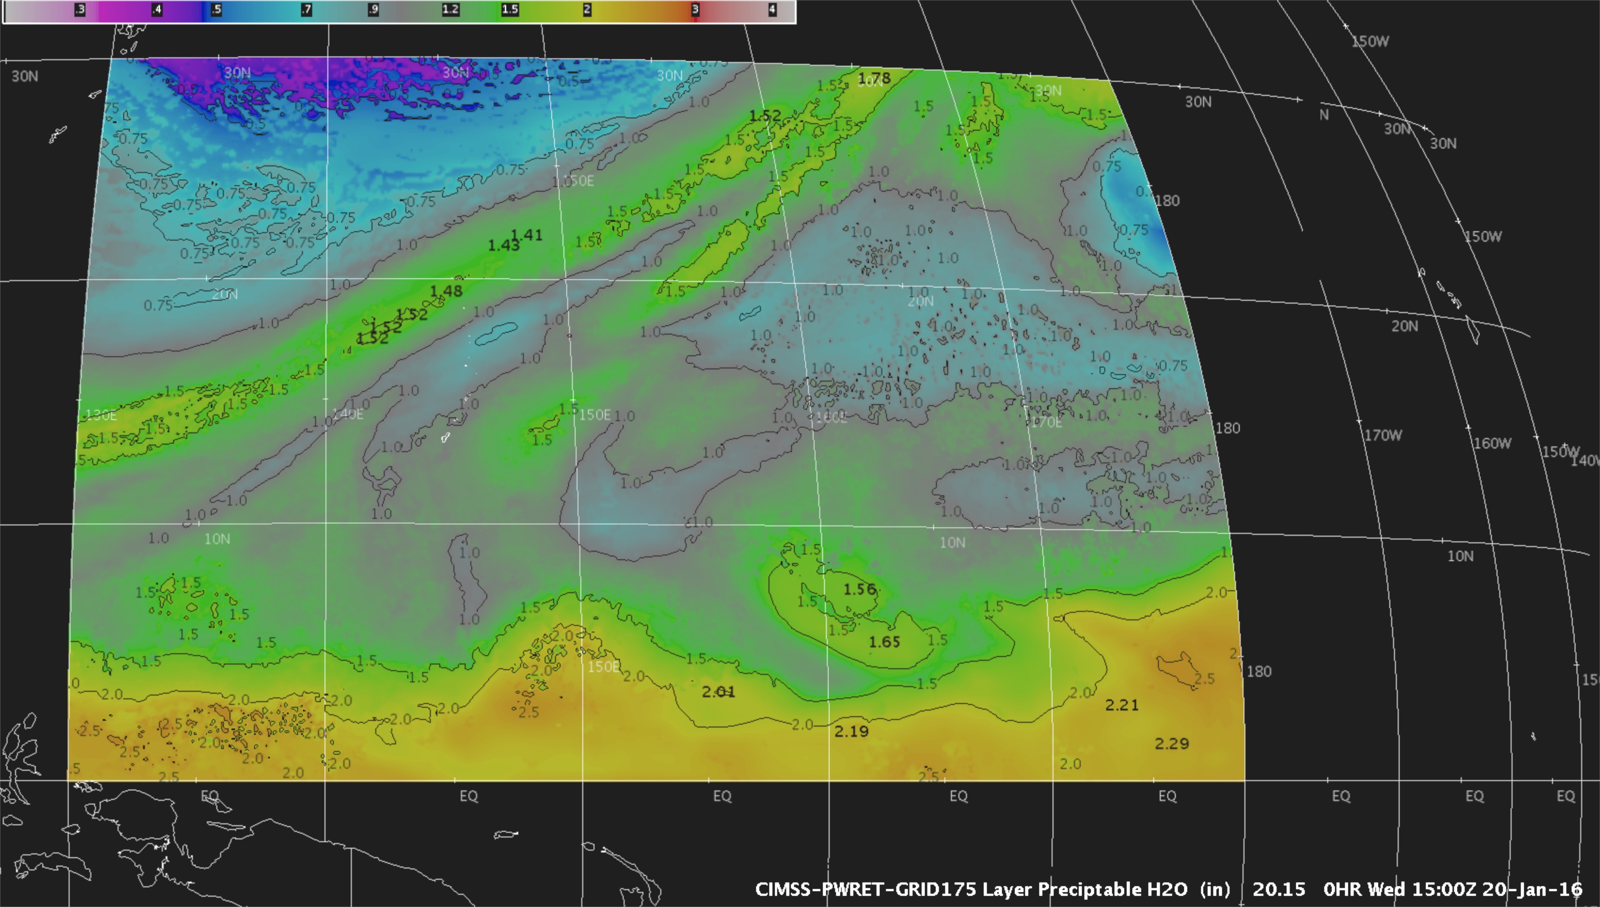
“All Weather” Total Precipitable Water on Grid 175 (covering Guam) One of the outputs from Jun Li’s GOES-R Risk Reduction Project

Slide 22
Recommendations
Operational software applications must be able to display new generation satellite imagery seamlessly at the temporal frequency and duration that the user desires.
Test and innovate before and during the post-launch period
Methods to reach users with training materials should be diverse and expansive.
Learning about the capabilities of new generation satellites will not occur in one sitting

Slide 23
Recommendations
We must consider the entire forecaster workflow as part of the training experience and technical implementation. Training content and capabilities of technical systems must be aligned.
Proving ground demonstrations can sometimes be too narrowly focused on the new and not as much on the existing.
Success requires reliance on a system of systems. Ensure the avenues are in place to work across organizational and technical boundaries.

Slide 24
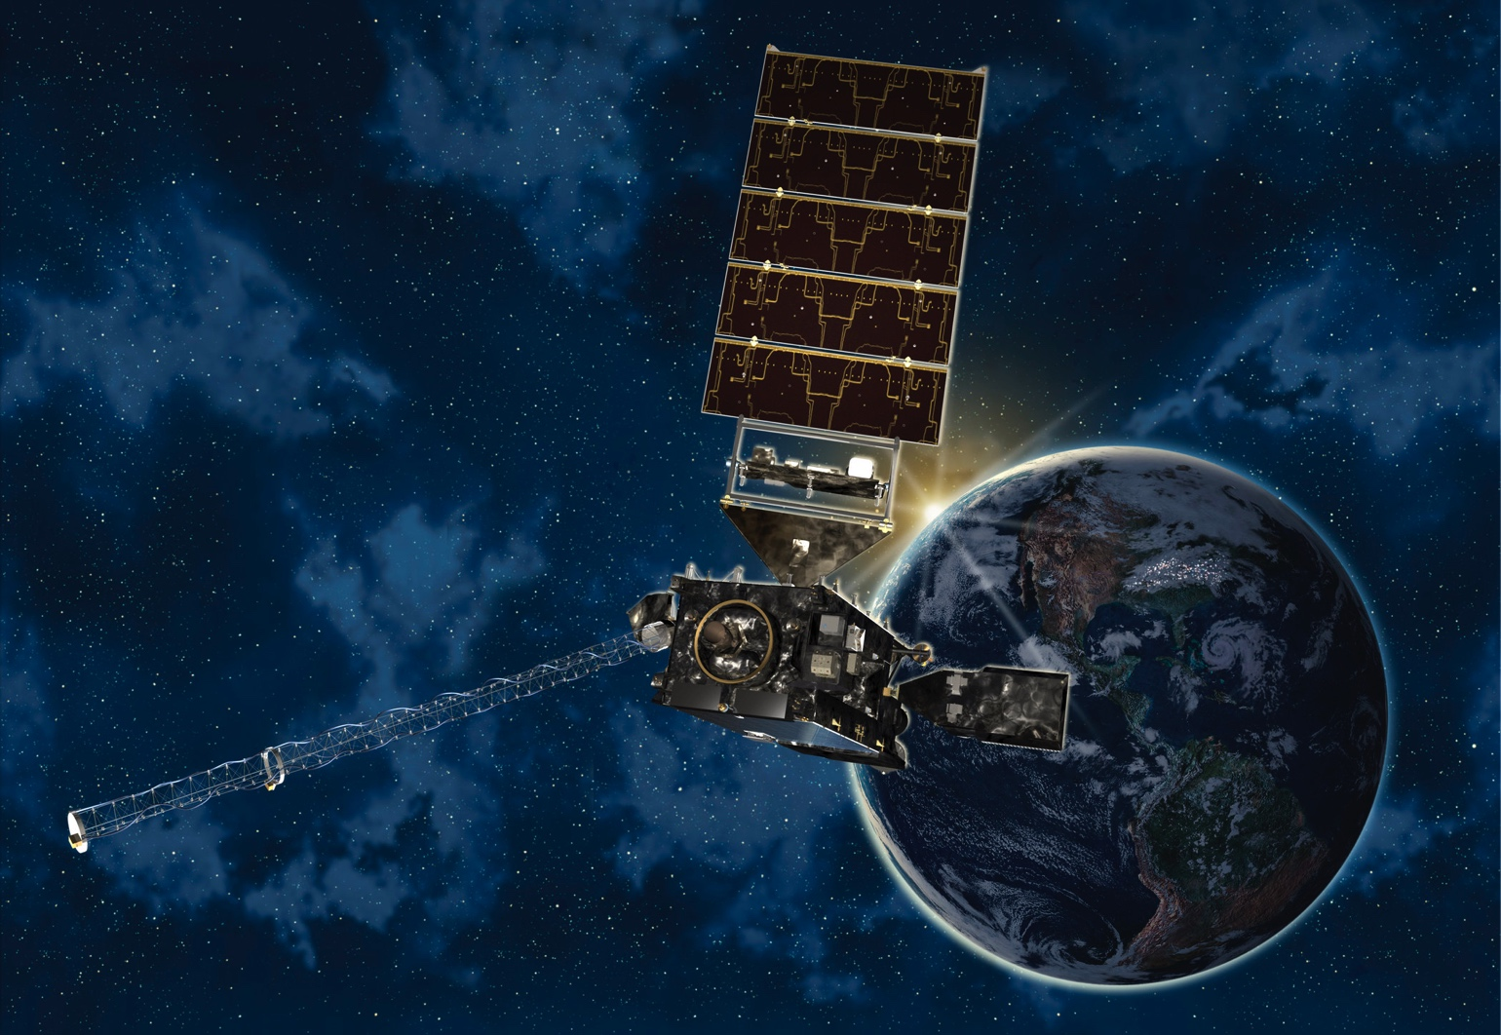
Questions? Comments?
Jordan Gerth Jordan.Gerth@noaa.gov
A Presentation

