Slide 1
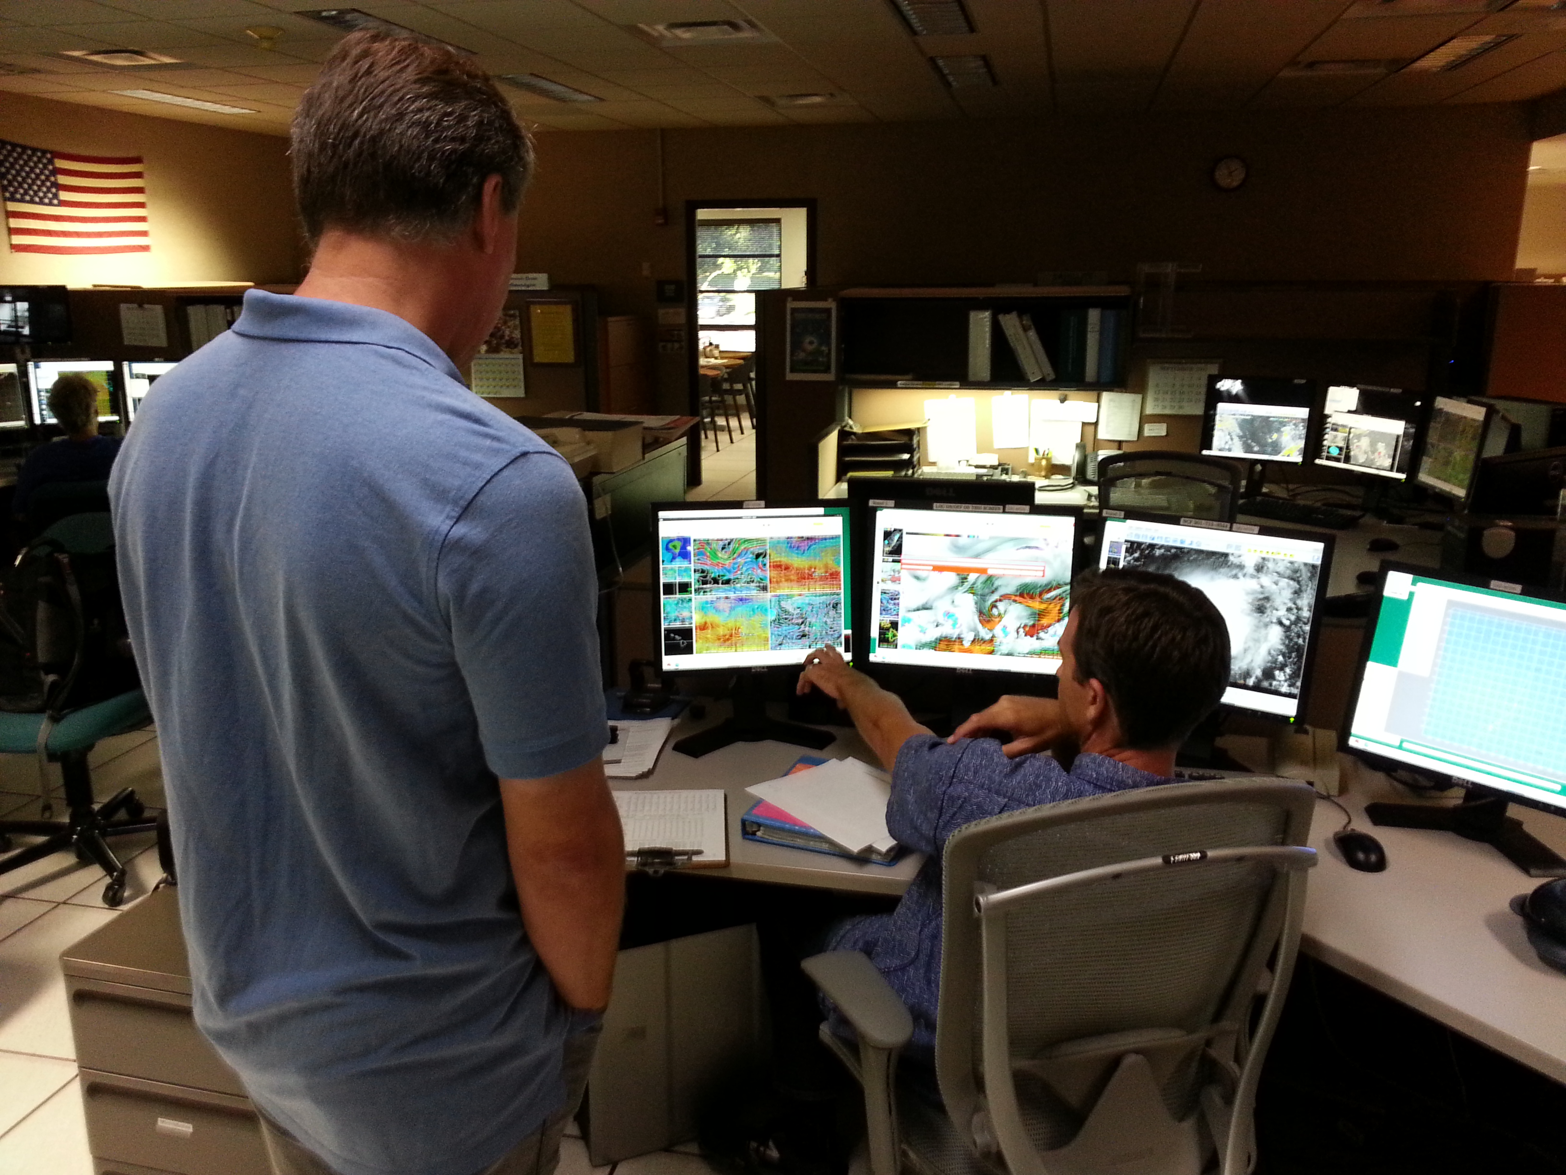
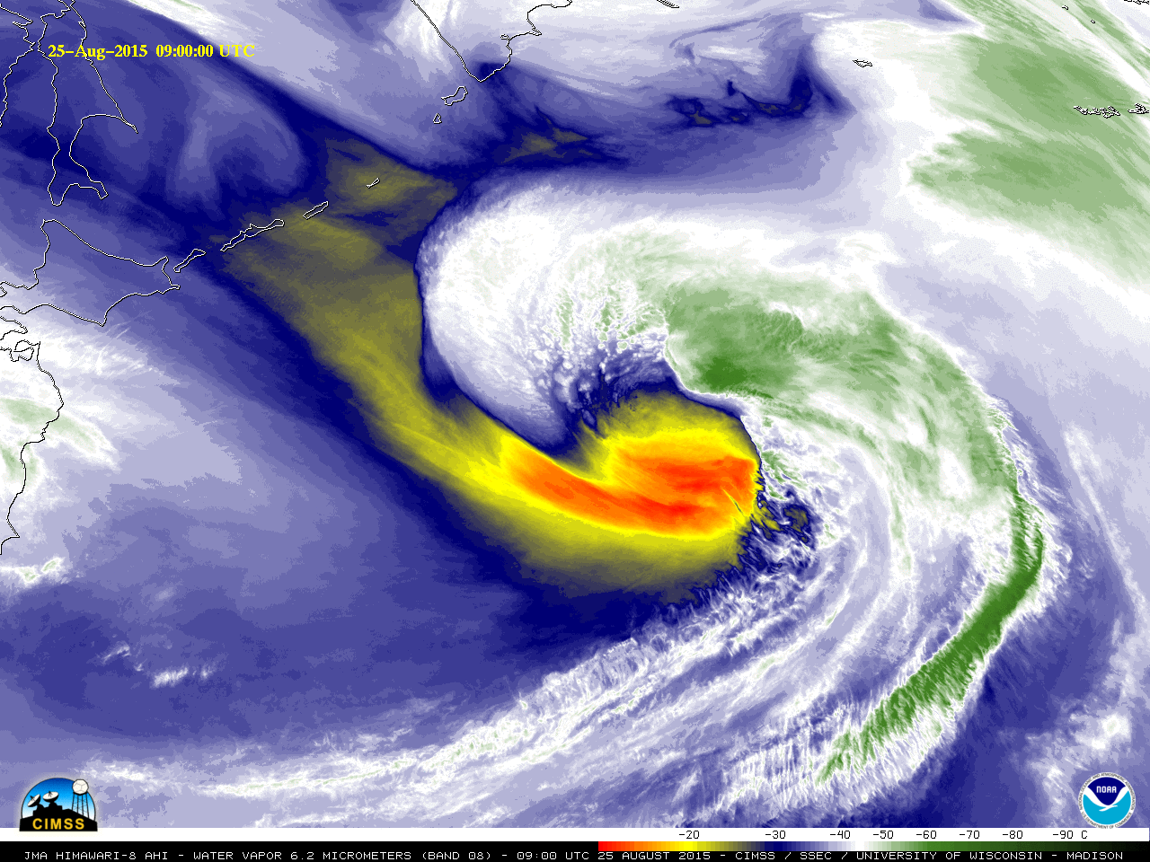
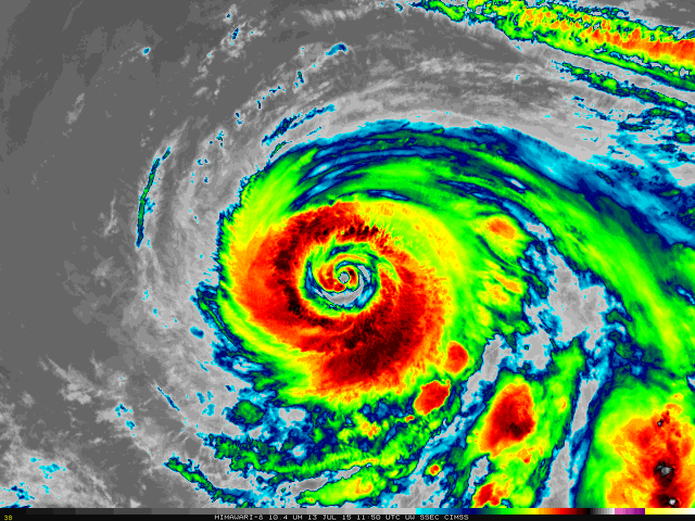
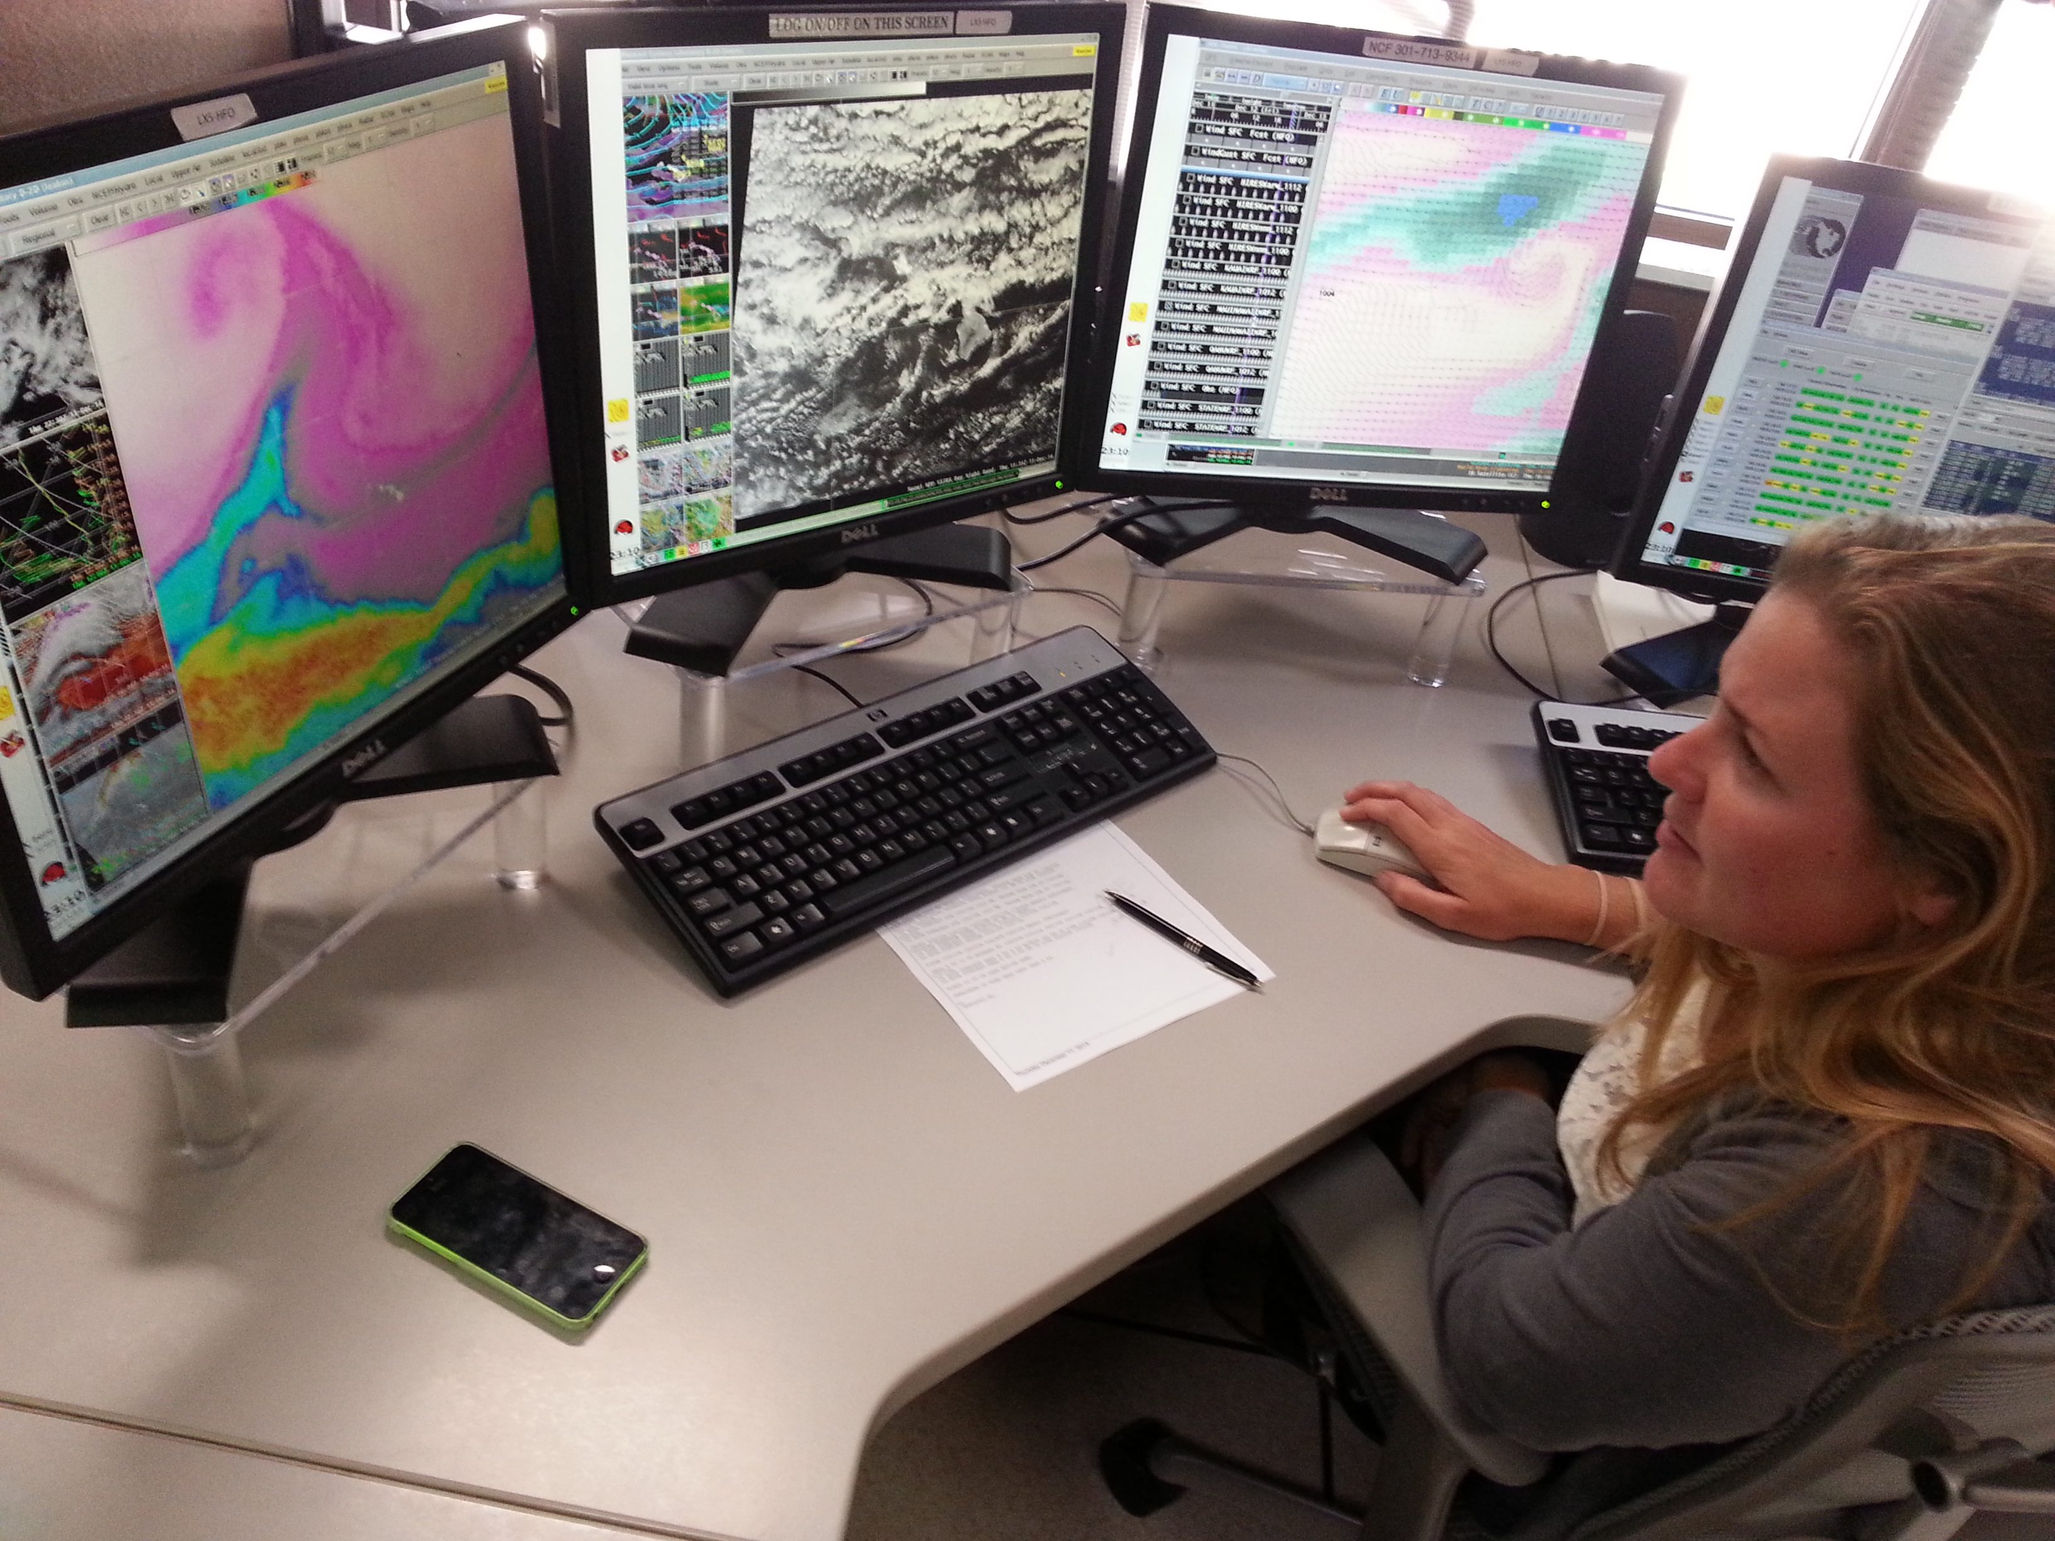
Training Experience: Himawari Training Examples using SIFT
Scott Lindstrom
Jordan Gerth
Cooperative Institute for Meteorological Satellite Studies (CIMSS), University of Wisconsin
Bill Ward
National Weather Service
ESSD Chief, Pacific Region
2016 NOAA Satellite Proving Ground/User Readiness Meeting
Norman OK, 12 May 2016

Slide 2
Training and Instructors
Three locations so far
Barrigada, Guam (November 2015)
Kansas City (February 2016)
Honolulu (April 2016)
Instructors
Jordan Gerth (Guam, Kansas City, Honolulu)
Kathy Strabala (Guam, Honolulu)
Scott Lindstrom (Guam, Kansas City, Honolulu)
Tim Schmit (Kansas City)

Slide 3
The training was brought to them by…
The National Weather Service (NWS) Science and Technology Integration (STI) portfolio office, the NWS Pacific Region Headquarters (PRH) Environmental and Scientific Services Division (ESSD), the University of Wisconsin, and the GOES-R Program Office (GPO)
Pacific Region meteorologists were among the first to receive formal training on the new generation of geostationary satellites
This was a pioneering effort to reach forecasters in their work environment : Forecasters at Guam/Honolulu were trained in their own WFOs and could take what they learned immediately to the Operations floor.

Slide 4
Objectives
Reaffirm understanding of core principles in radiation science
Develop familiarity with the ABI/AHI’s spatial, spectral, and temporal resolution
Increase ability to select and use certain bands of satellite imagery from ABI/AHI to solve short-term weather analysis and forecast challenges.
Takeaway: Exploring the imagery in the days immediately after the training is the best way to retain the training information.

Slide 5
Format of Training
Four segments
Each segment was approximately four hours
(At Guam/Honolulu: 2 Separate Courses for different forecasters; Monday/Tuesday and Thursday/Friday)
Each segment will have a
Short lecture (generally less than one hour)
Lab activity (two to three hours)
Computers provided
Self-paced (recommend working in groups)
Satellite Information Familiarization Tool (SIFT)
Web applications
Surprise! Students liked that it wasn’t Death by PowerPoint

Slide 6
Learning Topics
ABI/AHI Characteristics
Spectral Response Functions
Weighting Functions
RGB Composites
WebApps for 3. and 4.
http://cimss.ssec.wisc.edu/goes/wf/AHI/
http://cimss.ssec.wisc.edu/goes/webapps/satrgb/overview_ahi.html
SIFT to explore Imagery
Each Topic reinforces the knowledge learned from other topics

Slide 7
Reminder: Main SIFT Features
Loop through multiple bands for a single time, or multiple times for a single band
Change color enhancement by band
Transparent gradients are available
Seamless panning and zooming across entire full disk, even while looping
Probe a point to determine reflectance or brightness temperature for all loaded bands
Create histograms (single band) and density maps (two bands) based on user-defined polygon

Slide 8
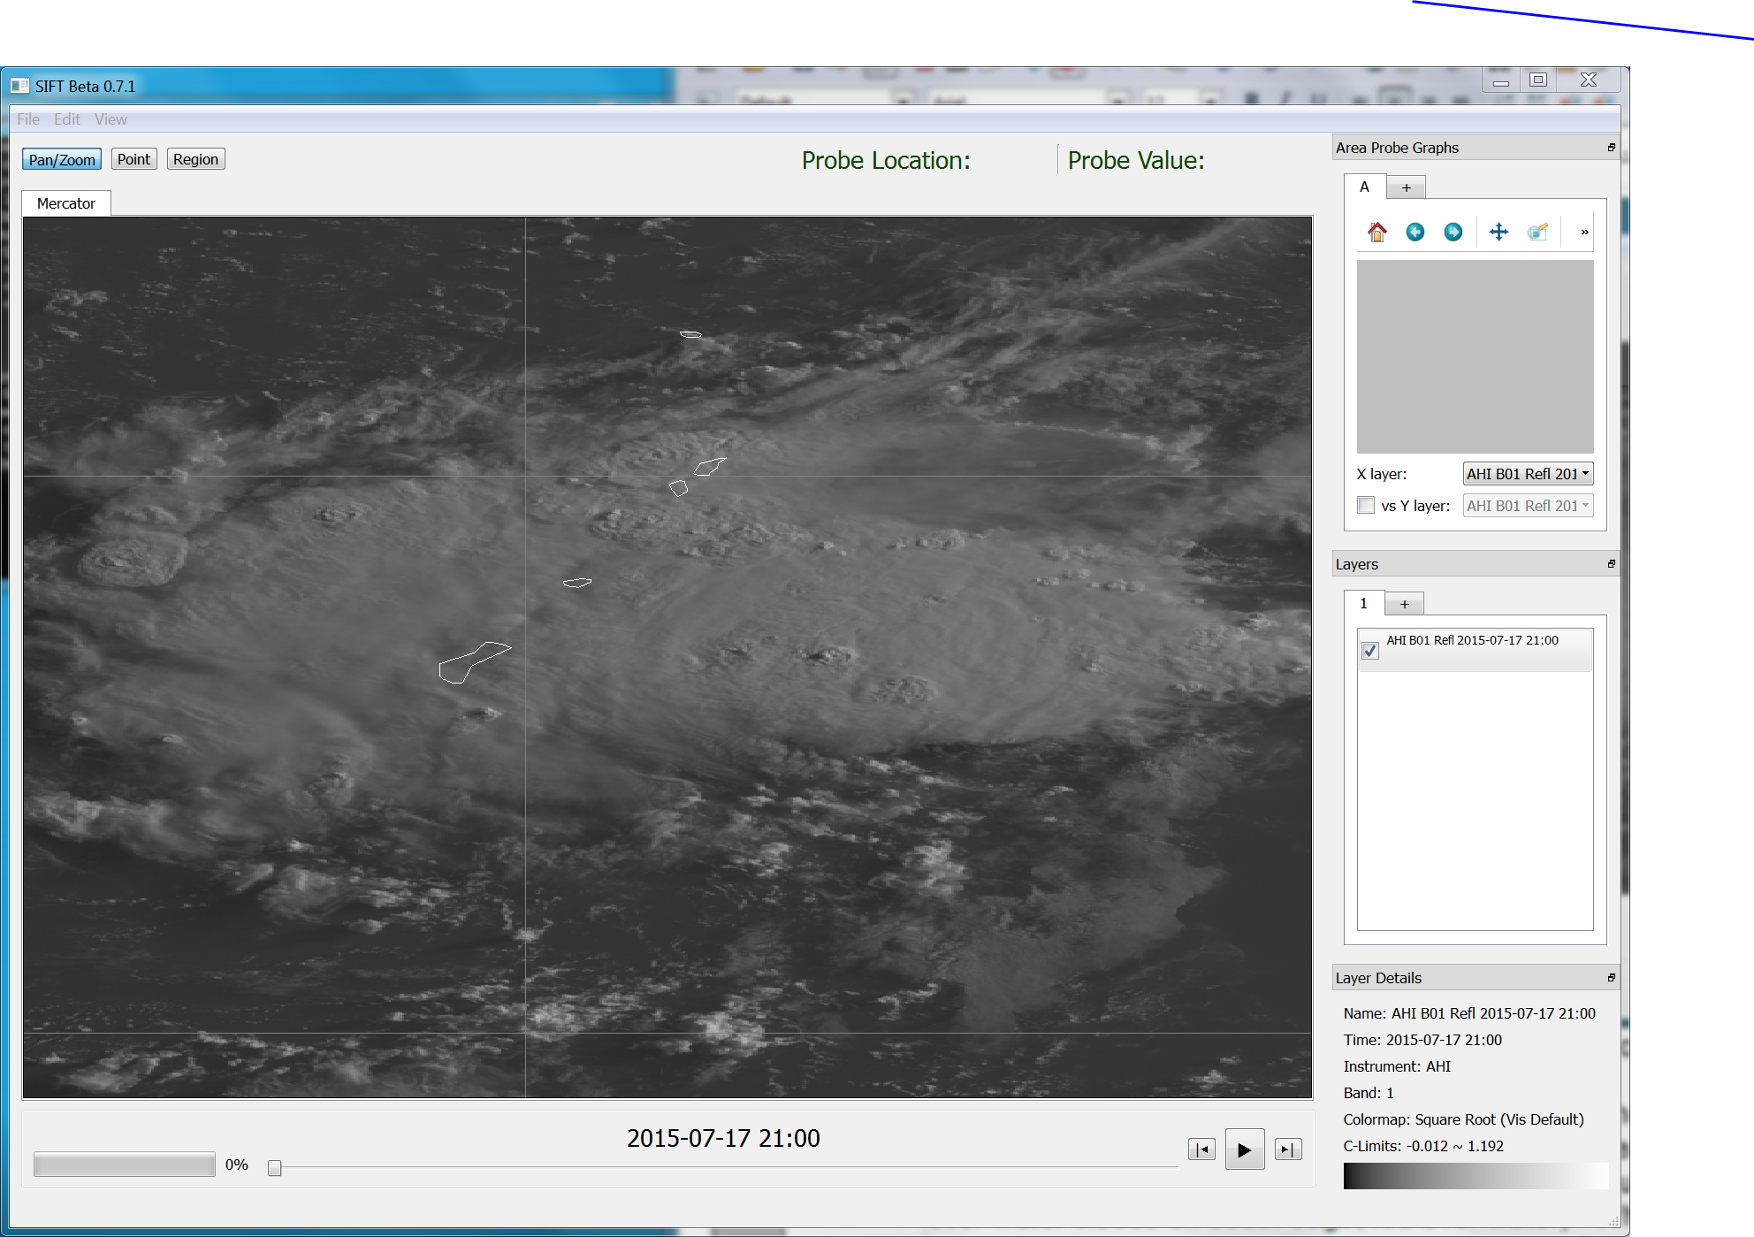
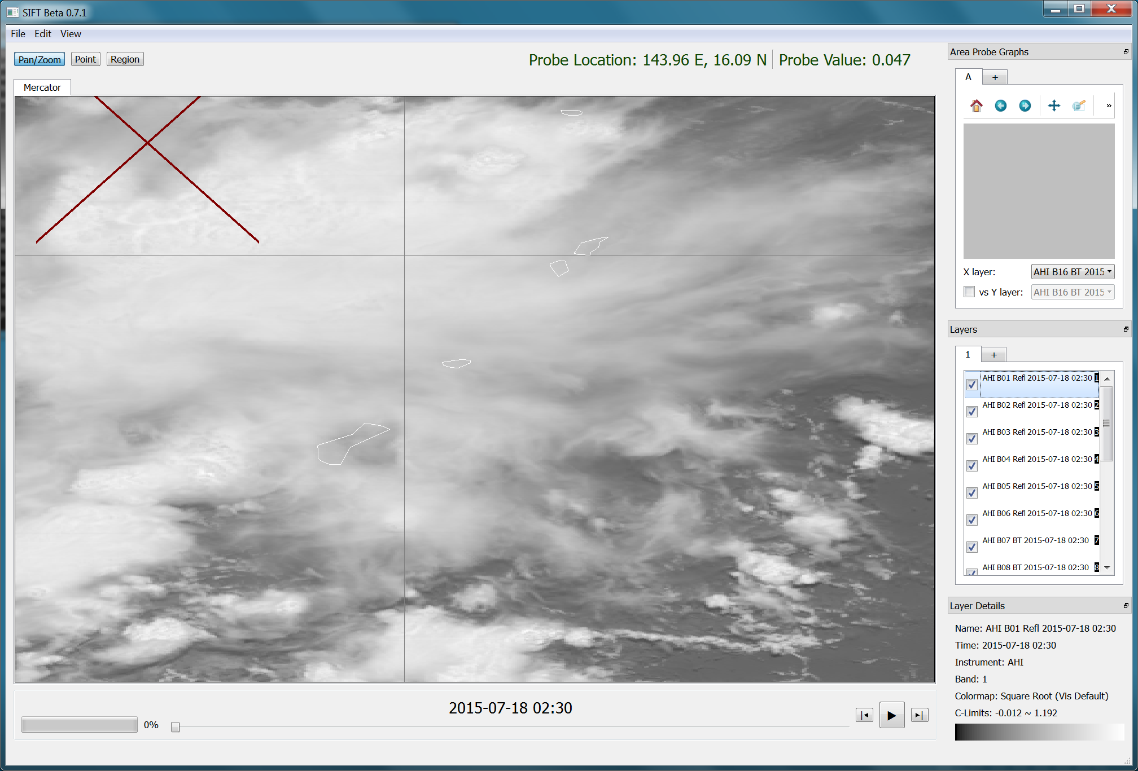
SIFT Example 1
#1
#2
First, just load up one image, then load up all bands for a different time
Ask a simple question: Why is Image #2 brighter?

Slide 9
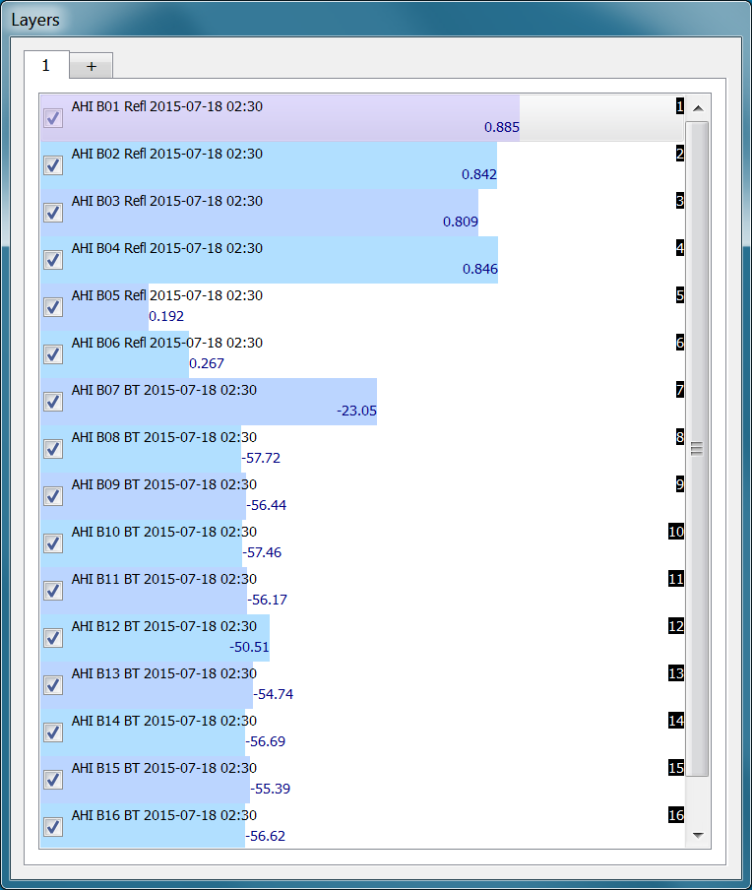
SIFT Example 1
Discuss Probe Features of SIFT Tool
What does this tell you about your scene?
Why is Band 5 reflectance small?
Why is Band 7 so much warmer?
Why is band 13 warmer than band 14?
Why is Band 12 Warmer than most other IR bands?
Day or Night?

Slide 10
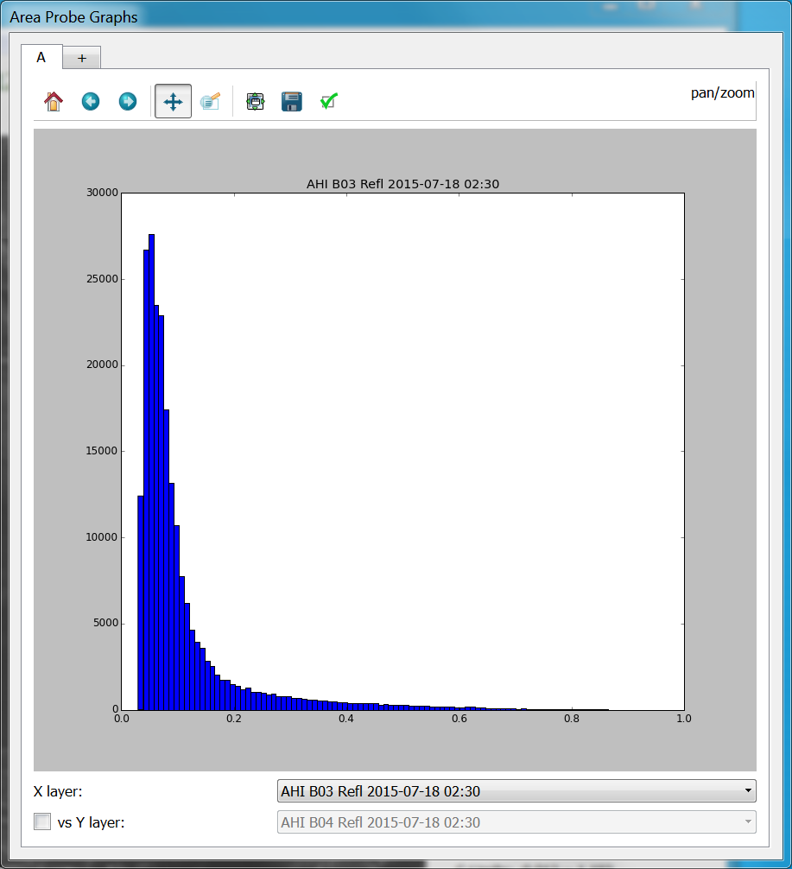
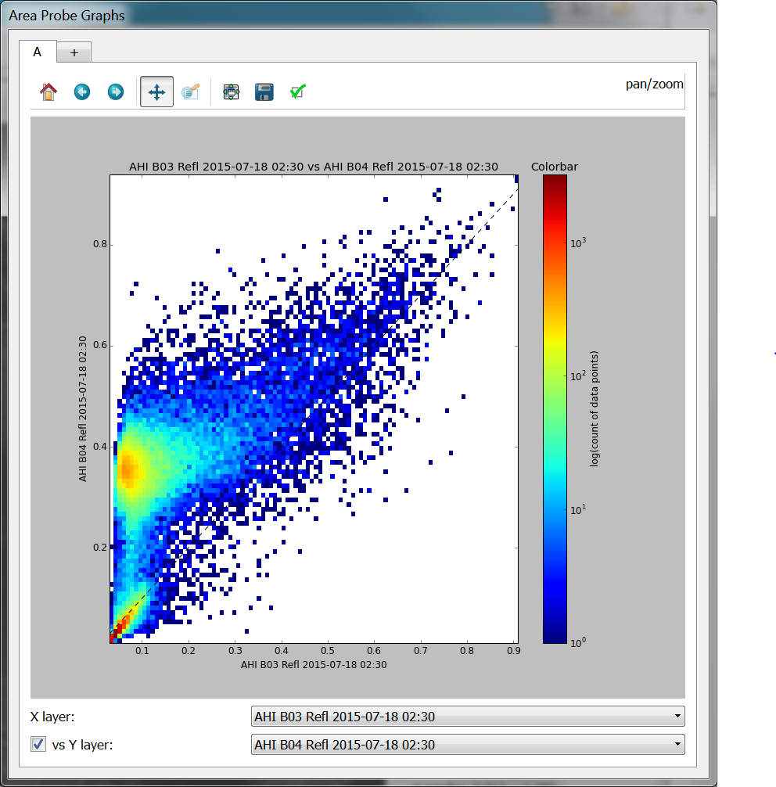
SIFT Example 2
Load up all Bands, and create a histogram & density diagram of a region – those are shown below. Explain what you see!
Why is there a region of relatively high Band 4 Reflectance?
Band 3 Reflectance is mostly small, with a few higher values
Conclusion: Mostly clear

Slide 11
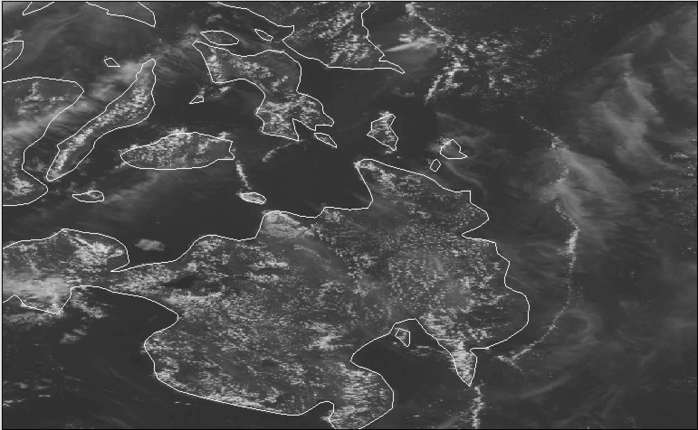
SIFT Example 2: AHI Band 3 Versus Band 4
AHI Band 3 (0.64 μm)
AHI Band 4 (0.86 μm)
Philippine Island of Mindanao

Slide 12
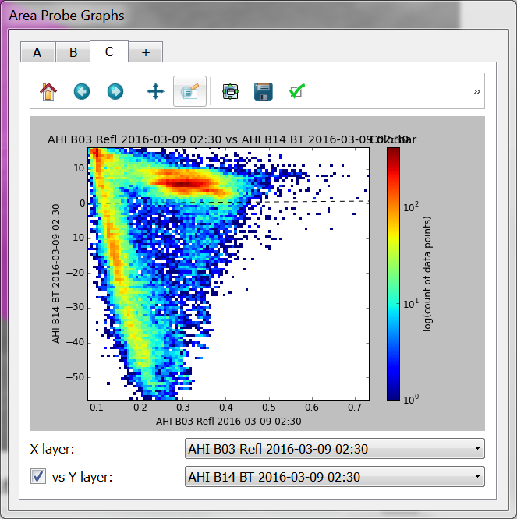
SIFT Example 3
Describe what you see in this Density Diagram (Band 3 v. Band 14)
This is an excellent way to make sure the students really do understand the capabilities of each individual band
Note there are two distributions:
Fairly Warm and Highly Reflective
Colder with Increasing Reflectivity

Slide 13
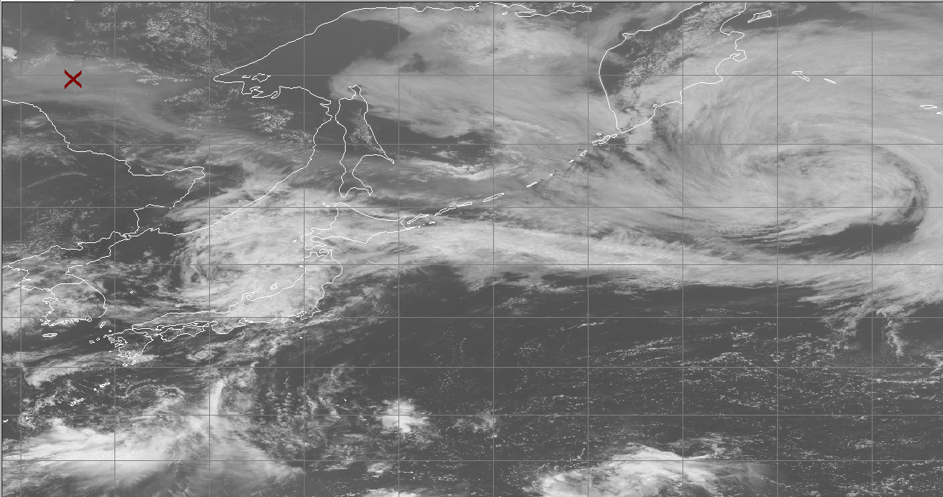
SIFT Example 4a
What are the different bands telling you here?
Is it day or night?
Is it cloudy? Thick clouds? Thin clouds?
What do the Water Vapor Bands Tells you?
Which two (that’s a hint) bands are most important in describing what’s going on?

Slide 14
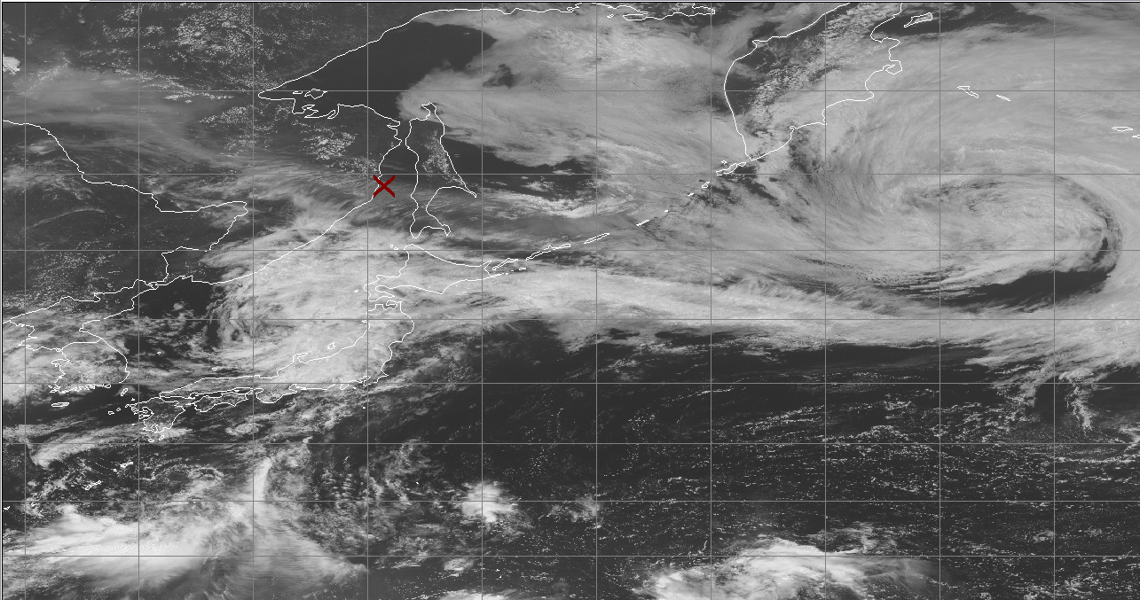
SIFT Example 4b
Which Probe Matches Which Scene?
Which Two Channels help most?

Slide 15
SIFT Example 4c
Behold the Power of Band 4 in highlighting Land!
Reflectivity is much greater

Slide 16
SIFT Example 5
Cirrus/Ice Band
At which two channels are you looking?
Visible or Infrared?
Veggie Band

Slide 17
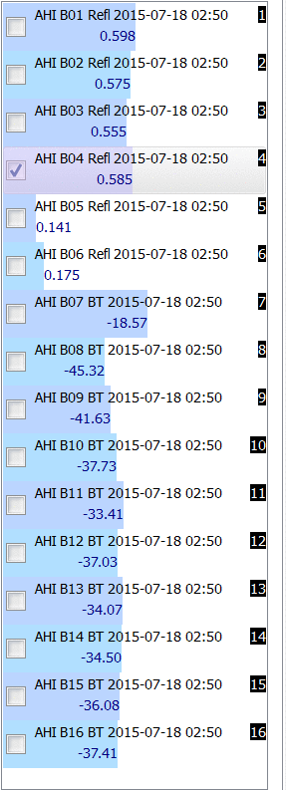
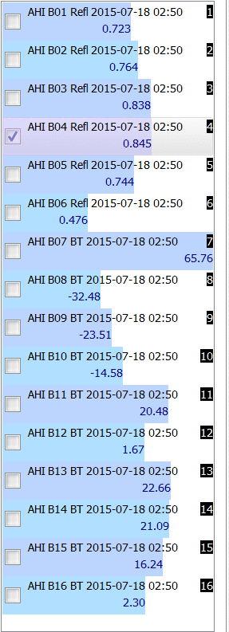
Sift Example 5
Which probe corresponds to the Ocean Location you just saw?

Slide 18
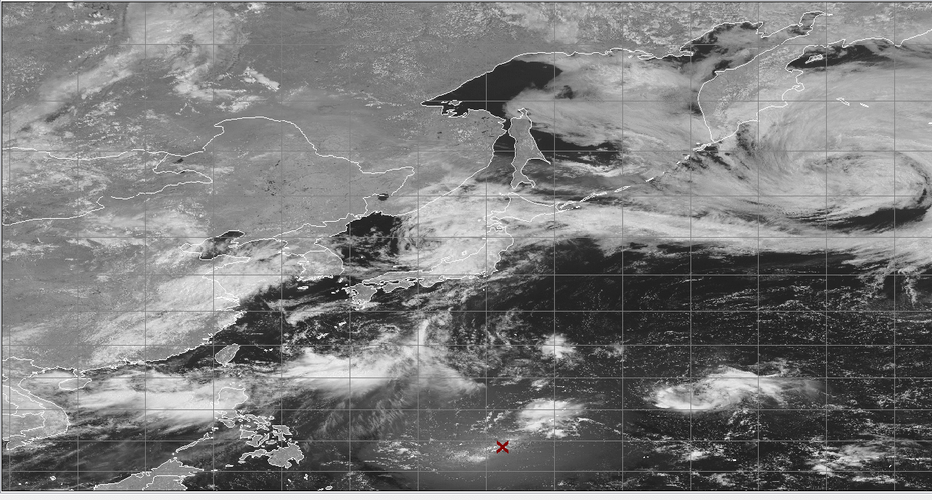
Sift Example 5
Of the remaining three probes, which corresponds to this point

Slide 19
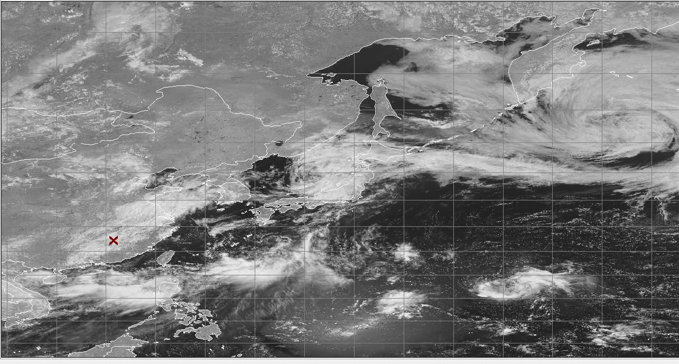
Sift Example 5
Match the Probe on the left to the Scene. Which goes with the ‘x’?

Slide 20
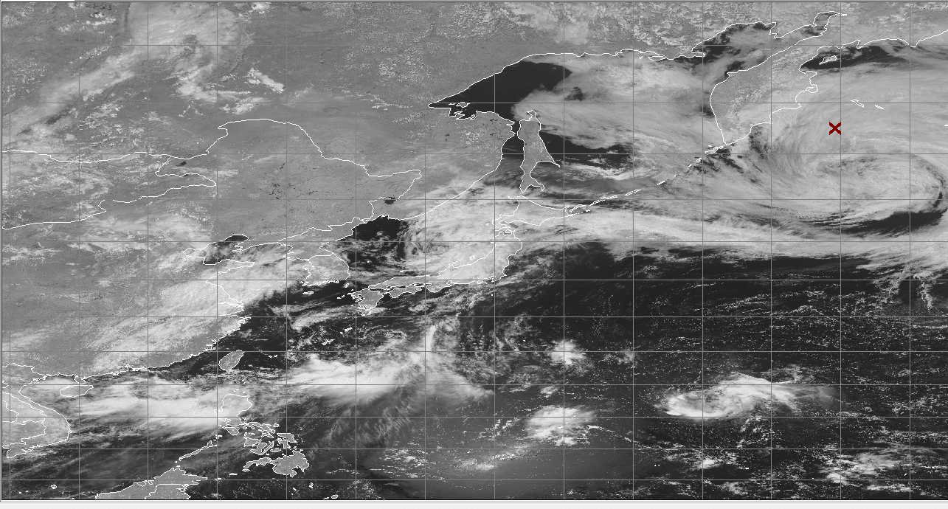
Sift Example 5

Slide 21
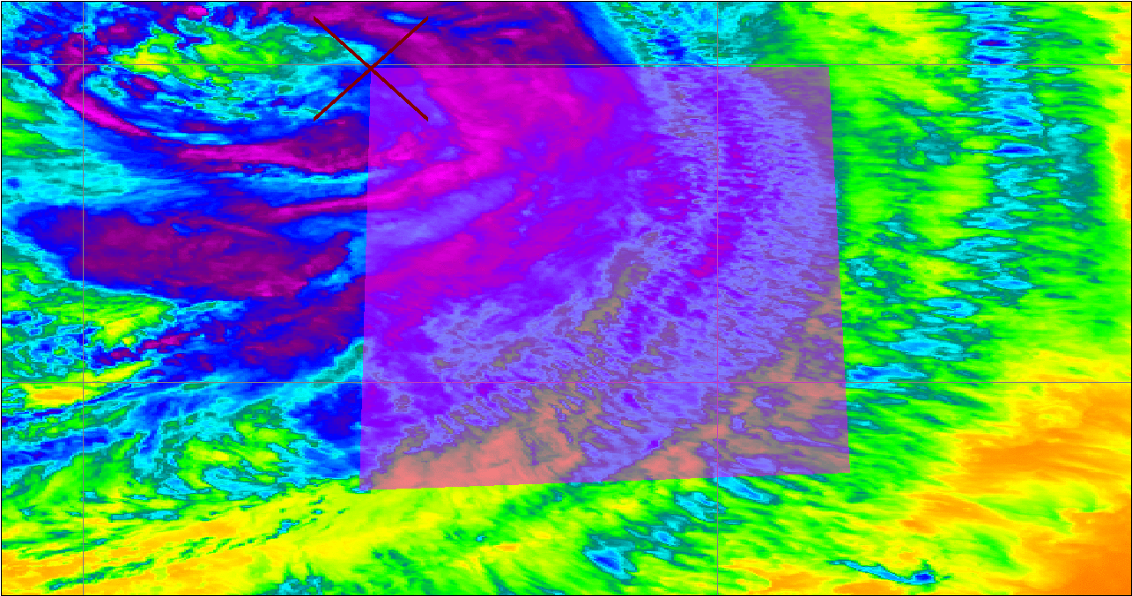
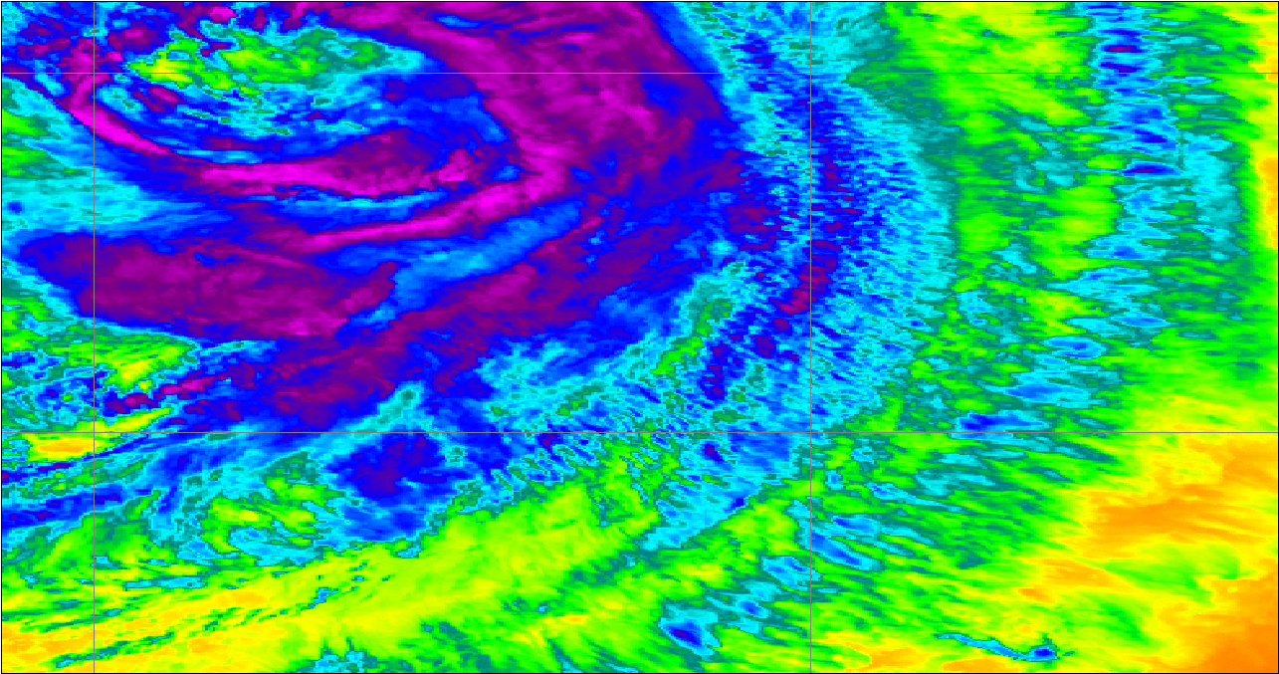
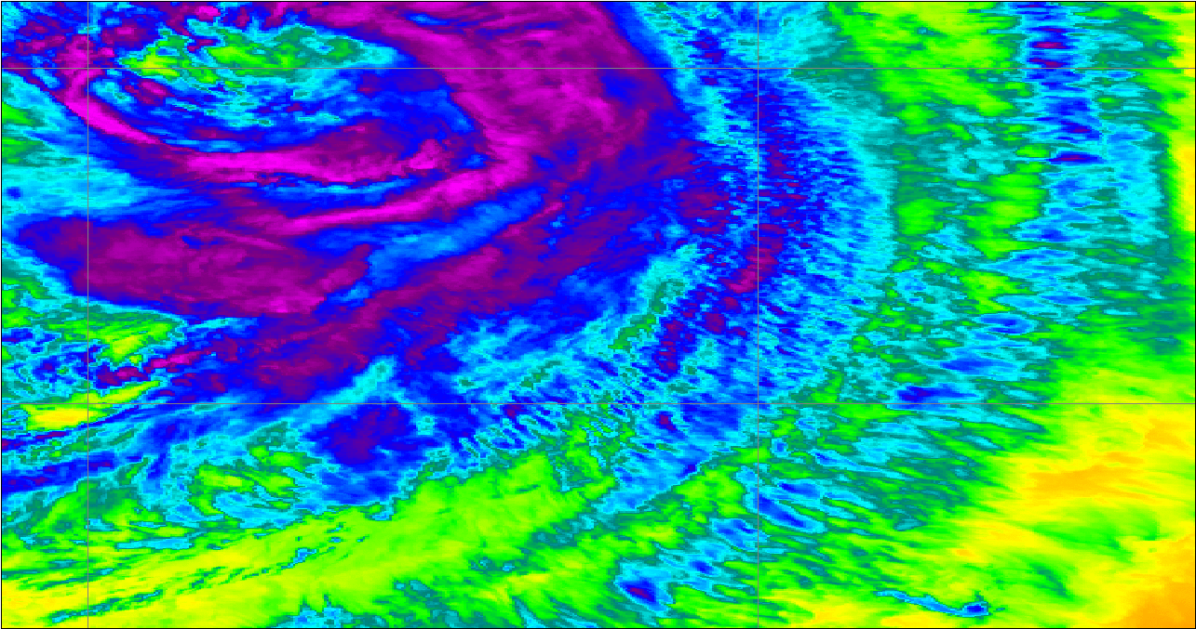
SIFT Example 6
13
14
15

Slide 22
SIFT Example 6

Slide 23
Questions asked in Lab
What AHI visible reflectance band is best for detecting/identifying low clouds?
What AHI visible reflectance band is best for detecting/identifying high clouds?
What AHI thermal infrared band is best for detecting/identifying low clouds?
What AHI thermal infrared band is best for detecting/identifying high clouds?
What AHI visible reflectance band is best for detecting/identifying land surface features?
What AHI thermal infrared band is best for detecting/identifying land surface features?
What AHI band or bands are best for detecting/identifying mid atmosphere features?

Slide 24
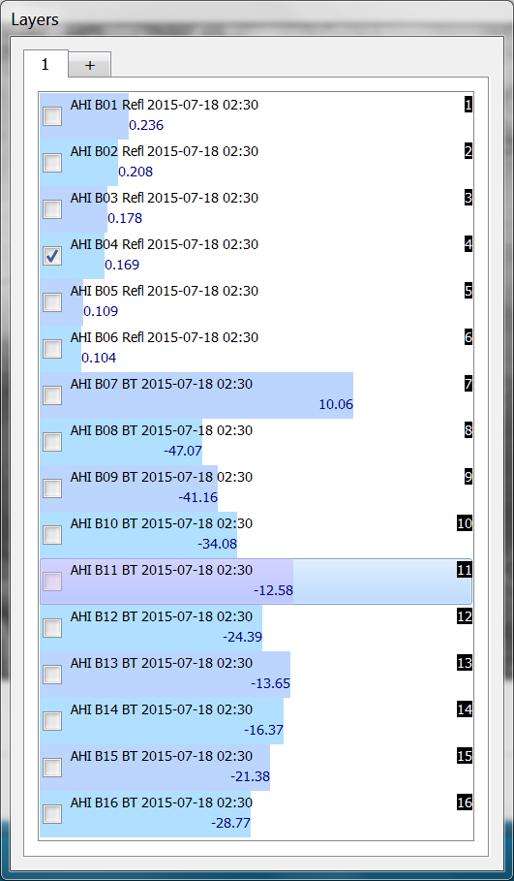
What does this scene represent?
Day or Night?
Water or Land?
Cloudy or Clear?
If cloudy: Thick clouds or Thin?
This forces the student to understand how each Band might be used.
(This is thin cirrus over land)

Slide 25
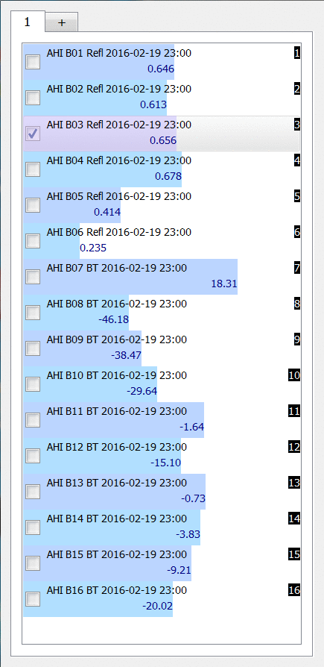
What’s the chief difference between these two probes?

Slide 26
SIFT Training always referred back to Spectral Response Functions
Why are the channels placed where they are?
What can you expect the bands to view given the Spectral Response Functions?
Handouts provided to facilitate learning

Slide 27
Advanced Baseline Imager Spectral Bands
AHI Band | AHI Approximate Central Wavelength (μm) | ABI Approximate Central Wavelength (μm) | ABI Band | Type | Nickname
1 | 0.47 | 0.47 | 1 | Visible | Blue
2 | 0.51 |  |  | Visible | Green
3 | 0.64 | 0.64 | 2 | Visible | Red
4 | 0.86 | 0.86 | 3 | Near-Infrared | Veggie
 |  | 1.4 | 4 | Near-Infrared | Cirrus
5 | 1.6 | 1.6 | 5 | Near-Infrared | Snow/Ice
6 | 2.3 | 2.2 | 6 | Near-Infrared | Cloud Particle Size
7 | 3.9 | 3.9 | 7 | Infrared | Shortwave Window
8 | 6.2 | 6.2 | 8 | Infrared | Upper-level Water Vapor
9 | 6.9 | 6.9 | 9 | Infrared | Mid-level Water Vapor
10 | 7.3 | 7.3 | 10 | Infrared | Lower-level Water Vapor
11 | 8.6 | 8.4 | 11 | Infrared | Cloud-Top Phase
12 | 9.6 | 9.6 | 12 | Infrared | Ozone
13 | 10.4 | 10.3 | 13 | Infrared | “Clean” Longwave Window
14 | 11.2 | 11.2 | 14 | Infrared | Longwave Window
15 | 12.4 | 12.3 | 15 | Infrared | “Dirty” Longwave Window
16 | 13.3 | 13.3 | 16 | Infrared | CO₂ Longwave
Handout

Slide 28
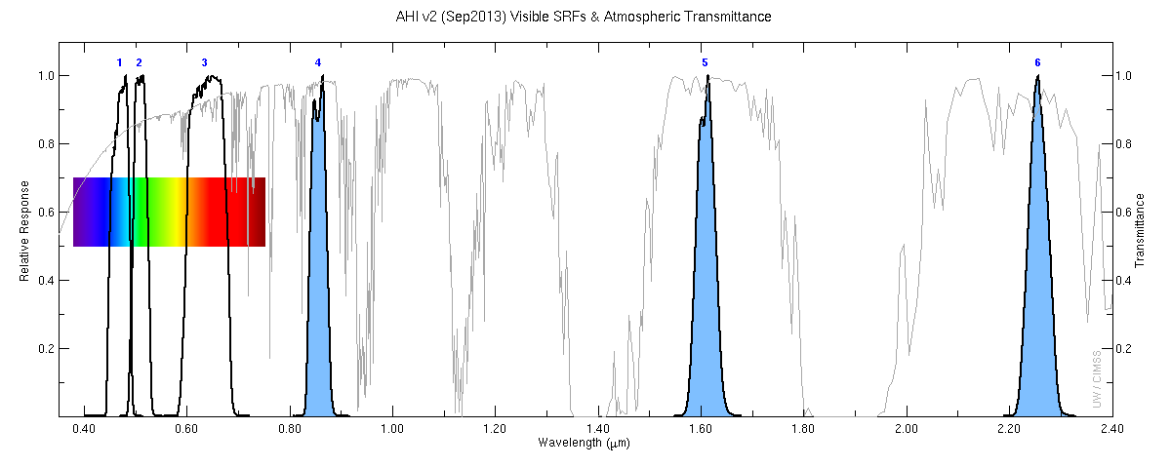
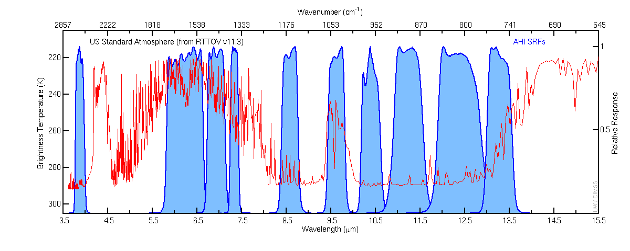
AHI
Handout

Slide 29
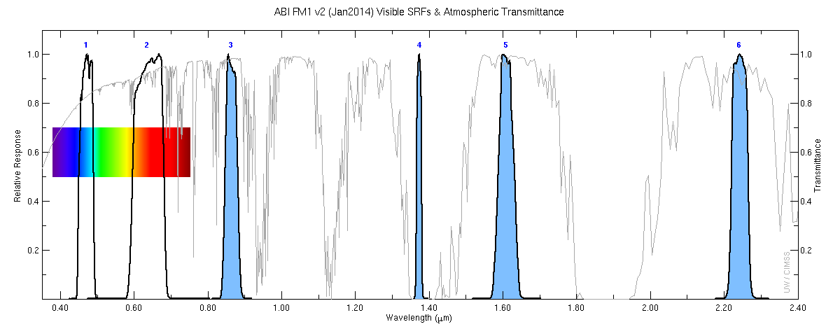
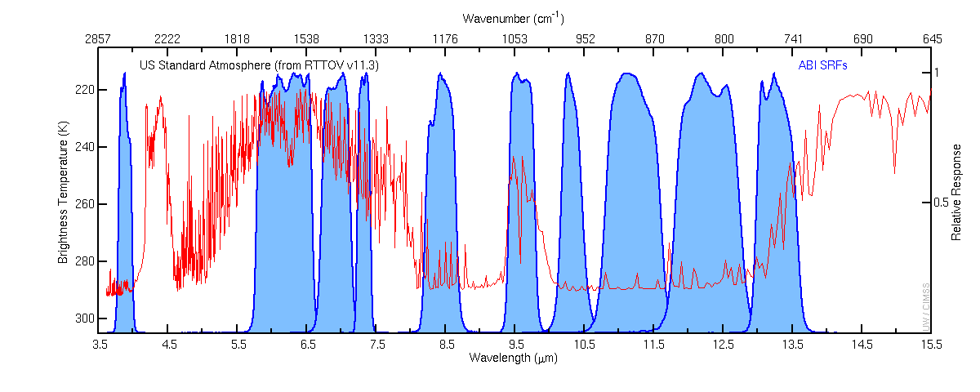
ABI
Handout

Slide 30
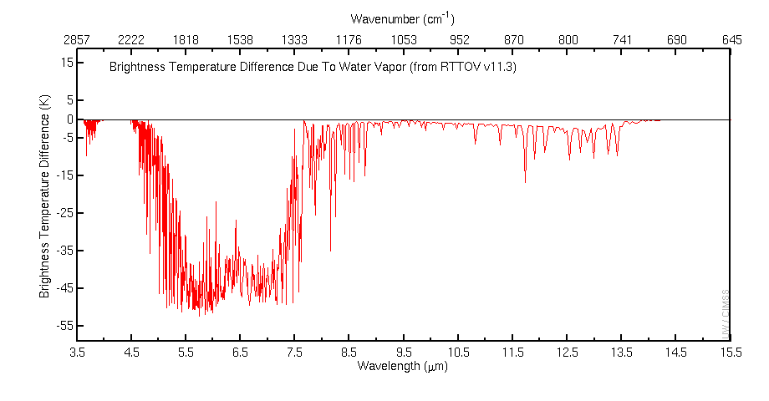
US Standard Atmosphere (1976) Brightness Temperature Difference
as a result of water vapor (H₂O) absorption
Why isn’t the window channel here?
Credit: Mat Gunshor, Cong Zhou, Tim Schmit, Allen Huang

Slide 31
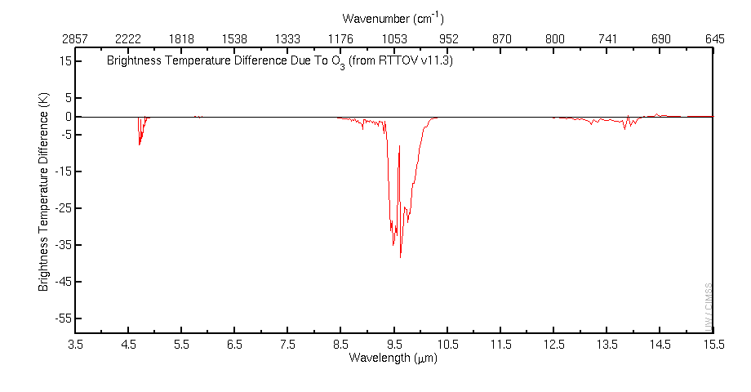
US Standard Atmosphere (1976) Brightness Temperature Difference
as a result of ozone (O₃) absorption
Credit: Mat Gunshor, Cong Zhou, Tim Schmit, Allen Huang

Slide 32
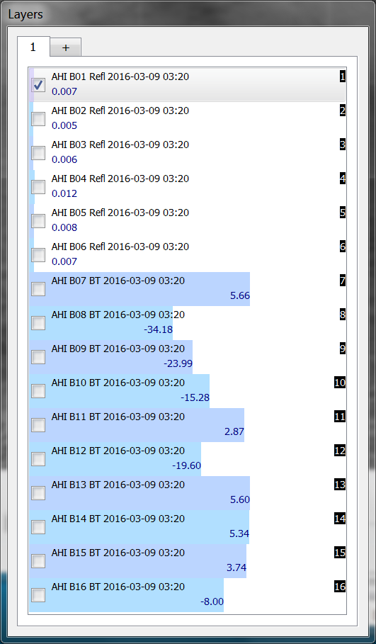
Once more: What does this scene represent?
Day or Night?
Water or Land?
Cloudy or Clear?
If cloudy: Thick clouds or Thin?
This is a trick question

Slide 33
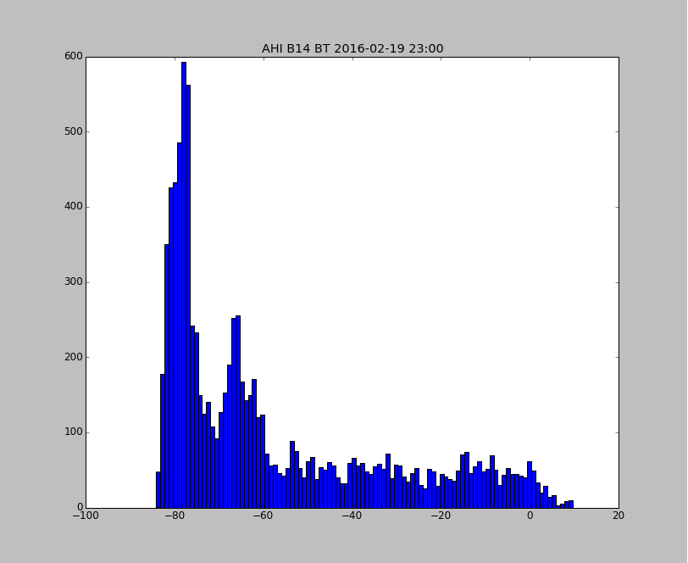
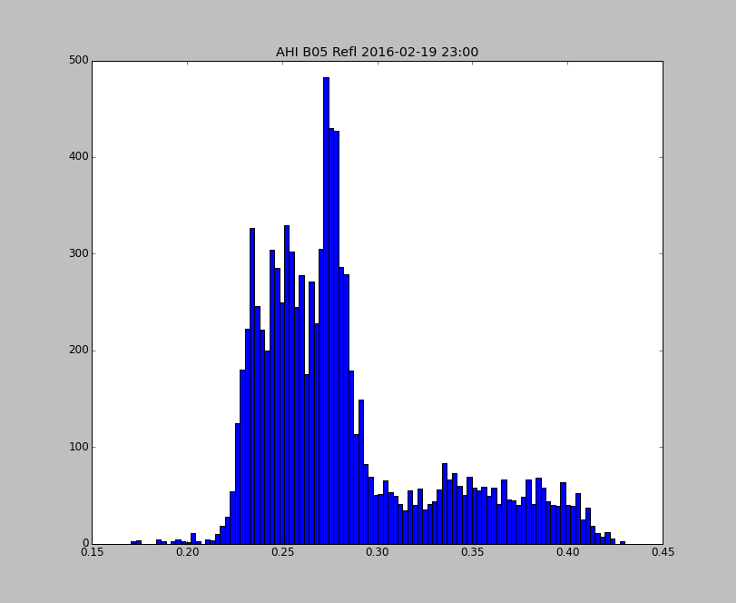
Questions?

