Slide 1
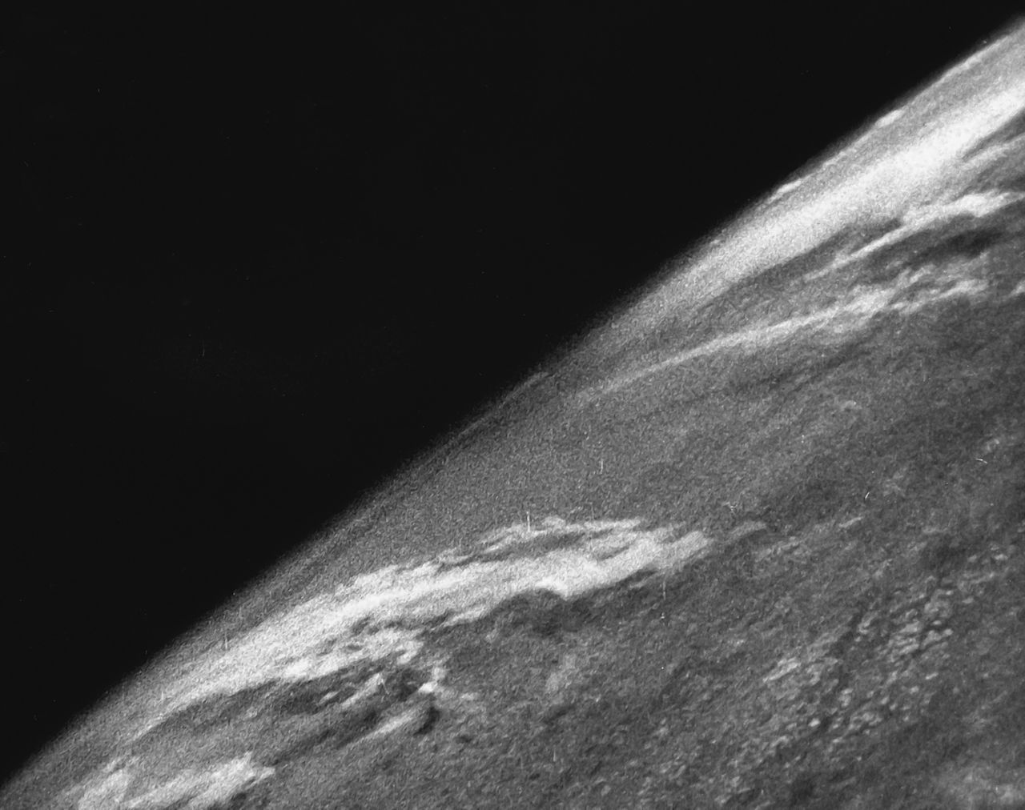
Challenges in Preparing
NWS Operational Staff &
Expectations for GOES-R
2016 Satellite Proving
Ground/User-Readiness Meeting
Paul Iñiguez
Science & Operations Officer
NOAA/NWS Phoenix, AZ

Slide 2
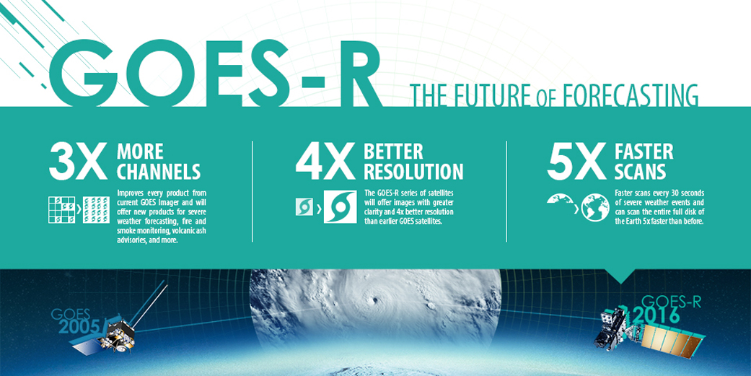
GOES-R – An Easy Sell!

Slide 3
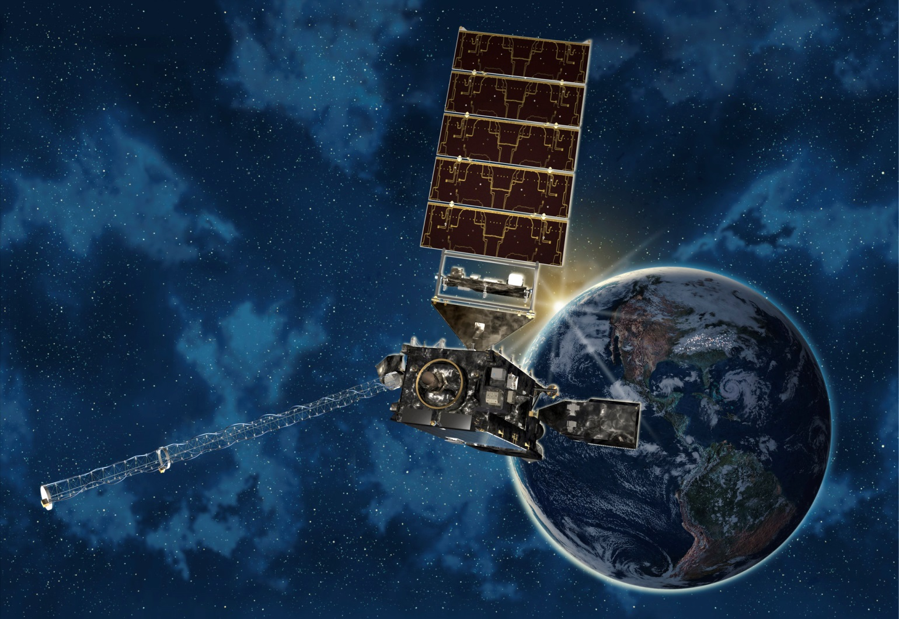
GOES-R Challenges
Coming
October 2016!

Slide 4
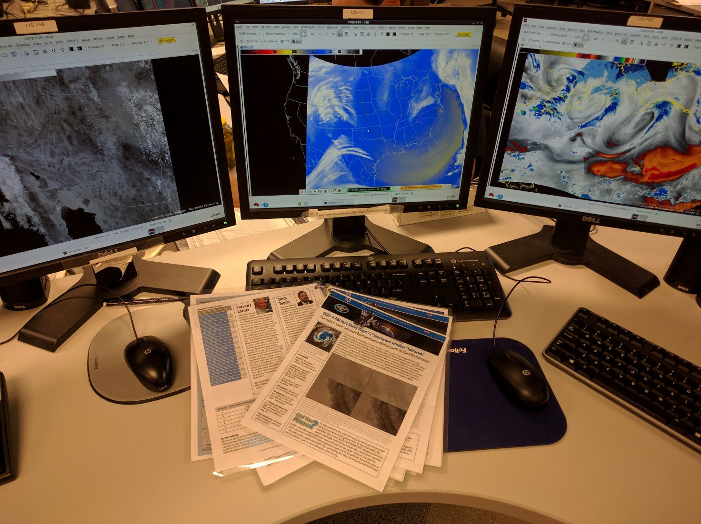
GOES-R Training, Thus Far…
Synthetic
Data
1-Pagers

Slide 5
GOES-R Synthetic Data
PROs
Simulates Look/Feel of Actual Data
Exposes Staff to Numerous New Channels
Appreciation for Faster Data
CONs
Simulates Look/Feel of Actual Data
Sporadic Downtime
Helpful Guy

Slide 6
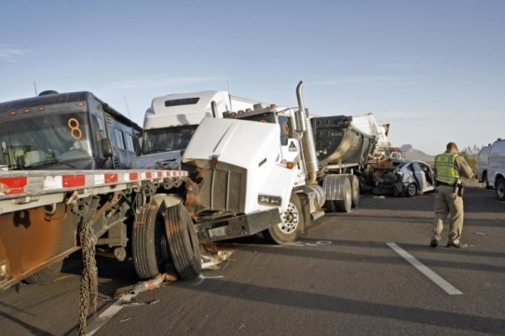
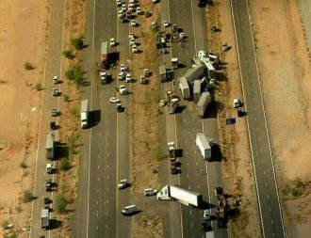
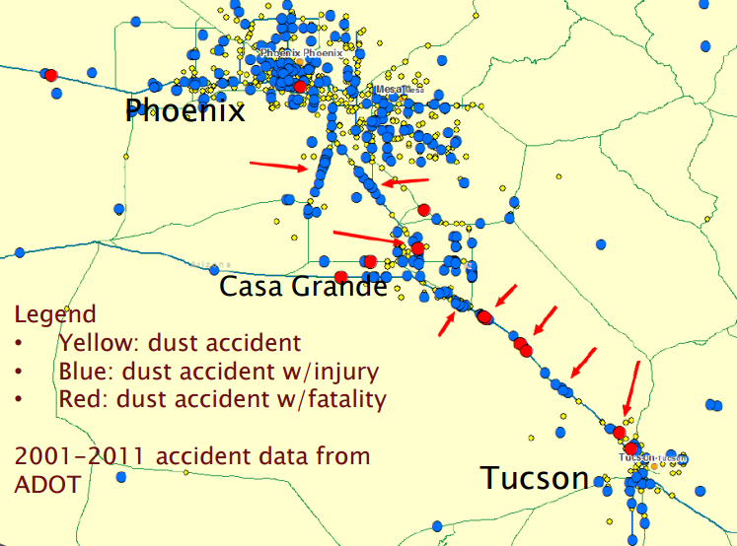
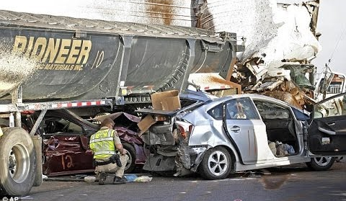
How will GOES-R help us?
Big Impact – Dust & Traffic

Slide 7
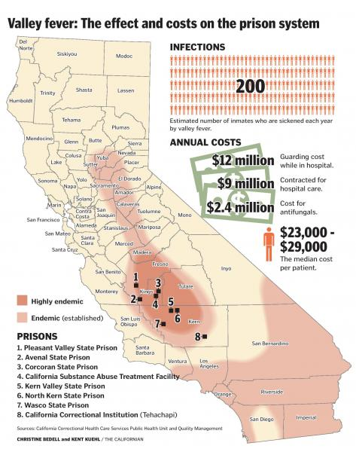
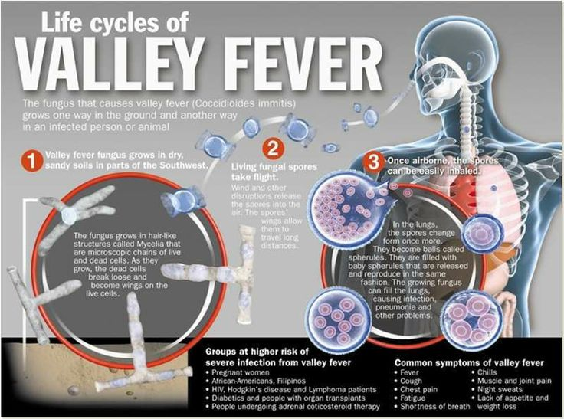
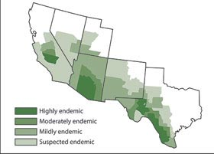
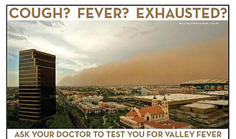
How will GOES-R help us?
Big Impact – Dust & Health

Slide 8
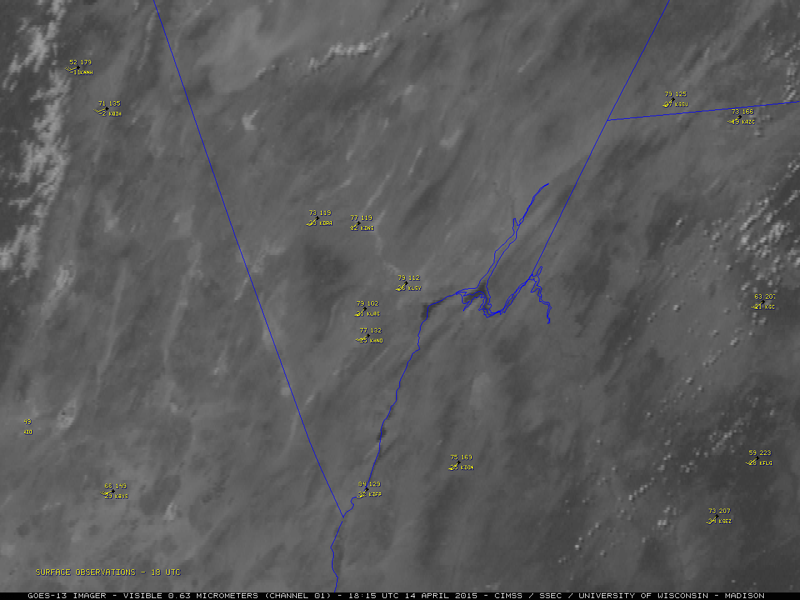
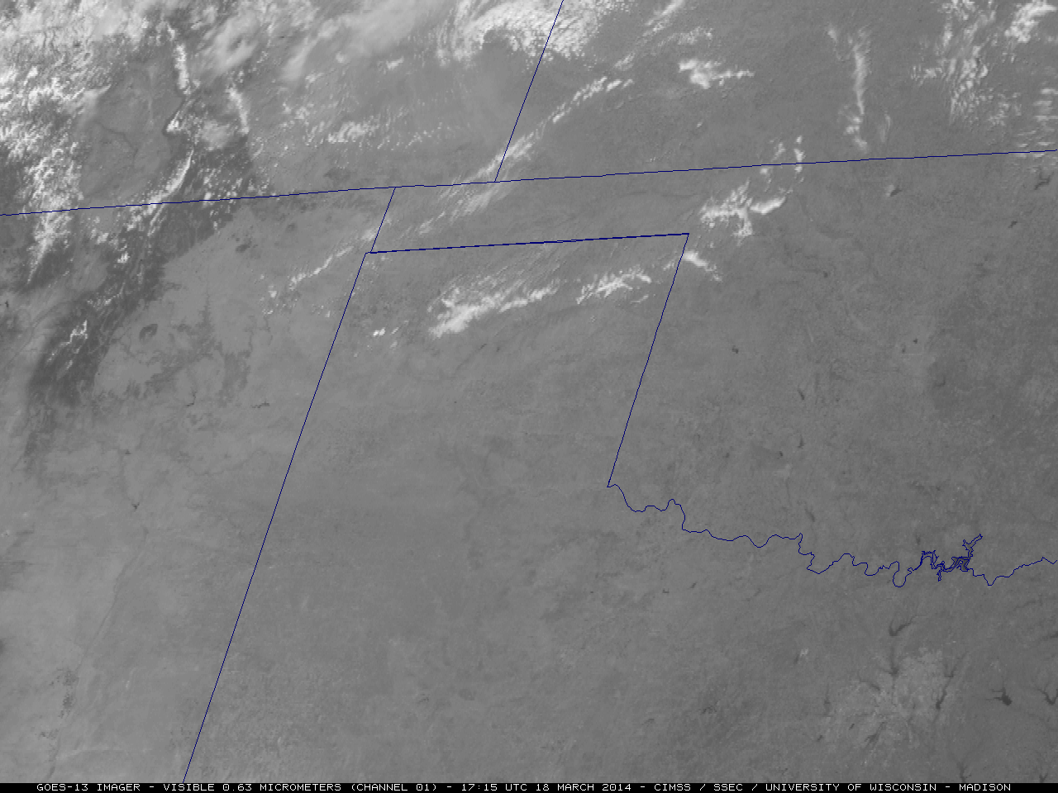
Expected Applications – Base Data
Synoptic Dust Events

Slide 9
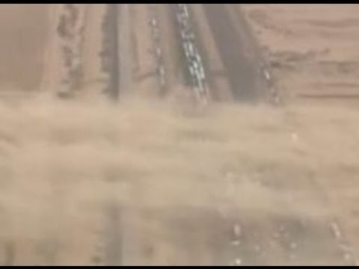
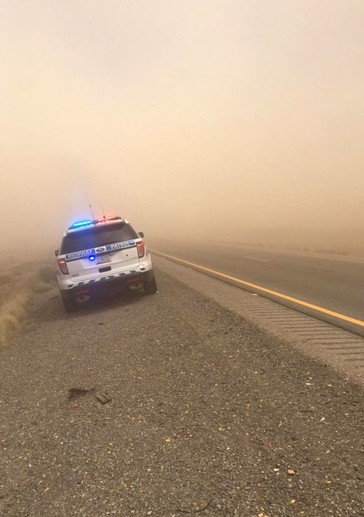
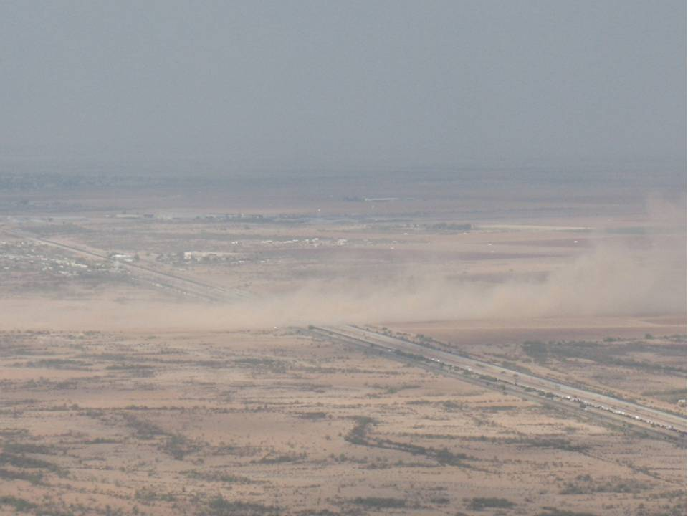
Expected Applications – Base Data
Dust Streamers

Slide 10
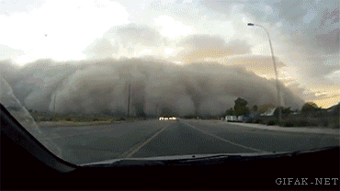
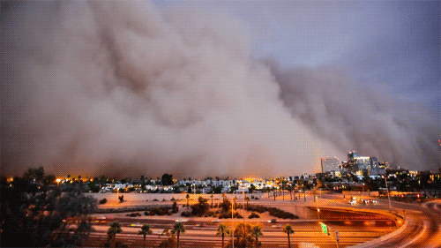
Expected Applications – Base Data
Haboobs/Dust Storms

Slide 11
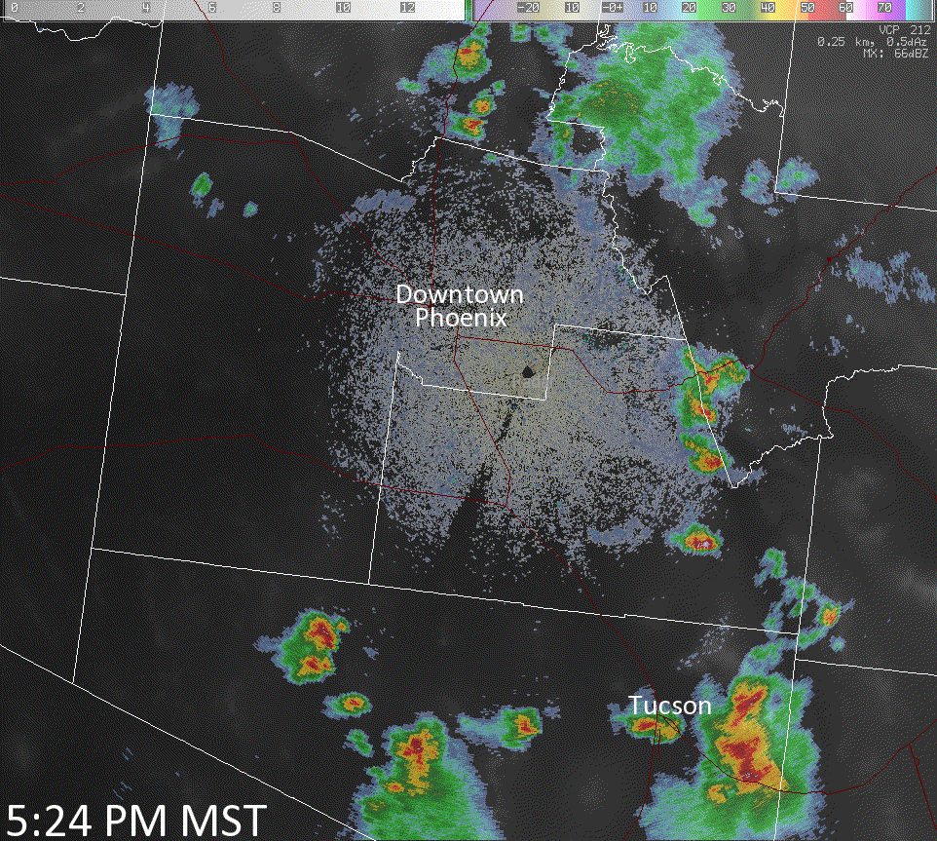
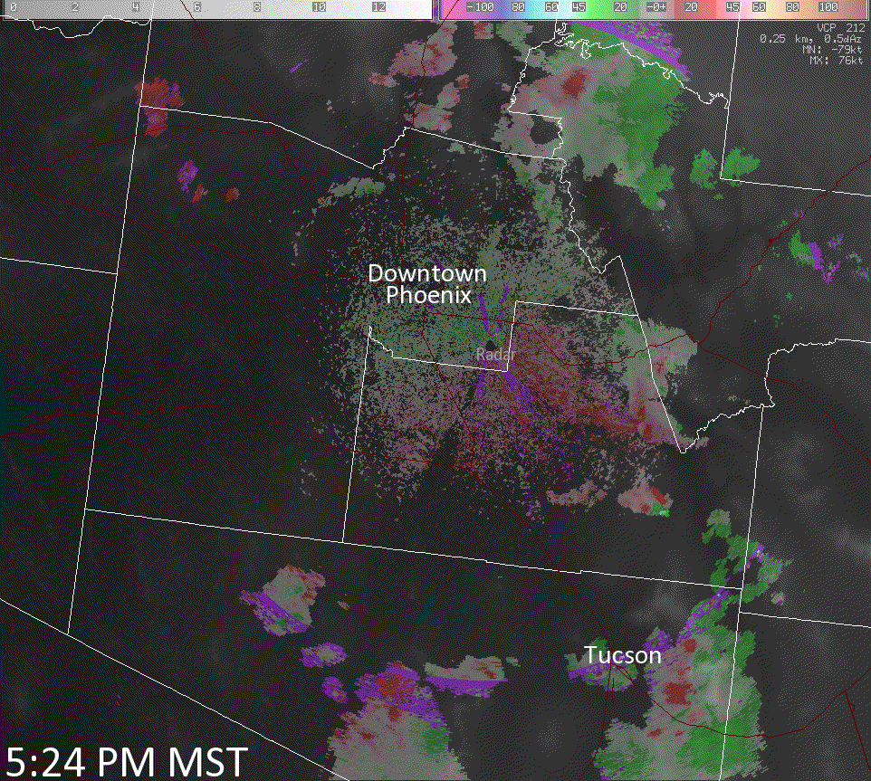
Expected Applications – Base Data
Haboobs/Dust Storms

Slide 12
Expected Applications – Base Data
Dust Detection
Looking NE
0.5°
Looking W
PHX
Looking S

Slide 13
Expected Applications – Base Data
Dust Detection

Slide 14
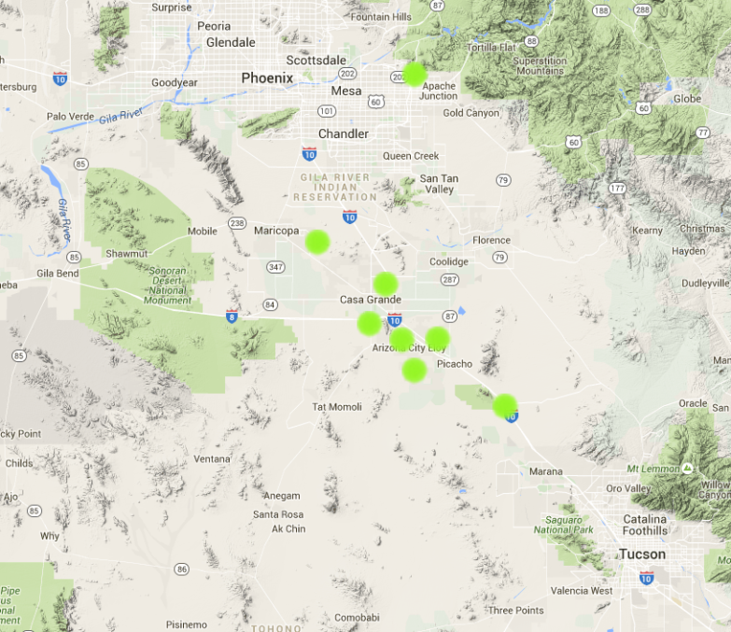
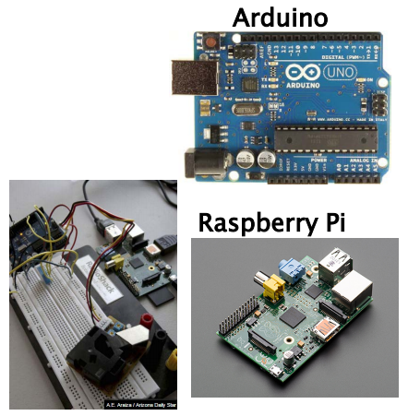
Expected Applications – Base Data
Dust Detection

Slide 15
Expected Applications – Base Data
Dust Detection
Better, Earlier, Faster Detection
Fill-in Existing Gaps
Detection at all!
Improved Communication to Partners in Real-Time
Reduction in Dust Impacts

Slide 16
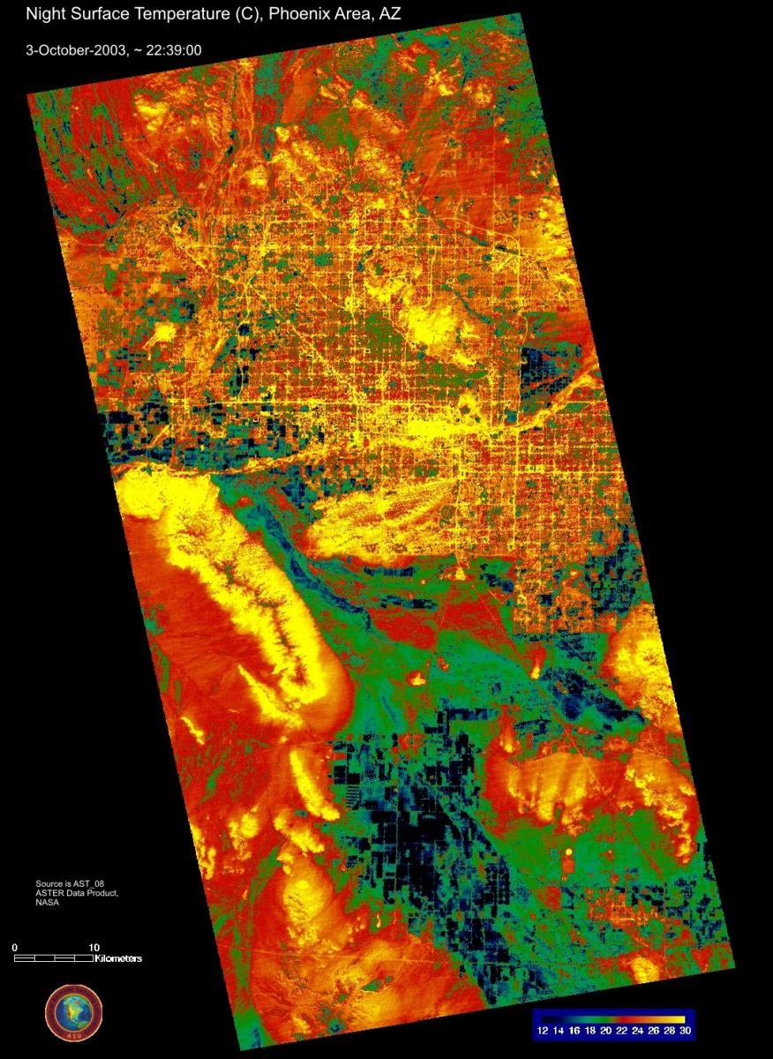
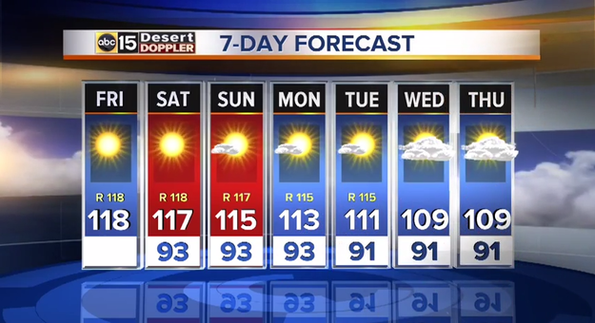
Expected Applications – Base Data
Extreme Heat Research

Slide 17
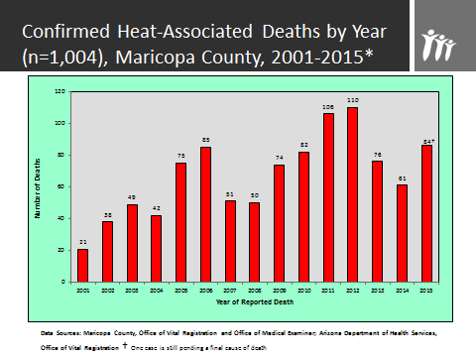
Expected Applications – Base Data
Extreme Heat Research
Improved assessment of vulnerability
Visually communicate threat
Reduced mortaility/morbidity

Slide 18
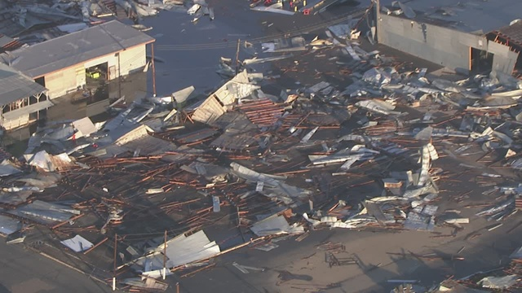
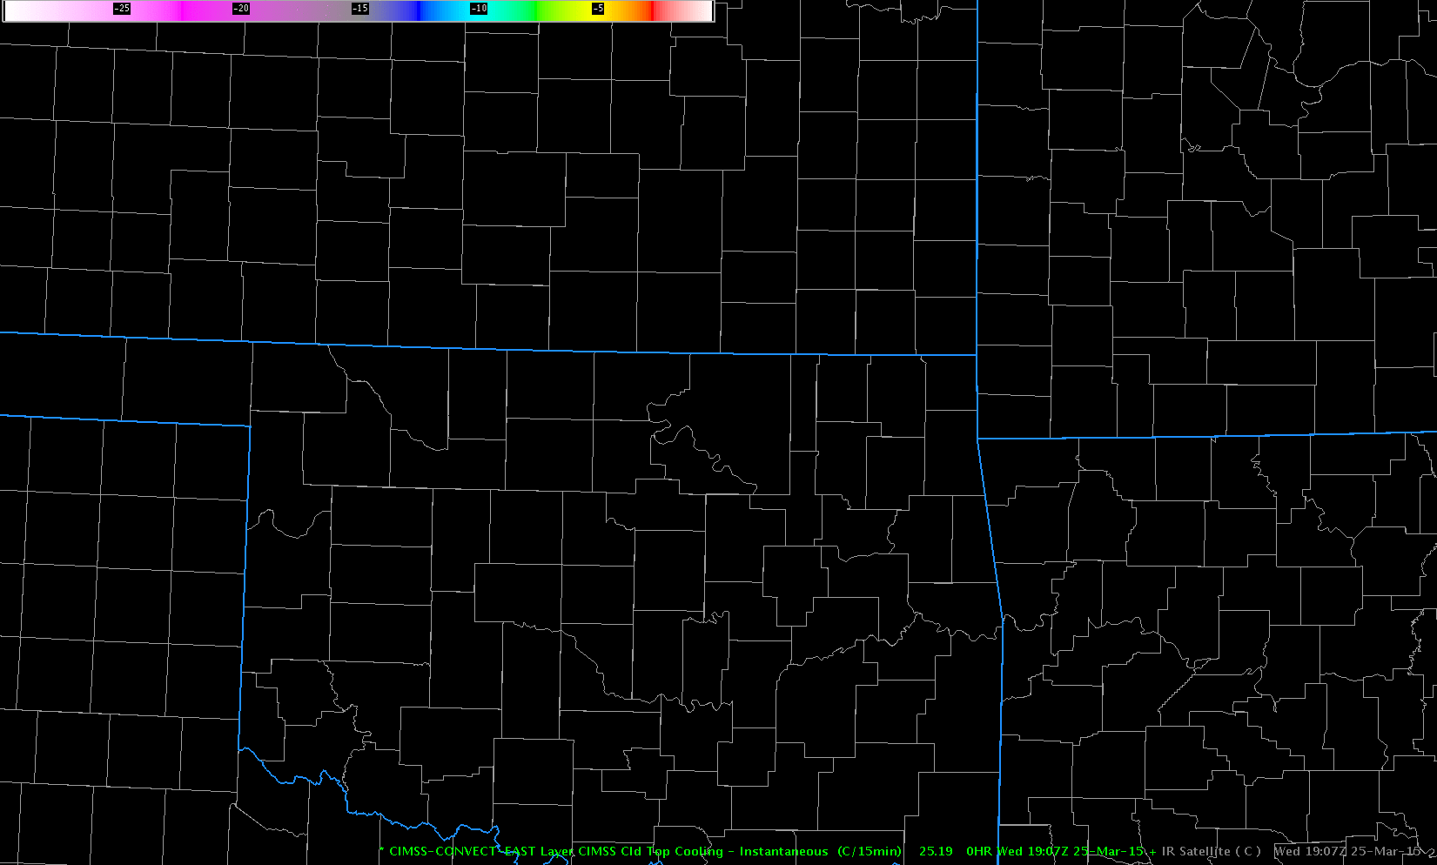
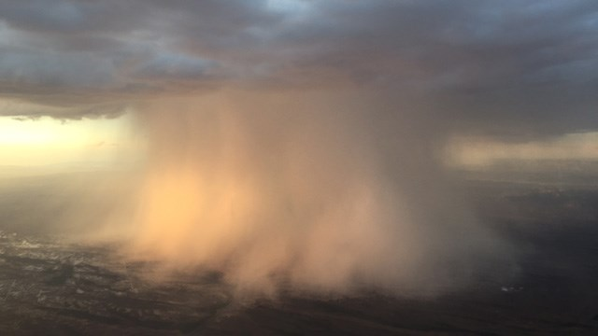
Expected Applications – Derived Data
Downburst Potential
Cloud Top Cooling
Glendale, AZ
Wittman, AZ

Slide 19
Expected Applications – Derived Data
Downburst Potential
Earlier & Improved Detection
Enhanced Predictability
Increased Lead-Time on SVRs, Reduction in Impacts

Slide 20
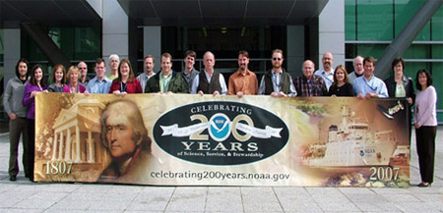
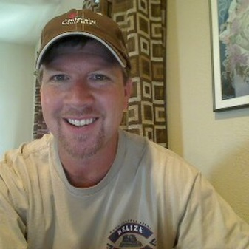
GOES-R Future Training
Work with OCLO, WR on down to implement training (communication)
Simulations
Work Hands-On with Forecasters
Need Data

