Slide 1
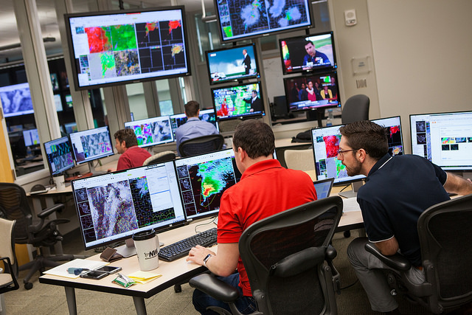
HWT 2016 GOES-R/JPSS Spring Experiment - Overview and Preliminary Takeaways through 3 (of 4) weeks
Bill Line
Research Associate/Satellite Liaison
University of Oklahoma/CIMMS
NOAA/NWS/Storm Prediction Center
Kristin Calhoun, Darrel Kingfield, Tiffany Meyer (CIMMS/NSSL), Gabe Garfield (CIMMS/OUN), John Mecikalski and Chris Jewett (UAH), Justin Sieglaff, John Cintineo, and Jun Li (CIMSS), Geoffrey Stano (SPoRT), Bob Rabin, Dan Lindsey, Mike Pavolonis, Tim Schmit, and Steve Goodman (NOAA/NESDIS), Chris Barnet and Antonia Gambacorta (STC)

Slide 2
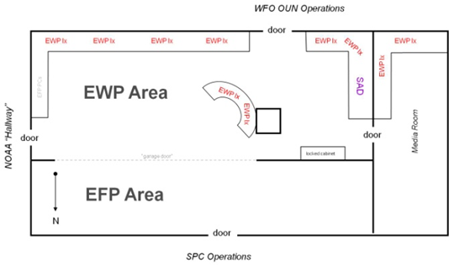
Hazardous Weather Testbed
Not just a facility…
EWP
EFP
SPC
OUN

Slide 3
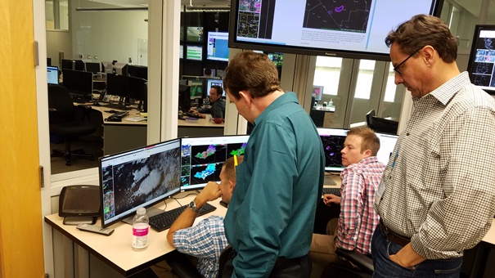
GOES-R and JPSS in the Hazardous Weather Testbed
Product developers observe their recently developed GOES-R and JPSS algorithms being used alongside standard observational and forecast products in a simulated operational forecast and warning environment (Research to Operations, R2O)
Feedback received from participants leads to the continued modification and development of GOES-R and JPSS algorithms (Operations to Research, O2R)
Education and training received by participants helps to enhance readiness for the use of GOES-R and JPSS data

Slide 4
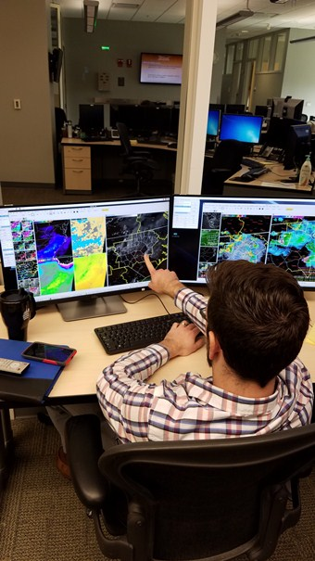
HWT 2016 GOES-R/JPSS Spring Experiment
4 weeks (18 April, 25 April, 2 May, 9 May)
3 NWS forecasters, 1 broadcast meteorologist per week
Real-time, simulated nowcast/warning environment using AWIPS-II.
Can operate anywhere in CONUS; begin prior to CI
“mesoscale forecast updates” (via live blog posts)
experimental severe t-storm and tornado warnings (via WarnGen).
Evaluating: GOES-R and JPSS Baseline, Future Capabilities, and Experimental Products
Training: 2 hours of Articulates
Feedback: Daily and weekly debriefs, daily and weekly surveys, blog posts, discussions, Webinar
We want forecasters to think about how they are using the experimental products in nowcast and warning decision making.

Slide 5
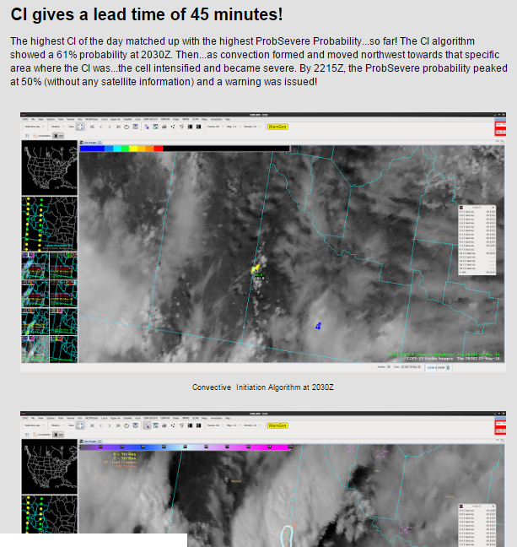
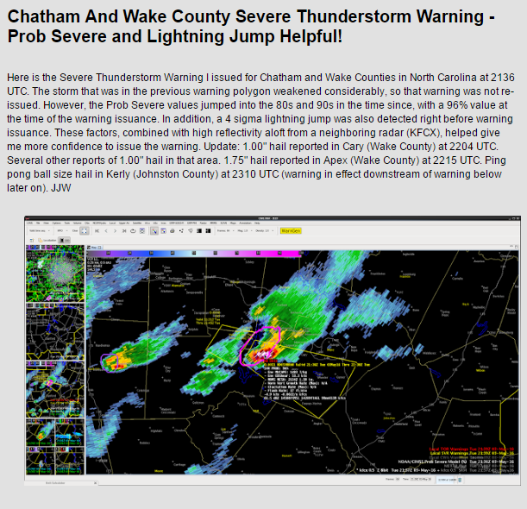
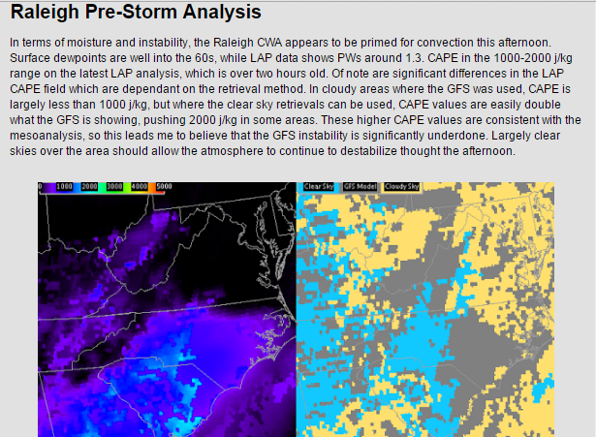
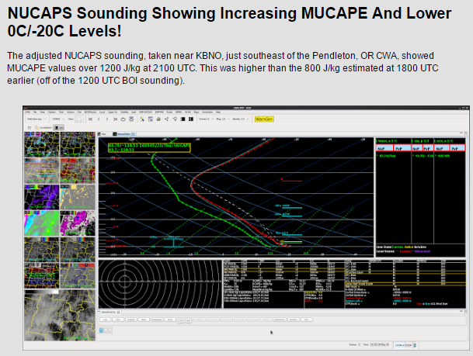
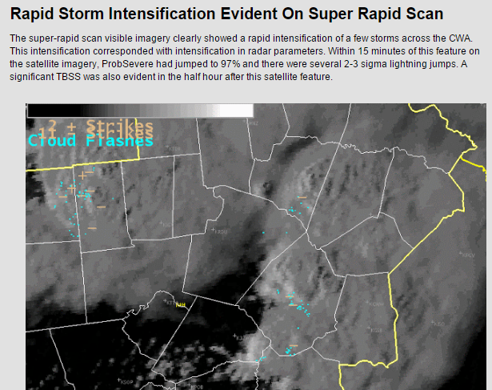
GOES-R/JPSS HWT Blog
http://goesrhwt.blogspot.com/
Mesoscale forecast updates
Reasoning behind warning decisions
Updates to previous warnings/forecasts
Best practices
Ideas for improvement
Any thoughts/feedback, good/bad, about the experimental products
~400 blog posts so far this year

Slide 6
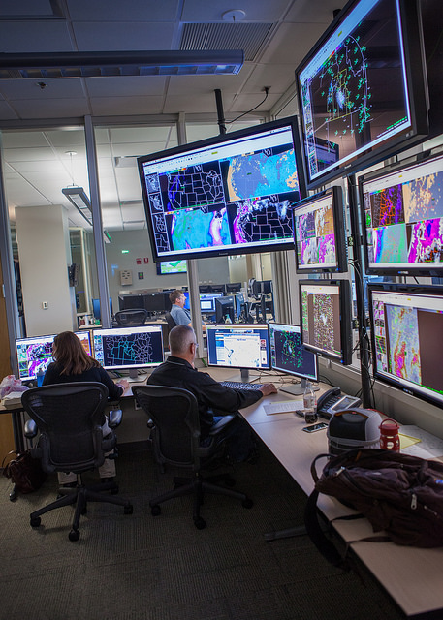
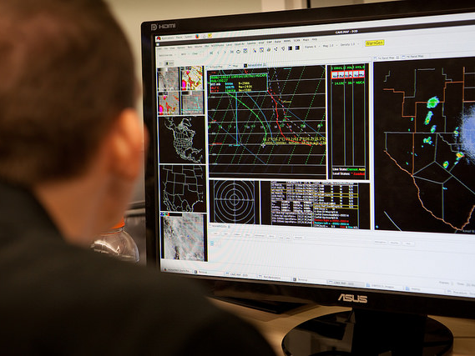
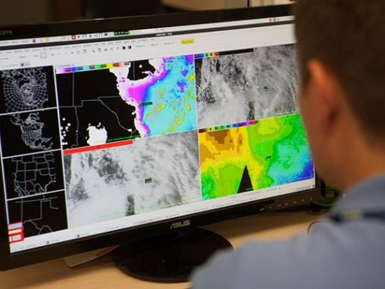
GOES-R and JPSS products demonstrated during 2015 Spring Experiment
GOES-R Legacy Atmospheric Profile (LAP) All-sky Thermodynamic Products
GOES-R Convective Initiation and Severe Convective Initiation
ProbSevere Model
GOES-14 Super Rapid Scan Operations for GOES-R (SRSOR) 1-min imagery
Atmospheric motion vectors (updating every 10 minutes)
Parallax-corrected 1-min imagery
Total Lightning using PGLM (in LMA networks)
Lightning Jump Algorithm (using ENI)
NUCAPS Temperature and Moisture Profiles (JPSS)

Slide 7
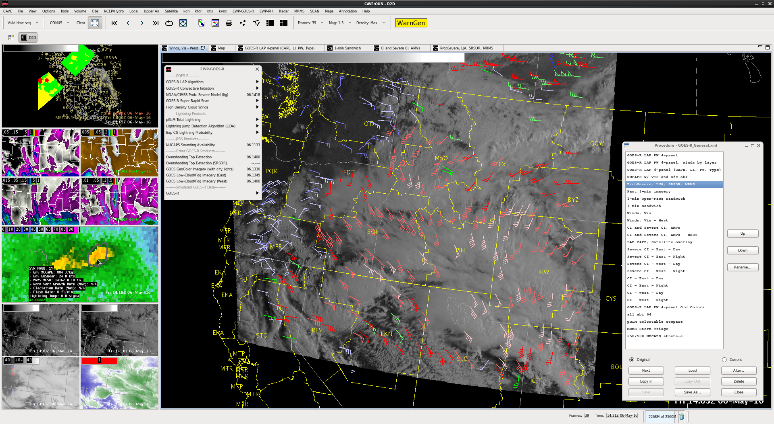
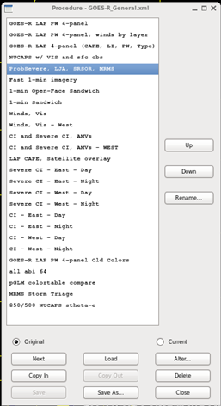
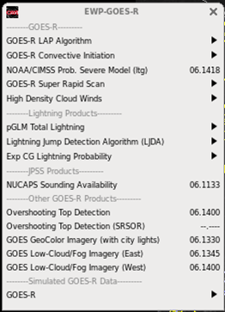
Products in AWIPS-II

Slide 8
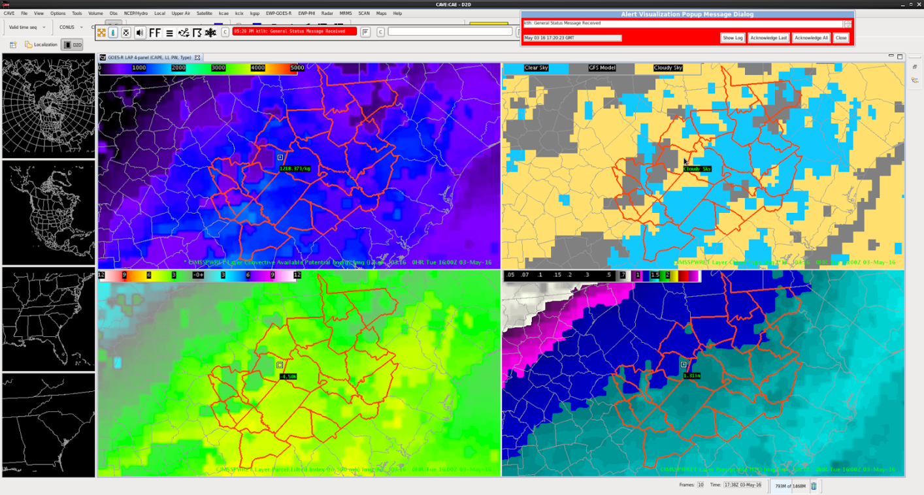
GOES-R LAP All-sky Products
Algorithm fuses clear-sky ABI LAP retrieval algorithm, cloudy-sky experimental retrieval algorithm, and GFS. Retrievals use GOES Sounder data.
Products include:
CAPE, LI, SI, KI, TT, TPW, LPW (SFC-0.9, 0.9-0.7, 0.7-0.3)
Identity of data source at a given point (clear retrieval, cloudy retrieval, GFS)
Where the LAP algorithm computes retrievals (clear sky or cloudy sky; using GFS as a first guess), it brings the instability up in line with what the other sources have.
CAPE
Data Type
LI
TPW
Takeaways: Forecasters want Layer PW from GOES; GFS underdoes CAPE but LAP retrievals generally correct in right direction.

Slide 9
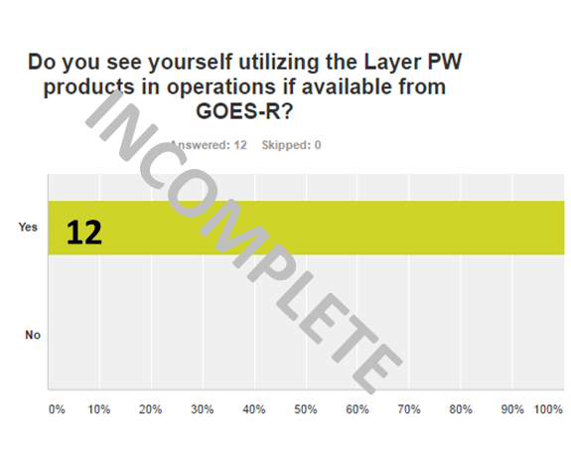
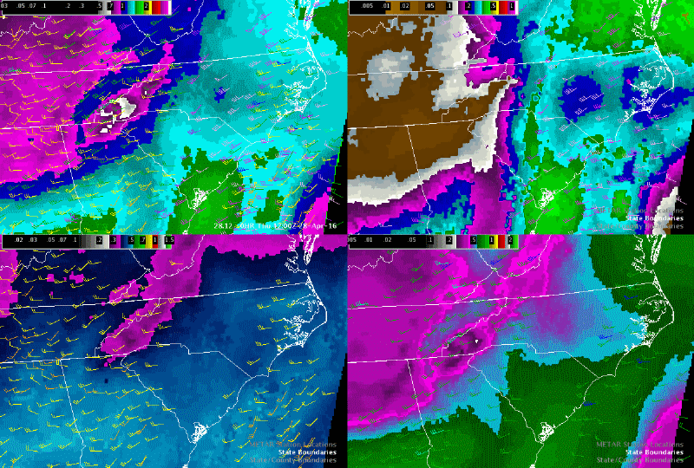
LAP Layer PW
Operational applications [of layered PW] are myriad; particularly for heavy precipitation and severe weather scenarios.
Takeaways: Forecasters want Layer PW from GOES; GFS underdoes CAPE but LAP retrievals generally correct in right direction.

Slide 10
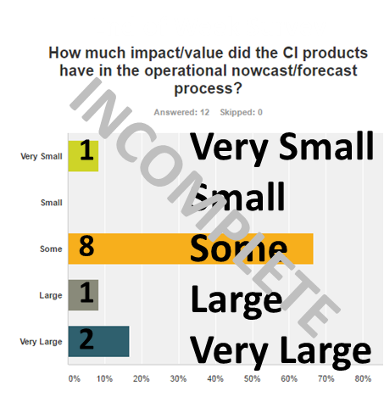
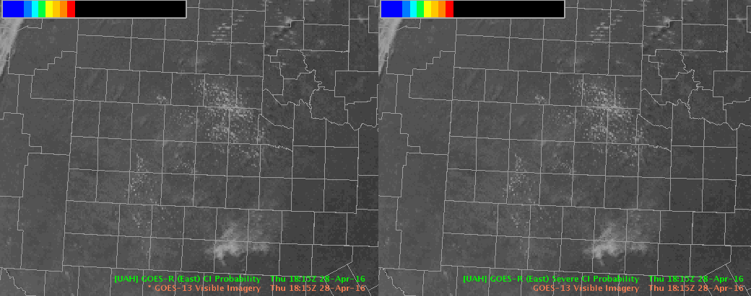
GOES-R Convective Initiation
Fuses GOES cloud products and RAP-derived environmental fields and uses a logistic regression framework to produce probability of future convective initiation.
Products include
0-2 h Probabilistic Forecasts of Convective Initiation
0-2 h Probabilistic Forecasts of Severe Convective Initiation
Regular CI
Severe CI
Over 50%: 1900UTC
Over 75% 1930 UTC
Initiation: 2000 UTC.
Over 70%: 1945 UTC.
1 inch hail at 2124 UTC.
Takeaways: Forecasters like idea of Severe CI, but it needs work. Regular CI effective in providing SA/lead-time to areas of future development, still sometimes messy with FA.

Slide 11
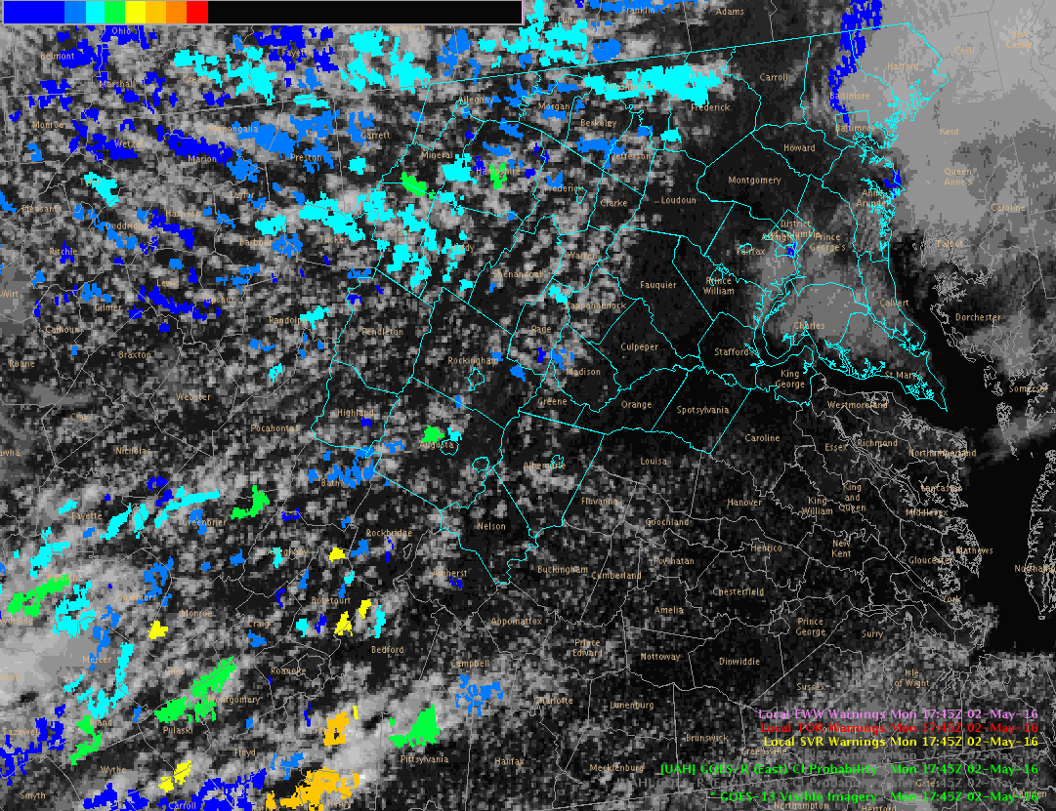
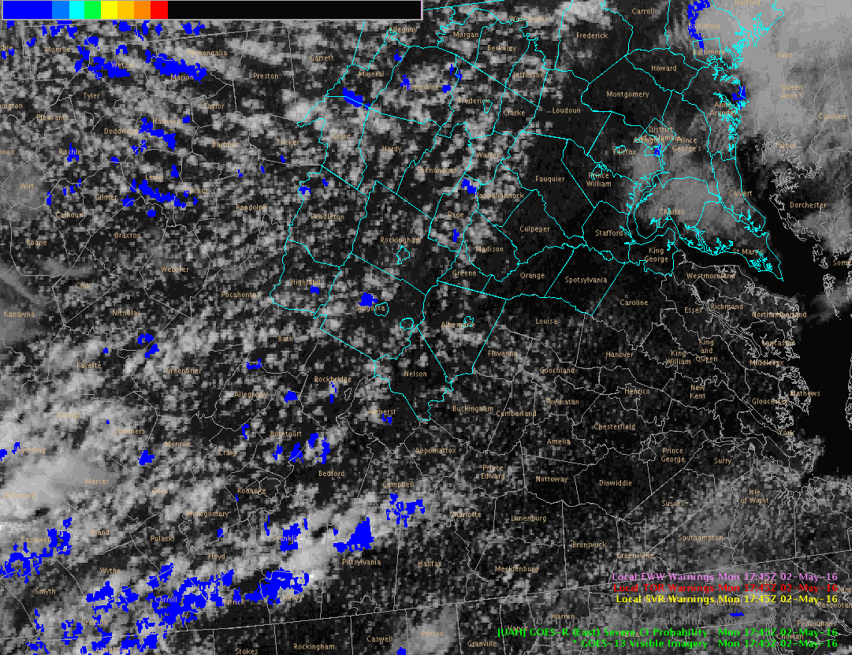
GOES-R Convective Initiation
White circles denote areas in Sterling where severe-producing storms developed.
Regular CI
Severe CI
CI over 60% in both areas 1+ hour prior to initiation
Severe CI never exceeded 30% despite reports of severe hail and wind with these storms
Takeaways: Forecasters like idea of Severe CI, but it needs work. Regular CI effective in providing SA/lead-time to areas of future development, still sometimes messy with FA.

Slide 12
ProbSevere Model
Fuses GOES cloud products, radar information, total lightning information, and RAP-derived environmental fields
Uses object-based tracking in both GOES and radar imagery and a statistical model to produce probability of future severe weather.
Products include:
ProbSevere probability contour and data readout
ProbSevere: 46% at 2144 UTC to 95% at 2146 UTC
Severe T-storm Warning: 2149 UTC
1” hail at 2225 UTC
These jumps, combined with the three body scatter spike developing aloft, gave me high confidence to issue the warning.
Takeaways: Helpful for maintaining SA to strongest storms and providing confidence/lead-time for warning decisions; forecasters want probability by threat, improved separation of nearby storms and linear/multicellular systems.

Slide 13
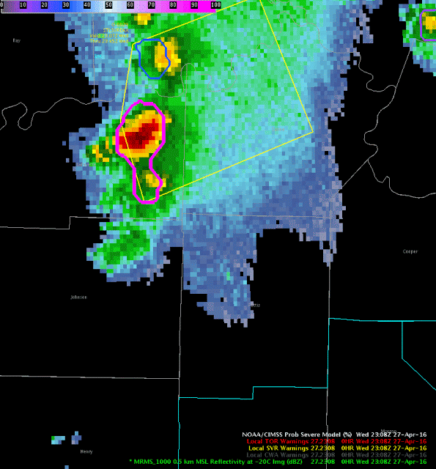
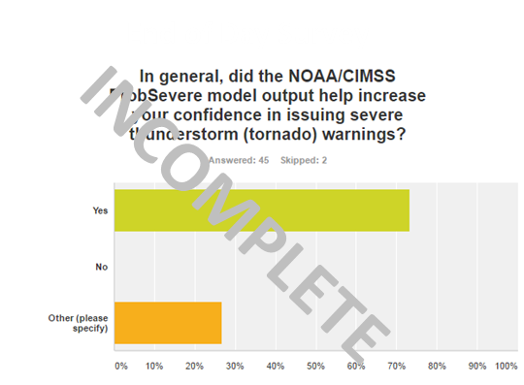
ProbSevere Model
Takeaways: Helpful for maintaining SA to strongest storms and providing confidence/lead-time for warning decisions; want probability by threat, improved separation of nearby storms and linear/multicellular systems.

Slide 14
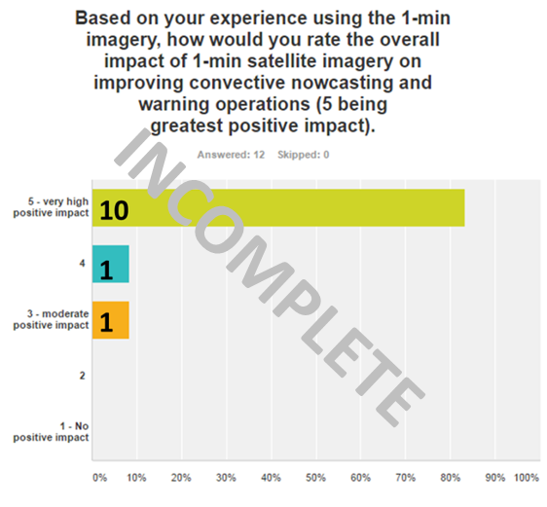
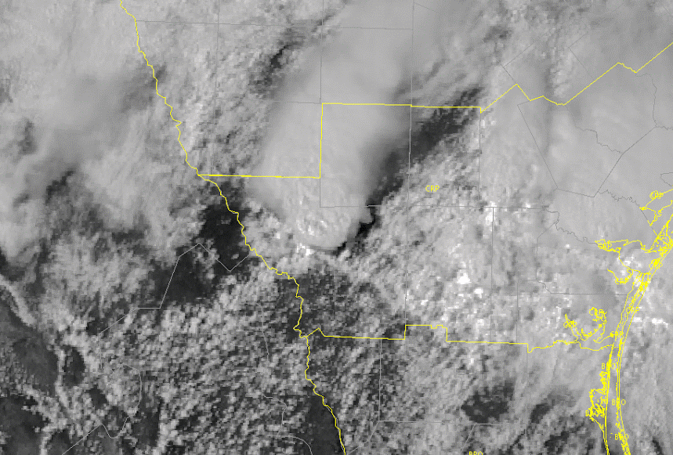
GOES-14 SRSOR (1-min) Imagery
Spring 2016 GOES-14 SRSOR: April 18 – May 15
One, daily-changing ~1500 km x 2000 km sector
Products include:
1-min VIS, IR, and WV imagery
Parallax-corrected 1-min VIS and IR imagery
10-min updating atmospheric motion vectors
The 1-min SRSOR VIS satellite data indicates this storm is elevated, as a well-defined boundary continues to track south of the storm in question. As a result, this storm likely poses a very limited tornado threat.
Takeaways: Utilized during warning operations in addition to pre-convective development. Forecasters see features/processes early than - and not apparent - in 5+ min imagery.

Slide 15
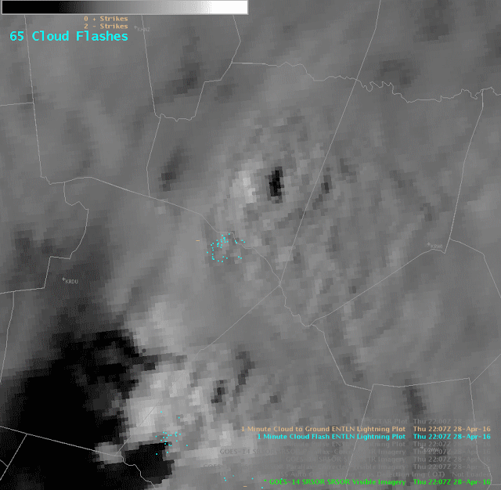
Parallax-Corrected Imagery
Forecasters want to have Parallax-Corrected Imagery available in AWIPS; must be weary of caveats (blocking features, chunky display).

Slide 16
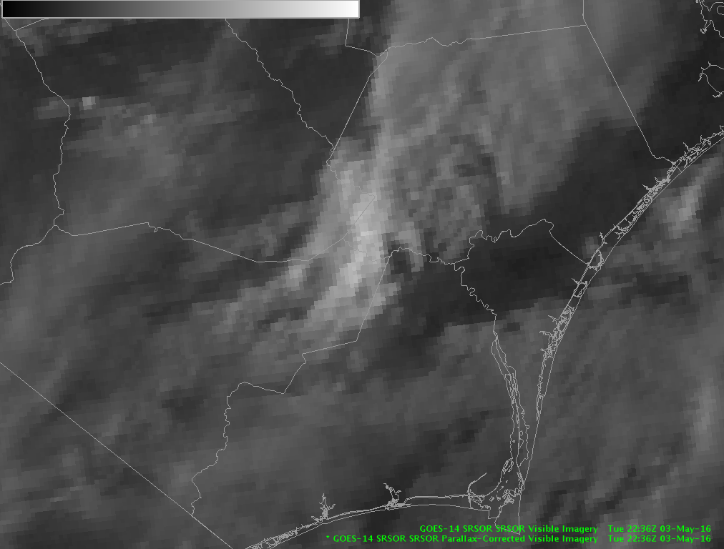
Parallax-Corrected Imagery
but beware!
New development
Forecasters want to have Parallax-Corrected Imagery available in AWIPS; must be weary of caveats.

Slide 17
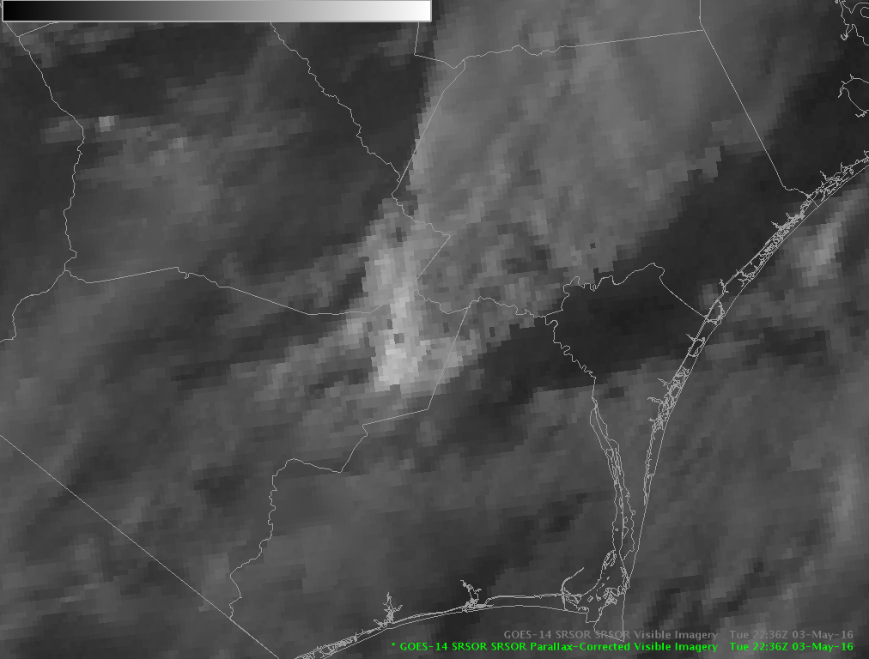
Parallax-Corrected Imagery
but beware!
New development
Forecasters want to have Parallax-Corrected Imagery available in AWIPS; must be weary of caveats.

Slide 18
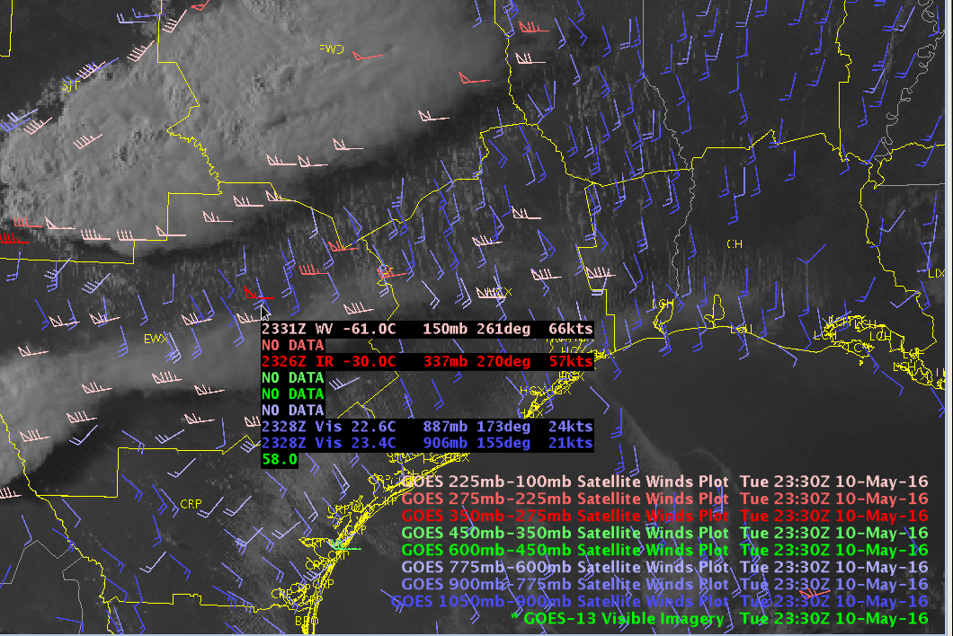
Satellite-derived Winds
0-1km shear trends can be inferred. This has potential application in severe weather forecasting by providing 0 AGL to cloud base shear values.
They provided updates on how the deep layer shear values were changing over the course of the afternoon.
The AMVs were able to pick up on low level wind shifts as the boundaries crossed through the area.
Takeaways: Helpful in diagnosing storm motion, deep shear, local speed max, divergence/convergence

Slide 19
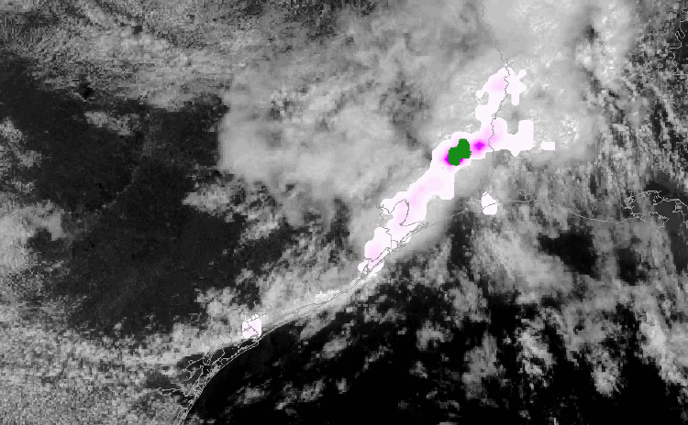
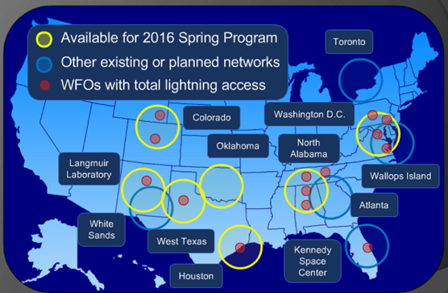
GOES-R Lightning Detection (using LMA proxy ; PGLM)
Pseudo Geostationary Lightning Mapper (PGLM) total lightning products are created using Total Lightning data from Lightning Mapping Array (LMA) regional networks around the US.
Products include:
Total Lightning Flash Extent Density
Available every 2-min (N. Alabama and D.C.) or as a running 2-min summation every minute.
Takeaways: Primarily used for SA and monitoring convective growth; Effective lightning training will be vital

Slide 20
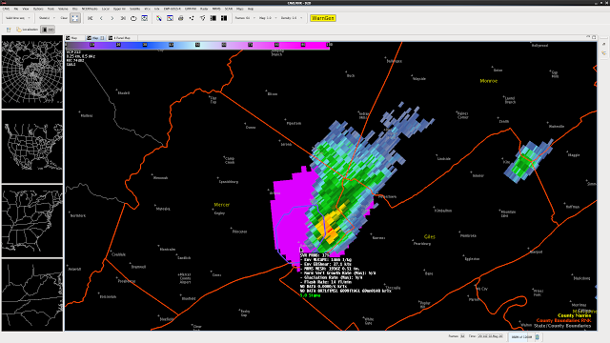
Lightning Jump Algorithm
The Lightning Jump Algorithm (LJA) uses data from the Earth Networks Total Lightning Network and computes the degree of jump (sigma-level) in total lightning activity for a tracked storm object.
Products include:
Identified storm objects, colorized by the magnitude of “jump” (x-sigma) for that period.
5-min LJ max.
5-sigma LJ: 1936 UTC
1” Hail: 2000 UTC
Takeaway: Default display not ideal, forecasters prefer transparency, and desire a contour display instead. Product effective in drawing users attention to rapid updraft intensification. 5-min max a nice addition. Often viewed with ProbSevere.

Slide 21
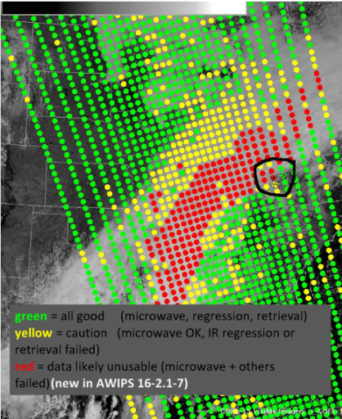
NOAA Unique Combined Atmospheric Processing System (NUCAPS)
NUCAPS algorithm generates temperature and moisture profiles using information from instruments aboard the Joint Polar Satellite System (JPSS) Suomi-NPP polar-orbiting satellite.
Products include:
NUCAPS Profile Availability (Time/Location) with quality control flags
NUCAPS Vertical Temperature and Moisture Profiles
NUCAPS Plan View displays (from product browser)
Example NUCAPS Selection
1800 UTC RNK
1800 UTC NUCAPS
Similar CAPE ~2300 j/kg
Takeaways: users find information to be an effective update of thermodynamic environment since morning RAOB; look forward to automated modification of low-levels, which is a necessity; would welcome additional satellites

Slide 22
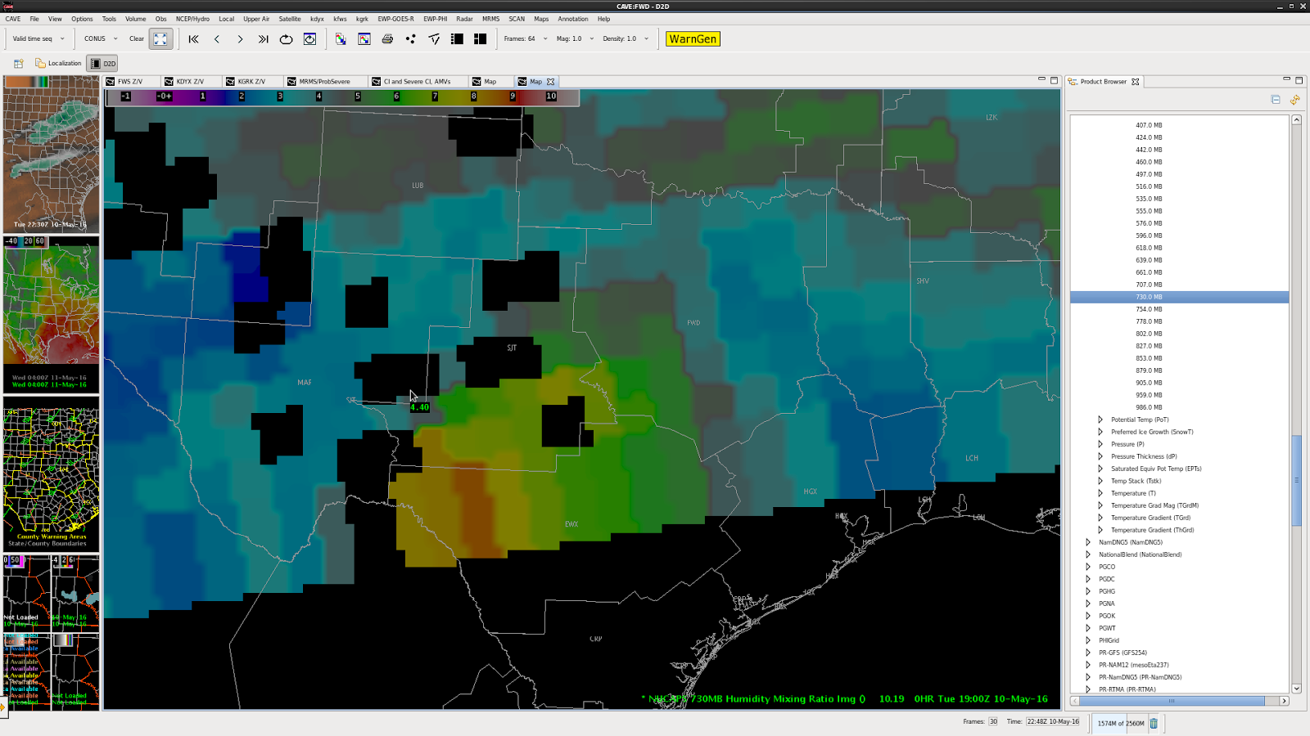
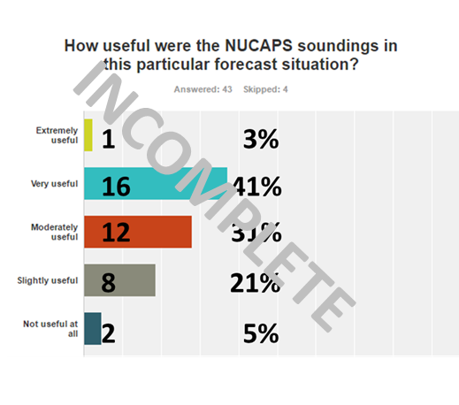
NUCAPS Plan View
730 mb Mixing Ratio
Takeaways: Nice to have quick look; derived fields desired: theta-e, dew point, height of FL, height of -20C, cape, pw

Slide 23
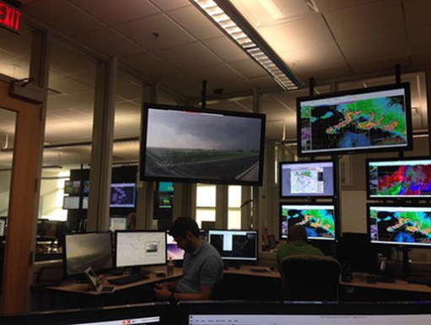
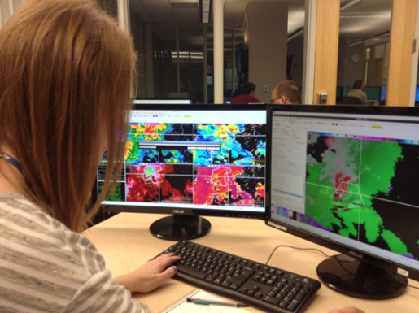
Summary
Satellite product demonstrations at the HWT help to
prepare users for future satellite technology
test algorithms in a simulated operational environment
All participants have found this year’s HWT GOES-R/JPSS experiment to be a great and productive learning experience.
May 2017, evaluations in HWT will be valuable for early/rapid gauging of forecaster understanding of real GOES-R data, and development of best practices, in a real-time hazardous weather warning environment
GOES-R HWT Blog: http://www.goesrhwt.blogspot.com/
bill.line@noaa.gov

