Slide 1
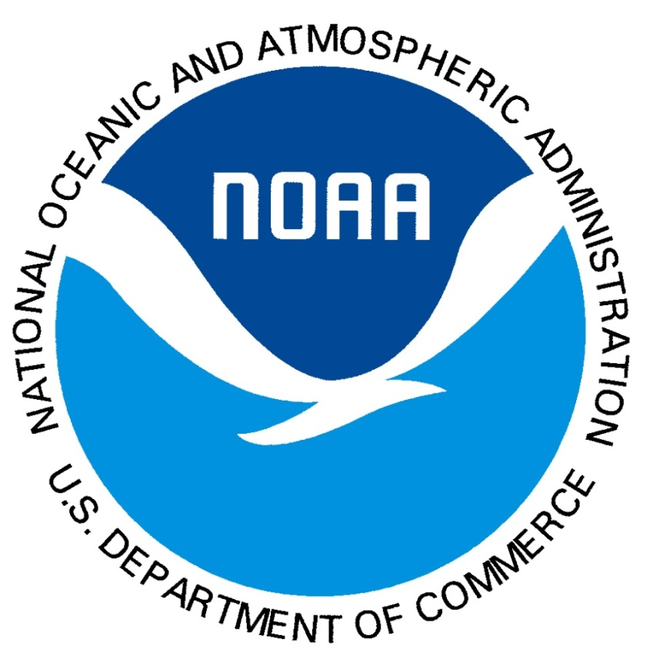
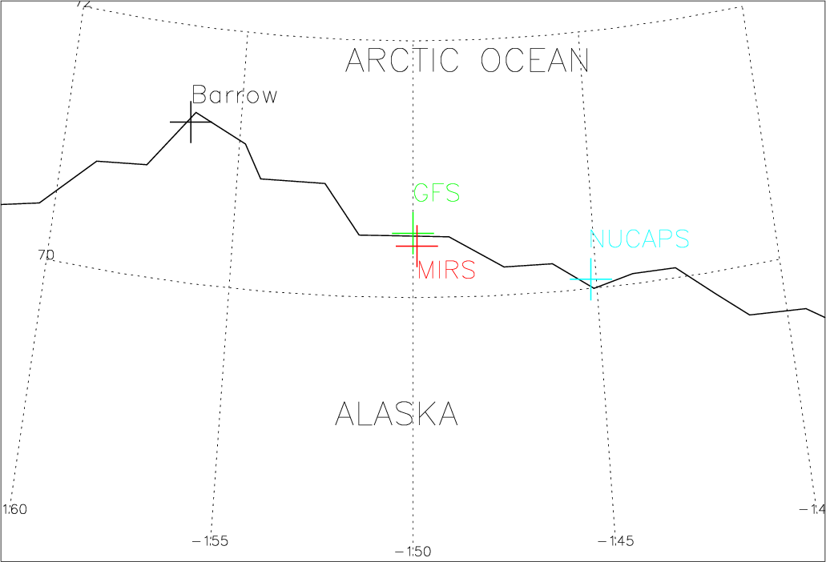
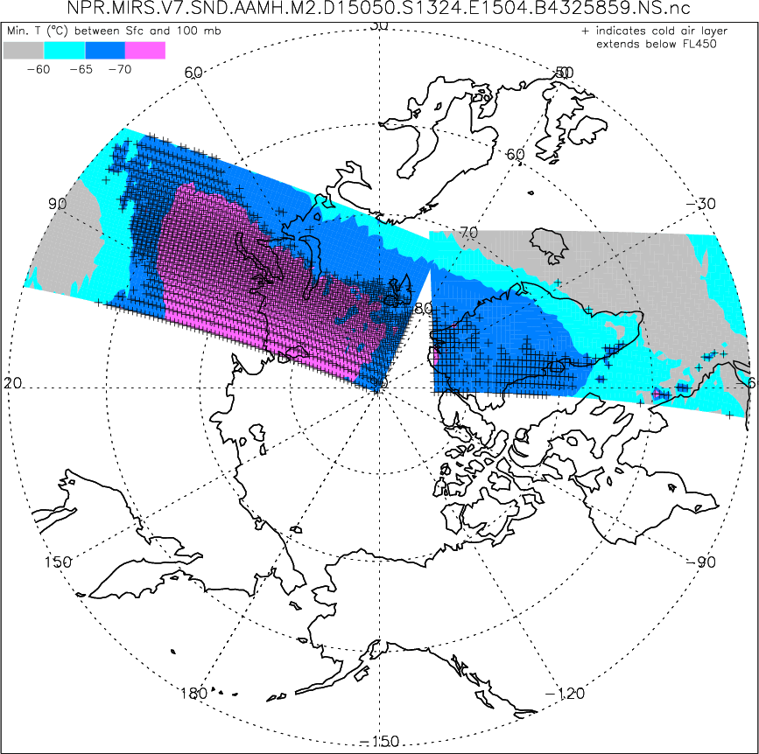
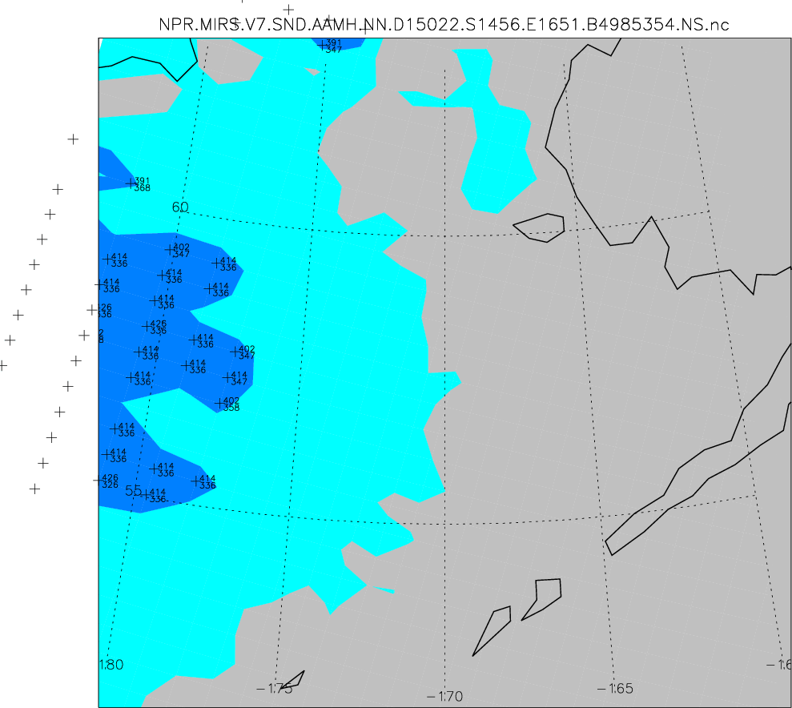
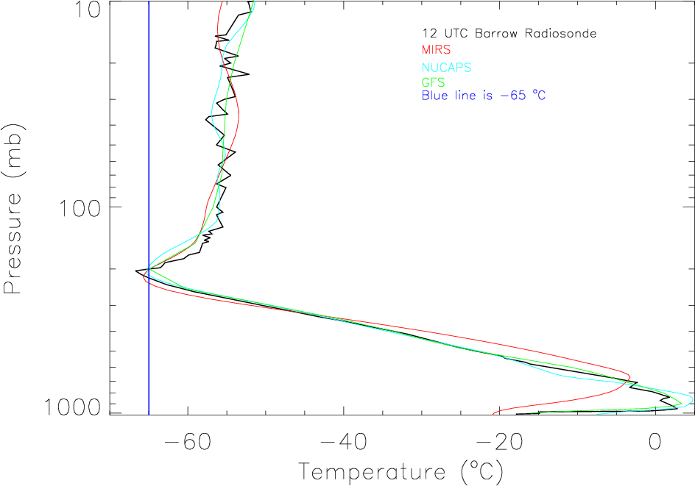
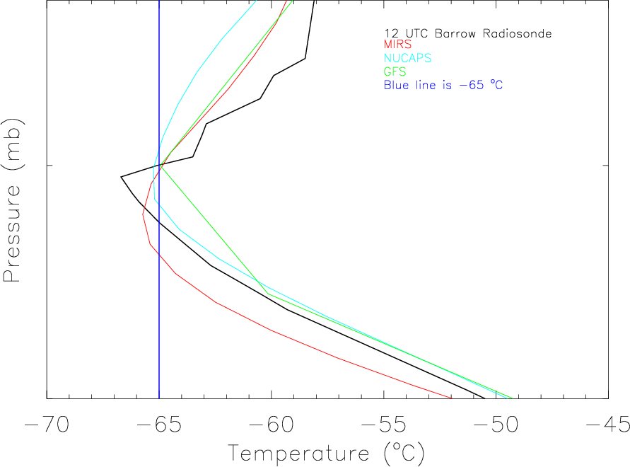
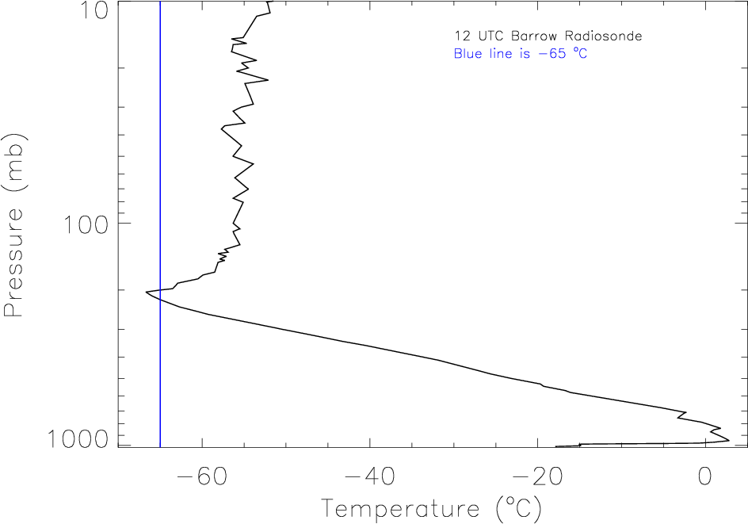
Using Polar-Orbiting Satellites to Monitor the Upper Atmosphere for Cold Air Pockets that are Potentially Dangerous to Passenger Aircraft Jack Dostalek, Steve Miller, Renate Brummer The Cooperative Institute for Research in the Atmosphere, Fort Collins, Colorado
Introduction
During the winter months, especially at high latitudes, air temperatures at altitudes used by passenger aircraft can get cold enough to cause jet fuel to gel (known as “cold air aloft” situations by the NWS). The temperature at which the gelling of jet fuel becomes a concern is typically considered to be -65°C. The knowledge of the location of pockets of air this cold is of importance to weather forecasters. Model forecasts are used, but confirmation from observations is beneficial. Radiosonde measurements and aircraft observations are at times available, but the temporal and spatial sampling is too coarse to accurately delineate the cold air pockets. Polar-orbiting satellites can provide vertical temperature profiles with higher temporal and spatial resolution and thus help to monitor the atmosphere for air which is dangerously cold for aircraft travel.
This work presents the application of vertical profiles of temperature derived from radiances measured by instruments aboard polar-orbiting satellites in the detection of areas of cold air aloft. In particular, a case of cold air aloft near Barrow, Alaska from 9 January 2015 will be investigated using the Barrow radiosonde, GFS forecast fields, and MIRS and NUCAPS temperature profiles from the S-NPP satellite. MIRS (Microwave Integrated Retrieval System) is NESDIS’ current operational microwave-only retrieval algorithm and is run on both the ATMS (Advanced Technology Microwave Sounder) and the AMSU (Advanced Microwave Sounding Unit). NUCAPS (NOAA Unique CrIS ATMS Processing System) is a combination microwave/infrared retrieval algorithm which uses the ATMS and the CrIS (Cross-track Infrared Sounder), both aboard the S-NPP satellite.
Example from 9 January 2015 cont’d
The S-NPP satellite passed over the region around 1220 UTC, allowing for a good comparison to the Barrow radiosonde. The map below shows the positions of Barrow and the MIRS and NUCAPS retrievals, as well as a GFS forecast sounding (6hr forecast of the 0600 UTC run of 9 January 2015) used for comparison.
Display of Near Real-Time Data
As the study of the utility of the MIRS and NUCAPS retrievals continues, a web page has been developed at CIRA to display in near real-time information on the existence of cold air aloft over the Artic:
http://rammb.cira.colostate.edu/ramsdis/online/cold_air_aloft.asp. The page currently displays only AMSU/MIRS data from NOAA-18, NOAA-19, MetOp-1, MetOp-2, and DMSP. ATMS/MIRS and NUCAPS data are not yet ready for near-real time display.
The page currently contains two links, one to an Arctic view and the second to a Bering Sea regional view. The color scheme denotes the coldest temperature at each footprint of a satellite swath:
Gray, T_{min} >-60°C
Cyan, -65°C < T_{min} < -60°C
Blue, -70°C < T_{min} < -65°C
Pink T_{min} < -70°C
If the layer of cold air exists below FL450 (~45,000 ft.) a ‘+’ is displayed. Additionally on the regional view, the extent of the layer of cold air, measured in units of flight level are also displayed. The left figure below shows the swath view of a MetOp-2 pass on 19 February 2015, with most of the cold air aloft over Russia and Greenland. The panel on the right is an example of the Bering strait view from 22 January 2015, a day when cold air aloft was reported by an aircraft at FL360 near the International Dateline and latitude 55°N.
The full sounding below on the left shows good agreement among all of the temperature profiles, with the low-level inversion somewhat higher in the MIRS data. The cold air aloft occurred around 200 hPa and the left panel shows that altitude more closely. All temperature profiles reach -65°C or colder near 200 hPa, but the exact location and extent of the cold layer varies: the MIRS is at the lowest altitude followed by the Barrow radiosonde and the NUCAPS retrieval, with the GFS temperature minimum at the highest level. The MIRS and NUCAPS profiles also show a broader layer of cold air. This is expected, as satellite retrievals are usually quite smooth in the vertical.
Example from 9 January 2015
On 9 January 2015, the Center Weather Service Unit in Anchorage, AK issued the following Meteorological Impact Statement concerning the existence of cold air aloft near Barrow, AK:
FAAK20 KZAN 091649 ZAN MIS 02 VALID 091645-100445 ...FOR ATC PLANNING PURPOSES ONLY... FROM 140N BRW-65NE BTI-115E FYU-90S BRW-140N BRW COLD AIR ALOFT TEMPS -65C OR LESS FM FL320-FL380. QS. NC. RSM JAN 15
The 1200 UTC Barrow radiosonde does indicate a thin layer of air with temperature below -65°C.
Efforts to understand this potentially dangerous atmospheric phenomenon are ongoing, and the introduction into AWIPS II of information regarding areas of cold air aloft have begun.
Acknowledgement is due to the other members of the cold air aloft team:
Brad Zavodsky (SPoRT) Eric Stevens (GINA)
Chris Barnet (STC) Tony Reale (NESDIS/STAR)
Kristine Nelson (AK CWSU) Emily Berndt (SPoRT)
Nadia Smith (CIMSS)
All of the profiles were able to capture the cold air aloft event of 9 January 2015. The determination of the overall performance of the satellite retrievals and model forecasts cannot be determined without many more cases. Of additional interest would be a study documenting the dynamical nature of these regions of wintertime cold air aloft.

