Slide 1
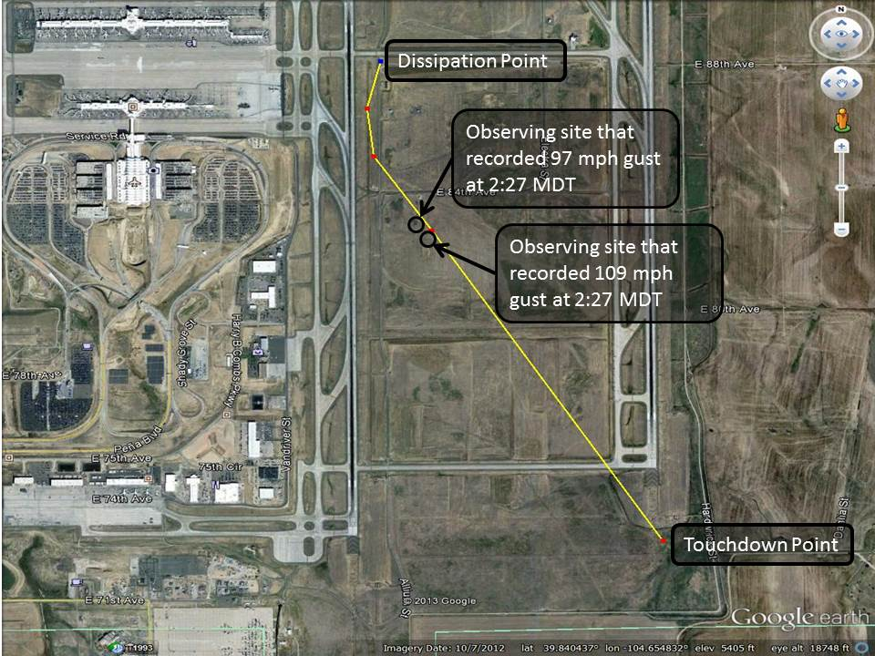
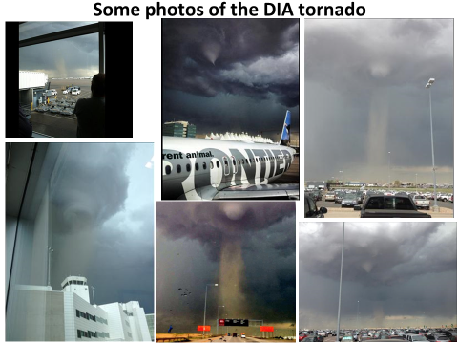
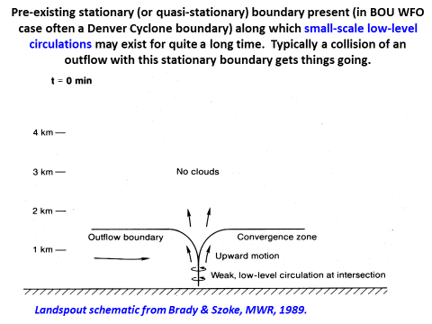
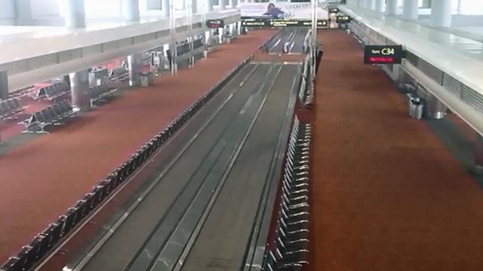
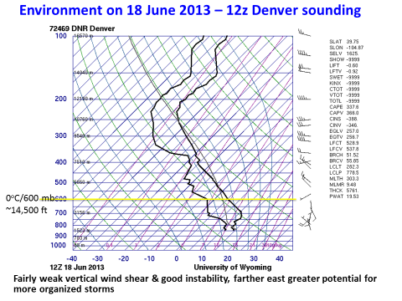
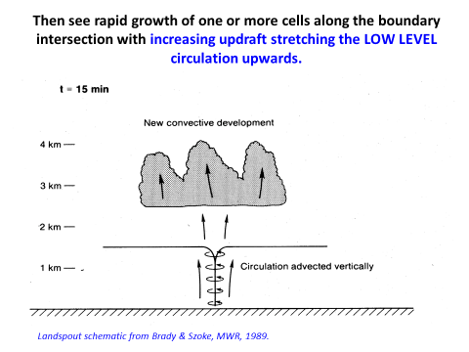
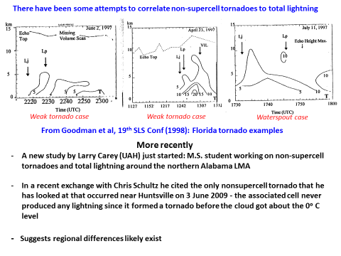
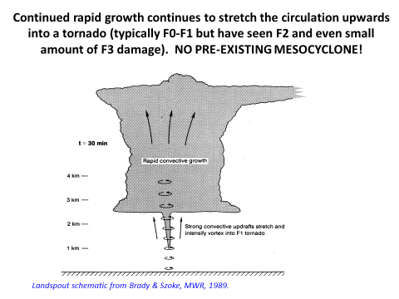
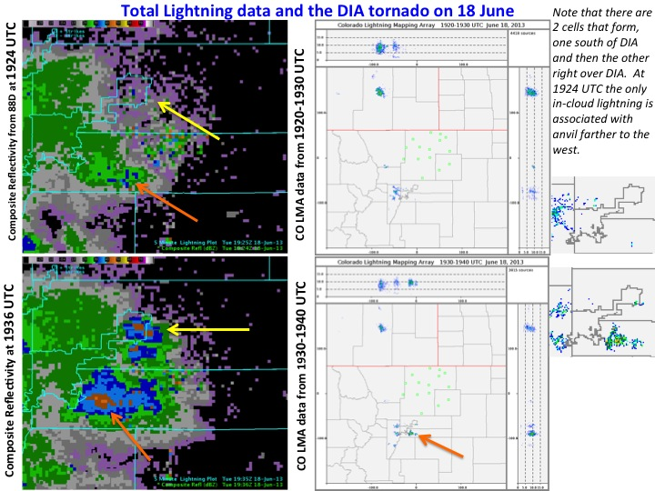
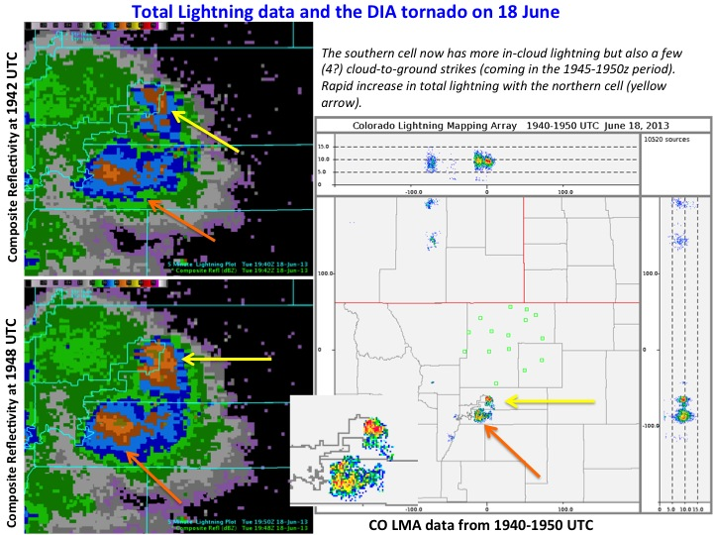
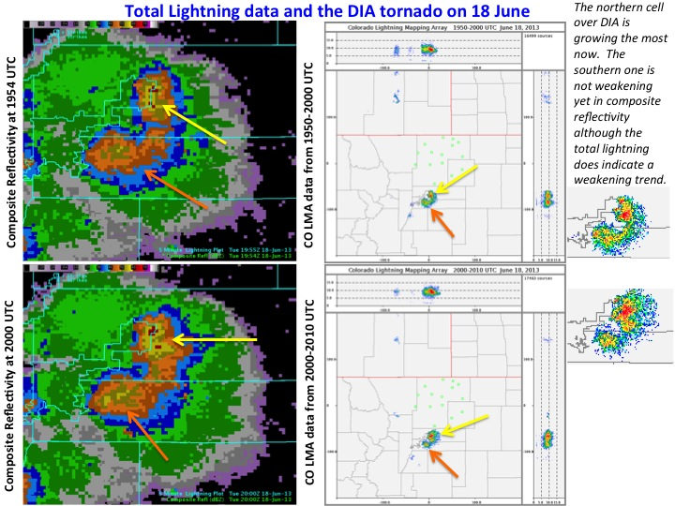
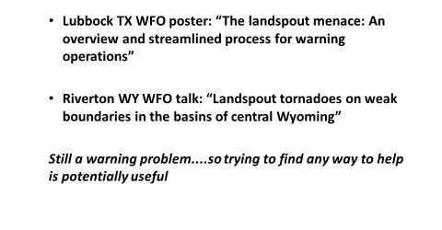
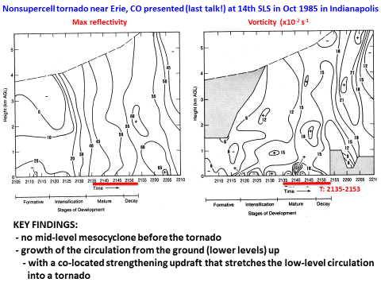
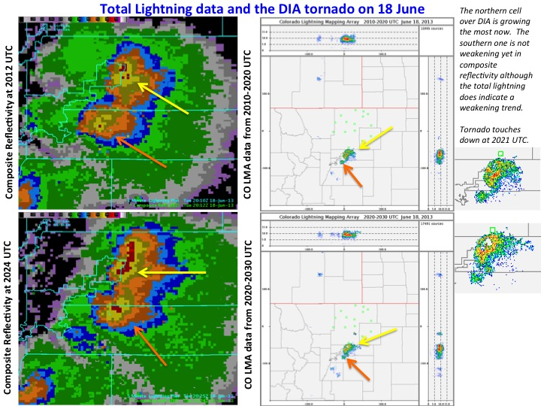
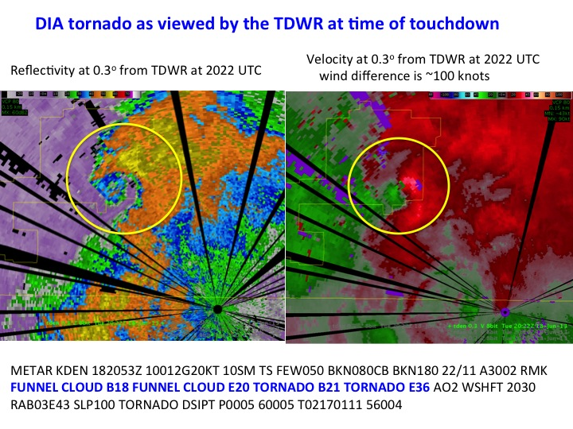
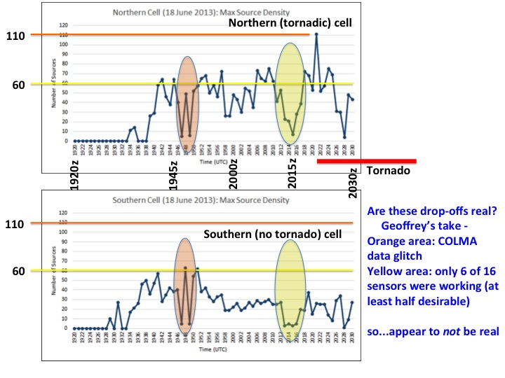
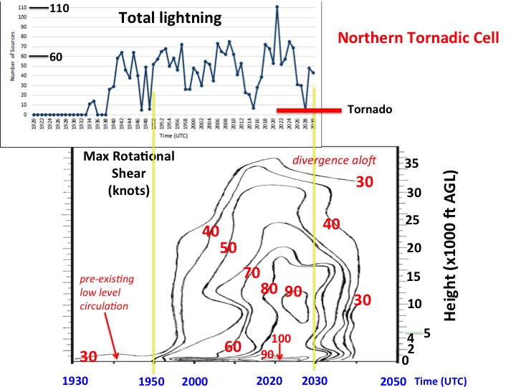
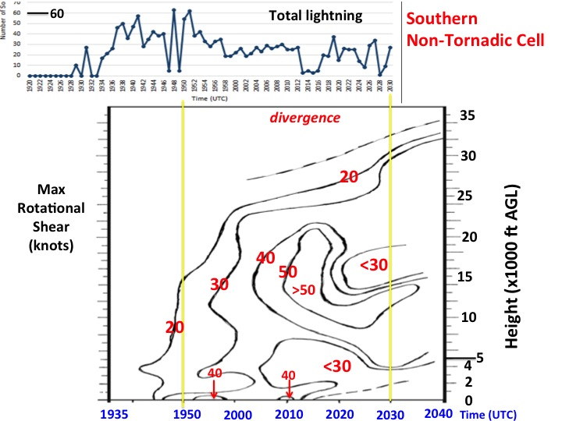
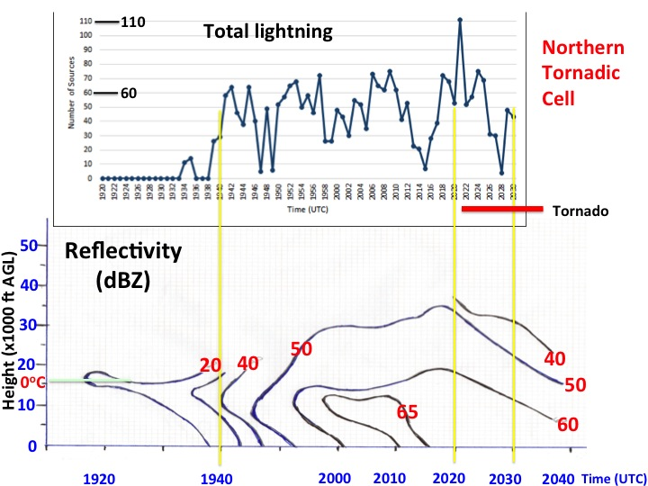
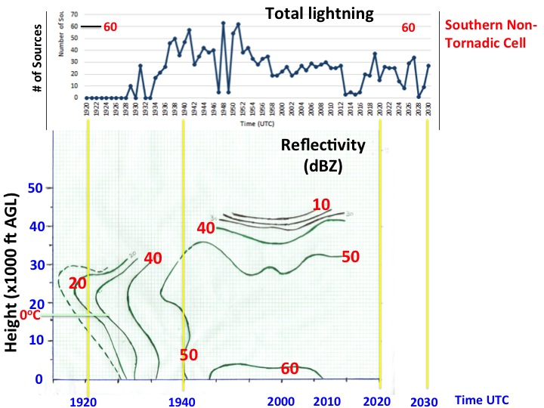
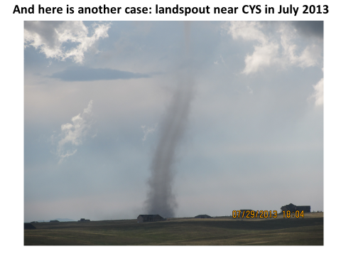
A Possible Relationship Between Total Lightning and Non-Supercell Tornadogenesis
Ed Szoke^{1,2}, Dan Bikos¹, Geoffrey Stano³, Pat Kennedy⁴, Steve Rutledge⁴, Robert Kleyla⁵,
Dave Barjenbruch⁵, Robert Glancy⁵, Robert Cox⁶ and Rebecca Mazur⁶
¹Cooperative Institute for Research in the Atmosphere (CIRA), Fort Collins, CO
²NOAA/Earth System Research Laboratory (ESRL)/Global Systems Division (GSD), Boulder, CO (email edward.j.szoke@noaa.gov)
³NASA/SPoRT, Huntsville, AL
⁴Colorado State University, Fort Collins, CO
⁵National Weather Service, Boulder Weather Forecast Office
⁶National Weather Service, Cheyenne Weather Forecast Office
Total lightning will be available from GOES-R. Until recently, ground-based measurements of total lightning were restricted to special arrays available at selected locations across the U.S. These arrays can be used to demonstrate potential applications of total lightning to forecasters. SPoRT has been involved in such an effort for many years using the Lightning Mapping Array (LMA) in Alabama. Colorado State University (CSU) operates an LMA that covers northeastern Colorado into southeastern Wyoming, within the forecast areas of the Boulder and Cheyenne National Weather Service (NWS) Weather Forecast Offices (WFOs). Working with SPoRT and CSU, data from the Colorado (CO) LMA has been available to these WFOs for over two years. One potential application of total lightning data that we speculated might be possible was in helping to diagnose non-supercell tornadogensis. This poster details what we have learned so far.
Total lightning at the BOU & CYS WFOs
- Began with Geoffrey Stano’s visit in Apr 2013
- Visited Spring Workshops at both WFO
- Explained the concept of total lightning
- And how it is related to severe storms
- Key is the relationship between amount of total
lightning and updraft strength
- Why single out non-supercell tornadoes?
- Because the updraft is the key to the development
of a non-supercell tornado
- As shown by previous research – see below
The Denver International Airport (DIA) non-supercell tornado of 13 June 2013
Excellent documentation with total lightning & radar data
Track of the tornado across DIA
~20:36 MDT
How non-supercell tornadoes form:
Stage 1
~2:21 MDT
Empty DIA concourse at midday! All terminals were evacuated (except for Howie Bluestein)
Set-up on 18 June: Denver cyclone surface boundary in place near DIA (good correlation with non-supercell tornadoes in June!)
Stage 2
What we saw in real-time: radar with CO LMA situational awareness display from CSU website
And at the NWA Conference in October:
Stage 3
Summary:
Above schematic is based on the study of the Erie, Colorado non-supercell tornado that occurred on 26 Jul 1985 – the first case documented with Doppler radar data (time-height results shown in this figure to the right).
For the 18 June DIA case we construct similar time-height cross-sections (shown below)
Height (x1000 ft AGL)
Summary, conclusions and future work

