Slide 1
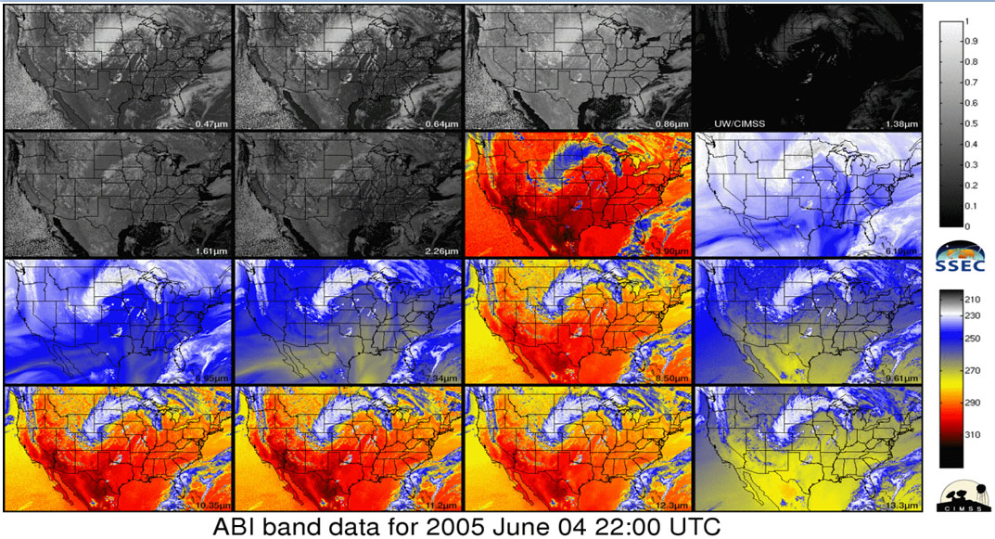
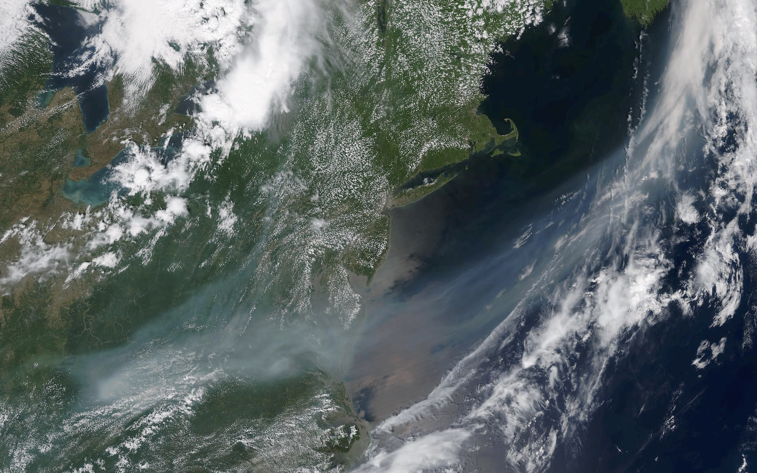
Overview of Satellite Short Courses
Jim Gurka
CICS/ U MD
Tim Schmit
NOAA/ NESDIS
Steve Goodman
NOAA/GOES-R Program Office/ NESDIS
LeRoy Spayd
NOAA/National Weather Service
Mitch Goldberg
NOAA/ JPSS Program Office/ NESDIS
Bill Sjoberg
NOAA/ JPSS Program Office/ NESDIS

Slide 2
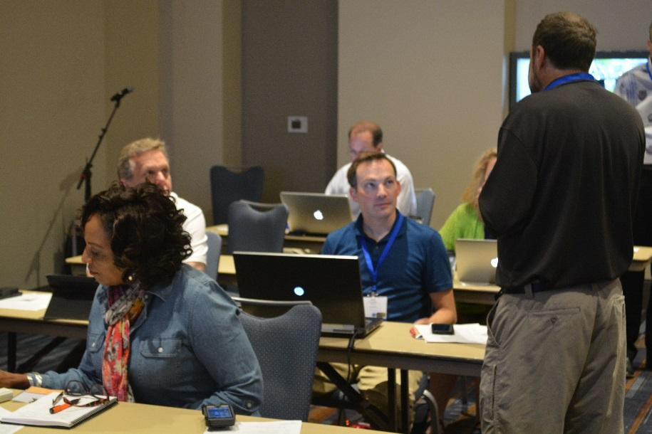
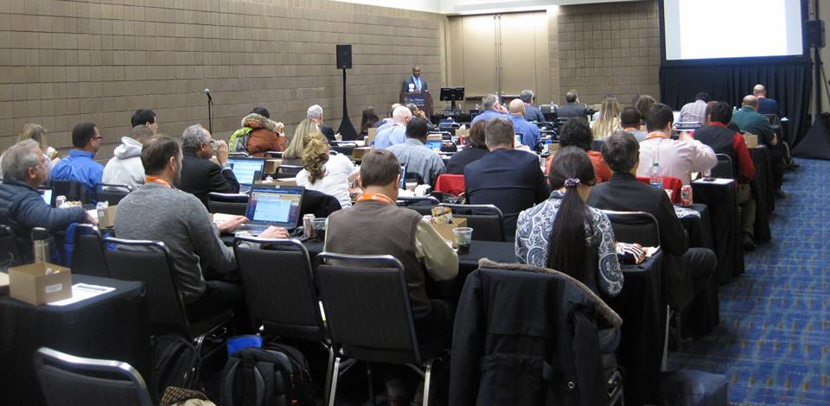
Short Courses Completed
GOES-R Preview for Broadcasters:
- 43rd AMS Conference on Broadcast Meteorology
- June 9, 2015; Raleigh NC
- 17 Broadcasters completed the short course
GOES-R and JPSS Preview for Users
- AMS Annual Meeting
- January 10, 2016; New Orleans LA
- Diverse mix of 40+ domestic & international participants from government, private industry and universities

Slide 3
GOES-R Preview for Broadcasters
Goal:
-Make broadcasters aware of:
a. GOES-R Capabilities;
b. How it can improve services to the viewing public;
c. What equipment upgrades are needed to handle the new data and products;

Slide 4
GOES-R Preview for Broadcasters 2015
Co- Organizers:
- Jim Gurka and Tim Schmit
Co Chairs:
-Steve Goodman & Dan Satterfield
Instructors:
- Tim Schmit; Scott Lindstrom; Chris Schmidt; Marianne Weingroff; Patrick Dills; Dan Satterfield; Chad Gravelle;
Bill Line
Lunch Speaker: Harvey Leonard (WCVB-5, Boston)
- “Buried in Boston: The Winter of 2014-2015”

Slide 5
GOES-R Preview for Broadcasters 2015
Participant input:
-Really enjoyed – good job
-Very informative
-Very excited for the new capabilities
-Very good presentations, liked the hands-on exercises
-Excellent seminar – good value for money
-Consider AMS send an email to group ahead of time (start times, links, etc)
- I enjoyed the short course – learned a lot of valuable information

Slide 6
GOES-R Preview for Broadcasters 2015
Suggested for Future Courses:
- More hands-on exercises – they were great
- This short course should be offered at next year’s Broadcasters Conference
- Perhaps more real-time, but it was all great
- Info from vendors, but I understand that they are in a competitive situation
- Real data, can’t wait

Slide 7
GOES-R & JPSS Preview for Users 2016
Goal:
- Make current and future GOES and JPSS users aware of:
GOES-R Capabilities;
How the new capabilities will improve environmental observations and forecasts;
JPSS Capabilities;
How to use JPSS NUCAPS/DNB capabilities through hands-on Exercises

Slide 8
GOES-R & JPSS Preview for Users 2016
Co-organizers and co-chairs:
- Tim Schmit; Steve Goodman; Jim Gurka; Mitch Goldberg;
Bill Sjoberg
Instructors from:
- CIMSS; COMET; CIRA; CICS; SPoRT; JPSS Program; NWS;
- Several hands-on exercises
Luncheon Speaker: Dr. Marshall Shepherd
- Director of U. GA, Atm. Science Program

Slide 9
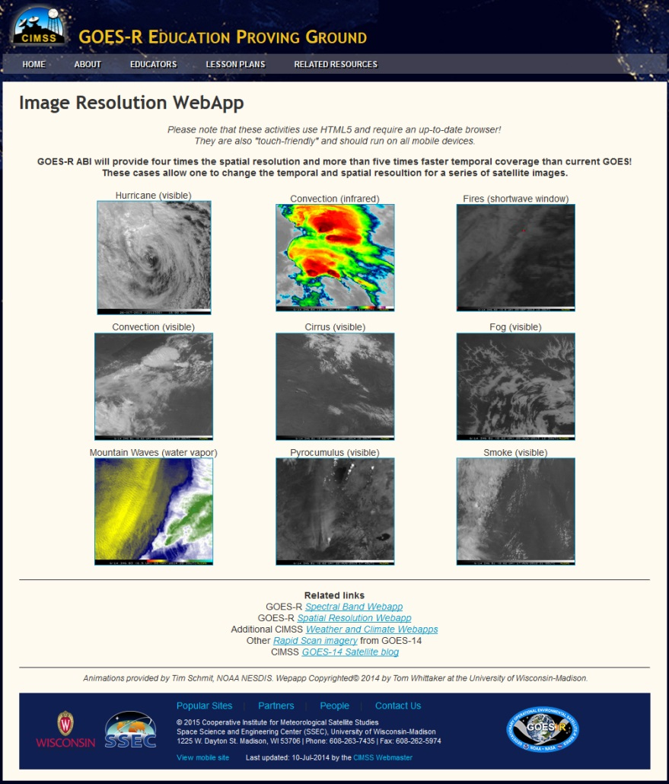
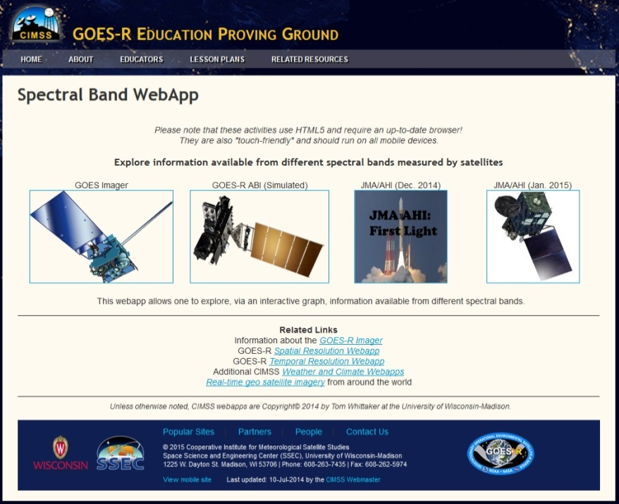
Educational WebApps
http://cimss.ssec.wisc.edu/education/goesr/

Slide 10
Educational Spectral Webapp
NOAA NESDIS ASPB teamed up with CIMSS researchers to develop three educational WebApps to explore space, time and spectral resolutions of satellite imagery.
Part of the GOES-R Educational Proving Ground at CIMSS:
http://cimss.ssec.wisc.edu/education/goesr
Users can step through spectral bands, or use the interactive graph to explore the relationship between spectral bands.
Sample interactive “Bandapp” educational webapp using simulated ABI images:
http://cimss.ssec.wisc.edu/goes/webapps/bandapp/
Notes:
Tim Schmit, ASPB
https://ams.confex.com/ams/95Annual/webprogram/Paper265203.html ABI = Advanced Baseline Imager
Other new webapps: one to change both the spatial and temporal sampling and the other only the pixel sampling

Slide 11
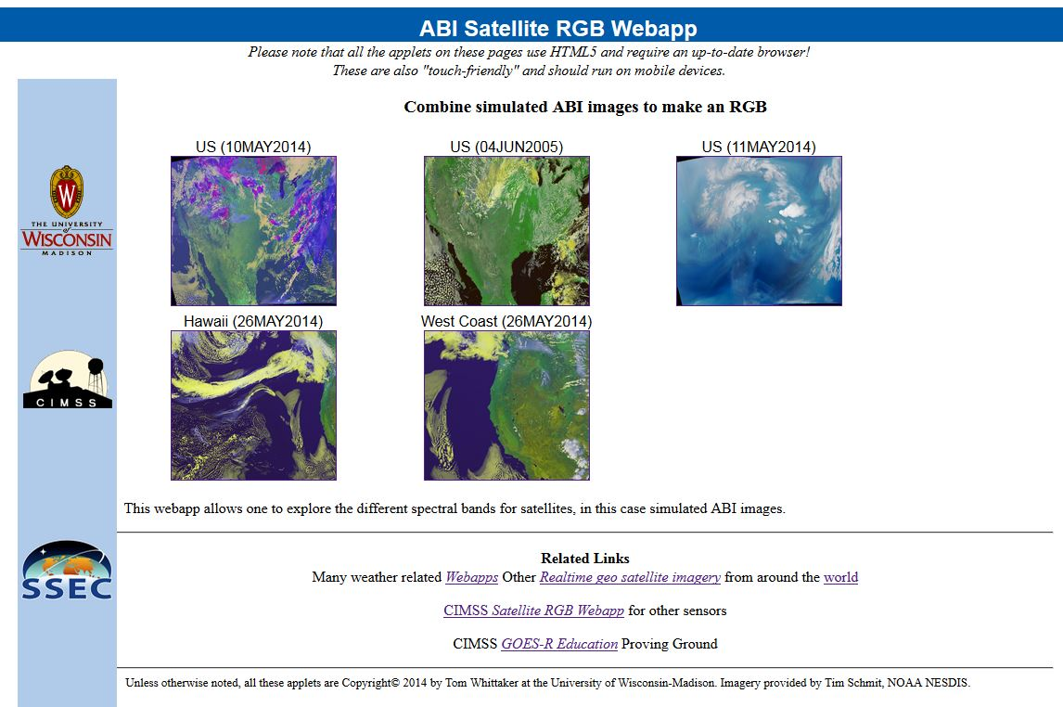
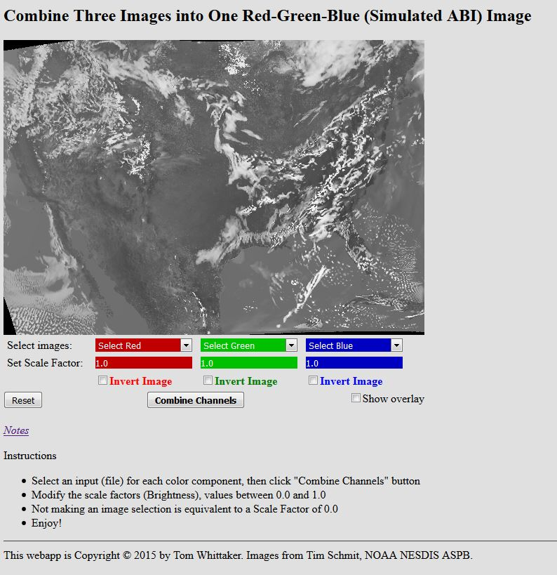
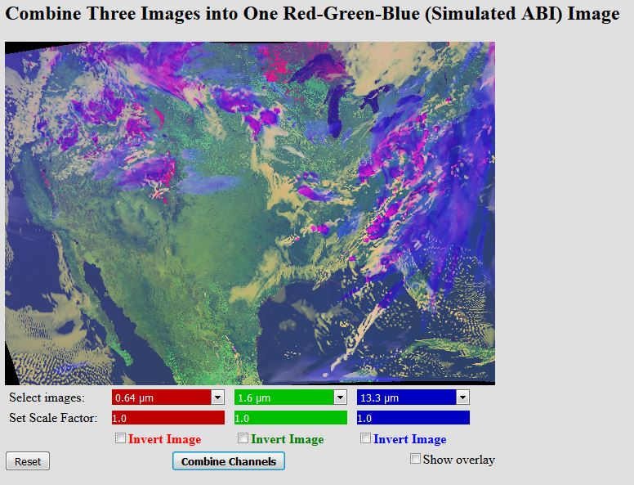
Educational RGB Webapp
Sample interactive “RGB” educational webapp using simulated ABI images:
http://cimss.ssec.wisc.edu/goes/webapps/satrgb/overview.html
Webapp to combine simulated ABI images into one image.
Notes:
Tim Schmit, ASPB
https://ams.confex.com/ams/95Annual/webprogram/Paper265203.html ABI = Advanced Baseline Imager
Other new webapps: one to change both the spatial and temporal sampling and the other only the pixel sampling

Slide 12
GOES-R & JPSS Preview for Users 2016
Questions and Results from AMS Evaluation Form:
(Questions answered on scale of 1-5: 1=Strong Yes; 5=Strong No)
Short Course met expectations? avg = 1.46
Pleased with the faculty? avg = 1.29
A/V clear and helpful? avg = 1.39
Course fee was a good value? avg = 1.18
Length of appropriate? avg = 1.64
*All 28 respondents gave positive evaluations.*
* Suggestions and specific comments in backup slides*

Slide 13
Future Short Courses
GOES-R Preview for Broadcasters:
44th AMS Conference on Broadcast Meteorology
June 14, 2016; Austin TX
Tell your favorite broadcaster!
Satellite Session and Evening Workshop
National Weather Association Annual Meeting Sep 2016
Mon pm Satellite Session (6 presentations)
Tue evening 2 hour workshop
JPSS and GOES-R Short Courses
AMS 2017 Annual Meeting; Seattle WA
JPSS on Sat 21 Jan and GOES-R on Sun 22 Jan

Slide 14
(Possible) Future Short Courses
-Independent Workshop
Aug, 2017 (TBD…2 days); Madison WI
- Broadcasters 2017 ?
-NOAA Satellite Conference
June, 2017; Location TBD - EUMETSAT Meteorological Satellite Conference
Sept. 2017
- National Weather Assn. Annual Meeting
Oct. 2017;
- AMS Annual Meeting
Jan, 2018
- NWA 2018 ?

Slide 15
Satellite Short Courses… Summary
Efficient way to make user communities aware of:
Satellite capabilities
How to access GOES-R and JPSS products
How to use satellite products to improve user services
How to get more information and training on use of satellite data and products
Positive feedback from the short courses that have taken place
Hands-on activities are the key
Participants have provided useful suggestions to improve future courses

Slide 16
GOES-R Short Courses… URLs
* http://www.goes-r.gov/users/2015_AMS-GOES-R-Short-Course.html
* http://www.goes-r.gov/users/2016_AMS-GOES-R-Short-Course.html
* https://www.ametsoc.org/ams/index.cfm/meetings-events/ams-meetings/44th-conference-on-broadcast-meteorology/ (upcoming broadcasters short course)

Slide 17
Backup Slides

Slide 18
GOES-R & JPSS Preview for Users
Comments and Suggestions from New Orleans Short Course:
1a. “I approve the short course very much. Thanks for putting this together.”
1b. “Please either assign background reading before the course or assume minimal background knowledge from the audience.”
2. “Could use a whole day for GOES-R.”
3. “Thought this was well-run and really appreciate the range of topics covered in a short time. Would like to see how to visualize/ plot archived data, please.”

Slide 19
GOES-R & JPSS Preview for Users
Comments and Suggestions from New Orleans Short Course:
4. “Good course with lots of information. Hard at times to follow some of the GOES-R ABI information since there are so many channels, but otherwise excellent.” “Good job. Speakers were excellent.”
5. “Could use a whole day for GOES-R.”
“Instructors excellent. Enjoyed the course. Excellent and useful presentations.”
“Very well done. Thank You!”

Slide 20
GOES-R & JPSS Preview for Users
Comments and Suggestions from New Orleans Short Course:
8. “Great. More.”
9. “I thought this was an excellent course and I learned a lot. Thank you for all your hard work putting this together.” “It was a bit long, but I understand there was much material to get through."
10. “Great speakers. They packed a lot of material into one day. Nice lunchtime speaker too.”
11. “Excellent!”

Slide 21
GOES-R & JPSS Preview for Users
Comments and Suggestions from New Orleans Short Course:
12. “Very intensive. I’m 14 years from operational use of satellite data, just now returning. The satellite capabilities have changed dramatically. I now know that I must spend much more time learning about GOES-R and JPSS. Thank You.”
13. “I liked how technical we got with ABI products. It would have been good to keep this up throughout the course. It would have been good to keep the conversation more focused on instruments and products in the GLM talk. Not sure how applicable WRF lightning forecasts were."

Slide 22
GOES-R & JPSS Preview for Users
Comments and Suggestions from New Orleans Short Course:
14. Suggestions: “more refined presentations; better references: include refereed journal articles; more discussion and Q&A; include space weather information; more references to real-time data/imagery; more staff needed to monitor course logistics and help students.”
“Some of the hands-on material was a little rushed. Slightly longer course might help.“
“Perhaps make the course more interactive if possible and remember many professionals are here. Some of the data gets a little dense and over the top at times.”

Slide 23
GOES-R & JPSS Preview for Users
Comments and Suggestions from New Orleans Short Course:
17. “Perhaps have questions for what you’d like to hear before the talk, so if certain attendees have topics they want covered, they can be touched on.”
18. “Wifi needs to be faster during hands-on presentations. Some of the graphics loaded too slowly and made it hard to keep up with the pace of the speakers.“
19. “Split the course over two days, GOES in day 1 and JPSS in day 2.”
20. “Have prerequisite of suggested reference materials that would be useful to better understand the examples.”

Slide 24
GOES-R & JPSS Preview for Users
Comments and Suggestions from New Orleans Short Course:
21. “Make the hands-on exercises: more time, more guidance. In the beginning, please give a clear step-by-step instructions. Two people next to me didn’t know how to get to Power Point presentations until the first break. I even got to it after browsing on Google. Let the audience participants know ahead of time that they need to bring laptops”
22. “More info on the SNPP products, such as VIIRS, ATMS, CRiS, OMPS, and CERES. For the hands-on exercises, I would like to see larger color tables and values in the legends with the satellite time-series loops.“
23. “I was expecting a little more on the hardware expectation and dissemination of the products.”

