Slide 1
Recent JPSS Data Applications
Daniel Nietfeld
2016 NOAA Satellite Proving Ground / User Readiness Meeting

Slide 2
JPSS/NPP data in the WFO
How important is the data to the operational forecast/warning (DSS) problem?
Is it valuable… even if only one-two snapshots per day?
Is it unique to other datasets? (NPP visible vs. GOES visible)
Can I get the same data from other sources?
Is the data accurate/representative?
Is the data timely?
Has the utility of all data been adequately explored?
Access to data?
Understanding of data? (i.e., 1.61 imagery, ATMS)

Slide 3
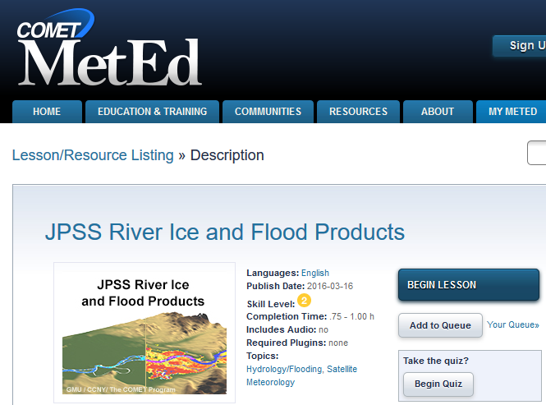
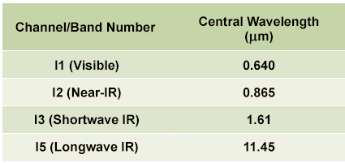
Do WFO Forecasters Understand the Data? Importance of Training

Slide 4
S-NPP Data that is making traction in the WFO
NUCAPS
VIIRS for river monitoring (see COMET module)
RGBs (dust, snow vs. clouds, etc…)
Day-Night Band (NCC – covered by Dan Lindsey and Eric Guillot)
JPSS Snowfall Rate (SFR) Product (used at WFO Sterling)
Other applications/data covered this week

Slide 5
NUCAPS More to come today and Thursday
NOAA-Unique Combined Atmospheric Sounding System
(NUCAPS) uses both infrared and microwave sounders
My experiences and interests with NUCAPS (became operational April 2014)
Here’s the problem…
Human forecasters bust forecasts often
NWP systems bust forecasts often as well

Slide 6
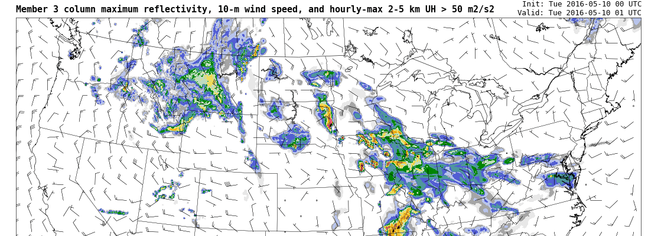
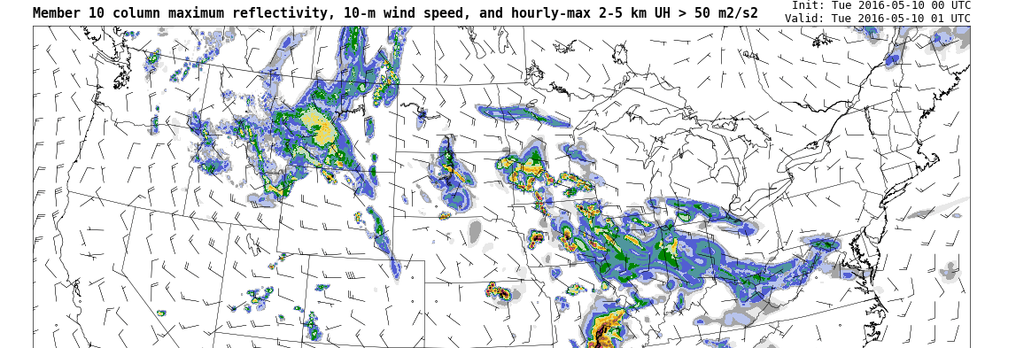
There is tremendous
reliance on NWP in
forecast and warning
operations

Slide 7
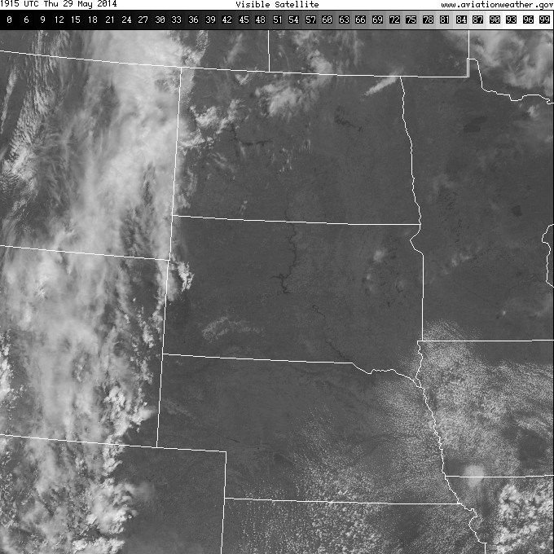
Forecast Problem: 29 May 2014 Afternoon/Evening Convection ?
GFS 9 hour fcst
From 12UTC 29 May
Valid 21 UTC 29 May
1915 UTC
Visible
Will the Cumulus Field develop further? (As suggested by the GFS)
Notes:
This is a more forecast-specific use of the soundings. Will that broken cumulus field on the border of Iowa/Nebraska develop? The GFS is predicting QPF later in the day.

Slide 8
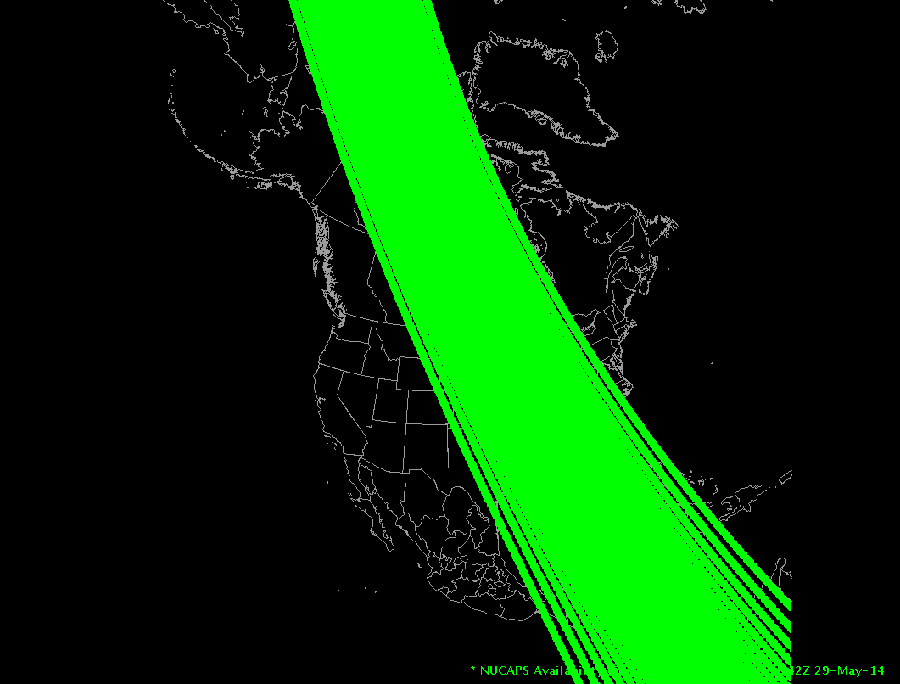
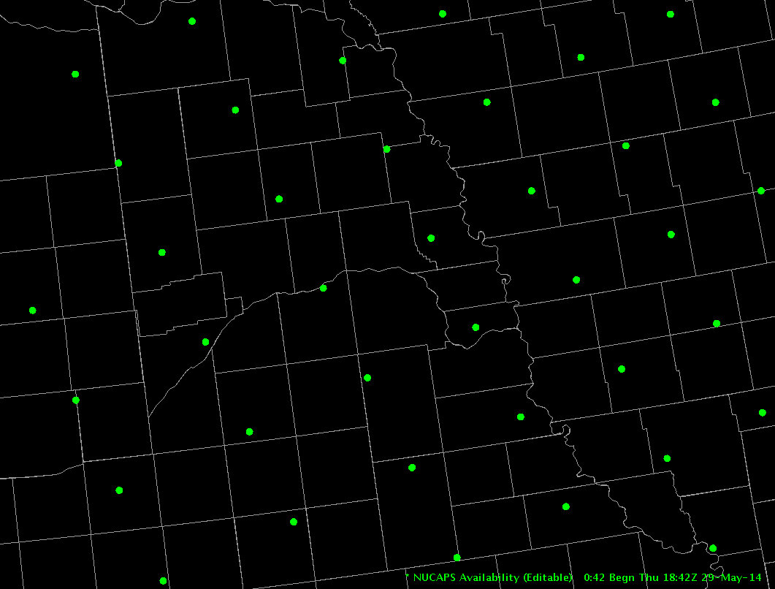
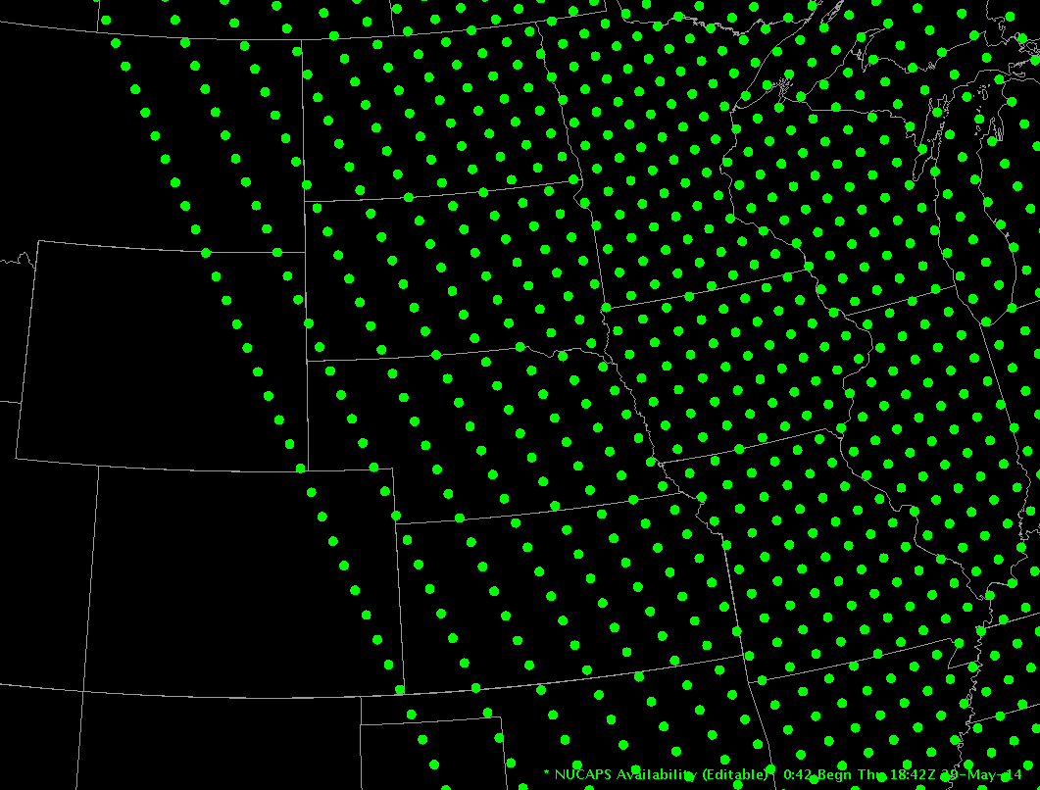
NUCAPS Soundings give thermodynamic information at a convenient time!
1842 UTC NPP pass
Notes:
Suomi NPP overflies the central US around 18 or 19z; this provides timely information on the state of the atmosphere in early afternoon. Here we have three different scenes, zooming in from North America to the Plains to WFO Omaha.
Let's look at the sounding in eastern Nebraska, circled in red.

Slide 9
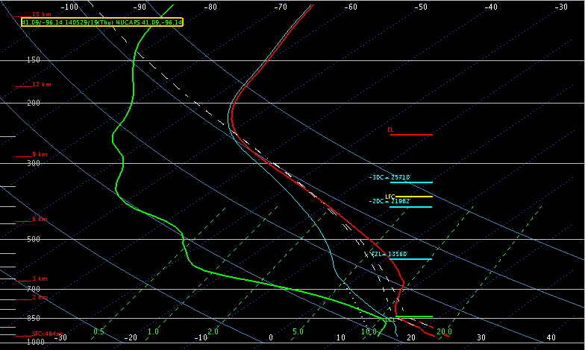
NUCAPS Sounding 1842 UTC 29 May 2014 Would you expect convective development?
T = 79F (METAR = 80F)
Td = 60F (METAR = 63F)
CAPE ~ 50 J/KG
Notes:
This sounding has a surface temperature and dewpoint close to observations (so we needn't edit the sounding to bring it into accord with observations). CAPE is small. Would you expect convective development?

Slide 10
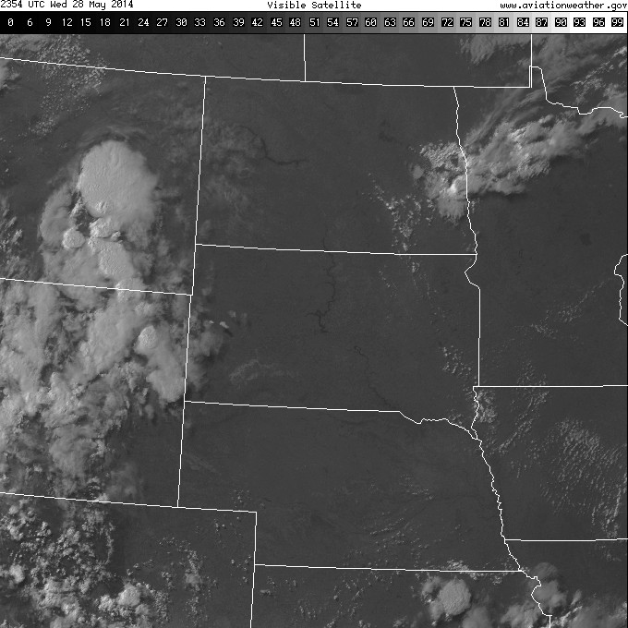
2354 UTC
Visible
Notes:
Late afternoon visible imagery shows that the cumulus field has dissipated.

Slide 11
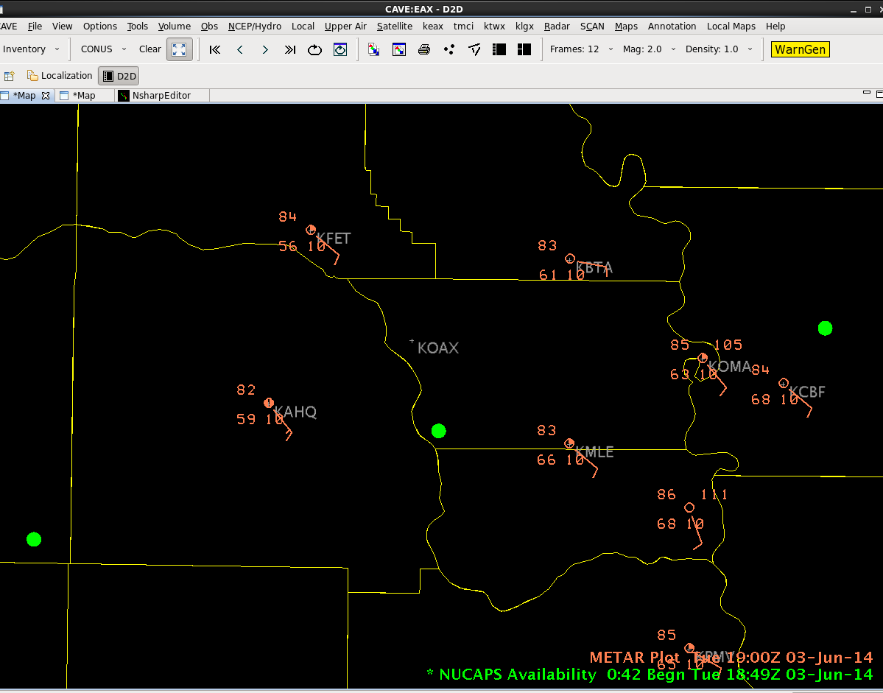
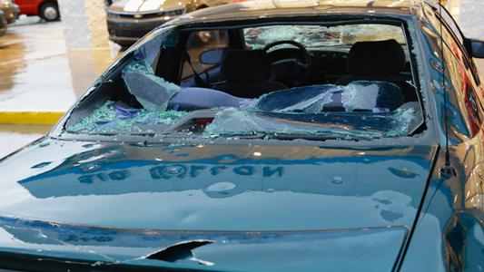
June 3, 2014 High Risk Severe Weather Event in Omaha
Notes:
A couple days later, Omaha experienced severe weather. This image shows the storm reports, damage, and two NUCAPS sounding sites from 1849 UTC on 3 June. Note also the gradient in dewpoint in the plotted METARs.
The next page shows the NUCAPS sounding for the site just south of the Omaha WFO -- the one in the Green Box.

Slide 12
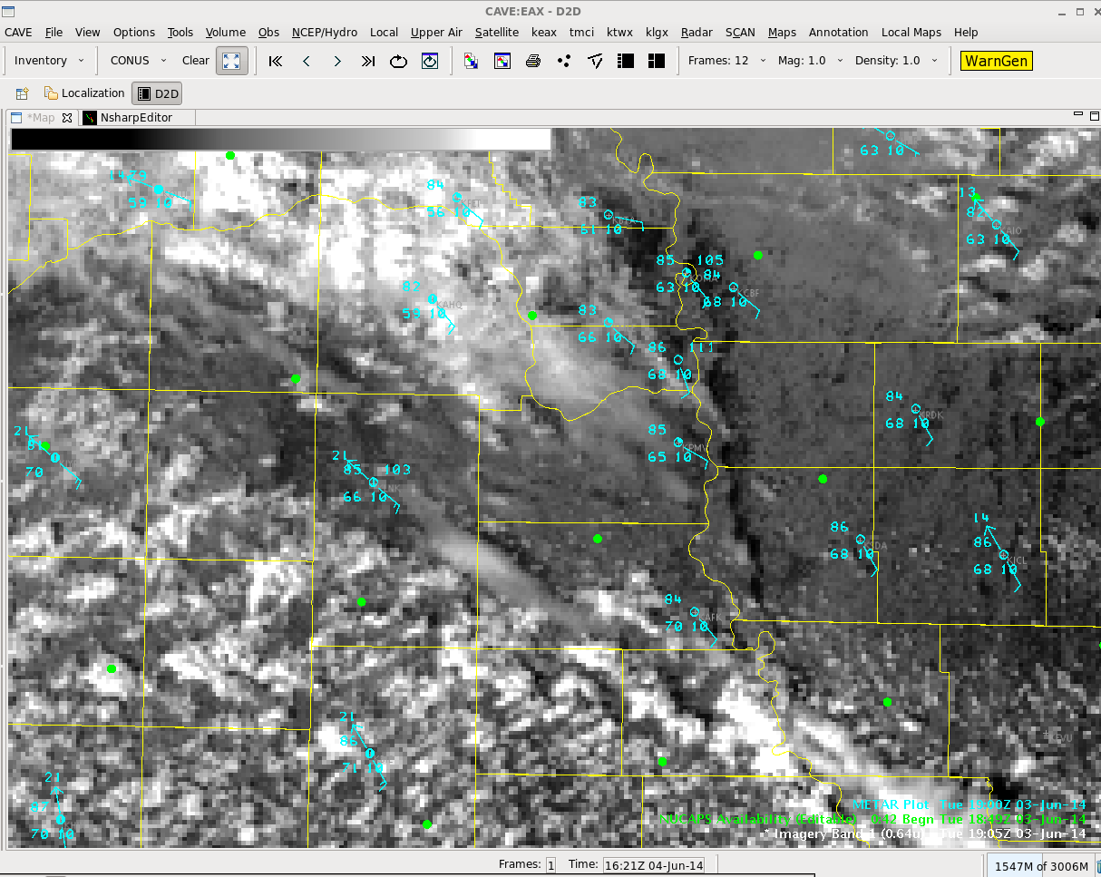
June 3, 2014 High Risk Severe Weather Event in Omaha
NUCAPS sounding locations
Overlaid with VIIRS 0.64
1905Z June 3, 2014
Location of OAX in yellow
Northern dot is within a few
KM of KOAX, but under
cloud cover
Southern dot is in a nearly
Cloud-free location, and is
warmer and more humid
OAX
Notes:
Zooming in again, we see the sounding from the cloudy region -- boxed in green, and also a second sounding to the south where skies are clearer. (And dewpoints are warmer there too)

Slide 13
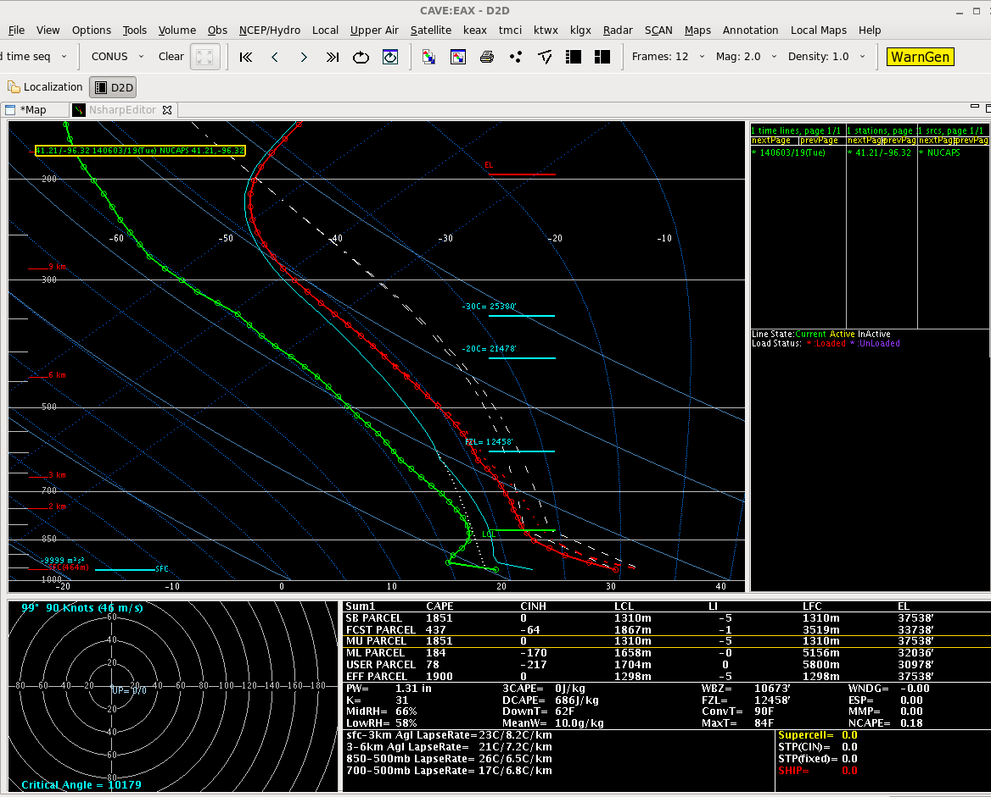
June 3, 2014 High Risk Severe Weather Event in Omaha
NUCAPS ~10 KM south of OAX
1849Z June 3, 2014 – cloudy
scene, but still gives info!
Modified for surface METAR
Ob of T=83, Td=63
SB CAPE = 1851
Notes:
The NUCAPS sounding from the site in the green box on the previous page -- a cloudy region, but the sounding still gives information. This sounding has been modified so the surface METARs match the sounding values. Surface-based CAPE is 1851.

Slide 14
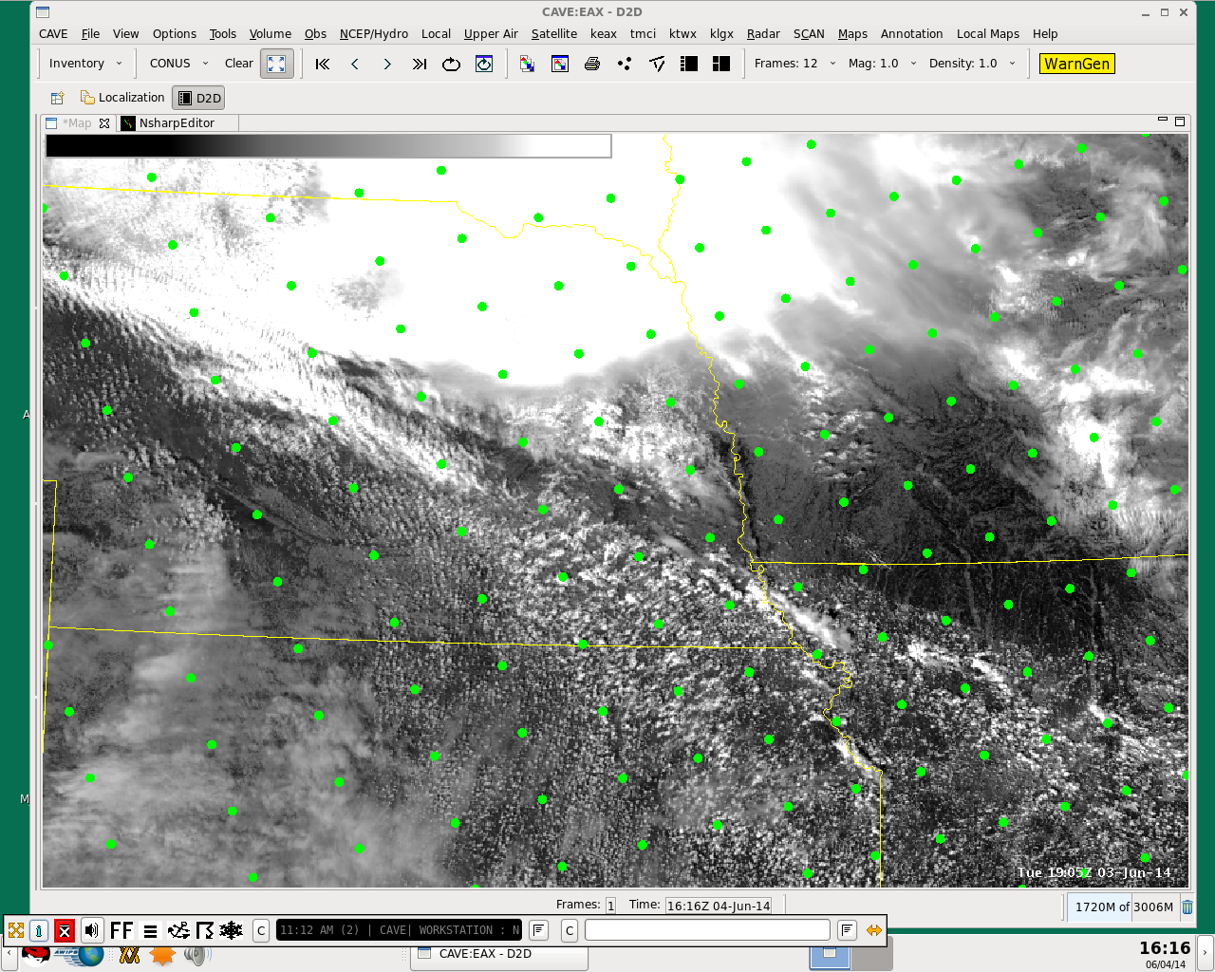
June 3, 2014 High Risk Severe Weather Event in Omaha
NUCAPS sounding locations
overlain on VIIRS 0.64
1905Z June 3, 2014
Notes:
The boxed site is the one we just looked at. Note that a clear Sounding is just south -- and recall that there is a strong dewpoint gradient in the region.

Slide 15
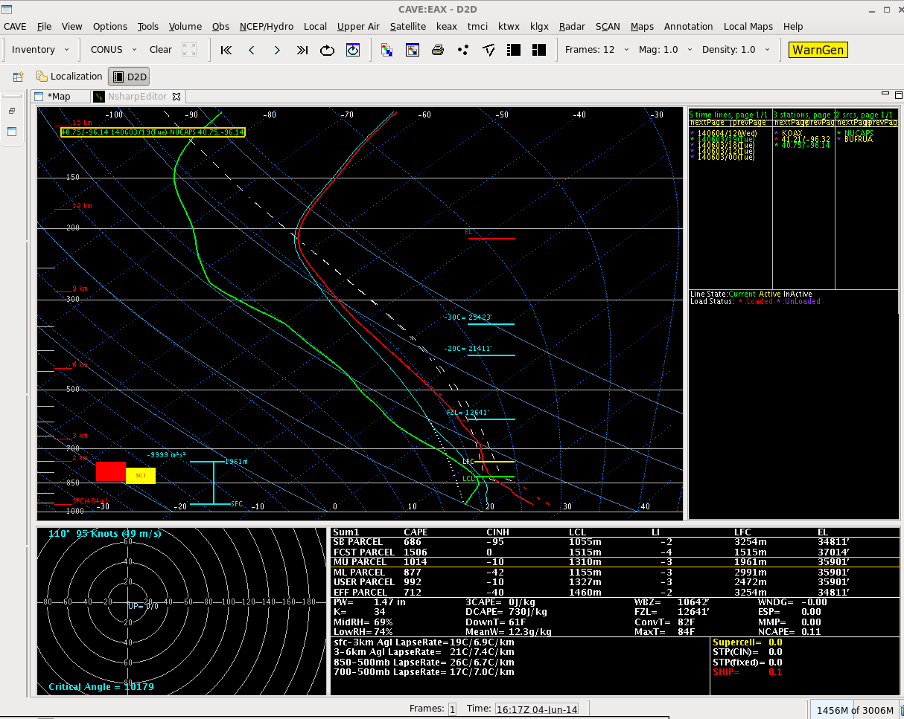
June 3, 2014 High Risk Severe Weather Event in Omaha
NUCAPS sounding
40 km south of OAX
1849Z June 3, 2014
Unmodified
SB CAPE = 686
Notes:
Here is the unmodified NUCAPS sounding at that southern site. Surface-based CAPE is around 700 -- but the surface temperature/dewpoint in the sounding do not match the METARs. This is a good sounding to edit.

Slide 16
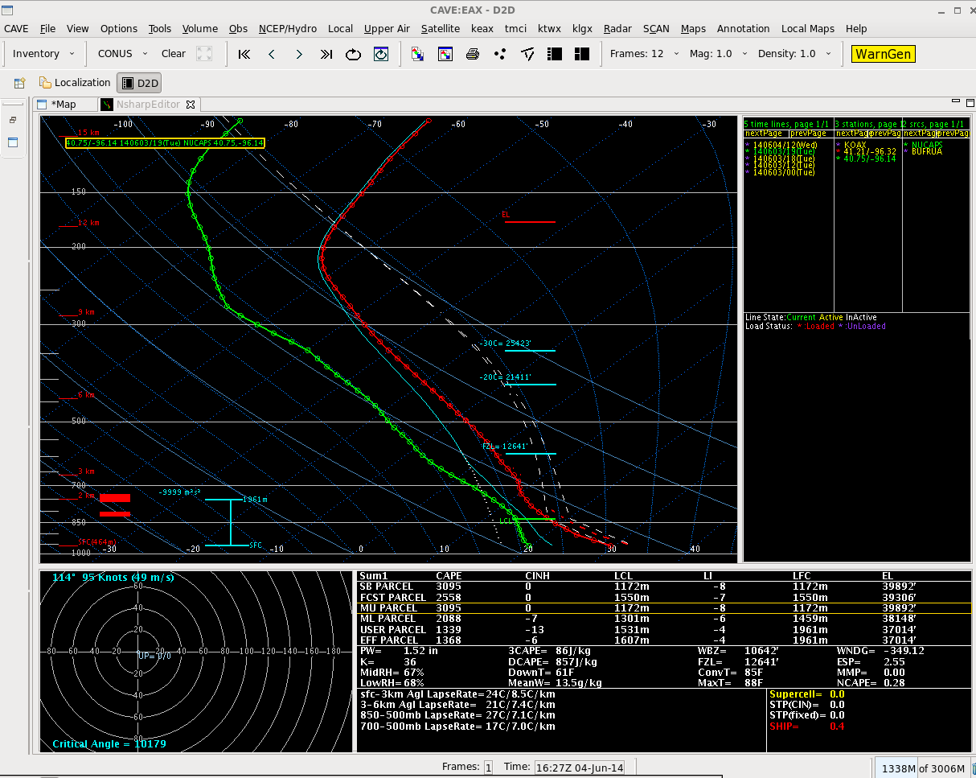
June 3, 2014 High Risk Severe Weather Event in Omaha
NUCAPS sounding
40 km south of OAX
1849Z June 3, 2014
Modified for surface METAR
Ob of T=85, Td=68
SB CAPE = 3095
Notes:
Once the sounding is edited so that its lowest temperature/dewpoint match the METAR, surface based CAPE exceeds 3000! This kind of information should influence your interpretation of present conditions.

Slide 17
Issue #1: Smoothing
Vertical resolution is a bit course
~20 temperature layers
~10 moisture layers
Significant smoothing
Identification of warm capping layers?
Identification of dry layers aloft (downburst potential)?

Slide 18
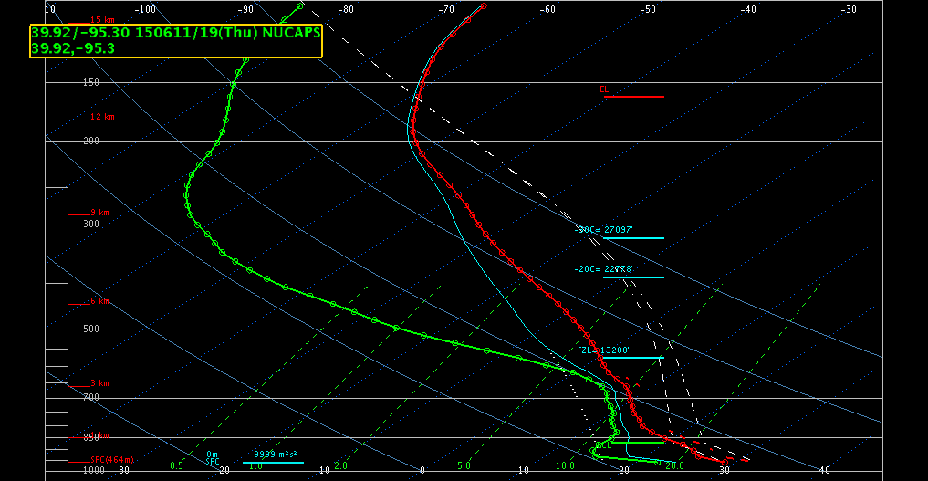

Slide 19
Issue #2: Surface/BL Modification
Modification is necessary 99+% of the time due to errors in surface T and Td
Techniques, such as SPC’s SFCOA, have been used to objectively modifying the low levels of a sounding (RAP) using METARs
Automation of Sounding Modification at the Surface and in the BL – ongoing project

Slide 20
Improving NUCAPS Soundings for CONUS Severe Weather Applications via Data Fusion
Jack Dostalek, Dan Lindsey, John Haynes, Chris Barnet, Dan Nietfeld
JPSS-funded project at CIRA

Slide 21
One of the main comments on NUCAPS from the HWT over the last 2 years has been that surface temperature and dewpoint are often incorrect, so the sounding must be manually modified to correct the surface values
A relatively new JPSS-funded project at CIRA involves blending of NUCAPS retrievals with surface and near-surface data to produce an improved sounding for severe weather nowcasting
We first need to characterize the performance of the NUCAPS retrievals during the warm season (April-September) over the United States, so we’re currently performing a careful validation of these matchups with radiosondes launched in the afternoon
We will also compare to the Rapid Refresh (RAP) Model soundings and potentially use that NWP data in the new altered soundings

Slide 22
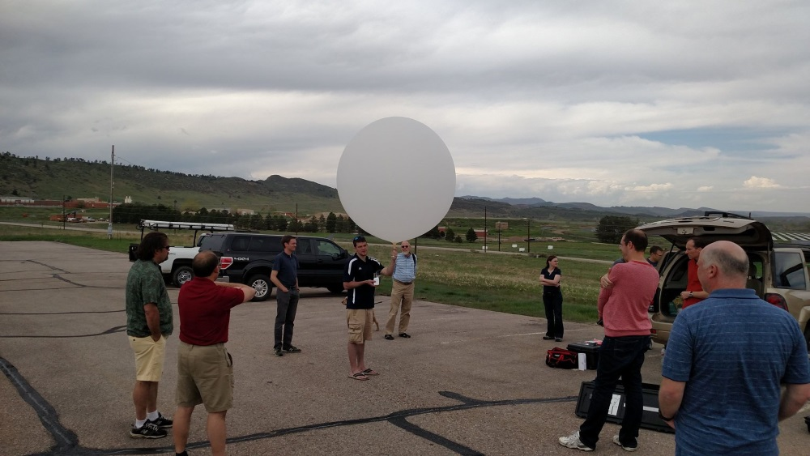
CIRA is launching radiosondes from northeast Colorado to supplement the NUCAPS validation dataset in order to include unique High Plains convective environments
Photo of CIRA’s first balloon launch from last Friday from the CIRA/CSU parking lot. The soundings are being sent to the SPC and local NWS offices for use in real-time ops. CSU Atmospheric Science grad students are helping out

Slide 23
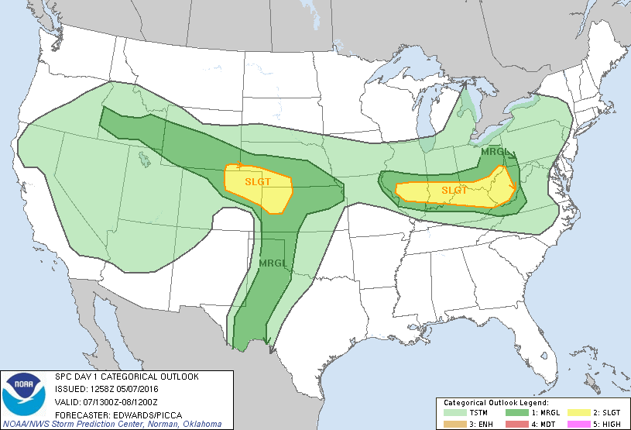
SPC Convective Outlook – May 7, 2016 (this past Saturday)
Radiosonde launch location – Saturday, May 7, 2016

Slide 24
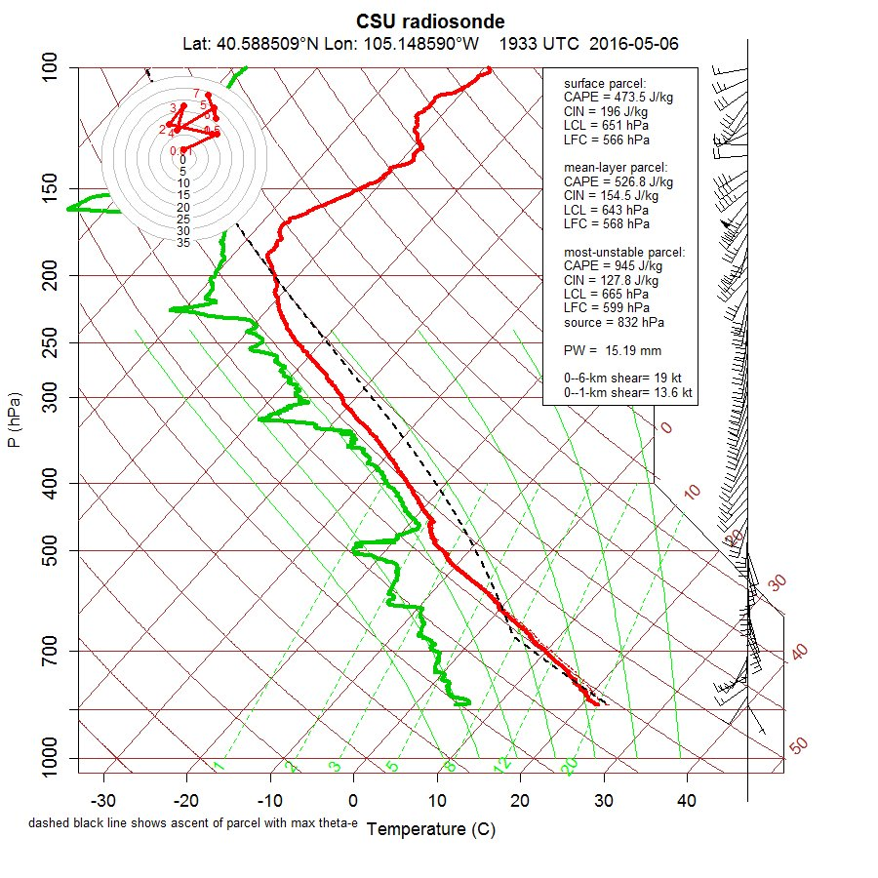
Our observed sounding from northeast Colorado – May 7, 2016 – 1933 UTC
This was sent to the SPC, BOU, and CYS for use in operations

Slide 25
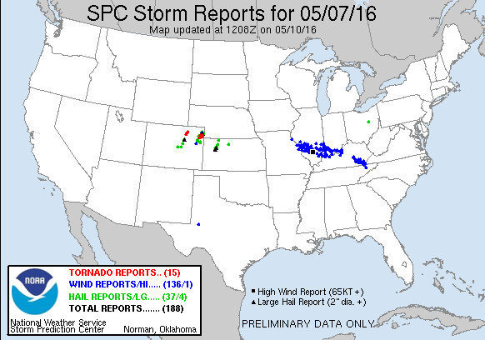

Slide 26
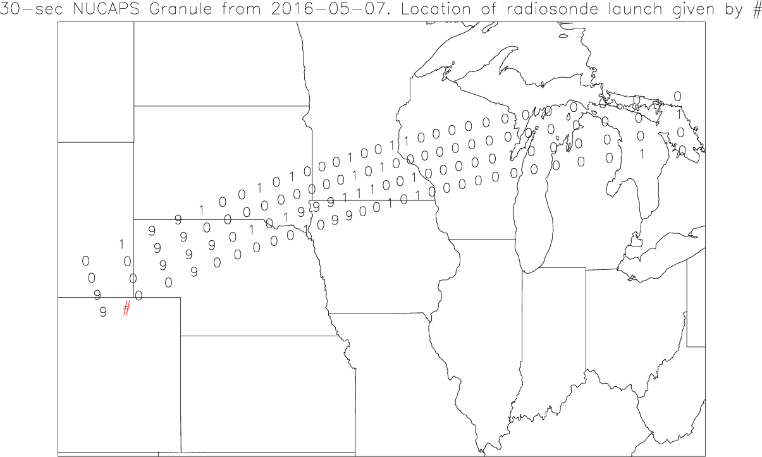
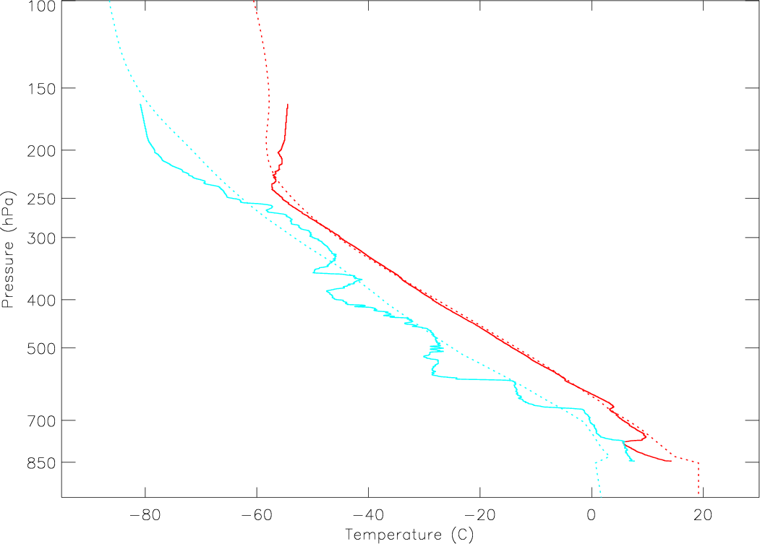
Available NUCAPS soundings
7 May 2016 – Afternoon granule
Radiosonde launch location
NUCAPS comparison (“good” quality flag)
NUCAPS is dashed, observed sounding is solid
Temperature red
Dewpoint cyan

Slide 27
JPSS/NPP (NUCAPS) data in the WFO
How important is the data to the operational forecast/warning (DSS) problem?
Is it valuable… even if only one-two snapshots per day?
Is it unique to other datasets?
Can I get the same data from other sources?
Is the data accurate/representative?
Is the data timely?
Has the utility of all data been adequately explored?
Access to data? [Available on AWIPS2 with QC status displayed]
Understanding of data? [Training module is available]

Slide 28
Successful Implementation of Applications into Forecast Operations
Tie it to a forecast problem
Show the added value
Ensure the data is available
Platform
Format
Timely
Help forecasters understand the data and application (training)
Talk to the users…the forecasters… make it a two-way conversation

