Slide 1
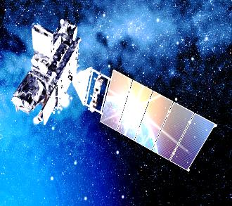
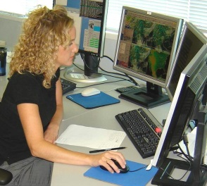
Satellite Training Advisory Team (STAT)
A Path for NWS Forecaster User Readiness for GOES-R/S

Slide 2
What is the STAT?
The Satellite Training Advisory Team (STAT), comprised of Science and Operations Officers (SOOs) and satellite liaisons, worked together to come up with a plan for training experts to follow while developing new foundational training tracks in satellite meteorology for National Weather Service (NWS) operational meteorologists.

Slide 3
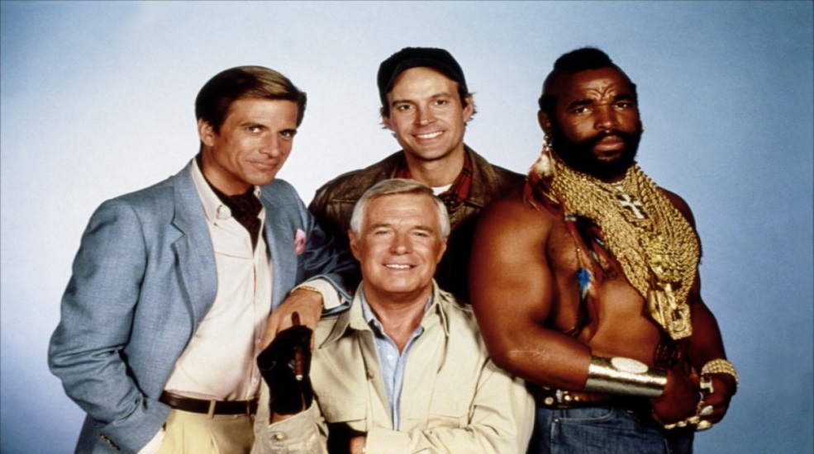
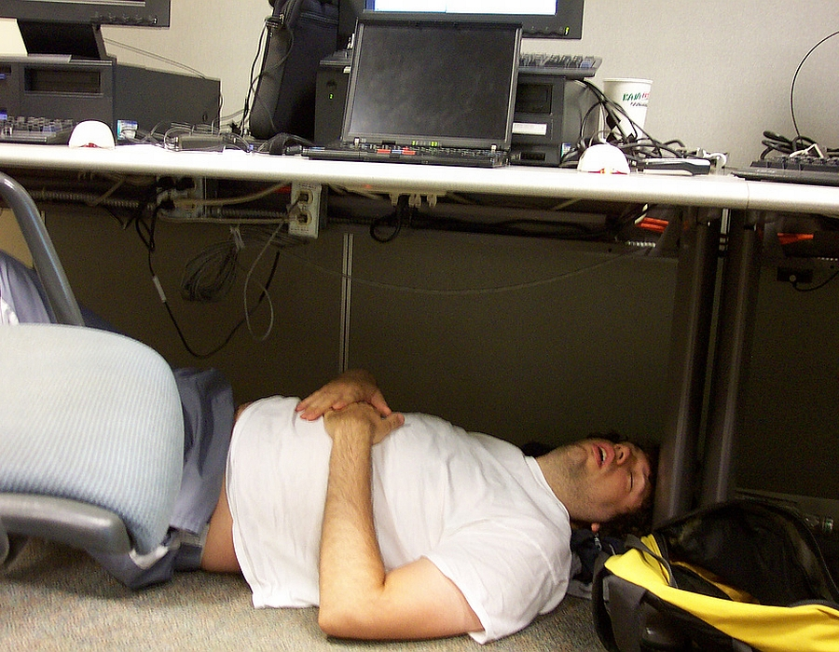
The STAT team
Frank Alsheimer (ER)
Brian Carcione (SR)
Nathan Eckstein (AR)
Michael Folmer (W/O/TPC)
Jordan Gerth (PR)
Dan Nietfeld (CR)
Mel Nordquist/Mike Stavish (WR)
Advisors
Anthony Mostek
Leroy Spayd

Slide 4
Birth of the STAT
SURT report in November, 2014.
User Readiness Training side-meeting at the 2015 NOAA Satellite Proving Ground / User Readiness Meeting.
List of Actions to meet deadline.
Offshoot team (STAT) identify learning/performance objectives.
OCLO would map training development activities to objectives.

Slide 5
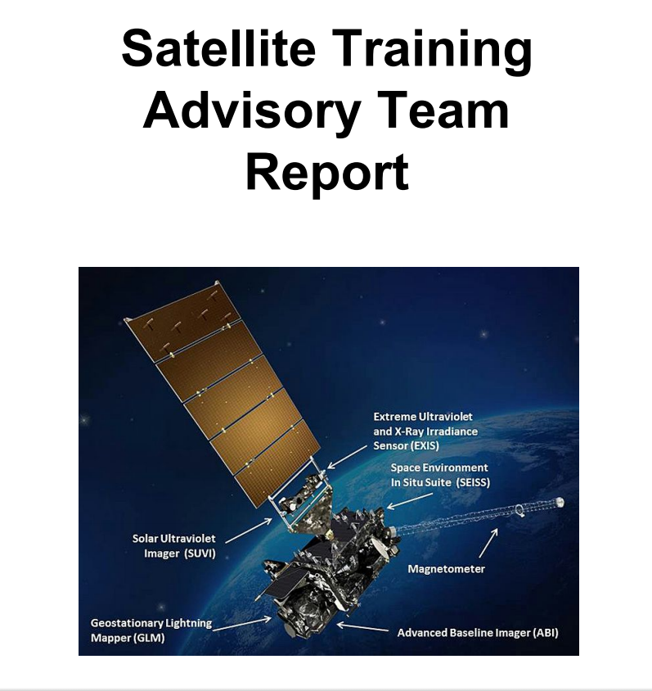
First STAT Meeting
The team met in Boulder in October, 2015.
A final report from that meeting was produced.
Defined topics for foundational training
Defined training/learning objectives
Suggested interaction methods
Reviewed existing satellite resources (i.e. Himawari, GOES-14 SRSOR)
Reviewed existing training resources (big help from Jim Gurka in pre-mapping)
Identified gaps in current training
Accounted for NWS operational considerations (i.e. training time constraints due to staff shortages).

Slide 6
Follow-On Activities
Weekly conference calls with STAT Team, advisors, and training developers.
A second face-to-face (mostly) meeting took place in February to take the details from the STAT report and refine them into a spreadsheet to refine and track the process of the module development

Slide 7
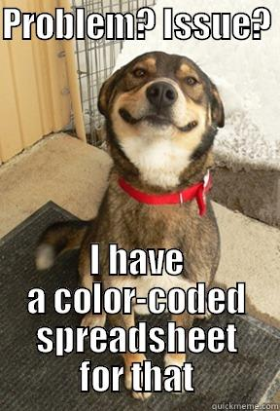
Tracking Spreadsheet
A tracking spreadsheet was developed to:
Show course organization and modules.
Identify training leads, SMEs, and reviewers.
Identify critical dates in the development process.
Color coded to ensure that dates are being met or are in danger of being missed.

Slide 8
Remaining Tasks
Identify STAT team lead reviewers (finished this week).
Continue to meet deadlines in tracking spreadsheet.
Ensure color curves are consistent between training and availability in AWIPS II.
Ensure local office expertise to support training effort.
Have face-to-face in September to clean up any loose ends and start getting ready to plan for level 2 training.
GET THE BIRD IN THE AIR!

