Slide 1
Experimental Products Development Team (EPDT)
Jason Burks
NASA SPoRT

Slide 2
Origins of EPDT
Originally SPoRT formed EPDT internally to focus on:
Creating advanced display capabilities for NASA research data in AWIPS II environment
Create training for AWIPS II development
General need for AWIPS II development training within community
Expanded EPDT out into the community
Funded jointly by GOES-R Proving Ground, JPSS, and NASA SPoRT
Support from the National Weather Service

Slide 3
GOES-R/JPSS Proving Ground EPDT
Objectives:
Create a community environment to share AWIPS II development knowledge
Develop technical expertise of AWIPS II within NASA, NOAA’s CIs, and NWS
Create AWIPS II plug-ins for GOES-R proxy and JPSS data
Ingest
Analysis
Display
Provide feedback to NWS on:
External development process
Governance of locally developed AWIPS II software

Slide 4
Learning Structure
Conference
Call
Hands-on
Learning
Hands-on
Learning
Code Sprint
Time
Conference Calls
Prepare for initial hands-on learning
Supplemental topics
Hands-on Learning
Classroom setting learning
Learn to develop a plug-in from ingest to display
Code Sprint
Participants pick project and “learn by doing”
Work on projects in small groups
Groups help each other

Slide 5
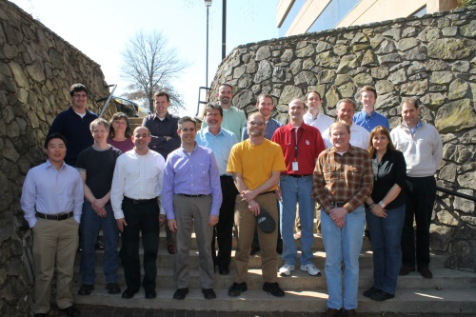
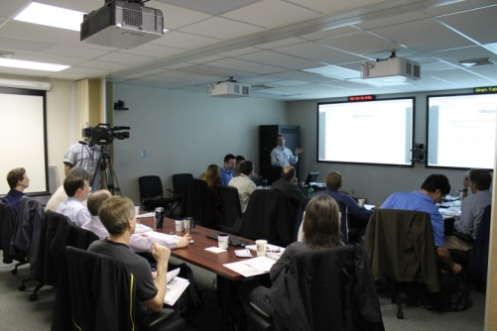
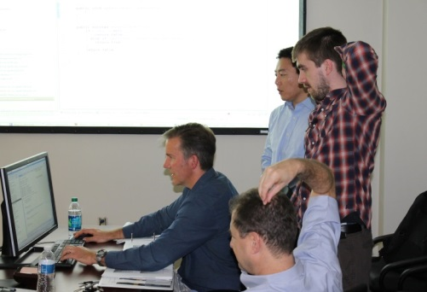
Hands-on Learning Training
Topics covering:
Ingest Plug-in EDEX (Day 1)
Data Model Plug-in (Day 1)
Visualization Plug-in CAVE (Days 2-3)
Hands-on exercises
Training was recorded and provided back to NWS
Training Hosted on VLab

Slide 6
Code Sprint Training
Team broken into small groups
Groups actively develop project during sprint
“Learn by doing” something meaningful
Produce working AWIPS II feature by end of code sprint
Continue working on feature after code sprint ends

Slide 7
Group A, B, and C
Group A (14 Participants)
Hands-on Learning March 2013
Code Sprint Fall 2013
Code Sprint Fall 2014
Group B (14 Participants)
Hands-on Learning April 2014
Code Sprint Fall 2014
Group C (14 Participants)
Hands-on Learning May 2015
Code Sprint Fall 2015

Slide 8
Participant Breakdown
Limit size to facilitate group learning and development activities
Participants are nominated by organizational leaders
One representative from:
NWS Regions
Each NOAA Cooperative Institute (and SPoRT)
MDL and GSD
NWS SEC
GOES-R PG AWIPS II developer
Team Lead/Instructor: Jason Burks (NASA SPoRT)
Instructor: Max Schenkelberg (Raytheon)
Advisor: Ed Mandel (NWS/OST SEC Development Branch Chief)

Slide 9
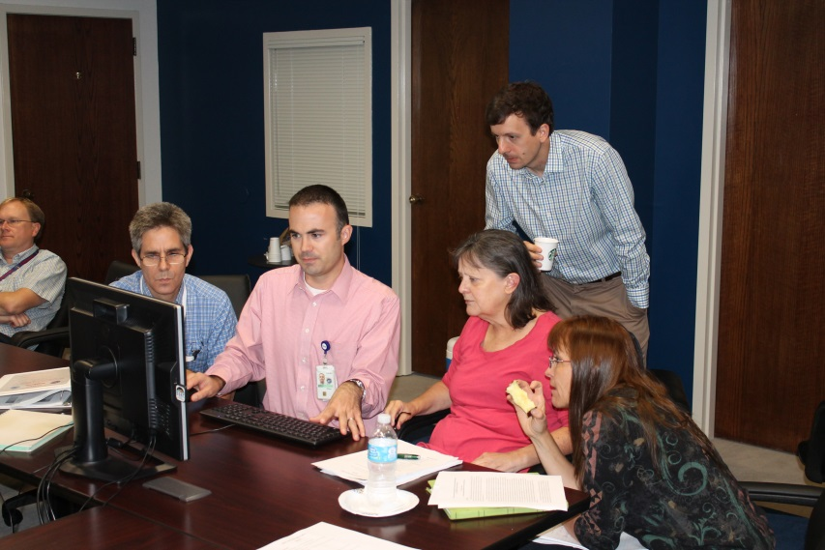
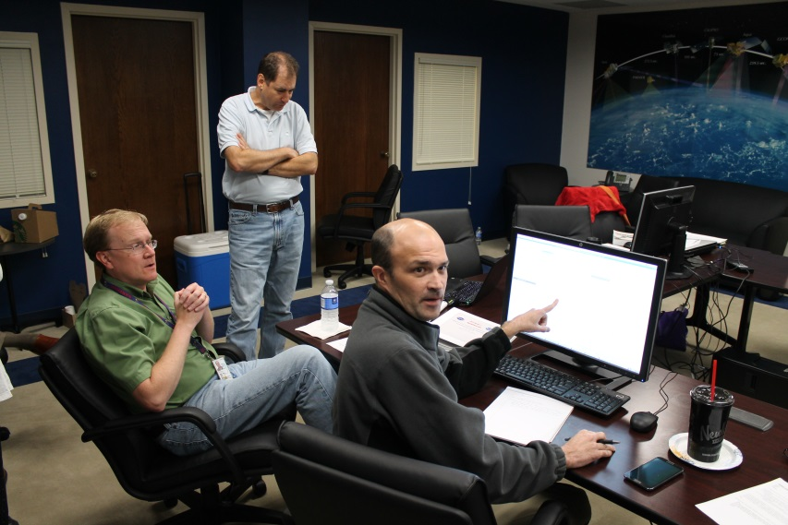
Code Sprint Development
EPDT subgroups worked on projects
Tracking Meteogram
Base-lined 15.1.1
RGB Recipe
Working on base-lining
mPing ingest and display
Moving toward base-lining soon.
GOES-R product ingest
Developing GLM ingest

Slide 10
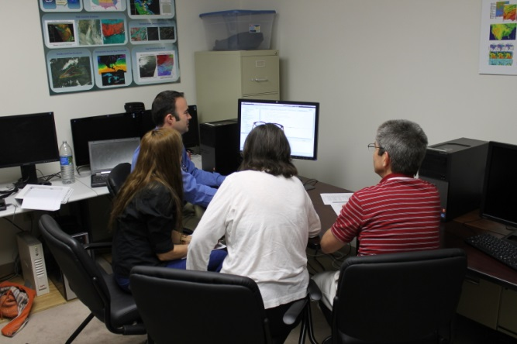
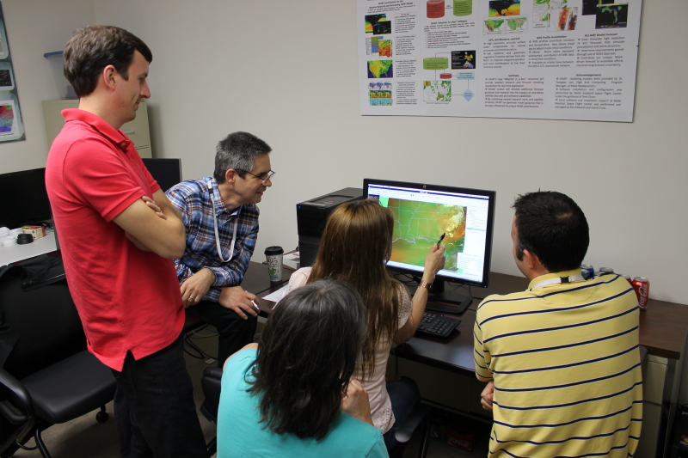
RGB Recipe Project
Identified current deficiency in AWIPS II true color imagery display
All EUMETSAT Recipes implemented
Air mass (VIIRS/CrIS)
Dust
Nighttime Microphysics
RGB Composites
Natural Color composite
Snow Cloud composite
VIS/VIS/IR composite
Can be used in 14.3.1, only localization needed
Implemented at WFO HUN
MODIS RGBs
Dust
NtMicro
24-hr Micro 24-bit RGB
VIIRS RGBs
Dust
NtMicro
24-hr Micro 24-bit RGB
Python code to be base-lined to provide ability to wider community (Working with SEC NWS)
Testing RGBs in OPG in early Fall 2015

Slide 11
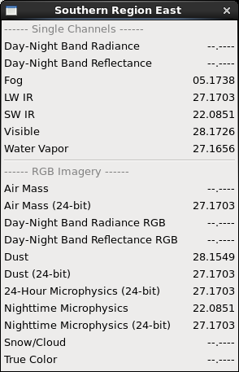
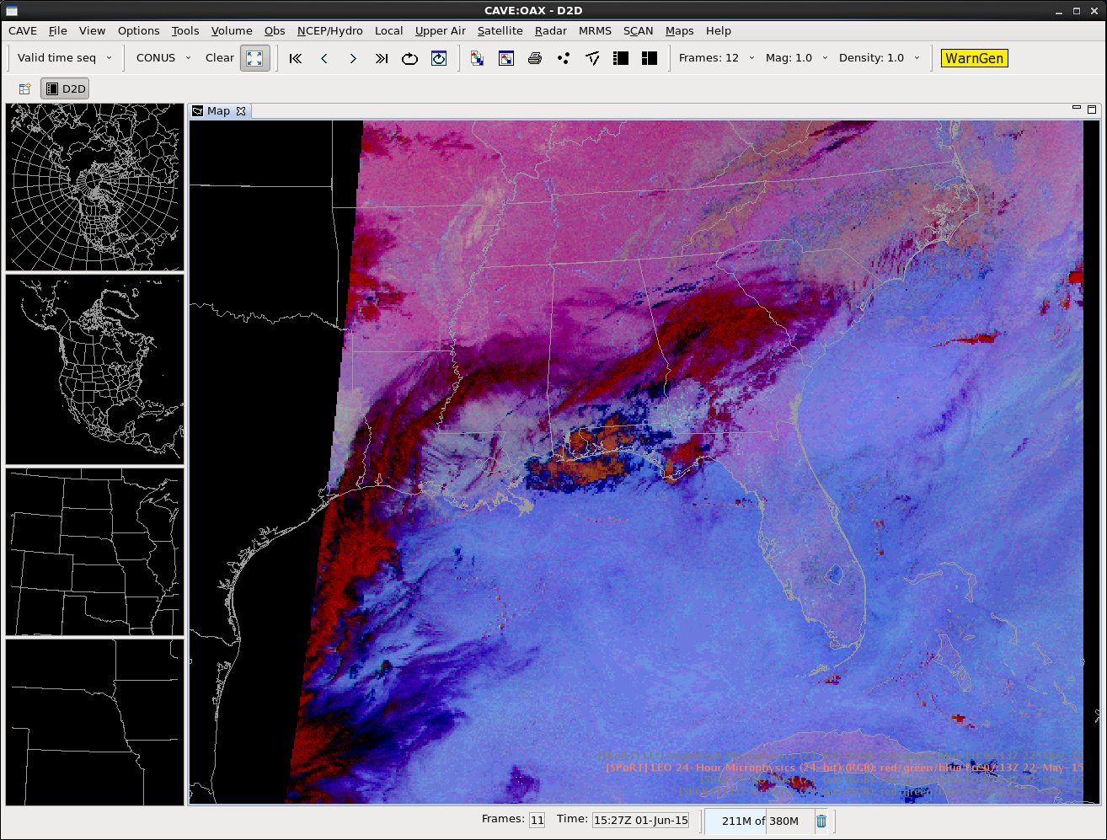
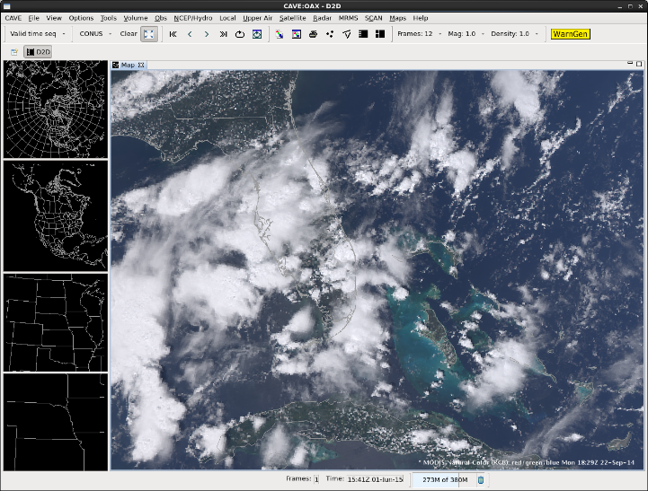
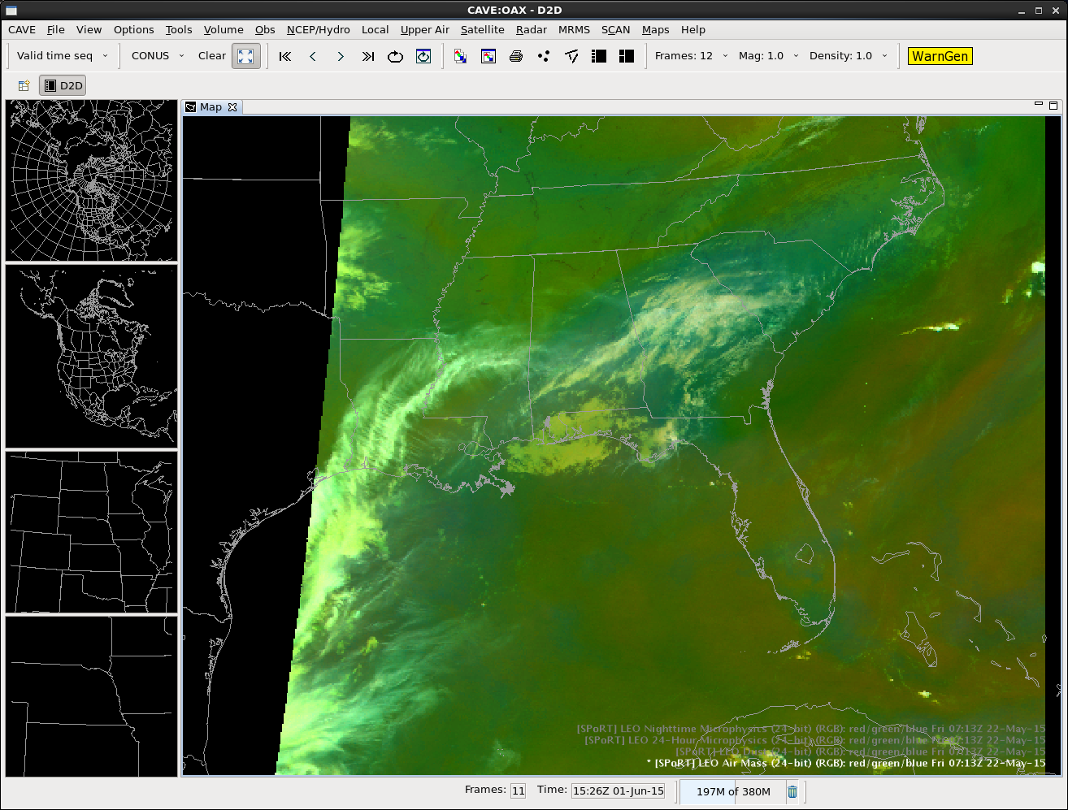
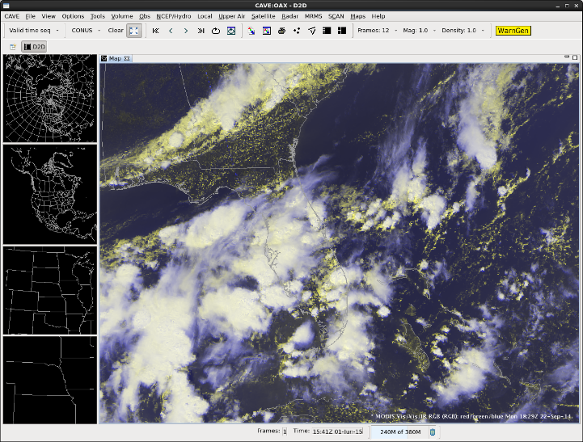
RGB Display at WFO HUN
MODIS 24Hr Micro
MODIS True Color
MODIS Airmass
MODIS Vis/Vis/IR

Slide 12
Benefits of EPDT
Expanded AWIPS II development knowledge in community
Helps NWS to assist in integration tasks from product developers
Direct Plugin development
Continued development keeps community up on technology within AWIPS II

Slide 13
Proposed EPDT Code Sprint development
RGB Localization Editor
Visual manipulation of RGB components
Drag and Drop interface
Just in Time Training plugin for AWIPS 2
Meet with product developers to address specialized needs

Slide 14
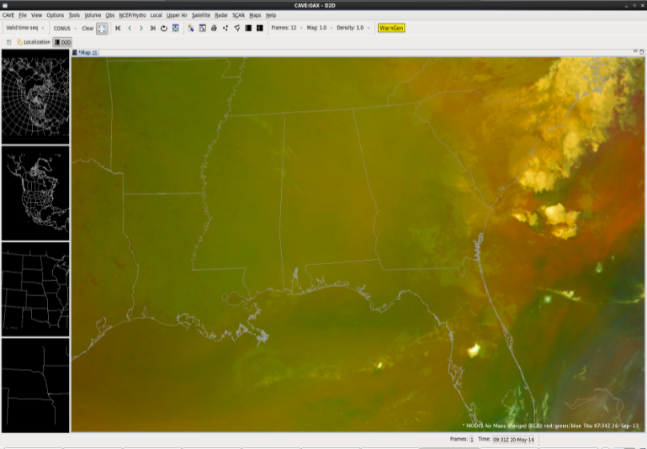
RGB Localization Editor
Python Derived Parameters
Air Mass RGB Recipe (XML)
6.2μm
AWIPS II
Visualization
Difference
A
B
Output
7.3μm
Difference
9.7μm
A
TrueColor Vis
Plug-in
B
Output
10.8μm
Invert
24-bit Air Mass
A
Output

Slide 15
RGB Localization Editor

Slide 16
Just in Time Training Concept
Training on product
Color
Density
Magnification
Sampling

Slide 17
Future EPDT
Group C Code Sprint Fall 2015
Previous EPDT Members continue to work on AWIPS II
Code Sprints to address GOES-R display and ingest needs
JPSS Proposal funding to host code sprints to address JPSS needs
Previous EPDT members have real world experience troubleshooting problems in AWIPS II

Slide 18
Questions

