Slide 1
Cloud Products in the GOES-R and JPSS Era; Current Applications and Opportunities for Growth
Andrew Heidinger, NOAA/NESDIS@CIMSS

Slide 2
Outline
Baseline Products (Where we are)
Cloud Product Review
Cloud Product Uses/Users
Areas of Growth (Where are going)
Cloud Cover Layer Applications
New Applications of the Cloud Optical Properties
Improving the Retrievals using New Data Sources

Slide 3
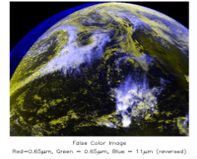
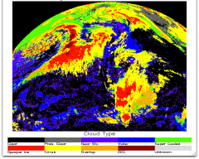
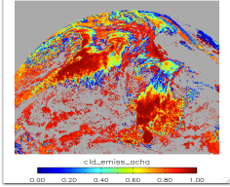
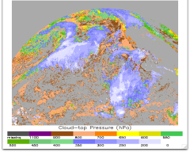
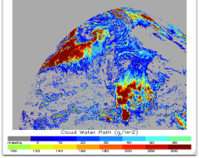
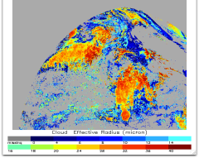
Cloud Product Review
We make 11 L1RD products. These fall into 4 general categories
classify cloud
mask, phase, type
the mass of water/ice
Optical depth, emissivity, water path
the vertical extent
height, pressure, temperature, fraction by vertical layer, base
cloud-top particle sizes
effective radius, IR microphysical index.
We successfully demonstrated that we meet the L1RD specs on many of the current sensors.
The AWG uses complex retrievals that rely on RTM and NWP information but meet the real-time every pixel requirement
Baseline Product Examples GOES-15
False Color
Classify: Type
Mass: Emissivity
Vertical Extent: Pressure
Mass: Cloud Water Path
μ-physics: Particle Size

Slide 4
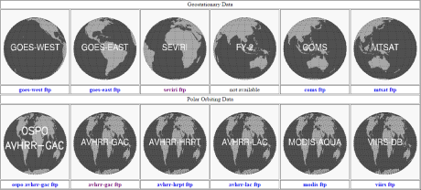
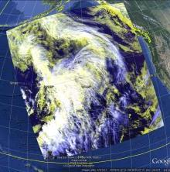
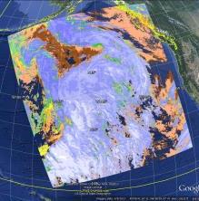
Cloud Product Uses/Users
Traditionally, many applications would use imagery metrics that were related to cloud products in other applications (i.e. BTD values for cirrus screening)
This has changed recently and many of the baseline cloud products feed into other applications including
Aircraft icing
Fog
AWV’s
Convective Applications
More applications use cloud products than any other AWG team’s products.
Many of these applications are pushing the development of the algorithms.
Cloud drift winds need accurate height assignments at cloud edges.
Real-time feeds
NOAA ESRL (RAP and LAP)
University of Alabama / Huntsville
NSSL
NWS AWC (CIMSS LDM)
NREL (Solar Energy Forecasting)
CIMSS Cloud Website showing supported sensors
VIIRS DB data processed in CLAVR-x/CSPP
real-time from CIMSS
False Color
Cloud Top Pressure

Slide 5
Examples of NWS-relevant Research Related to Cloud Products
Cloud Cover Layer Applications
New Applications of the Cloud Optical Properties
Improving the Retrievals using New Data Sources

Slide 6
Cloud Cover Layer Applications

Slide 7
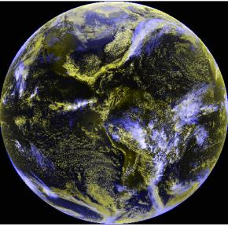
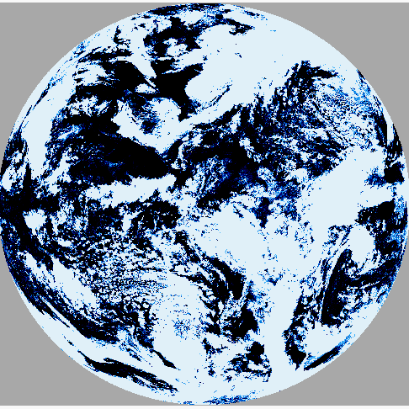
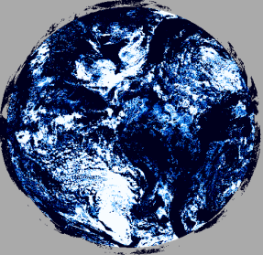
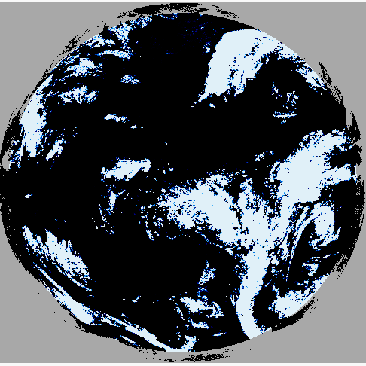
Cloud Cover Layers (CCL)
CCL is an option-2 product selected by NOAT for activation.
CCL reports the presence of cloud in 3 layers.
NOAT suggested modifications to CCL.
Match levels to 4 standard FLs
Include other fields like identifying convective cloud and super-cooled liquid water.
We have experimentally modified the baseline code to match the 4 FLs
We are waiting on direction if proceed with delivery to AIT/Ground System and with other extensions.
We appreciate the feedback/direction.
Total Cloud Amount
GOES-13 False Color
FL 100 Cloud Amount
FL 240 Cloud Amount

Slide 8
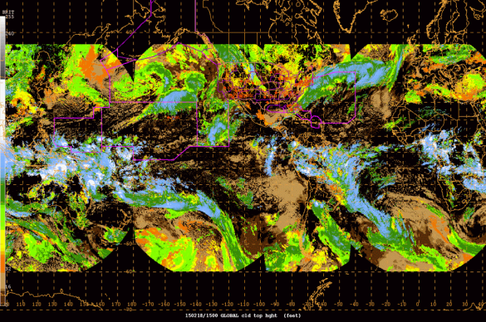
CCL and Global Cloud Altitude for AWC
NAWIPS Display of Global Geo Cloud Altitude
In 2013 AWC requested global composites of the AWG cloud height from the current geo constellation.
Done at CIMSS via PG.
We do this for GOES E/W, MSG, COMS and MTSAT. AHI in testing.
Amanda Terborg reports:
“It provides an easy, on the fly tool to identify which tops are above the FL200-FL250 threshold that requires a SIGMET”
“ they were curious if it would be possible to identify only convective cloud tops.”
Would like a high temporal resolution CONUS Display from GOES E/W
This product is a pressure altitude in kilo-feet. This differs from the baseline product and requires a code change. SPSRB request submitted for this product.
A similar in-cockpit display on IPads being explored at CIMSS

Slide 9
Detecting Convective Clouds in CCL
AWC and the NOAT have asked for us to identify areas of convection
We have implemented a scheme to detect deep convection by
11 υm brightness temperatures close to the tropopause temperature
6.7 – 11 υm brightness temperatures > -2K
We are implementing temporal tests to help identify active convection.
Examples are shown below from same Global Geo data sent to AWC. (2 days total)
11 um BT (K)
Deep Convection Mask
K-Index (Instability) from GFS

Slide 10
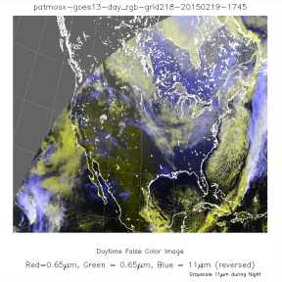
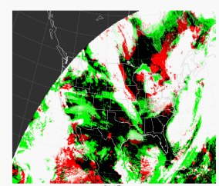
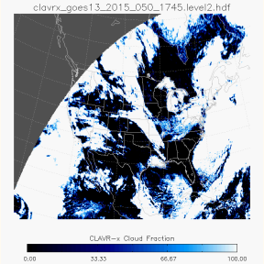
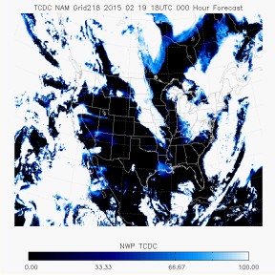
CCL Comparisons to NCEP Models
NESDIS has sent H/M/L cloud fractions to NCEP for model verification for 15+ years.
At CIMSS, Jay Hoffman has set up an automated web tool to interrogate CCL from GOES E/W and the NCEP NAM model.
We would like to include GOES-R H/M/L amounts into the RTMA/URMA
The CIMSS Sky Cover uses the same GOES E/W processing.
Satellite – NCEP NAM

Slide 11
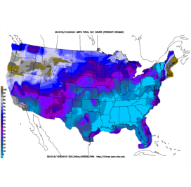
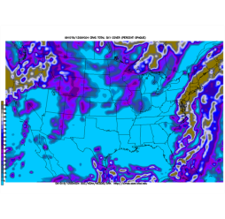
Using GOES to Generate Sky Cover (%) for the National Weather Service’s Real Time Mesoscale Analysis (RTMA)
Effective Cloud Amount (ECA), retrieved from the GOES-13/15 sounders, is currently used to populate the hourly, 5 km resolution, sky cover grid in the RTMA. This is a proxy at best.
A new algorithm is needed that uses GOES imager channels at 1 km resolution, forward calculated radiative transfer and spherical geometry to improve sky cover accuracy for all cloud regimes.
The algorithm must include a forward model that calculates sky cover using inputs from a forecast model. This will allow verification of sky cover forecasts from the operational models.
15-hour forecast sky cover (%) generated by the NWS forecast offices for the NDFD valid 12UTC Oct 19, 2009. Note discrepancies between forecast offices.
24-hour forecast sky cover derived from model output valid 12UTC 19 Oct, 2010.
A new sky cover algorithm is currently being used at the Cooperative Institute for Meteorological Satellite Studies to generate sky cover in real time. It is being evaluated by the NWS Office in Milwaukee.
Validating IR image from GOES-13 valid 12UTC 19 Oct, 2009.
(Courtesy of Robert Aune)
Notes:
11
1. Storm Reports (top right) from the Storm Prediction Center indicate severe storms that were observed on February 10, 2009.
2. The image below shows a 4-hour nearcast of de-stabilization forming in Central Oklahoma. Larger values of instability (mm differences) indicate a greaster potential for severe weather.

Slide 12
New Applications of the Cloud Optical Properties

Slide 13
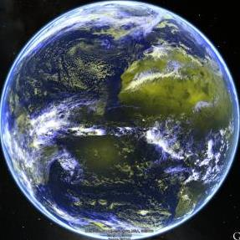
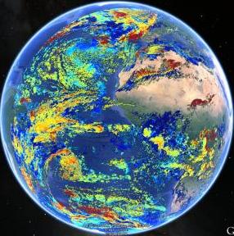
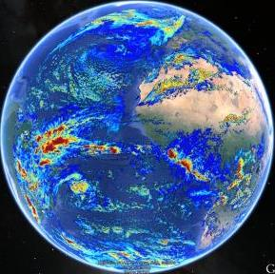
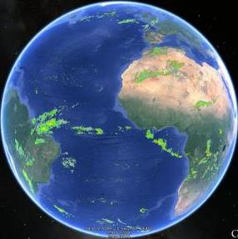
Cloud Optical Products and Precipitation
Cloud optical depth and particle size are standard L1RD products and meet their specifications.
But images of these products in general are not informative in AWIPS.
However, we can translate them into other quantities, namely precipitation, using simple relationships from the microwave community.
This precip product is limited but complements IR and microwave.
This translates the baseline optical depth and particle products into an AWIPS image relevant to a forecaster.
This product is successful in European forecast offices. (KNMI especially – GOES-R VSP 2014)
Particle Size
Cloud Water Path
Rain Rate From Cld Prod.

Slide 14
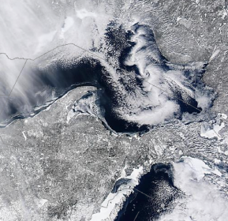
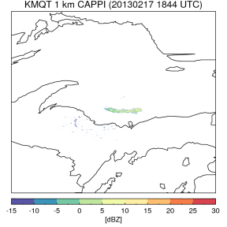
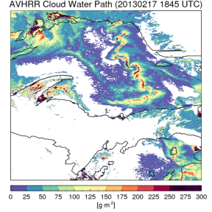
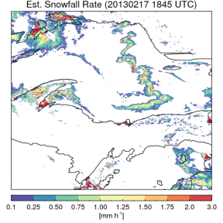
Application of Cloud Products for Snow
Lake effect snow bands are shallow and are often missed by radar.
Like rain, cloud products offer skill in snow detection and characterization.
M. Kulie compared satellite cloud products and radar in overlap regions.
Resulting snow rate is shown on lower right.
Good example of transforming cloud properties into a useful metric for NWS.
Mark Kulie, CIMSS

Slide 15
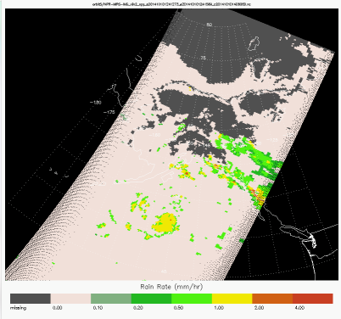
NLCOMP: Filling the Arctic winter gap: Precipitation
With the success of the JPSS-RR VIIRS DNB Cloud Project, we can also do this at night
ATMS sensor on NPP provides MW–based rain rate
Quantitative rain rate estimates from VIS/NIR algorithms ( Roebeling 2009)
- less physical retrieval
+ much higher spatial resolution
( 750m vs 35km )
Andi Walther, CIMSS
Notes:
Arctic winter: no COD/REF for a long time. Now we have .. Advantages: higher resolution, MW more physical, but low resolution.. Future: hybrid? Or using as test / train data ..
Other example : icing… etc..

Slide 16
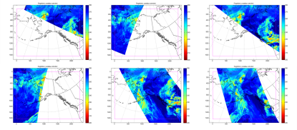
Alaska Composites of Cloud Products
Over Alaska, polar orbiter data is frequent but asynchronous with varying viewing angles and spatial resolutions.
Tony Wimmers has applied “optical flow” to composite polar and geo data to make polar orbiter data more useful for forecasters.
This applied to cloud height but it applicable to many products.
Does not “fix” artifacts due to algorithm performance on different sensors.
AVHRR 11μm Tb, 22 May 2013 0330 to 0630
AVHRR Cloud Height Composited Image
see Tony Wimmers’ Poster
Tony Wimmers (CIMSS)

Slide 17
Improving the Retrievals Using New Data Sources
VIIRS Day-Night-Band project is in its last year of JPSS-RR and we demonstrated day-time like performance for some key baseline cloud edrs.
VIIRS lacks some channels needed for accurate cloud detection and height estimation. We are developing a technique to use CrIS with VIIRS for improvements (JPSS-RR Proposal being drafted)
As shown earlier, ATMS cloud & precipitation products are highly complementary to those from VIIRS. We are exploring this synergy for CCL and icing.

Slide 18
Conclusions
Baseline product mission is accomplished
Cloud products are being used in more and more applications (probably due to a combination of product trust and availability).
Algorithms have evolved recently based mainly on interactions with meeting needs of other Applications.
Several new applications should have NWS relevance
Alaska Composites
Cloud Cover Layers
VIIRS DNB
Model Verification of Cloud Fractions
CSBT – Radiance Assimilation
Process to implement improvement into NESDIS Ops unclear

Slide 19
Extra Material Follows

Slide 20
Using Cloud Products to Improve Radiance Assimilation for GOES-R
CIMSS/NESDIS makes the Clear-Sky Brightness Temperature (CSBT) product.
Generated at 50 km resolution and used by ECMWF.
Uses a standard cloud mask applied to all IR BT values (middle)
GOES-R provides many more channels and high temporal/spatial resolution.
We developed a channel dependent mask that uses cloud height and clear-sky transmission functions to make an optimal mask (right).
AHI Demonstration will be delivered to ECMWF in Summer 2015.
6.7 μm Brightness Temp.
Standard Mask
Channel Dependent Mask

Slide 21
NLCOMP: Filling the Arctic winter gap: Precipitation
With the success of the JPSS-RR VIIRS DNB Cloud Project, we can also do this at night
ATMS sensor on NPP provides MW–based rain rate
Quantitative rain rate estimates from VIS/NIR algorithms ( Roebeling 2009)
- less physical retrieval
+ much higher spatial resolution
( 750m vs 35km )
Andi Walther, CIMSS
Notes:
Arctic winter: no COD/REF for a long time. Now we have .. Advantages: higher resolution, MW more physical, but low resolution.. Future: hybrid? Or using as test / train data ..
Other example : icing… etc..

