Slide 1
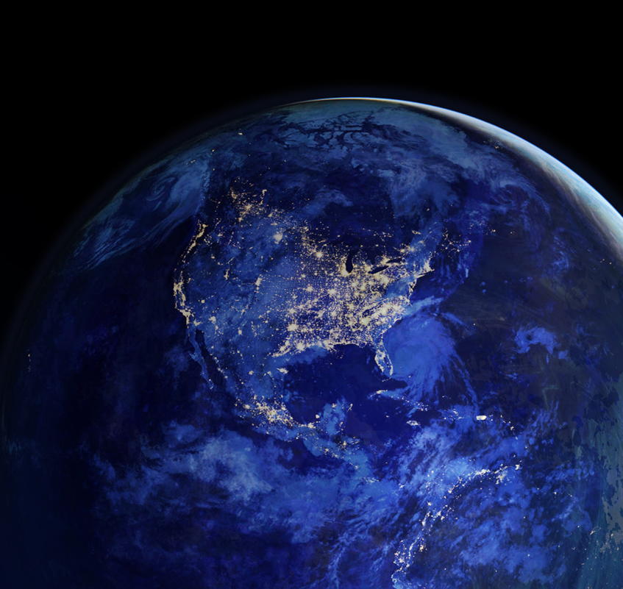
NOAA as the NATION’S ENVIRONMENTAL INTELLIGENCE AGENCY A Chief Scientist’s Perspective
Rick Spinrad, Ph.D., CMarSci
Chief Scientist
National Oceanic and Atmospheric Administration | NOAA
NOAA Satellite Science Week
Boulder, CO
March XX, 2015

Slide 2
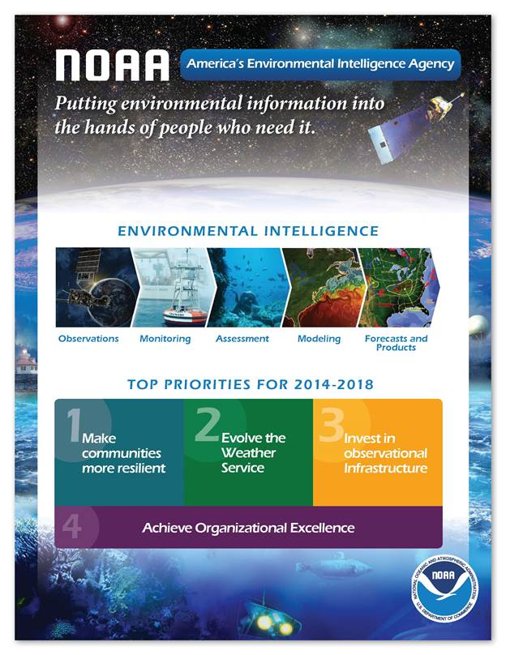
SCIENCE-BASED SERVICE AGENCY

Slide 3
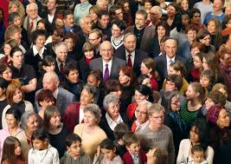
CHIEF SCIENTIST
OSTP
CONSTITUENTS
18-year gap
1996
2014

Slide 4
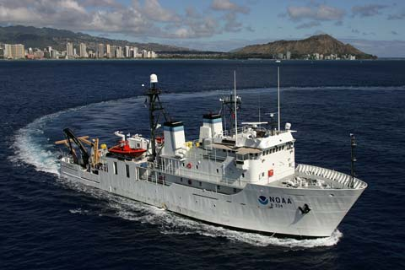
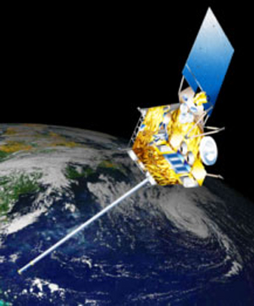
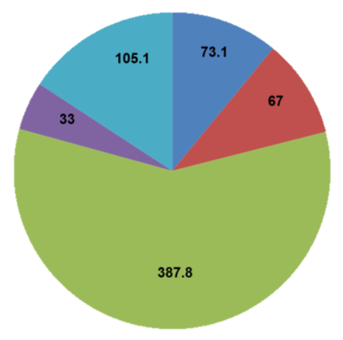
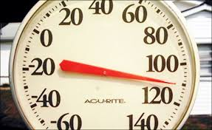
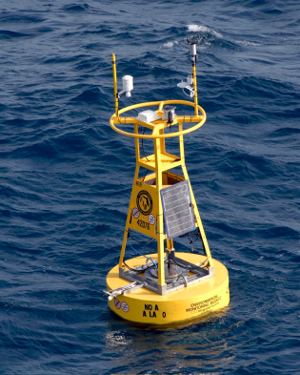
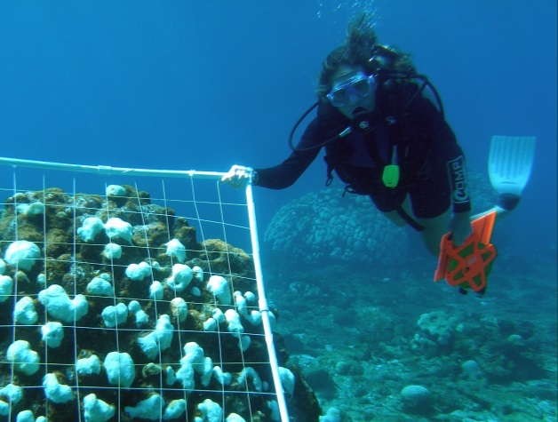
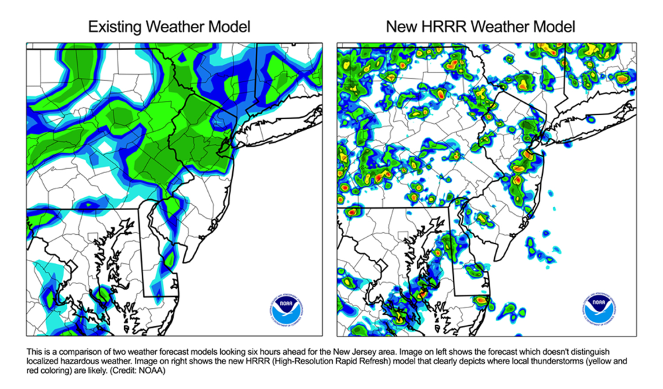
INCREASING AND INSTITUTIONALIZING THE EFFECTIVENESS OF NOAA’s RESEARCH
INVESTMENT
COLLABORATION
Cross-LO/program
CI, SeaGrant, etc.
TRANSITION (R2X)

Slide 5
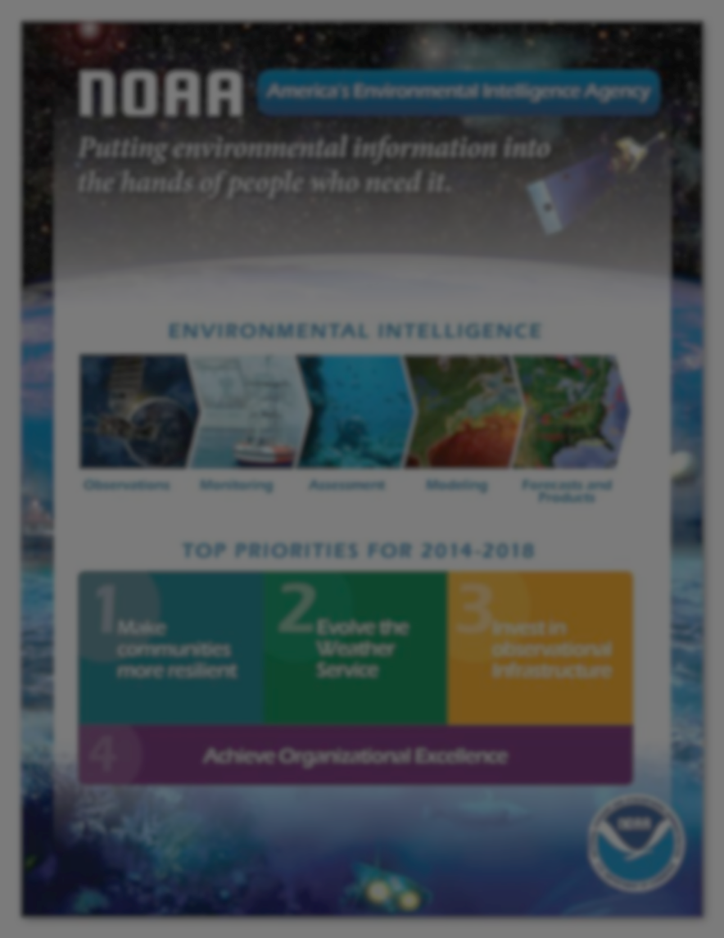
STRATEGIC RESEARCH GUIDANCE FUNCTIONS
Guides research to meet NOAA’s mission needs and priorities
Optimizes research investments (programs, personnel, infrastructure etc.)
Assess portfolio performance
…today and in the future

Slide 6
CHIEF SCIENTIST
OSTP
CONSTITUENTS
18-year gap
1996
2014

Slide 7
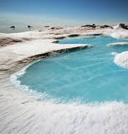
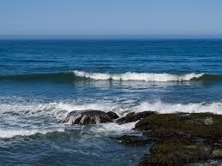
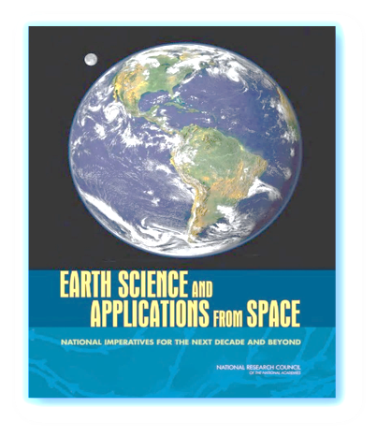
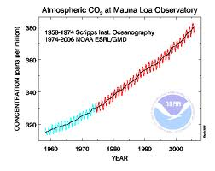
NATIONAL POLICY DRIVERS
REMOTE
SENSING
CLIMATE
EO
ARCTIC
OCEAN
?
President’s Climate Action
Plan
National Plan on
Civil Earth
Observations
National Strategy for the Arctic Region
National Ocean Policy
NRC Decadal
Survey

Slide 8
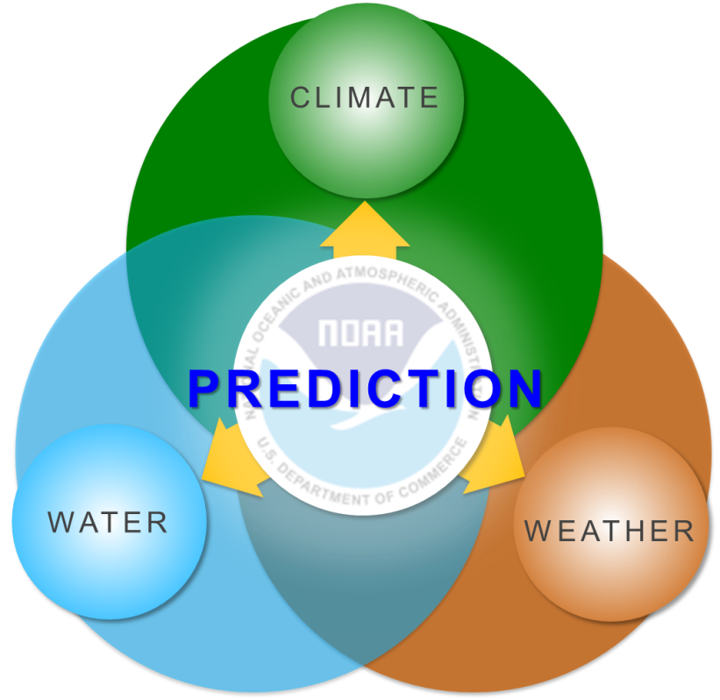
NOAA’s PREDICTIVE CAPABILITIES

Slide 9
DESIGN REQUIREMENTS
Precision and accuracy
Global coverage
Adequate density
Attribution (geographically and by process, i.e., natural vs. anthropogenic)
Calibrated to a common data standard
Cost-efficient
Integrated
Interoperable, discoverable
Coordinated across federal agencies
Transparent
…meeting societal requirements
9

Slide 10
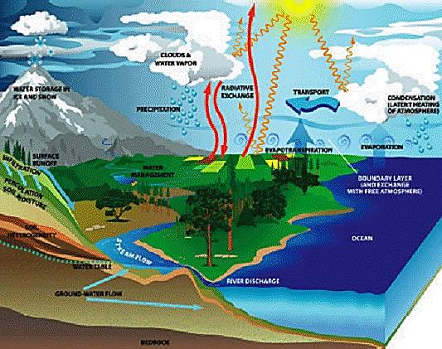
TOTAL WATER PREDICTION

Slide 11
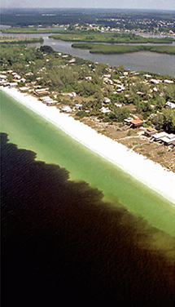
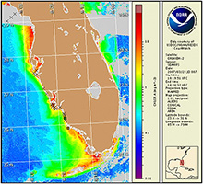
ECOLOGICAL FORECASTING
MODIS
EARLY WARNINGS for HARMFUL ALGAL BLOOMS

Slide 12
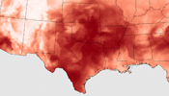
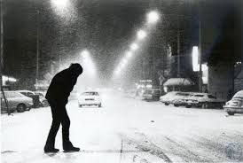
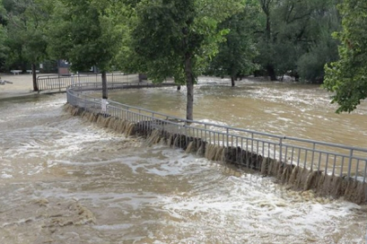
SCIENTIFIC CHALLENGE
Long-range Climate Prediction
MID-RANGE FORECASTING
Short-range prediction
Weeks
Months
Years
Decades

Slide 13
CHALLENGES OF THE FUTURE
Polar follow-on
Diversified observations, e.g. carbon
Sustained observations/monitoring
Public-private sector relations
13

Slide 14
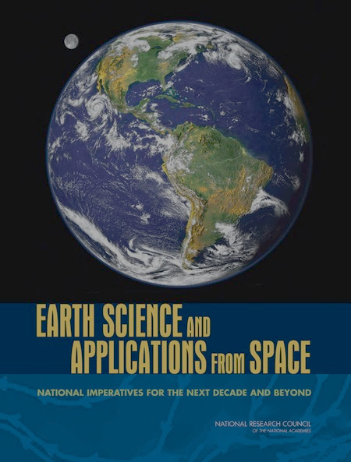
POSITIONING NOAA FOR THE FUTURE
THE NEXT DECADAL SURVEY
2018-2027
Nation’s Earth-system science
Integrated
Sustainable
NASA NOAA/NESDIS
USGS/Geography

Slide 15
Thank you
THANK YOU
15

