Slide 1
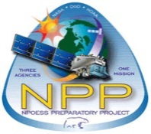
Night Shift Exploring Forecaster Benefits of the VIIRS Day/Night Band
Steve Miller¹, William Straka, III², and Curtis Seaman¹
¹Cooperative Institute for Research in the Atmosphere (CIRA)
Colorado State University, Ft. Collins, CO
²Cooperative Institute for Meteorological Satellite Studies (CIMSS)
University of Wisconsin—Madison
Notes:
Dual Connotations: NWS forecasters working the night shift, and a paradigm shift in our thinking about the night.

Slide 2
Outline & Key Take-Away Points
The VIIRS Day/Night Band: A Brief Primer
On the Prevalence of Nocturnal Light
Appreciation for the Unique Information Content
Examples of Regional Relevance
Thinking Synergistically in the GOES-R + JPSS Era
The Liaisons are Here to Help!

Slide 3
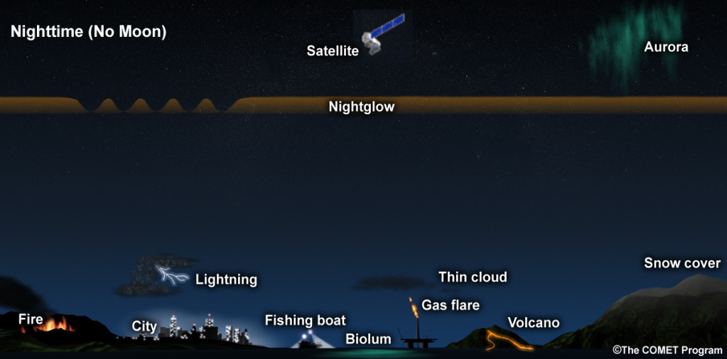
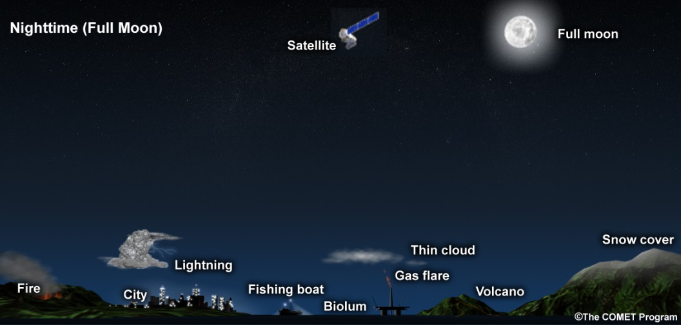
Day/Night Band on Suomi NPP
Spectral: visible/near-infrared (500-900 nm) (among 22 VIIRS bands)
Spatial: ~0.74 km spatial resolution across a ~3000 km wide swath
Sensitivity: dynamic range spanning day to the darkest of nights
Radiometric: 14-bit (16384) quantization → lots of gray shades!
COMET Training Module on DNB: www.meted.ucar.edu/training_module.php?id=990

Slide 4
Key Advantages of NightVis
Clouds, smoke, ash and dust scatter visible light efficiently
Readily detectable against darker land/ocean backgrounds
Allows us to ‘see through’ semi-transparent cirrus
Discern meso- to microscale flow patterns tied to topography & other factors
Snow and ice no longer get the cold shoulder at night
Stand out vividly against snow/ice-free backgrounds
Multi-spectral VIIRS bands can be enlisted to decouple features
The semi-transparency of cirrus helps to reveal additional features
Tripping the light fantastique—DNB sees the human footprint!
An useful proxy for where weather is affecting population centers
Useful in post-storm impact assessments (power outages)
Monitoring of ship activities
Proven utility for search and rescue efforts
The DNB is ‘Lord of the Flame’
Wild land fires, especially small fires
Natural gas flaring
Volcanic activity
Awareness of the many capabilities is the first step toward exploitation…

Slide 5
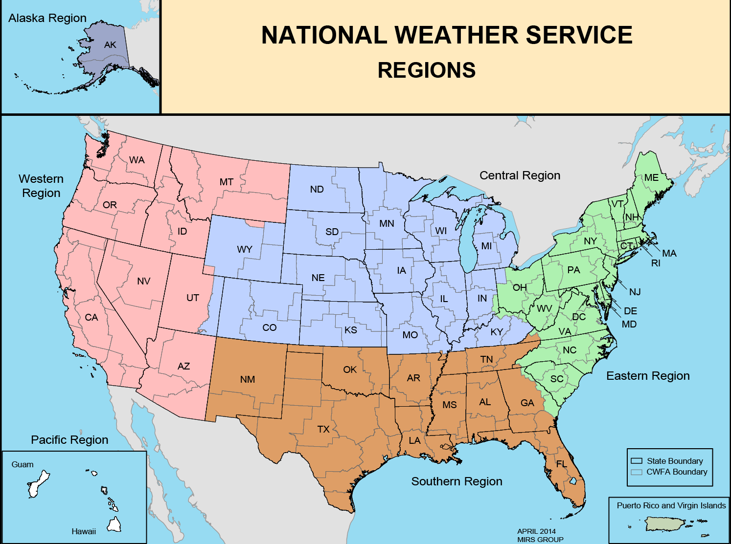
Alaska Region

Slide 6
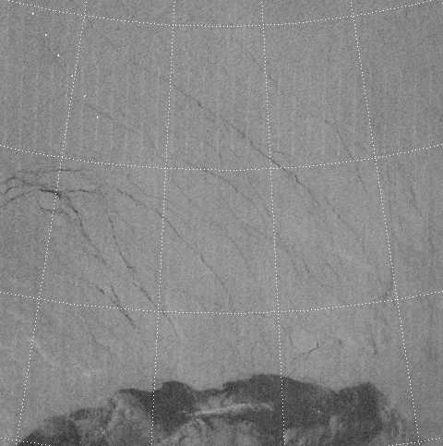
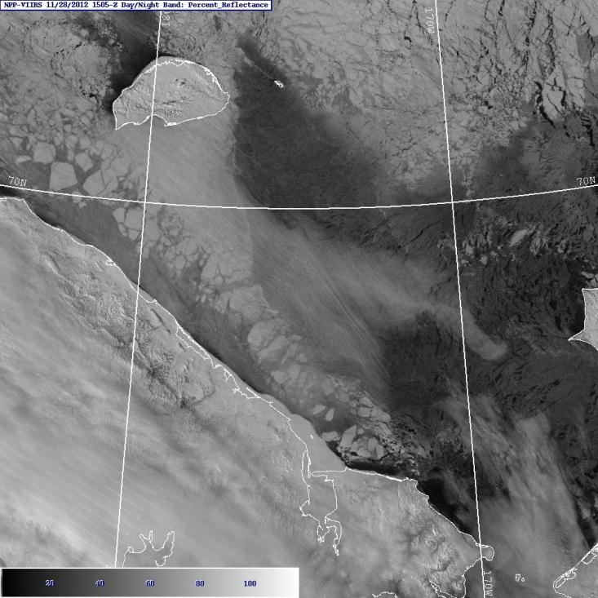
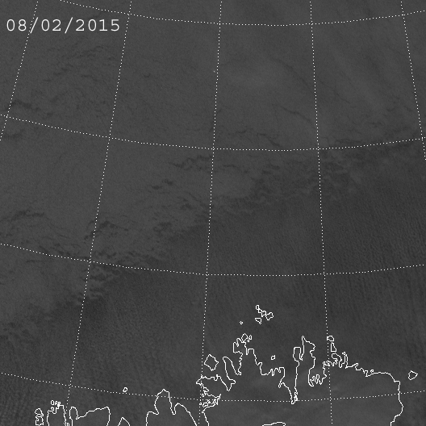
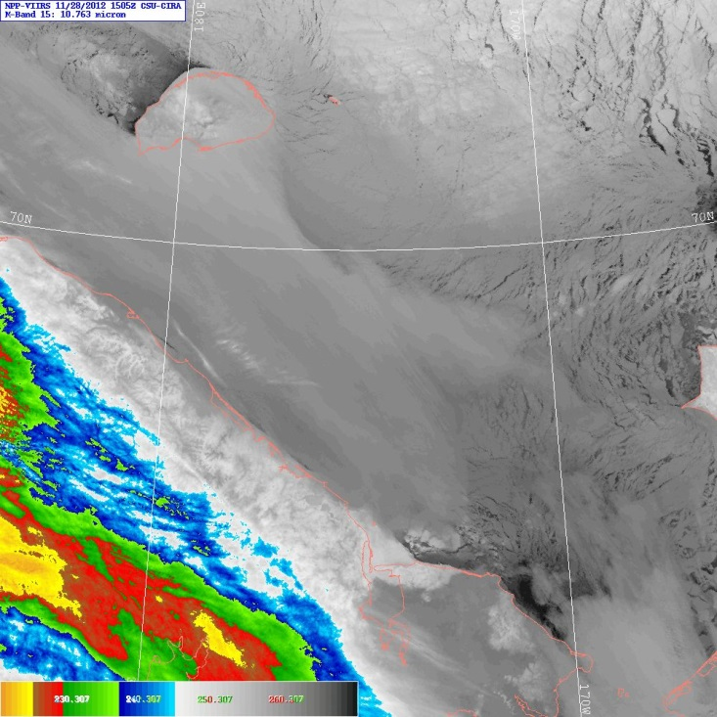
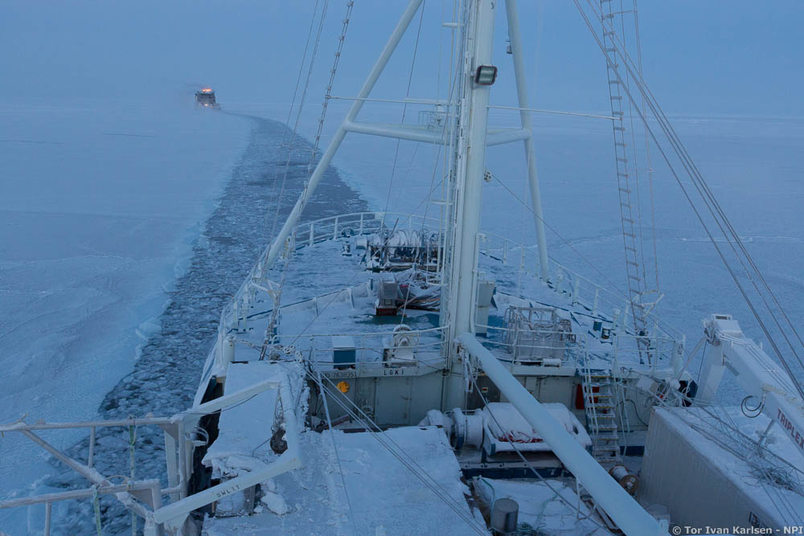
Sea Ice
Ship Lights
2015 Norwegian Young Sea Ice Cruise (N-ICE 2015)
Chukchi
Sea
Sea Ice
RUSSIA
High Cloud
Sea
Ice
Credit: Tor Ivan Karlsen
Many overlapping passes at high latitudes, offering lunar and nightglow illuminated imagery to this “Vis-challenged” Region (in winter).
The “obvious consumer of DNB”, but let’s now consider relevancy to other forecast Regions…
Snow
Cover
Low
Cloud

Slide 7
Western Region

Slide 8
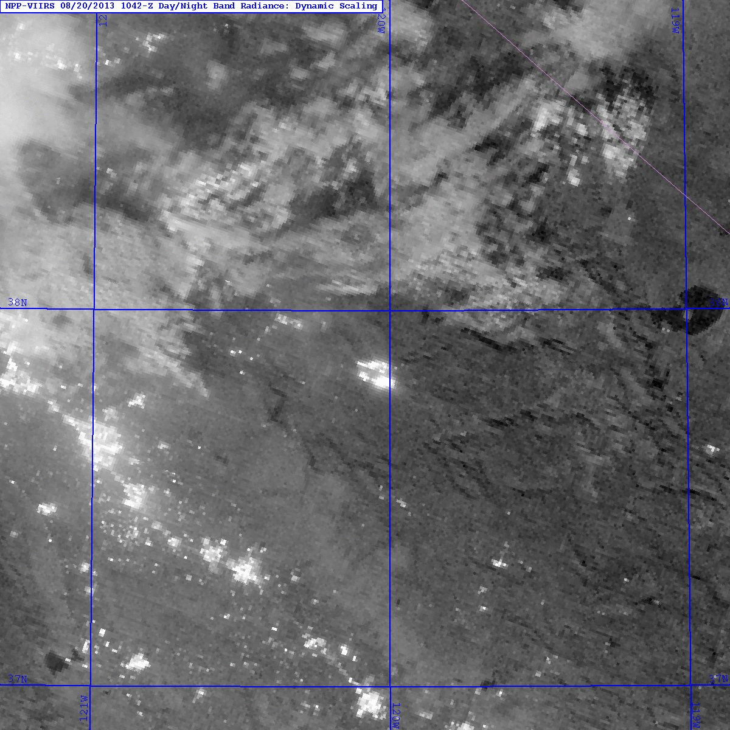
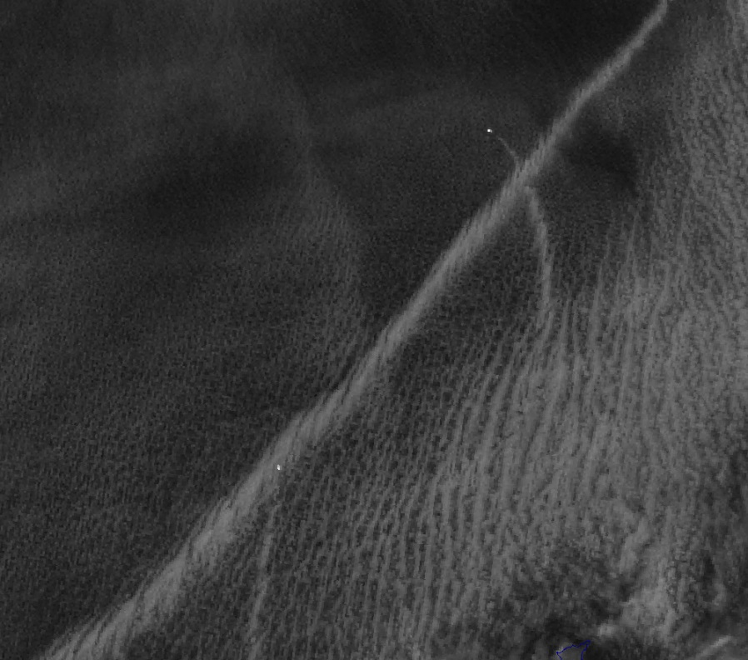
Low Clouds/Fog
Fire & Smoke
Ship Tracks & Lights
Pacific
Ocean
Los Angeles
Ship
Lights
Ship
Tracks

Slide 9
Central Region

Slide 10
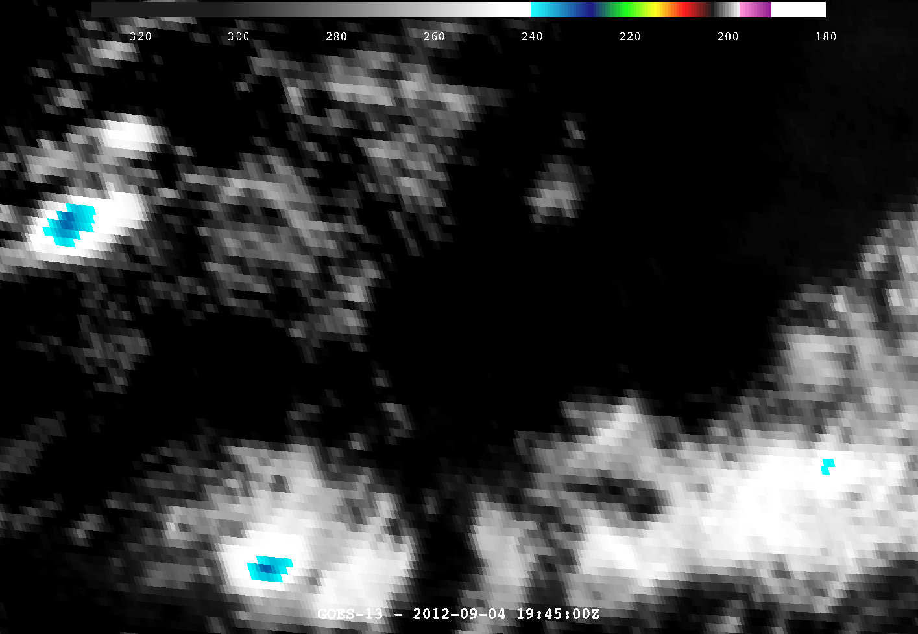
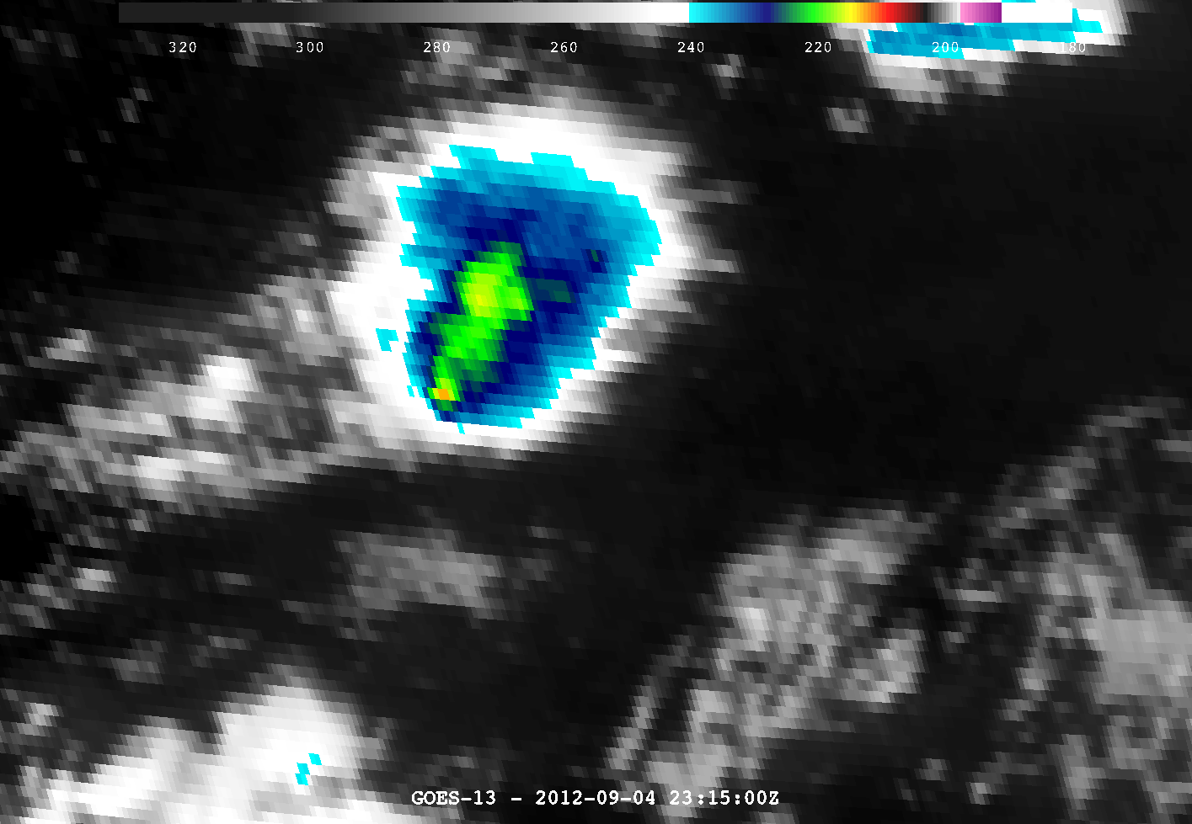
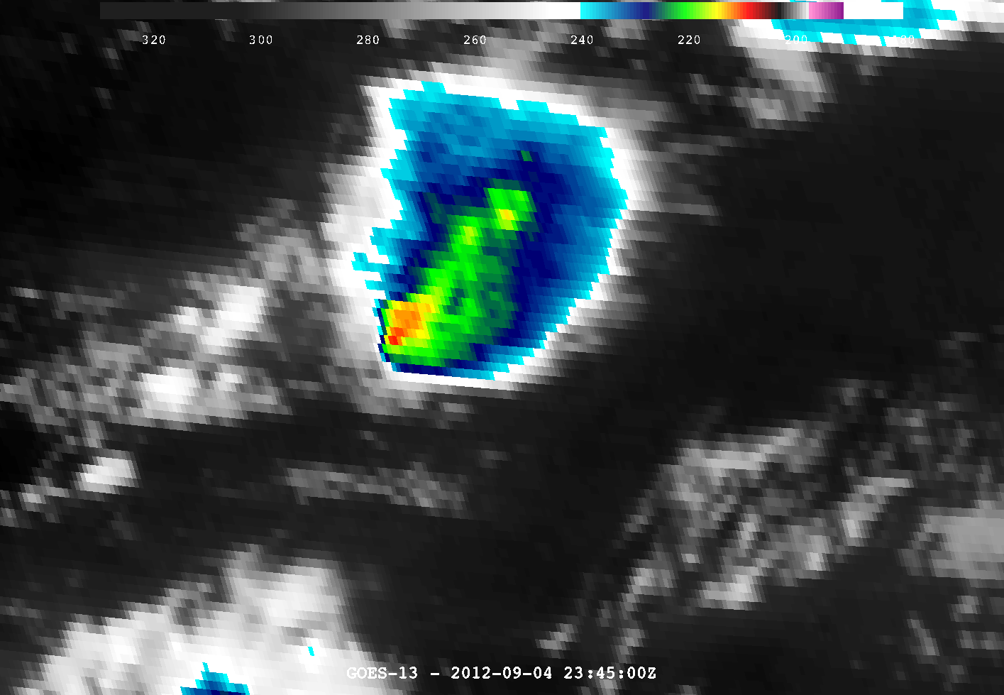
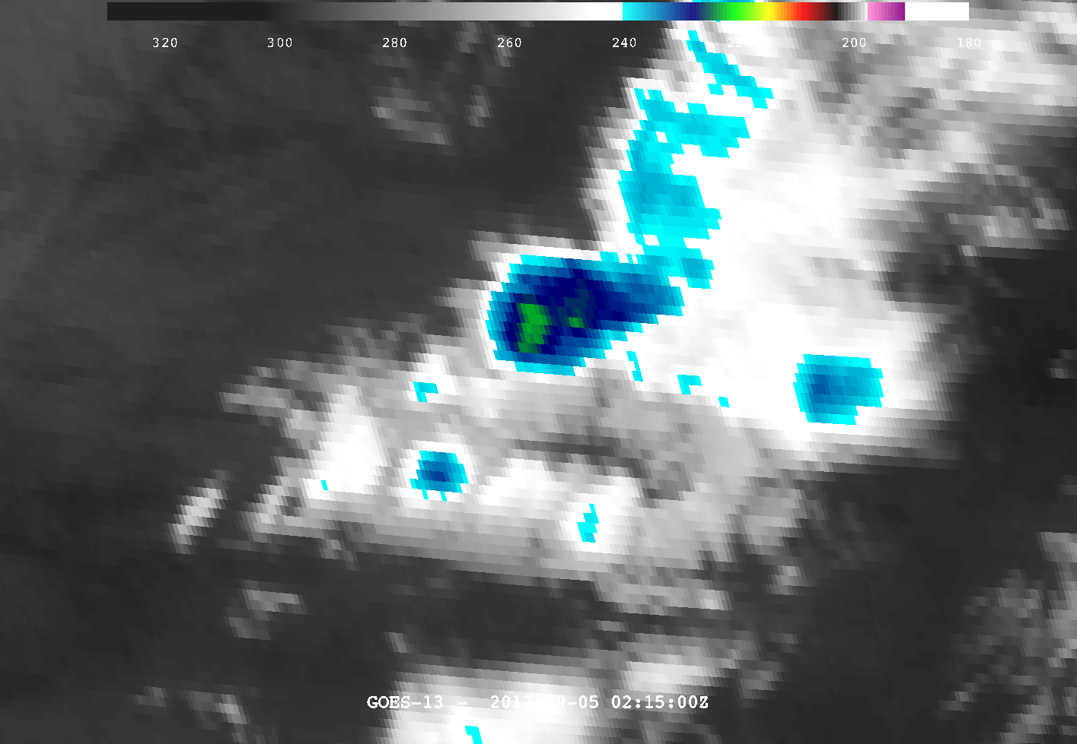
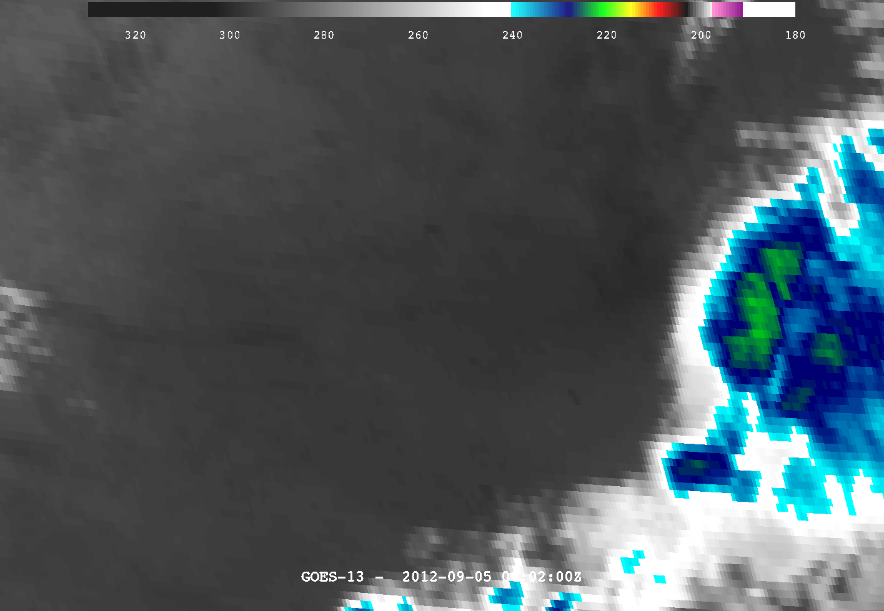
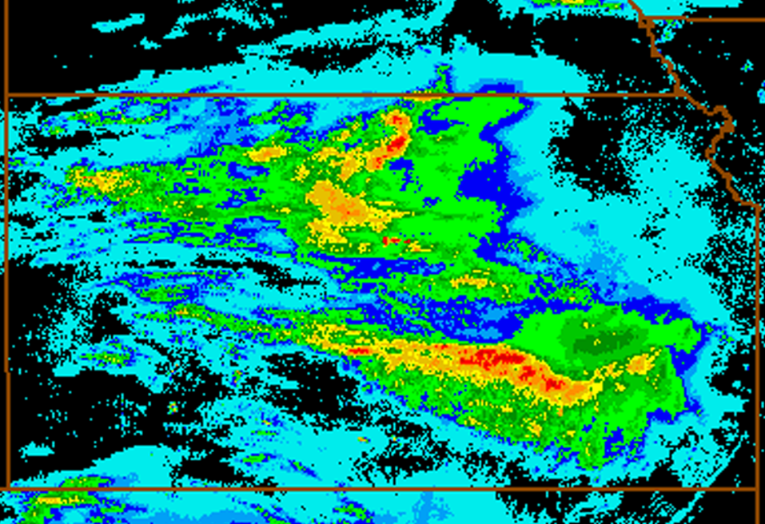
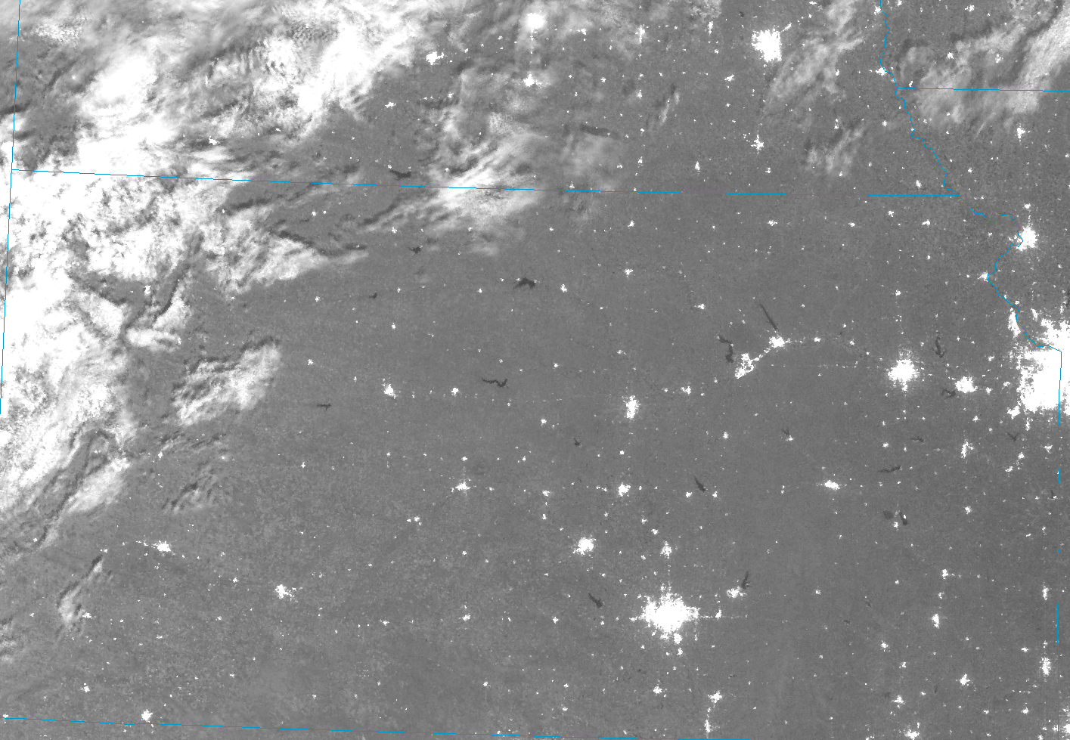
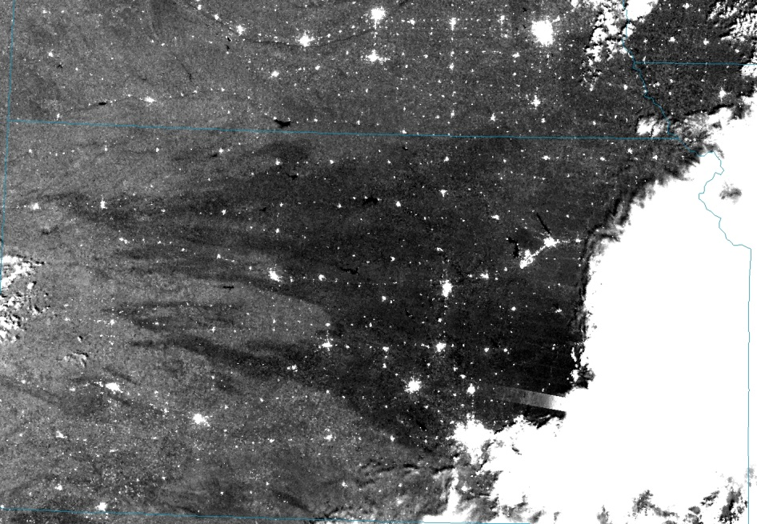
Snow Fields at Night
Soil Moisture Changes
GOES-13 9/4/2012 1945 UTC – 9/5/2012 0215 UTC
12 hr Accumulated Precip (in)
Nebraska
Kansas
Day/Night Band
9/3/2014 0844 UTC
9/5/2014 0806 UTC
→ Combine snow field information with GEO cloud/fog detection to understand context an predict surface temperature.
→ The DNB’s high radiometric resolution (14 bit) enables honing-in on small changes in reflectance, tied here to surface moisture.

Slide 11
Southern Region

Slide 12
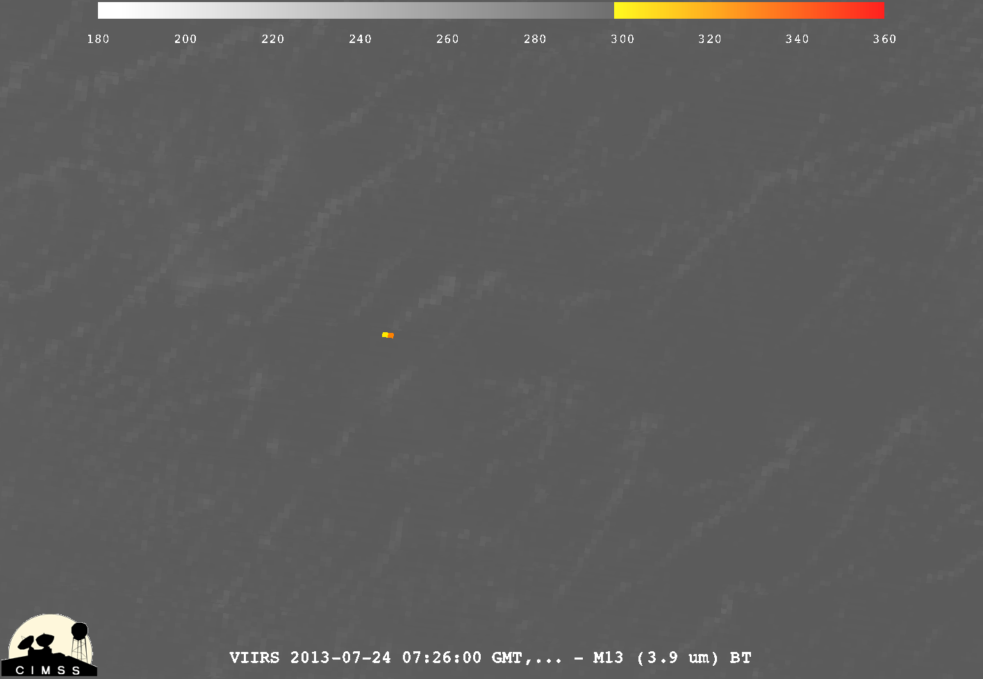
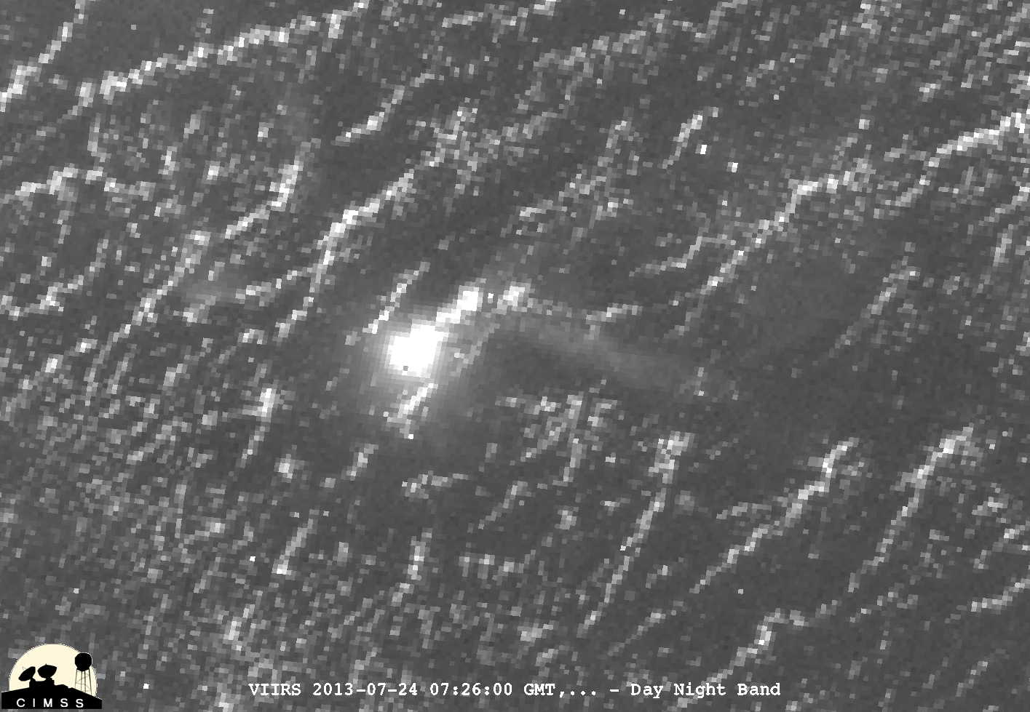
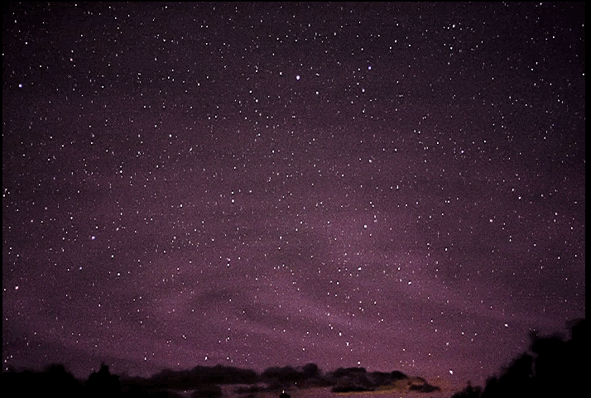
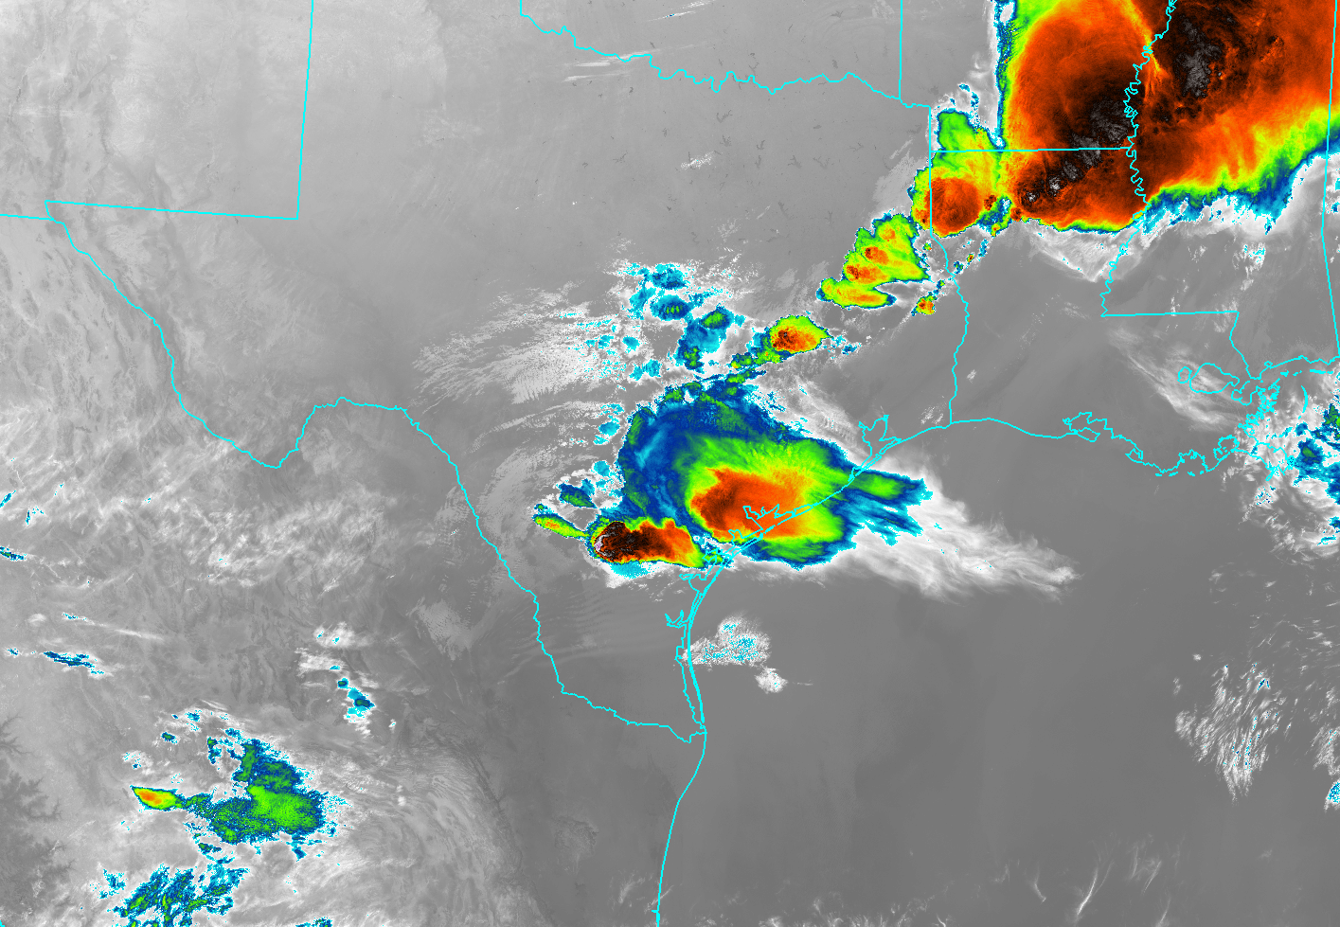
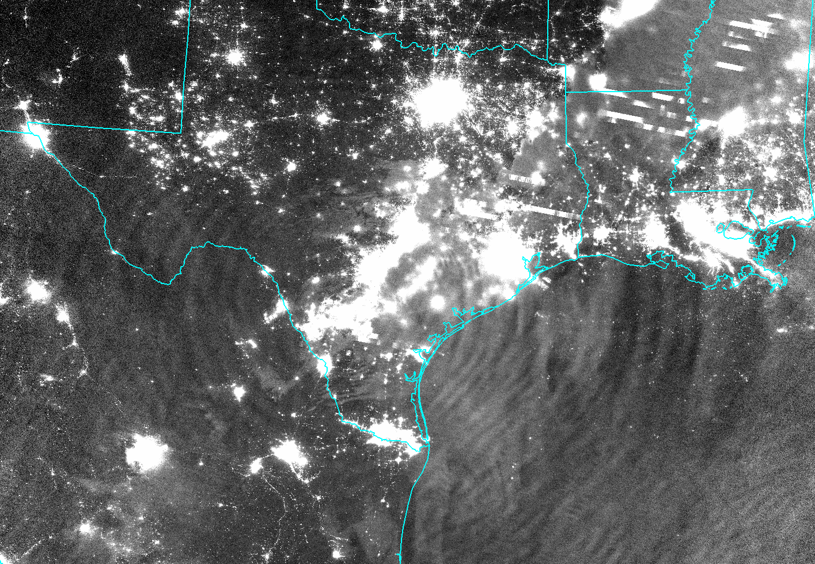
Low Clouds/Fog
Oil Rigs in the Gulf of Mexico
Fire
Nightglow Gravity Waves
Eastward View from Lamy, NM over Texas Panhandle
T. Ashcraft
Notes:
Oil Rig: Hercules #265. VIIRS M13 (3.9 um) vs. DNB

Slide 13
Eastern Region

Slide 14
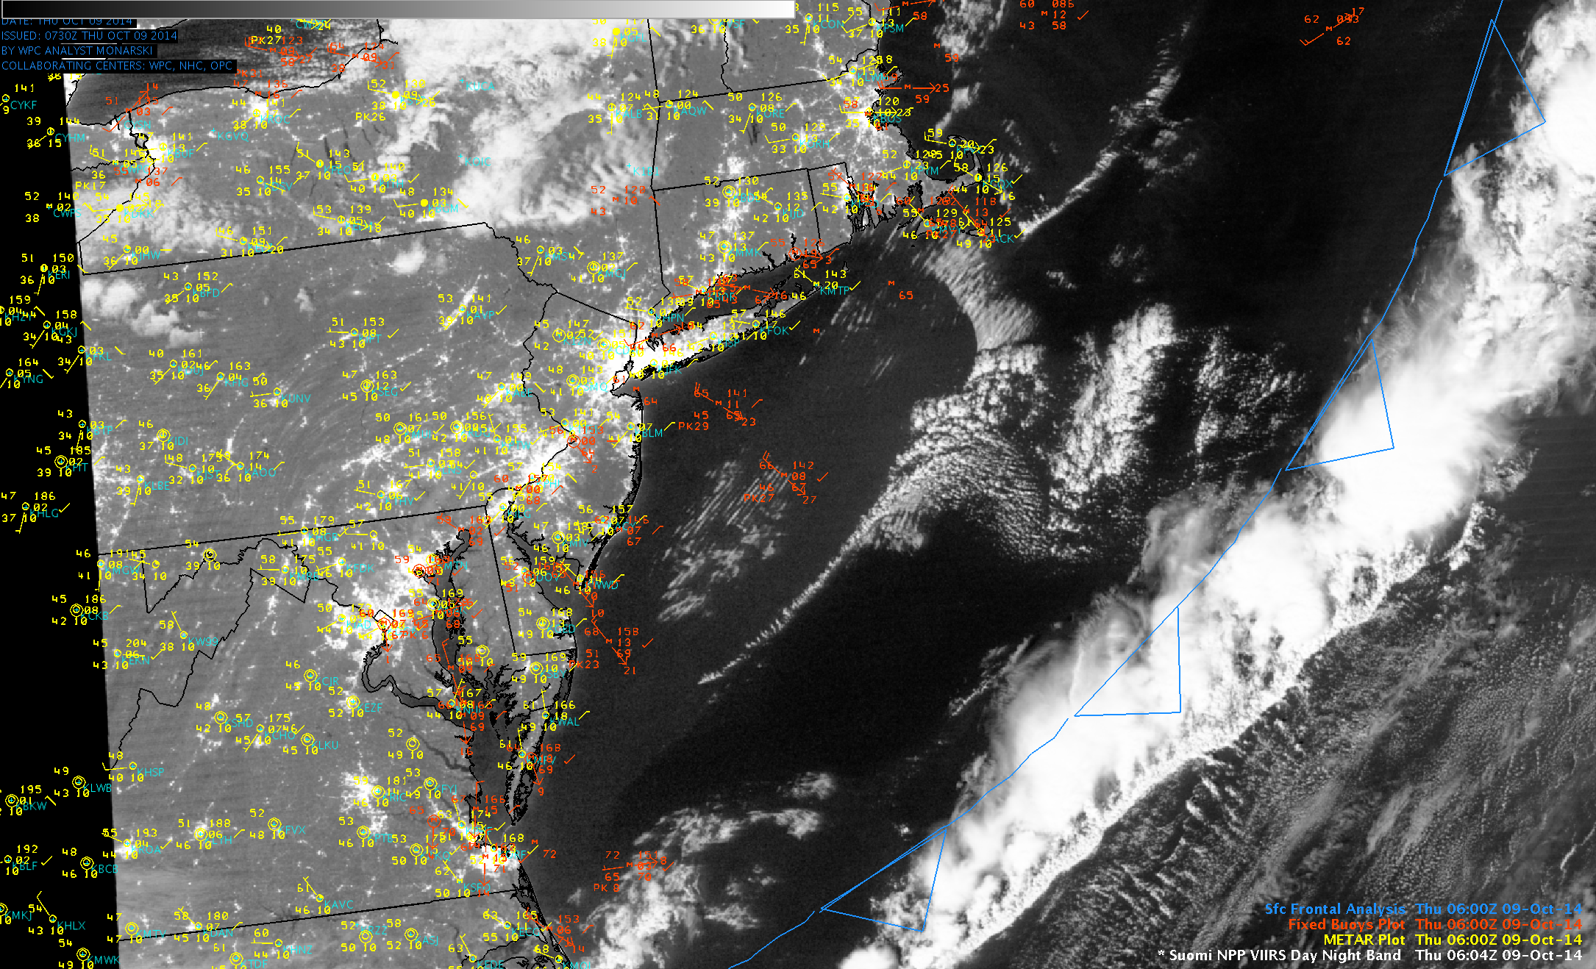
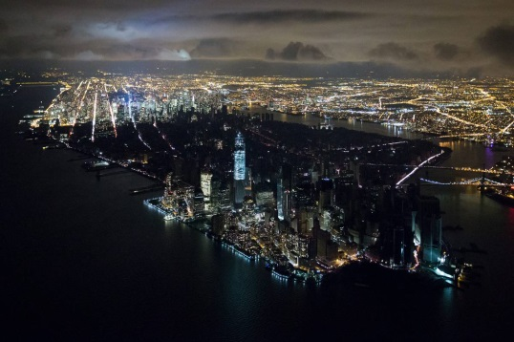
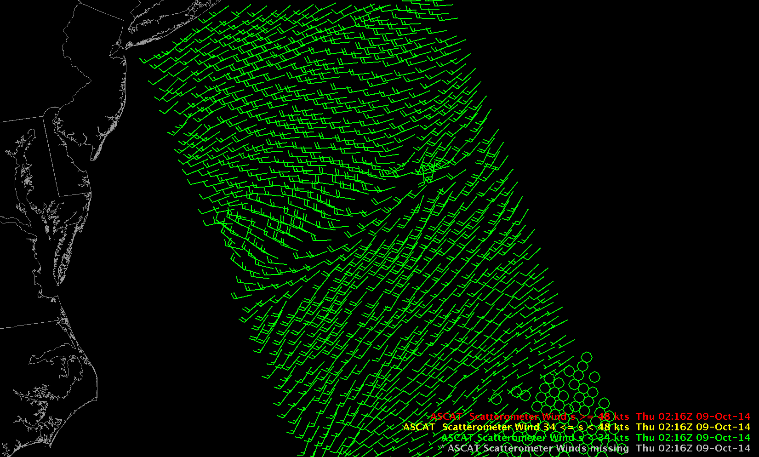
Lake Ice
Power Outages
New York City
DAY
NIGHT
Wind Structure via Moonglint
Metop-A
ASCAT
Surface
Winds
Power Outages
Lighter
Darker
S. Bachmeier (CIMSS)

Slide 15
Pacific Region and Caribbean

Slide 16
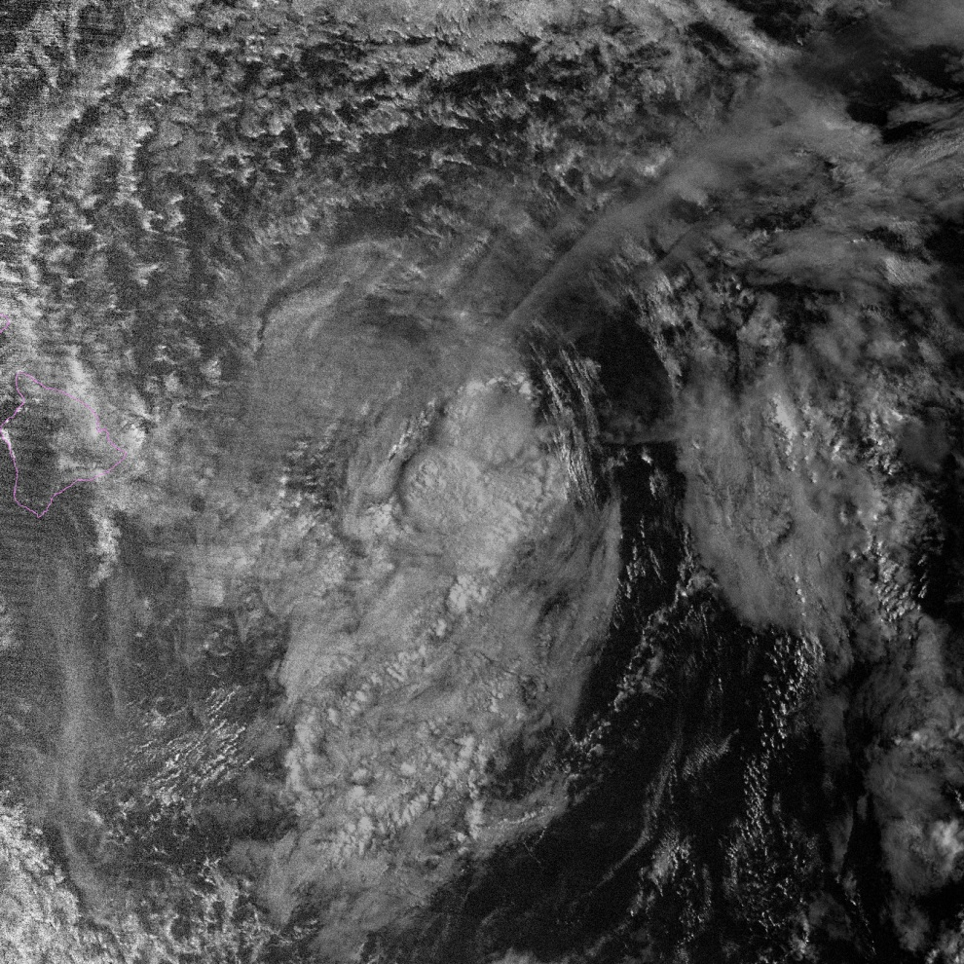
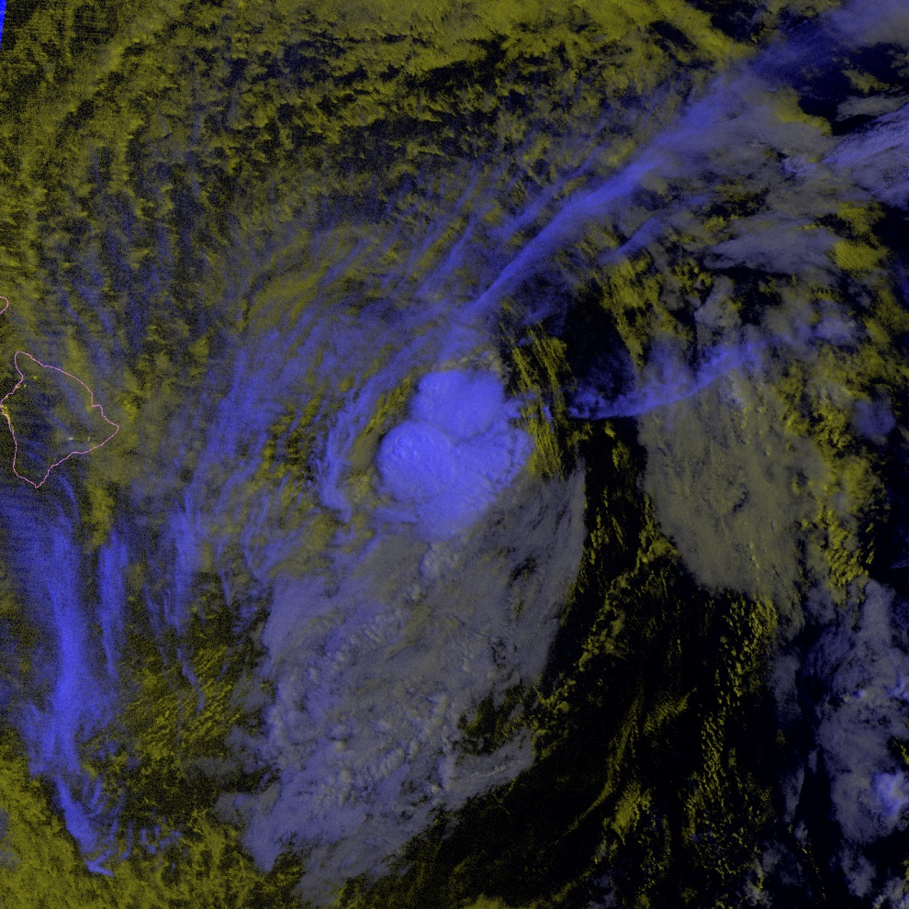
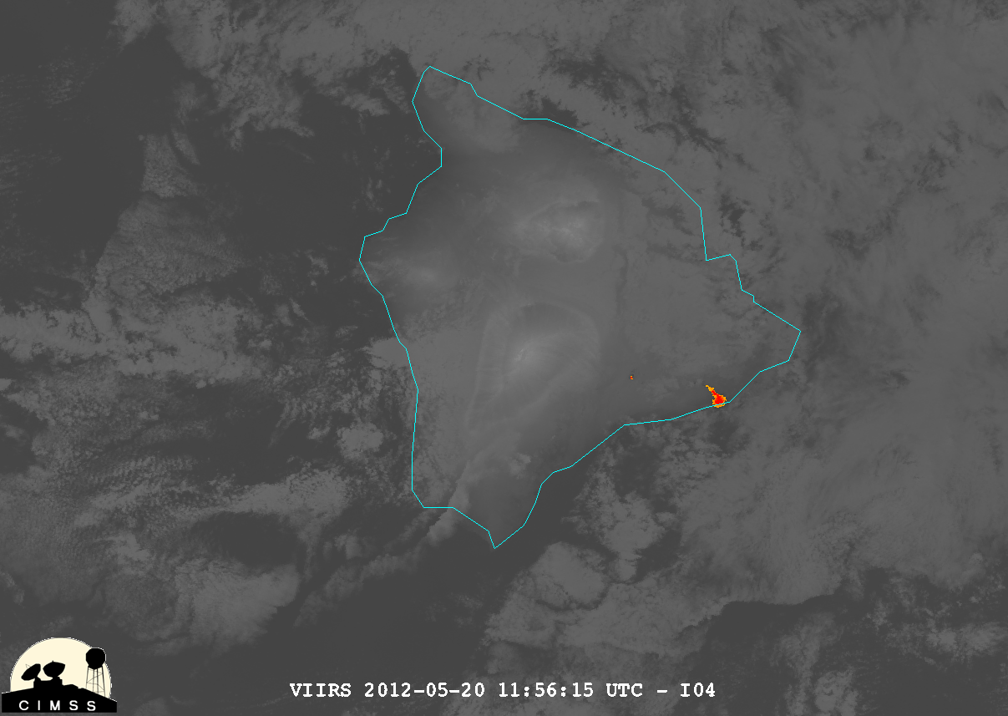
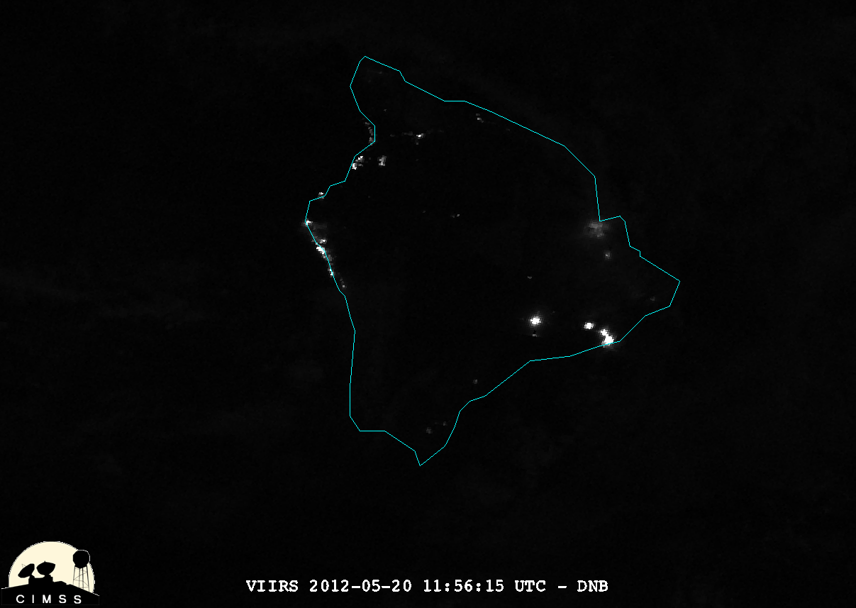
Tropical Cyclone LLC
‘Volcanic Light’
IR
DNB + IR
DNB
Hawaii
VIIRS I04 (3.74 μm) Day/Night Band
→ Unique sensitivity enables identification of features that are either obstructed or fall below thresholds of IR detection.
Notes:
Volcanic Light: VIIRS I04 (3.74 um) vs DNB

Slide 17
Conclusions
As Forecasters Operating on the Event Horizon of a New Era in Operational Satellite Technology…
Be Cognizant!
The DNB offers unique information content that can be used in synergy to complement GEO observations and improve situational awareness.
Be Opportunistic!
Don’t let the stigma of ‘just one pass per night’ cause you to miss out on a critical piece of information. Take advantage of the data when it’s available.
Be Connected!
The Satellite Liaisons are a valuable connection back to the algorithm developers. Let’s make the Proving Ground a true R2O2R program!
Take Back the Night!

