Slide 1
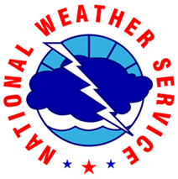
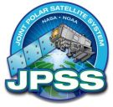
NWS Pacific Region “Preparing for GOES-R with Himawari-8”
Bill Ward
National Weather Service Pacific Region Headquarters
Honolulu, Hawaii
Wednesday, February 25, 2015

Slide 2
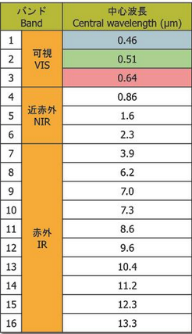
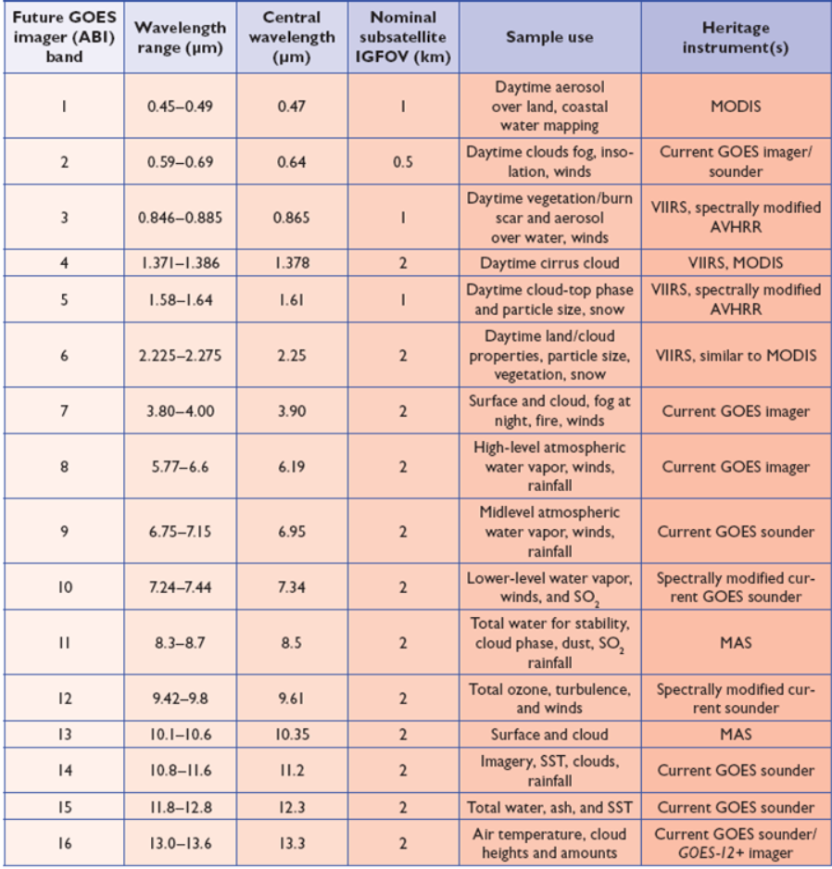
Notes:
Note that the Green Channel is not on the GOES-R ABI sensor and the Himawari AHI sensor does not have the ~ 1.4 channel.

Slide 3
Himawari Products
Planned Utilization at NOAA/NWS
NWS Centers and Field Offices | BUFR-Format Radiances | netCDF4-Format AHI Imagery² | BUFR AMVs (from GTS) | Other H-8/-9 L2 Products
NCEP Supercomputers (WCOSS) | 1 |  |  | TBD
NCEP Field Centers (e.g., NHC, AWC) |  |  | TBD
Alaska Region (Anchorage - Regional HQ, WFOs, RFCs, WSOs)
Pacific Region (Regional HQ, WFOs, WSO, and others)
Notes
1. AHI radiances - 16 spectral channels (Level 1b).
2. Further details of priorities of Off-CONUS imagery on next slide.

Slide 4
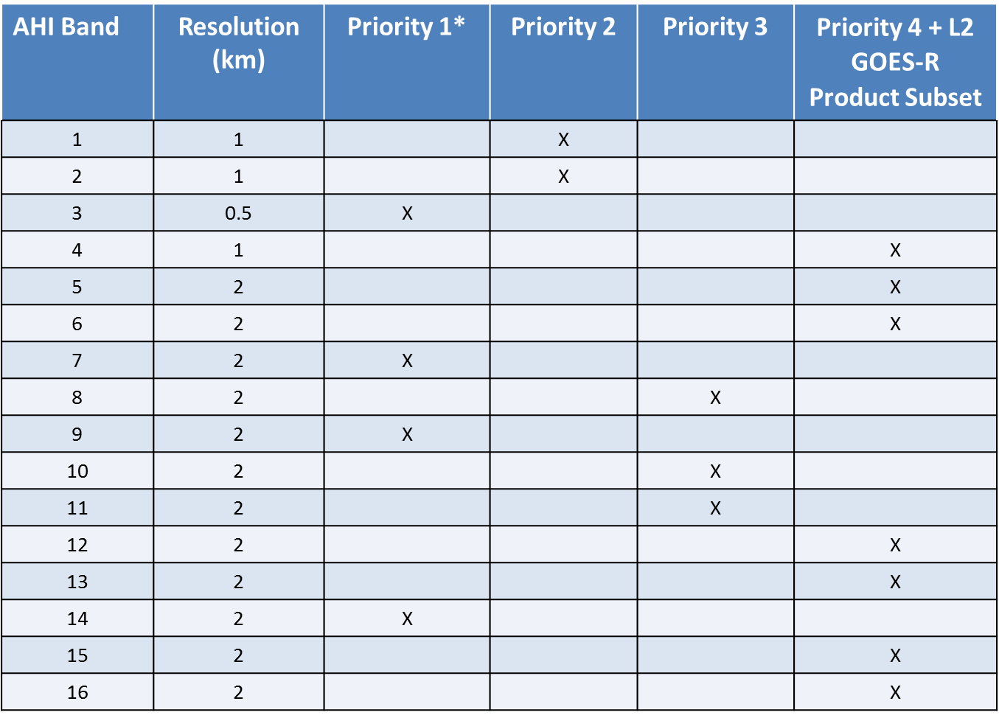
This needs to be scrubbed again now that we have data

Slide 5
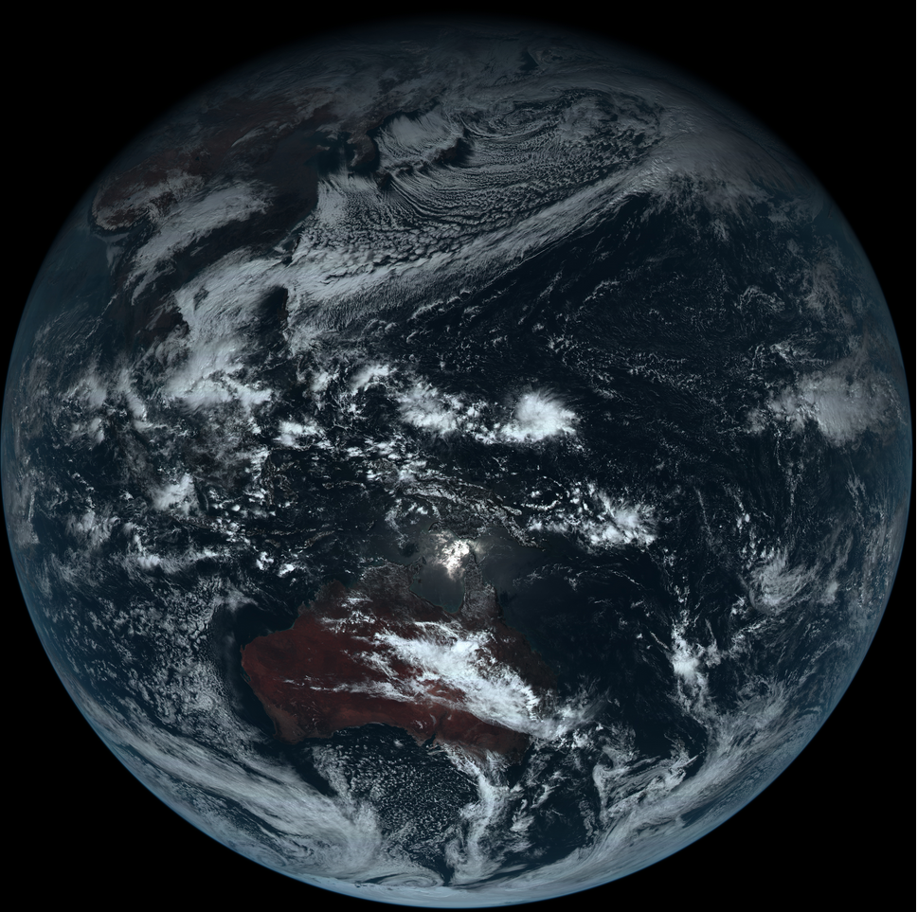
First shared Himawari–8 JMA imagery. This is a true color image of Himawari-8 from December 18, 2014 0240 UTC.

Slide 6
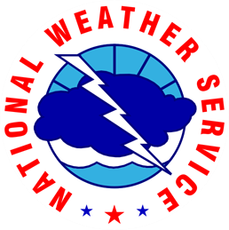
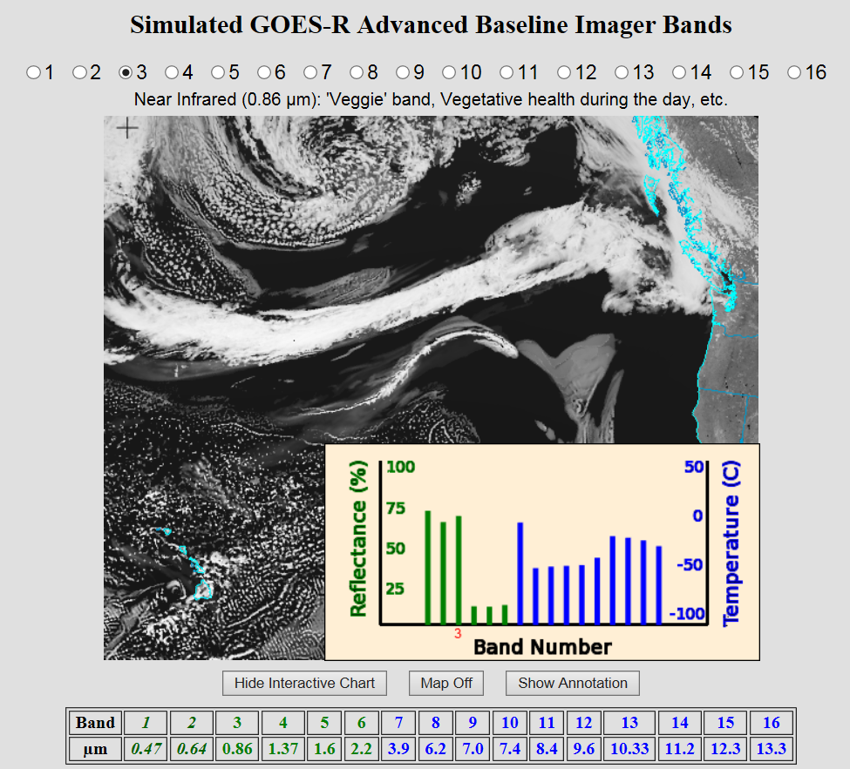
http://cimss.ssec.wisc.edu/goes/webapps/bandapp/overview_goes-r.html

Slide 7
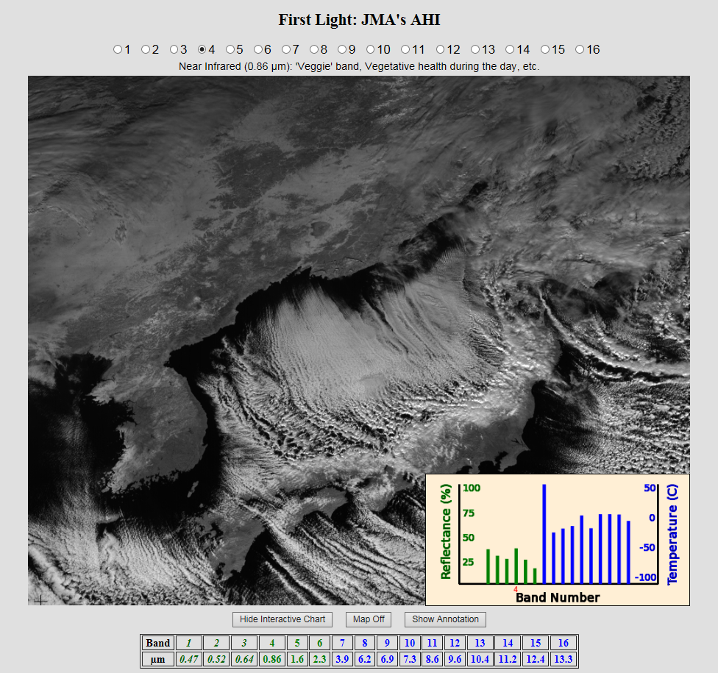
http://cimss.ssec.wisc.edu/goes/webapps/bandapp/images_ahi_first_light_Japan.html

Slide 8
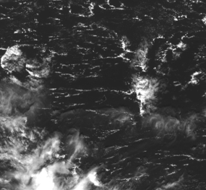
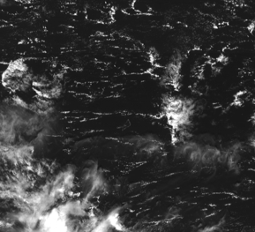
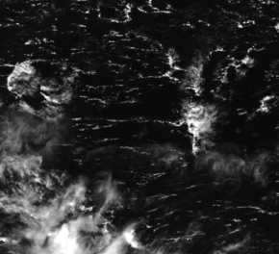
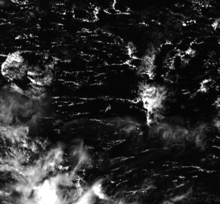
Band 1
Band 2
Yap Island
is in center
Band 3
Band 4

Slide 9
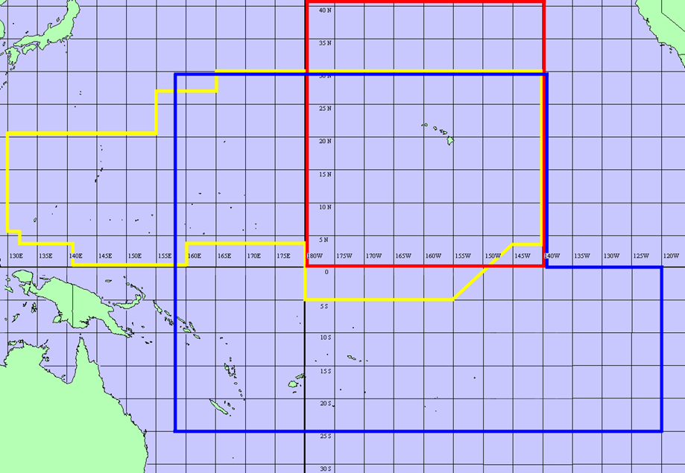
Value of Satellite Imagery in the Pacific Region
Data sparse region
Relatively few ground observing locations
10 upper air locations
Comms, SBN and bandwidth issues
Harsh and salty environment
Long distance to locations
Multiple responsibilities
Resource issues

Slide 10
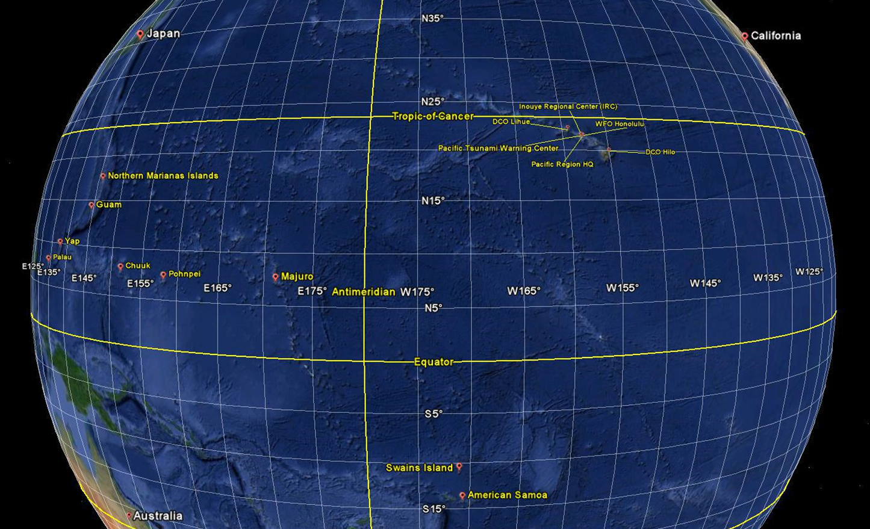
NWS Pacific Region

Slide 11
NWS Network Project
for Flowing Himawari Data to NWS Field Offices
The NWS network project for flowing Himawari imagery to NWS field
offices will be managed out of the NOAA Integrated Dissemination
Program’s Ground Readiness Project.
Project Manager: Scott Denton (of NWS Alaska Region)
Project Objective: To upgrade NWS networks needed to flow Himawari imagery
and other Level 2 products to NWS field offices. Initial focus on flowing priority products
(see following slides).
Start Date: March 2014
Target Completion Date for Priority Offices: Q2 Calendar Year 2015
DoD Handoff/Interfaces: Main coordination will take place through the COPC. One interface option is via the DISA connection at Suitland. OFCM has offered to facilitate
discussions on interagency field needs.

Slide 12
Himawari-8 Training development
The NWS is developing training for Himawari-8 using the Operation Proving Ground in Kansas City such that NWS forecasters are prepared when Himawari-8 goes operational mid 2015.
Understand what is operationally significant from this new era of satellite data
Scope out training requirements for these new 16 channels
Find potential overlap within NWS Centers and Weather Forecast Offices
Understand the requirements
What are the highest benefits for each particular mission
As you may already know, the AHI sensor on the Himawari 8 satellite is very close to that of the ABI sensor that will be on the GOES-R satellite.
Thus, given the overlap of channels,
We plan to leverage training and algorithms already being used and developed within the GOES-R Proving Grounds.

Slide 13
H-8 is coming fast
Data will travel over which lines?
Who is responsible?
Prioritization of data?
AWIPS II ingest and delivery?
Regional servers?
Training and delivery of Training?
Fact Sheets
Need help here, these fact sheets are not moving!
Web services as they are done today?
NESDIS continued to support to the PR…
Satellite Web services as they are today
Micronesia, American Samoa, Guam/CNMI & State of Hawaii
CSPP – GEO
What we do with Himawari will only strengthen plans for GOES-R

Slide 14
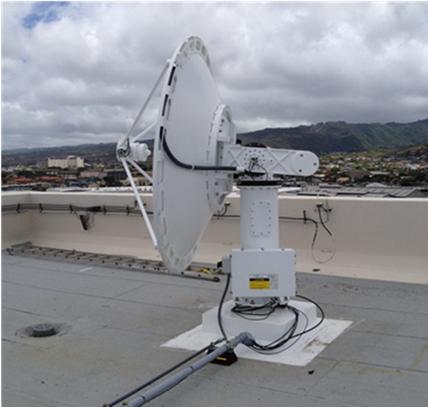
Tropical Pacific PG Training Tools
L/X Band antenna
JPSS Support
GOES-R Support
MTSAT Antenna (current)
Antennas on Honolulu and Guam
Support also to American Samoa and Micronesia
GOES-W antenna
Future capabilities
HimawariCast - (Guam June-15 and Hawaii May-15)
Perhaps late in FY15
L/X Band Antenna (Hawaii IRC, April 15?)
L/X Band Antenna (Guam ?)
Eventual GOES-R Hardware (Hawaii Sept-15)

Slide 15
TPPG Demonstrated Product task list
Lightning Detection
GOES-R requirement (not on Himawari – 8)
Volcanic Ash Detection and Height (not demonstrated as of yet)
Infrared wavelengths (7.3, 8.5, 11, 12 and 13.3)
Respectively Himawari channels (10, 11, 14, 15 & 16)
Rainfall Rate/QPE
Work continues with Bob Kuligowski and SPoRT
Initial results were not very promising
Looking to use Himawari – 8 data
Total Precipitable Water
Statistical Tropical Cyclone Intensity Models
Orographic Rain Index
Work to produce short term rainfall rates (0 to 3 hrs)

Slide 16
TPPG VSP Program
Presenters are SMEs on proposed and accepted VSP projects
Can be GOES-R or JPSS data sets
Himawari – 8
Projects must be proven in advance
VSP Requirements
Planning
Software installations/instructions
Trip report
Demonstration Plan
Products to be demonstrated
Training
ORD & IOC
What does completion look like?
CSPP Training
SPoRT QPE Training
5-9 May 2014
WFO HNL-CPHC / PRH / Air Force
Future Training for QPE & other Products by SPoRT

Slide 17
TPPG VSP projects for 2015
QPE continuation using Himawari – 8
Tropopause Folding Turbulence Prediction
Aviation
Develop better tools to find and detect turbulence
Fewer flights than over land
Cloud Layers/Heights
Enhanced "V" / Overshooting Top Detection

Slide 18
QUESTIONS:
Bill Ward
bill.ward@noaa.gov
(808) 725-6010

