Slide 1
A New Cloud Cover Layers Application
Andrew Heidinger and Dan Lindsey NOAA/NESDIS
Andi Walther, Steve Wanzong UW/CIMSS
Steve Miller, YJ Noh, Curtis Seaman and John Forsythe CSU/CIRA
Amanda Terborg – PG Liaison

Slide 2
Outline
CCL Products going to AWC Today
CCL Products going to AWC Soon
CCL Products under development.
Conclusions

Slide 3
Background
Cloud Cover Layers listed in Top-5 of NWS Operational Advisory Team (NOAT) requested products.
NOAT offered some “General” guidance to align cloud fraction layers with NWS National Digital Forecast Database (NDFD) and NCEP definitions.
NOAT offered “Aviation” guidance for an expanded CCL product.
Cloud fraction at 5 FL levels
Super-cooled cloud fraction
Convective cloud fraction
Both of these sets of guidance are significant alterations in horizontal and vertical resolution of the original GOES-R CCL specs.
CCL offers an application that can combine multiple Level-2 products into something more relevant to NWS.
JPSS-RR project funded to develop a CCL product that meets NOAT’s needs.

Slide 4
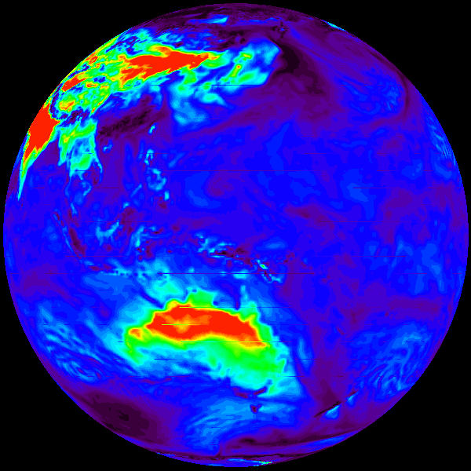
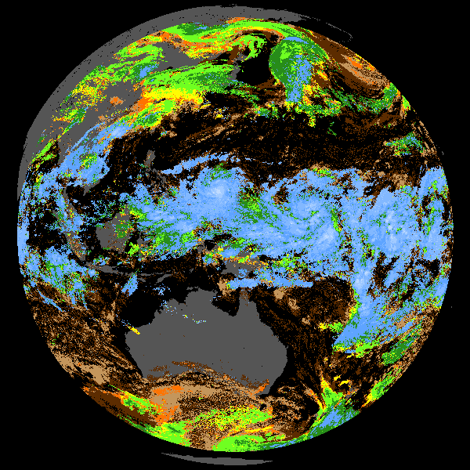
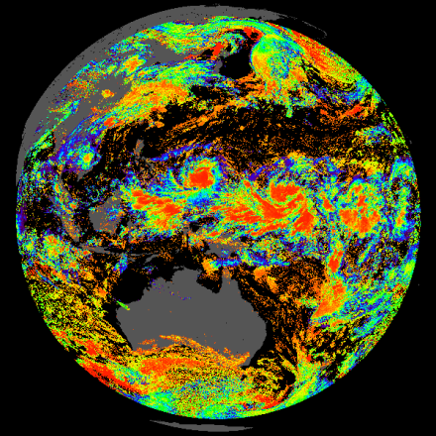
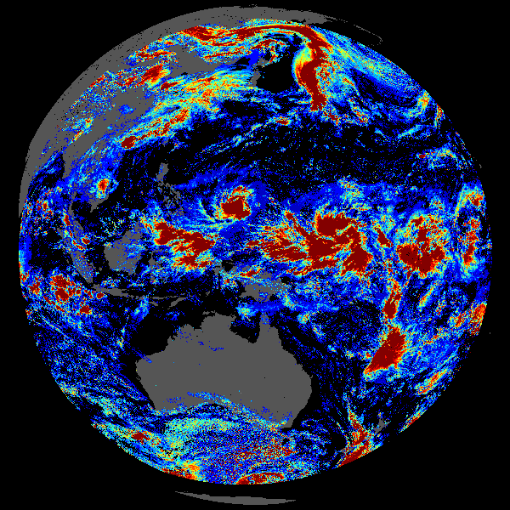
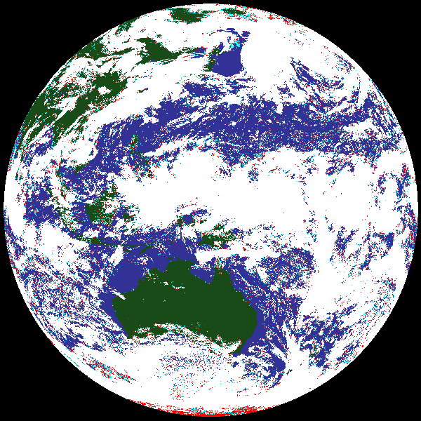
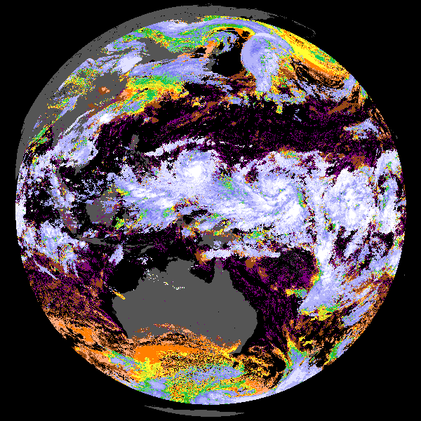
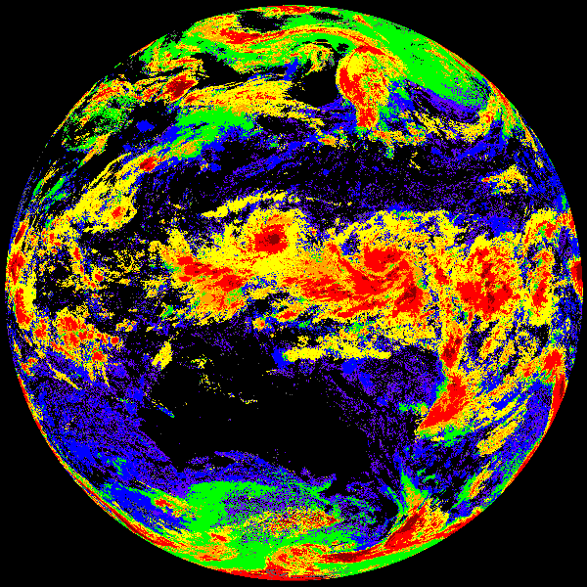
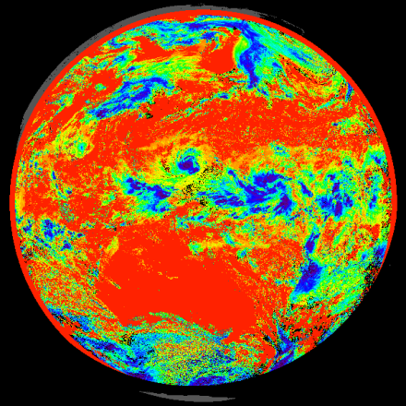
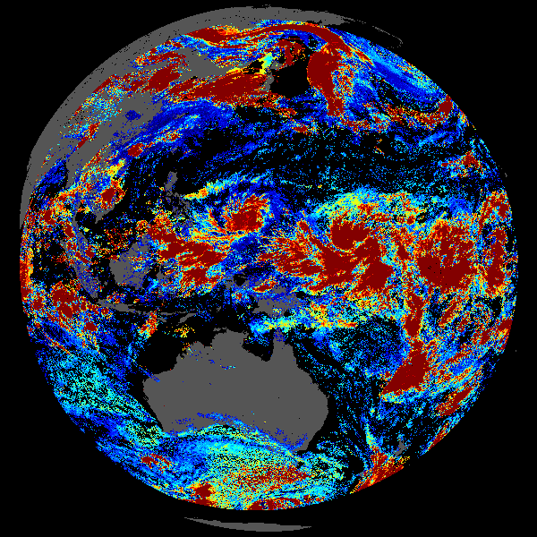
Reliance of CCL on Level-2 Cloud Products
Level-2 Cloud Products
CCL is an application that provides a satellite based vertical depiction of the presence of cloud along with other relevant cloud properties (convection, super-cooled water)
Altitude
emissivity
NWP LCL
water path
mask
temperature
Cloud Cover Layer Application
transmission
CCL will be based on multiple existing level-2 cloud products and some NWP.
Some of these level-2 products have been demonstrated in PG, some not.
type
particle size

Slide 5
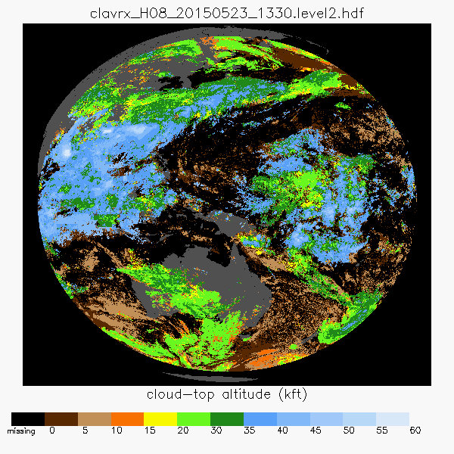
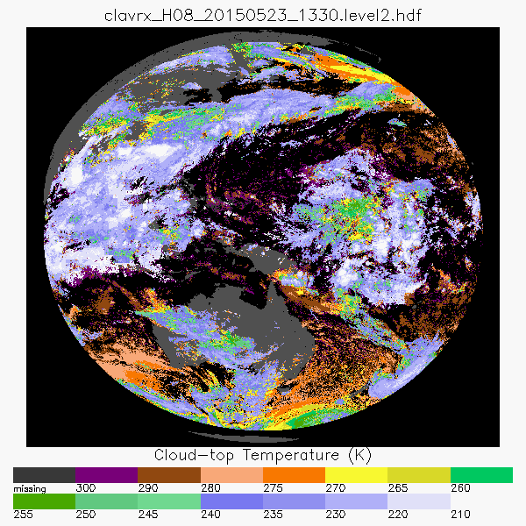
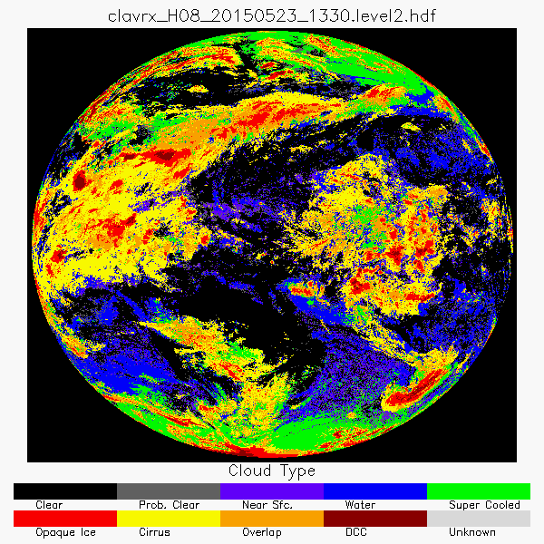
Cloud Products Going into AWC Today
We have been serving Geo cloud products to the AWC since 2014.
Sensors include GOES-13, GOES-15, MSG-10, COMS and MTSAT.
We serve 3 hourly Global Geo Composites and hourly NHEM composites. Satellites are GOES E/W, MSG, COMS and MTSAT
In 2015, we started 15 minute CONUS service.
Product List: Cloud Pressure Altitude, Cloud Temperature and Cloud Phase. (only a subset of level-2 cloud products)
Amanda Terborg says altitudes are often used, cloud phase less so and cloud temperatures are seldom used.
Cloud Pressure Altitude
Cloud Temperature
Cloud Type

Slide 6
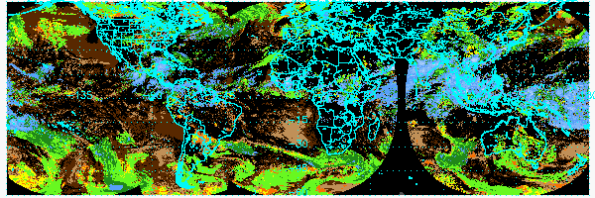
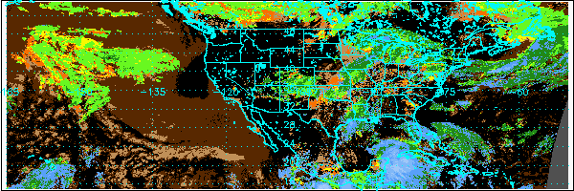
Examples of AWC Cloud Altitude Products
Roughly 2 days of data shown
GLOBAL (3 hr)
NHEM (1 hr)
Cloud pressure altitude is a simple extension of the baseline cloud-height product but not in the baseline.
CONUS (0.25 hr)
(Images are not NAWIPS, but same color enhancement)

Slide 7
Cloud Products Going into AWC Soon
Replace MTSAT-2 with HIMAWARI-8/AHI in August 2015.
NOAT asked us
Align our pressure levels for H/M/L cloud to match that used in National Digital Forecast Database (NDFD). H < 350 hPa, L > 642 hPa.
Make 2 km imagery of the column cloud fraction in these layers.
AWC feedback included a request for a product to identify convective clouds.
We are making these products now and will work with AWC to optimize their performance and visualization.
Examples of these new products come from HIMAWARI-8 observations on May 23, 2015 during Singapore Airlines Flight SQ836 which experienced a loss of engine power due to extreme exposure to ice crystal icing.

Slide 8
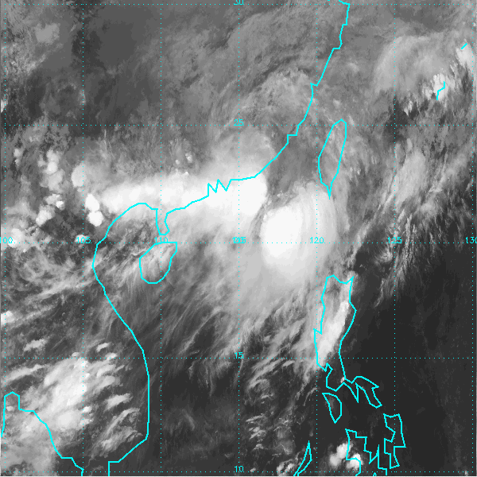
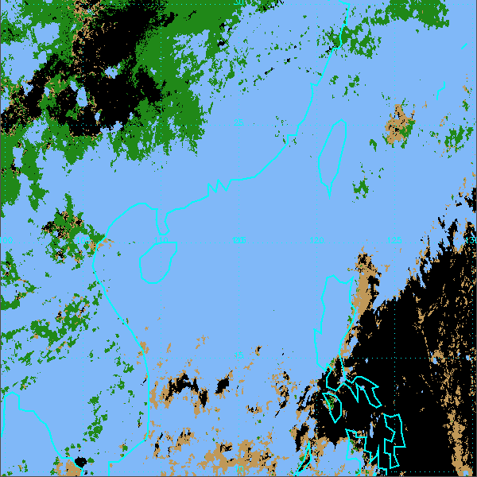
Cloud Layer
We were requested to make 2km imagery of cloud fraction in H/M/L layers.
Where H < 350 hPa, L > 642 hPA.
Original CCL was 10 km in resolution and used different levels.
Image below shows an example that we can make now. Image uses color scheme similar to NAWIPS altitude scheme.
At 2km, most fractions are 0 or 1.0. We compute fraction as mean over 3x3 array.
This should make into the Harris GOES-R System via the STAR AIT.
11 μm BT (11 – 13 Z, May 23, 2015)
Cloud Layer (H/M/L)

Slide 9
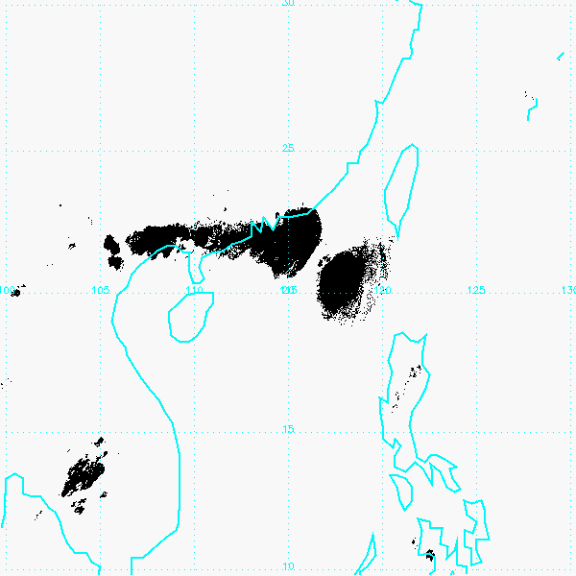
Deep Convective Cloud Mask
AWC requested that we add a deep convective mask.
Our goal is to identify convection that reaches Tropopause.
Geo imagers provide two ways to accomplish this:
Clouds with temperatures close to the NWP Tropopause temperature
Clouds with BT 6.7 μm > BT 11 μm
Potentially available now to AWC and we will optimize it based on PG feedback.
Considering adding detection of “growing” and “dying” convection at least for CONUS.
11 μm BT (11 – 13 Z, May 23, 2015)
Deep Convective Mask

Slide 10
Cloud Products Under Development
With support from JPSS-PG/RR, we will tackle the full suite of capabilities requested by the NOAT for CCL and Aviation support.
The request is for information at 4 flight levels (FL 050, 100, 180 and 240). The requested products are:
Super-cooled cloud fraction
Deep convective cloud mask
Cloud phase
This application offers a chance to merge existing level2 products with new information to make a more relevant application to the NWS.

Slide 11
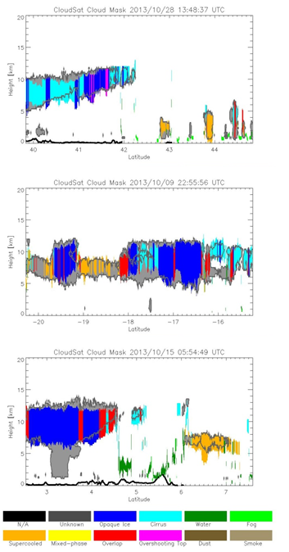
Cloud Base for CCL
Cloud Geo Thickness compared to CloudSat (grey). VIIRS Examples
Knowledge of cloud base is critical in moving from a top-down perspective to a more 3d perspective.
Skill at cloud base is highly correlated with cloud type.
For thin cirrus or low level water cloud, obs provide some skill.
For very thick clouds, obs provide no skill and NWP is best.
For intermediate clouds, CIRA is showing skill at using CloudSat to estimate cloud geometrical thickness based on other cloud products.
Images of preliminary CloudSat tuned algorithm on the right. Colors are for cloud types. Regression does not use type.
Still optimizing the fusion with NWP for thick clouds (condensation levels).
We are finishing this and will transfer this capability to the NOAA Enterprise System via the STAR AIT.

Slide 12
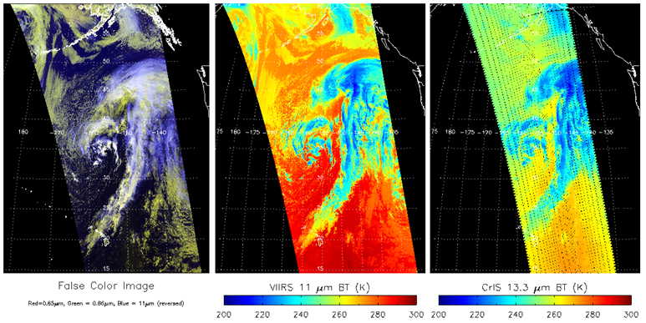
Fusing CrIS with VIIRS for Better CCL
VIIRS is lacking the IR water vapor (6.7, 7.3 μm) and CO2 (13.3 - 15 μm) channels that help in cirrus cloud heights and detection of multiple layers.
CrIS can provide those channels and the UW/SSEC has developed tools to spectrally integrate and spatially interpolate the CrIS data.
Our JPSS-RR CCL work will use CrIS for a better CCL especially over Alaska.
Example of VIIRS + CrIS data

Slide 13
Layer Definition for New CCL
NOAT guidance referenced 4 flight levels (050,100,180 and 240)
We interpret this as a request to define layers that surrounds these FL.
We have chosen these 5 layers
Layer 1 = SFC to 2.5 km
Layer 2 = 2.5 to 7.5 km
Layer 3 = 7.5 to 14 km
Layer 4 = 14 to 21 km
Layer 5 = 21 to 28 km
Layer 6 = 28 km to TOA
Levels
Layer Bnds.
TOA
28 km
FL 240
21 km
FL 180
14 km
FL 100
7.5 km
FL 050
2.5 km
SFC

Slide 14
CCL Plans
With Cloud Base nearing completion, we will start initial development of the new CCL with JPSS-RR
Questions that remain
Are our CCL layer definitions optimal?
Our super-cooled detection is really only at cloud top. Should we fuse with NWP to extend this information down into the cloud?
Visualization will be key for this application.

Slide 15
Take-Aways
The Cloud-Height component of the CCL application is being sent today through the GOES-R PG to AWC. We just expanded to 15 minute CONUS composites as requested. Amanda Terborg is our PG Liaison. HIMAWARI-8 AHI will flow in July.
We have acted on the “General” CCL recommendations of the NOAT and AWC and have developed initial versions of the requested cloud layer product and deep convective mask (also requested by AWC). These are ready for feedback from AWC. A training briefing is coming.
With support from JPSS-RR, we are pushing forward on the “Aviation” recommendations from the NOAT and working towards a more complete CCL application. CIRA’s work on base is a critical component. CrIS synergy is critical for VIIRS CCL. We still are open to continued guidance as we develop this. Stay tuned.

