Slide 1
River Ice/Flooding Products Overview and Training Resources
David Santek¹, S. Li², N. Chaoch³, J. Gerth¹, J. Hoffman¹, P. Alabi³
¹University of Wisconsin-Madison/SSEC/CIMSS
²George Mason University
³City College of New York
2015 Satellite Proving Ground/User-Readiness Meeting
NWS Training Center - Kansas City, Missouri
18 June 2015

Slide 2
Overview
Two products
River flood from GMU
River ice from CCNY
Realtime processing
SSEC/CIMSS
Geographic Information Network of Alaska (GINA)
Product distribution
AWIPS II for use and evaluation by National Weather Service
RealEarth (Web Map Service at CIMSS) for general access
Training
Status and future plans

Slide 3
River Flood Product
Estimate of flooding water fraction
Regions of ice, cloud, snow cover, and cloud shadow identified
Algorithm developed at George Mason University (GMU)
VIIRS: SVI01, 2, 3, 5, Cloud mask (IICMO)
Ancillary: Global land cover, DEM, land/sea mask, MODIS water mask, land/sea surface temperature
C/C++ and IDL

Slide 4
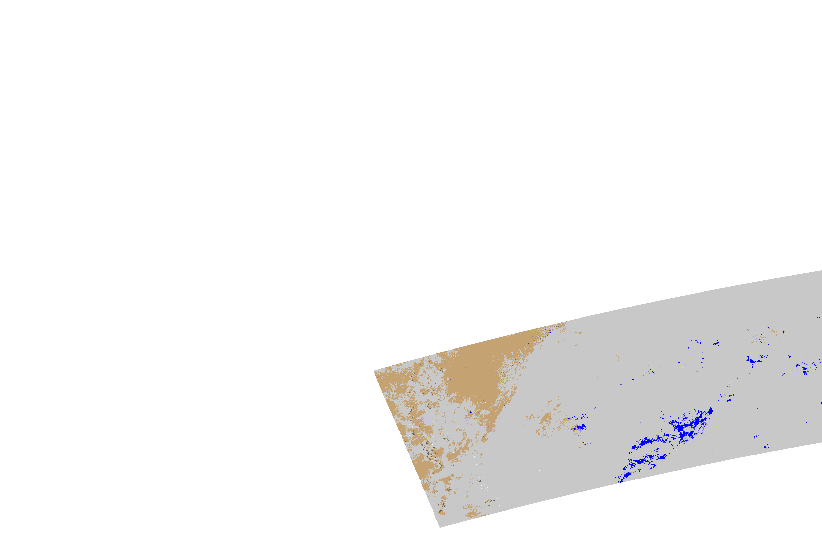
River Flood Product
Output: HDF and PNG files, by granule
Contact: Sanmei Li
Reference: Sanmei Li, Donglian Sun, Yunyue Yu, Ivan Csiszar, Antony Stefanidis, Mitch Goldberg (2012). A New Shortwave Infrared (SWIR) Method for Quantitative Water Fraction Derivation and Evaluation with EOS/MODIS and Landsat/TM data. IEEE Transactions on Geoscience and Remote Sensing, 51.

Slide 5
River Ice Product
Information on river ice location, extent, and concentration
Algorithm developed at City College of New York (CCNY)
VIIRS: SVI01, 2, 3, 5, Cloud mask (IICMO)
Ancillary: CCNY provides Matlab files of specific rivers
Matlab

Slide 6
River Ice Product
Output: HDF and PNG files, by granule
Contact: Naira Chaouch
Reference: Naira Chaouch, Marouane Temimi, Peter Romanov, Regina Cabrera, George Mckillop, Reza Khanbilvardi.(2014). An Automated Algorithm for the Monitoring of River Ice over the Susquehanna River Basin using MODIS data. Hydrological Processes. 28, Issue: 1, 62-73.

Slide 7
CIMSS Role
Produce the products in near real-time
Use Community Satellite Processing Package (CSPP)-generated VIIRS SDRs and EDRs from SSEC and GINA Direct Broadcast (DB) data
Work with algorithm providers (GMU and CCNY) to run their research code in our environment
Reformat products
Convert and concatenate PNG files to:
AWIPS II compatible netCDF files
GeoTIFF for use in SSEC’s RealEarth Web Map Service (WMS)
RealEarth WMS available as part of IMAPP

Slide 8
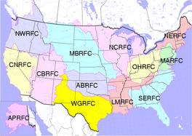
CIMSS Role
Distribute products for evaluation to:
NWS River Forecast Centers (RFC) via the Unidata Local Data Manager (LDM) to their AWIPS II
RealEarth for everyone
Update algorithms
Based on user feedback
Bug fixes
General improvements
Performance, etc.
NCRFC: North Central
NERFC: North East
MBRFC: Missouri Basin
WGRFC: West Gulf
APRFC: Alaska Pacific

Slide 9
RealEarth
http://realearth.ssec.wisc.edu/
Web Map Service (WMS) hosted at SSEC
Provides overlays, transparencies, color enhancements
Right click to probe and get data value
Left and right arrow keys to step through different times
‘Share’ button in the Display Controls
Options to share display: web link, KML (Google Earth), Facebook, Twitter
Save as GeoTIFF
200+ real-time satellite, radar, METAR, snow depth, etc.
River Ice and Flood products are in the ‘Hazards’ category

Slide 10
Products Legend (RealEarth)
River Flood
MS: Missing
LD: Land
SN: Snow
IC: Ice
CL: Cloud
CS: Cloud Shadow
WA: Water
0 – 90: Water fraction
River Ice:

Slide 11
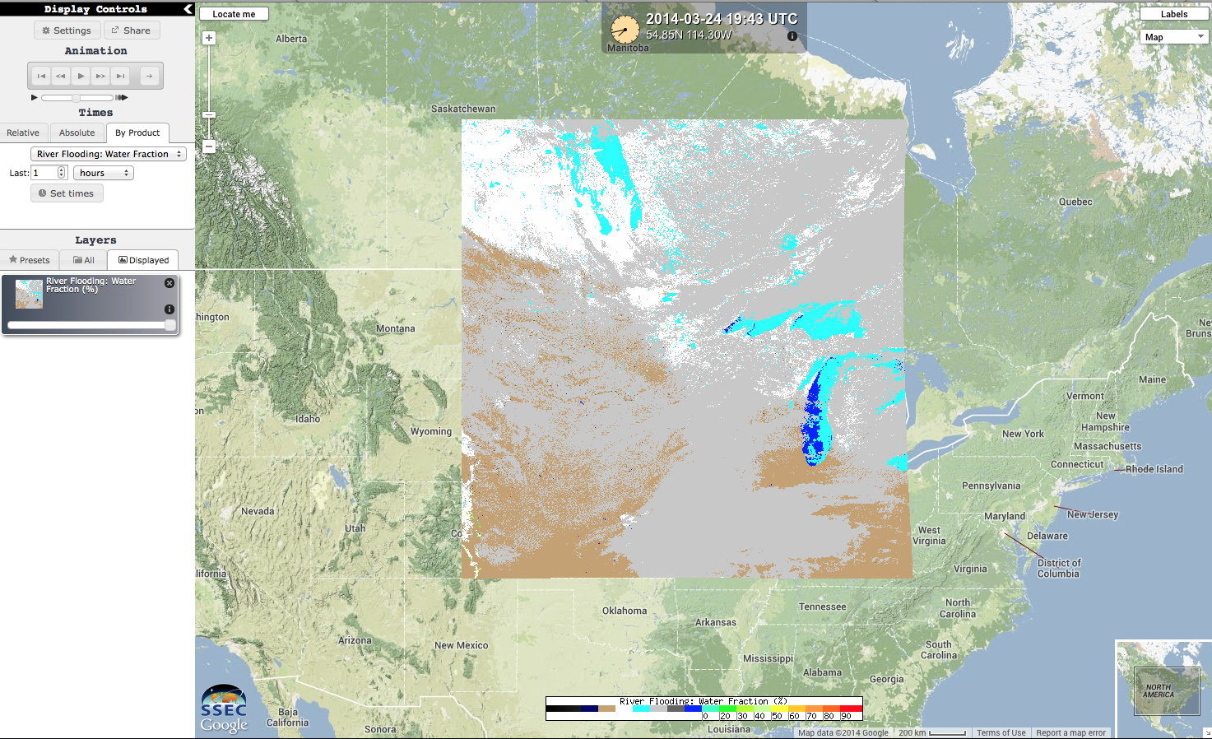
NCRFC: River Flood
Transparency

Slide 12
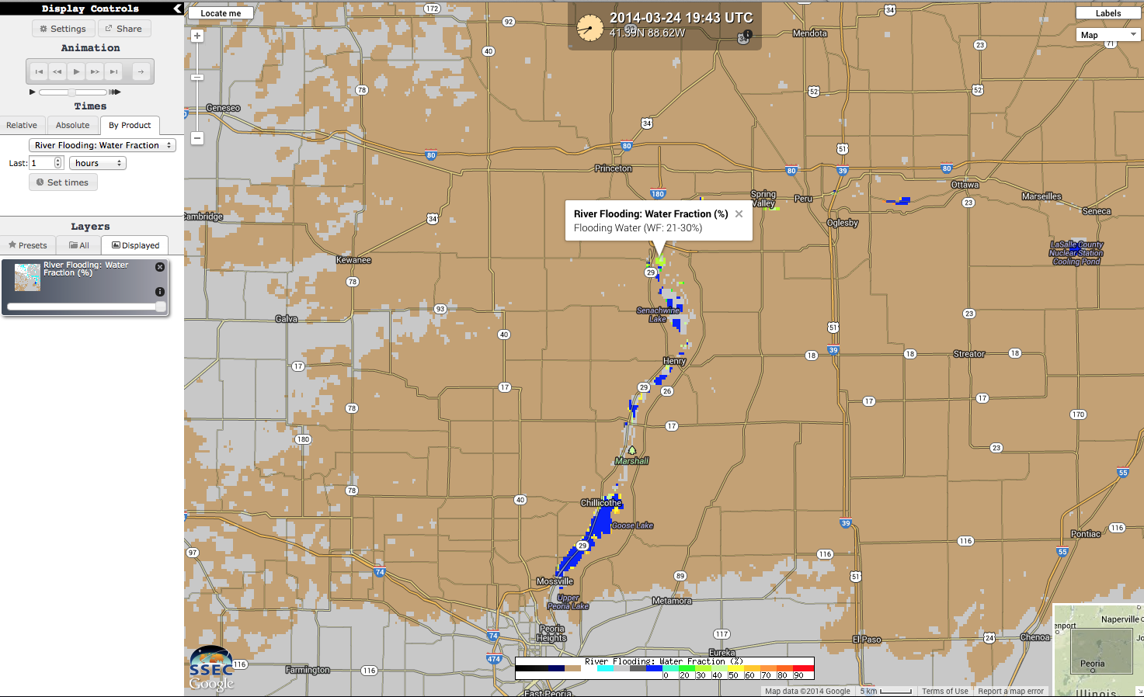
River Flood (Data Probe)

Slide 13
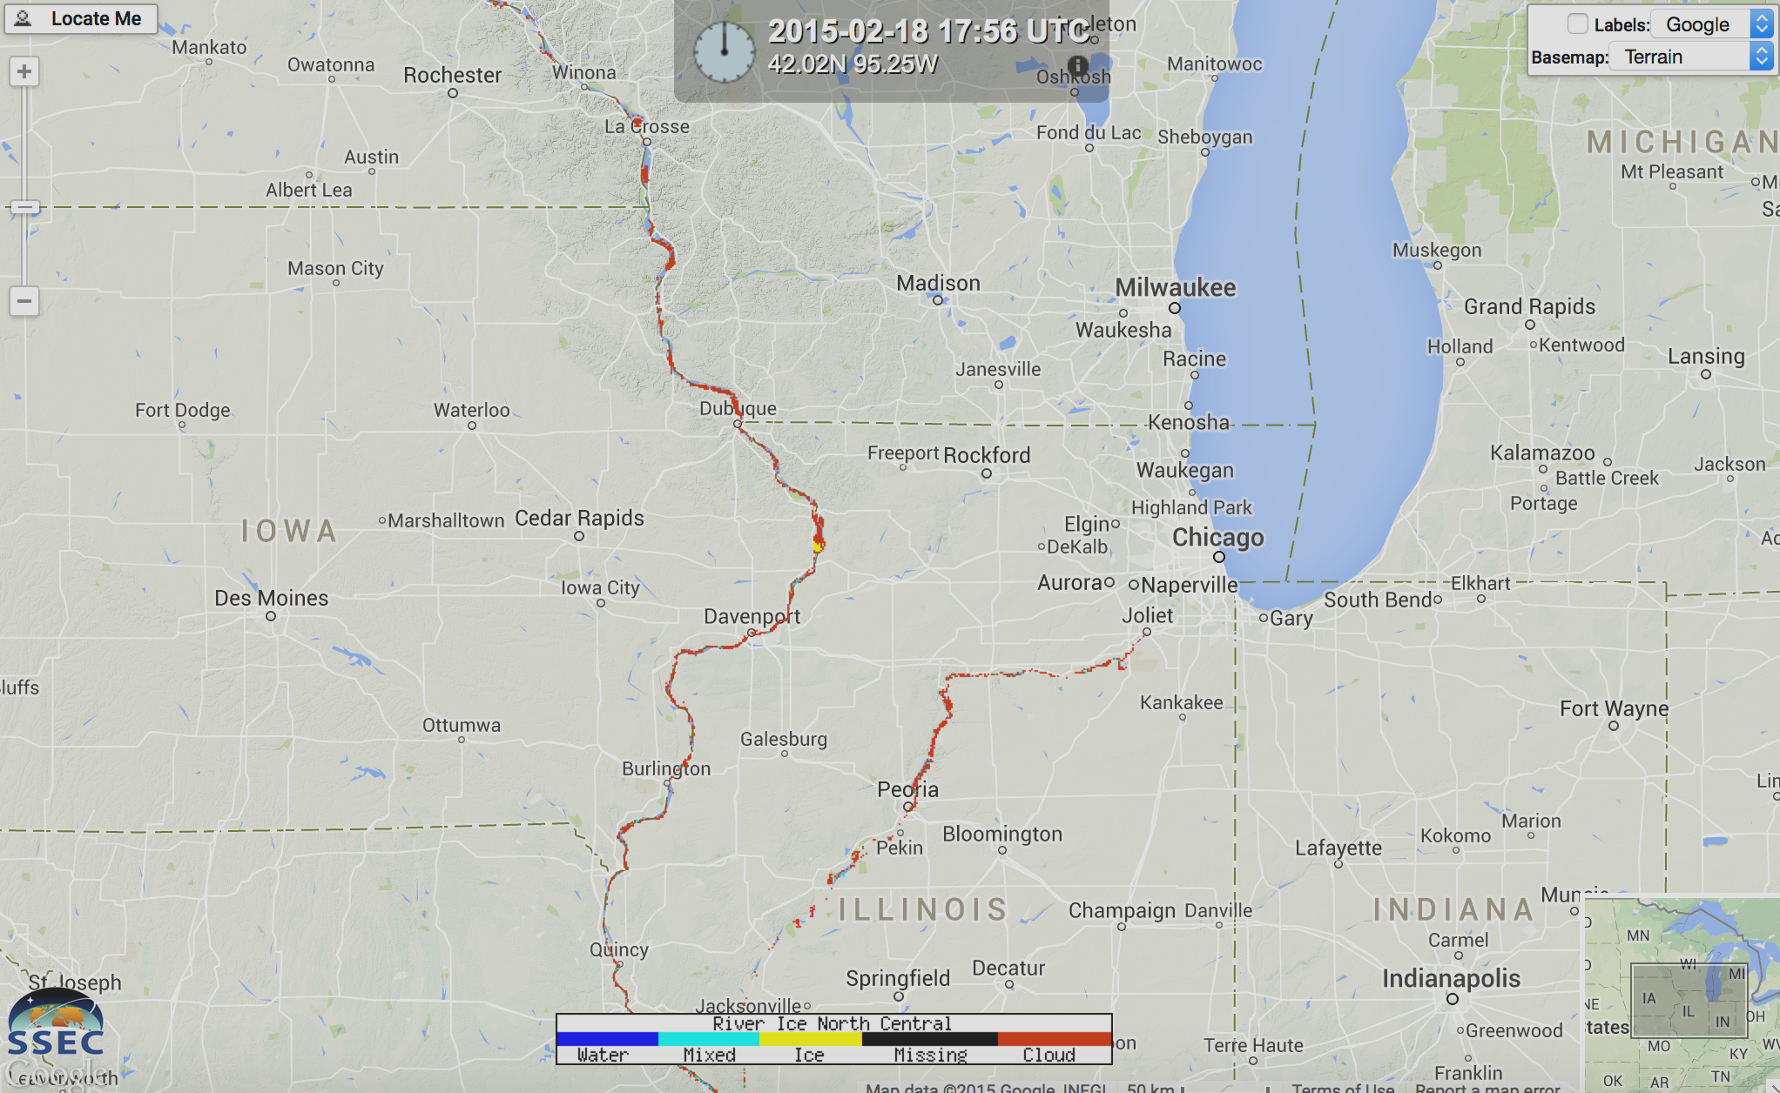
NCRFC: River Ice

Slide 14
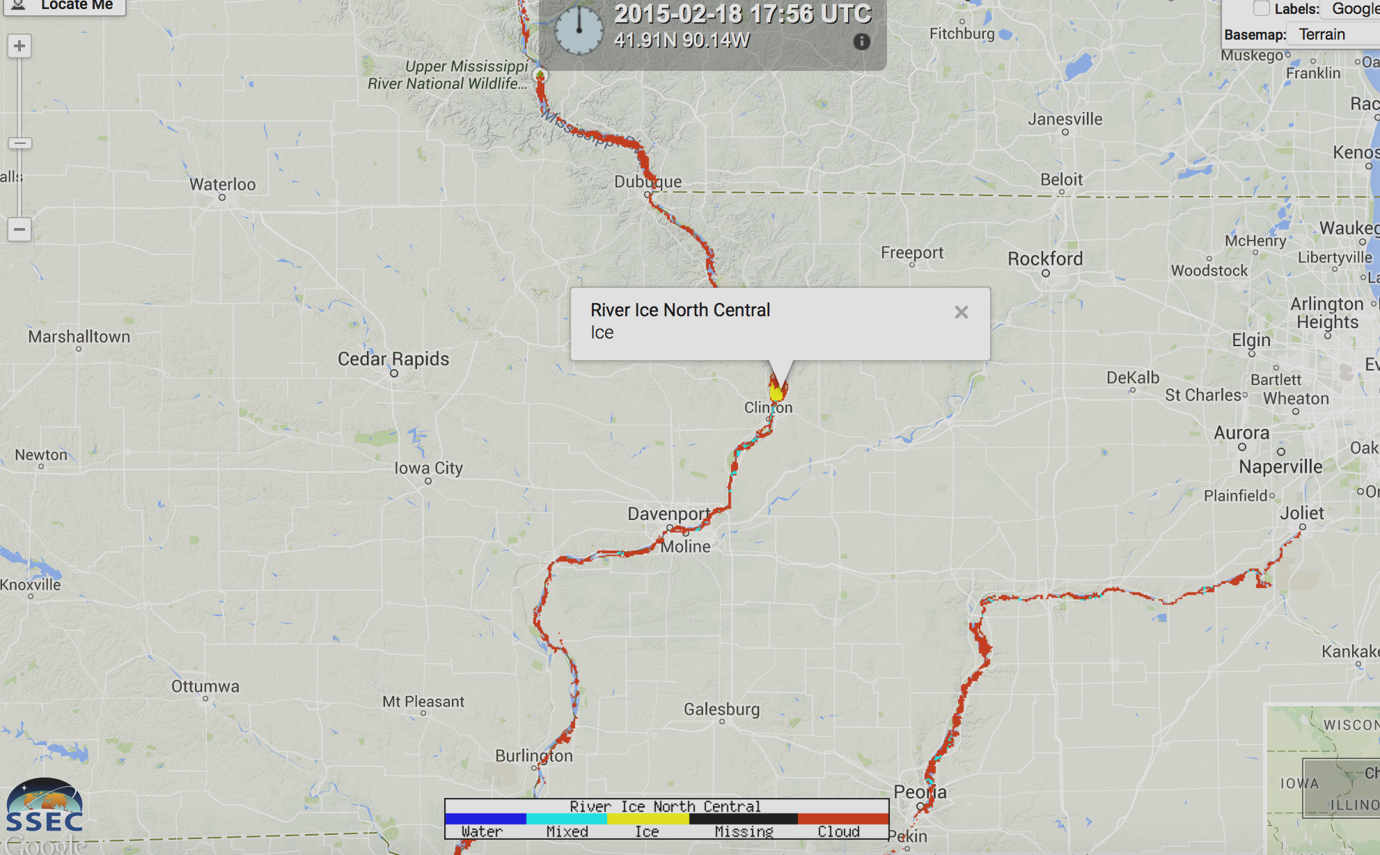
River Ice (Data Probe)

Slide 15
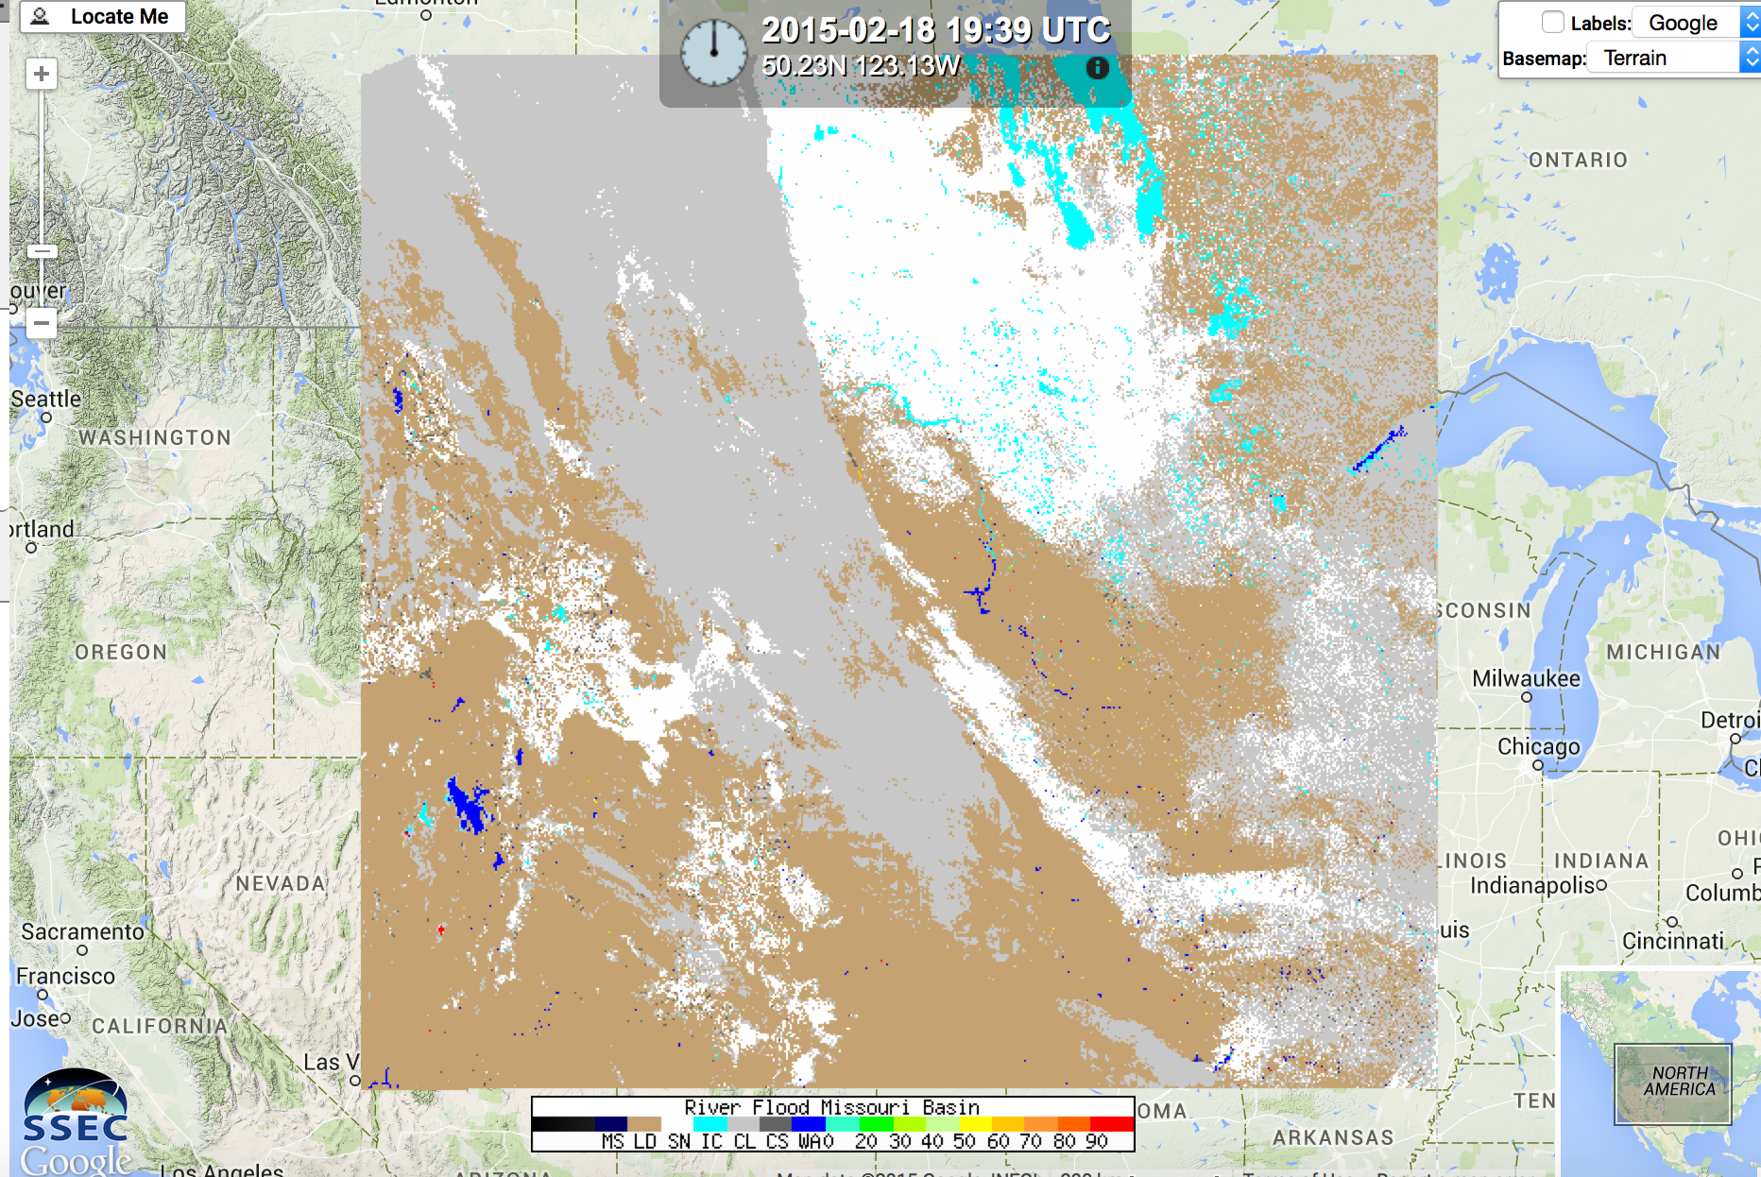
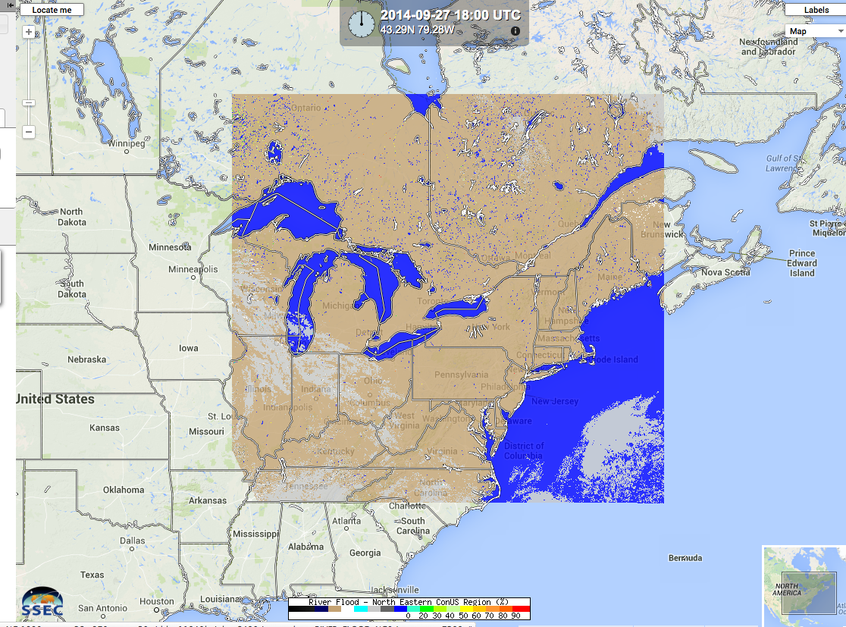
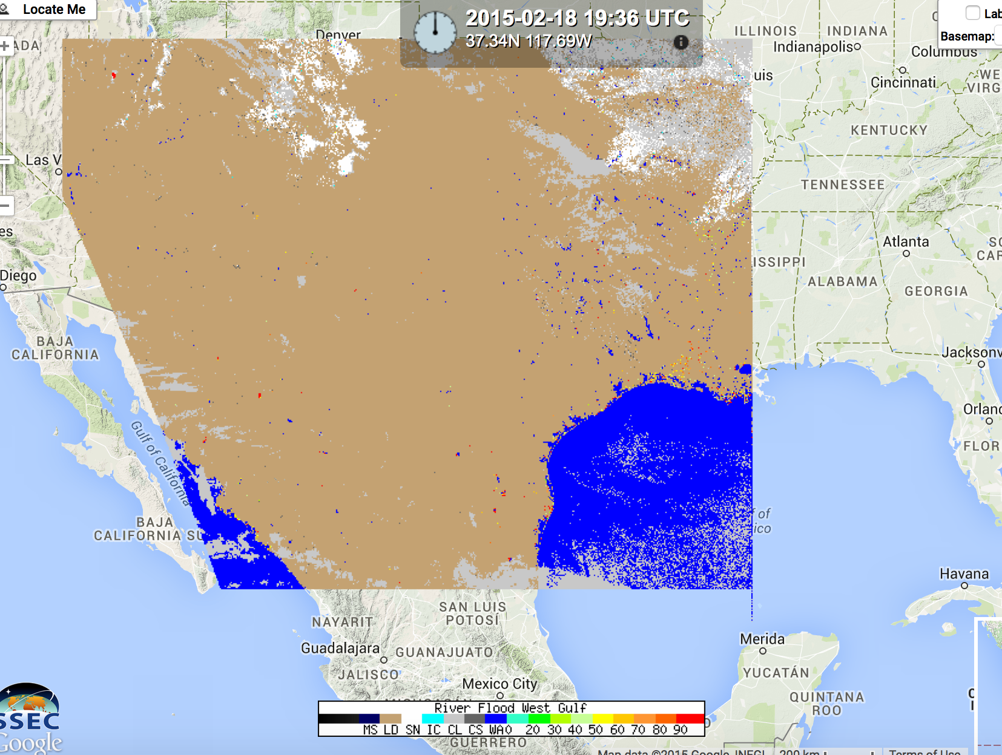
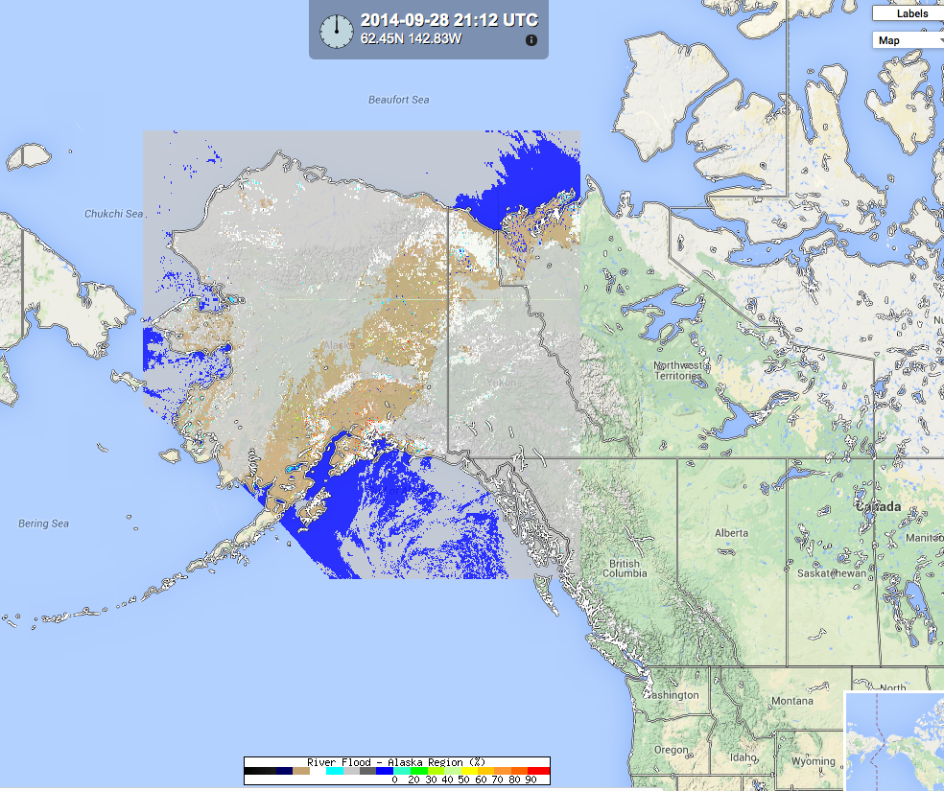
Regional coverage
Missouri Basin
North East
West Gulf
Alaska Pacific

Slide 16
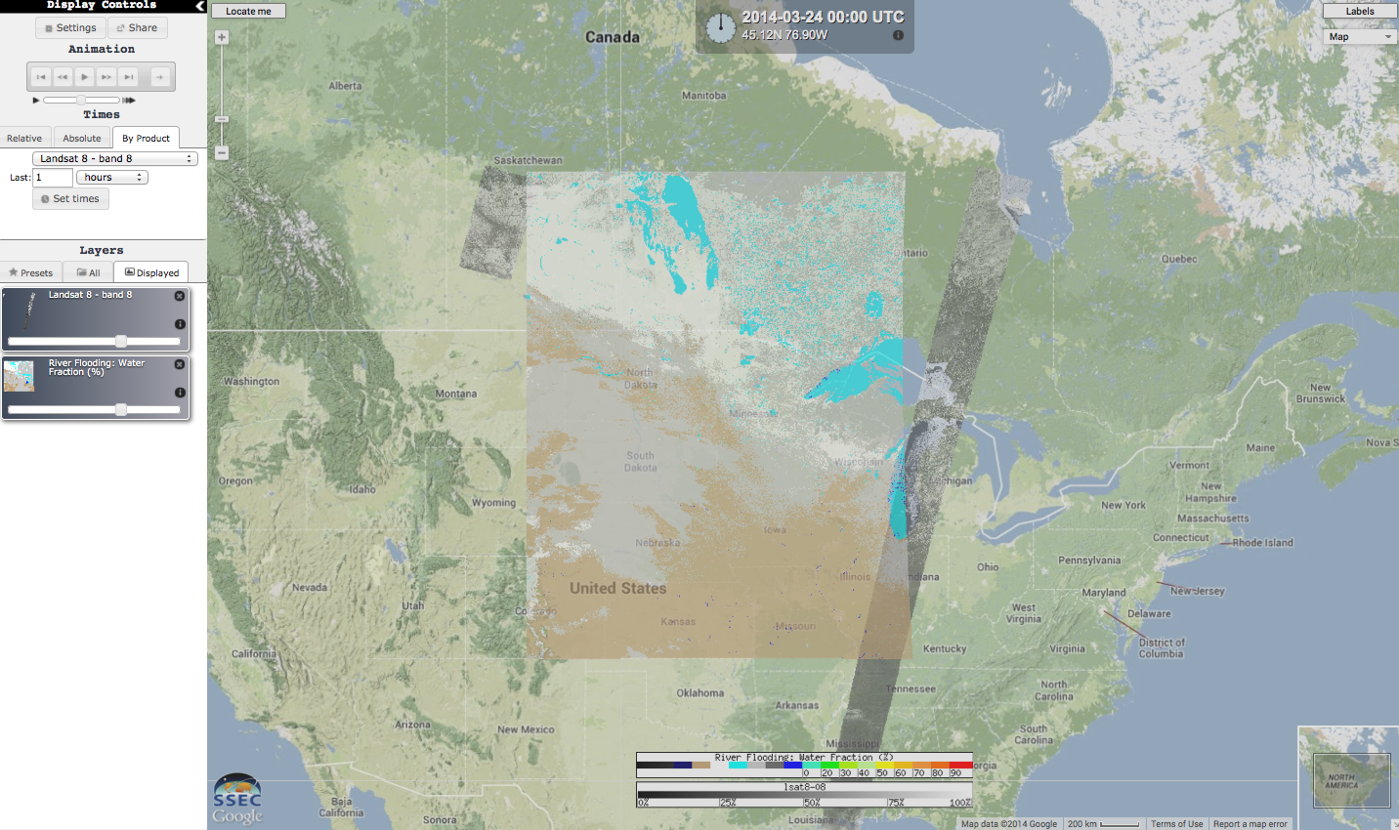
River Flood with Landsat

Slide 17
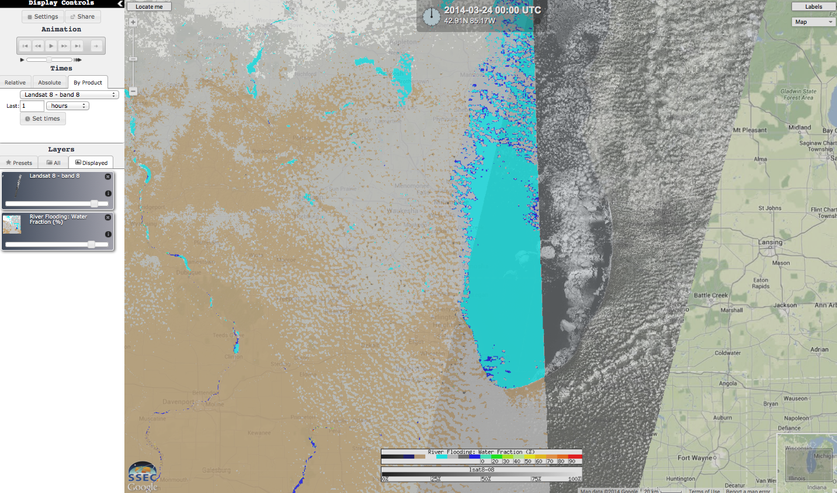
River Flood with Landsat

Slide 18
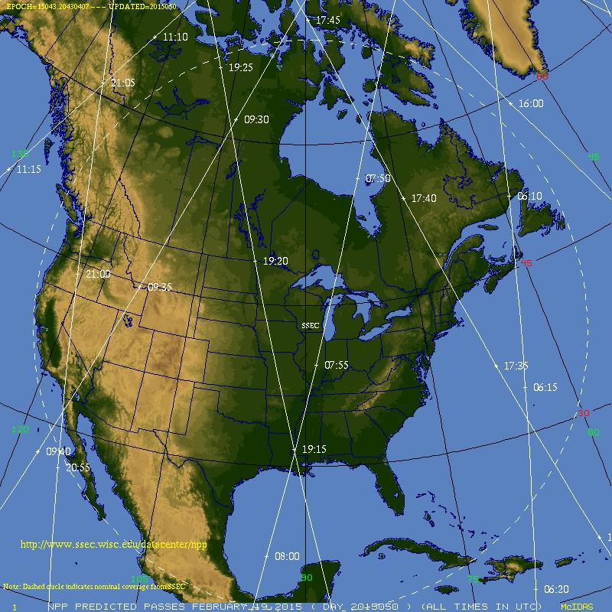
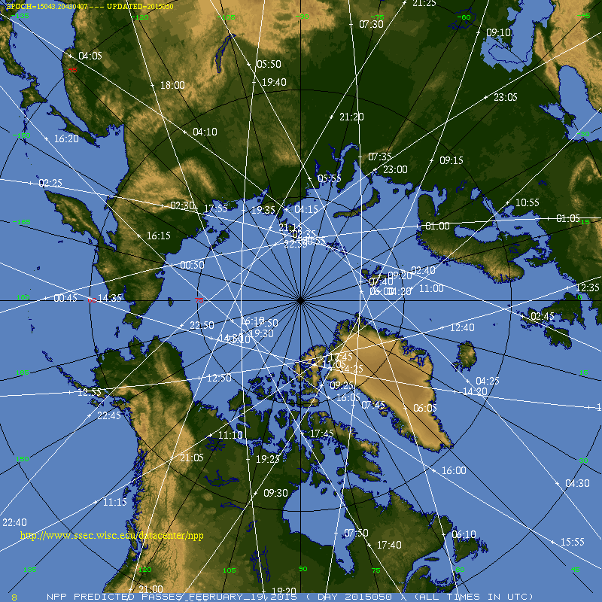
Product Status
River Flood: All sectors generated routinely
River Ice: All sectors generated routinely
Products updated about twice daily for each RFC region
Polar orbit tracks
http://www.ssec.wisc.edu/datacenter/npp/NA.html
http://www.ssec.wisc.edu/datacenter/npp/ARCTIC.html

Slide 19
River Flood in RealEarth
NCRFC, NERFC, MBRFC, WGRFC, APRFC regions
These links will always display the last 2 days
North Central: http://realearth.ssec.wisc.edu/s/S1ZuU
North East: http://realearth.ssec.wisc.edu/s/E1ZxU
Missouri Basin: http://realearth.ssec.wisc.edu/s/f1Zys
West Gulf: http://realearth.ssec.wisc.edu/s/y1ZBB
Alaska Pacific: http://realearth.ssec.wisc.edu/s/01ZCM

Slide 20
River Ice in RealEarth
NCRFC, NERFC, MBRFC, APRFC regions (no WGRFC)
These links will always display the last 2 days
North Central: http://realearth.ssec.wisc.edu/s/e2eZW
North East: http://realearth.ssec.wisc.edu/s/v2f1P
Missouri Basin: http://realearth.ssec.wisc.edu/s/A277j
Alaska Pacific: http://realearth.ssec.wisc.edu/s/j274a

Slide 21
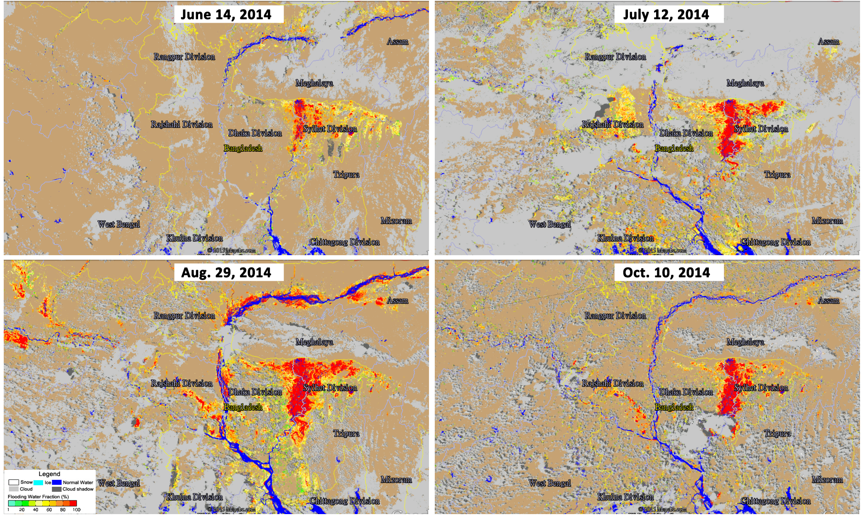
River Flood Product: Bangladesh
Changes in flooding over the summer of 2014 in Bangladesh
“An official at the disaster management…said the floods have affected more than 74,000 people…and have also affected crops, with more than 100,000 acres of farmland submerged in 20 districts, most in the north of the country.” (Reuters, 26 Aug 2014)

Slide 22
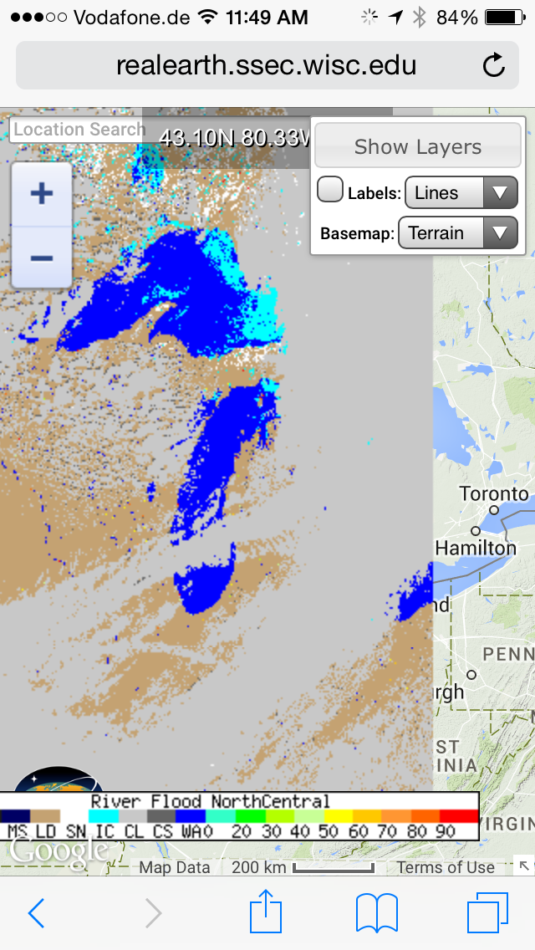
Mobile access to RealEarth: Browser
Start with shortcut link
No data probes
http://realearth.ssec.wisc.edu/s/S1ZuU

Slide 23
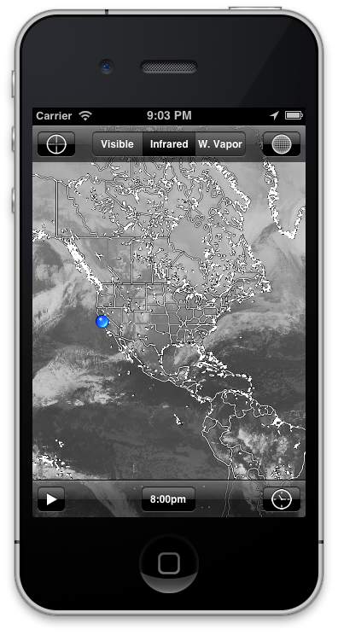
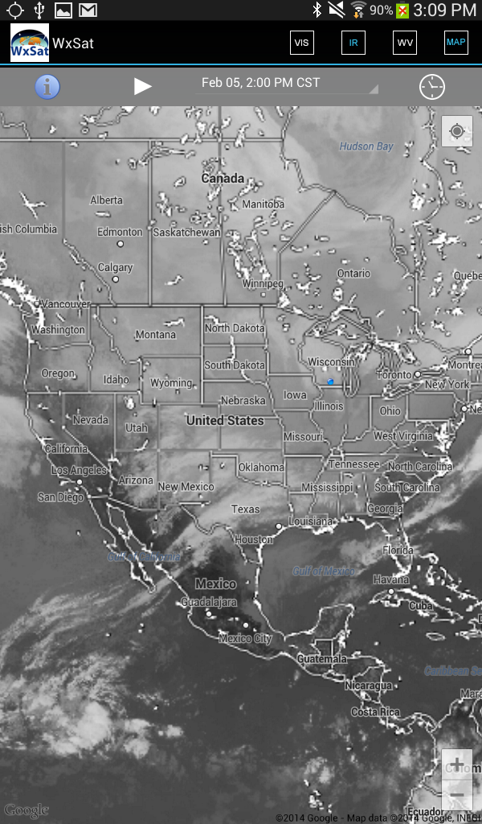
Mobile access to RealEarth: Native app
WxSat on iOS and Android
https://itunes.apple.com/us/app/wxsat/id627994249?mt=8
https://play.google.com/store/apps/details?id=edu.wisc.ssec.wxsat
Currently only global composites of visible, IR window, and water vapor channels

Slide 24
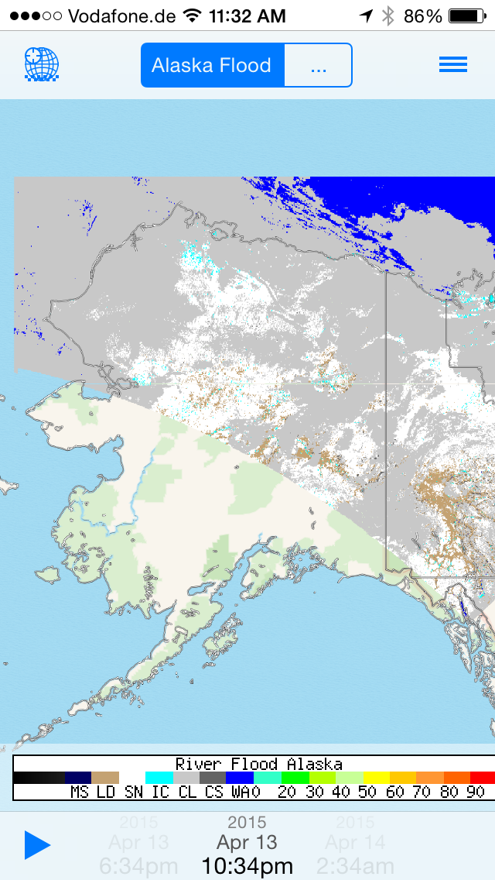
Update to WxSat App
Access to all 200+ RealEarth products
Create favorites
Likely to be called ‘RealEarth’
Available later this year

Slide 25
Training
NOAA-led (Bill Sjoberg) monthly telecons:
NWS, algorithm developers (GMU, CCNY), CIMSS
Work through issues, discuss specific flood and river ice cases, evaluate updates to products
Documentation and interpretation of products
CIMSS provides product generation and a means for viewing in AWIPS (NWS) and RealEarth (all others): Facilitates interactions between algorithm developers and NWS forecasters

Slide 26
Status and Future Plans
Product generation continues at CIMSS and GINA
NOAA PG/RR proposal funded to continue the product generation, maintenance, etc. of the flood and ice algorithms
Update to WxSat app to access all RealEarth products

