Slide 1
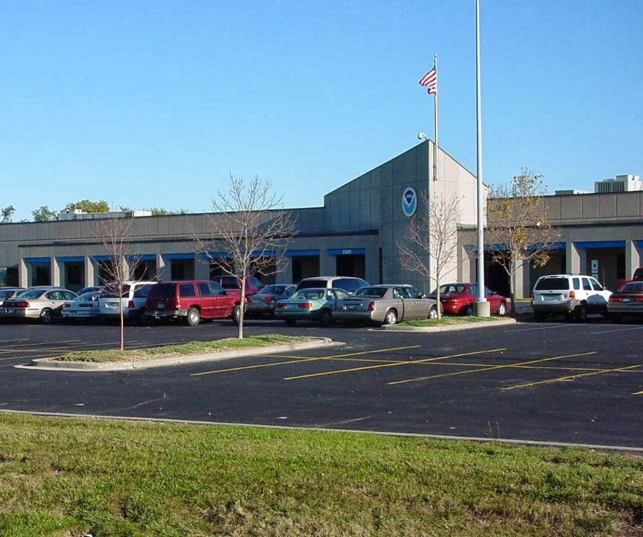
Training Resources Highlighting the Benefits and Impacts of Satellite Data Assimilation into NWP (AKA: Where to learn more)
Wendy Schreiber-Abshire,
Patrick Dills, & Bill Bua
UCAR’s COMET Program
17 June 2015
Satellite Proving Ground/User-Readiness Meeting
The purpose of this meeting is to assess the status of GOES-R and JPSS user-readiness for NWS and other NOAA staff while identifying the remaining gaps in preparation for the 2016-2017 launch targets.

Slide 2
Over 100 Satellite-specific lessons on MetEd, and three multi-lesson courses, one of which is on GOES-R⁺ (69 English, 25 Spanish, 16 French)
Open to all to use. A simple free registration required.
Over 20,000 meaningful English satellite lesson user sessions per year
NESDIS satellite training activities with the COMET Program attract additional funding and training development specifically in the satellite topic area from both EUMETSAT and the Meteorological Service of Canada
This presentation specifically highlights one of our newer satellite publications: “How Satellite Data Impact NWP”
Notes:
I will use this slide to set the groundwork. The idea for this lesson came out of a PG User Readiness meeting several years ago.

Slide 3
2014 Lesson Usage (Eng):
> 400 Sessions
Lesson released:
12 March 2014
Notes:
I will highlight the lesson usage in it’s first 9 months
Another 193 uses during Jan-April 2015

Slide 4
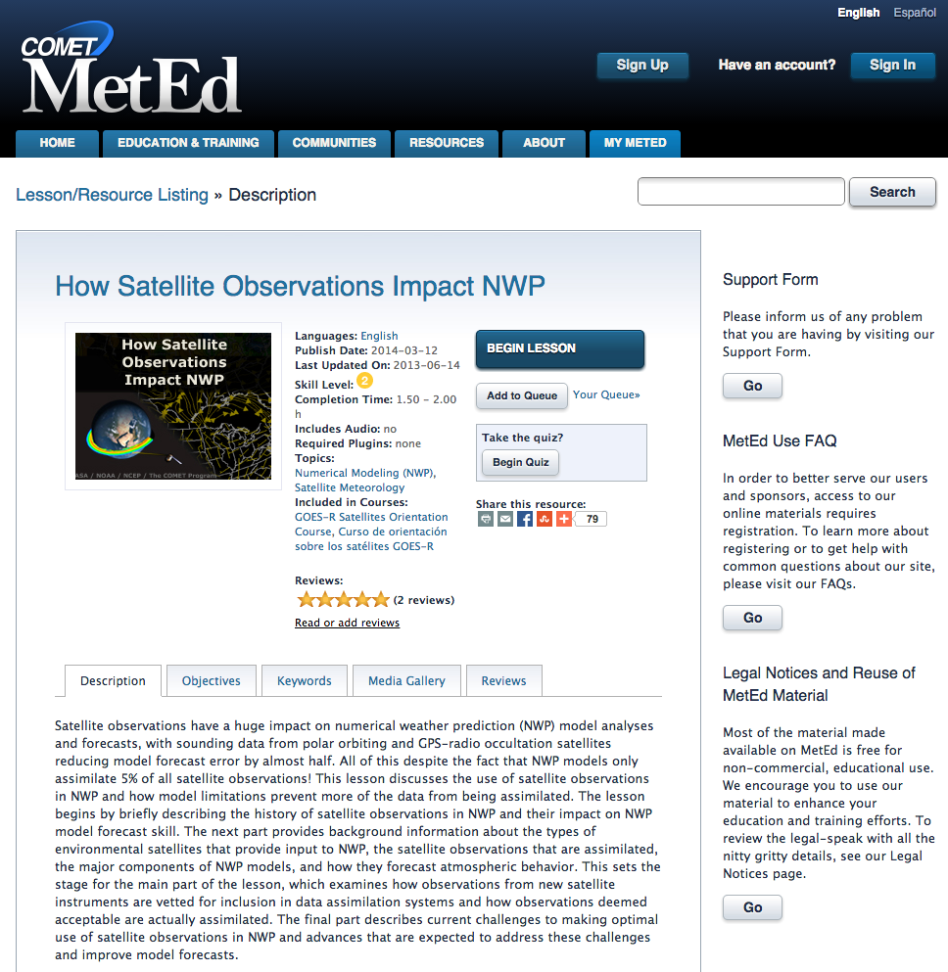
Notes:
I will highlight the metadata for the lesson and important related tabs

Slide 5
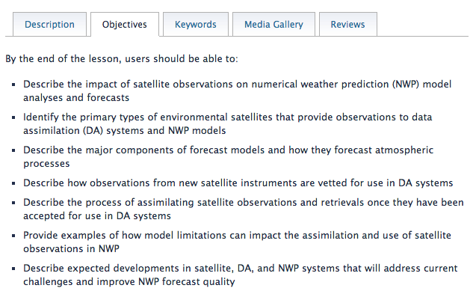
How Satellite Observations Impact NWP
90-120 minute interactive lesson
meted.ucar.edu/satmet/sat_nwp
Notes:
Highlight the lesson objectives

Slide 6
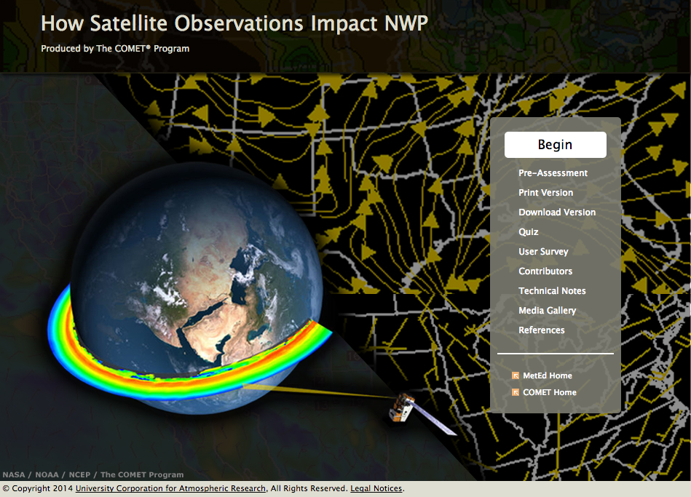
Notes:
Discuss the elements of the lesson package shown in the menu

Slide 7
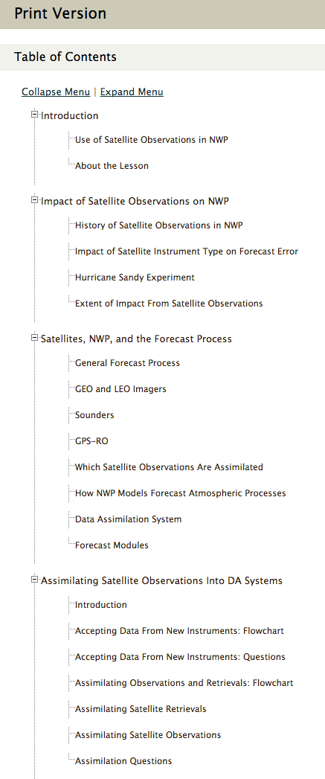
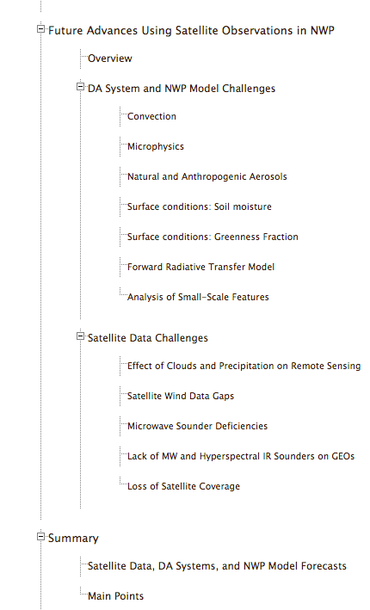
Notes:
The complete Table of Contents for the Lesson

Slide 8
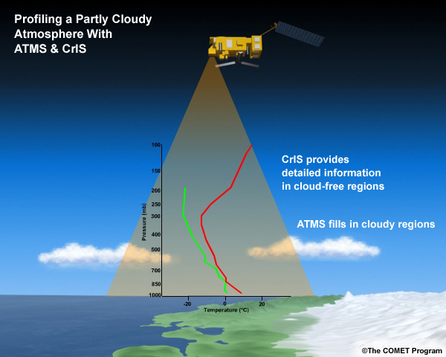
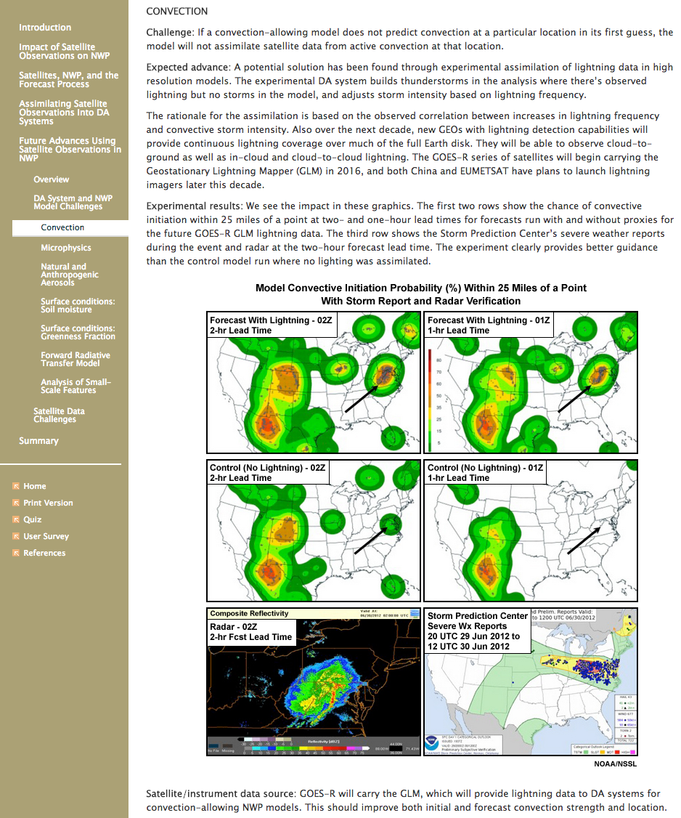
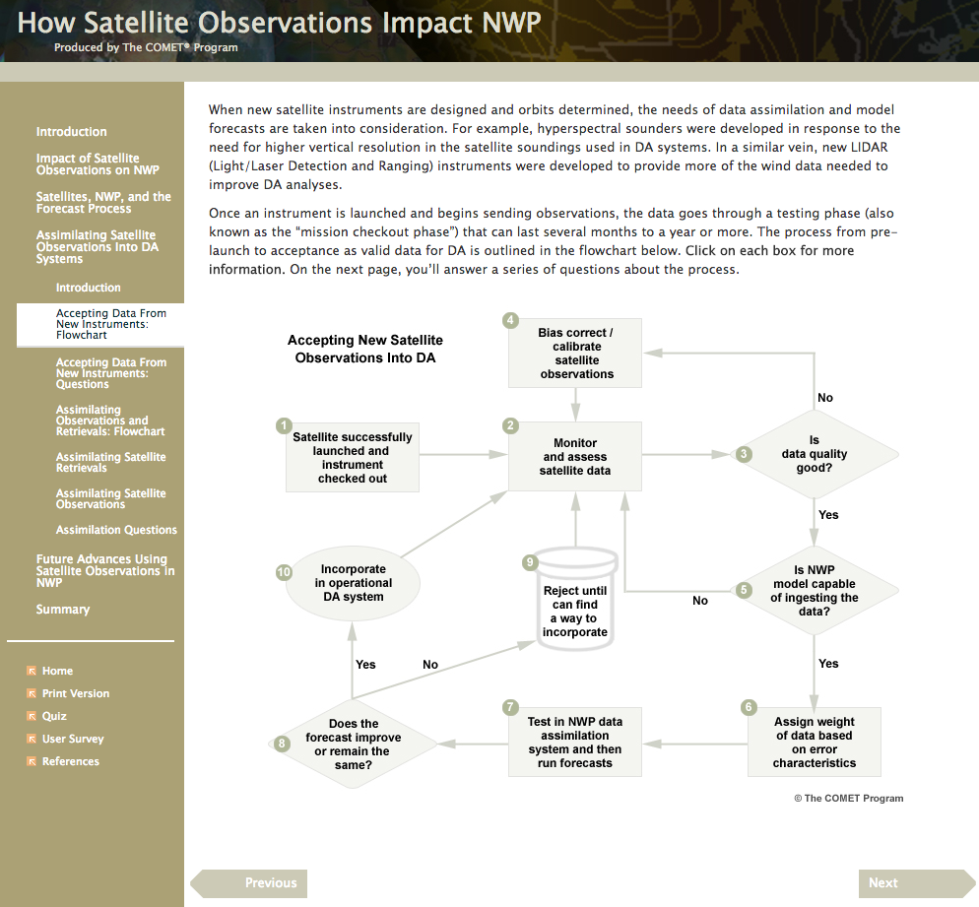
Notes:
Sample graphics and screens. Original artwork, interactive flow chart on the DA process, explanation of anticipated advancements, etc

Slide 9
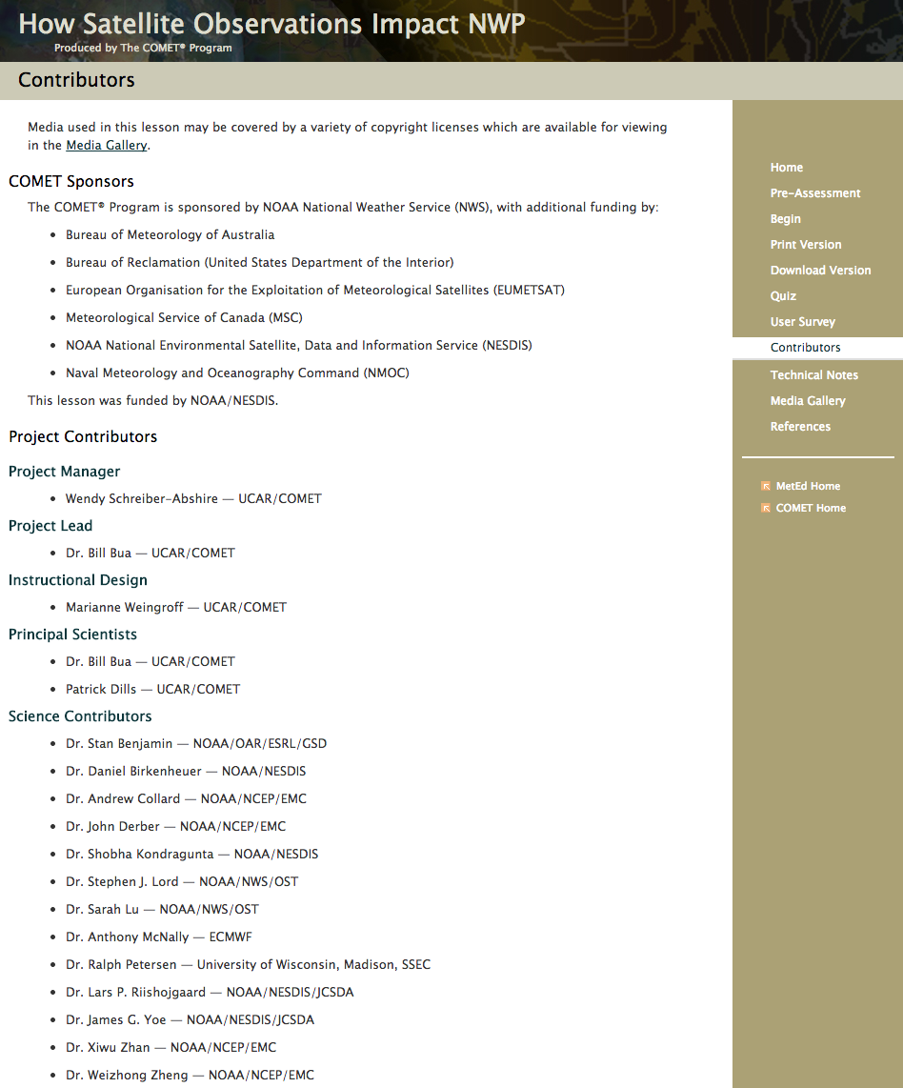
Grateful to an expert team of contributors and reviewers
Notes:
Acknowledge the team of external contributing scientists.

Slide 10
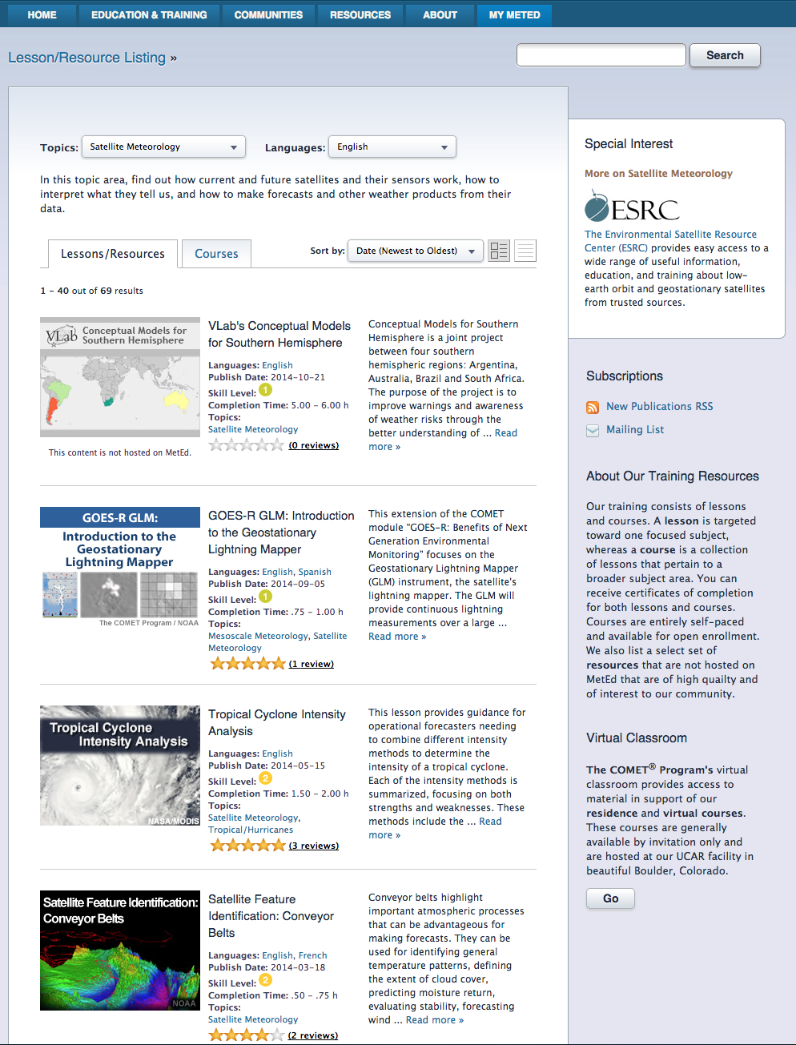
1
or
2
3
4
Notes:
I will walk audience through accessing/finding the materials.

Slide 11
abshire@ucar.edu
or bua@ucar.edu
http://meted.ucar.edu
http://meted.ucar.edu/topics/satellite
or search by keywords for either Lessons, Courses, or Images & Media

