Slide 1
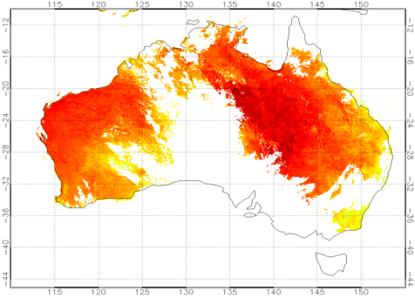
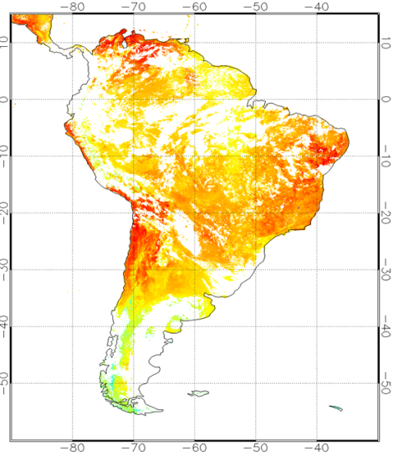
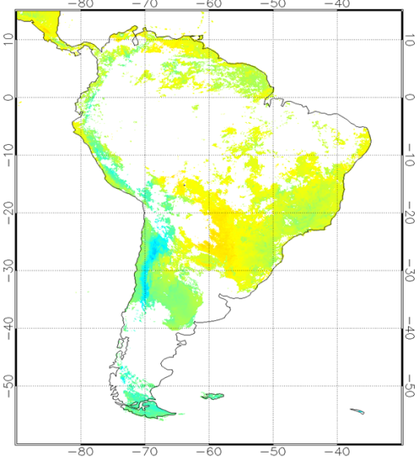
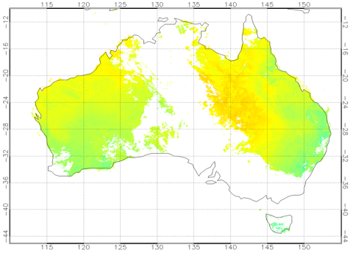
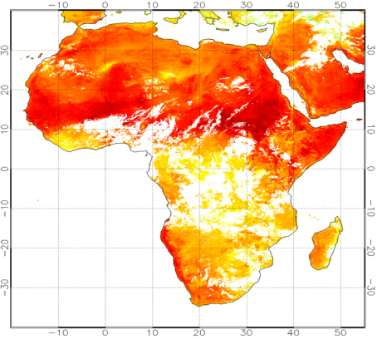
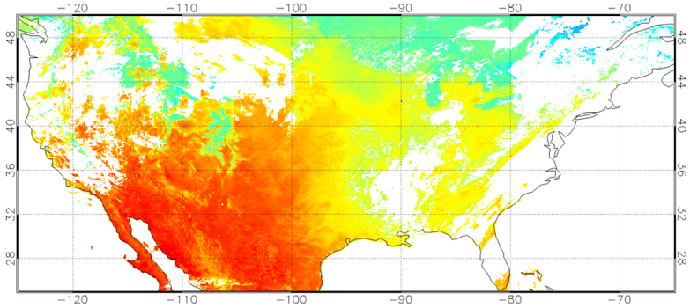
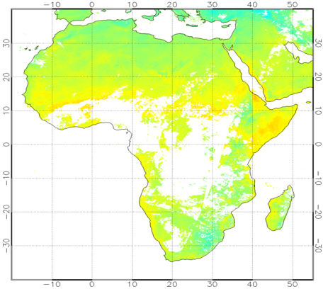
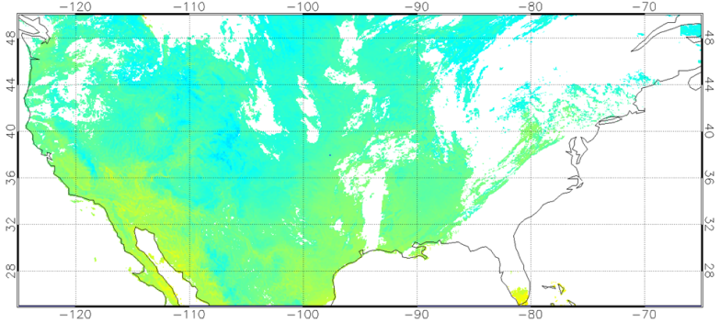
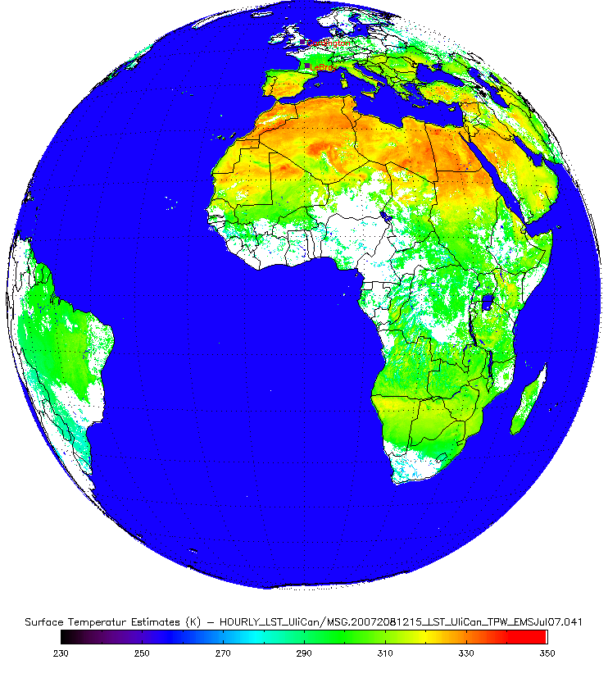
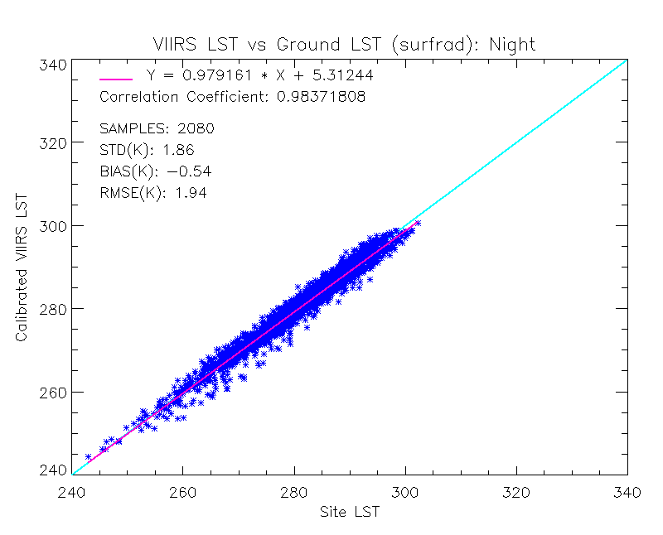
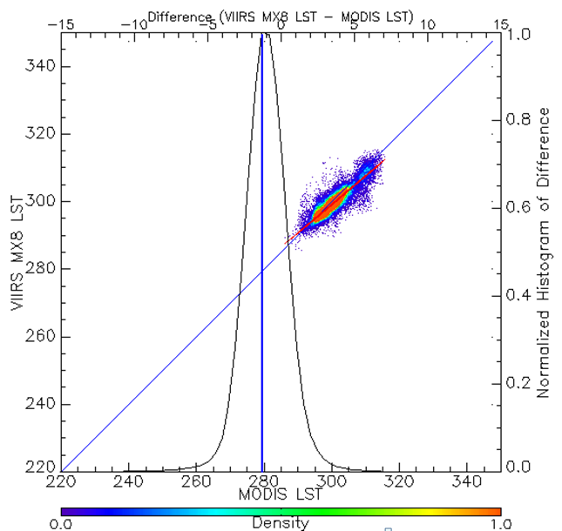
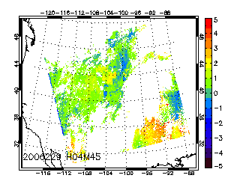
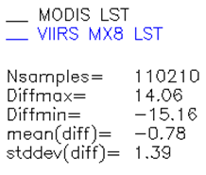
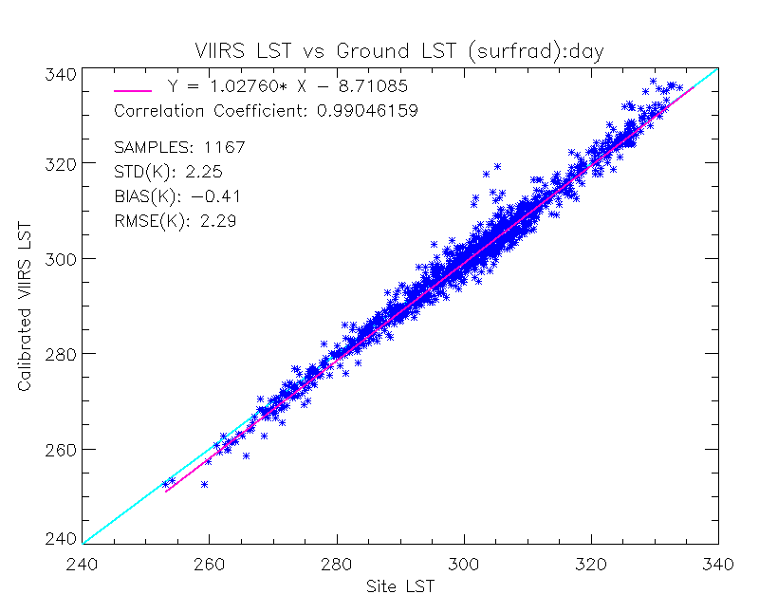
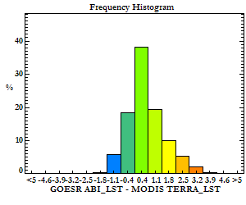
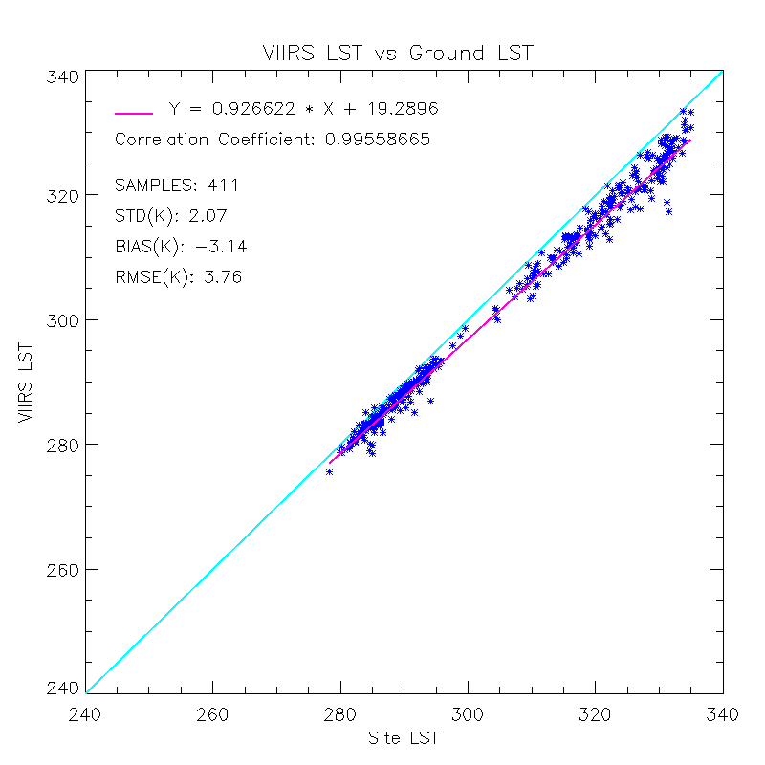
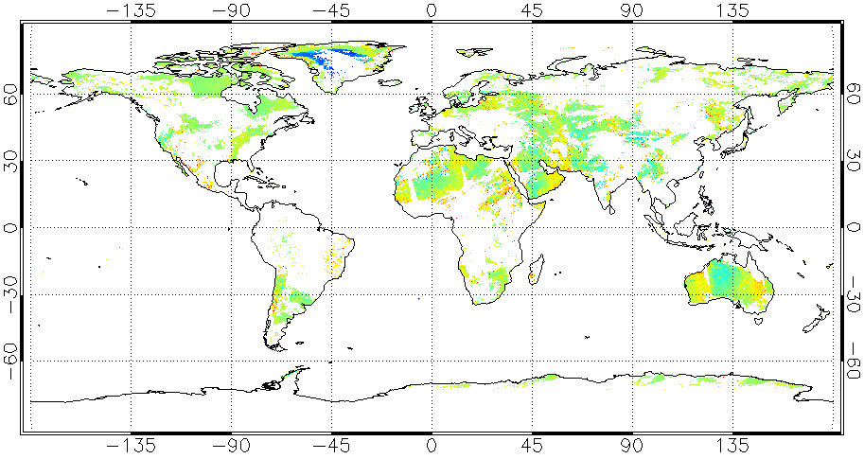
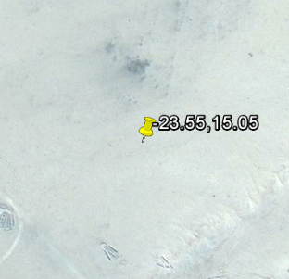
Land Surface Temperature Production
for GOES-R and JPSS Missions
Yunyue Yu¹, Yuling Liu^{1,2}, Peng Yu ^{1,2}, Jaime Daniels¹
¹NOAA/NESDIS/STAR, ²Univ. of Maryland
Introduction
Land surface temperature (LST) measurement is important for understanding climate change, modeling the hydrological and biogeochemical cycles, and is a prime candidate parameter for Numerical Weather Prediction assimilation models. Development of land surface temperature Environmental Data Record (EDR) for the U.S. Geostationary Operational Environmental Satellite (GOES) R series (GOES-R) satellite mission and the Joint Polar-orbiting Satellite System mission is one of the major tasks of the land product team at Satellite Meteorology and Climatology Division (SMCD), center for SaTellite Applications and Research center (STAR). The LST algorithm for GOES-R mission has been developed based on an emissivity explicit, split window linear regression approach, while the LST product for JPSS S-NPP mission is based on a surface-type dependent, split window regression algorithm. Pre-launch evaluation of the GOES-R LST algorithm using real satellite (proxy) data, as well as simulation data, indicates that it will be a stable and high quality product when high quality surface emissivity data at the thermal infrared band is available. Post-launch monitoring and validation works show that quality of the JPSS S-NPP LST product is equivalent to the NASA MODIS LST product. However, it may be greatly impacted by quality of the VIIRS surface type data. The first validated version of the JPSS S-NPP LST product readiness has been reviewed in December 2014; shall be operationally available March 2015.
JPSS S-NPP LST Production
JPSS S-NPP LST Algorithm
A split-window regression algorithm is running for the JPSS/VIIRS land surface temperature, T_{s}, production:
T_{s} = a_{0,i} + a_{1,i} T₁₁ + a_{2,i} (T₁₁ – T₁₂) + a_{3,i} (secθ – 1) + a_{4,I} (T₁₁-T₁₂)²
where a_{k, i} are algorithm coefficients; i indicates 17 IGBP surface types; θ is view zenith angle. T₁₁ and T₁₂ represent the VIIRS sensed brightness temperatures at 11 and 12 micron channels (the split-window).
Sample VIIRS LST Maps
GOES-R LST Production
GOES-R ABI LST Algorithm and Process Chain
A split-window, emissivity-explicit regression algorithm is implemented for the GOES-R/ABI land surface temperature, T_{s}, production:
T_{s} = a₀ + a₁ T₁₁ + a₂ (T₁₁ – T₁₂) + a₃ ε + a₄ (T₁₁ – T₁₂) (secθ – 1)
where a_{k} are algorithm coefficients, θ is view zenith angle; T₁₁ and T₁₂ represent the ABI sensed brightness temperatures at 11 and 12 micron channels (the split-window).
ABI Snow/Ice Mask
Land/coast Mask
Emissivity
NCEP WV
ABI Cloud Mask
Extract
Ancillary
Data
Data
Mapping
Land
Check
Cloud
Filtering
ABI Goelocation
Extract
ABI Inputs
Criteria values
ABI Radiances
Coeffs LUT
ABI Solar-View Geometry
Dry/Moist
Flagging
ABI Sensor QC flags
QC
Control
Day/Night
Flagging
LST
EDR
LST
Wrap up
SW LST
Algorithm
ABI Sensor Input
ABI Ancillary Input
ABI LST Processing Chain
Non-ABI Ancillary Input
Evaluations using proxy data
Other Input
Evaluations
ABI LST Map using SEVIRI data as a proxy (right), and evaluation results using MODIS as proxy (bottom).
1. Evaluation against SURFRAD Station data
Surface type | Day/ Night | datanum | Provisional |  | Beta
 |  |  | Bias | STD | Bias | STD
Deciduous Broadleaf Forest | day | 4 | -0.67 | 0.80 | 0.31 | 3.10
 | night | 11 | -0.13 | 1.60 | -0.13 | 1.60
Closed Shrub lands | day | 37 | -0.81 | 1.77 | -1.16 | 1.77
 | night | 57 | -1.37 | 0.80 | -2.48 | 0.63
Open Shrub lands | day | 277 | -0.1 | 1.90 | 0.67 | 1.90
 | night | 327 | -0.88 | 0.79 | -2.38 | 0.79
Woody Savannas | day | 46 | -1.09 | 2.39 | -0.34 | 2.81
 | night | 81 | 1.38 | 1.35 | 1.38 | 1.35
Grasslands | day | 172 | -0.38 | 1.90 | 1.11 | 2.36
 | night | 500 | -0.35 | 1.41 | -0.35 | 1.41
Croplands | day | 266 | 0.14 | 2.95 | 2.39 | 3.54
 | night | 558 | -0.21 | 1.58 | -0.21 | 1.58
Cropland/Natural Veg Mosaics | day | 208 | -0.83 | 1.98 | 0.13 | 2.15
 | night | 459 | 0.47 | 1.94 | 0.47 | 1.94
Snow/ice | day | 97 | -1.16 | 1.67 | -1.95 | 1.70
 | night
Barren | day | 60 | 0.72 | 1.68 | 0.12 | 2.10
 | night | 87 | -1.17 | 0.88 | -2.67 | 0.88
SURFRAD LST over 6 sites covering the time period from Feb. 2012 to December 2013
Night
Day
2. Evaluation against MODIS LST data (above: Granule comparison; bottom right: Global comparison)
3. Evaluation against ground station dataset at Gobabeb, Namibia.
*The data (2012) is provided by Frank Goettsche, thanks Pierre for sharing the data.
Validation sample: Image and histogram plot of LST difference between the proxy GOES-R LST and the MODIS LST. The data is sampled from MODIS Terra, on August 17, 2006.
April 19th, 2014
Summary
An explicit split-window algorithm has been applied for the GOES-R ABI LST measurement.
The algorithm package has been developed and implemented in the mission’s ground system.
The U.S. SURFRAD station measurement is applied for evaluation of the GOES-R ABI LST data.
Simulation and proxy satellite data have been used for the pre-launch validation; the requirement is met .
A validation and monitoring tool is in development.
The Japanese Himawari-8 satellite data will be used for the pre-launch evaluation.
Overall, S-NPP/VIIRS LST quality meets the Mission’s requirement, based on the in-situ LST measurements from the U.S. SURFRAD stations during the period from Feb. 2012 to Aug. 2014.
Quality of S-NPP/VIIRS LSTs and MODIS LSTs are similar, based on the comparisons of over 100 VIIRS/MODIS simultaneous nadir observation scenes.
The S-NPP/VIIRS LST production is stable, based on STAR weekly LST monitoring.
Impact of sensor noise is ignorable; impacts of ST misclassification and cloud contamination are significant.
Validated V1 version of the VIIRS LST product will be available March 2015.

