Slide 1
The USE OF GOES-R RGB and AIRMASS IMAGERY at nhc/TAFB
Hugh Cobb, Chief NHC/Tropical Analysis and Forecast Branch
NOAA GOES-R Satellite Proving Ground Readiness Meeting
Kansas City, MO - 18 June 2015
* Acknowledgment – Loops courtesy of Michael Folmer

Slide 2
Tafb goes-r pg timeline
1 Aug 2010 - NHC begins GOES-R Proving Ground activities
(Hurricane Season only)
Jan 2012 – TAFB joins OPC/SAB/HPC proving ground (Year-round)
Oct 2012 – Satellite Proving Ground for Marine, Precipitation and Hazardous Weather
Summer 2014 – Nelsie Ramos becomes Satellite PG Focal Point in TAFB

Slide 3
GOES-R PRODUCT DEMO timeline
Aug 2010-Spring 2012 – RGB Airmass and Dust
Summer 2012 – Saharan Air Layer (SAL)
Pseudo Natural Color
Tropical Overshooting Tops (TOT)
Summer 2013 – Overshooting Tops Detection (OTD)
VIIRS Night/Day Band
Summer 2014 – Lightning Density
Winter 2015 – Fog and Low Stratus
Summer 2015 – Layered TPW
Convective Initiation (CI)
WRF Simulated ABI

Slide 4
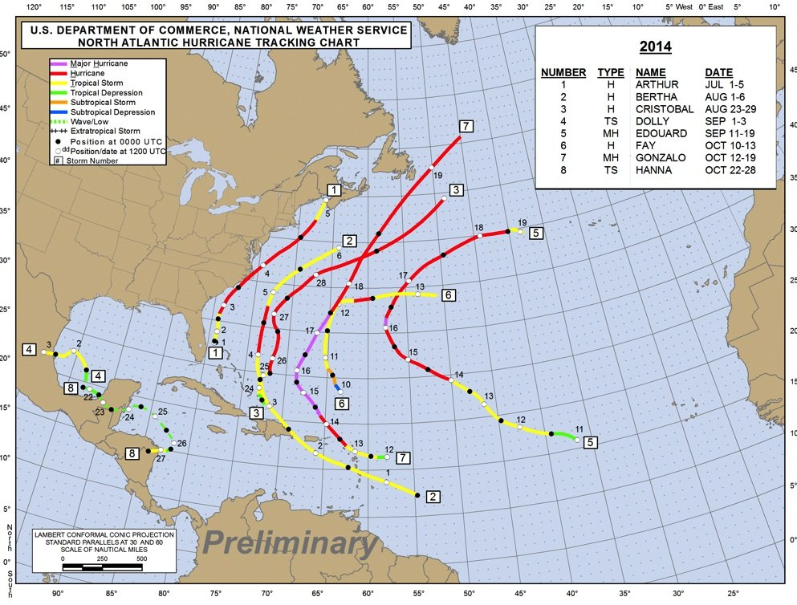
CASES
Below average 2014 season
87% Hurricanes > 25 North
4 Weak Tropical Waves
RGB Airmass, Dust and SAL imagery

Slide 5
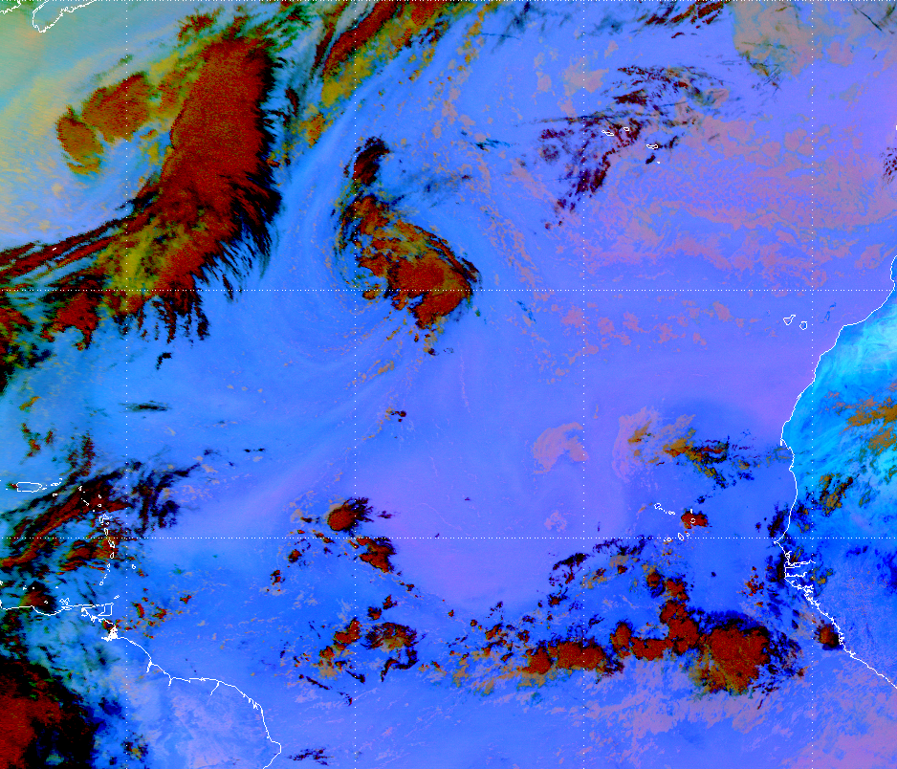
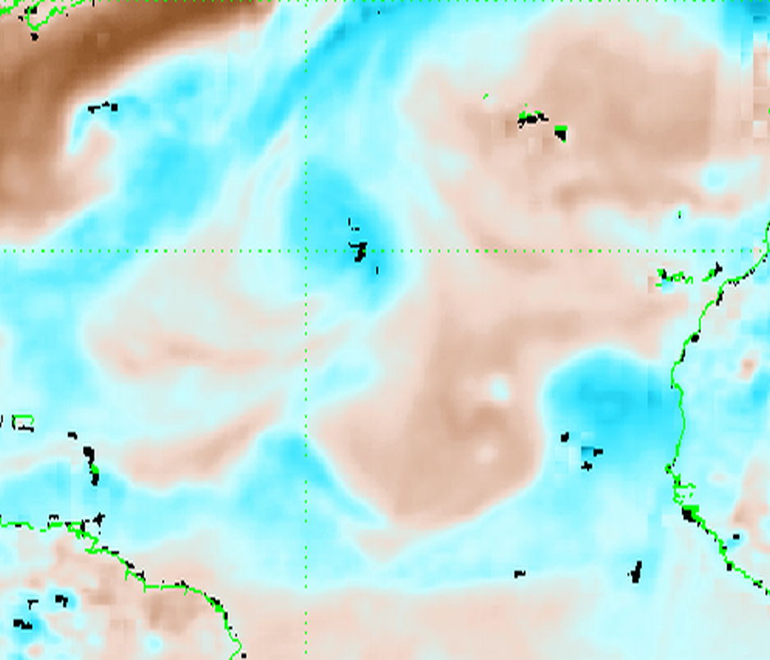
T.S. Humberto 18 September 2013
GOES-R RGB Dust – 1200 UTC
GOES-R Blended TPW – 1200 UTC
Imagery Courtesy of Joachen Karl Kerkmann

Slide 6
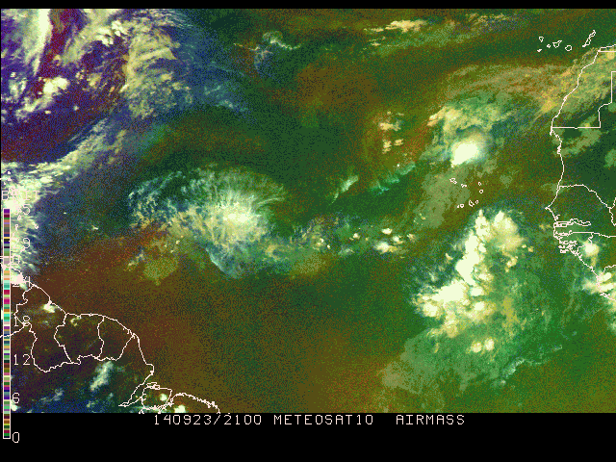
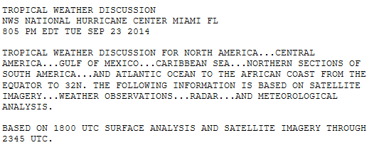
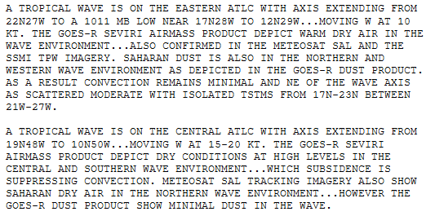
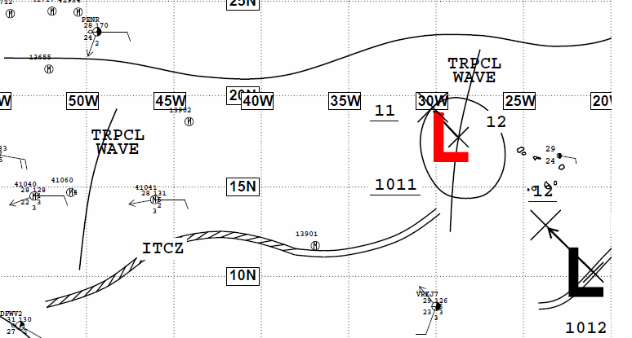
CASE 1 – 23 September 2014
2100 – 0300 UTC 23-24 September
Analysis - 1800 UTC 23 September

Slide 7
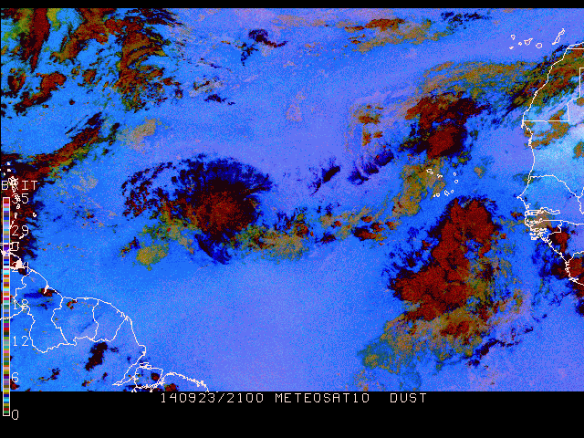
CASE 1 – 23 September 2014
2100 – 0300 UTC 24 September

Slide 8
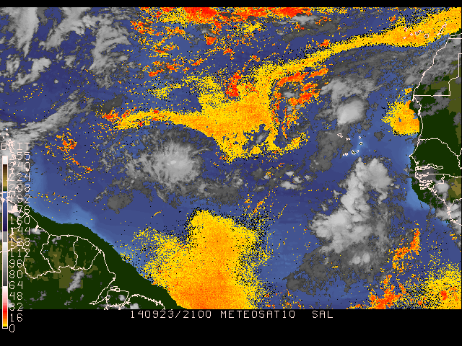
CASE 1 – 23 September 2014
2100 – 0300 UTC 24 September

Slide 9
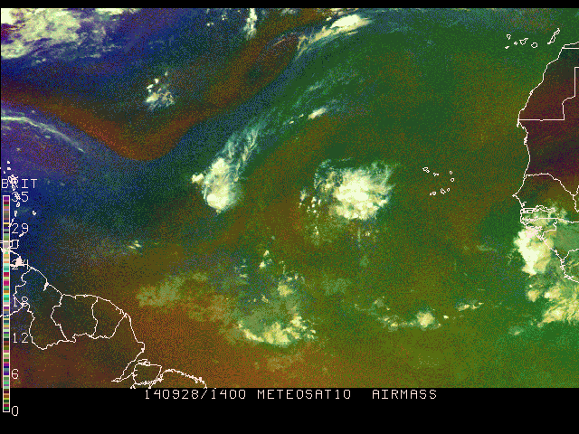
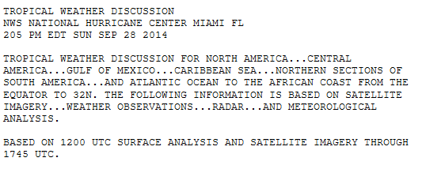
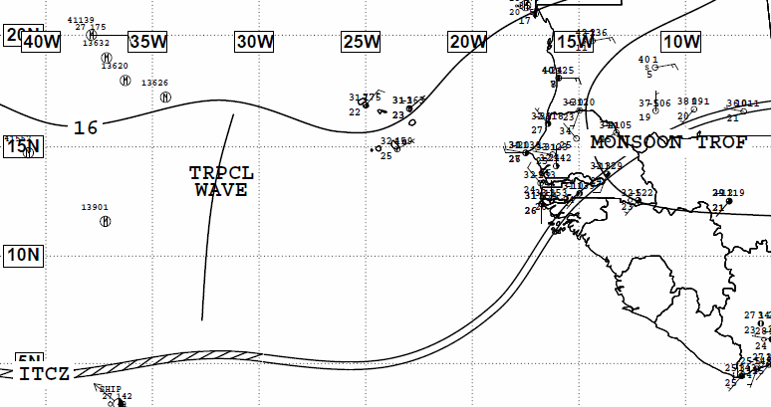
CASE 2 – 28 September 2014
1400 – 2000 UTC 28 September
Analysis - 1200 UTC 28 September

Slide 10
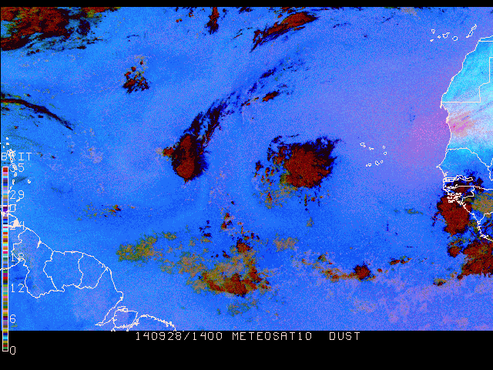
CASE 2 – 28 September 2014
1400 – 2000 UTC 28 September

Slide 11
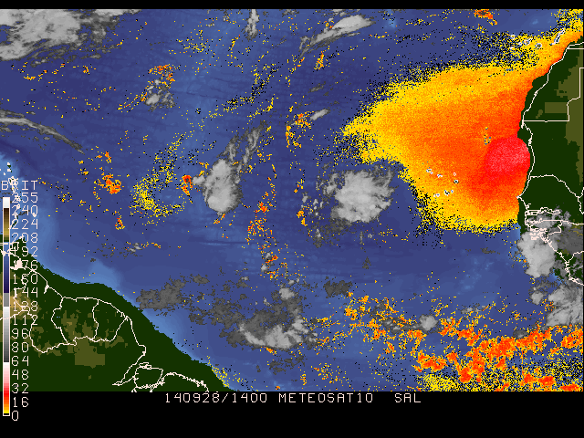
CASE 2 – 28 September 2014
1400 – 2000 UTC 28 September

Slide 12
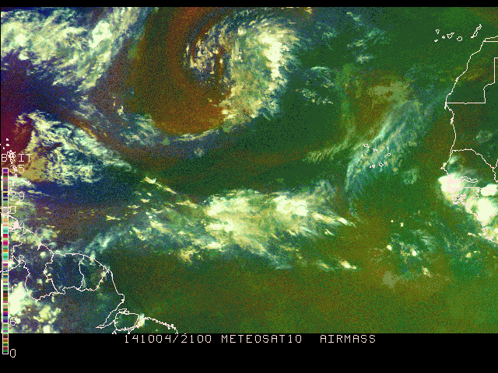
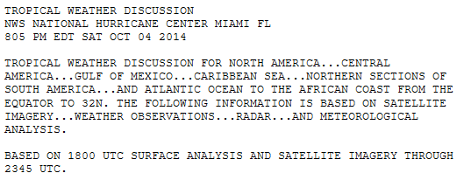
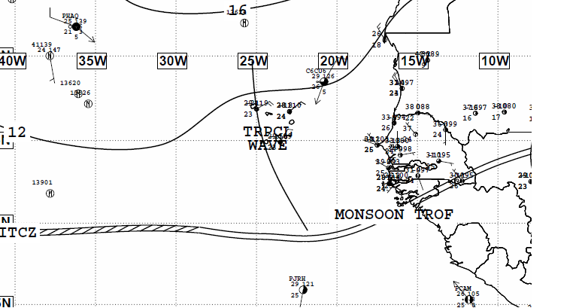
CASE 3 – 4 October 2014
2100 – 0600 UTC 4-5 October
Analysis - 1800 UTC 4 October

Slide 13
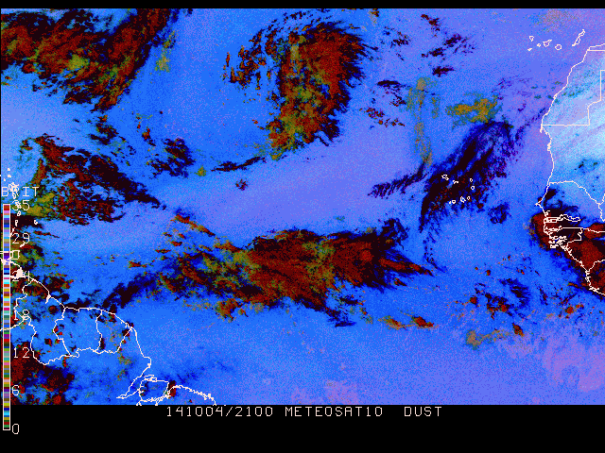
CASE 3 – 4 October 2014
2100 – 0600 UTC 4-5 October

Slide 14
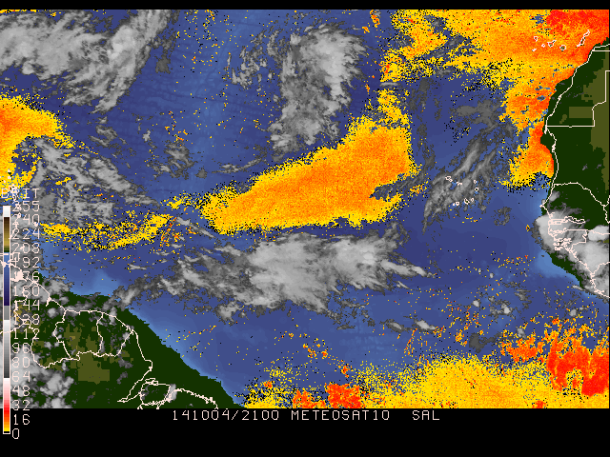
CASE 3 – 4 October 2014
2100 – 0600 UTC 4-5 October

Slide 15
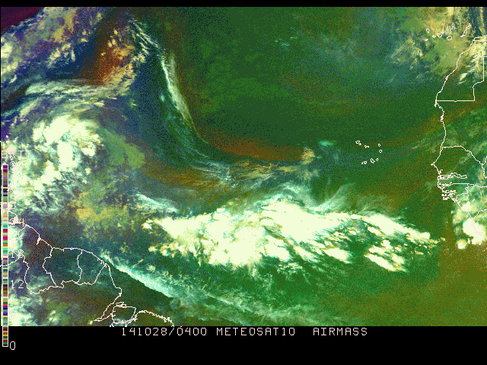
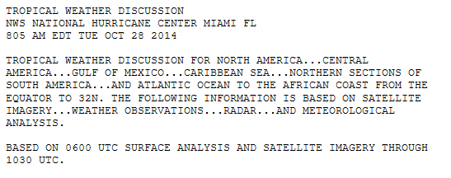
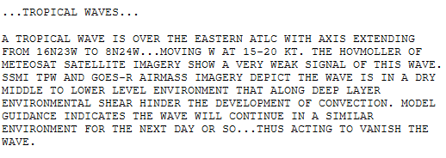
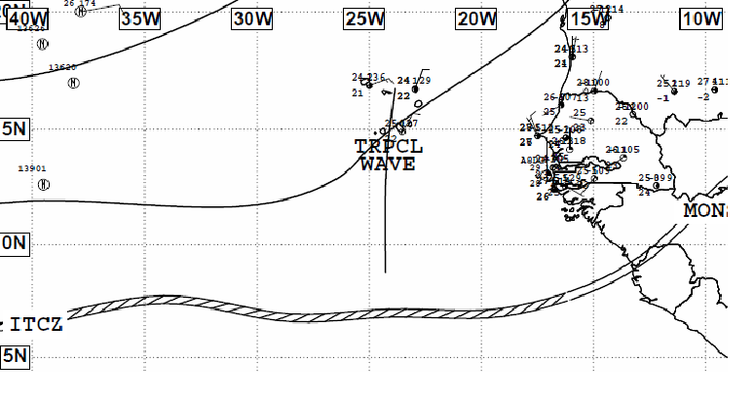
CASE 4 – 28 October 2014
0400 – 1200 UTC 28 October
Analysis - 0600 UTC 28 October

Slide 16
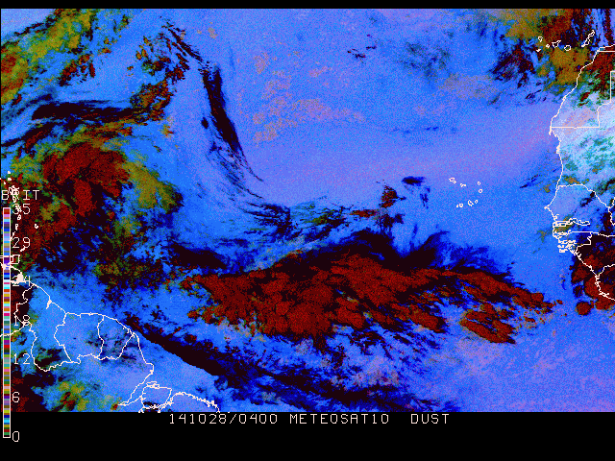
CASE 4 – 28 October 2014
0400 – 1200 UTC 28 October

Slide 17
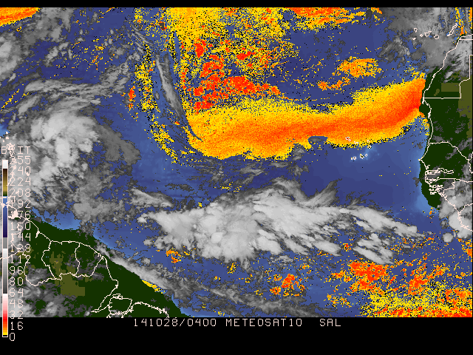
CASE 4 – 28 October 2014
0400 – 1200 UTC 28 October

