Slide 2
GOES-R in Max
The benefits are well known, 5x faster data, 4x better resolution, ~3x more spectral channels
What challenges does this new data present?
How is The Weather Company overcoming these challenges?
What kind of data can be expected?

Slide 3
GOES-R produces roughly 1.75 TB of data per day, much more data than current satellites, and changes the paradigm of how data should be delivered

Slide 4
Traditional Data Delivery for Max (“Skybase”)
Data is pushed to each customer (by subscription)
Point data (e.g. iCast feed, obs, etc.)
WWA Info
“Raster” data (e.g. Radar, Satellite, Forecast model grids). Note that Raster data is often referred to as “RQT” (raster quad tree) data
Skybase data is always there, even if never used.
Not very efficient – requires more…
Bandwidth
System processing power
System disk space

Slide 5
IBM is making significant investments in analytics and cloud computing. As an enterprise, we are committed to making “Big Data”, including GOES-R, available wherever it is needed.
Introducing the “Data From the Cloud” (DFC) Service

Slide 6
DFC Service (New)
New data products (including GOES-R data) are pushed to the Cloud
Max scenes automatically fetch required data from Cloud
For scenes that are active in hits (shows), or workspaces
Max will not fetch parameters or areas of the world that the scene does not need
If geography of a scene changes, Max will adjust and begin fetching what it needs (also new parameters, new models, etc.)
A slight delay will be apparent for the first fetch, then data is cached and kept up to date thereafter.
For maximum efficiency, data is fetched ONCE by the Max Core and shared automatically with all workstations, even if Max is not running

Slide 7
DFC Service
Available with Max v6.3:
Global 13km RPM
Himawari-8 Satellite Imagery (similar imager as GOES-R)
NOAA Satellite Data
GOES-East and West - IR 4k, VIS 2k, WV 4k
15 min update w/ 7.5 min Rapid Scans

Slide 8
Weather Company GOES-R Plans
Much Higher Resolution = Much Bigger Images
Example: One full disk .5km Visible image is 21,696 x 21,696 (~471M pixels) and 270 Mb.
Even at 50Mbps download speeds, that would take close to a minute for just that one image (not efficient)
Logical Product Footprints Being Adopted
The following examples will be made available in Max systems that meet the minimum hardware requirements.

Slide 9
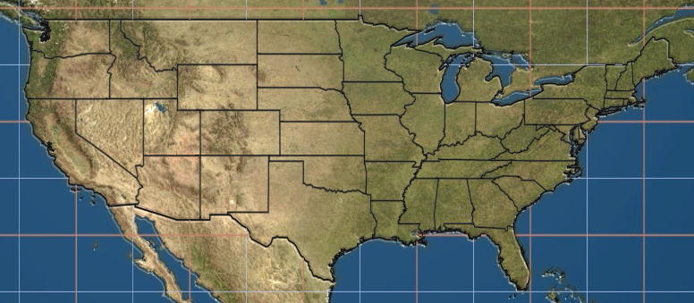
GOES-R Sample Footprints (approximate)
CONUS 0.5km VIS… 5 min updates
CONUS 2km IR … 5 min updates

Slide 10
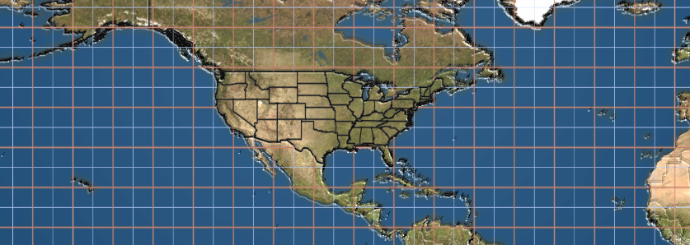
GOES-R Sample Footprints (approximate)
Northern Hemisphere 0.5km VIS… 5 or 15 (most likely) min updates
Northern Hemisphere 2km IR… 5 or 15 (most likely) min updates
Northern Hemisphere 2km WV… 5 or 15 (most likely) min updates

Slide 11
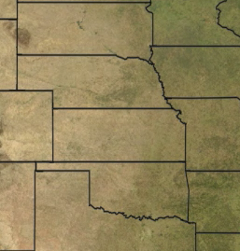
GOES-R Sample Footprints (approximate)
Floater .5km VIS… 30 sec or 1 min (most likely) updates
Floater 2km IR… 30 sec or 1 min (most likely) updates

Slide 12
Weather Company GOES-R Plans
Future Products
Access to GLM data
Other L2+ products are being investigated (rainfall rate, derived stability indices, total precipitable water etc.)
http://www.goes-r.gov/products/baseline.html
Anything outside of “Radiances” in the ABI column is a Level 2+ product

Slide 13
Weather Company GOES-R Plans
Media System Access
Full-resolution data sets only available on Max (i.e. not WxPro, Fusion, :LIVE, LiveWire, etc.)
Minimum Max configuration includes a newer Dual Core (less than 4 yrs. old) & z820 or better workstation(s)
We will use GOES-R data to synthesize current generation GOES products (spatial and temporal resolution) for legacy/older systems. These products will look essentially as they do today.

Slide 14
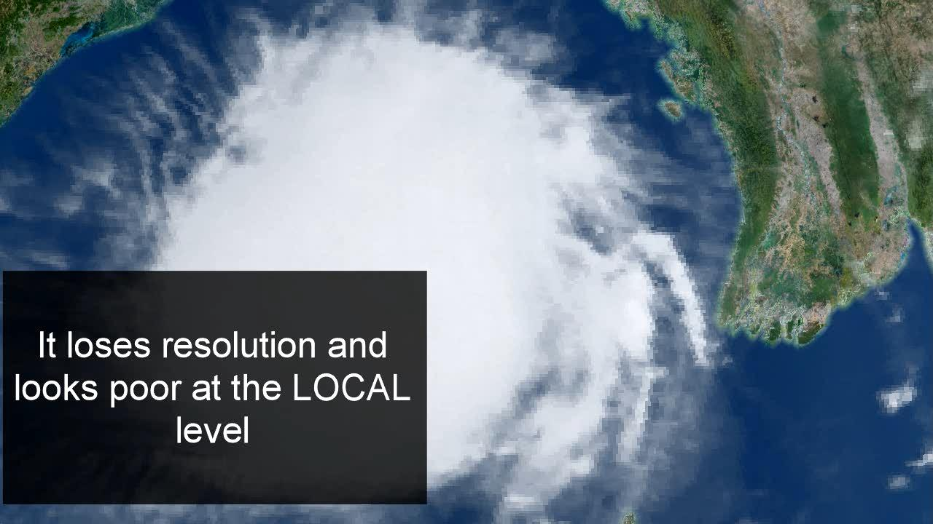
Example – Existing 4km IR

Slide 15
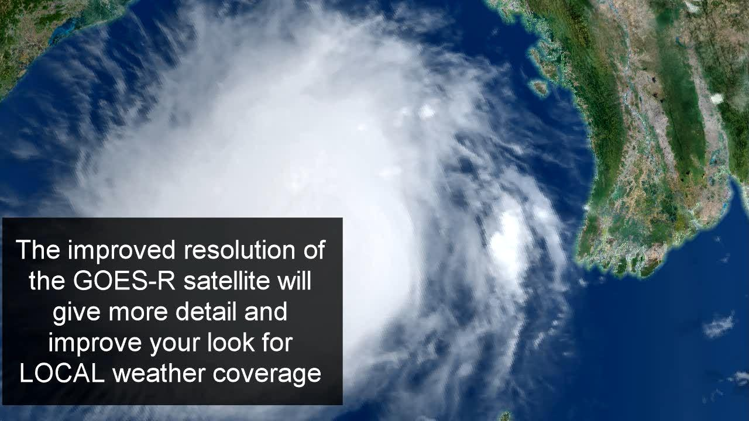
Example – 2km IR from HIMAWARI

Slide 16
Example – 4km Visible Sector (legacy display system)

Slide 17
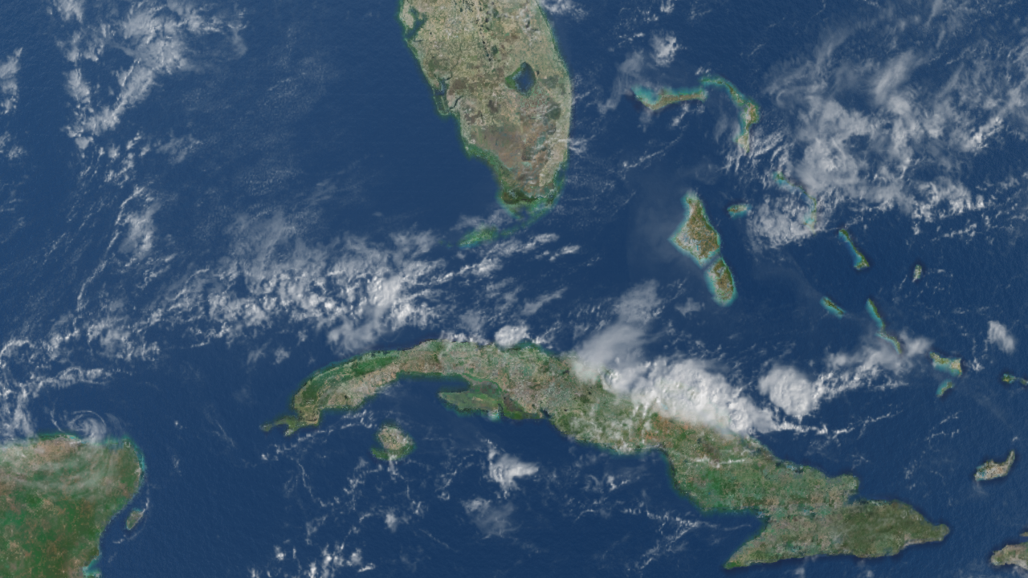
Example – 1km Visible (GOES-R will be even better)

Slide 18
Thank You!
pat.feldhausen@weather.com four foundational dimensions:

Slide 19
Backup Slides
four foundational dimensions:

Slide 20
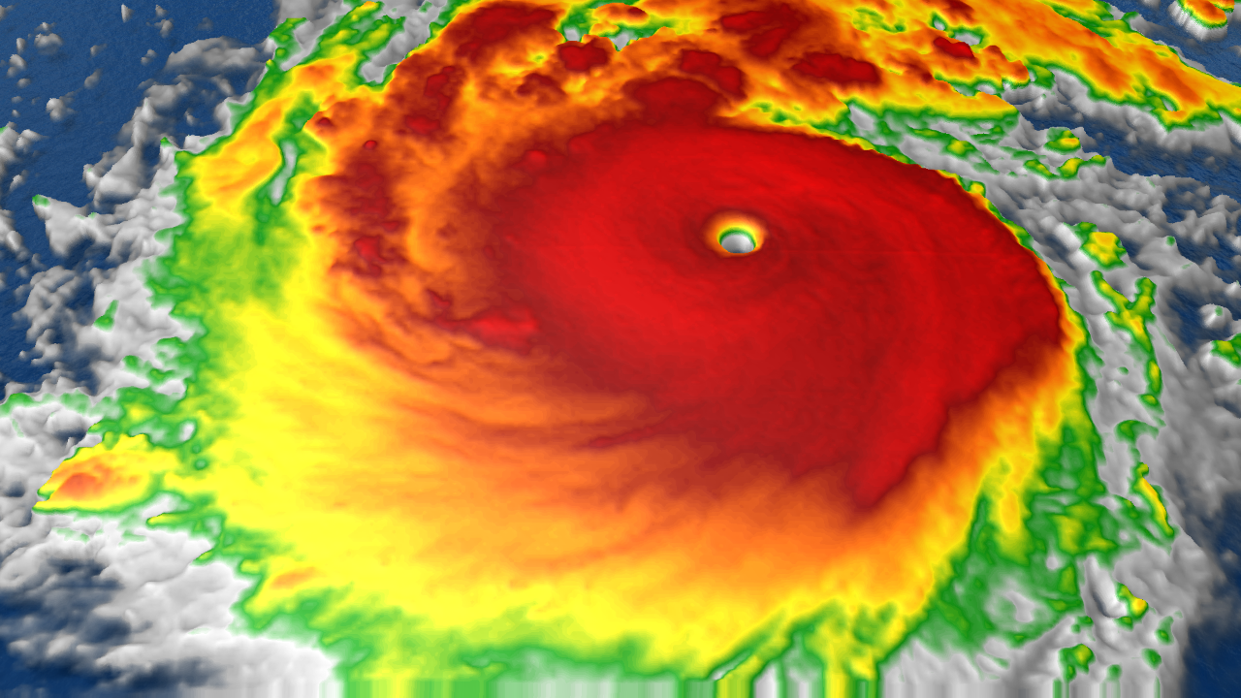
DFC Service – Data Samples
Himawari-8 2km IR Satellite Image of Super Typhoon Nepartak

Slide 21
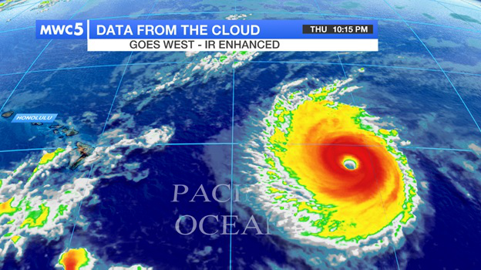
DFC Service – Data Samples
NOAA IR Satellite Image of Hurricane Lester

Slide 22
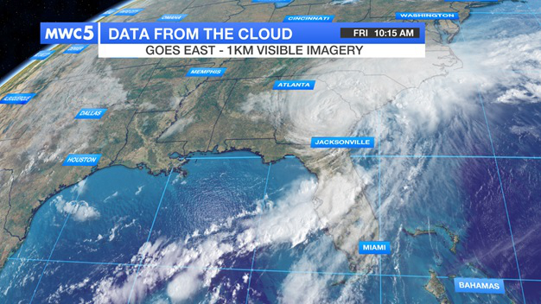
DFC Service – Data Samples
NOAA VIS Satellite Image of Tropical Storm Hermine

Slide 23
Current GOES vs. GOES-R
Item | Current GOES | GOES-R
Spectral Channels of Data | 5 channels across visible and IR | 16 Channels across visible, near IR and IR
Visible Imagery Resolution | 1km | 0.5km
IR Imagery Resolution | 4km | 2 near IR channels 1km Rest of IR 2km
Real Time Lightning Mapping | None | Lightning density over entire full disk (including oceans)
Solar and Space Monitoring | GOES-R has significantly improved instrumentation to improve reliability and accuracy of space weather forecasts over the current GOES

Slide 24
Current GOES vs. GOES-R
Update Frequency | Current GOES | GOES-R
Full Disk | Every 3 Hours | Every 15 Minutes or every 5 minutes depending on mode of operation
CONUS | Every 15 Minutes | Every 5 Minutes
Floater Sectors at 1000km x 1000km | N/A | Every 1 Minute if 2 Sectors are Activated Every 30 Seconds if 1 Sector is Activated

