Slide 1
Tropical Oceanic Rainfall and SST Structure parsing causation from correlation a likely source of systematic errors in highly parameterized models
R. E. Carbone¹ and Yanping Li ²
¹National Center for Atmospheric Research
²University of Saskatchewan
Sub-topics
Initiation of Rain MJO Bandpass Model Error Relevance
Li and Carbone, JAS 2012 Carbone and Li (in review) TBD

Slide 2
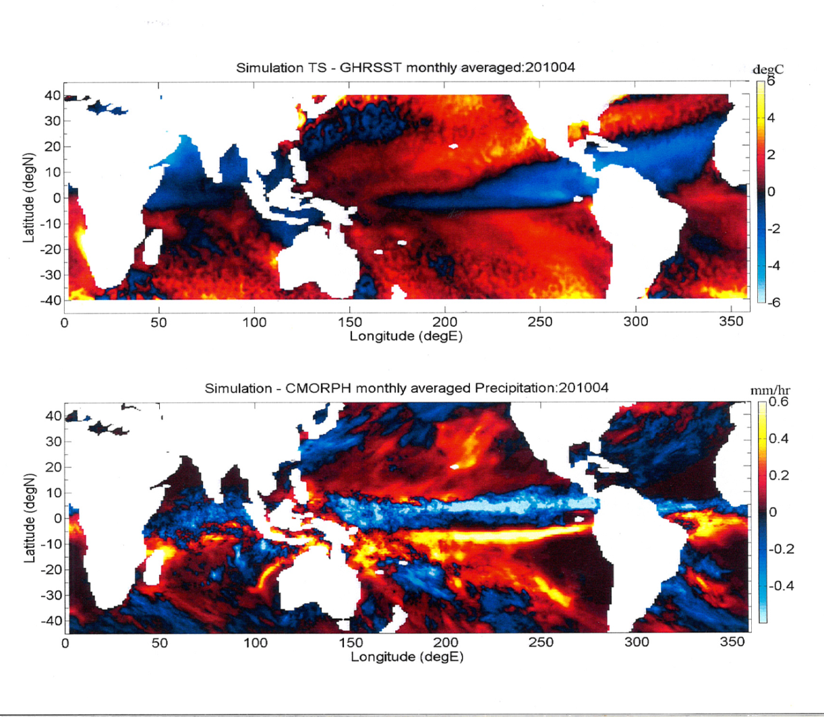
Why important? : Global Model Errors
SST Errors (model – obs)
Rainfall Errors (model – obs)
Extensive impact on general circulation

Slide 3
What are the respective roles of SST and SST Gradients in tropical Oceanic rainfall production?
The SST gradient is more important than local SST in determining w. (Lindzen and Nigam, 1987).
The observed low level convergence is determined by the absolute value of local SST (Needlin and Held, 1987; Ramanathan and Collins, 1991).
Why the Confusion?
SST and the Laplacian of SST are often covariant, obscuring their respective roles.
Satellite Datasets Needed?
GHRSST-like product that resolves SST diurnal cycle (e.g. GOES microwave?)
Improved scatterometer winds, continuity of sampling
CMORPH, GPM(IMERG) and similar datasets
3
Notes:
3

Slide 4
Working Hypothesis
(Li and Carbone, JAS 2012)
Laplacian Divergence
A disproportionate fraction of western Pacific warm pool rainfall events are triggered over mesoscale SST gradients.
+0.5
-0.5
blue water breezes
~3-7 x 10⁻⁵ s⁻¹, ~10-20 x Hadley-Walker
Notes:
Rhs is Established theory, nothing new except application @ meso-convective scale over blue water. All previous work at large scale, which is an impedance mismatch to the phenomenon.

Slide 5
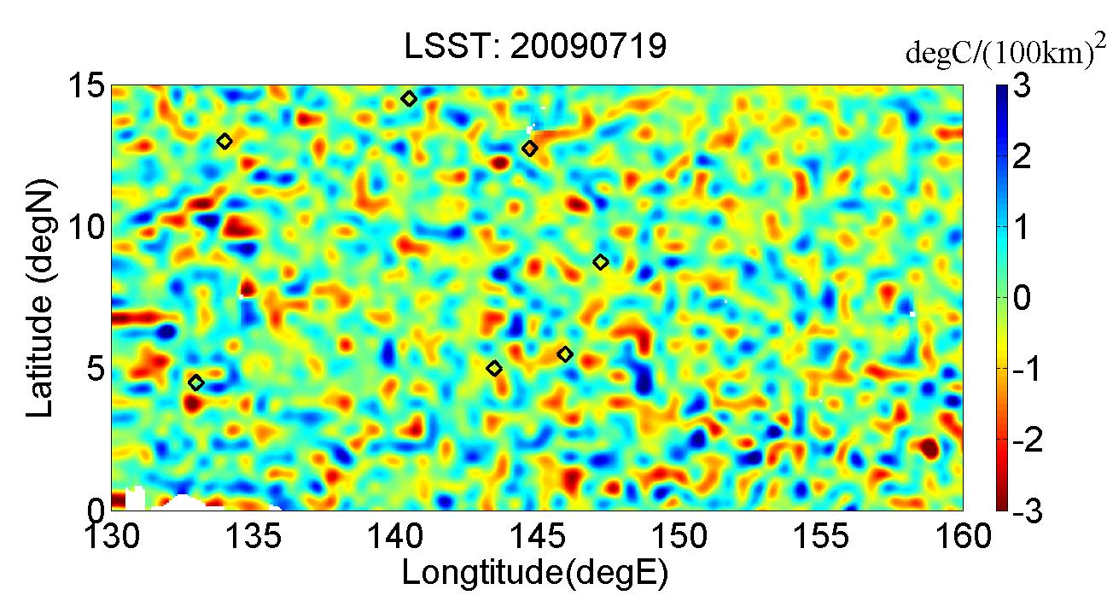
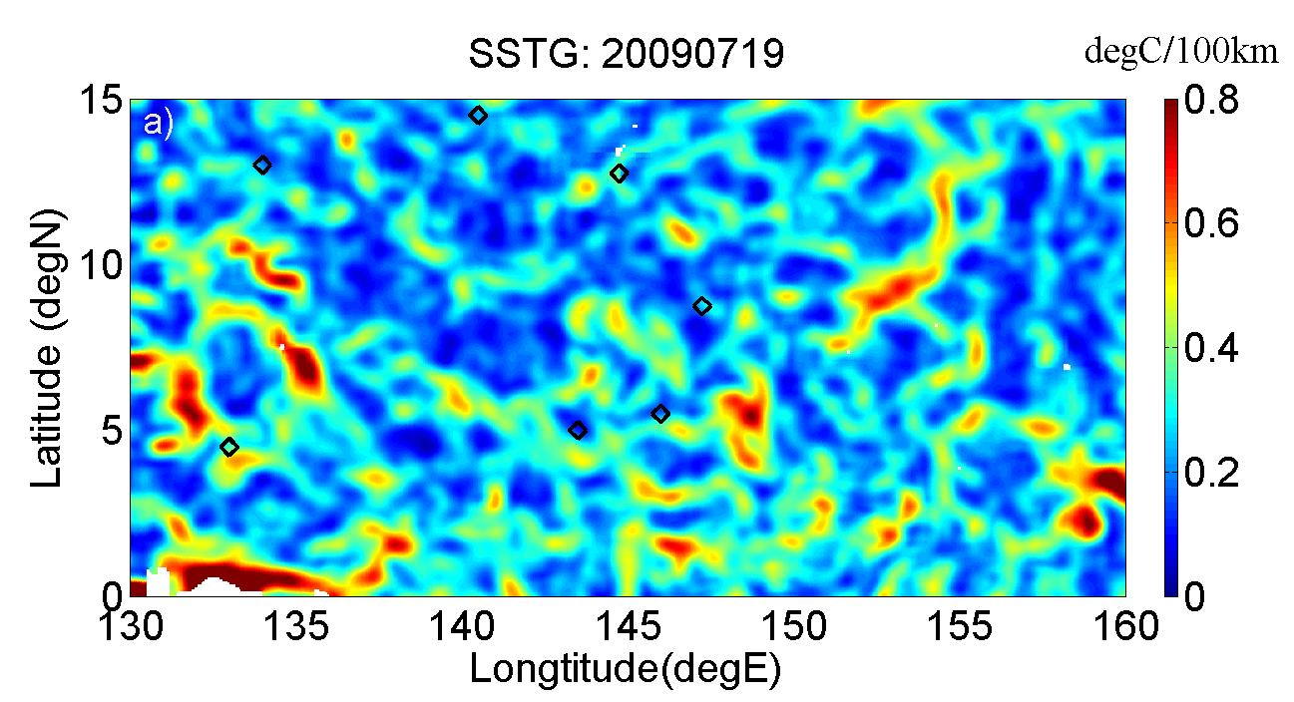
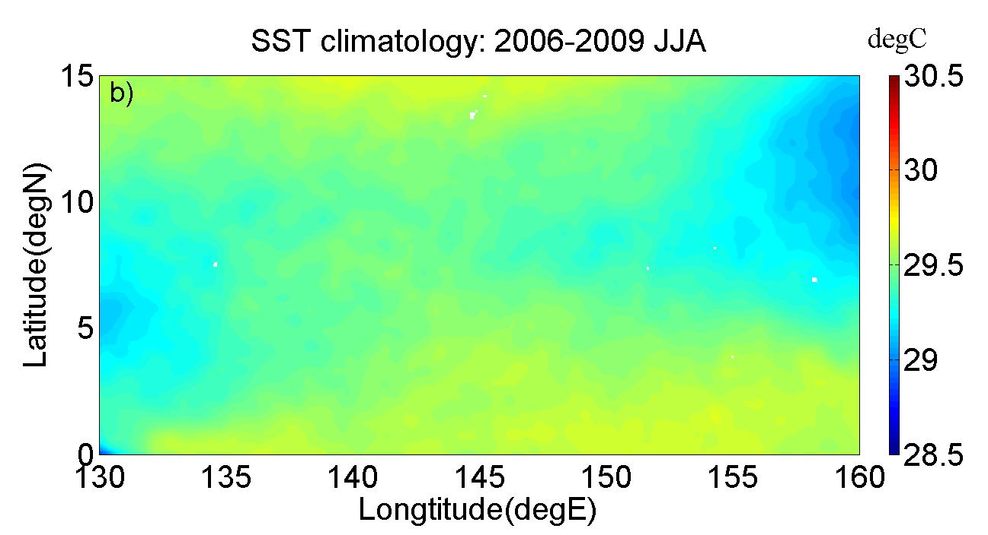
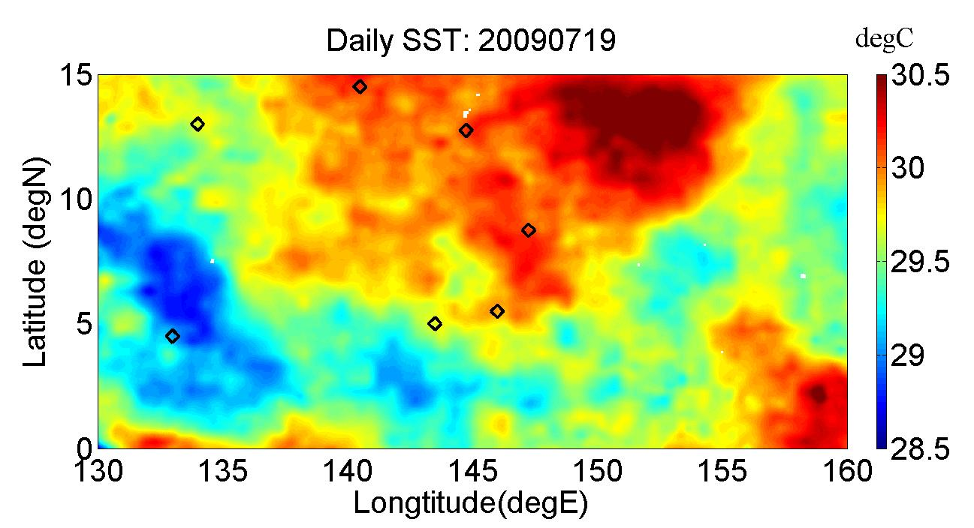
2009 July 19
Laplacian
(yellow-red infer convergence)
Gradient Amplitude
SST
Notes:
Poster child day, statistically representative of entire timeseries given warmer SSTs in boreal summer
Excitation of events at black diamonds.. 7/day is the timeseries avg, no events at SST extremes is typical on a given day
Gradient are pseudo cellular not elongated frontal like CESM ocean. LSST dipoles locally variable, 50/50 overall.

Slide 6
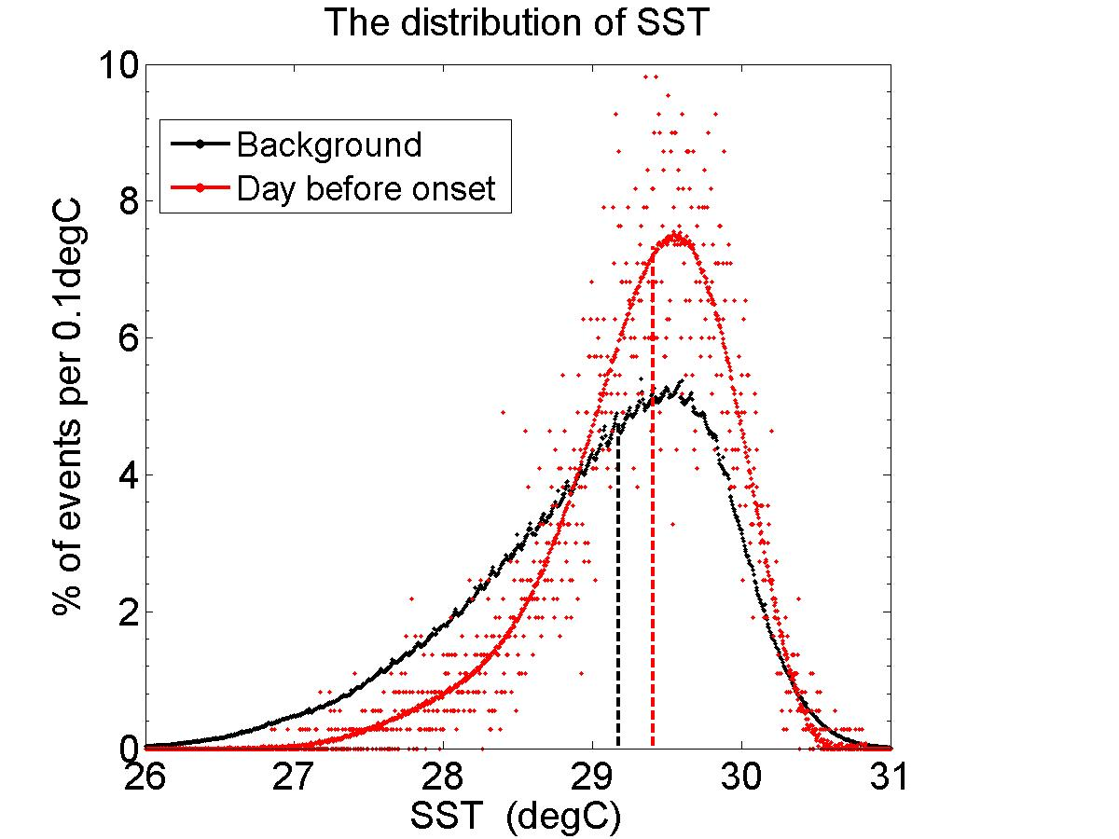
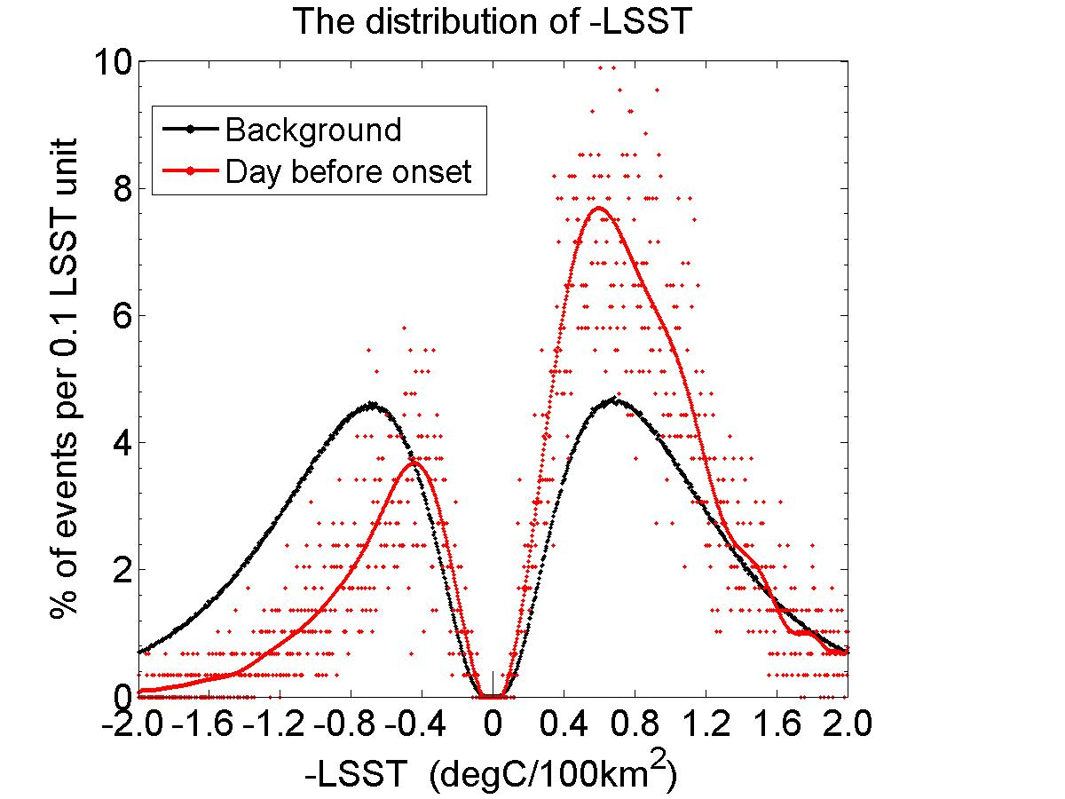
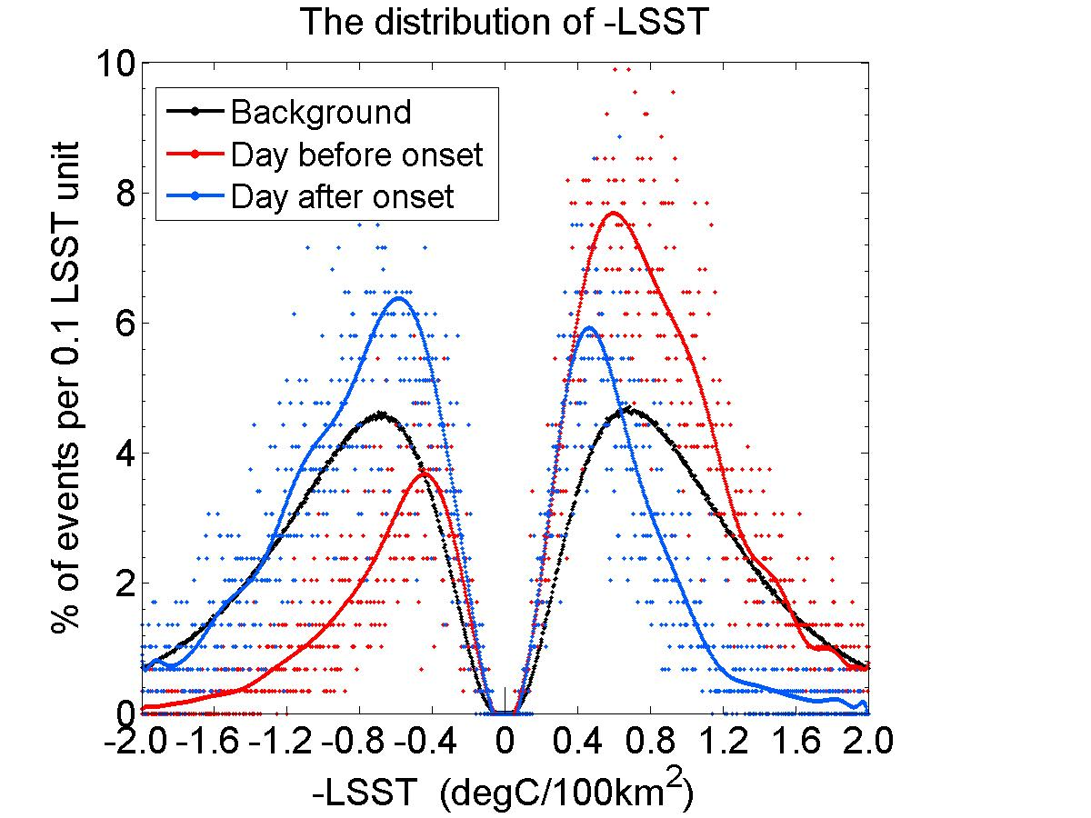
4-yr rain onset distribution of -LSST
Onset and Background Distributions, SST
(10K events)
>10,000 EVENTS
Onset peaks near mode of background
Minimum CIN near SST mode
Background and Onset median monthly -LSST
Onset
conv
div
VKE ratio ~3:1
60% of onset locations are divergent
Background
75% of onset events LSST convergent
Notes:
Self explanatory…. Day after rain depletion of conv LSST is all in mod to large conv values… consistent with larger w, and Vert KE for trigger.

Slide 7
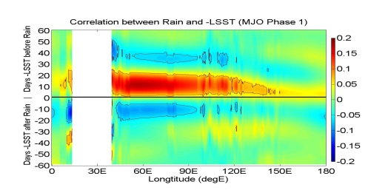
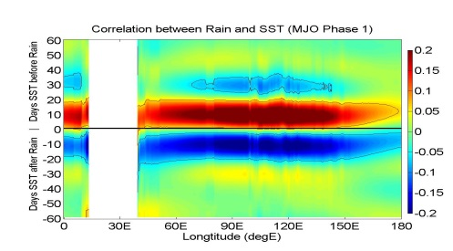
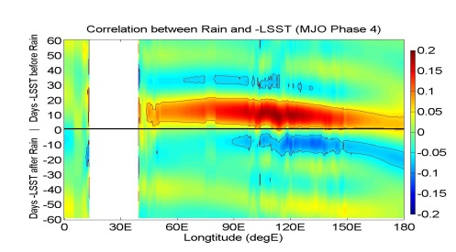
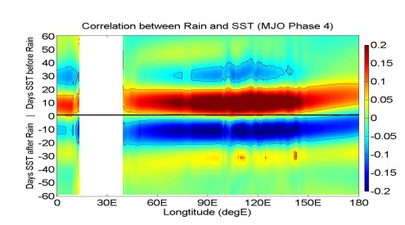
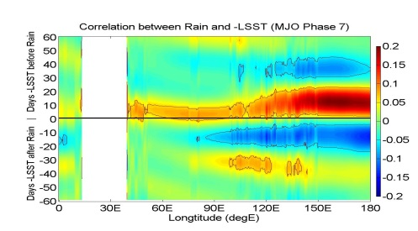
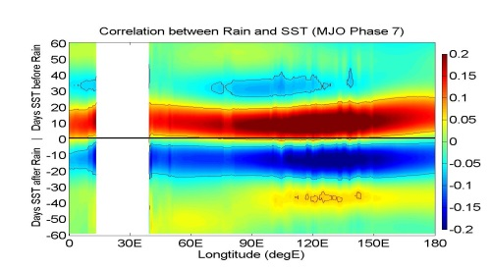
MJO Phase Correlation (49 months)
-LSST
MJO
Phase
1
4
7
SST
-LSST : specific to active phase
SST anomaly: broad, stationary
“Blind” to the active phase
Notes:
Most important slide of seminar… stops everyone in their tracks. This result has never appeared in the literature, never even suspected!
Easiest interpretation consistent with all other data is SST’s conditional relationship to cumulative rainfall, i.e. if a rain event is triggered, there will likely be more rain over warm anomaly of SST. I am pretty confident this is the nuanced role of SST… very important, highly correlated, but conditional on triggers of various kinds.

Slide 8
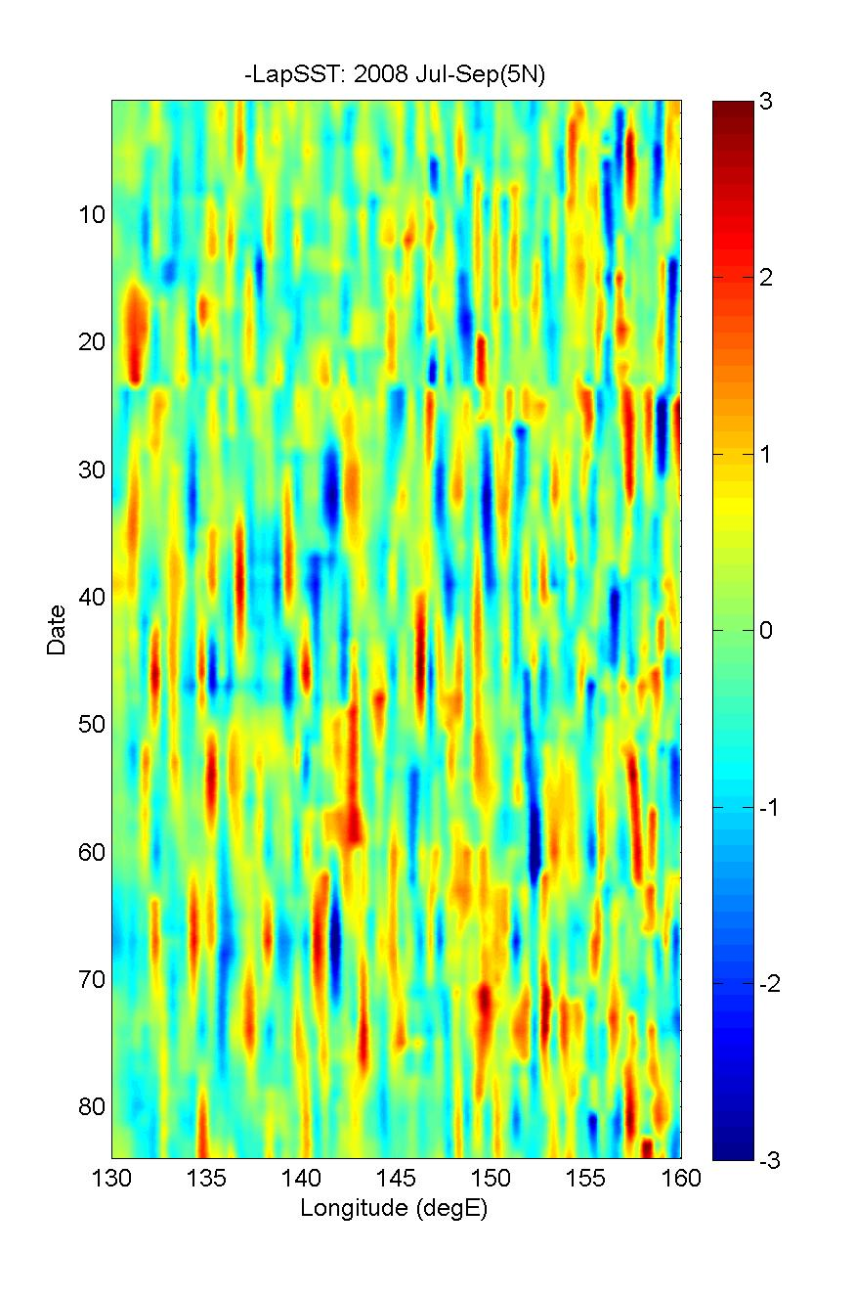
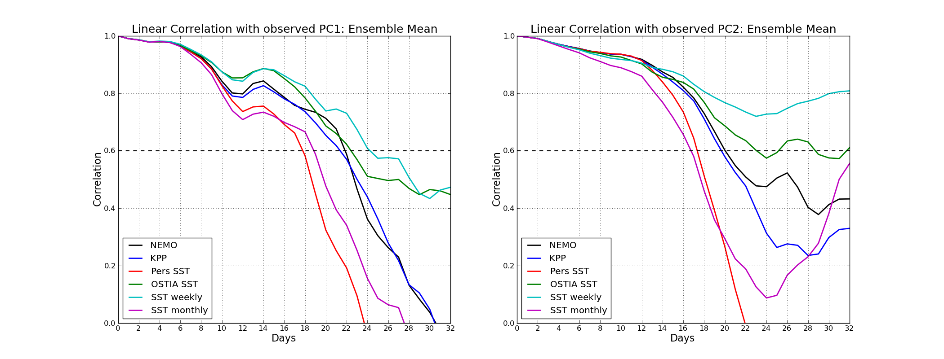
LSST ~6-10 day coherence
Fusion with NWP?
IMPACT OF THE SST ON THE ATMOSPHERE RESPONSE:
MONTHLY FORECASTING OF THE MJO
de Boisseson¹, Balmaseda², Vitart², and Mogensen²
1CNRM/GAME,, France
2 European Centre for Medium Range Forecast
TOGA COARE MJO, 1992-93
-LSST: 2008 Aug-Sep (5N)
0
10
20
30
40
50
60
Linear Correlation PC2 Ensemble Mean
D
A
Y
S
weekly
daily
C
O
U
P
L
E
D
persistent
monthly
weekly SST consistent with coherence of LSST
these may be causally related
Notes:
Message here is that LSST field is not noise…coherence is of oreder 1 week. See next slide I have added (not in seminar) showing best result in ECMWF hindcast exp when SST is weekly running mean. This shocked the authors who thought it would be best with daily SST. This is the only global model capable of capturing the essential dynamics of LSST at this scale… the 0.7-0.8 correlation is a record high performance. I’m giving a seminar at Reading in May.

Slide 9
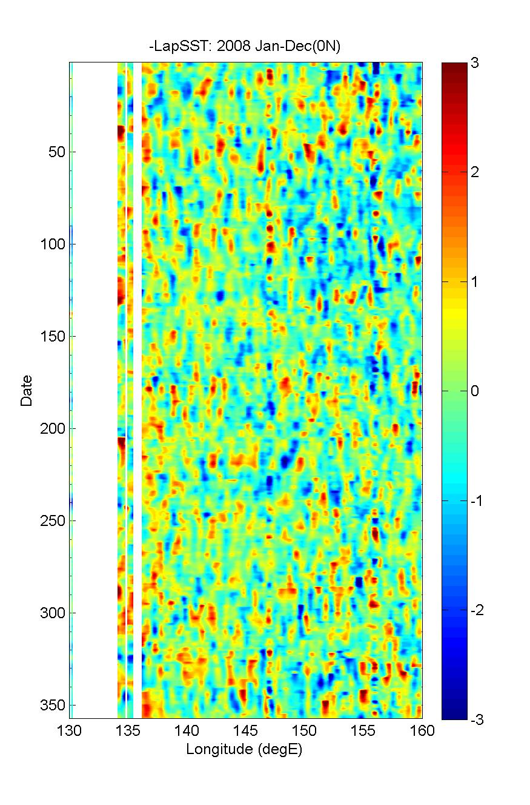
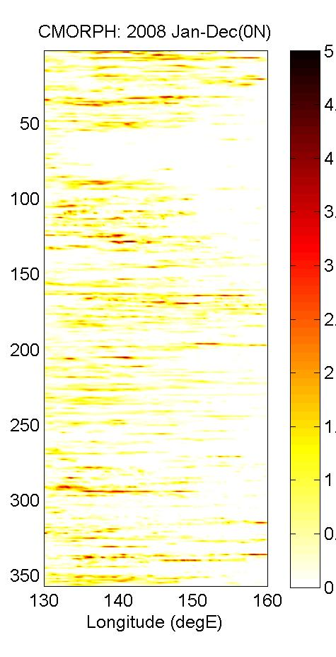
Systematic errors in global models?
Intra-seasonal to intra-annual variability
LSST 2008 EQ
Rainrate (mm/hr)
Respective roles of SST and SST Gradients
in tropical Oceanic rainfall production?
Main role of SST is in production of moist static energy.
A conditional relationship:
If rain occurs, then more rain is likely if SST is warmer
Main role of LSST is to trigger precipitation events.
Directly associated with onset of rain:
Modulates frequency of rainfall events
LSST varies systematically in the MJO passband.
Correlation specific to active phase:
Leads the active phase by 10 -12 days
9
Notes:
9

Slide 10
Thanks for Listening
“Lies, damned lies, and statistics”

