Slide 1
Fog and Low Stratus Training Resources: Blogs, Videos and Facts sheets (and how they complement each other)
Scott Lindstrom
University of Wisconsin-Madison
SSEC/CIMSS
Curator: http://fusedfog.ssec.wisc.edu
Contributor: http://cimss.ssec.wisc.edu/goes/blog/

Slide 2
Thank you to people Also known as: What is needed to make a coordinated training effort?
Developer is available to answer the blogger’s many many many questions. (Thank you Mike and Corey!)
Data flow into AWIPS (1 and 2) is happening so that imagery captured is familiar to forecasters (Thank you Jordan)
Anything in AWIPS is far more likely to be used than something you have to go to the web for: Frank Alsheimer, 16 June 2015
Thank you to Liaisons! Great Advocacy.

Slide 3
Satellite (GOESR) Training Timeline ©John Ogren, OCLO
FY16
Launch
Pre-Req
Foundational
Cont.
Learn
FY15
Data?
FY17 and Beyond
Application
Exercise
Make it
Stick
Basic Remote Sensing
Characteristics of Satellites
Pull together from COMET, VISIT, CIMSS, CIRA, SPoRT, WMO Vlab, etc.
NWS Specific development
GOES vs GOES-R
Himawari, MSG & SNPP as examples
Geo vs Polar
Strengths & Weaknesses
Forecast/ warning process
Phenomena based
Baseline products
Service areas (severe, winter, hydro, tropical, fire, aviation, etc.)
10-15 minute modules
Techniques
QuickGuides
Simulations
Local training initiatives
“As it occurs” training
Evolve initial satellite concept of operations
Reference materials in AWIPS
Repeat…practice
Blogs
Seasonal readiness
Peer-to-peer sharing
Storm-of-the month webinars
Demonstrated performance
Continuous Learning
Operations to Research
Optimize implementations for operations
Update for evolving science
Put in IDSS and WRN context
Keep this arrow in mind: Where do the specific components fit?

Slide 4
What kind of Training
What are the training goals?
3-5 different versions of training; one size does not fit all (audio vs. no audio!) Telling isn’t Training.
What is expected and what can be demonstrated after the training pieces are absorbed?
Developer must:
Understand the Forecast Process (#CarvenScott on Monday)
Weather Service should not operationalize the product: Training should include how to do that (Typically a link to a website that describes it)
MUST HAVE MANAGEMENT BUY-IN
This talk focuses on GOES-R Fog/Low Stratus: How this is incorporated into the forecast process maybe more self-evident than other products.

Slide 5
What Training Resources are available? GOES-R IFR Probability
VISITview training
First thing done (?)
Describes algorithm, background, gives examples
Given via Live Teletraining or in-person visits
Also: a Recorded version in Dept of Commerce LMS (Useful for reminders or for midnight shifts)
Requires Java
Finite set of examples demonstrate product
From the Training Arrow: Application!
Foundational information Re: BTD is included in training

Slide 6
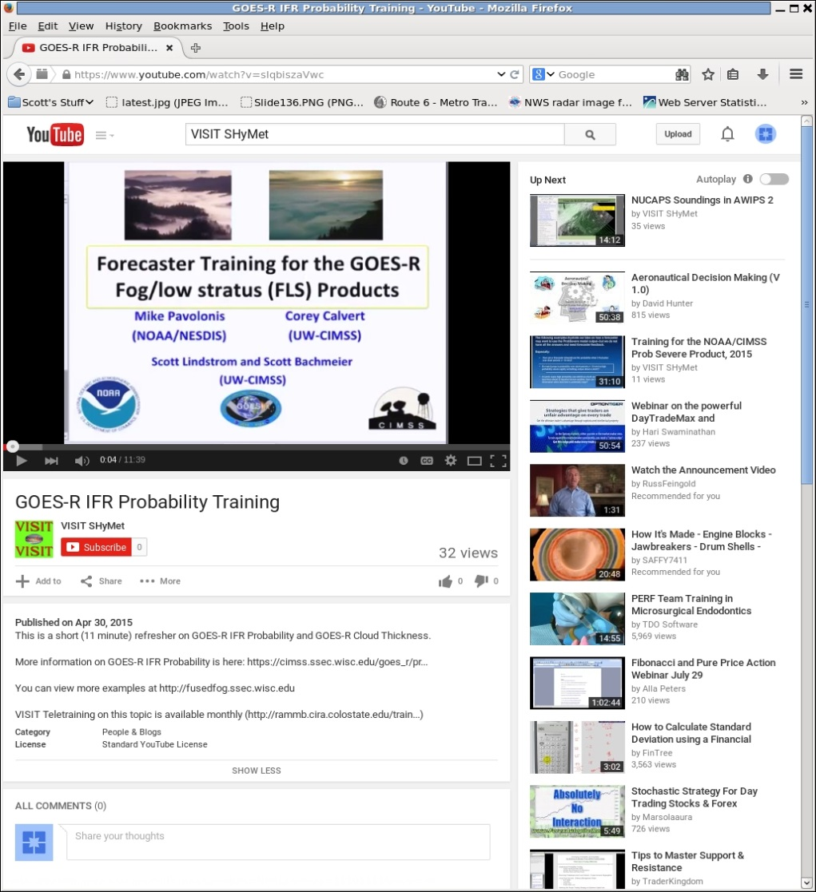
What Training Resources are available? GOES-R IFR Probability
YouTube Videos
Quick Reminder (10 minutes) of algorithm basics
Not many examples for each Region
Format works on many platforms
Culled from Visitview Training
Notes:
Audio is important! But! Each time you change a YouTube video with an update, you change the url

Slide 7
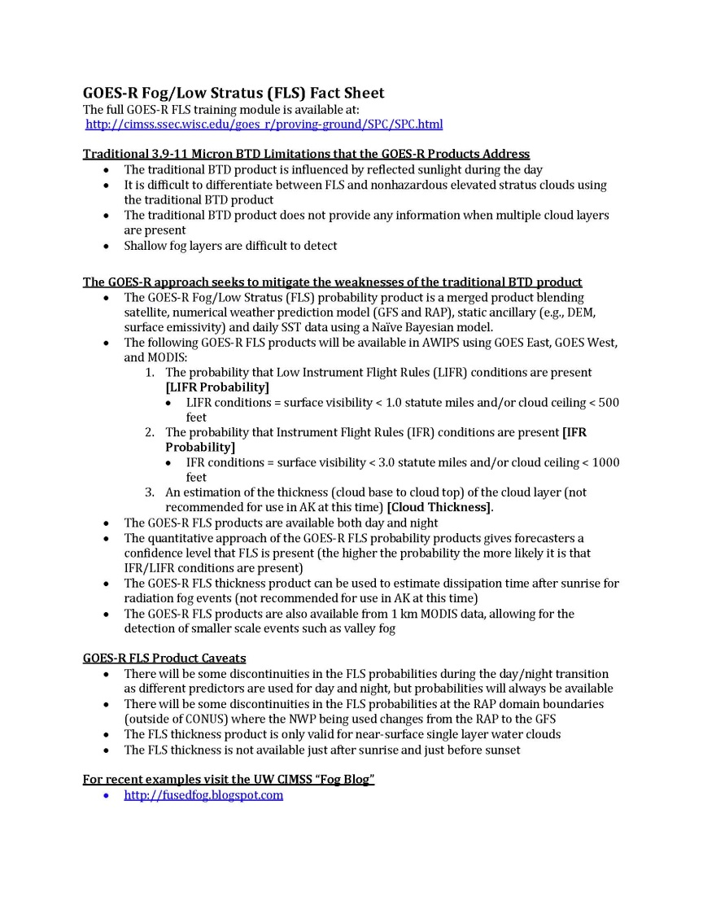
What Training Resources are available? GOES-R IFR Probability
‘Fact Sheets’
A little dry
Serve as a good reminder
Useful for peer-to-peer
Limited examples
Something that could added to AWIPS?

Slide 8
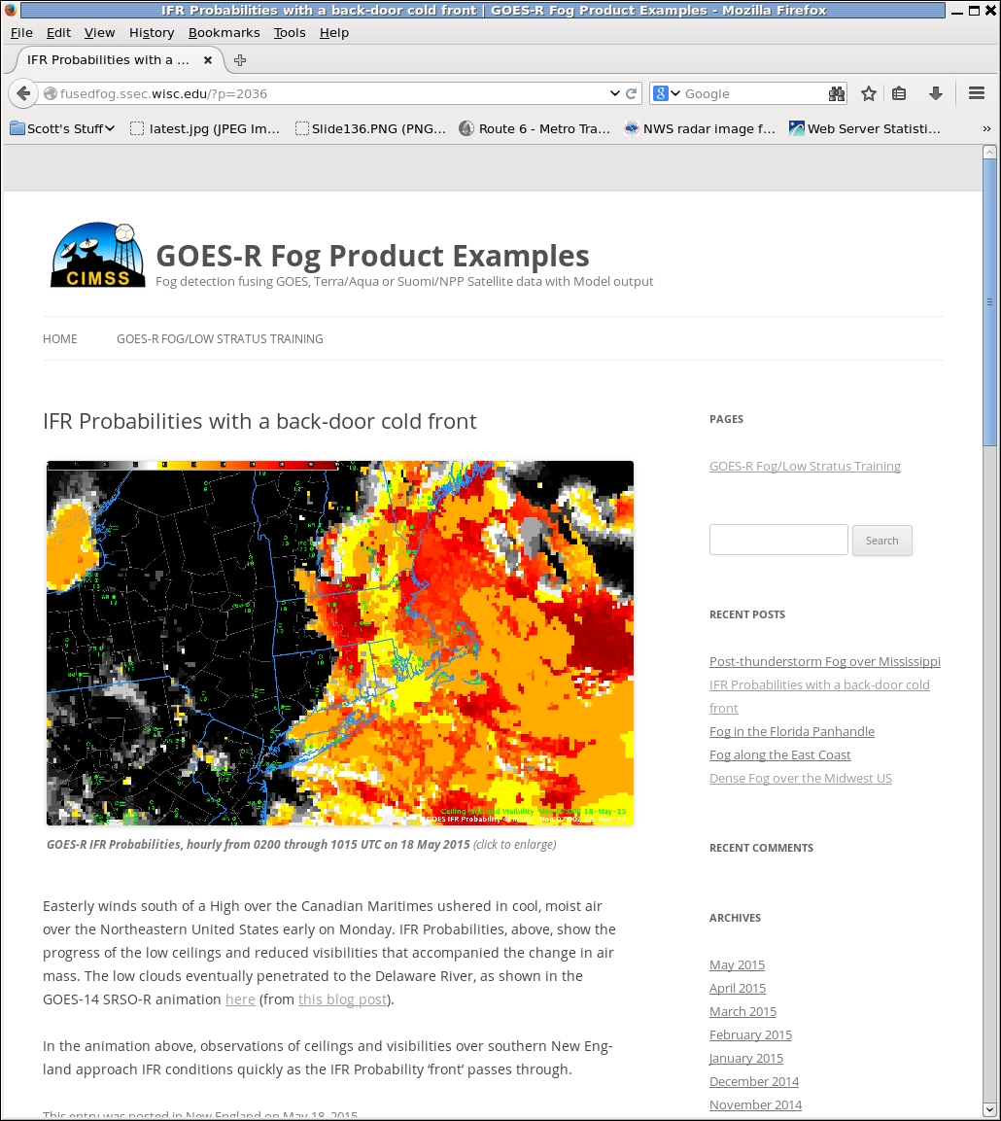
What Training Resources are available? GOES-R IFR Probability
Blogs
http://fusedfog.ssec.wisc.edu
Current examples given, usually by Noon of the day in question
Alerting E-mail sent to affected WFOs
‘Constant’ updates on the efficacy of the product
Establish dialog between Developers/Bloggers/Users
Natural evolution from ‘general’ blogging
Link to a series of blogposts from AWIPS?
Reach a LOT of people, good advertising (How do we get examples out? )

Slide 9
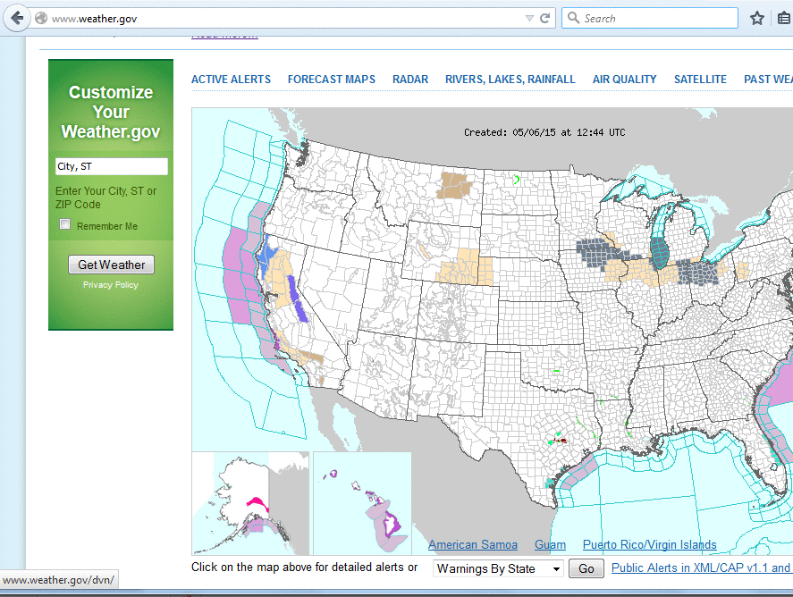
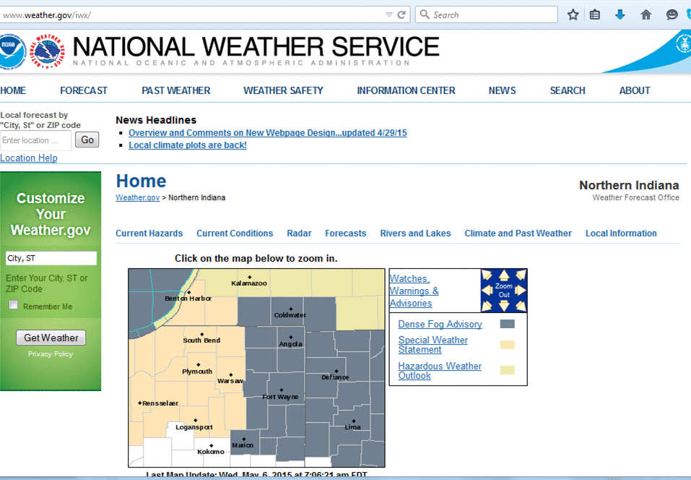
Look at Weather.gov every morning
Look at imagery near WFO…
….does the imagery tell a good story?

Slide 10
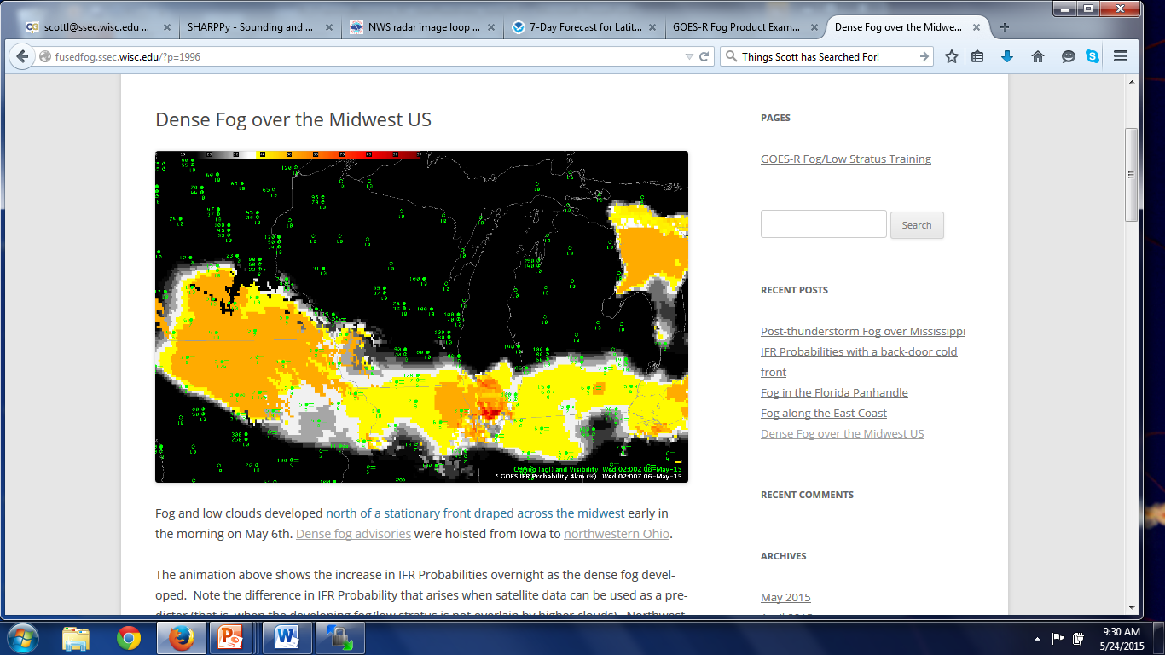
A good blog post writes itself!
Advantages of GOES-R Algorithm compared to heritage
Why does the field look like it does?
How does the field compare to observations?

Slide 11
Then, send email to WFOs
Three Typical Outcomes
No Response
Short Thanks
Longer email
Sent case around office
Confirmed use of product
Asked questions about/commented on use
Making it Stick!
Include Foundational and Application Training in Blog Posts

Slide 12
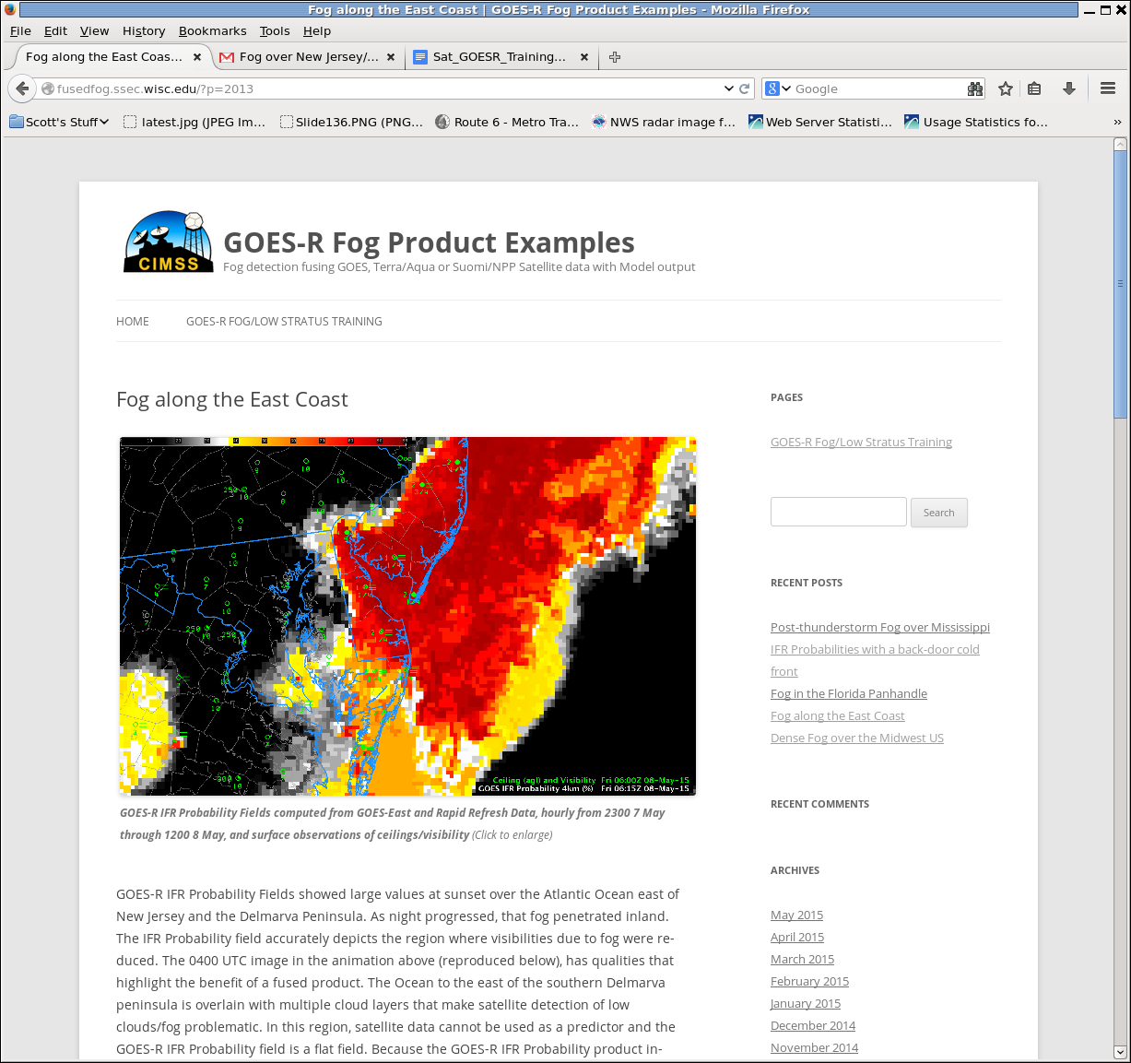
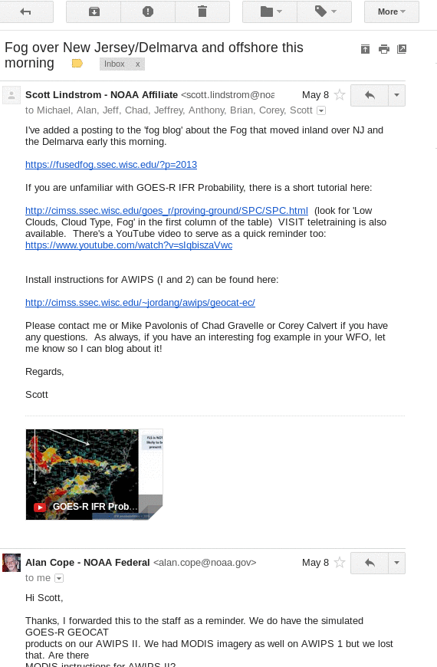
Important: Dialog with SOOs
Publish post,
Email forecast
offices
Why e-mail? Make sure someone is seeing your work

Slide 13
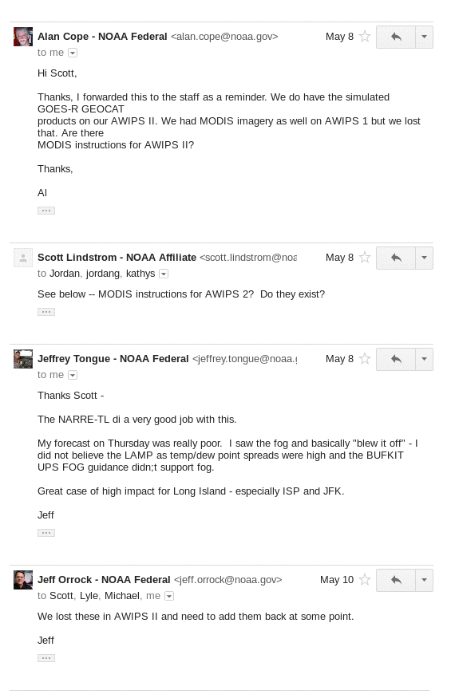
Dialog
Benefits:
Learn what users think
of the product
2. Learn of any problems
3. Feedback for Developer
4. Help to cultivate a
Local Champion

Slide 14
Other Training Resources available?
Other things I’ve found – you make an attempt to coordinate with this, especially when names confuse (“Fog Product”)
FAAST YouTube: https://www.youtube.com/watch?v=KJj2DYyUiz4
http://faasafety.gov
Is there inter-governmental coordination?
This is from BIS – so emails to them will circle back to it

Slide 15
Satellite (GOESR) Training Timeline ©John Ogren, OCLO
FY16
Launch
Pre-Req
Foundational
Cont.
Learn
FY15
Data?
FY17 and Beyond
Application
Exercise
Make it
Stick
Basic Remote Sensing
Characteristics of Satellites
Pull together from COMET, VISIT, CIMSS, CIRA, SPoRT, WMO Vlab, etc.
NWS Specific development
GOES vs GOES-R
Himawari, MSG & SNPP as examples
Geo vs Polar
Strengths & Weaknesses
Forecast/ warning process
Phenomena based
Baseline products
Service areas (severe, winter, hydro, tropical, fire, aviation, etc.)
10-15 minute modules
Techniques
QuickGuides
Simulations
Local training initiatives
“As it occurs” training
Evolve initial satellite concept of operations
Reference materials in AWIPS
Repeat…practice
Blogs
Seasonal readiness
Peer-to-peer sharing
Storm-of-the month webinars
Demonstrated performance
Continuous Learning
Operations to Research
Optimize implementations for operations
Update for evolving science
Put in IDSS and WRN context

Slide 16
Developer Creates Product
Factsheet
AWIPS
Insertion
Case Studies Created
Saved on Blogs?
Trainer
and/or
Blogger
Training Module Created.
There is a relationship between the Developer (Scientist) and User (Scientist) that is facilitated by the trainer (Scientist)
Short YouTubes
User
(Local Champion)

Slide 17
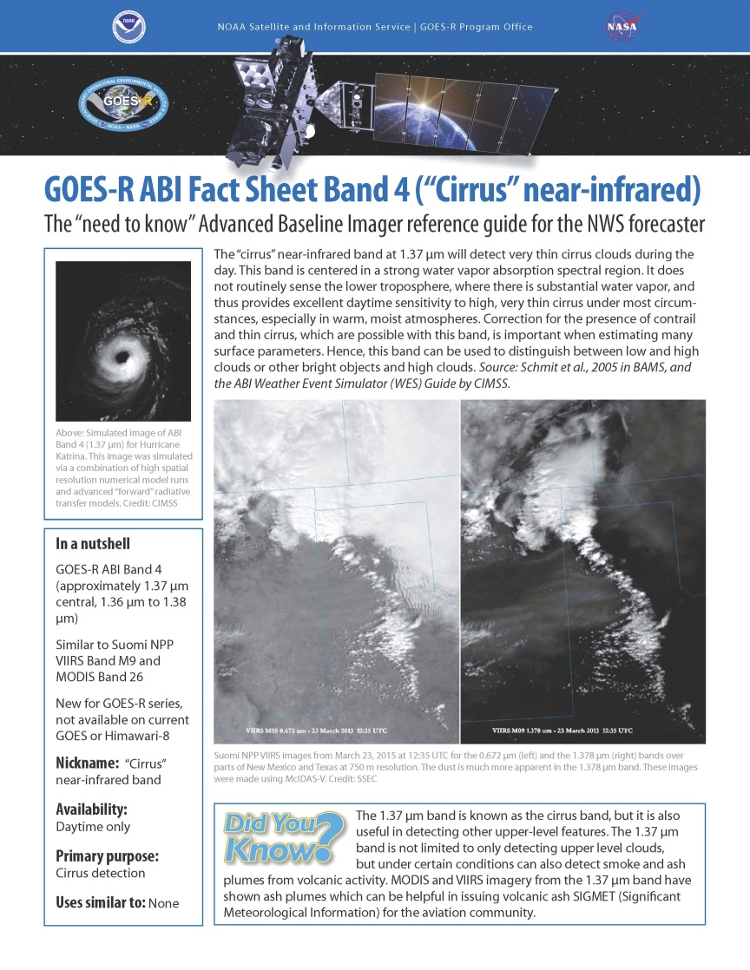
What Training Resources are available? ABI Channels
‘Fact Sheets’
A little dry
Serve as a good reminder
Useful for peer-to-peer
Limited examples

