Slide 1
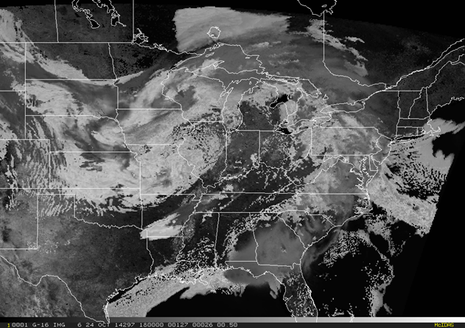
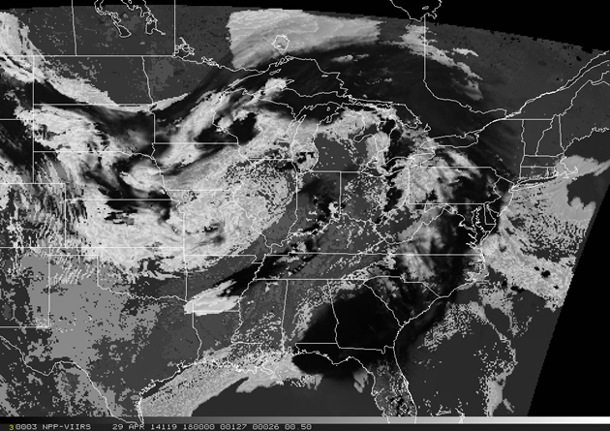
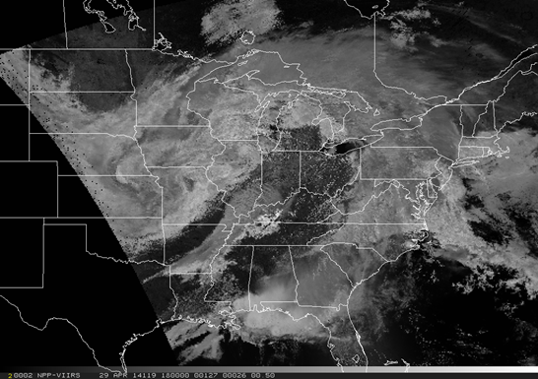
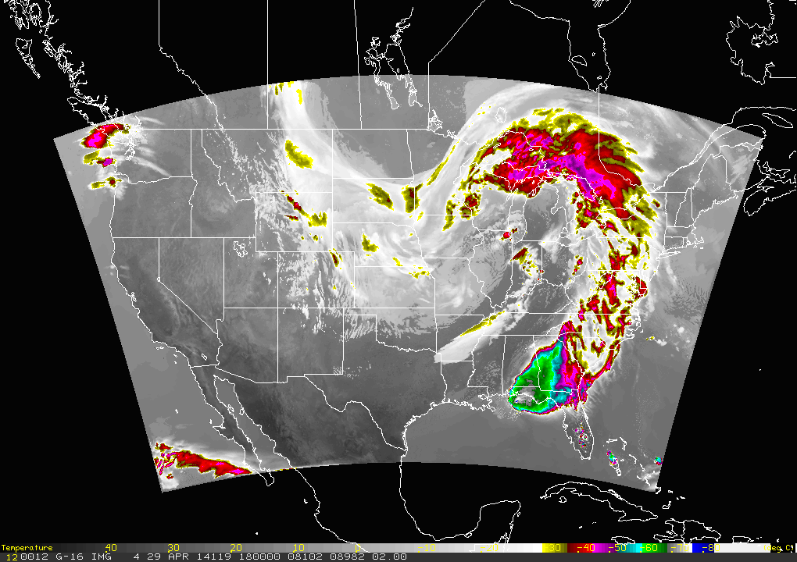
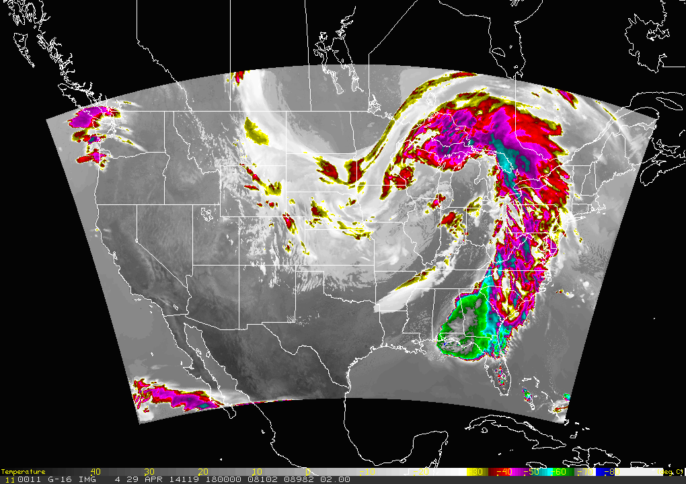
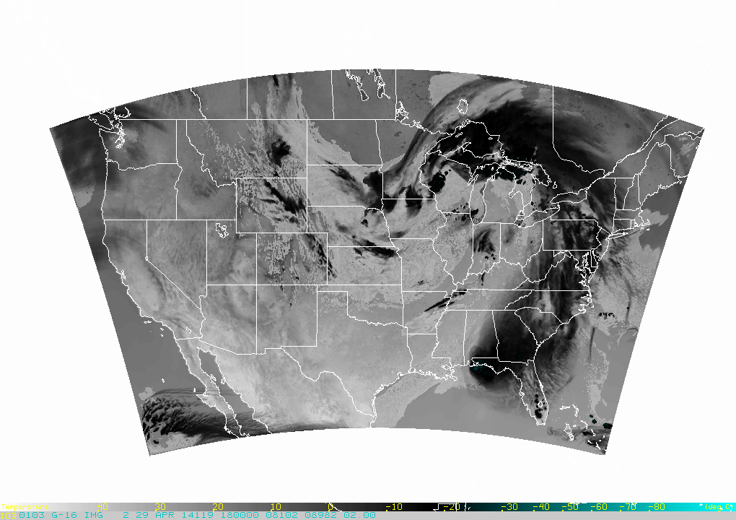
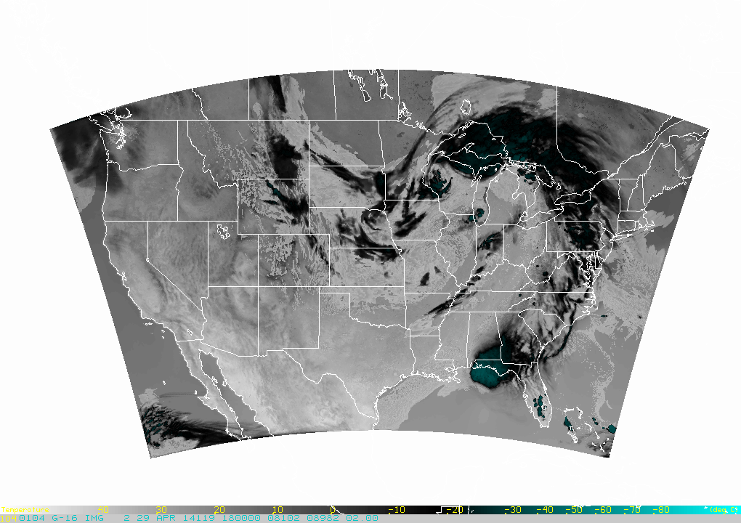
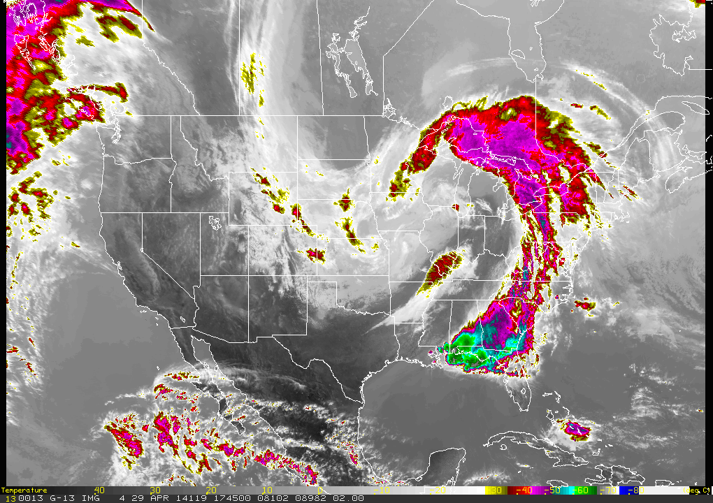
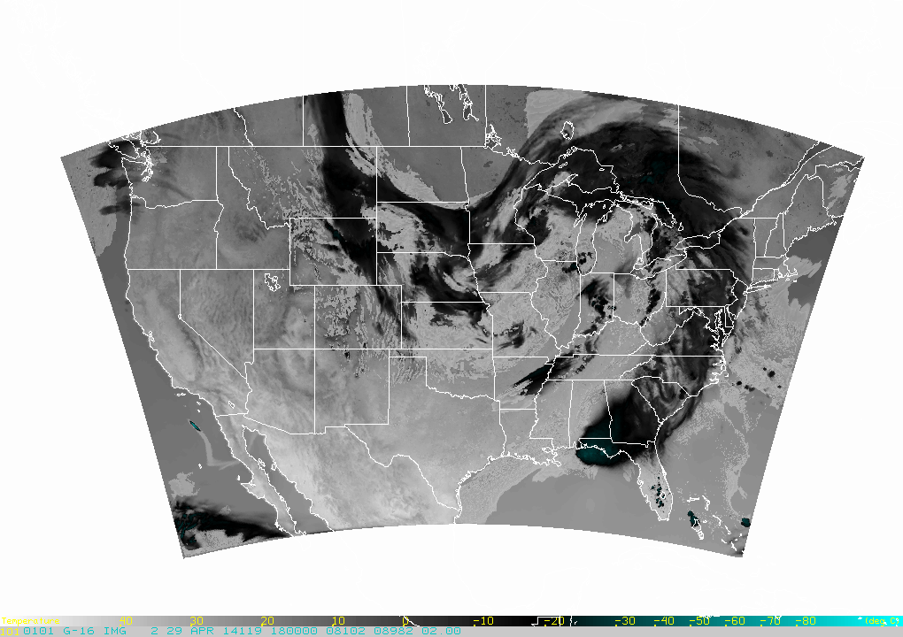
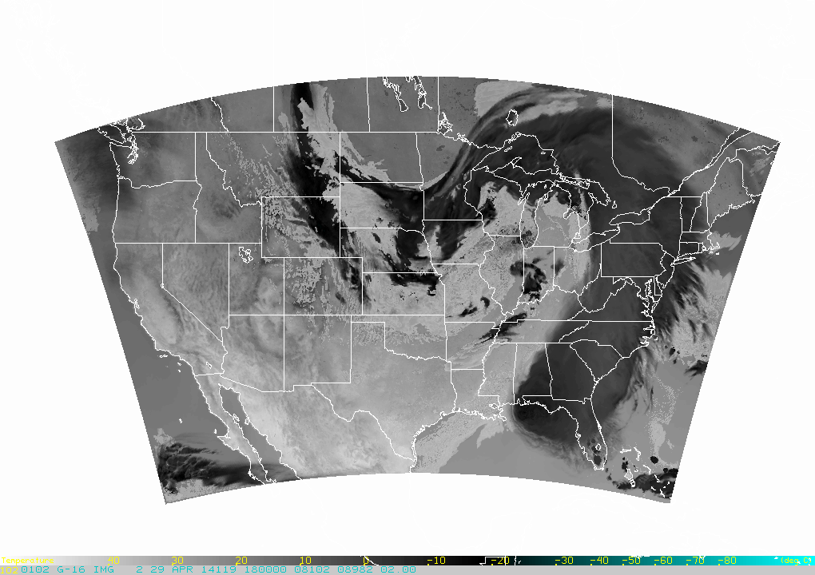
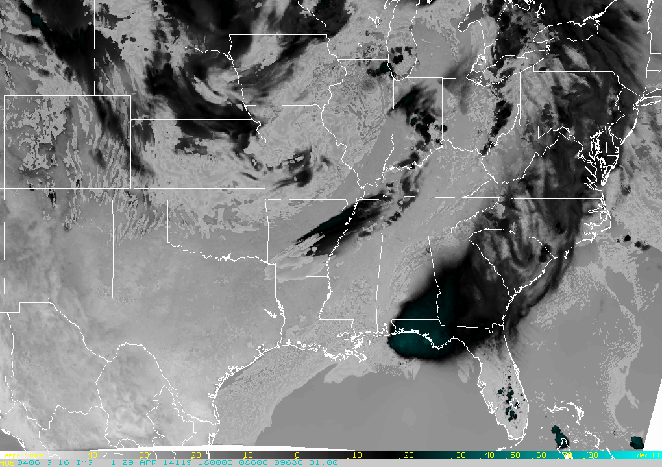
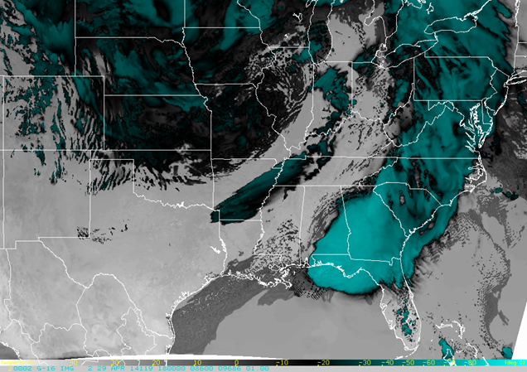
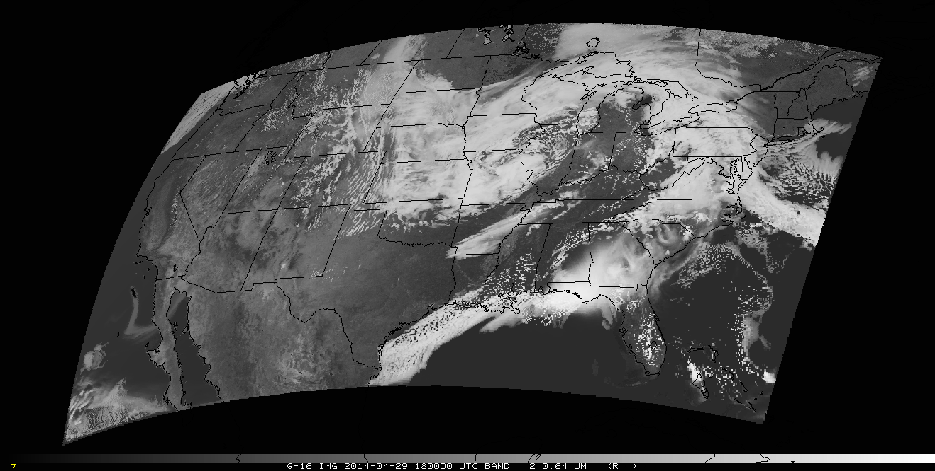
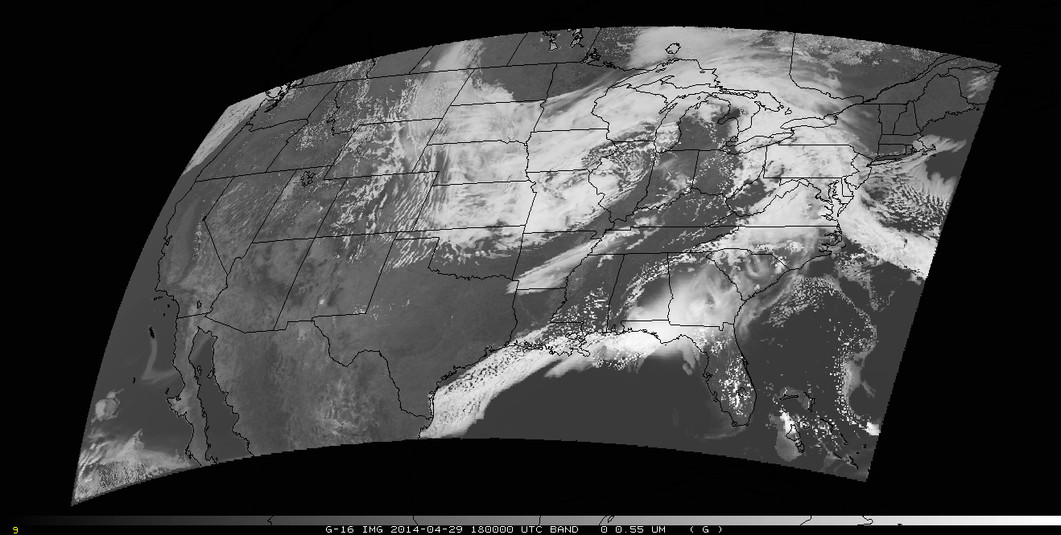
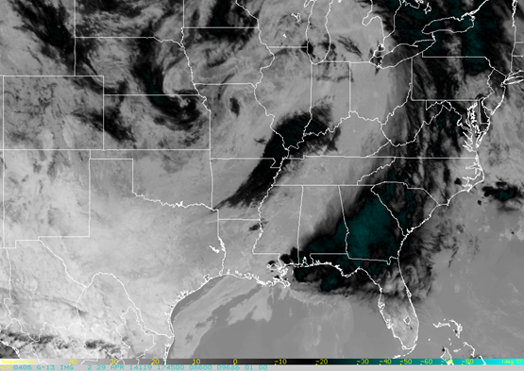
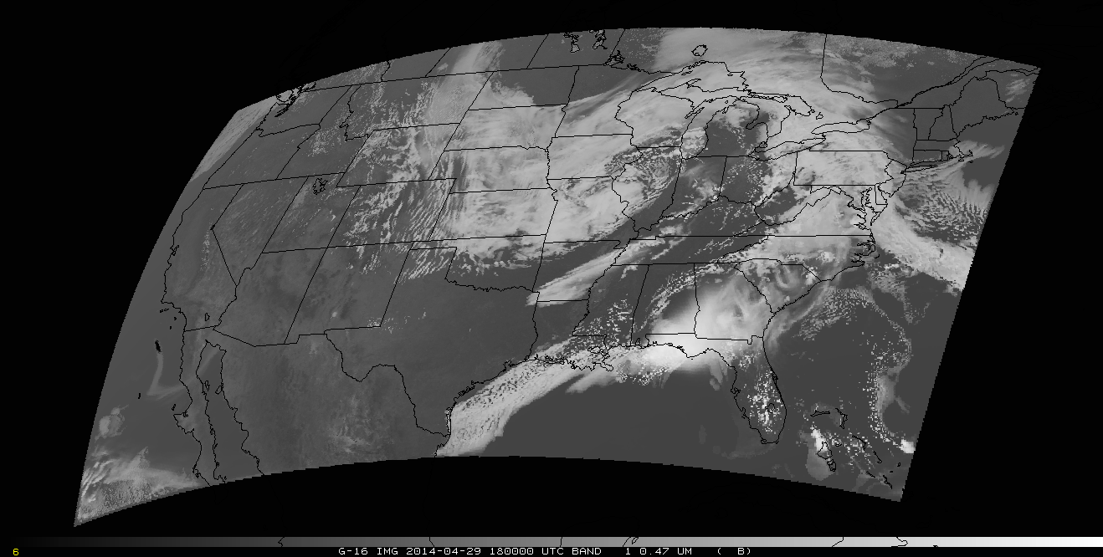
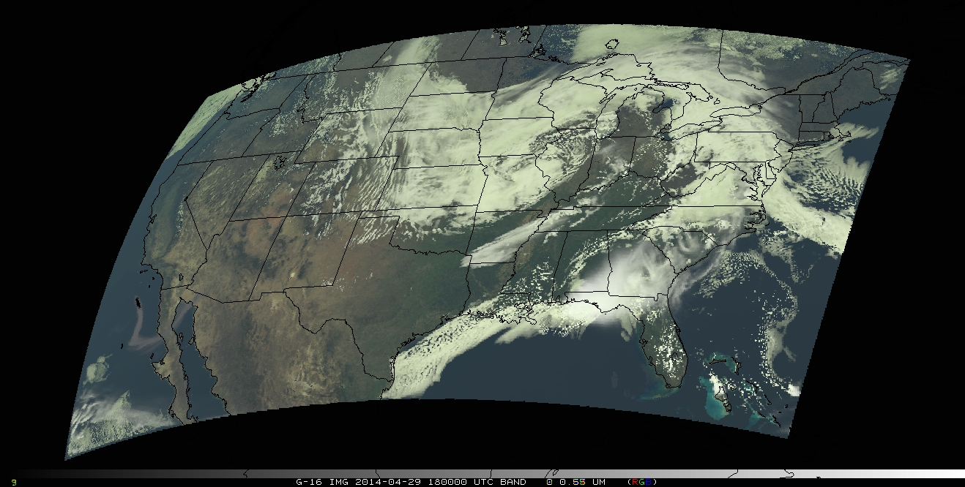
24Feb2015 Poster 2
GOES-R ABI Synthetic Imagery at 3.9 and 2.25 µm
Louie Grasso, Yoo-Jeong Noh
CIRA/Colorado State University, Fort Collins, CO 80523-1375
Dan Lindsey and Don Hillger
NOAA/NESDIS, SaTellite Applications and Research (STAR)
Regional And Mesoscale Meteorology Branch (RAMMB)
Fort Collins, CO 80523-1375
E-mail: Lewis.Grasso@colostate.edu
Introduction
For the past several years, synthetic satellite imagery has been produced at the Cooperative Institute for Research in the Atmosphere (CIRA) in collaboration with the NOAA/NESDIS/StAR Regional and Mesoscale Meteorology Branch. The imagery serves two primary purposes: 1) to serve as proxy data for future sensors such as the GOES-R Advanced Baseline Imager (ABI), and 2) synthetic imagery is an excellent visualization tool for high resolution numerical model output, allowing forecasters to easily and quickly see forecast cloud locations.
This poster provides examples of synthetic GOES imagery generated from the National Severe Storm Laboratory’s (NSSL) 4-km Weather Research and Forecasting-Advanced Research WRF (WRF-ARW) forecast model. Imagery is generated with both on Observational Operator that was developed at CIRA and the Community Radiative Transfer Model (CRTM).
Synthetic Imagery Production
Output from the 4-km model, including geo-potential height, temperature, water vapor, and microphysical variables such as cloud water and pristine ice are sent to CIRA
This data is used as input to the CRTM, which then outputs simulated satellite brightness temperatures at various wavelengths/bands
The brightness temperature fields are converted to various formats to be used by the National Weather Service’s operational display software
Comparisons between the CRTM (V2.1.3), the CIRA Observational Operator (CIRA-OO), and Observations
29 April 2014 – 18 Z – based on WRF forecast – Thompson microphysics
CIRA-OO
2.25 μm ABI band v/s VIIRS
CRTM
Ice cloud: 5.5 W/(m^2 sr μm)
Ice cloud: 0.5 W/(m^2 sr μm)
Comparisons between the CRTM (V2.1.3), the CIRA Observational Operator (CIRA-OO), and Observations
29 April 2014 – 18 Z – based on WRF forecast – Thompson microphysics
Plotted values are radiances
Darker colors correspond to less 2.25 μm reflectance
CRTM has ice cloud reflectance values far too low
Liquid water cloud reflectances are in the ballpark of VIIRS observations for both the CRTM and the CIRA-OO (both a little too large)
CIRA-OO
10.35 μm ABI band
CRTM
Ice cloud: 6.5 W/(m^2 sr μm)
CIRA-OO 3.9 µm ABI 29 April 2014 – 18 Z – based on WRF-ARW forecast
Morrison
Morrison P3
GOES-13 Observations (10.7 μm)
CIRA-OO and CRTM produced very similar output, and both compare well with GOES observations
Thompson
Milbrandt-Yau
CIRA-OO
3.9 μm ABI band
CRTM
R
G
Liquid water cloud: 31 °C
Ice cloud: -22 °C
Liquid water cloud: 8 °C
Ice cloud: -70 °C
The 3.9 μm band should include an emitted and a solar reflected component during the daytime
Note that the CRTM ice cloud has a 3.9 μm brightness temperature similar to the value at 10.35 μm, showing that it includes no solar reflection
Solar reflection warms the BT by ~50 °C in this case
CRTM liquid water cloud has a 3.9 μm brightness temperature colder than the value at 10.35 μm, showing that “solar reflection” is not being handled correctly
CRTM 3.9 μm BT about 24 °C colder than observations of liquid water clouds
GOES-13 Observations (3.9 μm)
B
RGB
Liquid water cloud: 32 °C
Ice cloud: -21 °C
Synthetic Red, Green, and Blue that are combined into an RGB image. These images serve as an example of efforts to generate true-color imagery as part of the AWG IVT project.
Related References:
Grasso, L., D. T. Lindsey, K-S Lim, A. Clark, D. Bikos, and S. Dembek, 2014: Evaluation of and Suggested Improvements to the WSM6 Microphysics in WRF-ARW Using Synthetic and Observed GOES-13 Imagery. Mon. Wea. Rev., Vol 142, No. 10, 3635-3650.
Lindsey, D. T., L. Grasso, J. F. Dostalek, and J. Kerkmann, 2014: Use of the GOES-R Split Window Difference to Diagnose Deepening Low-Level Water Vapor. J. Appl. Meteor. Climat., 53, 2005-2016.
Questions? Send email to Lewis.Grasso@colostate.edu . The views, opinions, and findings in this report are those of the authors, and should not be construed as an official NOAA and or U.S. Government position, policy, or decision.

