Slide 2
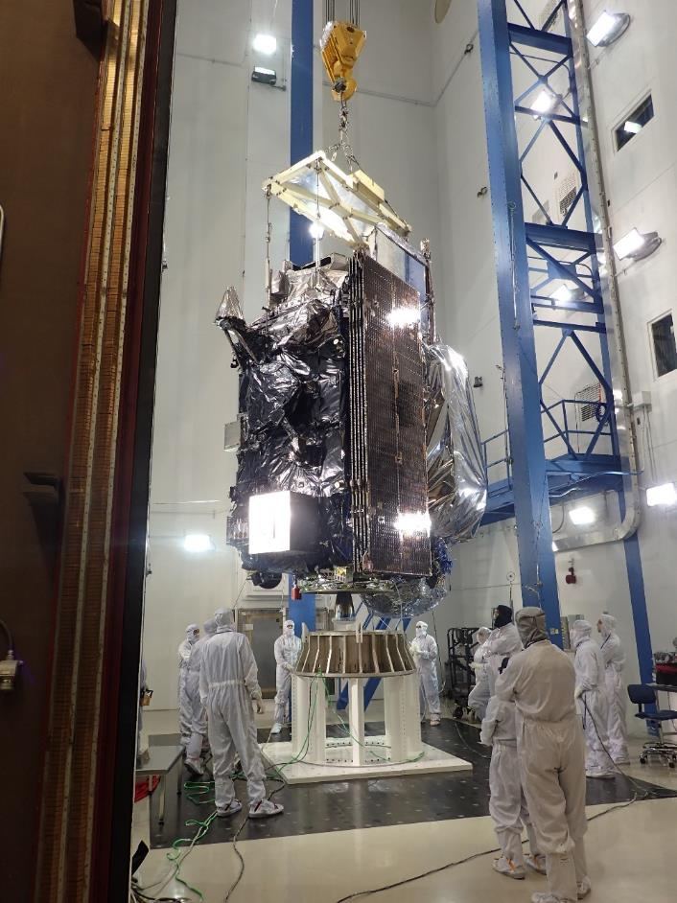
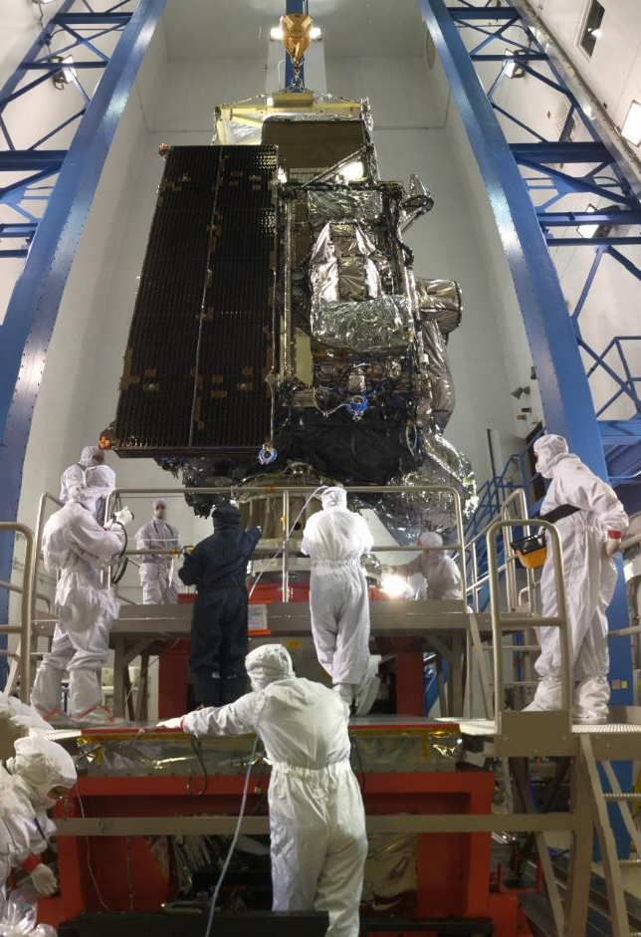
GOES-R Completed Mechanical Testing
Sine Vibe
Acoustics

Slide 3
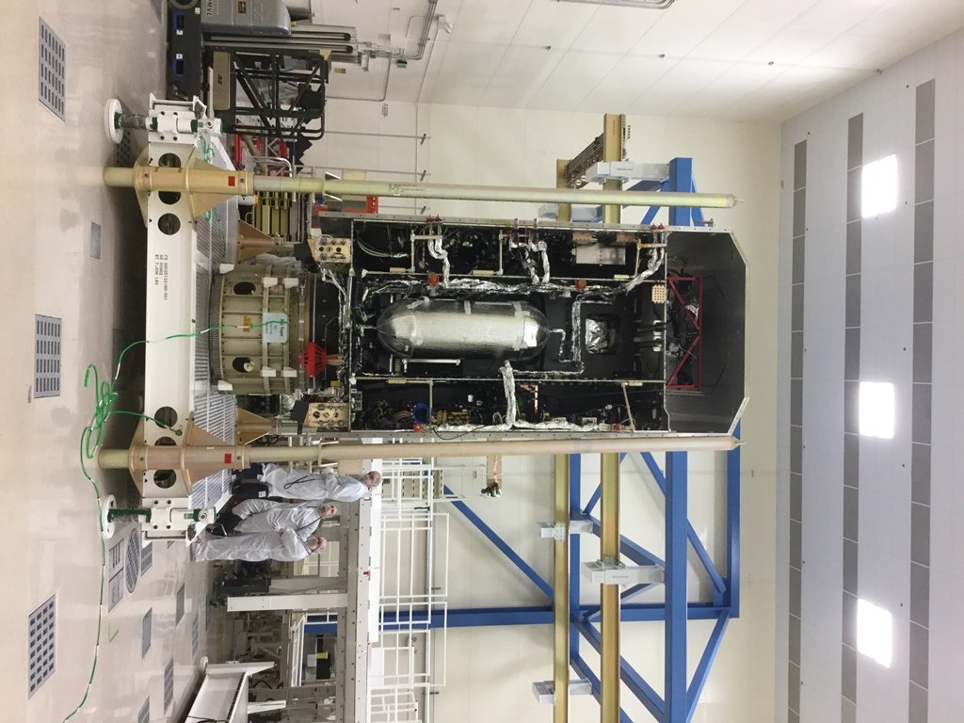
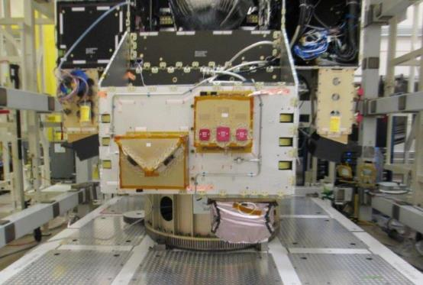
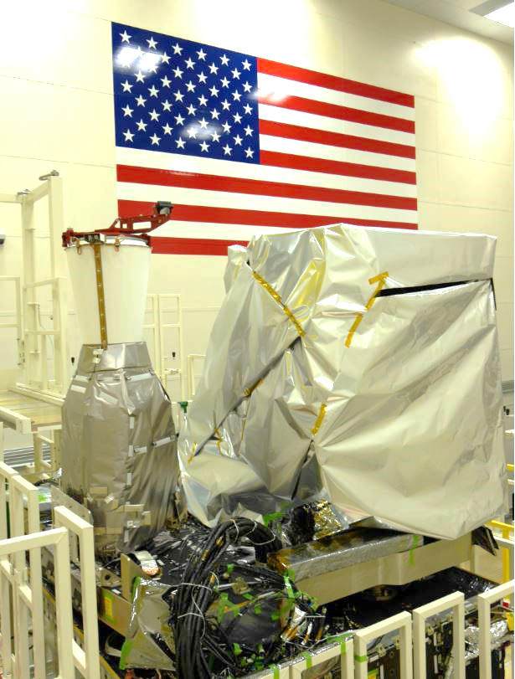
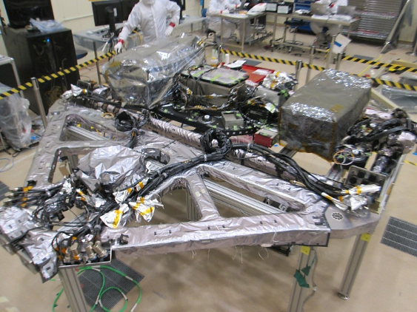
GOES-S Progress
GOES-S Mated
GOES-S Instruments Integrated
SEISS Sensors on SEISS Cabinet
ABI and GLM integrated to GOES-S Earth Pointing Platform
SUVI and EXIS integrated to GOES-S Solar Pointing Platform

Slide 4
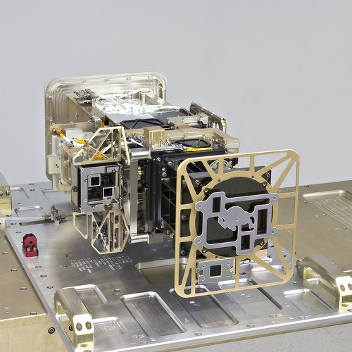
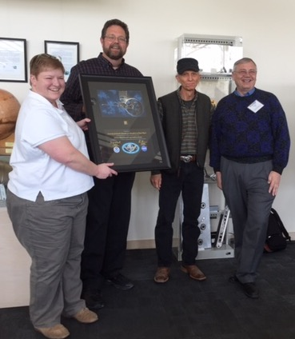
LASP Completed 4th & Final EXIS Instrument

Slide 5
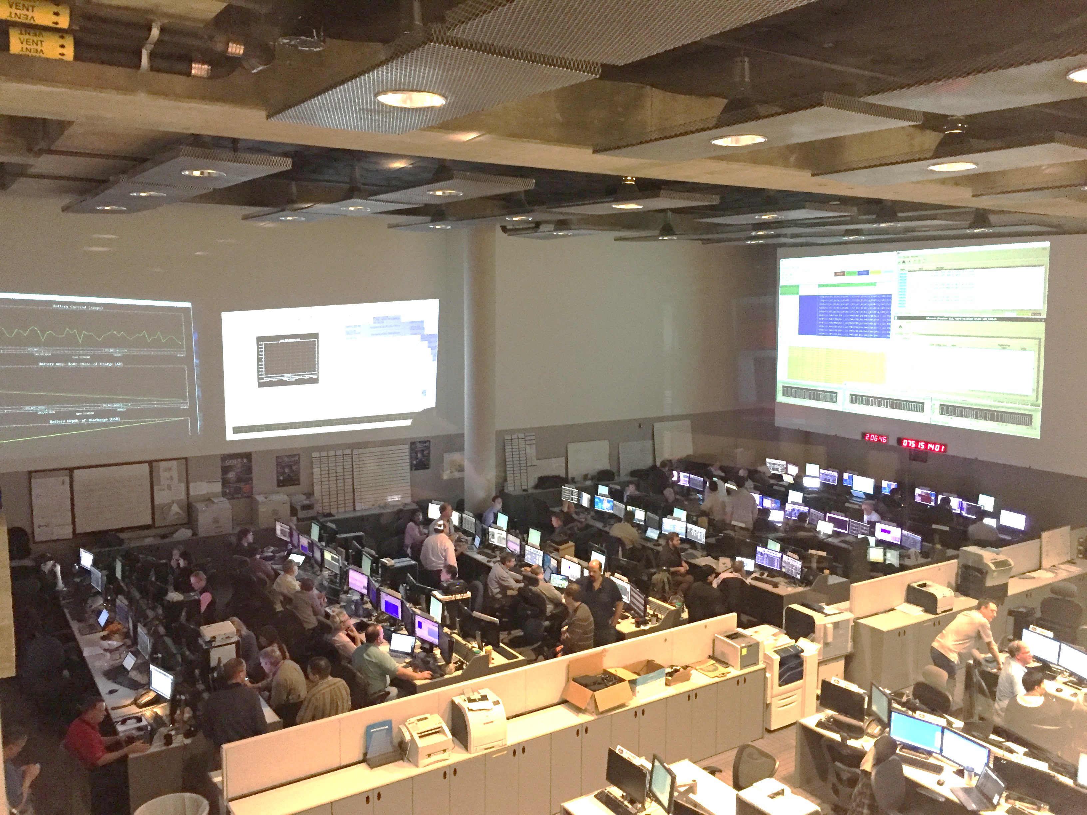
Executed Mission Rehearsal 1 & 2

Slide 6
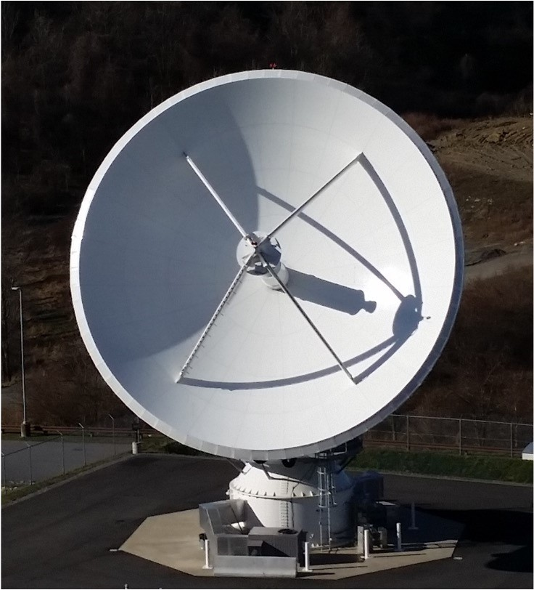
Antenna System
Five of six 16.4m GOES-R Antennas complete
R-3 Antenna at CBU
W-3 Antenna foundation pour at WCDAS

Slide 7
The Road to Launch… is Paved with Reviews
Element | Review Date | Board | Location
GOES-R Pre-Ship Review (PSR) | July 12- 13 | IIRT | LM - Denver
Operational Readiness Review (ORR) | July 26 - 28 | SRB | NSOF
Launch Vehicle Readiness Review | L-2mo | NASA KSC LSP | KSC
MRR | L-2mo | CMC | GSFC
SMSR | L-1.5mo | NASA HQ/OSMA & OCE | NASA HQ
MRB (KDP-E) | L-1mo | DPMC | NOAA HQ
Spacecraft Mate Readiness Review | L-2wk | ULA | CCAFS
Flight Readiness Review | L-1wk | NASA KSC LSP | KSC
Mission Dress Rehearsal | L-4d | NASA KSC LSP | KSC/CCAFS
Launch Readiness Review | L-2d | NASA KSC LSP | KSC
45th Space Wing Commander’s Launch Readiness Review | L-2d | USAF/45th Space Wing Commander | Patrick AFB

Slide 8
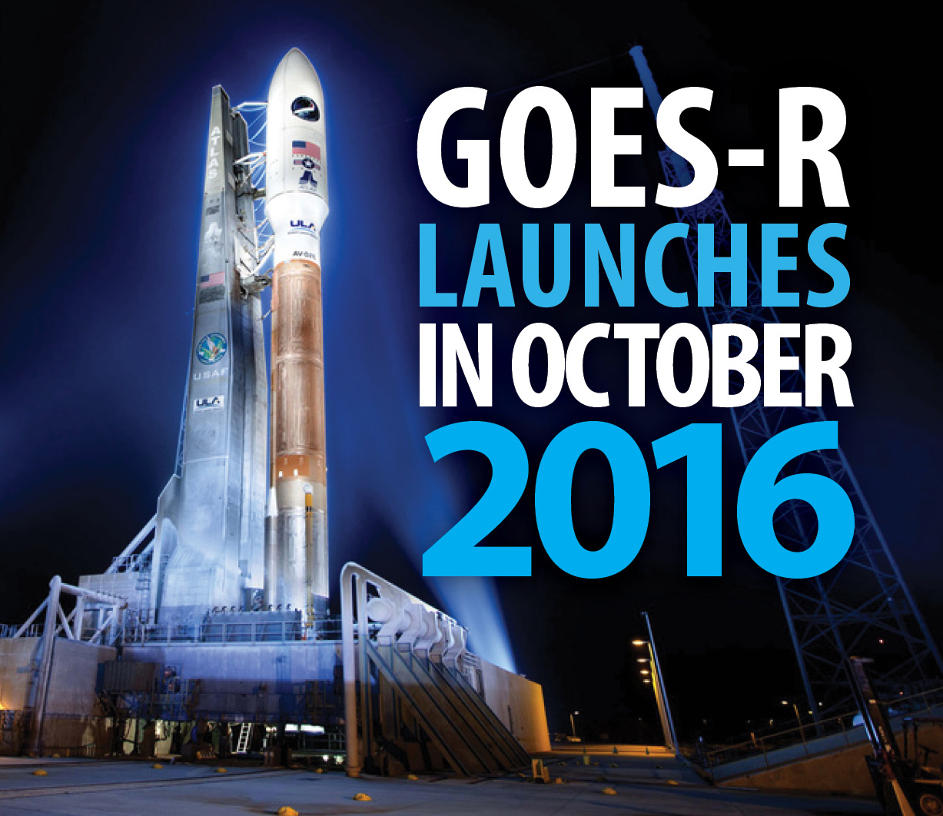
GOES-R Launch
October 13, 2016 at 5:43pm (EDT) ? ?
Launching from: Cape Canaveral Air Force Station, Florida
Vehicle: United Launch Alliance Atlas V (AV-541)
Pad: Launch Complex 41

Slide 9
Thank you!
For more information visit www.goes-r.gov
www.facebook.com/GOESRsatellite
www.youtube.com/user/NOAASatellites
twitter.com/NOAASatellites
www.flickr.com/photos/noaasatellites

