Slide 1
Current and future satellite data assimilation into Warn-on Forecast 2016 Satellite Proving Ground/User-Readiness Meeting
By:
Dr. Thomas Jones
Collaborators:
Kent Knopfmeier, Dustan Wheatley, Gerry Creager, Patrick Minnis, Rabindra Palikonda, and Louis Wicker
May 11, 2016
December 11, 2015

Slide 2
Outline
1. Overview of combined satellite and radar data assimilation system using an ensemble adjustment Kalman filter (EaKF) for the Warn on Forecast project
Comparison of radar and satellite data observation types
Model configuration
Comparison of radar-only and radar+satellite experiments
2. Adaptive data thinning
Combine radar and satellite observations in a fashion where unnecessary observations are removed from the data sample prior to assimilation
3. Future plans and operational considerations

Slide 3
1. Warn-on-Forecast
Provide accurate, short range (0-1 h) probabilistic forecasts of severe convective storms is a key component of the Warn-on-Forecast project
A regional, convection allowing ensemble model is essential to achieving this goal
Requires hi-resolution observations of convection and the near storm environment
Robust methods to assimilate high resolution remote sensing observations from multiple platforms and sensors
Model-based probabilistic forecasts can aid in severe weather warning guidance and leading to significantly improved lead times
Move from observation based warnings to a mix of observations and probabilistic forecasts

Slide 4
Satellite Data Assimilation
GOES-Imager observations are suitable for storm-scale DA
High temporal and spatial resolution, low data latency
Supplements radar observations from WSR-88D
WSR-88D not as sensitive to non-precipitating clouds
Low-level stratus, cirrus outflow from storms
Developing convection during CI
Clear-air reflectivity is not the same as cloud-free radiances / retreivals
Future GOES-R data will provide additional and higher resolution cloud products
Launches in October 2016
First useable data available Spring 2017
Important consideration: Assimilating satellite observations must be able to show skill in high impact weather forecasting compared to only assimilating radar data

Slide 5
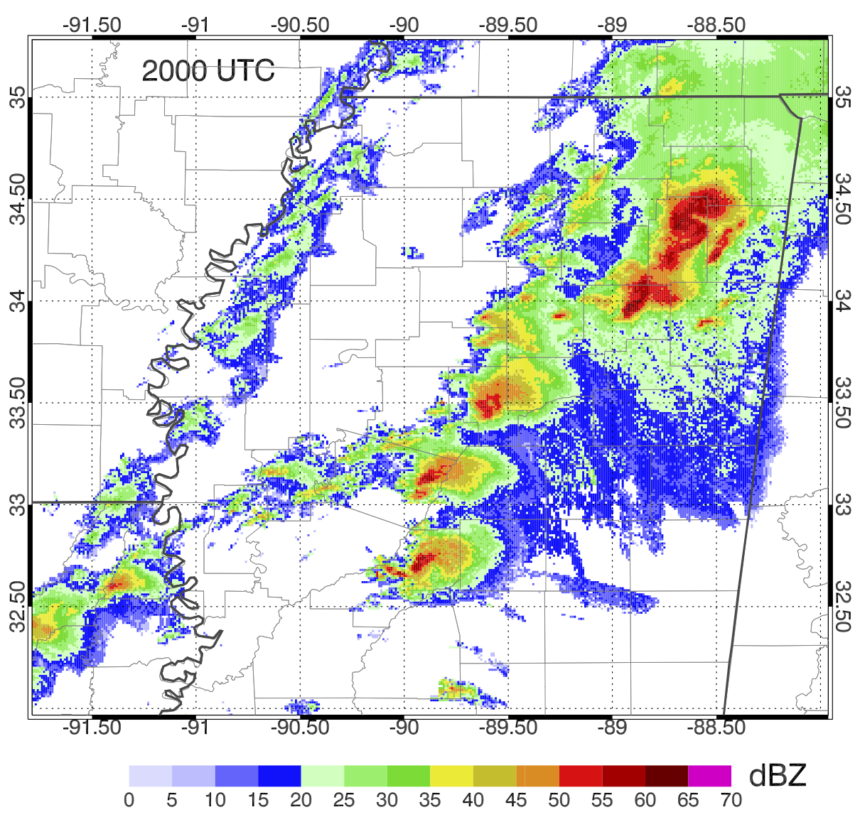
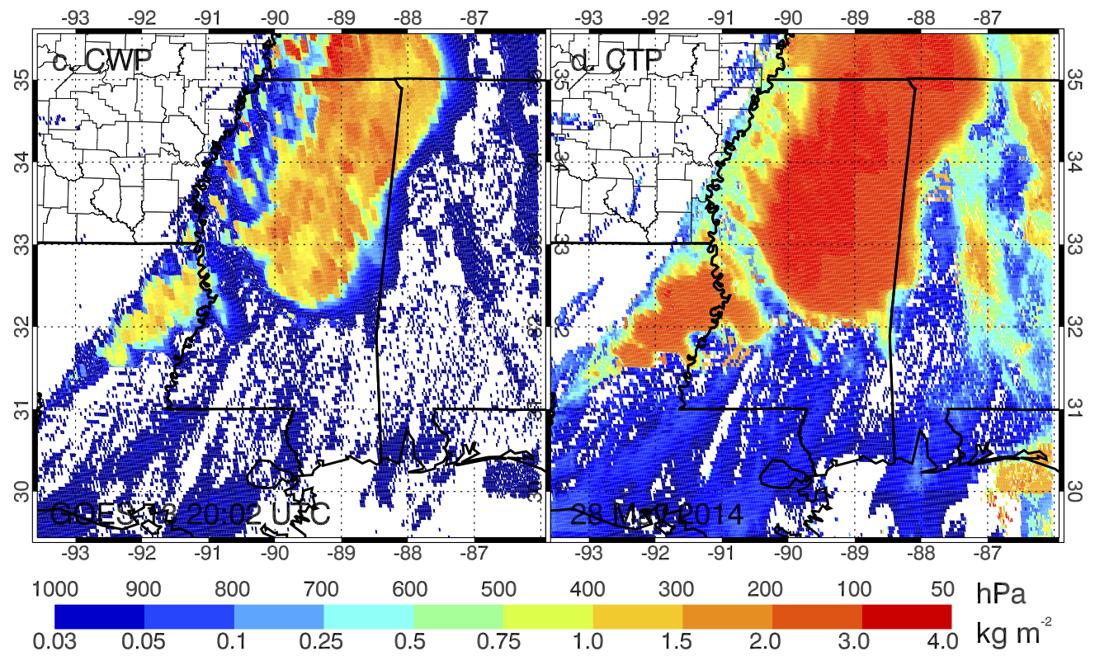
Satellite vs. Radar Obs.
Reflectivity
CWP
CTP
Radar Reflectivity: Location of precipitation cores; 3D structure
Cloud Retrievals: Cloud cover, thickness and height information
Assimilating both is dogs and cats living together…mass hysteria!

Slide 6
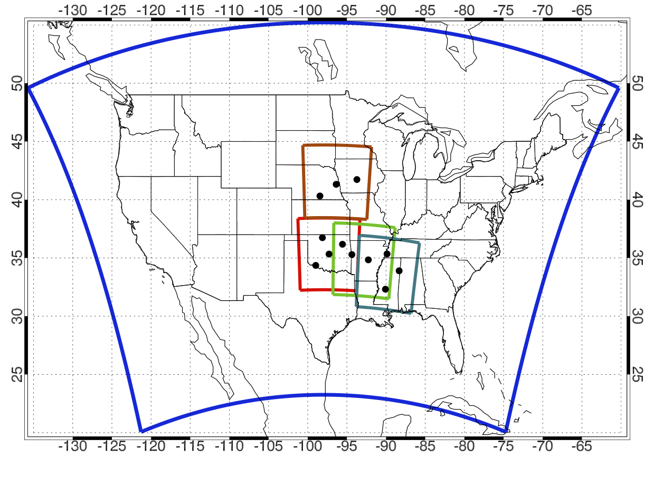
NSSL Experimental Warn-on-Forecast System for ensembles (NEWS-e)
CONUS Mesoscale domain with nested storm-scale domain to enable short term (0-1 h) forecasts of severe weather events.
15 km Mesoscale grid
11 May
3 km Storm-scale grids
19,20,31 May
28 Apr
27 Apr
GOES-13 CWP domain
Black dots: WSR-88D locations
http://www.nssl.noaa.gov/projects/wof/news-e/

Slide 7
Ensemble Design
WRF-ARW: v3.4.1
Mesoscale (15 km) and storm-scale (3 km) domains
Run simultaneously in a 1-way nest
36-member ensemble with physics diversity
Cloud microphysics: Thompson
Cumulus parameterization (mesoscale only): KF, Grell, Tiedtke
PBL: YSU, MYJ, MYNN2
Radiation (SW/LW): Dudhia/RRTM, RRTMG/RRTMG
RAP LSM, 6 soil levels
IC/BCs for both grid downscaled from first 18 members of Global Ensemble Forecast System (GEFS)
Data assimilation (DA) procedure:
DART Parallel EAKF
Prior adaptive inflation applied to state
Gaspari and Cohn spatial vertical and horizontal localizations
Localization radius is a function of observation type

Slide 8
Storm-scale DA
Begins at hour following the end of mesoscale DA
15 minute assimilation cycle with observations partitioned into ±2.5 minute windows
Assimilated observations:
Level II WSR-88D Reflectivity and Doppler radial velocity from 3 radars
Liquid and Ice water path (LWP, IWP) retrievals from GOES Imager
All radar and satellite observations objectively analyzed to 6 km resolution (2 delta-X model grid)
OK Mesonet observations (grid permitting)
Additive noise applied to (T, T_{D}, u, v) where reflectivity observations indicate strong precipitation
Radar/Satellite/Mesonet DA on nested grid only
All assimilation on mesoscale grid ceases
Cycling continues until convection ends or at 0000 UTC
Current satellite retrievals ineffective after dark

Slide 9
Experiments
RAD:
Only assimilate radar reflectivity and radial velocity
Assimilate both positive and clear-air (0 dBZ) reflectivity
RADSAT:
Assimilate LWP, IWP, and clear-sky (CWP = 0 kg m⁻²) retrievals in addition to radar observations
No clear-air reflectivity assimilated
One goal is to replace 3-D clear-air observations with 2-D satellite clear-sky observations
RAD0SAT:
Same as RADSAT, but with clear-air reflectivity also assimilated
20 May and 27 April only

Slide 10
2013-14 Events
19 May 2013
20 May 2013
31 May 2013
Carney, Norman – Shawnee
Moore
El Reno
27 April 2014
28 April 2014
11 May 2014
Central AR
Southeast US outbreak
Southeast NE

Slide 11
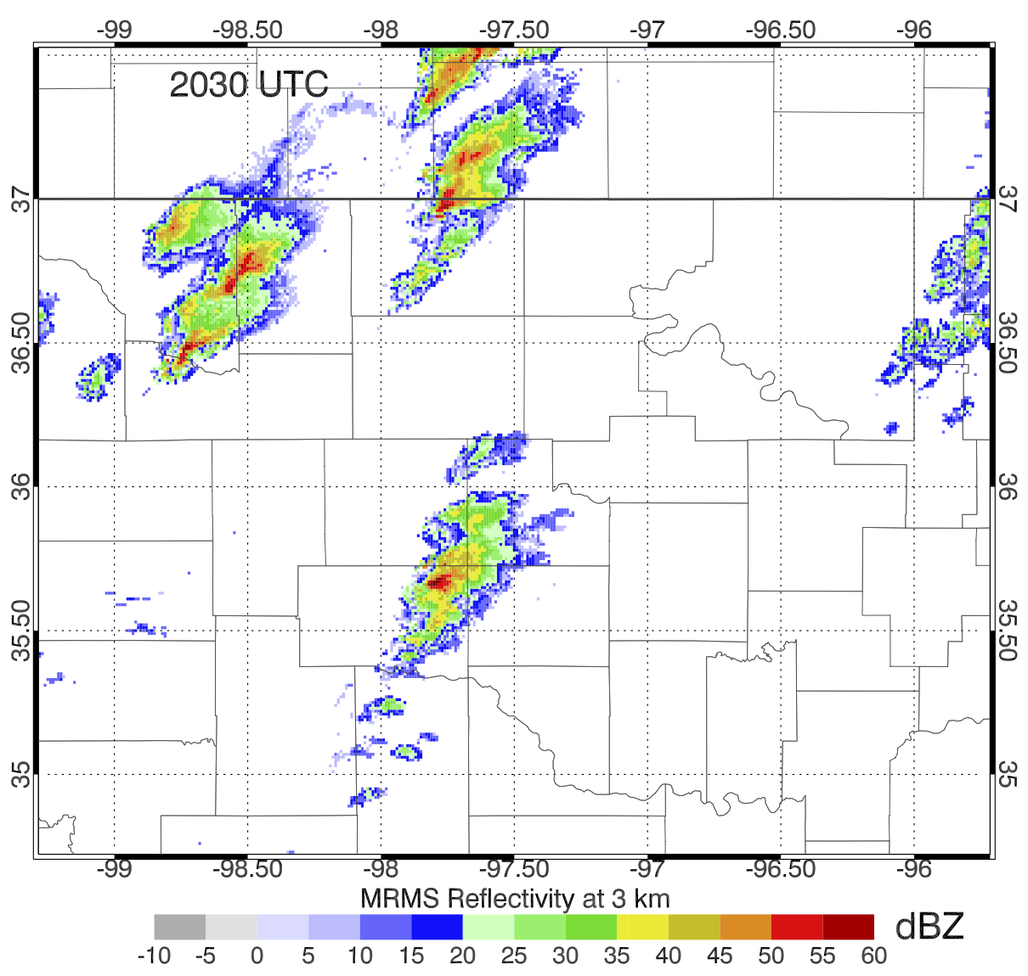
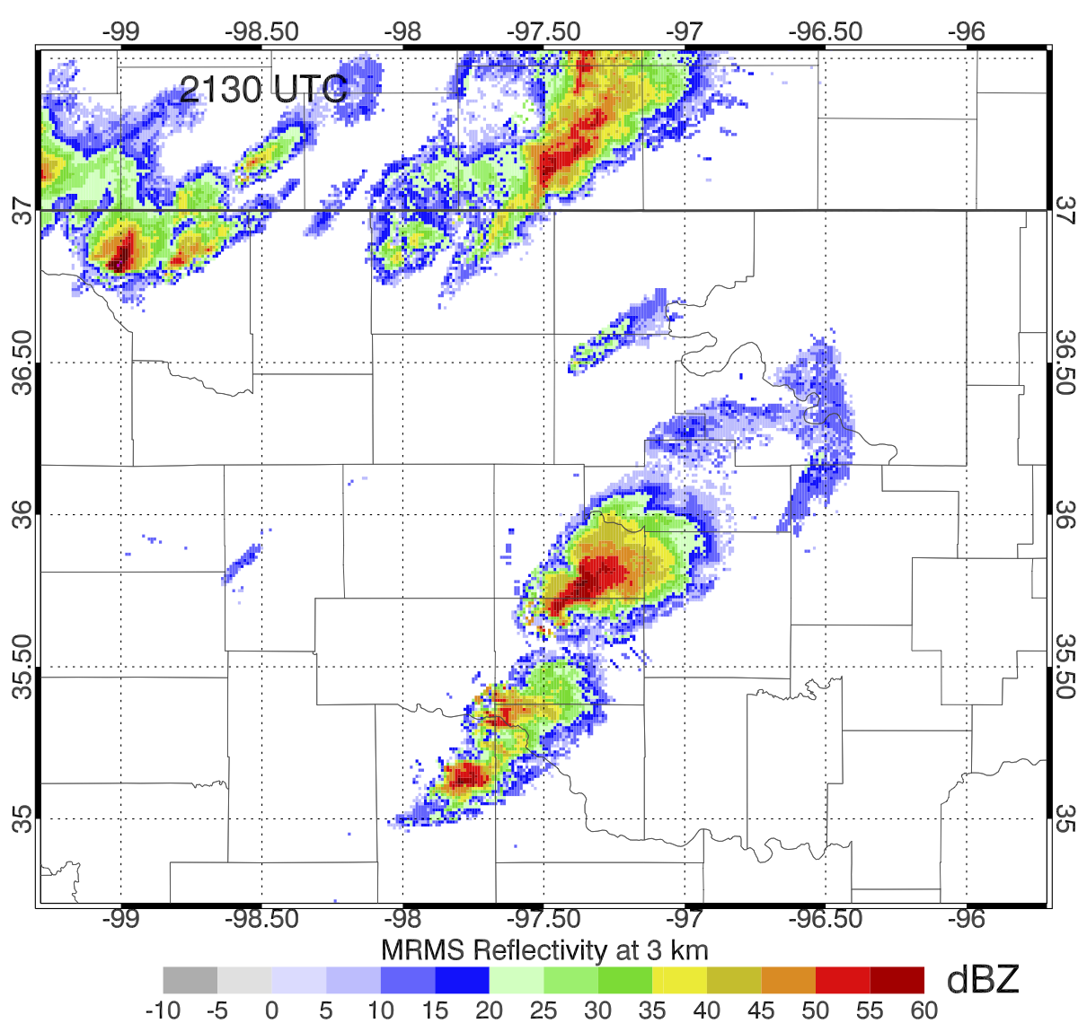
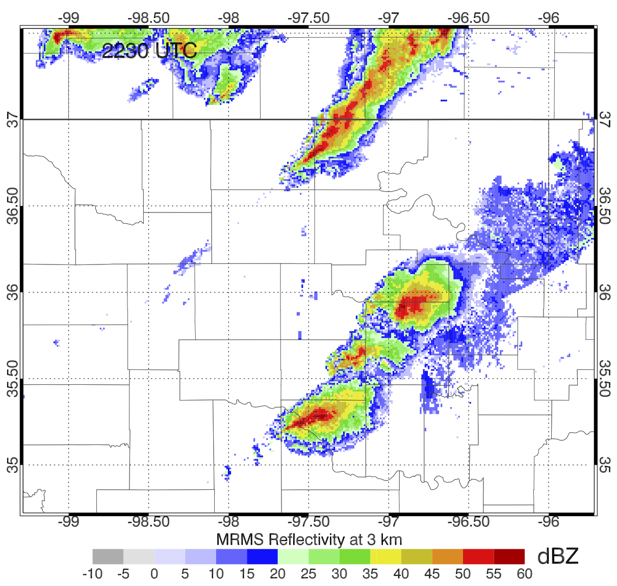
19 May 2013
Radar – Satellite DA begins at 1900 UTC
1 hour forecasts generated beginning at 2030, 2045, 2100, 2115, 2130, 2145, 2200 UTC
Focus on 2045 UTC initialization time, which is 56 minutes prior to touchdown of Carney tornado
2030 UTC
2130 UTC
2230 UTC
#1
#1
#1
#2
me

Slide 12
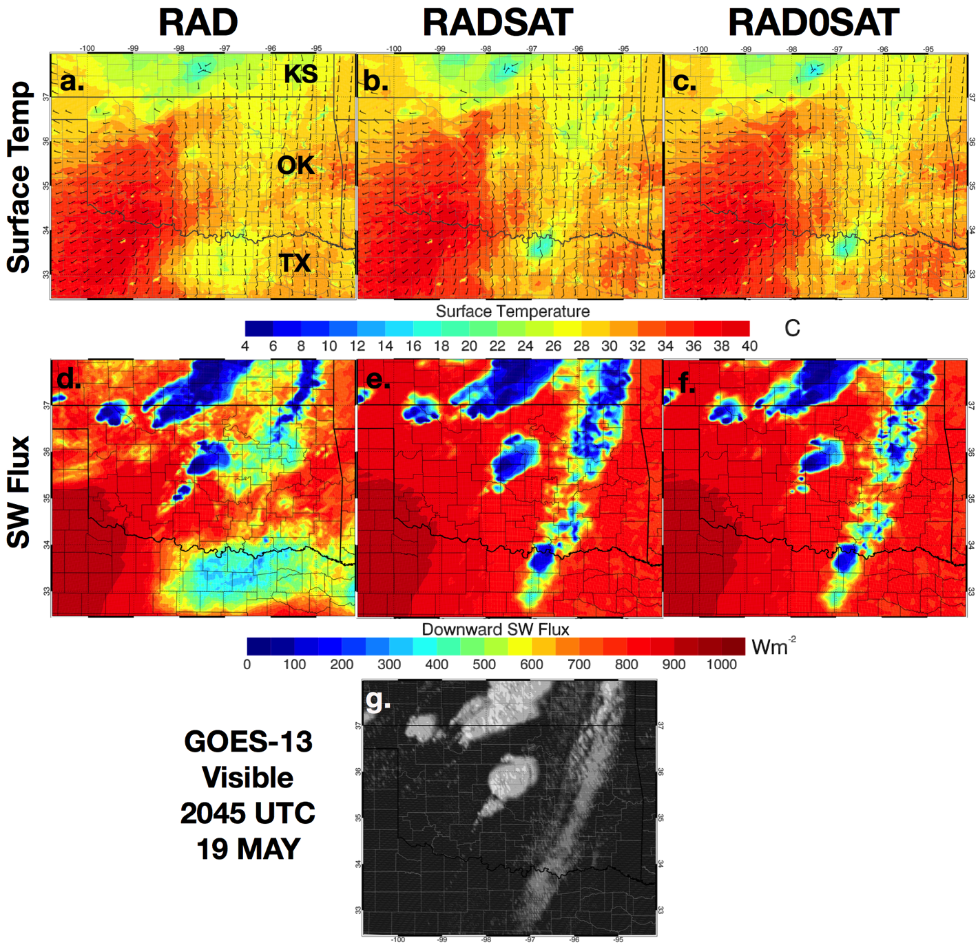
19 May 2013 2045 UTC
Both RADSAT experiments are warmer in north TX
RAD generates anomalous low-level clouds in this region indicated by the low SW Flux
RADSAT also better analyzes linear band of clouds east of developing supercells

Slide 13
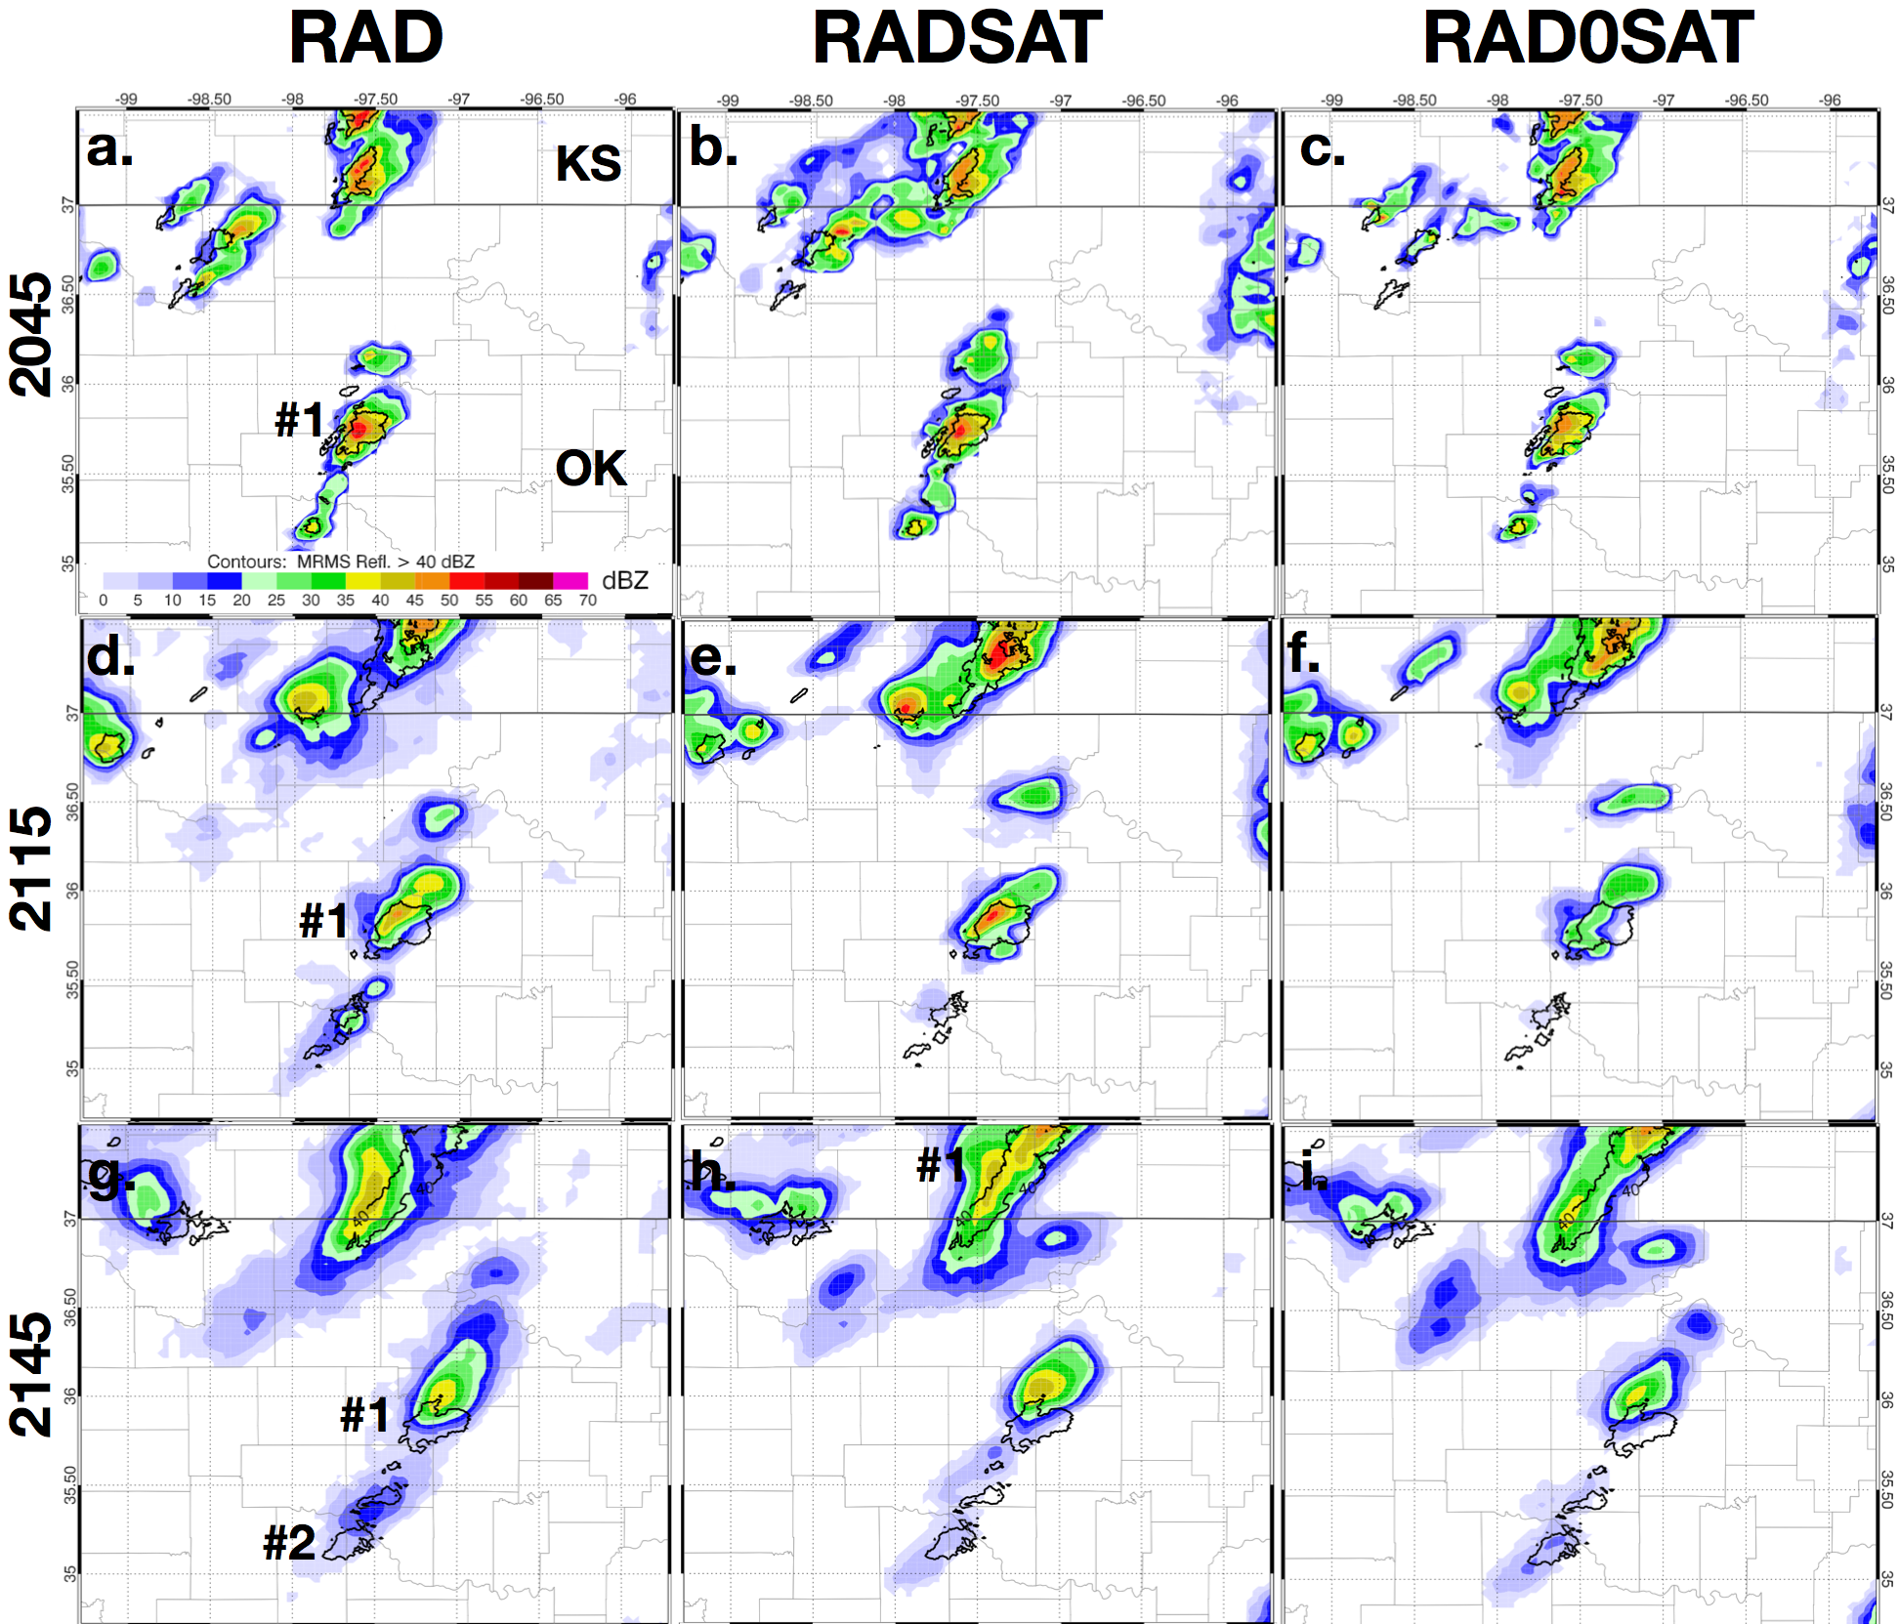
19 May 2013 1 hour forecast from 2045 UTC
Black contour:
MRMS > 40 dBZ
Lower max refl.
values
Hi refl. core
maintained
Hi refl. core
gone
3 km Ensemble Mean Reflectivity

Slide 14
19 May 2013 2045 – 2145 UTC
RADONLY
RADSAT
RAD0SAT
Probability 0-2 km vertical vorticity > 0.004 s⁻¹
RADSAT generated higher somewhat higher probabilities associated with Carney storm and other severe convection along OK – KS boarder
RAD0SAT generated lowest probabilities
Indicates that too much clear-air reflectivity DA is bad

Slide 15
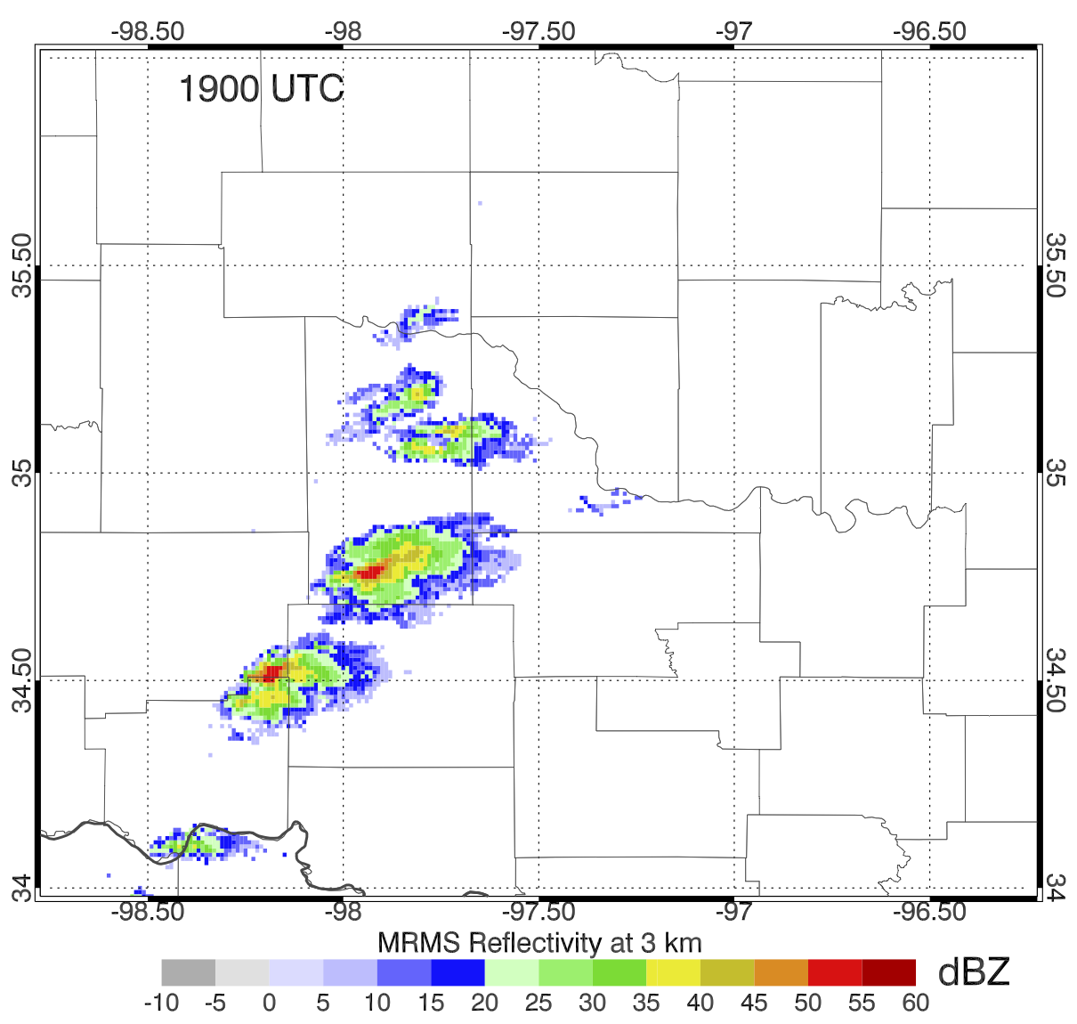
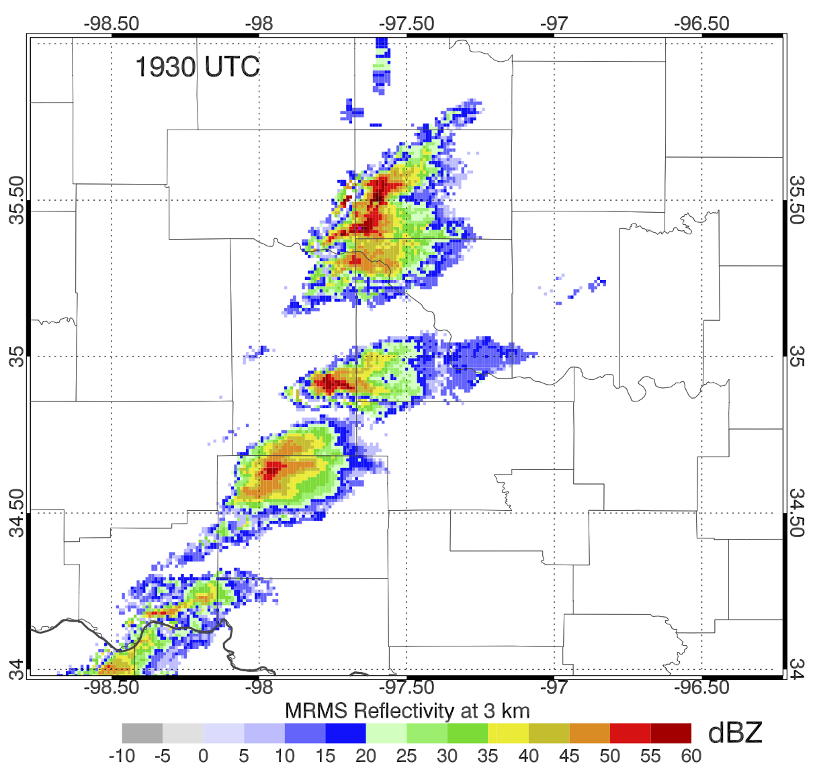
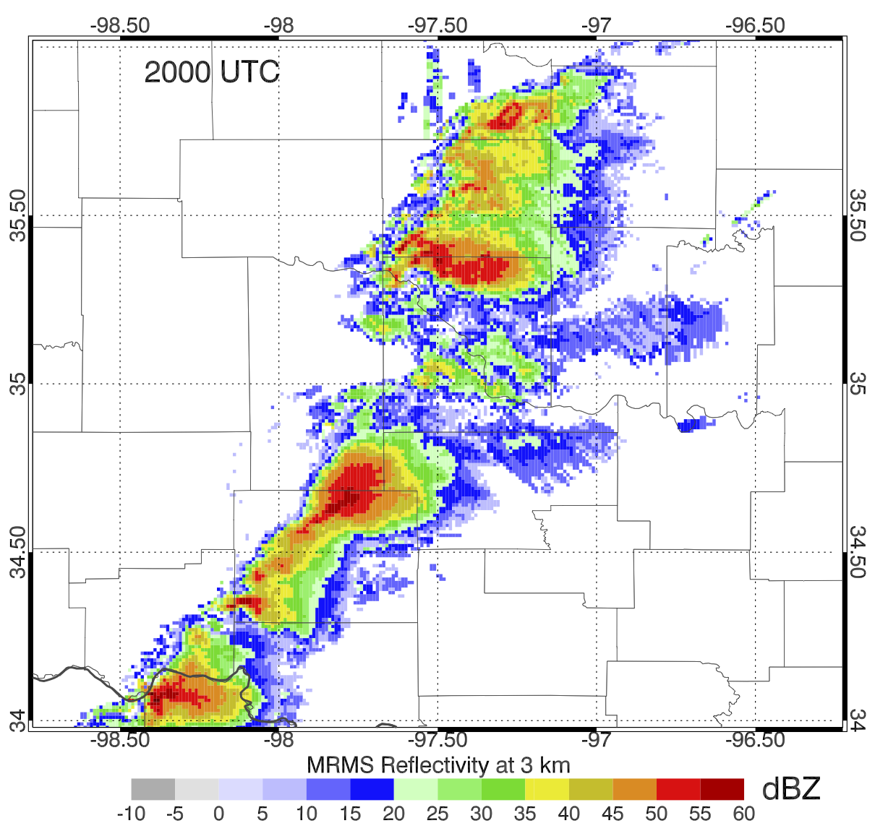
20 May 2013
Radar - Satellite DA begins at 1800 UTC
1 hour forecasts generated beginning at 1900, 1915, 1930, 1945, and 2000 UTC
Focus on 1915 UTC initialization time, 41 minutes before touchdown of Moore tornado
1900 UTC
1930 UTC
2000 UTC

Slide 16
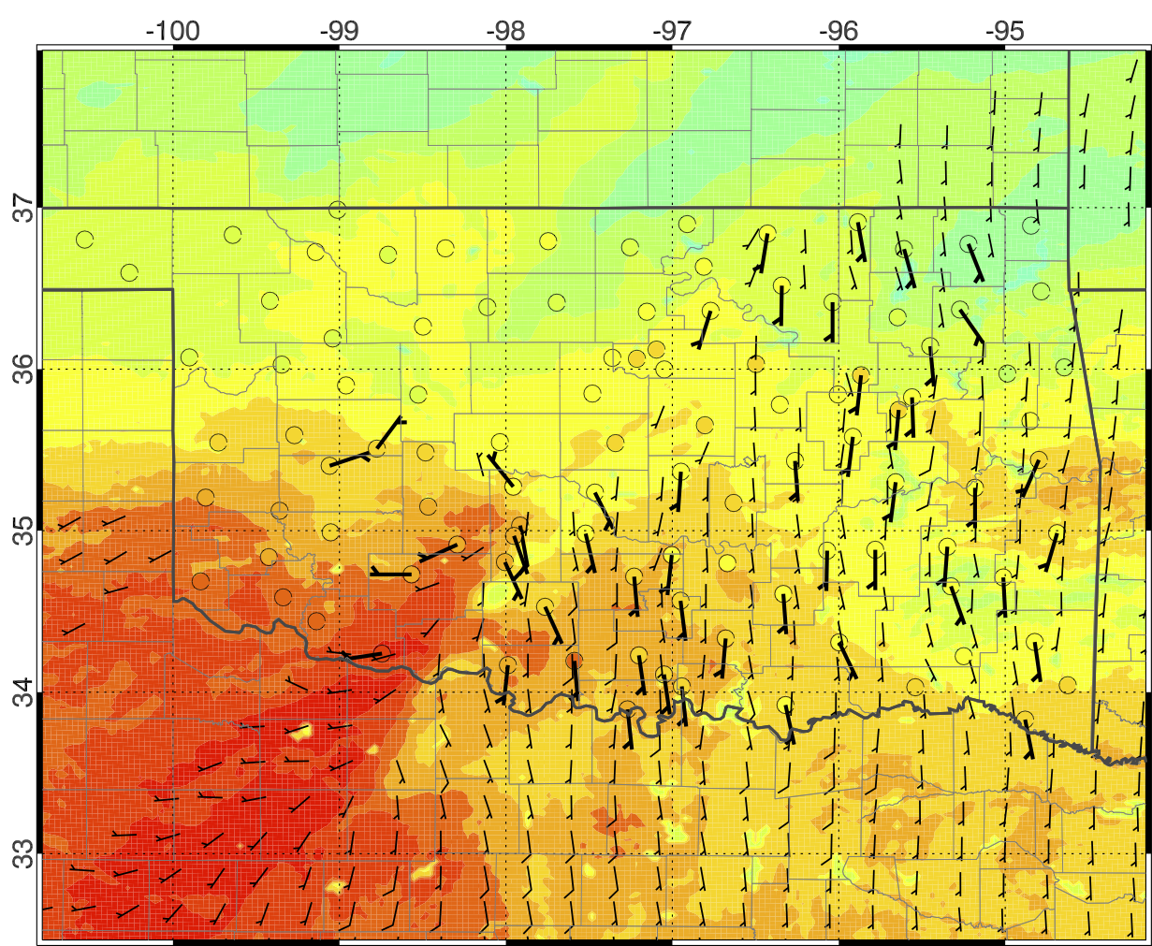
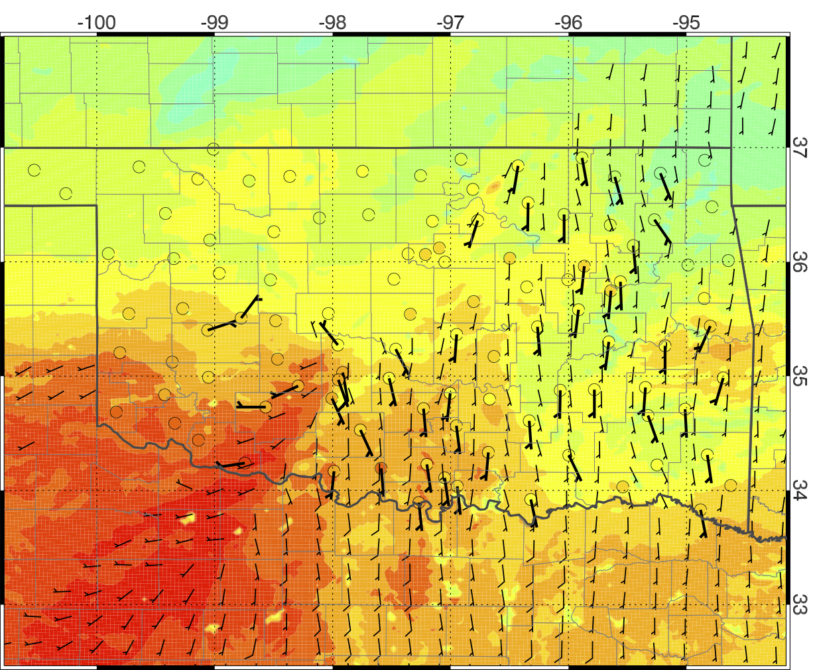
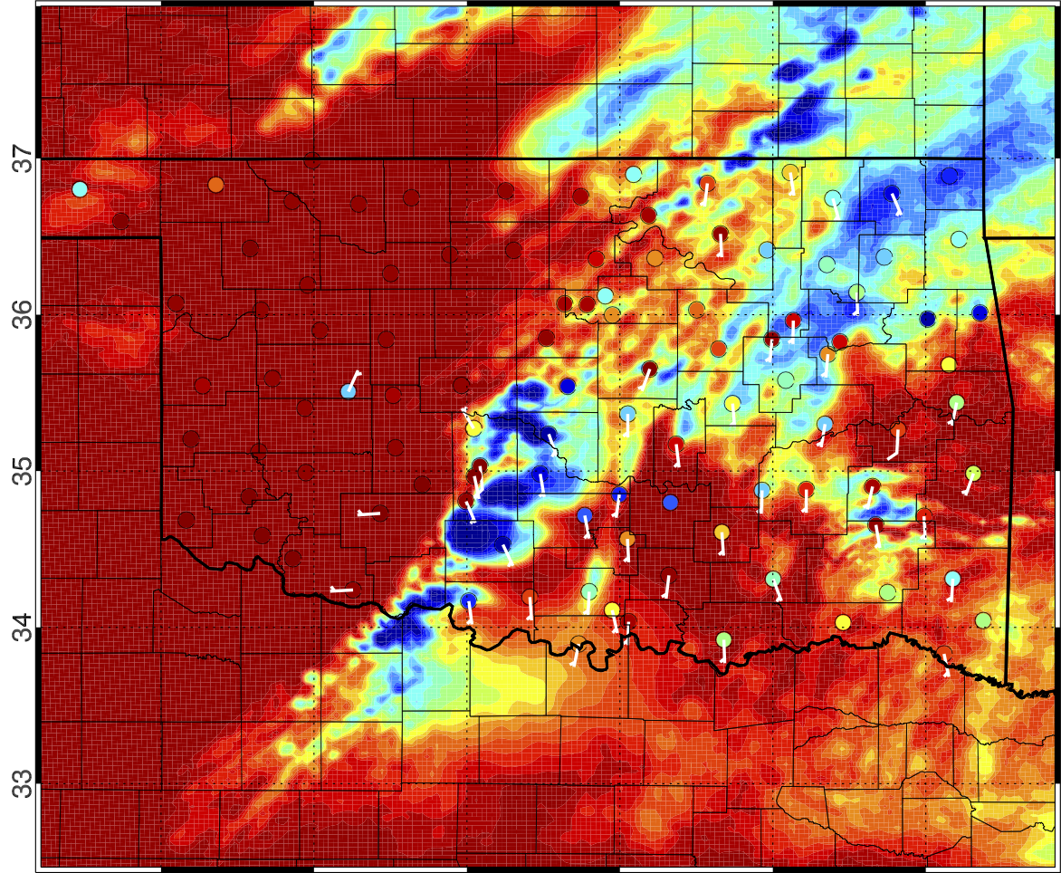
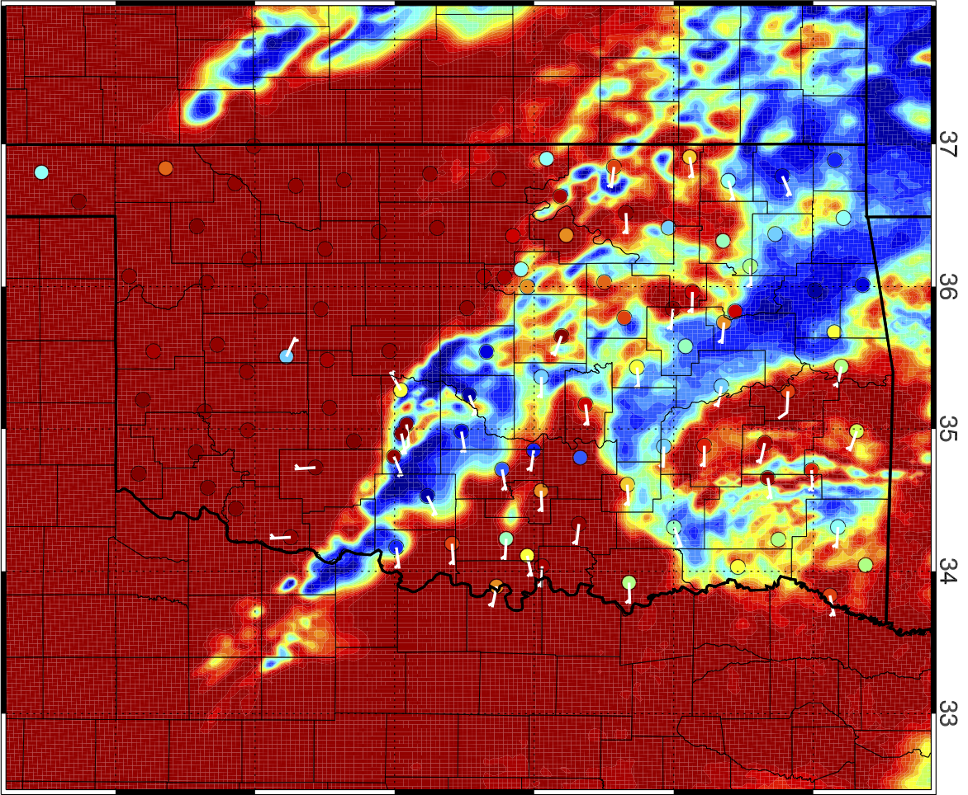
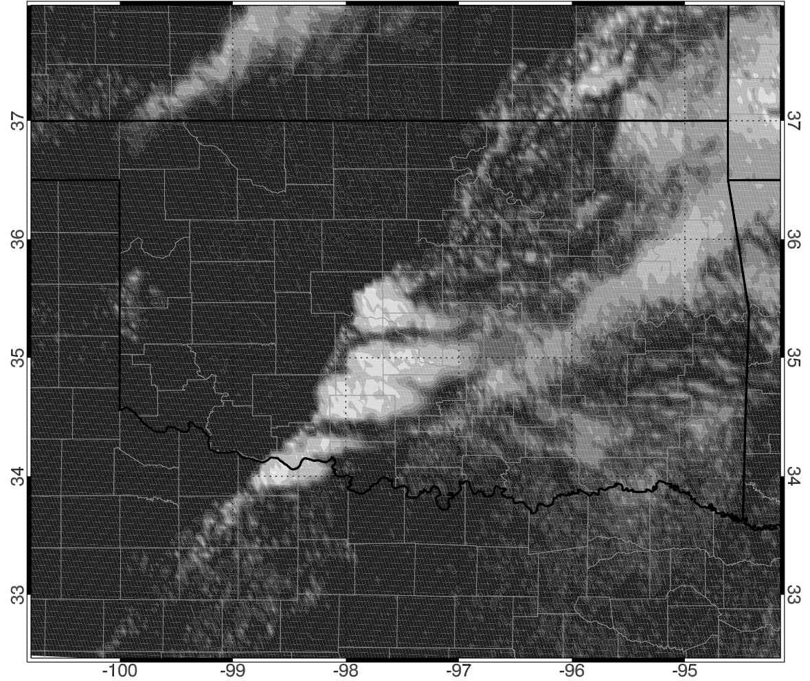
20 May 2013 1915 UTC
RADONLY
RADSAT
Assimilating CWP generates better representation of cloud cover in model
Impact on near-storm environment
2-m Temp
RADSAT
Warms sfc
RADSAT
Adds non-precip clouds
SW Flux
RADSAT
Remove clouds
GOES-13 Visible: 1915 UTC

Slide 17
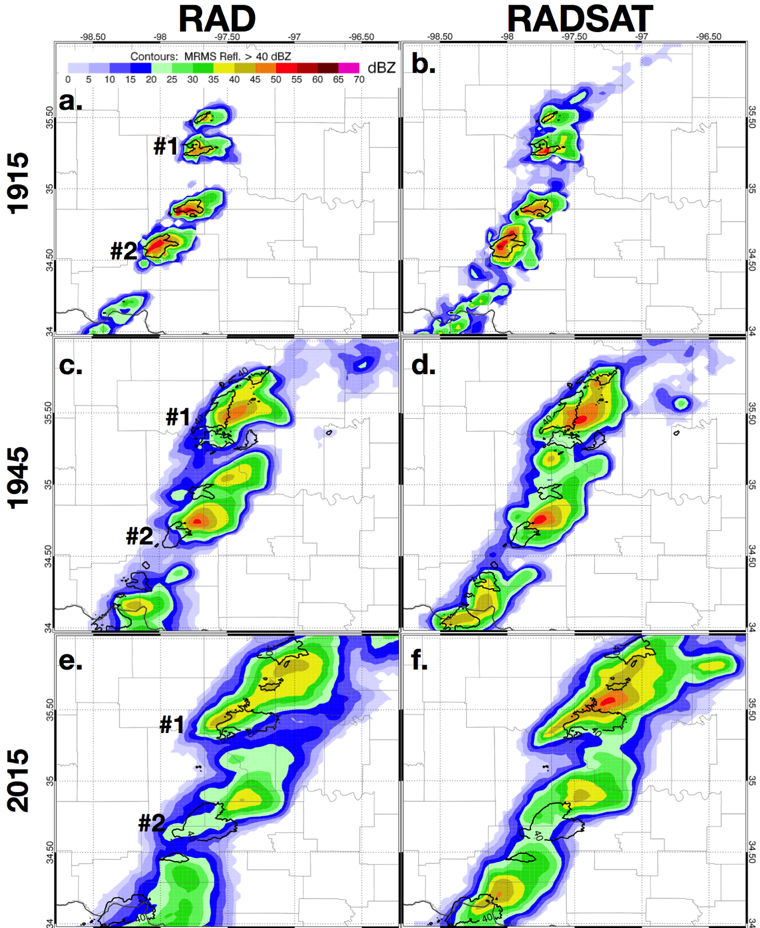
20 May 2013 1 hour forecast from 1915 UTC
RADSAT over analyzes 0-30 dBZ coverage
RADSAT maintains higher reflectivity storm cores than RADONLY for 30 – 60 minute forecast period.
Both experiments have a northeast bias

Slide 18
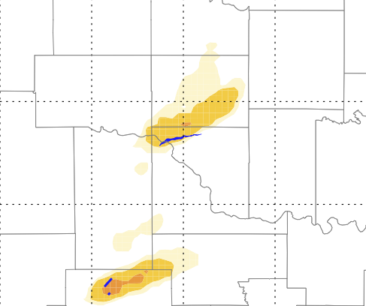
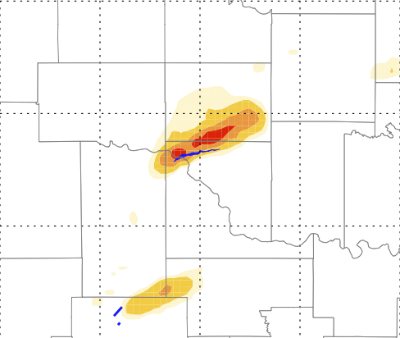
20 May 2013
Impacts on 1 hour low-level vorticity forecasts
Corresponds to forecast track of mesocyclone
RADONLY
RADSAT
Moore Tornado
Begin: 1945 UTC
One hour forecast beginning at 1915 UTC
Assimilating CWP observations increases low-level vorticity probability during forecast period for Moore storm

Slide 19
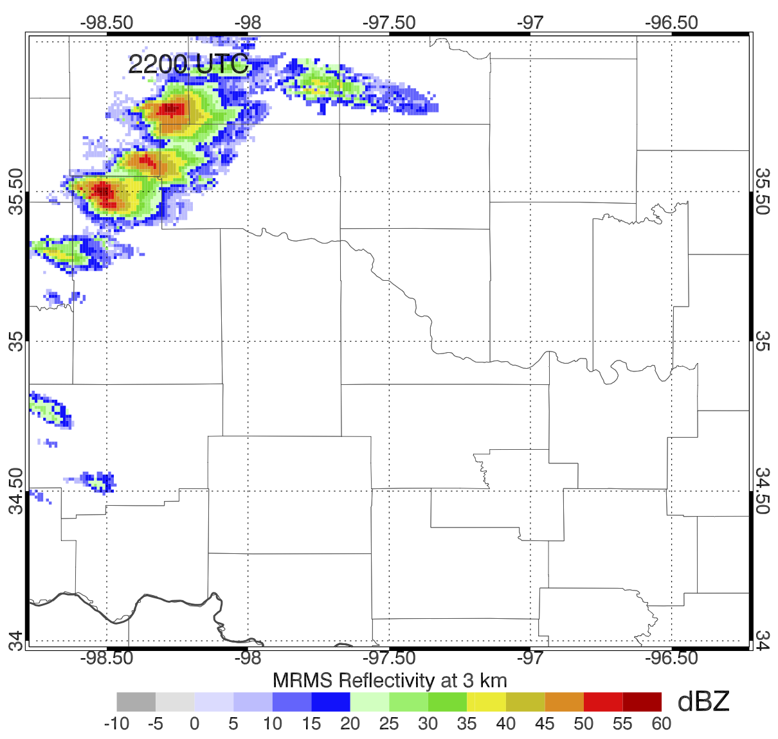
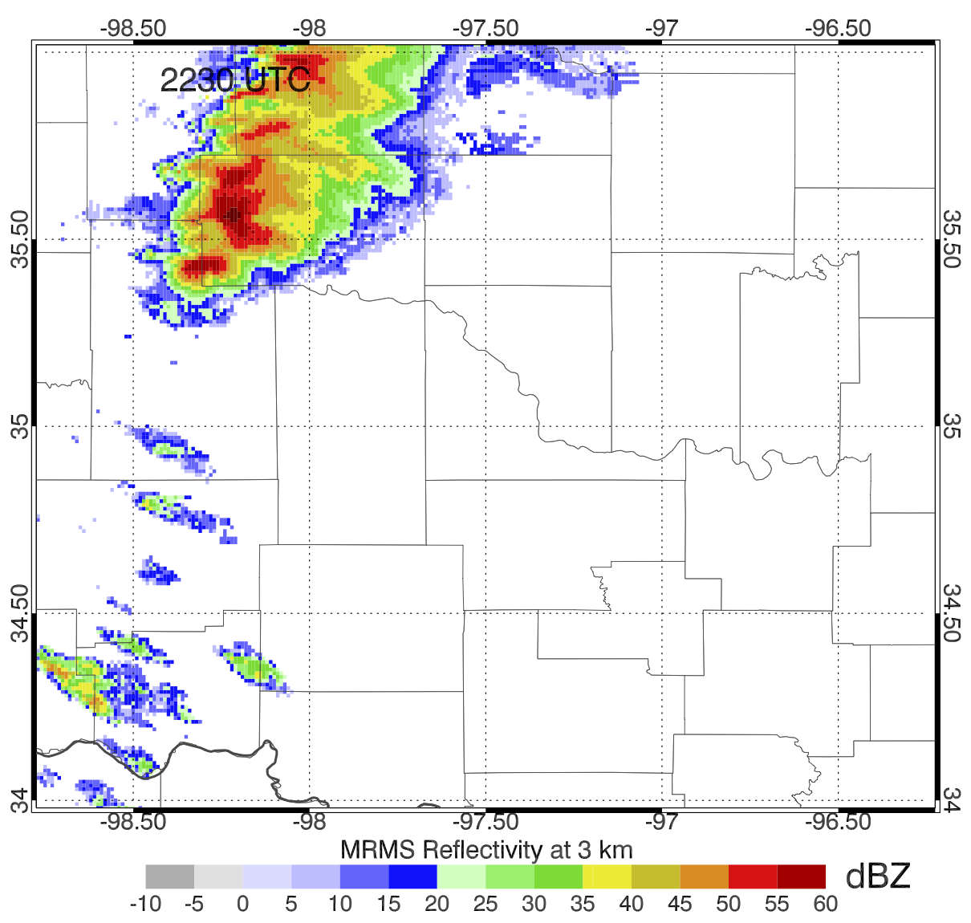
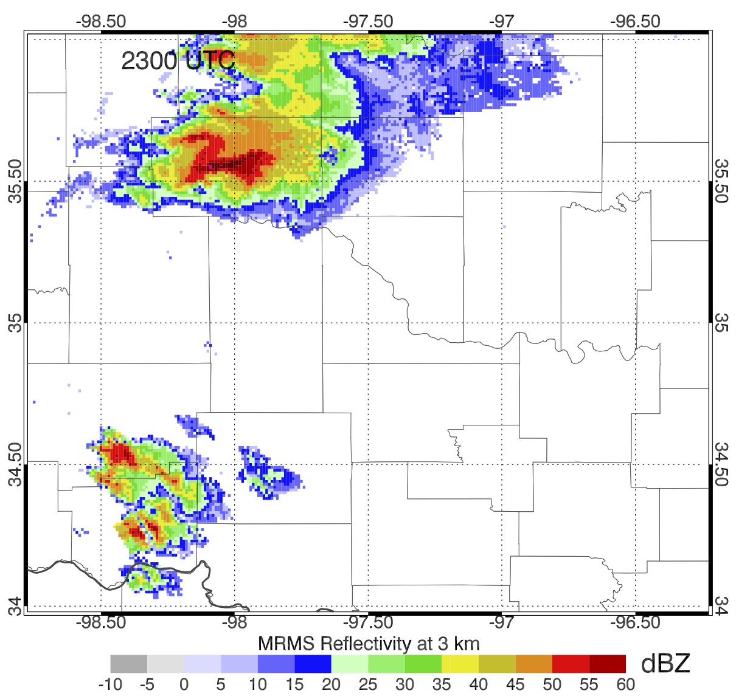
31 May 2013
Radar - Satellite DA begins at 2100 UTC
1 hour forecasts generated beginning at 2200, 2215, 2230, 2245, and 2300 UTC
Focus on 2200 UTC initialization time, 65 minutes before touchdown of El Reno tornado
2200 UTC
2230 UTC
2300 UTC

Slide 20
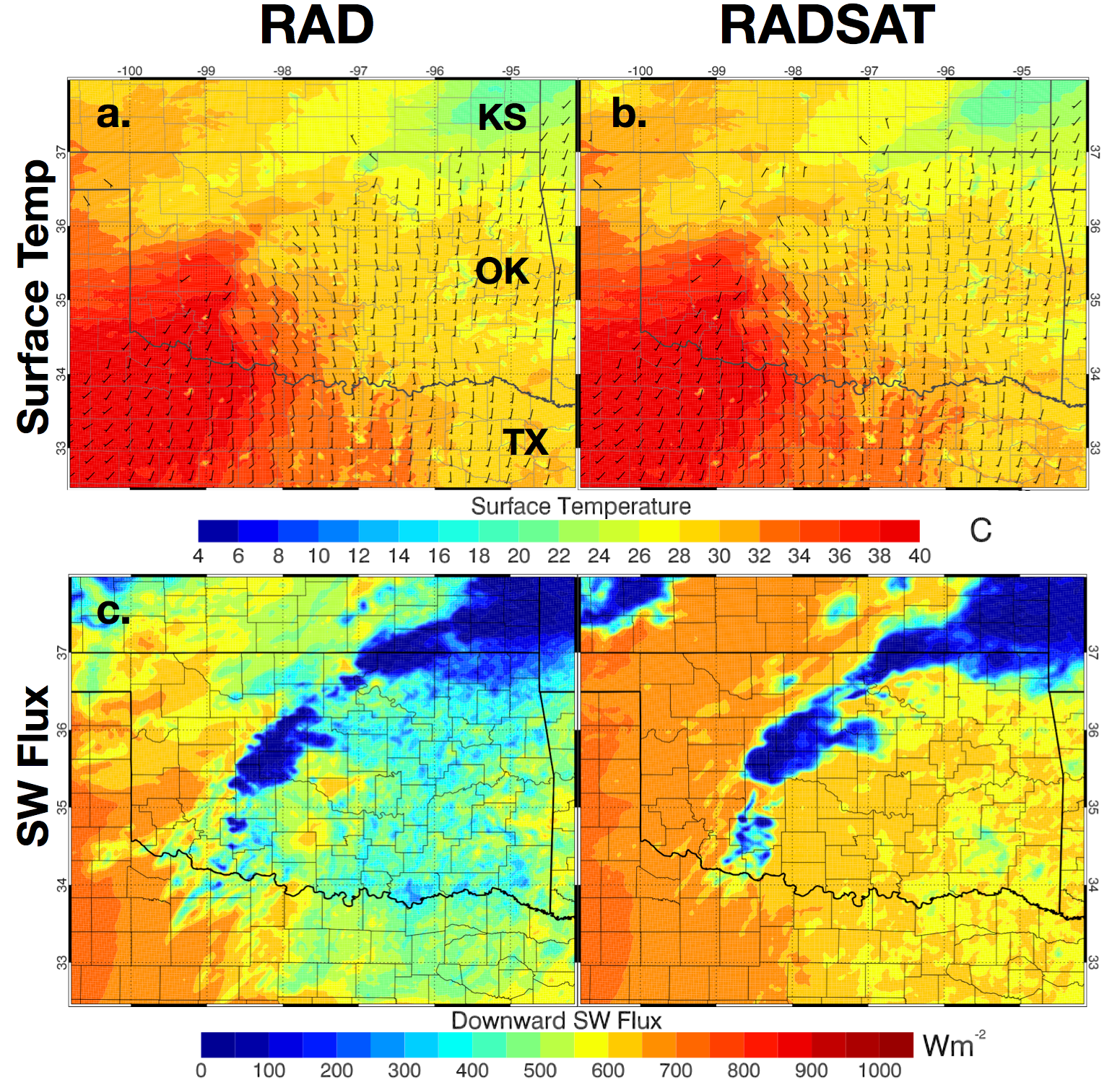
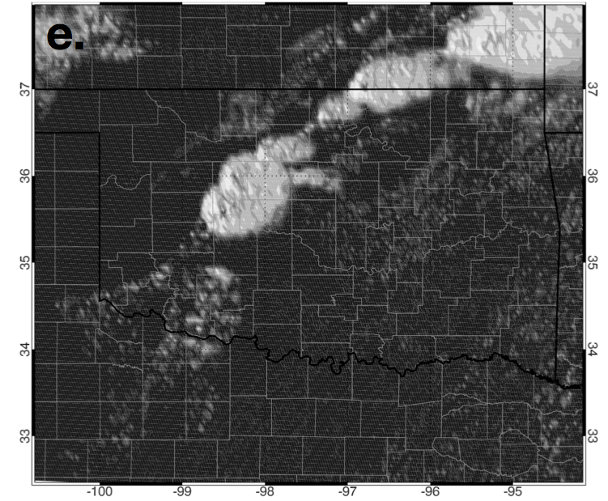
31 May 2013 2200 UTC
RADSAT significantly reduces cloud cover over much of the domain
Towering Cu
GOES-13 Visible: 2200 UTC

Slide 21
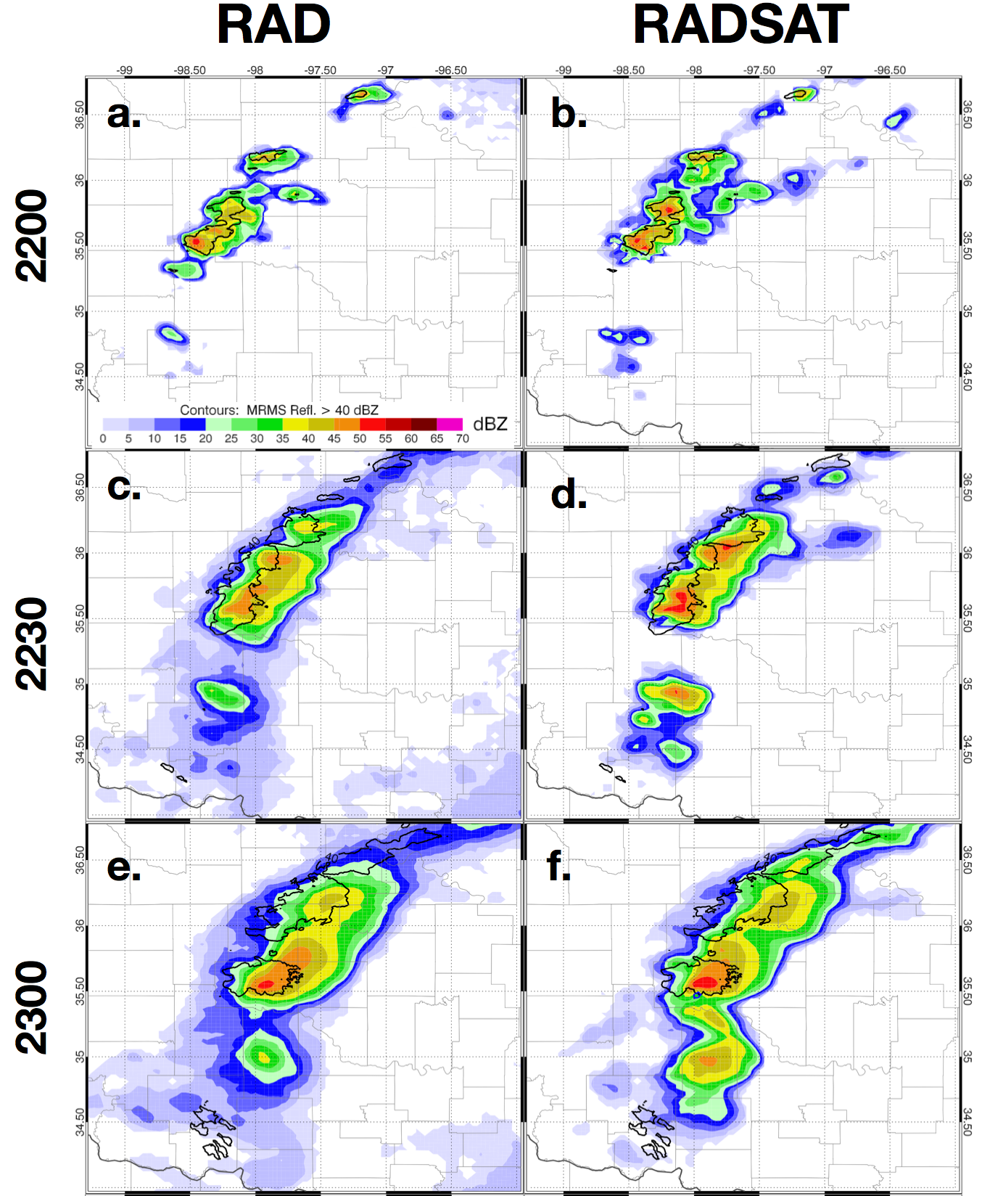
31 May 2013 1 hour forecast from 2045 UTC
RADSAT generates high ensemble mean reflectivities at analysis time and for 30 minute forecasts
Both experiments generally capture tornadic storm well
RADSAT generates some excess convection in southern OK
Associated with the assimilation of towering cumulus in this region

Slide 22
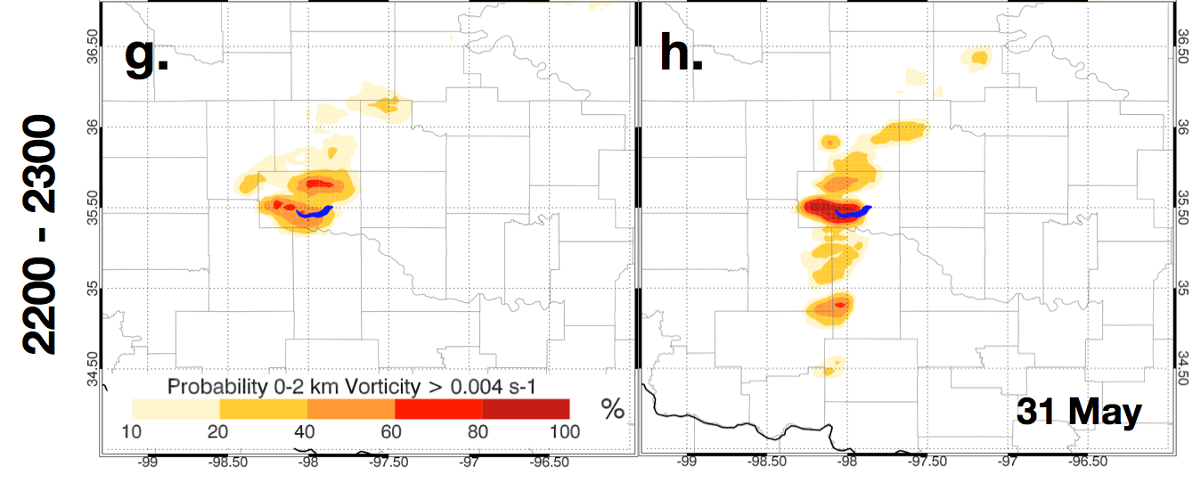
31 May 2013 2200 – 2300 UTC
RADONLY
RADSAT
False Alarm ?
RADSAT generates higher vorticity probabilities associated with El Reno storm
Excess probabilities also present in RADSAT further south
Unclear which is better from a severe weather-forecasting perspective

Slide 23
Temperature & SW Flux error
2 m Temp
SW Flux
RMSE calculated for 2-m temperature and SW Flux between each ensemble member and OK mesonet data
RMSE from each forecast period initiated at 15 minute intervals are averaged to gain an estimate of overall model skill
“error bars” represent standard deviation of RMSE over each member and then averaged over each set of forecasts
Do not represent statistical significance
19 May
20 May
31 May

Slide 24
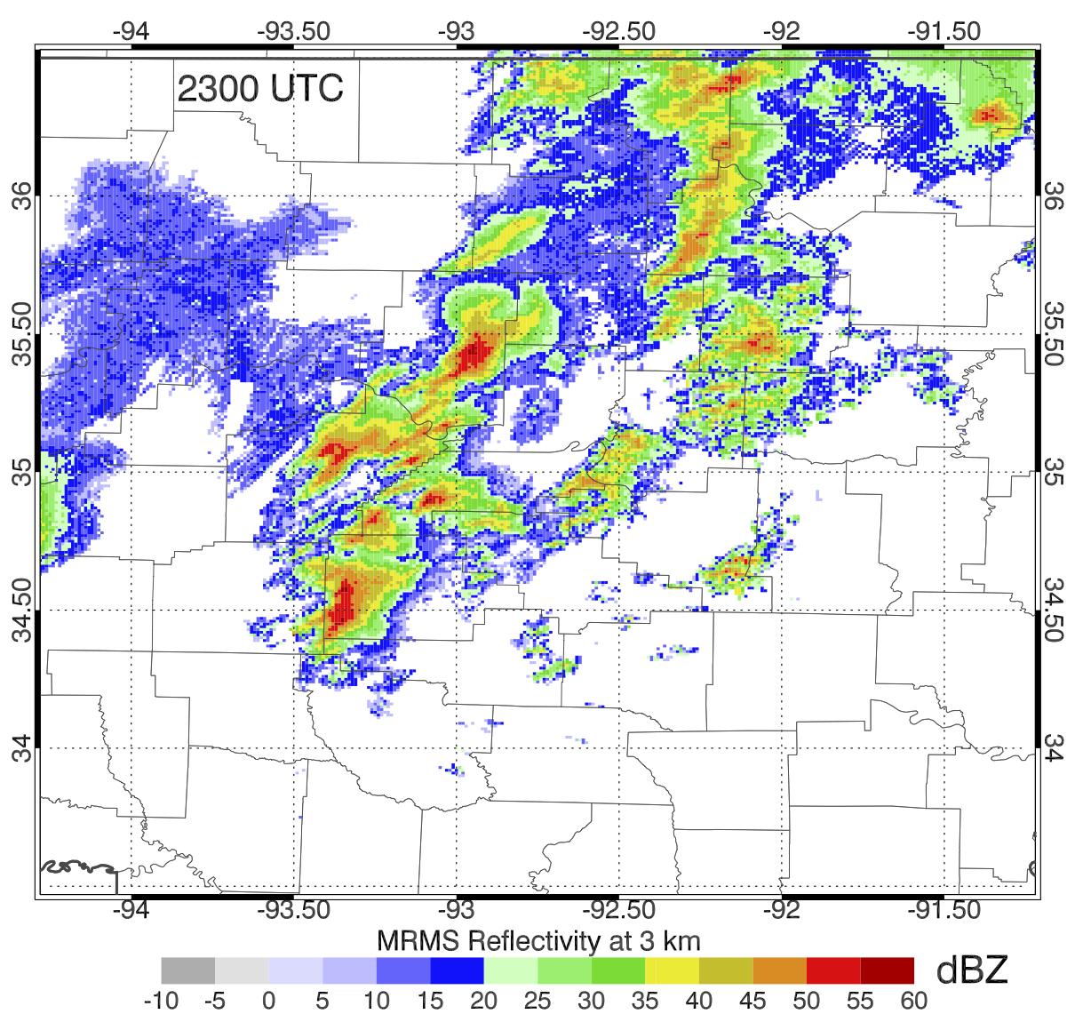
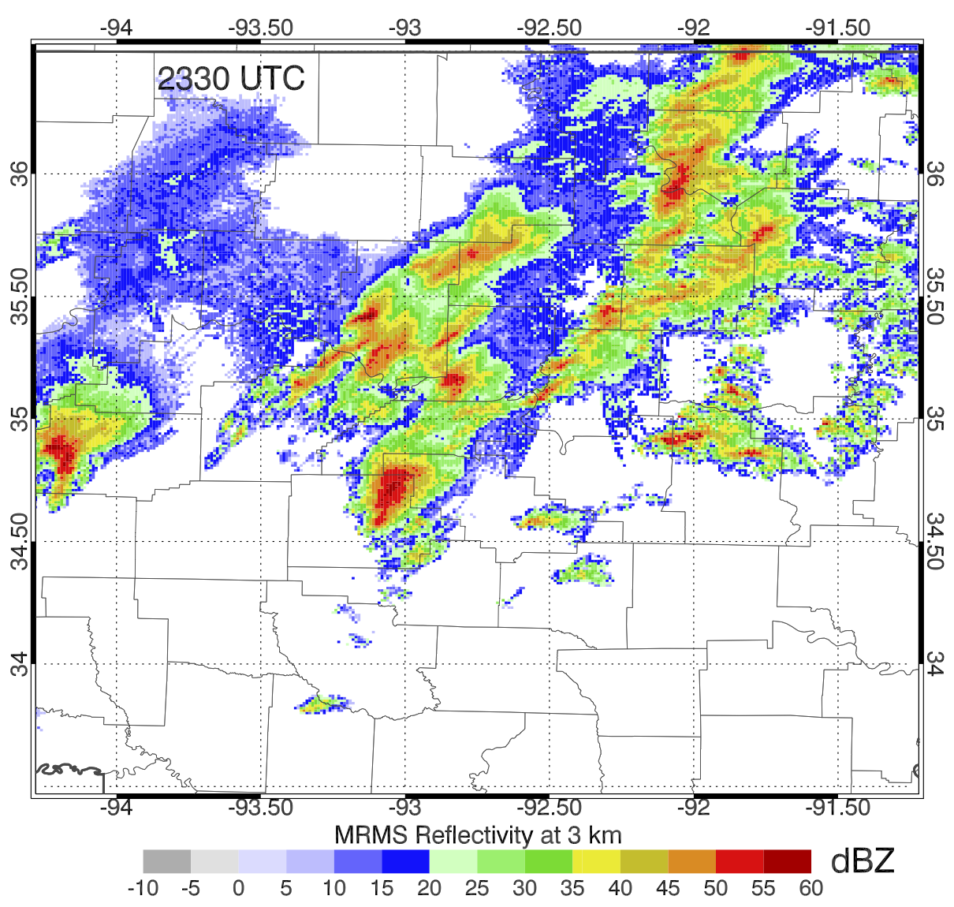
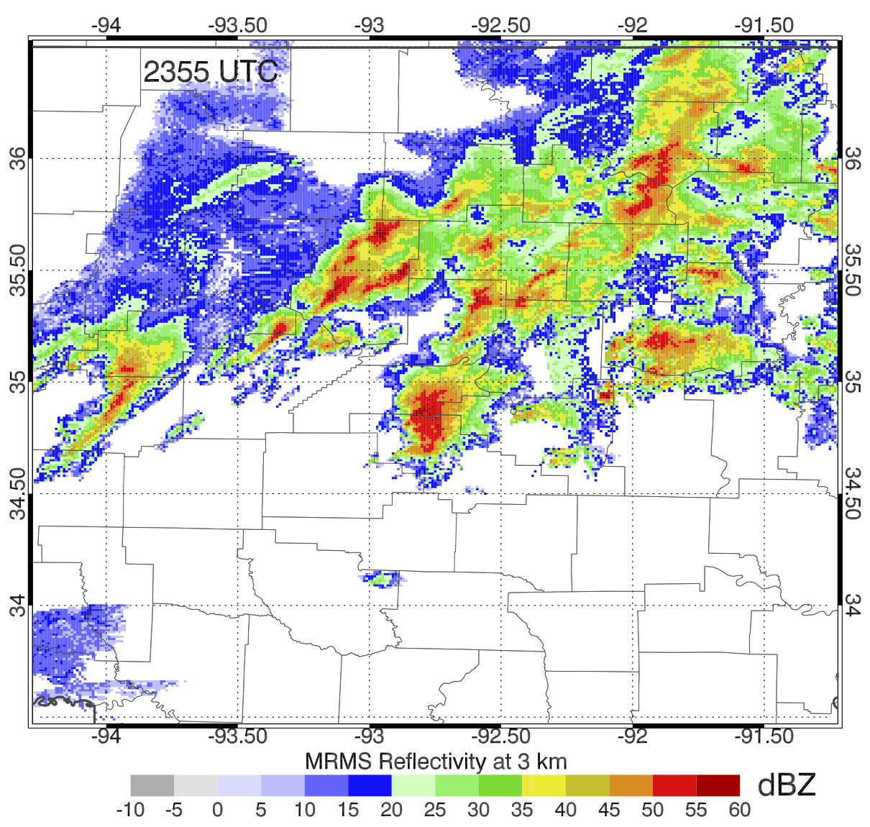
27 April 2014
Radar - Satellite DA begins at 2000 UTC
1 hour forecasts generated beginning at 2300, 2315, 2330, 2345, and 0000 UTC
Focus on 2330 UTC initialization time, 36 minutes before touchdown of Moore tornado
2300 UTC
2330 UTC
0000 UTC

Slide 25
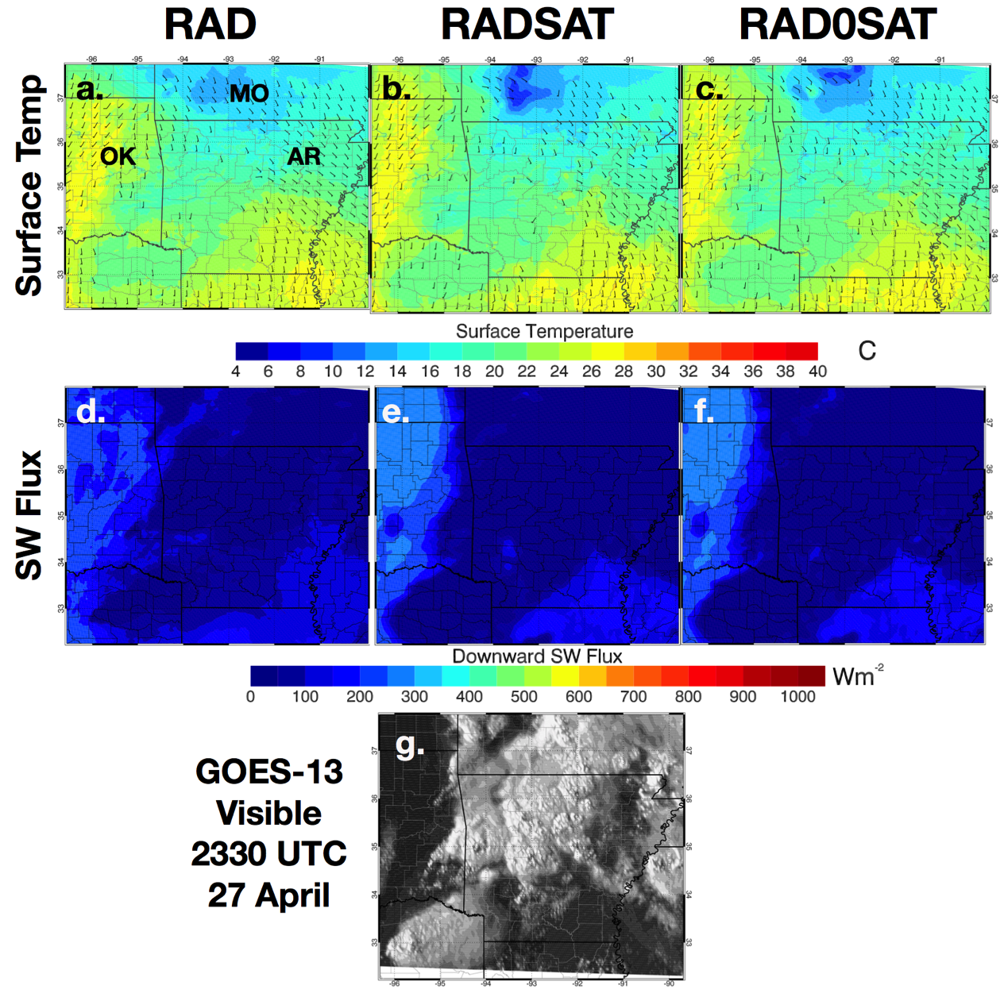
27 April 2014 2330 UTC
Surface temperature similar for all experiments
Much cooler than 2013 cases
SW Flux also small since the analysis time is near nightfall
Differences in SW Flux analysis present in northeastern and southeastern portion of domain where clear-sky satellite observations are assimilated
RADSAT and RAD0SAT are similar

Slide 26
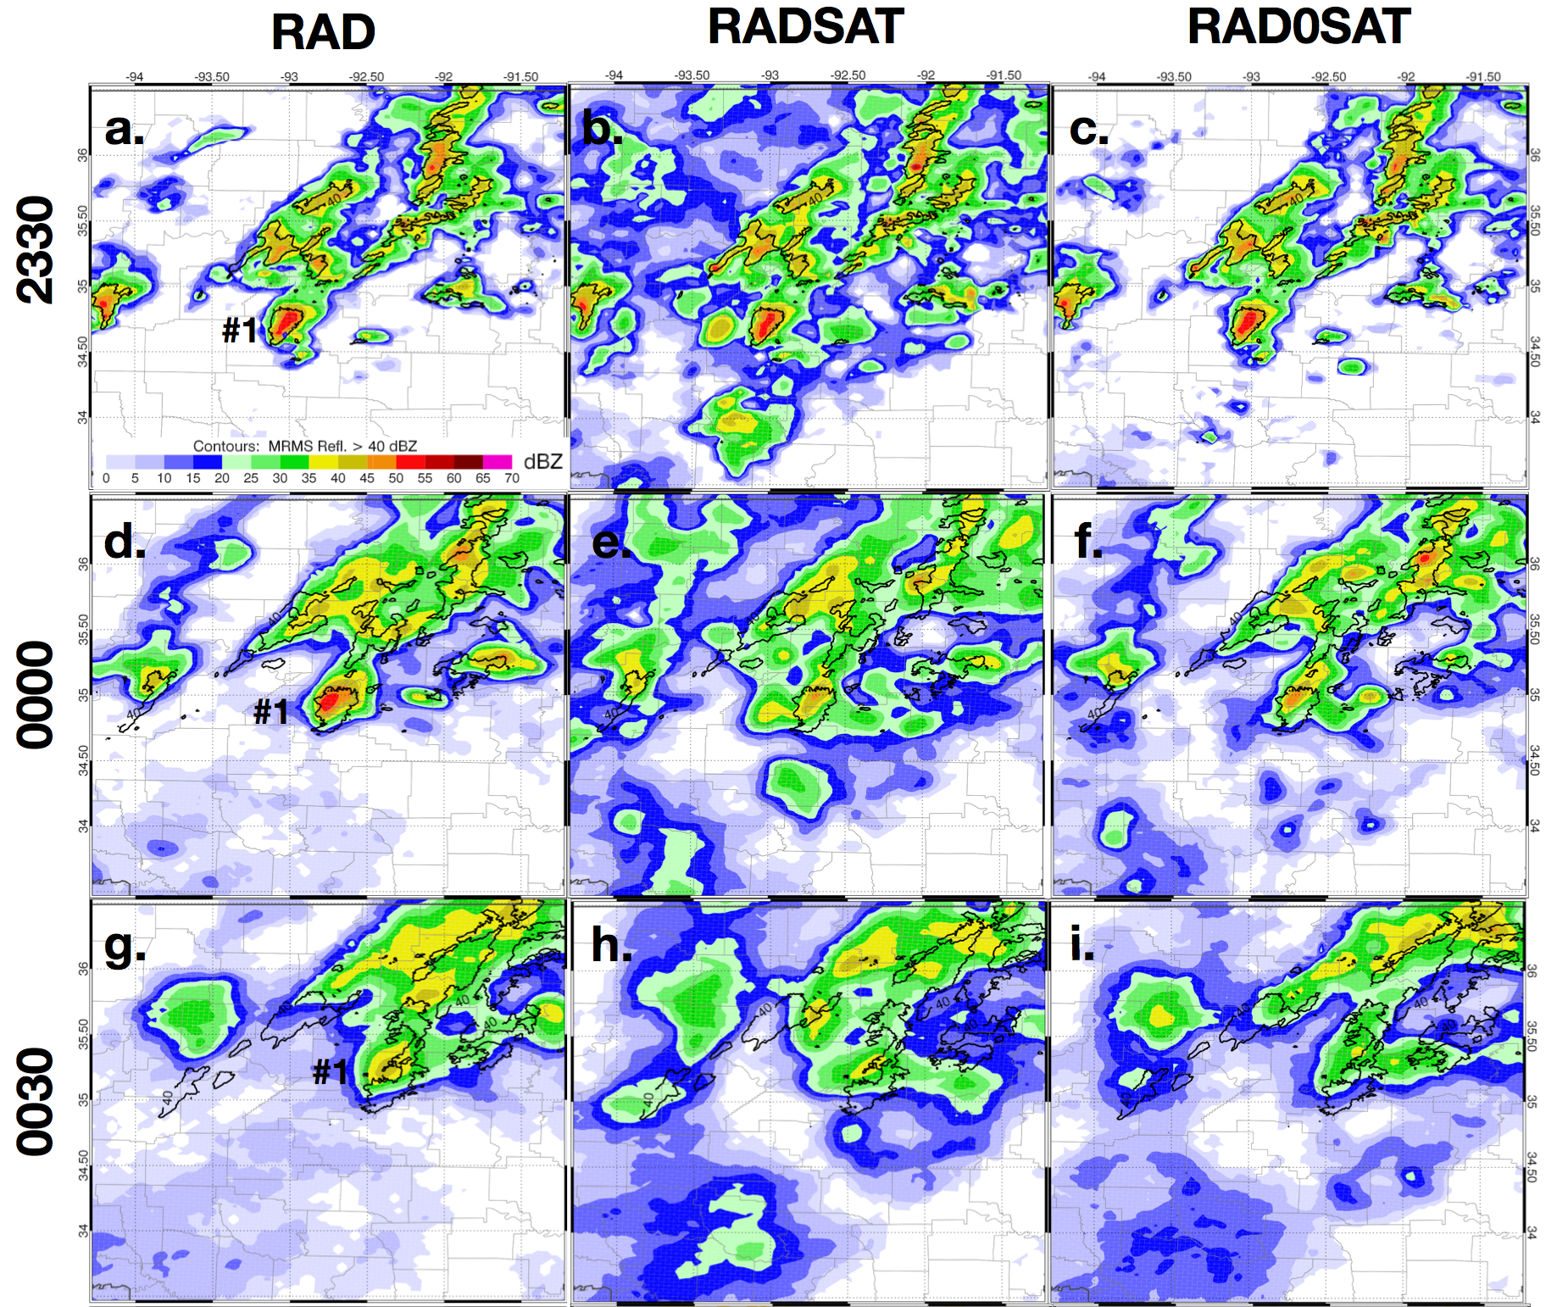
27 April 2014 1 hour forecast from 2330 UTC
RADSAT generate way too much light to moderate precipitation compared to RAD
RAD0SAT removes this unwanted precipitation
Clear-air reflectivity needed in cloudy regions
Excess Precip
Weak Storm

Slide 27
27 April 2014 2330 – 0030 UTC
RAD
RADSAT
RAD0SAT
Vorticity probabilities significantly lower in RADSAT experiment
Storm dies out in the model after 30 minutes
RAD0SAT brings the forecast much more in line with the RAD experiments
Still not quite as good.

Slide 28
Summary
The Good:
Assimilating CWP improved surface thermodynamic conditions for several experiments
This improvement generally corresponded to better forecasts of reflectivity and low-level vorticity
The Bad:
For messy cases such as 27 April, assimilating CWP had the effect of increasing light precipitation in cloudy regions and decreasing the intensity of storm cores
The result being that supercells died off too quickly in some RADSAT experiments
Fixing the Bad:
Further analyze model configuration, specifically radar and satellite forward operators
Determine the optimal combination of satellite and radar data to assimilate.
Dumping everything into the model without considering the relationship between radar and satellite observations is certainty not optimal

Slide 29
2. Adaptive Thinning
Results from 2013-2014 cases suggest the potential for destructive interaction between satellite and radar observations when assimilated at the same location
2 Goals of adaptive thinning
1. Remove unnecessary and/or conflicting observations from the assimilation sample
2. Determine the thinning strategy that produces the best results for the smallest number of assimilated observations
Re-map satellite retrievals onto 6 km MRMS grid
Enables quick comparisons of co-located reflectivity and satellite observations
Want to use which ever set of observations that best describes the atmospheric feature being observed.

Slide 30
Thinning Experiments
RAD_L2
Radar reflectivity and radial velocity observations directly from Level II data
Radar data pre-processed using OPAWS (part 1 method)
RAD_MRMS
MRMS reflectivity, Level II radial velocity
6 km horizontal resolution, 1 km vertical (1 – 10 km)
Clear air reflectivity at 3 and 7 km only, every other clear-air observation masked.
RADSAT_NOTHIN
Same as RAD_MRMS, but assimilates IWP, LWP, and CWP=0 kg m⁻²
RADSAT_THIN25
Remove IWP / LWP observations where max column reflectivity > 25 dBZ
Remove clear-air reflectivity if CWP = 0 kg m⁻²
Only assimilate clear-air reflectivity above and below cloud layer
Remove clear air reflectivity if observation height > CTH or height < CBP
Remaining clear-air reflectivity and clear-sky retrievals share same mask as in RAD_MRMS

Slide 31
Observation plots 2000 UTC
Level 2 dBZ @ 3km:
KFDR, KTLX, KVNX
MRMS dBZ @ 3 km
MRMS dBZ @ 7 km
Anvil
Clear-air
~ 6 km obs resolution
No adaptive thinning of radar and satellite observations
Level 2 experiments only use 3 radars, observations from other radars in the domain are not used
Clear-sky
CWP

Slide 32
Thinned Observations
MRMS dBZ @ 3 km
MRMS dBZ @ 7 km
CWP
Anvil
Storms
Clear-sky
Clear-air reflectivity removed where in favor of clear-sky satellite observations
CWP observations where reflectivity > 25 dBZ removed in favor of radar observations
At 7 km, clear-air reflectivity removed in favor of IWP observations to better capture cirrus outflow

Slide 33
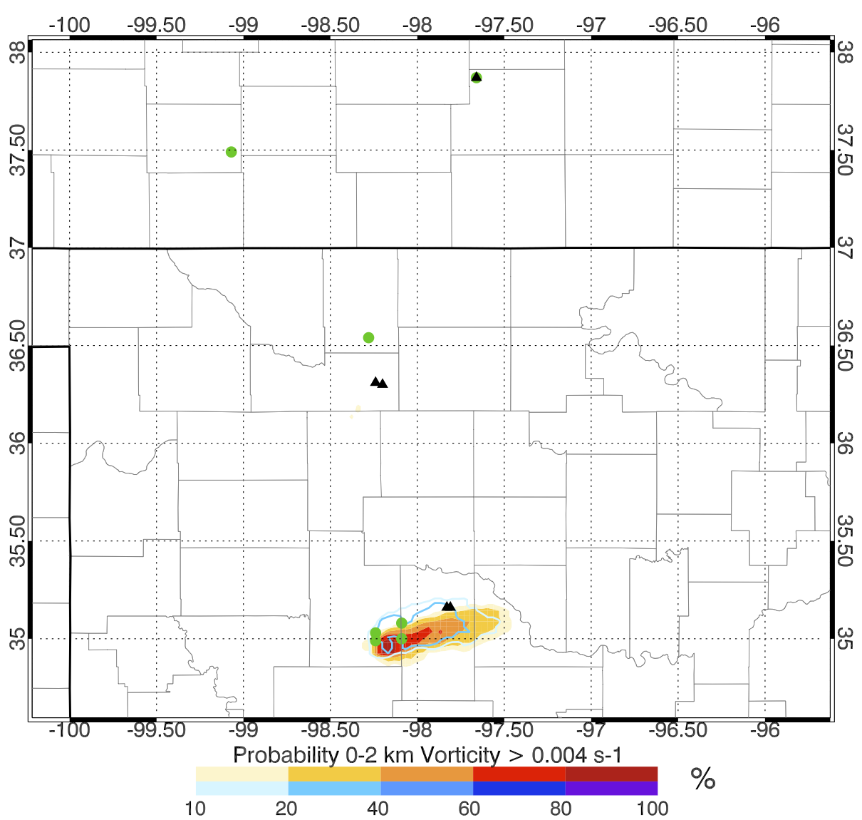
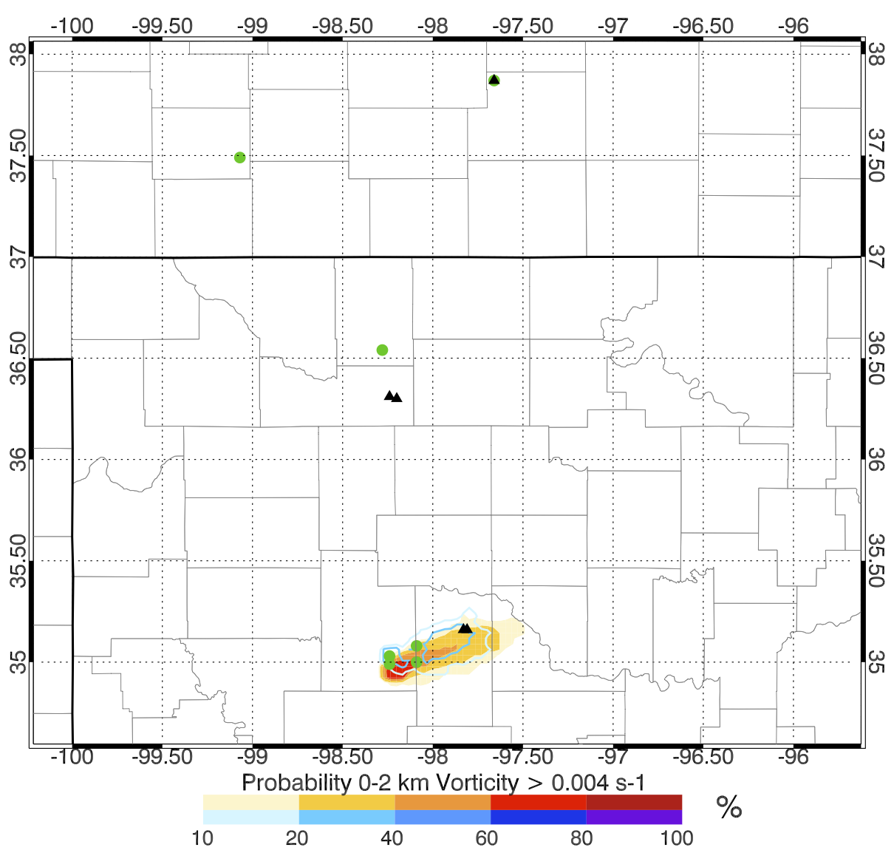
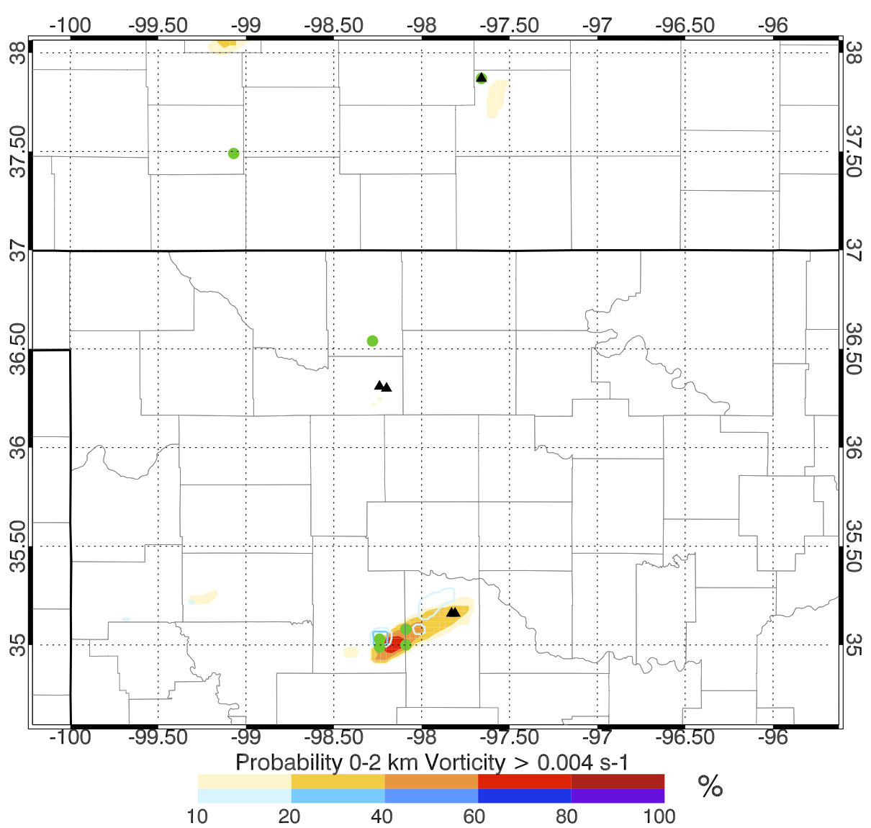
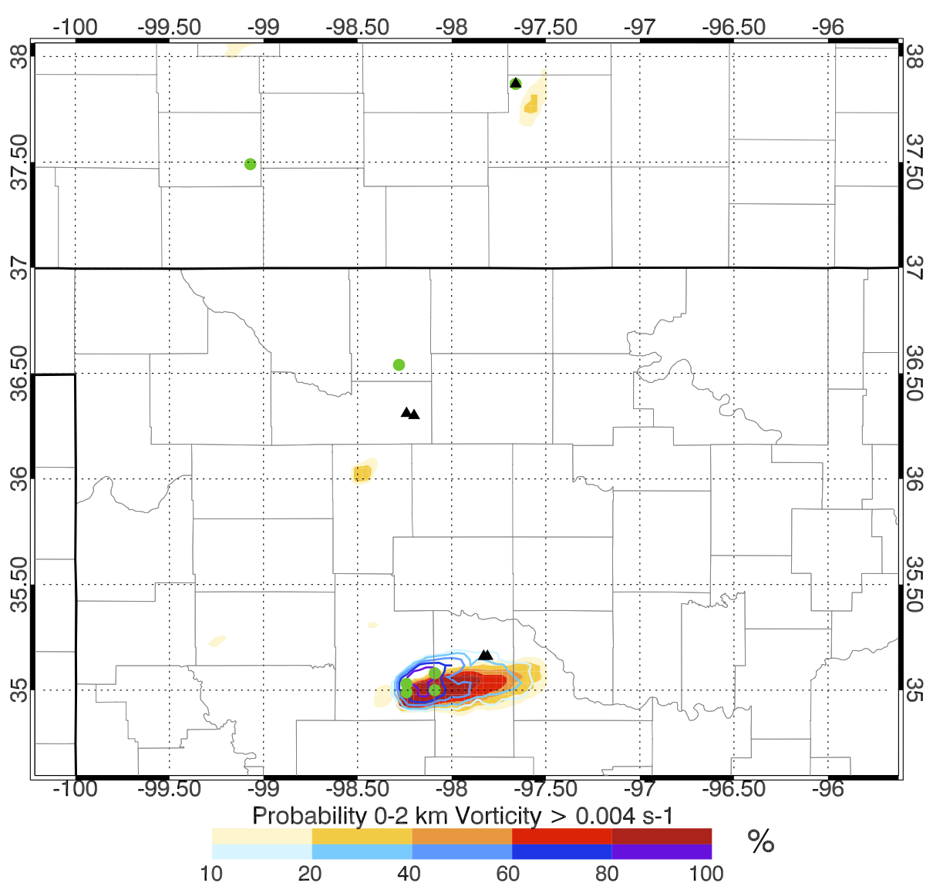
6 May 2015 2000 – 2200 UTC 2 hour forecast
RAD_L2
RAD_MRMS
RADSAT_NOTHIN
RADSAT_THIN25
Thinned dataset leads to
highest vorticity probabilities

Slide 34
3. Future plans and operational considerations
Challenges:
Assimilating combined radar and satellite observation data remains challenging
Further research in forward operators, data thinning techniques and new observation types (radiances, polarimetric radar) will be required going forward
In addition to clouds, rapid updates of aerosol concentrations will also have to be considered
Plans:
Transition ensemble data assimilation system to GSI-EnKF
Take advantage of all the satellite QC options
Perform experiments for other event types such as land-falling tropical cyclones and winter weather events
Begin operational testing (2016 HWT)

Slide 35
Questions

