Slide 1
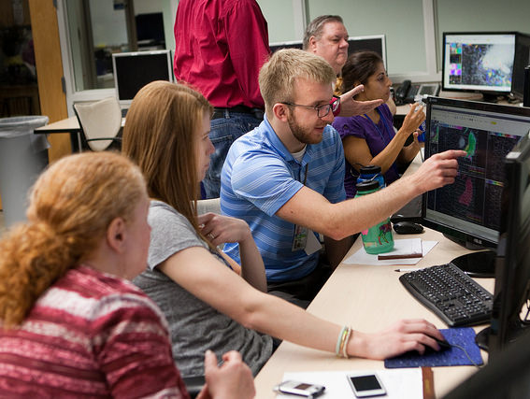
Satellite Training at the Hazardous Weather Testbed
Bill Line
Research Associate/Satellite Liaison
University of Oklahoma/CIMMS
NOAA/NWS/Storm Prediction Center
Kristin Calhoun, Darrel Kingfield, Tiffany Meyer (CIMMS/NSSL), Gabe Garfield (CIMMS/OUN), John Mecikalski and Chris Jewett (UAH), Justin Sieglaff, John Cintineo, and Jun Li (CIMSS), Geoffrey Stano (SPoRT), Bob Rabin, Dan Lindsey, Mike Pavolonis, Tim Schmit, and Steve Goodman (NOAA/NESDIS), Chris Barnet and Antonia Gambacorta (STC)

Slide 2
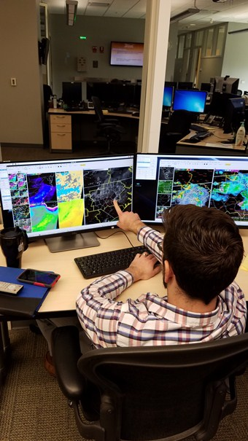
HWT 2016 GOES-R/JPSS Spring Experiment
4 weeks (18 April, 25 April, 2 May, 9 May)
3 NWS forecasters, 1 broadcast meteorologist per week
Real-time, simulated nowcast/warning environment using AWIPS-II.
Can operate anywhere in CONUS; begin prior to CI
“mesoscale forecast updates” (via live blog posts)
experimental severe t-storm and tornado warnings (via WarnGen).
Evaluating: GOES-R and JPSS Baseline, Future Capabilities, and Experimental Products
Training: 2 hours of Articulates
Feedback: Daily and weekly debriefs, daily and weekly surveys, blog posts, discussions, Webinar
We want forecasters to think about how they are using the experimental products in nowcast and warning decision making.

Slide 3
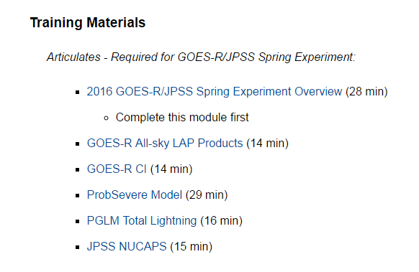
Training completed prior to experiment
Articulate Training Modules
(2016: ~2 hours)

Slide 4
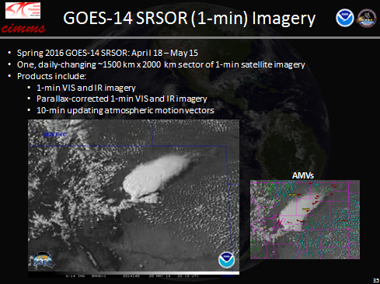
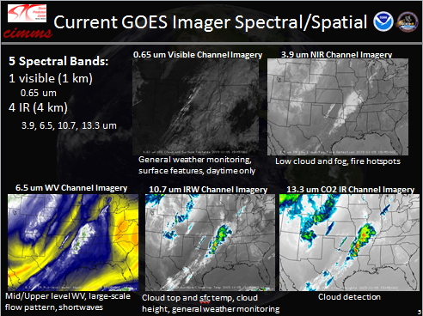
2016 GOES-R/JPSS Spring Experiment Overview - Training

Slide 5
Individual Articulates
What is being demonstrated
Background information on product
Why was product developed
What data go into it
How does it work, etc.
Verification statistics and strengths/weakeness
Use examples and best practices

Slide 6
Example: ProbSevere

Slide 7
When forecasters arrive to HWT
Orientation (~1 hour)
Schedule for week
Expectations
Quick reminder of products being evaluated
AWIPS-II walkthrough – where to find products, recommended displays, procedures
Introduction to using the blog
After orientation, forecasters becoming familiar with products in AWPS-II, building procedures as they begin experimental forecast/warning operations (~ 1 hour)

Slide 8
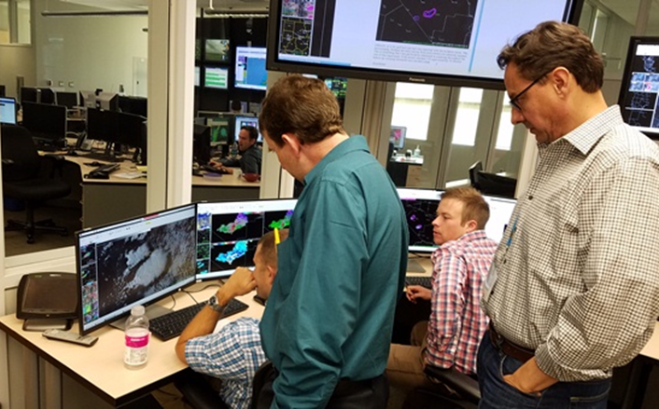
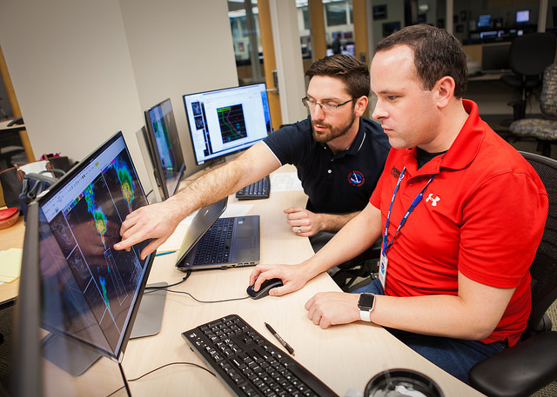
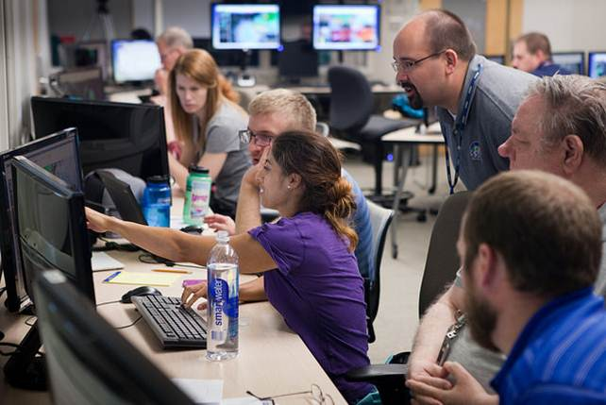
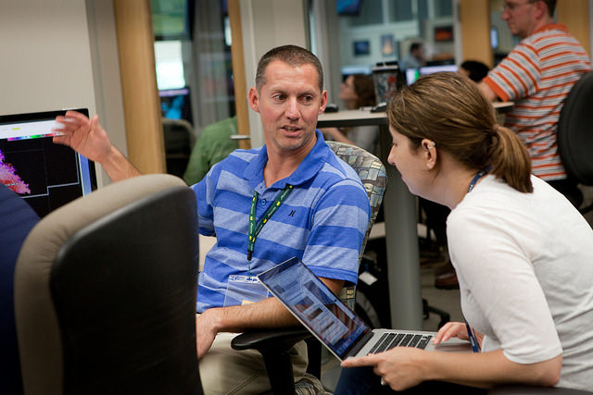
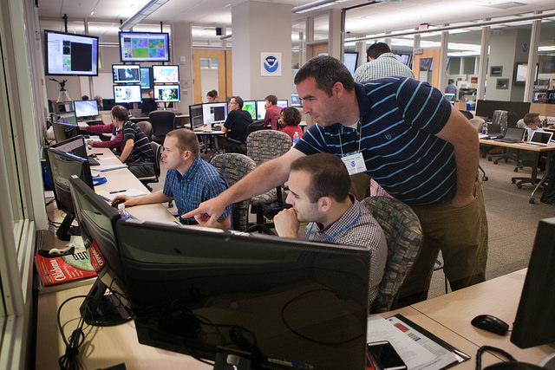
The whole week is a training experience!
Forecasters learn from each other:
Forecasters learn from scientists and vice versa

Slide 9
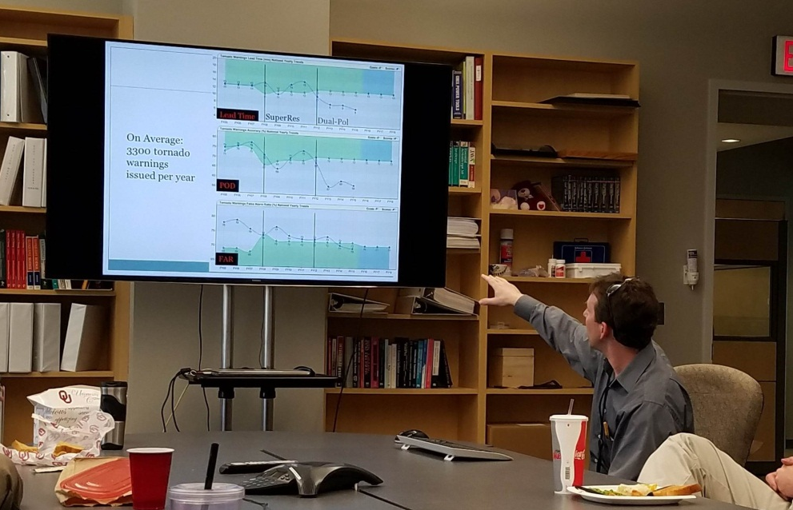
Forecasters share research with Norman meteorology community
Presenter: Chris Gitro
Title: The Use of Multiple GOES Sounder Water Vapor Channels to Monitor the Evolution of Mid-level Dry Air in Convective Events
Presenter: Mike Jurewicz
Title: Using Layered Precipitable Water and Other Satellite Derived Datasets to Anticipate High Impact Weather Events: Severe Weather Applications
Presenters: Chris Gitro and Michael Jurewicz
Title: The Utility of Considering ZDR and KDP Signatures in the Tornado Warning Process. Part II: Discriminating Between Tornadic and Non-tornadic Storms in High-End Severe Weather Events

Slide 10
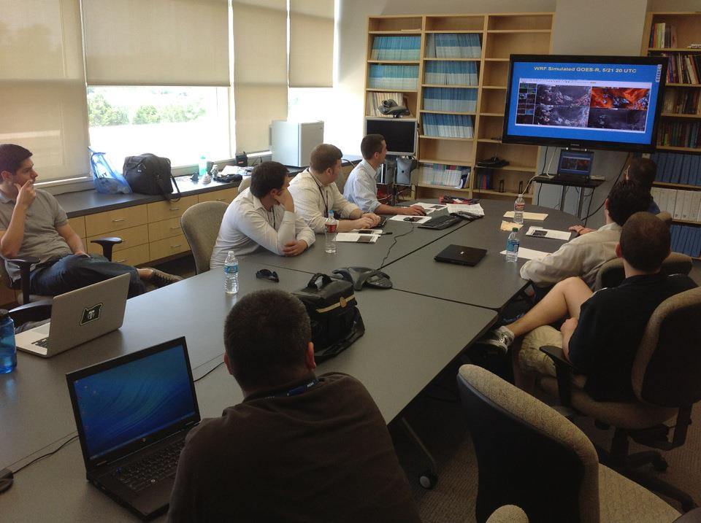
Weekly Webinars “Tales from the Testbed”
2013-2016 TftT webinars available online: http://hwt.nssl.noaa.gov/tales/
A summary of that week's experience, presented by the NWS participants.
Each Friday from 1200-1240 CDT from the NWC in Norman.
The forecasters have 22 minutes to discuss their key takeaways that week.
Weekly topics - To be determined
Audience: WFO/CWSU peers, RHQ, NWHQ, project scientists, funding agencies.
Facilitated by WDTD (similar to dual-pol
Storm of the Month").

Slide 11
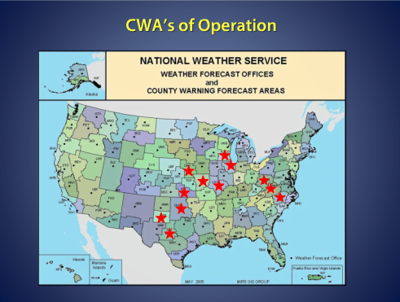
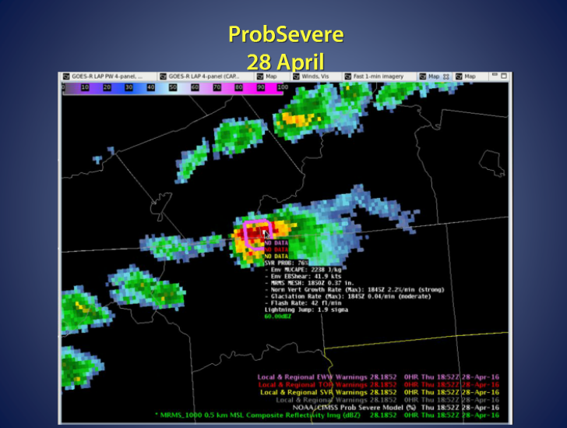
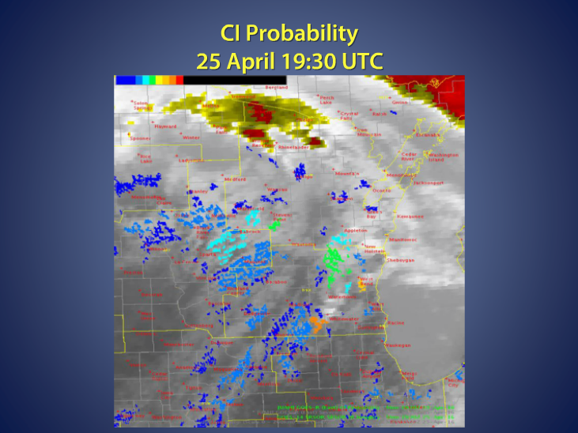
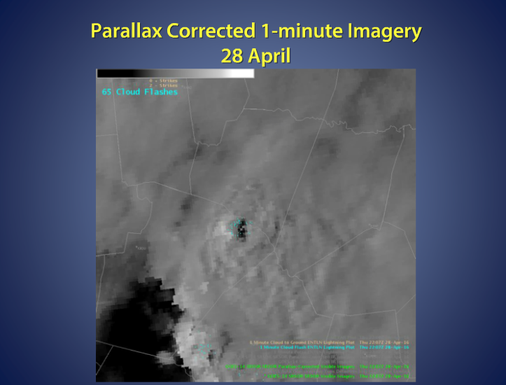
Weekly Webinars “Tales from the Testbed”
2013-2016 TftT webinars available online: http://hwt.nssl.noaa.gov/tales/

Slide 12
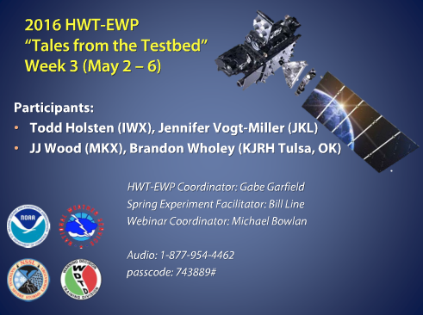
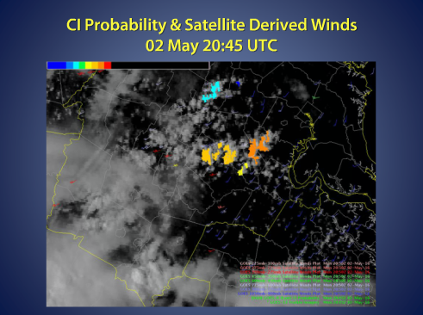
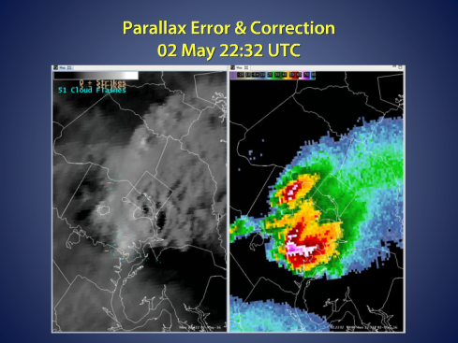
Weekly Webinars “Tales from the Testbed”
2013-2016 TftT webinars available online: http://hwt.nssl.noaa.gov/tales/

Slide 13
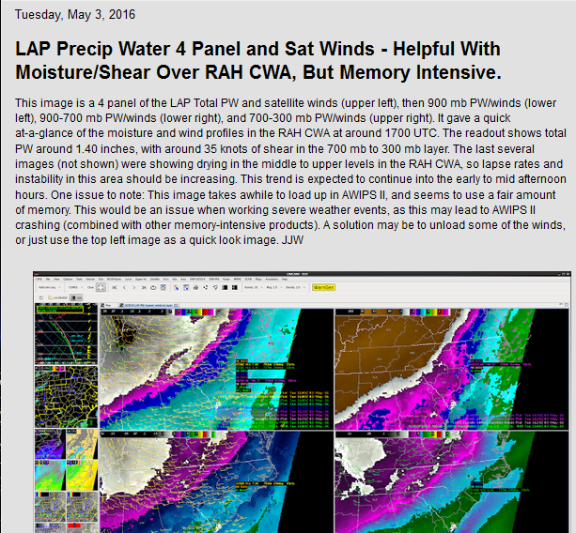
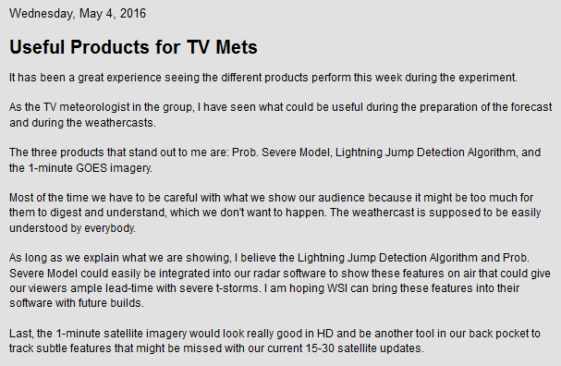
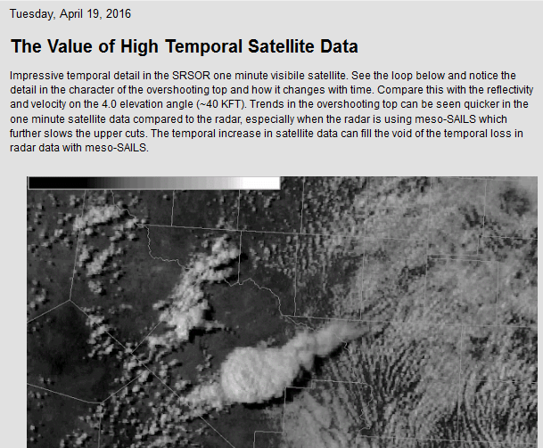
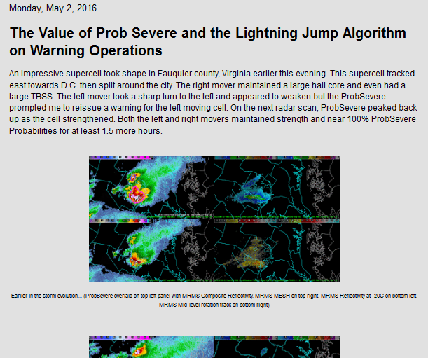
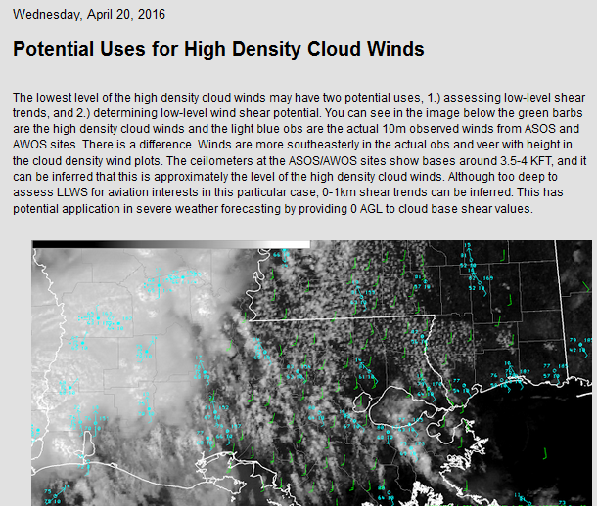
New Training Material Derived from HWT Activities - Blog
Mesoscale forecast updates
Reasoning behind warning decisions
Updates to previous warnings/forecasts
Best practices
Ideas for improvement
Any thoughts/feedback, good/bad
2016: 400+ Posts

Slide 14
After the Experiment
Feedback received from evaluations is incorporated into operational training development

Slide 15
After the Experiment
Participants often share HWT experience with their home office
HWT Blog and TftT webinar available online for anyone to view
Final report organizing results
Best practices/lessons learned from HWT should help ease transition to GOES-R/JPSS
May 2017, evaluations in HWT will be valuable for early/rapid gauging of forecaster understanding of real GOES-R data, and development of best practices, in a real-time hazardous weather warning environment
bill.line@noaa.gov

Slide 16
NUCAPS Training Experience
Bill Line
Dan Nietfeld

Slide 17
NUCAPS Training Experience
2015 NUCAPS Training for HWT
2016 NUCAPS Training for HWT
Changes/additions to training from 2015 to 2016
QC flags
Method of surface modification
MetOp A/B
Verification Statistics
Operational use examples (from HWT)
2017 NUCAPS Training?
Plan views and cross sections
Automated surface/ll modification
NUCAPS v2

Slide 18
HWT 2016 NUCAPS Blog
Modification in RAH
Drying in N OK
Around a dryline
Comparison with RAOB in RNK
NUCAPS Plan View
http://goesrhwt.blogspot.com/search/label/NUCAPS

