Slide 1
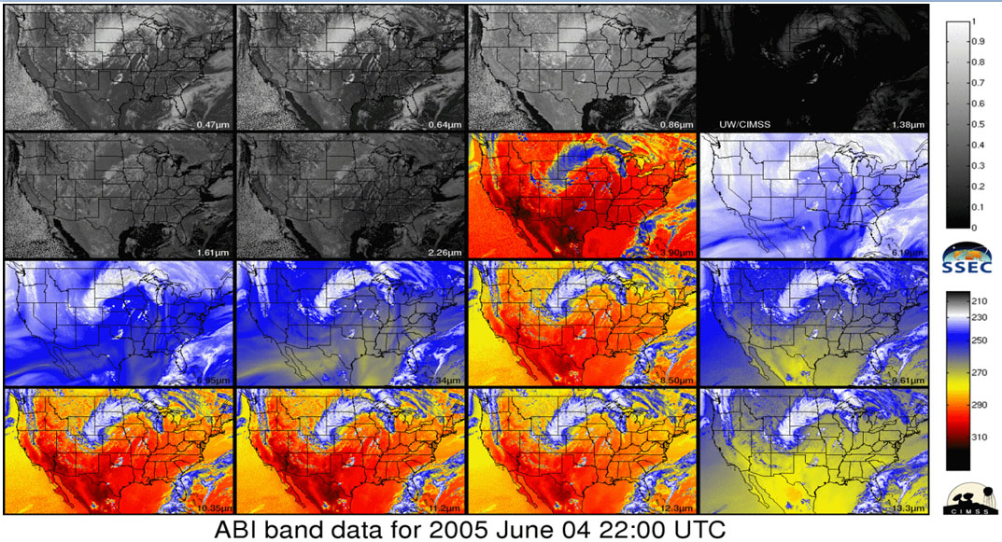
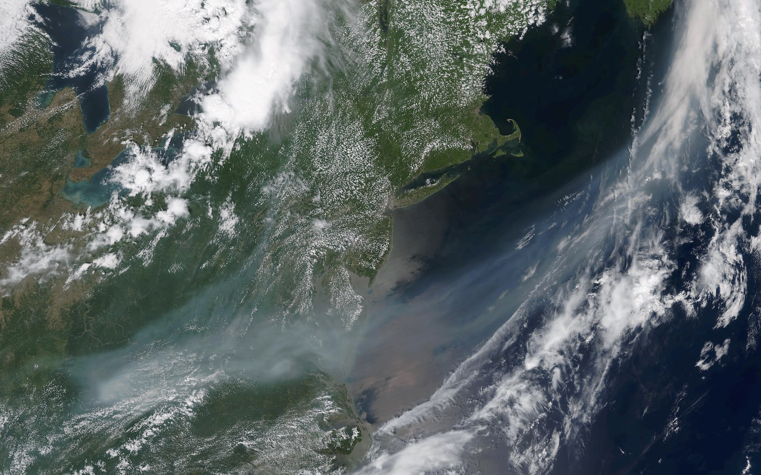
Status of Satellite Training Actions
Anthony Mostek
Chief, Forecast Decision Training Division (FDTD/OCLO)
LeRoy Spayd
NOAA/National Weather Service
Office of Chief Learning Officer (OCLO)
With The Satellite Training Team
Proving Ground/User Readiness
May 2016 in Norman, OK

Slide 2
Today’s Training Topics
Last Year’s PG/UR Training Actions led to
SOO/DOH Workshop Sept 2015 Updates led to
Satellite Training and Advisory Team (STAT) meetings
Plan, Implement/Develop, Trackers and Current status
Deliver GOES-R Foundation Training leading to
What’s available & what’s coming
Next Phase – JPSS Plans and Level 2 Apps
Notes:
Here is the agenda of talk to get training day going!.
Welcome to all of you and the many members and contributors of training team!

Slide 3
Satellite Training Timeline
FY15
Oct 2016
Launch
Data?
Jan 2017 Launch 2018 & Beyond
Making it
Stick
Continuous Learning
Prerequisites
Foundation
Application
Exercise
Training Stages
Prerequisites – overall basics
Foundation – satellite specifics
Application – operational setting
Exercise – simulations, practice
Making it Stick – multi-situational, sharing
Continuous Learning – evolve and update
Notes:
Remember the Timeline? – Had March 2016 as Launch Date – launch is still 2016 and right after that have JPSS in Jan 2017!

Slide 4
Training Actions – June 2015
1. The SURT will reconvene for a short period of time to identify the user readiness performance objectives. Performance objectives will be delivered to the OCLO and NOAT (due date: July 10 - DONE)
2. The OCLO will derive learning objectives from the performance objectives (due date: July 31 - DONE)
3. The OCLO will map existing training, available both internally and externally, to the NWS to the learning objectives (due date: July 31 - DONE)
4. The OCLO will identify additional training needing development to achieve learning objectives and will specify instructional design approach and delivery mode (due date: July 31 - DONE)
5. The OCLO and NOAT will collaborate on identifying personnel to assist in training development (due date: August 14 - DONE)
6. The OCLO will meet with OCONUS Regional personnel to determine how OCLO personnel can best assist the development of training for Himawari and also have that training infrastructure be applicable to GOES-R training (due date: August 14 - DONE)
7. The OCLO meet with COMET to develop a user readiness pre-test to be used by the SOOs (due date: October 30 - DONE)
8. The OCLO announces availability of foundational training (due date: day after GOES-R launch - Underway)
9. OPG will load the Sport EDPT on their AWIPS system and evaluate as a potential framework tool to share “just in time” training (DONE)
10. NOAT will work with Sport and AWIPS to get the Sport EDPT implemented in time for the Oct/Nov DOE4 GOES-R readiness test. Underway.

Slide 5
Training Actions – June 2015
Action Status
1. Identify user readiness performance objectives
July 10 - DONE
2. Determine learning objectives
July 31 - DONE
3. Map existing training to learning objectives
July 31 - DONE
4. Identify instructional design and training delivery mode
July 31 - DONE
5. Identify personnel for training development
August 14 - DONE
6. Find OCONUS training solutions for Himawari and GOES-R
August 14 - DONE
7. Develop a user readiness pre-test for SOOs
October 30 - DONE
8. Announce training availability
Day after GOES-R launch
Underway
9. Evaluate AWIPS as a “just in time” training platform
DONE
10. Prepare Sport EDPT for Oct/Nov DOE4 GOES-R readiness test
Underway

Slide 6
Updated Training Actions From SOO/DOH Sept 2015
Action Status
Identify inventory review panel,
specify resources needed for review completion
DONE
SOO Advisors, OCLO (John O) meet for satellite inventory review,
November 2, 2016
develop recommendations
OCLO revise and prepare course material effort
DONE
NOAT/SOO Advisors identify liaisons, SMEs for training development
DONE
Presentations to STI:
NOAT proposed GOES-R foundational training,
DONE
OCLO required resources & schedule
CIMSS Himawari-8 training transferred to OCLO,
DONE
Himawari training in Guam, November 16
OCLO, COMET develop user readiness assessment for SOOs
DONE
October 13, 2016?
OCLO delivers foundational training
GOES-R launch + 1 day
Notes:
Key Point with the actions is Number 2 on the list: Setup up meeting of SOO STAT team that met in Boulder last week in October to prepare the STAT plan… coming up…

Slide 7
STAT - Satellite Training and Advisory Team
Brian Carcione – Huntsville, AL
Frank Alsheimer – Columbia, SC
Dan Nietfeld – Omaha, NE / Boulder, CO
Mike Stavish – Medford, OR
Nat Eckstein – Anchorage, AK
Mike DeWeese – Chanhassen, MN
NCEP SOO
Field connection - provide the team with ops perspective and input.
STAT prepared plan and is starting to review modules for the Foundation Course

Slide 8
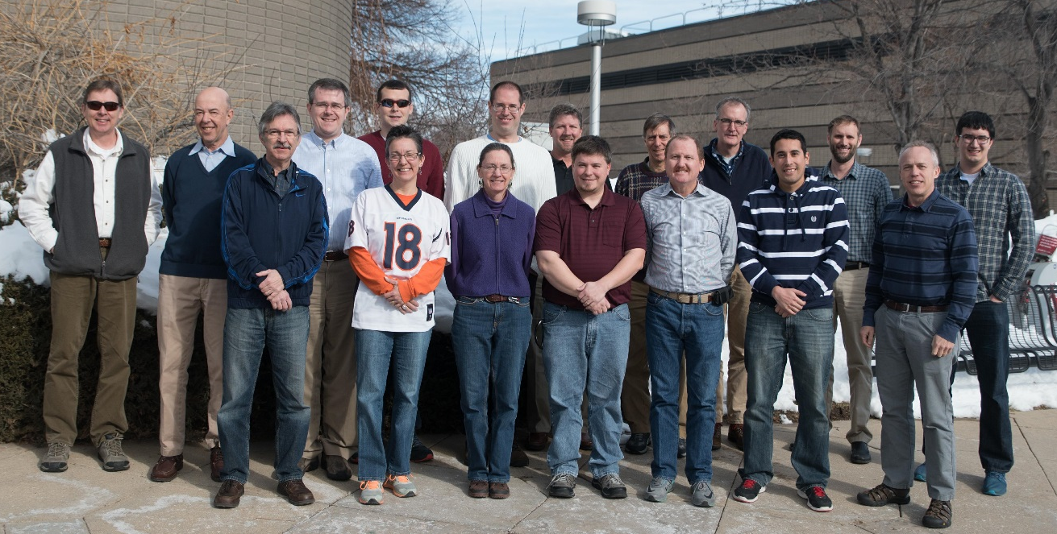
STAT - Satellite Training and Advisory Team
Wendy
Abshire
James
Ladue
not in photo
Daniel
Bikos
Scott
Lindstrom
Frank
Alsheimer
Michael
Bowlan
Anthony
Mostek
Leroy
Spayd
Brian
Carcione
Dan
Nietfeld
Bernie
Connell
Mike
Stavish
Michael
Folmer
Edward
Szoke
Jordan
Gerth
Jorrel
Torres
James
Gurka
Bill
Ward

Slide 9
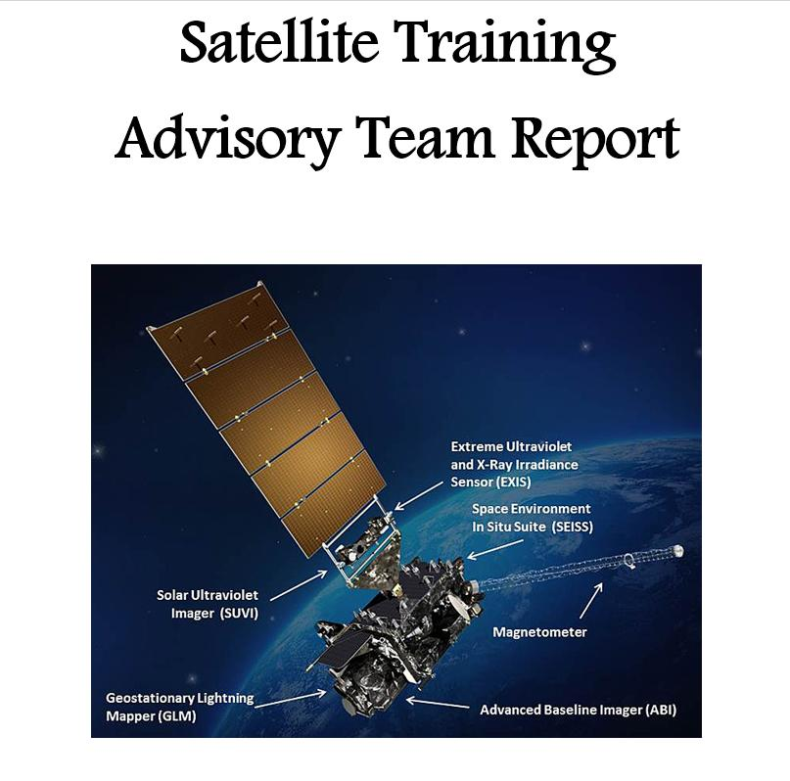
Notes:
Here is the cover of the STAT Plan/Report that you will hear about next!

Slide 10
Satellite Foundational Course
GOESR Introduction and SatMet Background Track (240 minutes)
- Basic principles of radiation (15 minutes)
- Basic operation of the GOES-R satellites (15 minutes)
- Spectral bands (90 minutes)
- Multichannel interpretation approaches (30 minutes)
- Baseline products (90 minutes)
Geostationary Lightning Mapper Track (40 minutes)
Mesoscale/Convection Track (120 minutes)
Synoptic Features Track (80 minutes)
NWP/Data Assimilation Track (30 minutes)
Interactive Lessons and Simulations - Provide an opportunity to view & interact with the GOES- R imagery & products to firmly establish understanding and interpretation.

Slide 11
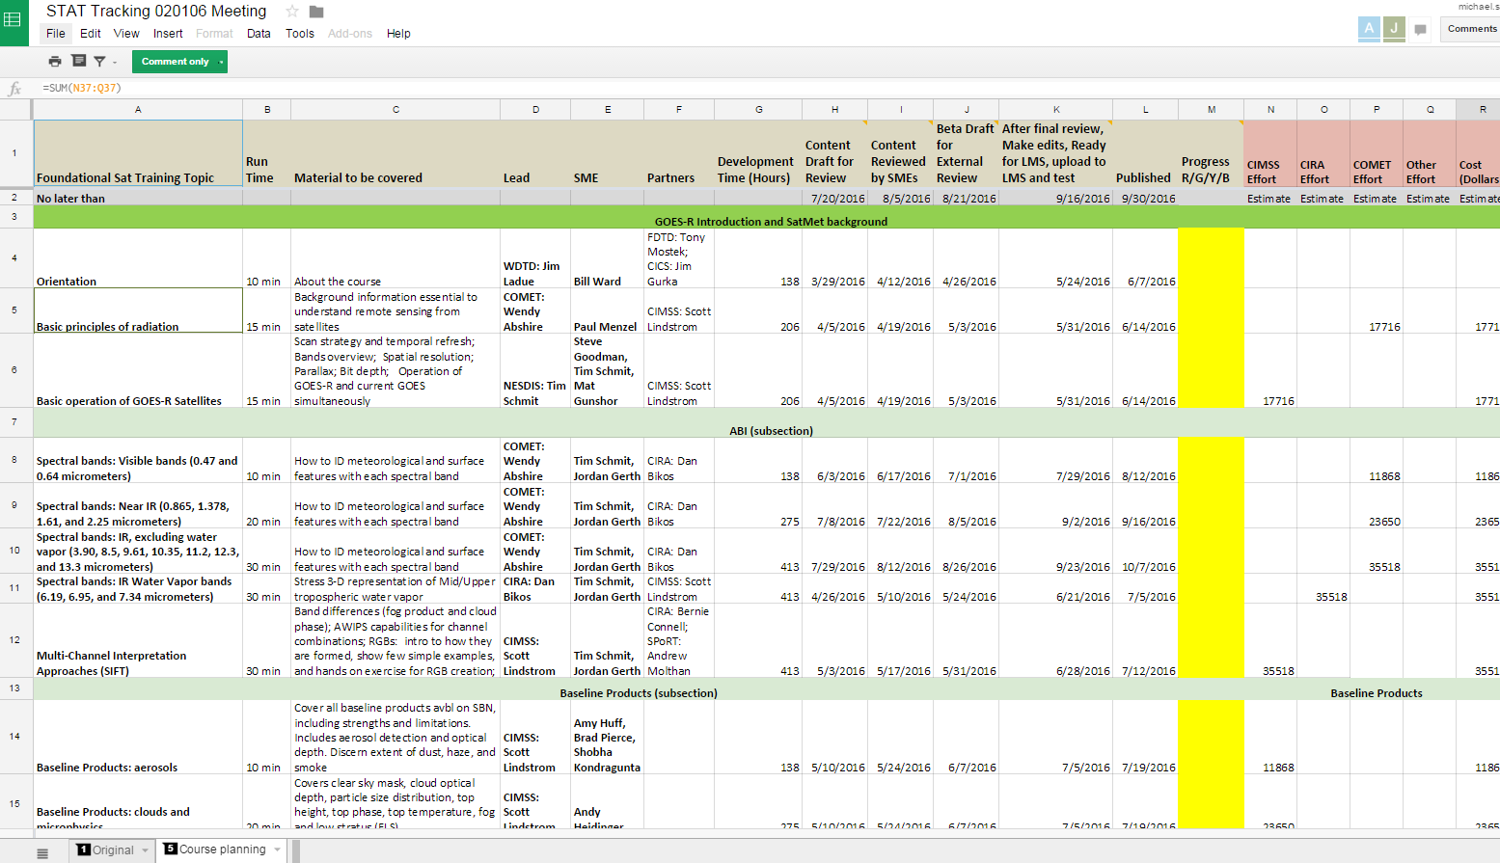
STAT Tracking Doc
Guiding the development of Satellite Foundational Course - GOES-R
40 modules
Each 10-30 min
Total time 8.5 hrs.
Will be “SatFC-G” in CLC/LMS

Slide 12
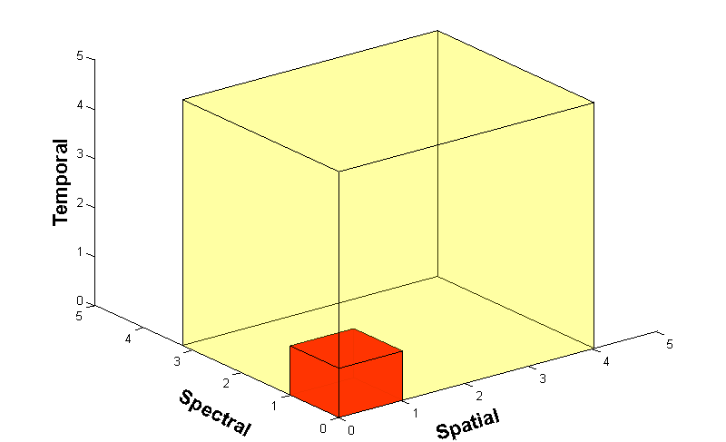
Advanced Baseline Imager
The ABI : a game-changing instrument, scanning more wavelengths faster and with better spatial resolution
ABI Data Volume
Current GOES Data Volume
5X
Faster coverage (5-minute full disk vs. 25-minute)
4X
Improved spatial resolution
(2 km IR vs. 4 km)
3X
More spectral bands (16 on ABI vs. 5 on current imager)
GOES-R will send about 1 terabyte of data daily!! ~60-fold increase
Notes:
Slide from one of the first modules units - J. Gerth, CIMSS. There will be a 60-fold increase in the amount of data sent by the ABI compared to GOES-13 through -15. The ABI on GOES-R acquires a full-disk image 5 times faster than the imager on GOES-13 through GOES-15. Spatial resolution on the ABI compared to present GOES increases by a factor of 2 in both horizontal directions. There are about 3x more spectral bands on GOES-R. The cubes represent the data volumes from present GOES, in dark orange, and GOES-R, in beige. The combination of increased resolutions means a 60-fold increase in data; more than a terrabyte of data will flow daily from GOES-R!

Slide 13
STAT Foundation Course Release
Key Dates for Each Stage of Training Development:
- Upload to CLC/LMS and Test: 9/16/2016
- Publish Date: 9/30/2016
- NWS AA Announces After launch
Satellite Foundational Course

Slide 14
GOES-R Timeline
Launch date is October 13th, 2016 ?
Upon successful launch, Foundational Course is announced.
There will be 4 months to complete prior to actual data feed and test period starting in March 2017.
Initial GOES-R Data at WFO’s = January 2017 ABI Channels - GLM will take longer & Derived Products up to 6 months.
Operational test & evaluation phase begins March 2017 until ?? at Central Position…

Slide 15
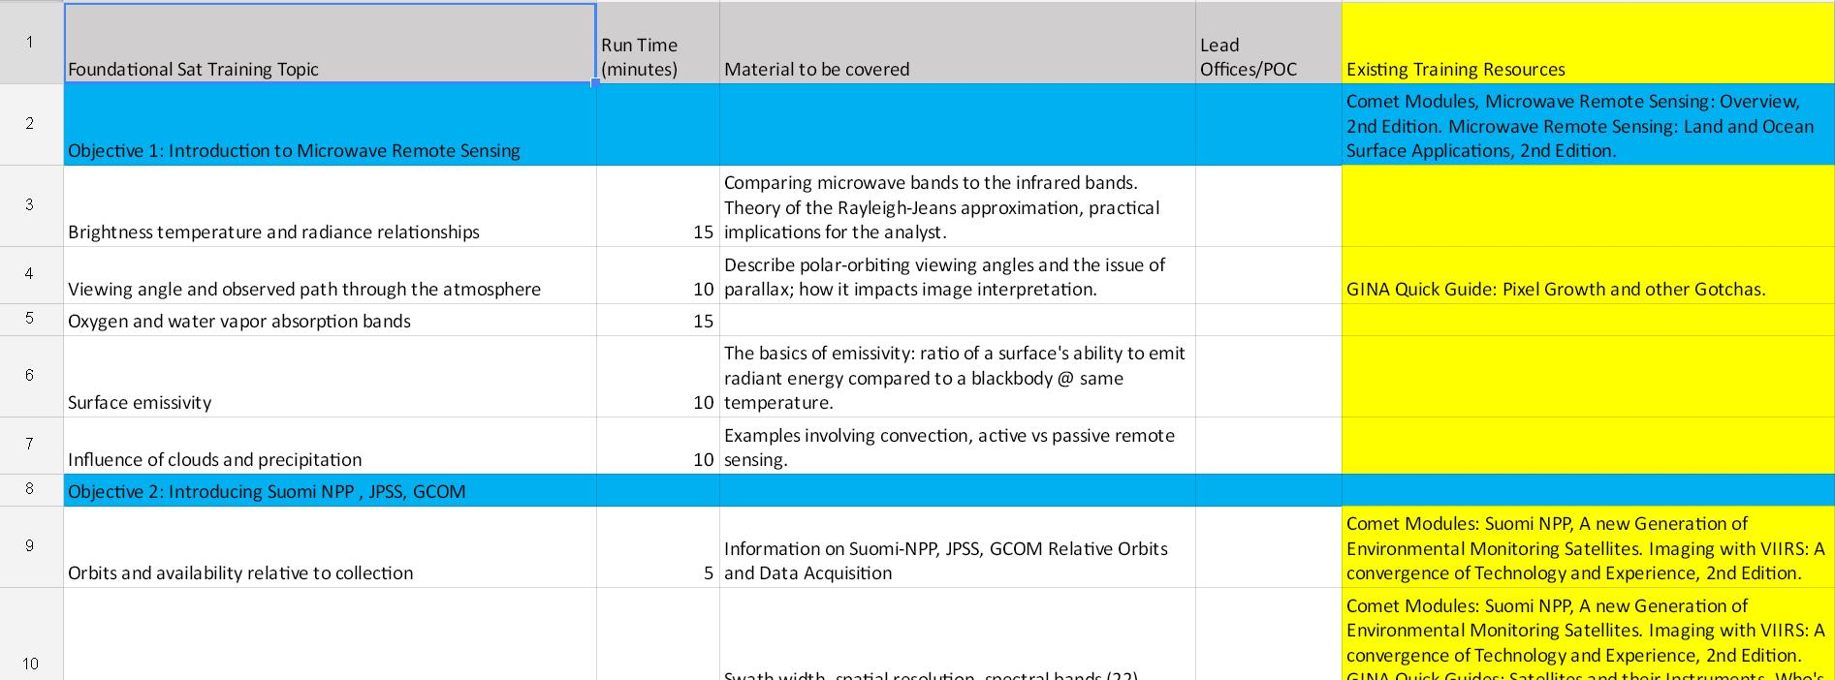
STAT JPSS Doc
Initial Draft Prepared and Shared at Feb STAT meeting
JPSS Sat Liaison Adapted to STAT Tracker
STAT will review with developers in Fall for Release early in 2017 (after launch)

Slide 16
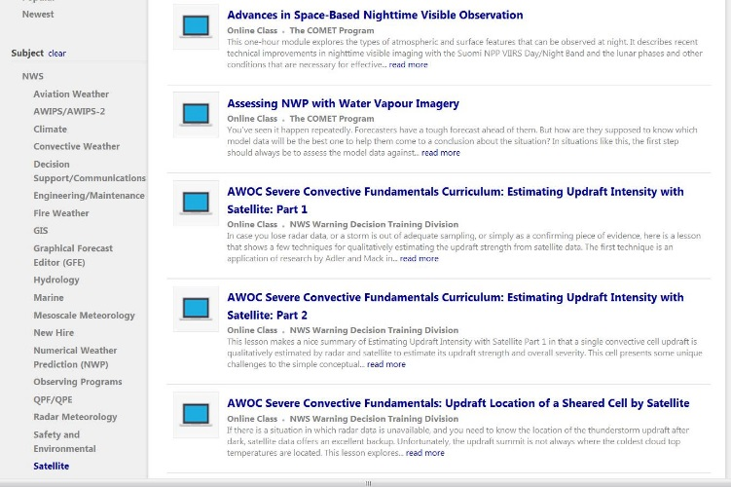
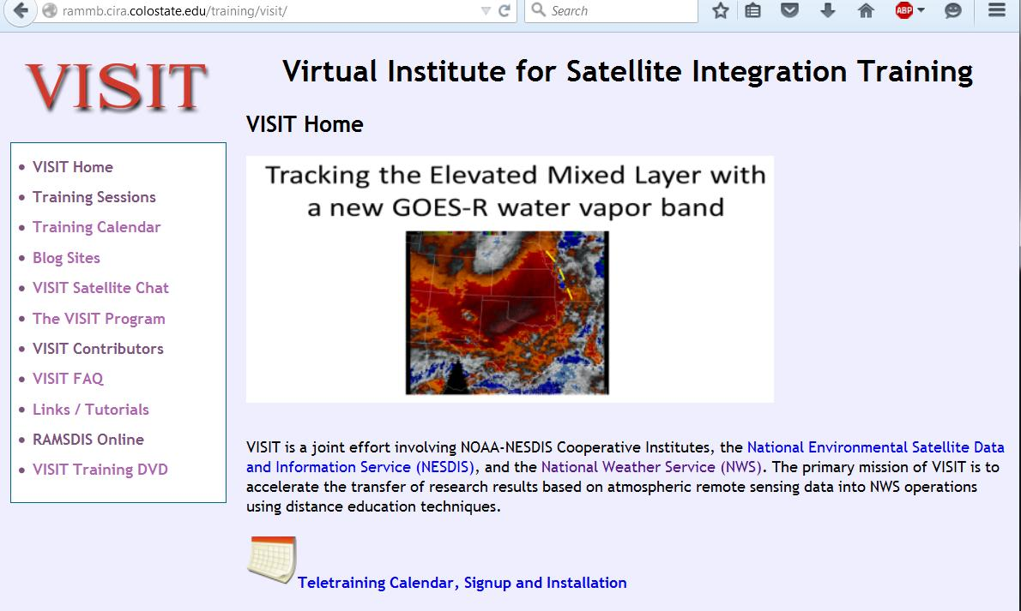
Where to Find Training Now
VISIT Chats (Fire WX, Lightning, …)
Satellite Blogs
Webinars
COMET MetEd

Slide 17
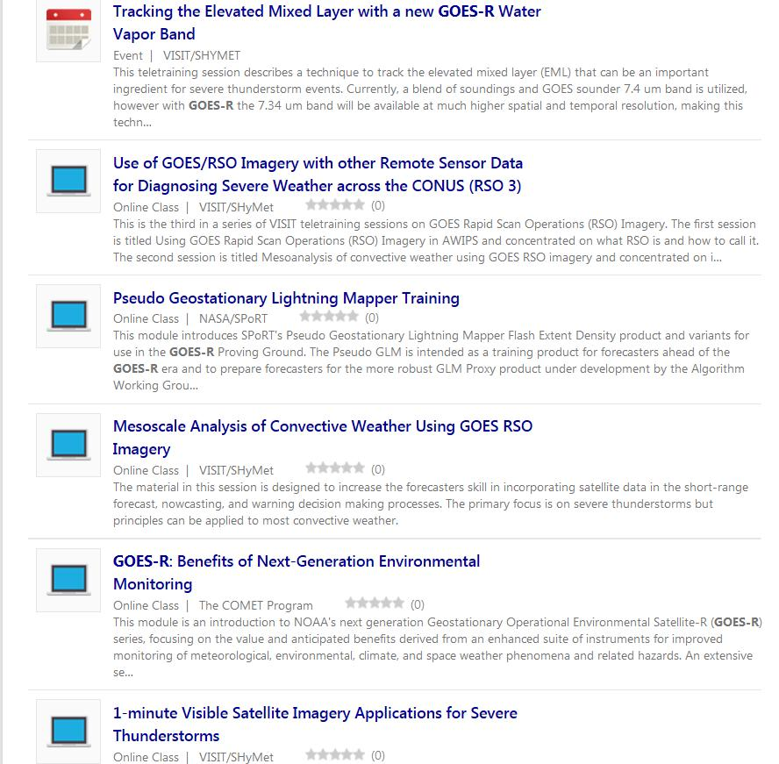
Current Satellite Training on CLC/LMS
GOES-R & SNPP Training

Slide 18
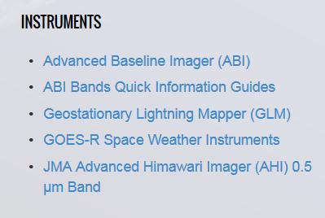
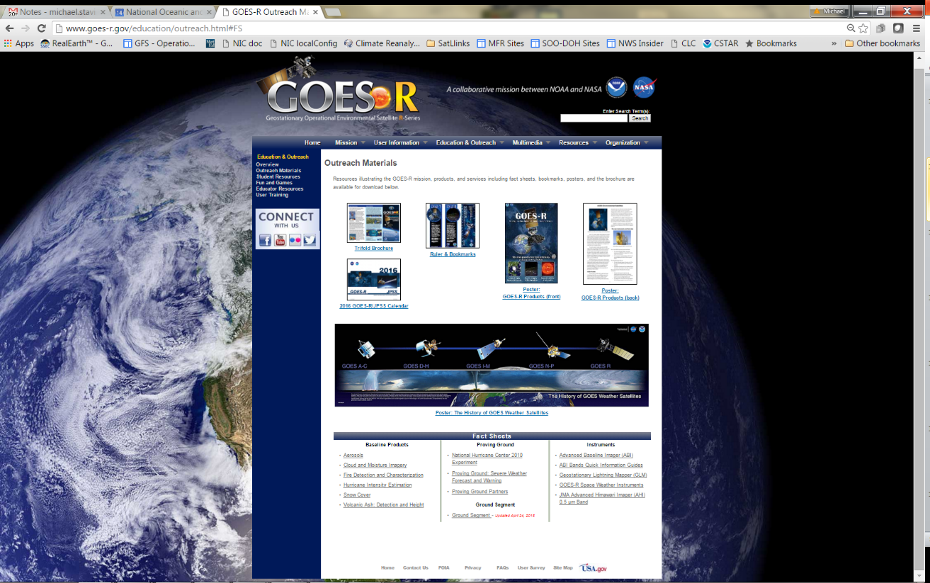
More Resources
ABI Band quick–guides are available now.
http://www.goes-r.gov/education/outreach.html#FS
On OCLO and TOWR-S VLAB pages.
Resources -> Fact sheets
Notes:
Google GOES-R, hit the main page, then
Go to Resources -> Fact sheets

Slide 19
Questions?
What’s Next…
Monumental changes in NOAA’s Operational Observing Systems are coming with GOES-R & JPSS.
OCLO & Training Partners – CIRA, CIMSS, COMET, SPoRT, CIMMS - are moving ahead at full speed.
What else is needed to get ready for both GOES and JPSS data – Launch satellite to Central Position and get data flowing!
Hear next from SOO STAT and then Update on STAT Tracker.

