Slide 1
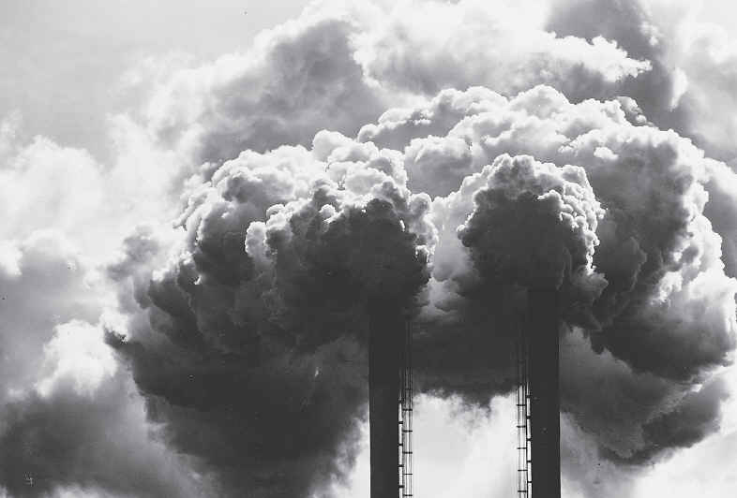
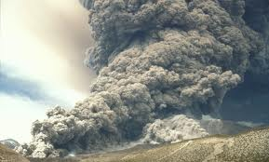
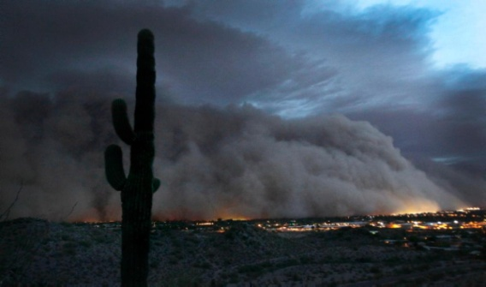
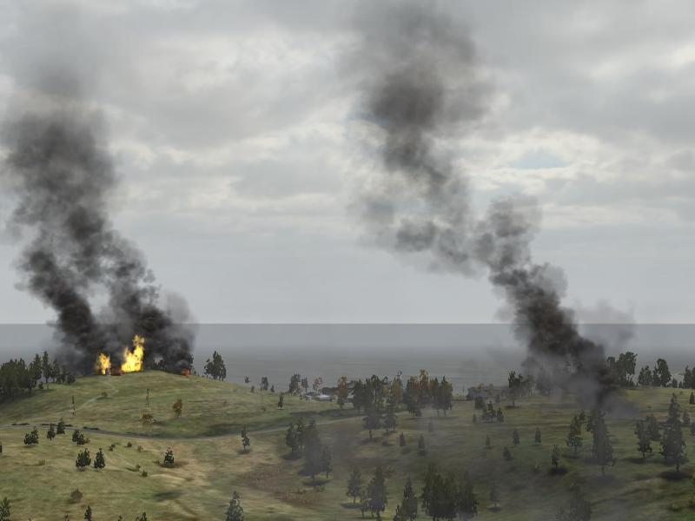
NOAA’s Blended Fire and Smoke Web-Based Product: eIDEA
Amy K. Huff (Penn State University)
Shobha Kondragunta and Istvan Laszlo (NOAA NESDIS)
Hai Zhang, Pubu Ciren, and Hongqing Liu (IMSG at NOAA)

Slide 2
NOAA’s Fire and Smoke Initiative
Began in May 2014
Objectives:
Evaluate the current use of geostationary and polar-orbiting satellite capabilities in support of the Fire and Smoke mission
Identify current SNPP/JPSS and new GOES-R data and capabilities with the potential to improve support to this mission
Establish methodologies and procedures for the operational demonstrations of these capabilities
Identify the satellite capabilities whose operational impacts are sufficient to warrant transition from research to operations
Working with NWS and air quality personnel responding to fires in Alaska and Western U.S. in 2014 and 2015
Current fire conditions (general purposes): visualized in RealEarth (http://realearth.ssec.wisc.edu/)
Identified need: develop web-based version of Blended Fire and Smoke product, for IMETs and other fire/smoke end users

Slide 3
Blended Fire and Smoke Product Demonstration Workgroup
Sub-group of overall Fire and Smoke Initiative
Taking information gathered from overall Initiative and developing web-based version of product for testing by end users (IMETs)
Overall objectives:
Create initial version of web-based Blended Fire & Smoke Product
Demonstrate initial version at annual IMET meetings in March 2016
Obtain feedback from users on initial version and use it to create an updated version for use during 2016 fire season
Workgroup members include:
NWS WFO staff (Western Region, Boise, Anchorage)
NOAA product developers
JPSS program staff
Air quality forecaster (Mid-Atlantic Region)

Slide 4
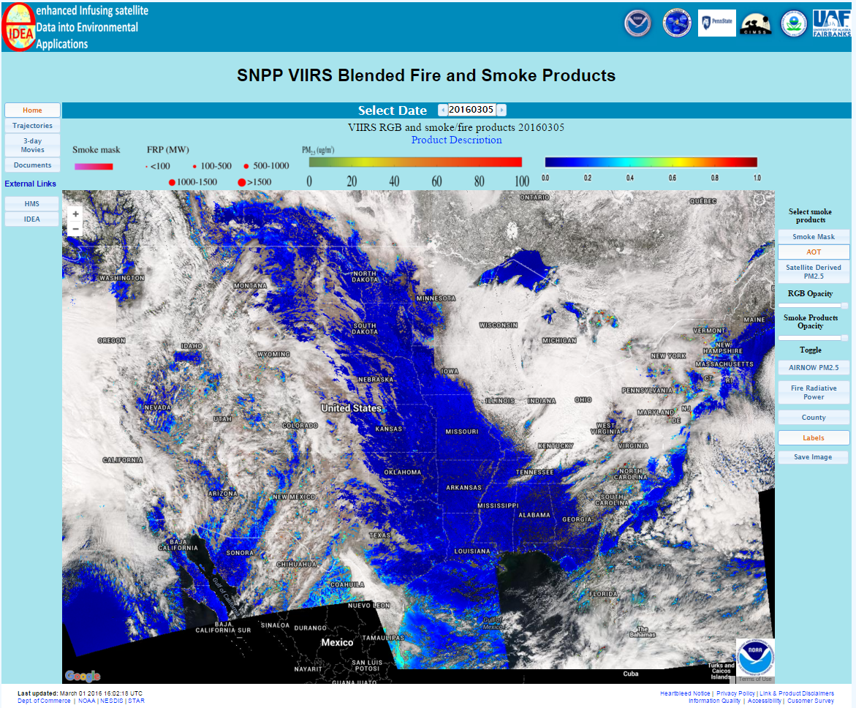
Web-Based Blended F&S Product: eIDEA
http://www.star.nesdis.noaa.gov/smcd/spb/aq/expr/expr2/
Enhanced Infusing satellite Data into Environmental Applications - Homepage
Domain: CONUS and Alaska
calendar to select date of interest
animations and external links
main product overlay buttons

Slide 5
Products on eIDEA
Data overlays:
VIIRS aerosol optical thickness (AOT)
VIIRS smoke mask
VIIRS fire hotspots and fire radiative power (FRP)
VIIRS estimated surface fine particulate matter (PM_{2.5}) concentration
VIIRS true color imagery (RGB)
Ambient surface PM_{2.5} concentrations (from U.S. EPA’s AirNow network)
Data animations:
48-hour aerosol forward trajectories
3-day movies (AOT, smoke mask, and PM_{2.5})

Slide 6
eIDEA: Overlays
“Smoke Mask” is default smoke product; click on “AOT” or “Satellite Derived PM_{2.5}” to switch b/w smoke products
Product legends
Slider bars adjust opacity of RGB and smoke products
Add/remove additional product overlays using toggle buttons
Click “Save Image” to save configuration as a graphics file

Slide 7
eIDEA: Animations
Click “Home” to return to home page
Click to view animations
Product Description
Link to additional documentation
Links to NOAA Hazard Mapping System (HMS) and main IDEA webpages
Animation controls
Product legends
Regional subsets

Slide 8
Demonstration of Web-Based Blended Fire & Smoke Product for IMETs
Presented new Blended F&S web-based product, eIDEA, at two IMET trainings in March:
IMET Virtual Workshop, March 9 (~50 IMETs)
IMET CEE Training Workshop, Boise, ID, March 15 (~25 IMETs)
30 min presentation and demo, plus questions
IMETs asked to test eIDEA and provide feedback on its format and data products

Slide 9
Initial Feedback from IMETs on eIDEA
Increase domain:
Extend southward to see smoke coming from Central America
Extend westward to see aerosols coming from Asia
Make buttons/slider bars a bit bigger
AOT more useful than Smoke Mask
Trajectories:
Add a slider bar to see only pink trajectories
Add capability to use HRRR in addition to NAM
Add zoom capability
Add GOES-R data to eIDEA

Slide 10
Next Steps for Blended F&S Team
Modifying eIDEA based on feedback from IMETs:
Increasing domain
Investigating options for using 4 km NAM and HRRR as drivers for 48-hr forward trajectories
Adding simulated GOES-R data to eIDEA
AOD and fire products
Revisit eIDEA with IMETs in a few months
“Fire on the Fives” telecon
Adding F&S products to:
IMET’s Thin Client software
Components of Blended F&S Product available for display in AWIPS-II in summer 2016
Mobile app coming in next year

Slide 11
Building on GOES-R Air Quality Proving Ground Activities
Air quality user interaction began in 2010 with GOES-R Air Quality Proving Ground (AQPG)
Created simulated ABI aerosol data for training of user community
Formed Advisory Group of ~40 air quality forecasters, modelers, and analysts who provided feedback on simulated ABI aerosol products
Developed training and outreach materials to inform users
eIDEA combines results from VIIRS and GOES-R AQPG activities
One-stop, easy to use web-based interface for access to VIIRS and GOES-R fire and smoke imagery

Slide 12
Acknowledgements
NESDIS/STAR Fire team
Ivan Csiszar (NOAA - fire team lead)
Marina Tsidulko (IMSG at NOAA)
JPSS Program office
University of Alaska at Fairbanks
Scott McFarlene
University of Wisconsin
Liam Gumley and Kathy Strabla

Slide 13
Extra Slides

Slide 14
Data Availability
VIIRS is on SNPP, a polar-orbiting satellite
~1:30 PM overpass time (local time)
So “today’s” near-real time VIIRS observations on eIDEA are available in the mid-afternoon, typically ~2-3 hours after overpass
NOAA is working on options to decrease latency for NRT VIIRS aerosol products
Archived products begin on Feb 29, 2016
Case study products: Aug 15-31, 2015

Slide 15
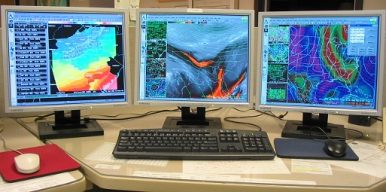
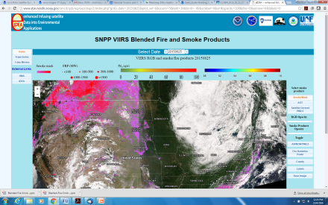
Data Flow and Processing
SNPP VIIRS Data
Direct Broadcast from UW and UAF
SDRs
VCM
FTP pull to STAR computers
STAR Enterprise AOT, SM, and Fire Algorithms
AWIPS-II
eIDEA

Slide 16
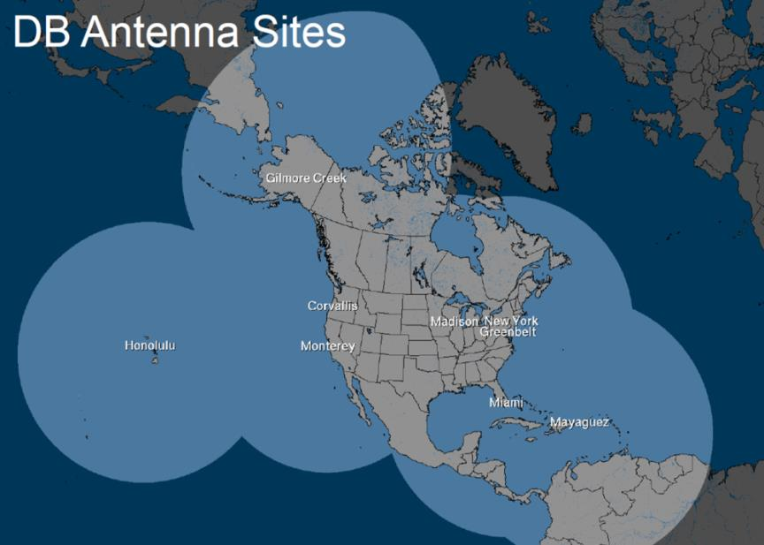
Additional Direct Broadcast Sites
Currently, DB data for eIDEA from:
UW (CONUS)
UAF (AK)
Corvalis (West coast)
Options to increase eIDEA domain will need to incorporate DB data from additional sites

Slide 17
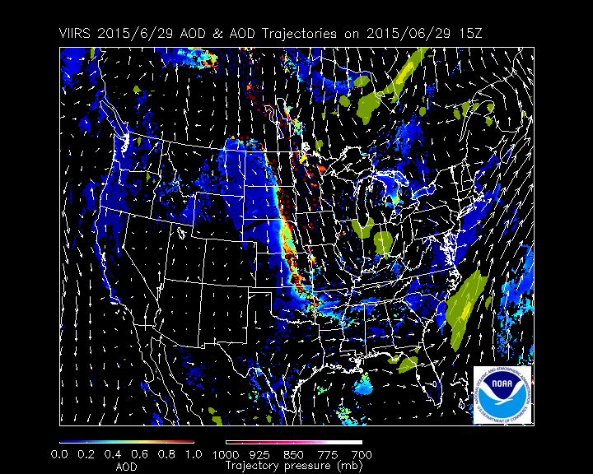
48-Hour Forward Aerosol Trajectories
Trajectories give idea of transport of aerosol plumes
Areas of high AOT (>0.4) used as starting locations
Trajectories initialized at 50, 100, 150, and 200 mb above surface
Trajectories run using NAM 12Z run output:
Pink: near surface
White: away from surface
850 mb wind vectors (white)
3-hr accumulated precipitation (yellow)

Slide 18
3-Day Movie Loops
PM_{2.5}
Smoke Mask and FRP
Animation controls
AOT
Regional subsets

