Slide 1
Operational Use of RGBs in Alaska
Eric Stevens
University of Alaska Fairbanks (UAF), Geographic Information Network of Alaska (GINA)

Slide 2
Outline
A brief editorial and brief disclaimer
Examples of RGBs in Alaska
Training Issues with RGBs
The Future: Client-Side RGB Generation on AWIPS2
Closing Thoughts for Operational Users

Slide 3
Editorial: The Strength of RGBs
NWS Forecasters have more of (almost) everything nowadays:
More NWP models, ensemble products
More mesonet obs, webcams
More grids and services to provide to the public
More satellite channels and products are coming
Forecasters do not have more hours on a shift
RGBs allow forecasters to take in more info more quickly. Essential in the era of the 16-band ABI and 22-band VIIRS

Slide 4
The Disclaimer
There is a lot going on with RGBs
There is only time here to show a handful of RGB examples
The inclusion, or lack of inclusion, of a particular RGB in this presentation is not intended to be a value judgement of any particular RGB

Slide 7
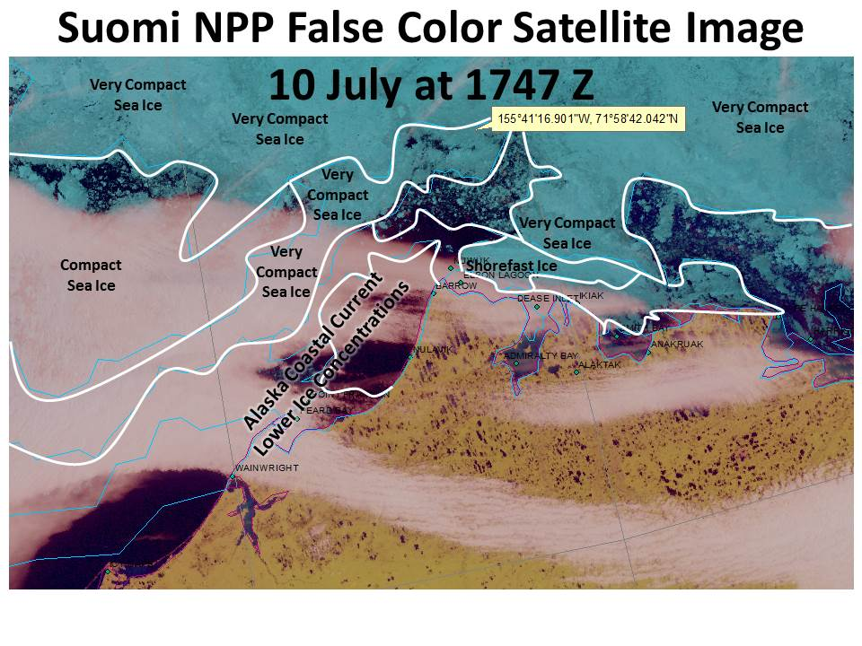
Good Afternoon USCG Juneau, Here is the latest update on the sea ice conditions near the vessel's latest position of 71.978345N 155.688028W. The vessel is currently surrounded by sea ice in an area of 70-90% ice cover. An area of 80-100% ice cover is less than 2 nm to the north of the vessel's latest position. A region of 60-90% sea ice cover lies 12.5 nm to the south of the vessel's position and 8.5 nm to the southeast of the vessel's current position. The situation is becoming increasingly concerning at this point in time. Easterly winds are expected to persist through today... becoming Northerly winds tonight through Saturday at 10-15 knots. With this northerly wind flow the overall pack ice north of the vessel is expected to compact and shift to the south... closing off lower concentration ice pathways and options for the vessel to escape the sea ice. Winds are expected to become westerly Saturday night and then southwesterly Sunday into Monday. This wind will shift the compact ice to the west of the vessel over to the east... also packing in the sea ice surrounding the vessel. It is likely by Monday that this area will be in roughly 80%-100% ice cover north of 71.55N Early next week we are also having increasing confidence of a strong storm moving over the Chukchi Sea. Another item of concern for this vessel. The best option for avoiding the high concentrations of ice compacting to a very serious situation for this vessel is to advise the vessel to head toward the west facing coast of Barrow.

Slide 8
USCG Rescues Mariner in Sailboat Trapped in Ice North of Barrow
WFO Anchorage sea ice forecasters provided “phenomenal weather products” that proved key to USCG decision makers, said Rear Adm. Dan Abel, commander, 17th Coast Guard District.

Slide 9
“Fire Temperature” RGB from CIRA
Notes:
Uses VIIRS M10, M11, M12 bands 1.6 through 3.7 micron

Slide 10
“Microphysics” RGBs from NASA/SPoRT
Goal is to deliver products that help identify cloud type, elevation, and potential for fog
Modeled on approach developed by EUMETSAT
Two similar products: one during overnight hours, one during the day
Formal “assessments” in winter 2013-2014, 2014-2015, summer 2015

Slide 11
RGB Night-Time Microphysics
Color | Band(s) | Physically Relates to… | Small contribution to composite means… | Large contribution to composite means…
Red | 12.0µm – 10.8µm | Optical Depth | Thin clouds | Thick clouds
Green | 10.8µm – 3.9µm | Particle phase and size | Ice particles, or bare ground | Water clouds with small particles
Blue | 10.8µm | Temperature of surface | Cold surface | Warm surface

Slide 12
RGB 24hr Microphysics
Color | Band(s) | Physically Relates to… | Small contribution to composite means… | Large contribution to composite means…
Red | 12.0µm – 10.8µm | Optical Depth | Thin clouds | Thick clouds
Green | 10.8µm – 8.7µm | Particle phase and size | Ice particles, or bare ground | Water clouds with small particles
Blue | 10.8µm | Temperature of surface | Cold surface | Warm surface

Slide 13
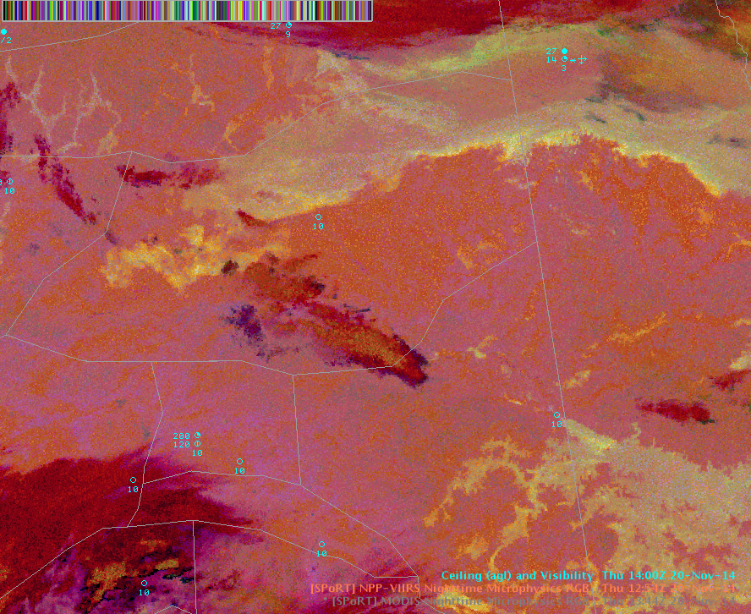

Slide 14
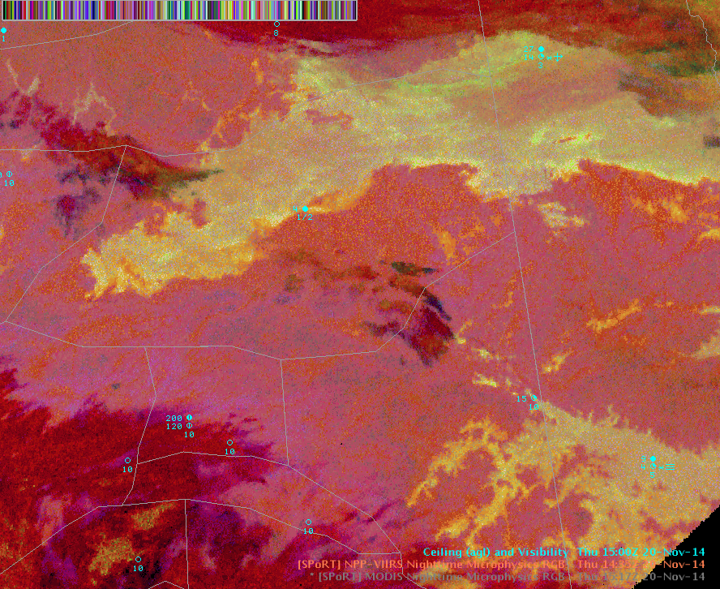

Slide 15
VIIRS 2115 UTC (12:15pm), 1/28
This case focused on a cloud deck hovering near the MVFR/VFR threshold (3000 feet) in Bethel. It was not clear in GOES IR and Visible what the areal extent of this cloud deck was across the Kuskokwim Delta.
24hr Micro (green gamma=1.2), no LBC
NtMicro

Slide 16
VIIRS 2115 UTC (12:15pm), 1/28
This case focused on a cloud deck hovering near the MVFR/VFR threshold (3000 feet) in Bethel. It was not clear in GOES IR and Visible what the areal extent of this cloud deck was across the Kuskokwim Delta.
24hr Micro (green gamma=1.2), LBC
NtMicro

Slide 17
Training Issues and RGBs
Use of RGBs on the forecast desk is much less intuitive than was the case with other products such as DNB
SPoRT’s assessments included giving forecasters resources like QuickGuides and Articulate lessons, as well as join.me teleconferences and almost real-time feedback via email; not simply “throwing the product over the fence.”
Mouse roll-over in AWIPS gave useless info, but this problem is now being partially solved

Slide 18
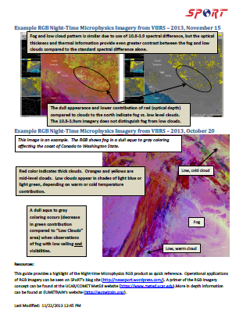

Slide 19
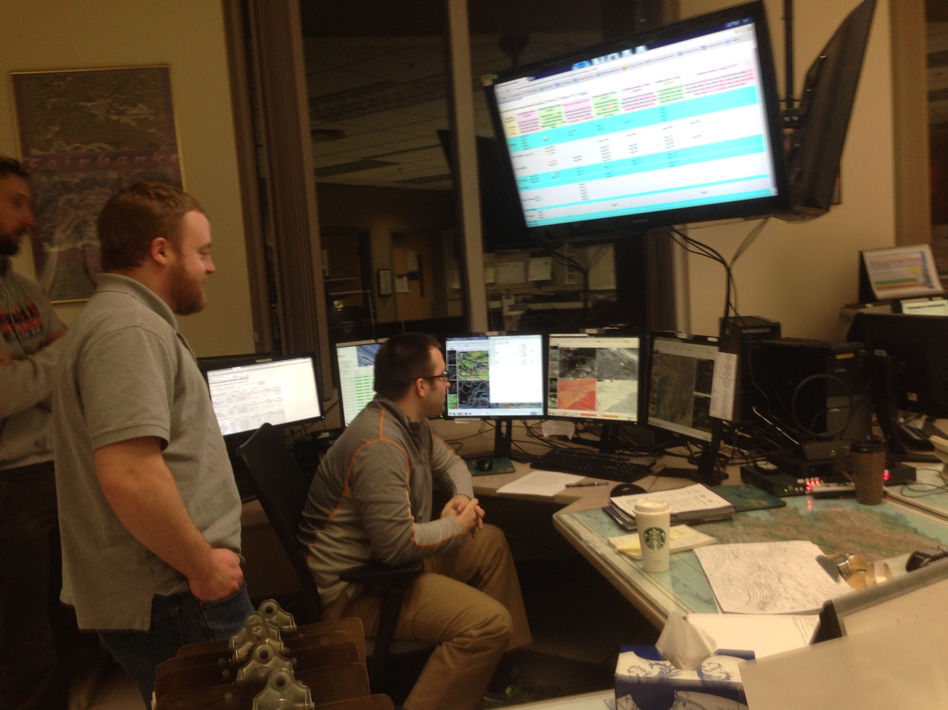
The Desired Outcome: Products Forecasters Find Helpful and Like to Use

Slide 20
The Future: client-side RGB production
Two ways to get an RGB on AWIPS for use by NWS meteorologists:
A cooperative institute produces the RGB and delivers the finished RGB to AWIPS
A cooperative institute delivers single channels to AWIPS, and these single channels are then combined into an RGB
“Client-side RGB Production”
“RGB on the Fly”

Slide 22
Pros and Cons of Client-Side RGB Production
Pros:
Forecaster gets more useful information by sampling via mouse-over
Allows local forecasters to experiment with their own local RGBs to solve their own local issues
Cons:
RGB production is more complicated than simply making a custom color-curve
Less consistency from WFO to WFO

Slide 23
Client-Side RGB Production: The Goldilocks Approach
Can we do both?
Have a consistent set of “default” RGBs that are the same from WFO to WFO
Also allow customized RGBs to be developed at local WFOs if those WFOs so desire
An opportunity to produce training to the WFOs: “Dos and Don’ts of Client-Side RGB Production”

Slide 24
Closing Thoughts for Operational Users
RGBs are a powerful way to get more satellite information into your mind more quickly
New RGBs may not be intuitive to use at first, so investing some time in training and familiarization is required
“Client-side RGB production” has potential to allow local forecasters to build customized products tuned to address local challenges

Slide 25
eric@gina.alaska.edu

