Slide 1
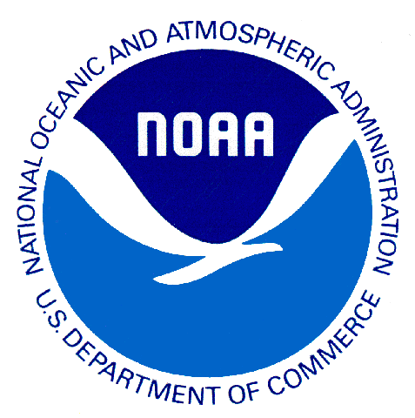
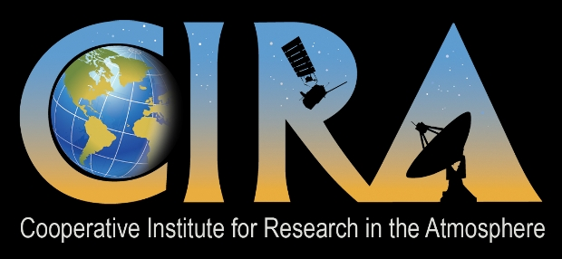
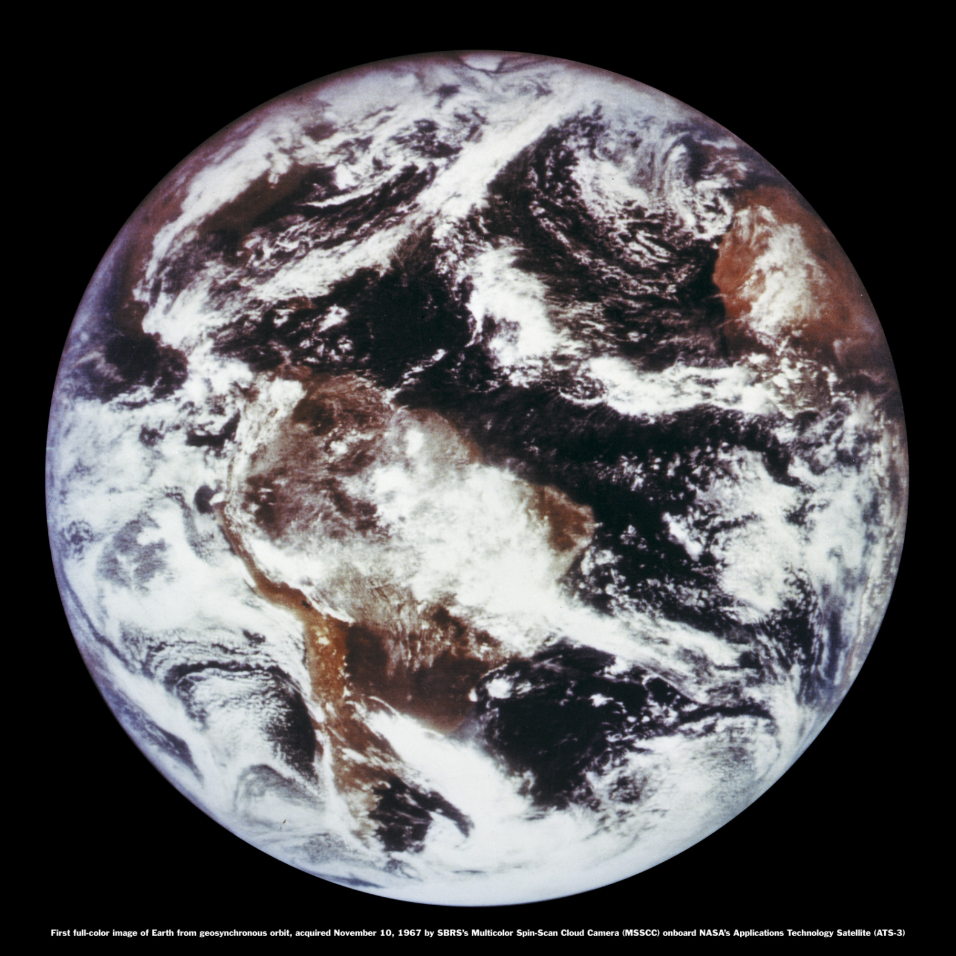
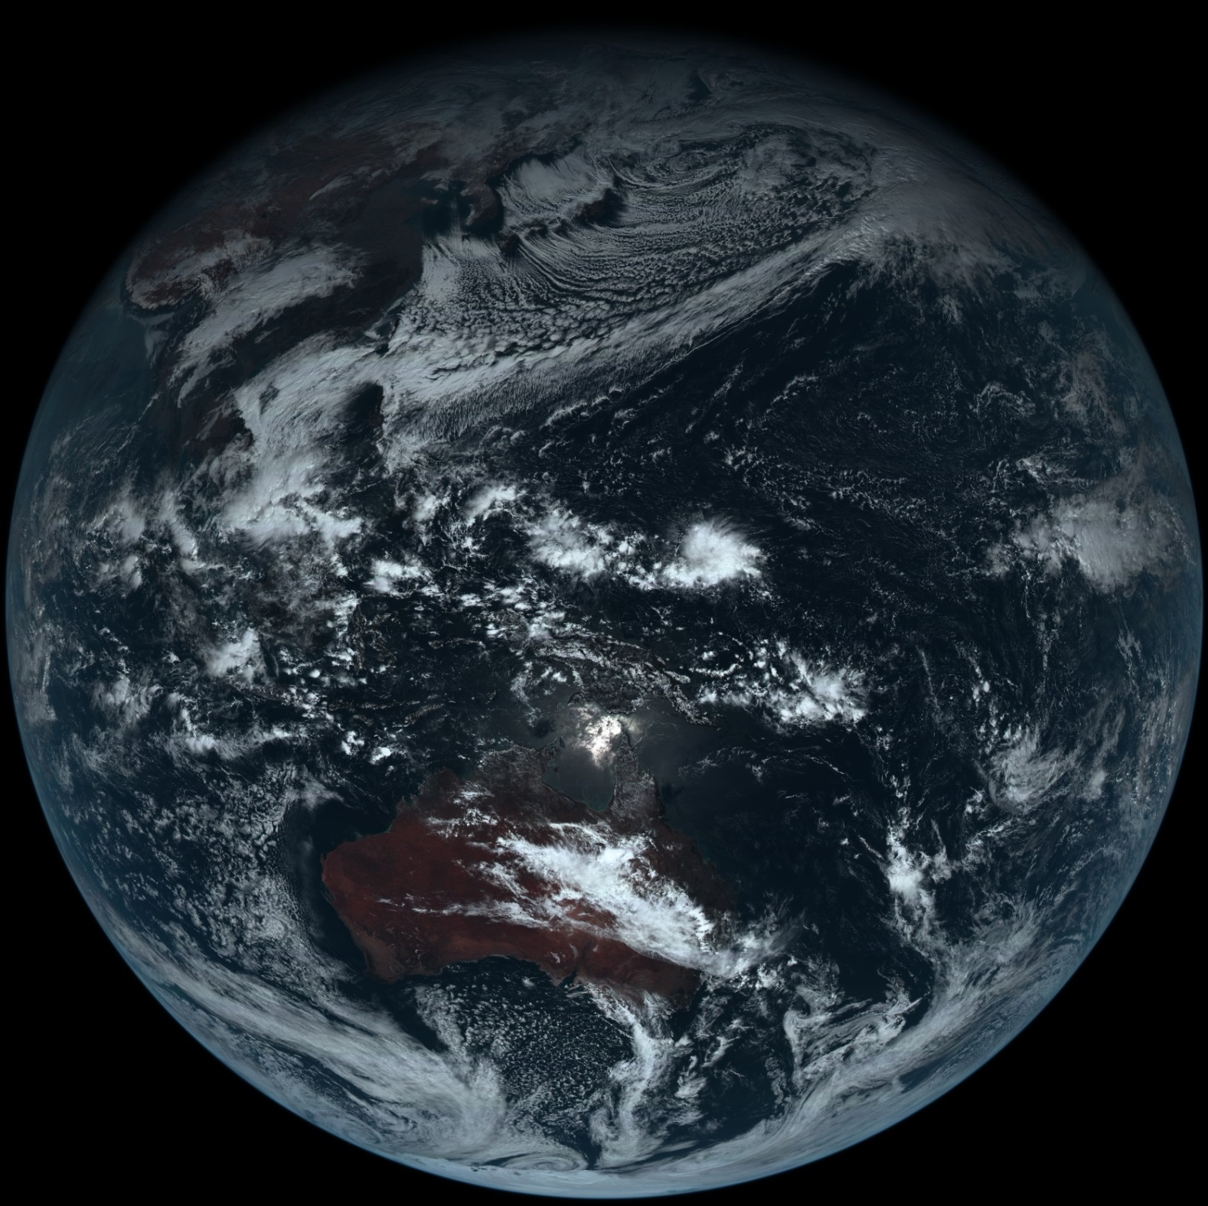
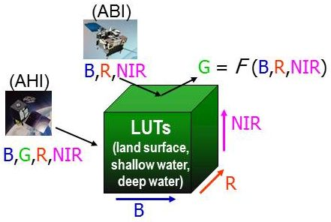
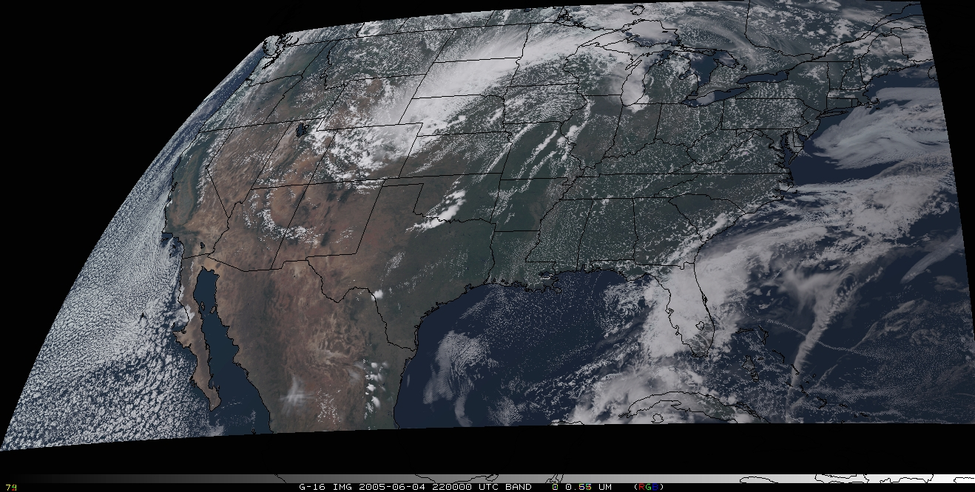
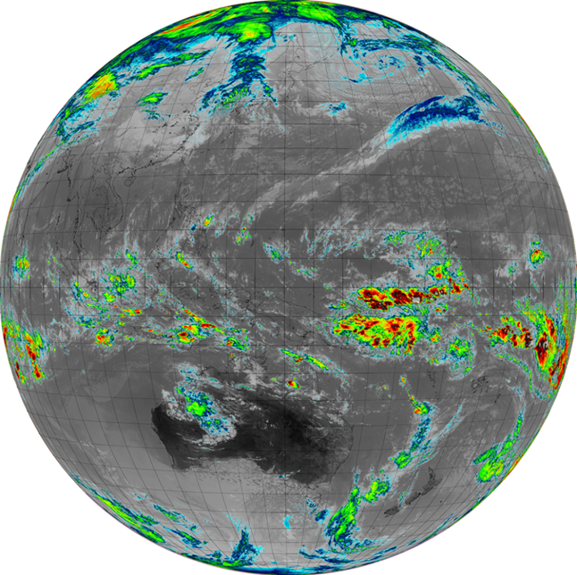
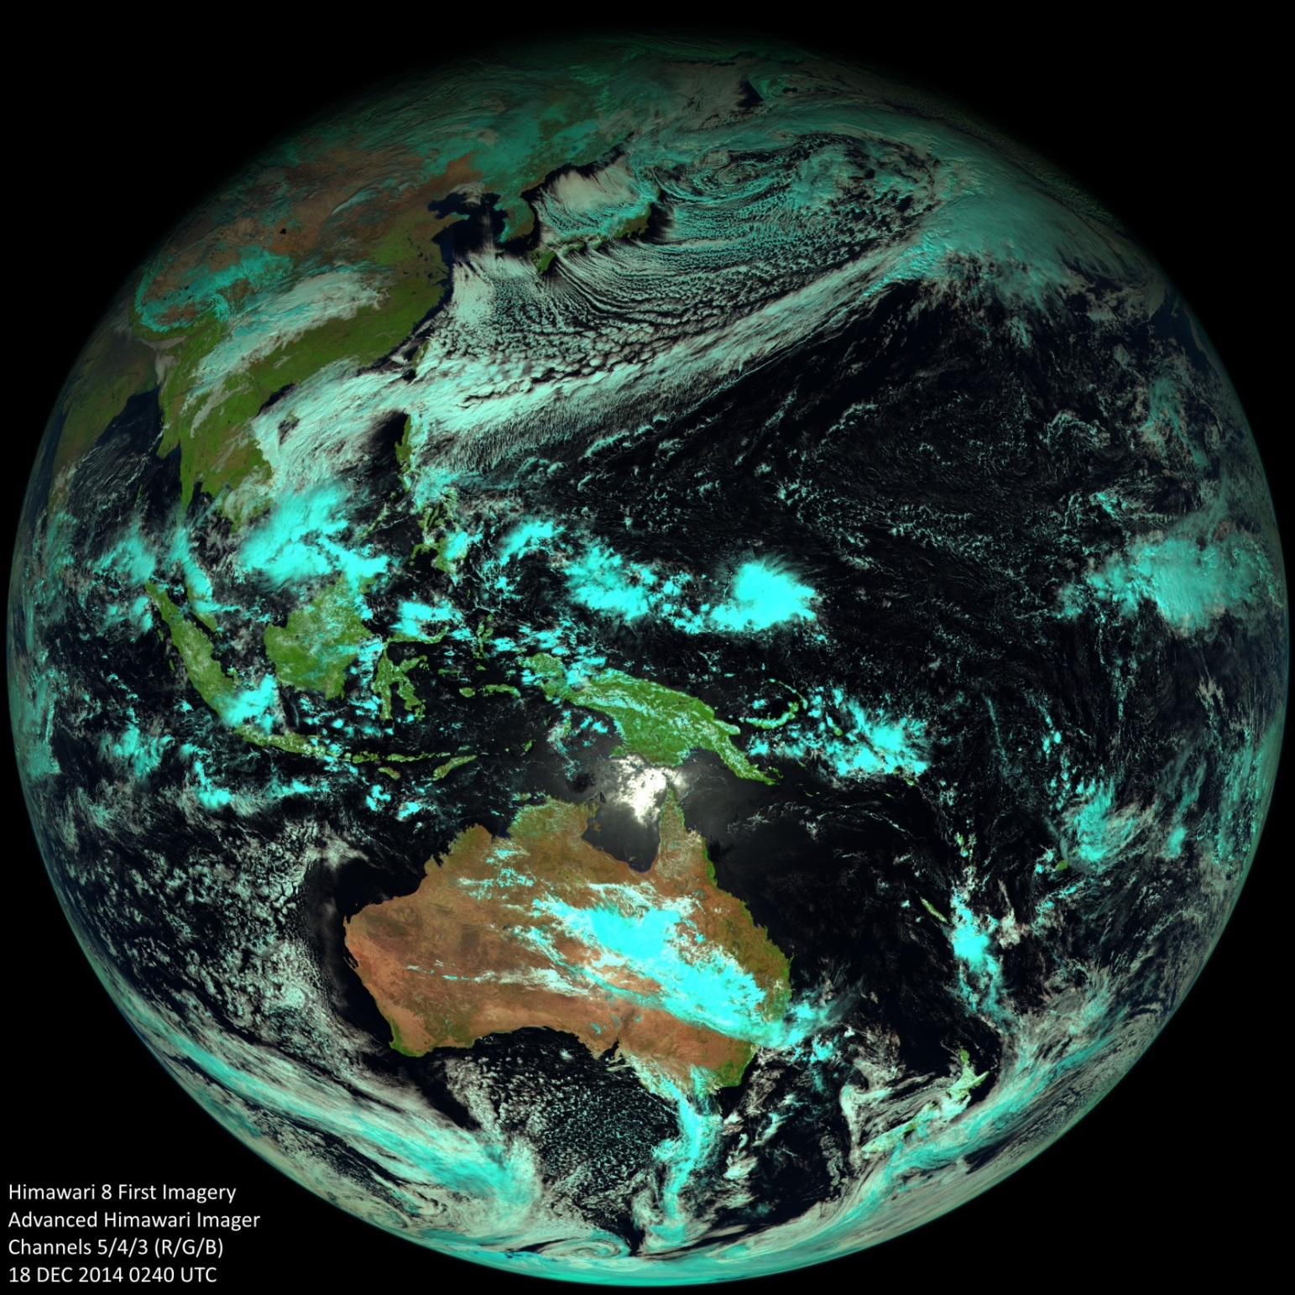
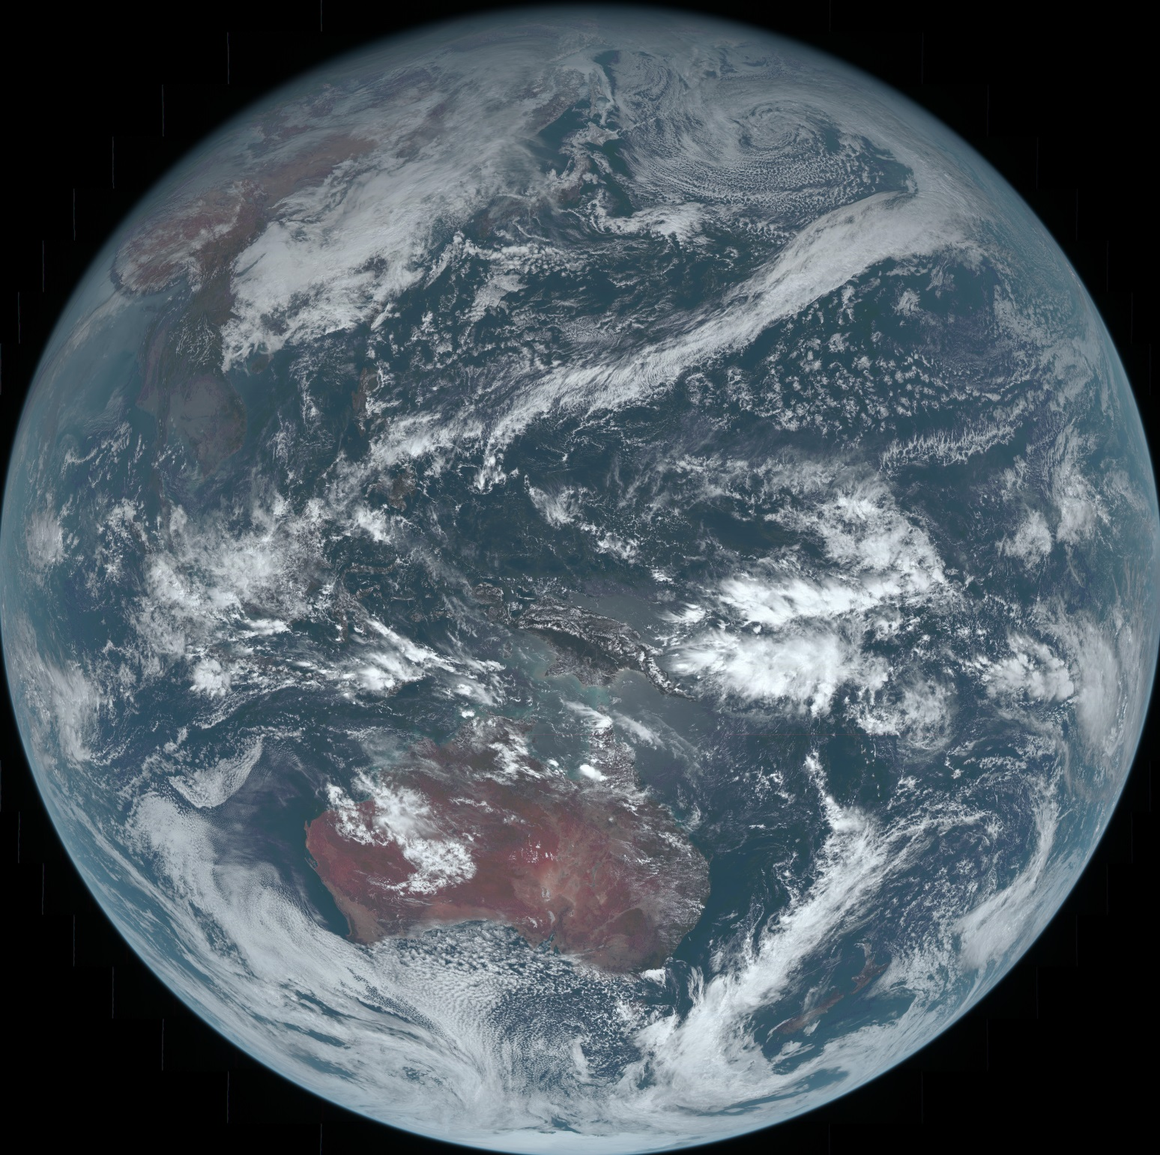
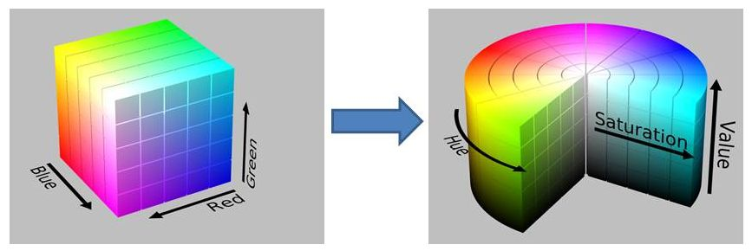
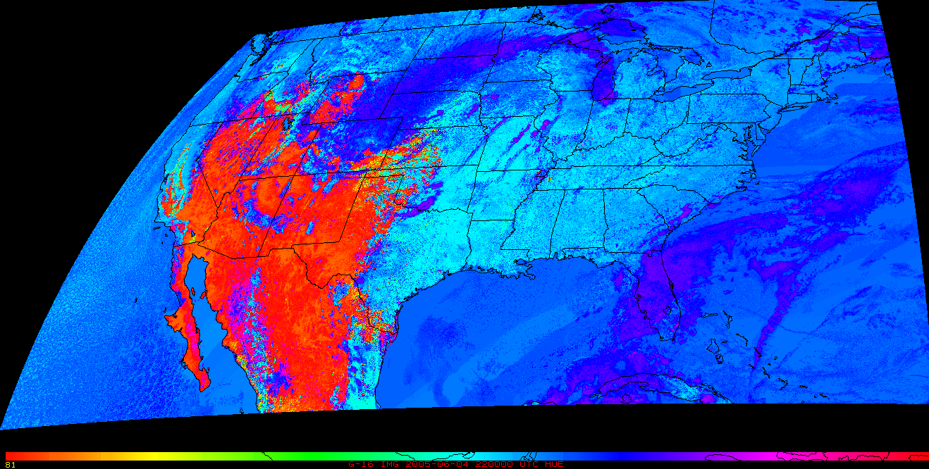
24Feb2015 Poster
True-Color Imagery for GOES-R: Creating a Green Band for ABI
Don Hillger
NOAA/NESDIS, SaTellite Applications and Research (STAR)
Regional And Mesoscale Meteorology Branch (RAMMB)
Steven Miller, Louie Grasso, Curtis Seaman, and Stan Kidder
CIRA/Colorado State University
Fort Collins, CO 80523-1375
E-mail: Don.Hillger@noaa.gov
Introduction
True-color imagery from geostationary orbit first became available from the third Applications Technology Satellite (ATS-3) in 1967. The image at the right is one of the true-color images produced from the Red, Green, and Blue bands of the Multi-color Spin-Scan Cloud Camera (MSSCC) instrument on ATS-3.
A number of satellites and instruments have included the Red, Green, and Blue component bands to be able to product true-color imagery. A table of those satellites and their instruments is provided. Interestingly, most of those satellites are polar orbiters, and even the International Space Station has an instrument with true-color imaging capability. Note that true-color imagery from geostationary orbit has been very limited, with an especially long gap between ATS-3 and the current and planned capabilities of Himawari and GOES-R.
Not until the launch of the (Japanese) Himawari-8 in 2014 are true-color images once again available from geostationary orbit. The first example of AHI true-color imagery is shown at the right. A Rayleigh-corrected true-color image is under development and will soon be available. That image should look more like the bright true-color images that NASA routinely generates.
ABI true-color imagery
Although the AHI was derived from the Advanced Baseline Imager (ABI), there was a change in AHI spectral band coverage to include the Green spectral band instead of the 1.38 µm spectral bands of ABI. (See the accompanying table of ABI and AHI spectral bands.) Because of choices made during the design phase of the ABI, true-color imagery was not as high priority as other spectral bands. (The choices were also limited by the number of available (16) spectral bands in the current ABI/AHI design, with fewer bands equating to lower cost.) Later considerations would probably have opted for a Green spectral band on ABI. However, at this point, the only option for creating true-color imagery from ABI is through a process that synthesizes the Green band from nearby reflective bands in the Red, Near-IR, and Blue spectral bands.
Synthesized Green band
Two of the three spectral components of true-color are available on ABI, but the Green spectral band needs to be synthesized from the other ABI spectral bands. The only other near-visible spectral band is the 0.86 µm Near-IR (NIR) band that is often used for vegetation monitoring, mainly thru a Normalized Difference Vegetation Index (NDVI). The NIR band can be utilized in a regression-like process, along with the Red and Blue bands, to create the needed Green band. That regression can take the form of a Look-Up Table (LUT) that is trained on actual imagery to output a Green band based on the Red, NIR, and Blue bands as inputs. Training data for this purpose can come from either MODIS or AHI imagery.
THEN
NOW
ATS-3 true-color image from 10 Nov 1967
Himawari-8 AHI true-color image from 18 Dec 2014 (source JMA website)
Himawari-8 as training for GOES-R
Once AHI data become routinely available, that data will become the training for the LUT that will allow ABI to produce both the Green band and true color imagery. But until that happens, the focus has been on using simulated ABI to test algorithm development, along with MODIS imagery as the training dataset. In particular, some early ABI simulations were done very well and the Green band algorithm has been available for use with simulated ABI, only to be improved with further application of AHI as training data.
ABI vs. AHI spectral bands
Himawari AHI |  | GOES-R ABI
Band number | Central wavelength (μm) | Band number | Central wavelength (μm)
1 (blue) | 0.46 | 1 (blue) | 0.47
2 (green) | 0.51 | X (green) | simulated
3 (red) | 0.64 | 2 (red) | 0.64
4 | 0.86 | 3 | 0.865
- | - | 4 | 1.378
5 | 1.6 | 5 | 1.61
6 | 2.3 | 6 | 2.25
7 | 3.9 | 7 | 3.90
8 | 6.2 | 8 | 6.19
9 | 7.0 | 9 | 6.95
10 | 7.3 | 10 | 7.34
11 | 8.6 | 11 | 8.5
12 | 9.6 | 12 | 9.61
13 | 10.4 | 13 | 10.35
14 | 11.2 | 14 | 11.2
15 | 12.3 | 15 | 12.3
16 | 13.3 | 16 | 13.3
History of true-color (red, green, and blue) imagery from satellite instrumentation
Satellite(s) (and Instrument) | Satellite Orbit | Year(s)
ATS-3 (MSSCC) | Geostationary | 1967 only
Nimbus-7 (CZCS) | Polar-orbiting | 1978 → 1994
Landsat-4 (TM) Landsat-5 (TM) | Polar-orbiting | 1972 → 1993 1984 → 2013
ADEOS (OCTS) ADEOS-2 (OCTS) | Polar-orbiting | 1996 → 1997 2002 → 2003
Orbview-2 (SeaWiFS) | Polar-orbiting | 1997 → 2010
EOS Terra and Aqua (MODIS) | Polar-orbiting | 1999 →
Landsat-6 (ETM+) Landsat-7 (ETM+) | Polar-orbiting | 1993 [failed to orbit) 1999 →
EO-1 (Hyperion) | Polar-orbiting | 2000 →
Envisat (MERIS) | Polar-orbiting | 2002 → 2012
ISS (HICO) | Low-inclination | 2009 →
SAC-D (primary instrument) | Polar-orbiting | 2011 →
S-NPP (VIIRS) | Polar-orbiting | 2011 →
Landsat-8 (OLI) | Polar-orbiting | 2013 →
Himawari-8 (AHI) | Geostationary | 2015 →
DSCOVR (EPIC) | L1 orbit | 2015 →
GOES-R (ABI) | Geostationary | 2016 →
The Look Up Tables (LUTs) generated from AHI imagery will be used to create the ABI Green band.
CIMSS simulated ABI
In 2005 some very time-intensive simulations of ABI imagery were accomplished by CIMSS. Those simulations have been among the best to date, with most realistic simulations of true-color imagery, which have not been reproduced nearly as well by less computer-intensive modeling. An example of a true-color image from that CIMSS simulation of ABI is provided.
True-color image of CMSS-generated simulated ABI from 2005. Few ABI simulations have been this excellent.
Hue Imagery as an analysis and validation tool
How do we know if the true-color simulations are indeed ‘true’? One of the ways to assess true-color imagery is by using a color transformation of Red, Green, and Blue into Hue, Saturation, and Value imagery. There are variations on this process, but most have the primary (Hue) image in common. Hue is the fully-saturated color from the full color spectrum. For any pixel it represents the most common color at that point. Although the true color may be subdued because of lighting conditions or intensity, the Hue best represents that color. The details of this transformation are beyond the scope of this poster, but can be found elsewhere in the published literature. Hue images are presented as a methodology that will be used for validation of true-color imagery.
First CIRA-decoded image of AHI band-13 (10.4 µm) based on an AHI data file released by JMA.
“Natural-color” image created from AHI bands 5, 4, and 3 at 1.6, 0.86, and 0.63 µm, respectively.
The RGB to HSV transformation is a tool that will be used for validation of true-color imagery produced from ABI.
Rayleigh-corrected ABI true-color image
Coming soon!
Hue image of CMSS-generated simulated ABI from 2005, with emphasis on blue, indicating that there is a lot of Rayleigh scattering in the image. The red areas are desert surfaces with little atmospheric contribution, thus less scattering.
(Non-Rayleigh corrected) True-color image created from AHI bands 3, 2, and 1 at 0.64, 0.51, and 0.47 µm, respectively.
Rayleigh-corrected true-color image created from AHI under development.
Questions? Send email to Don.Hillger@noaa.gov. The views, opinions, and findings in this report are those of the authors, and should not be construed as an official NOAA and or U.S. Government position, policy, or decision. Special thanks to Kotaro Bessho and the JMA for providing AHI imagery that has already been provided to initiate this work, and will become available routinely in the near future.

