Slide 1
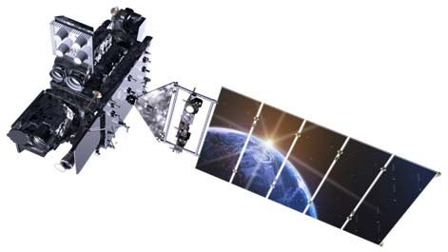
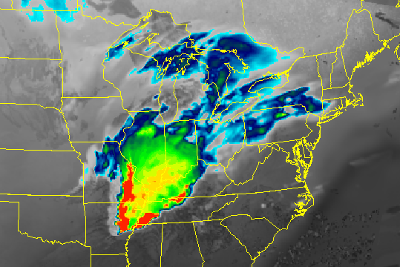
GOES-R RPM Synthetic Ingest and Display at WFO Medford, OR
Mike Stavish, SOO
3rd NOAA Satellite Proving Ground/User-Readiness Meeting
Norman, OK 2016
Notes:
Sorry if you’re hearing this twice
Repetition is good

Slide 2
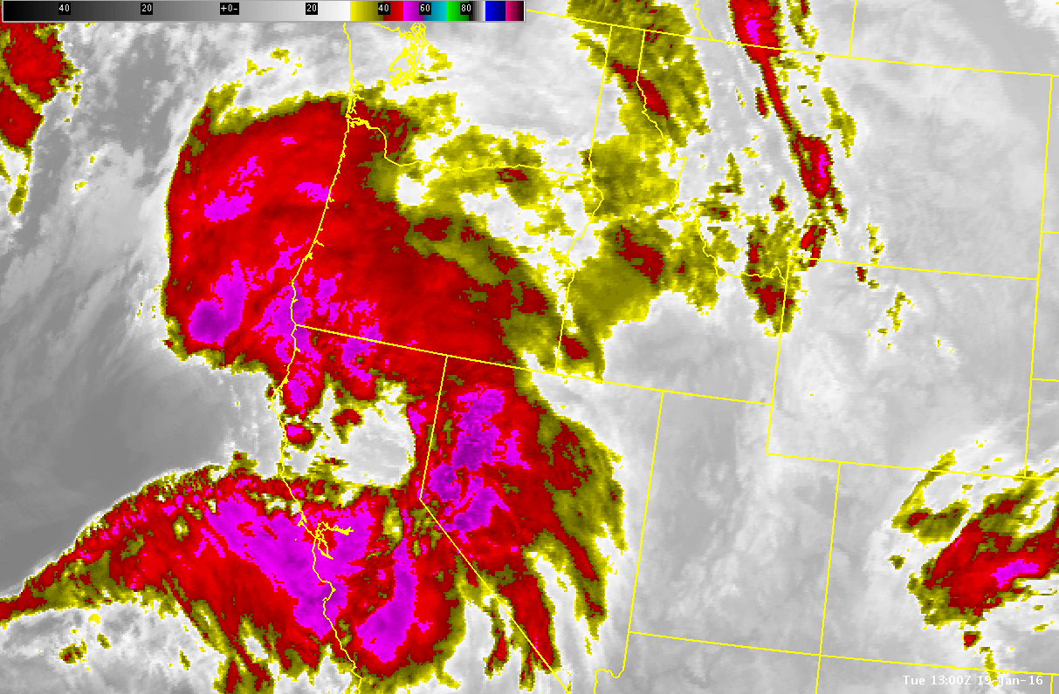
19JAN2016
13z-16z

Slide 3
RAP13
16z-00z forecast
wrf2k
HRRR

Slide 4
20:09Z
Notes:
The point of this case is to demonstrate that the forecasters did not envision this squall developing.

Slide 5
Klamath Falls 2030z
Notes:
This was NOT what the forecasters had envisioned with the high wind event…

Slide 6
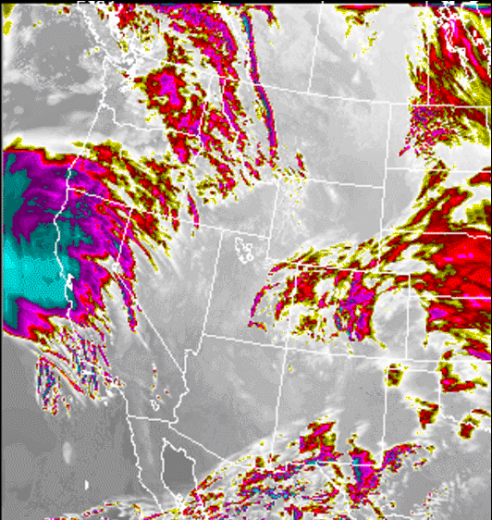
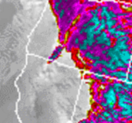
Is it live?
Or is it Memorex?
Notes:
This is in fact synthetic from the Real-Time NSSL 4 km WRF-ARW accessed from RAMSDIS Online – GOES-R Proving ground.
. Synthetic imagery serves to give the forecaster a real-world forecast of the weather in a much different perspective that viewing model data in traditional ways.
However, the synthetic goes-r data used in the TOWR-S is different in that the imagery was fed to us in “real-time”, it is still model forecast but is fed as if it were real time. I.e. we could not see it in the future. AND, this would actually be useful to forecasters.

Slide 7
Background
Past NASA SPoRT Assessments
Involvement with WFO neighbor Mel Nordquist
(WindSat , WR Satellite Team, STAT team)
Notes:
Just a few of the ways MFR has been involved with Satellite projects.
STAT team via mel.

Slide 8
Background
Red Flag Warning Mission Threads with Mel
and Eric Guillot (TOWR-S )
GOES-R OPG – Forecaster Marc Spilde
1-minute Imagery
RGB Products
Notes:
Just a few of the ways MFR has been involved with Satellite projects.

Slide 9
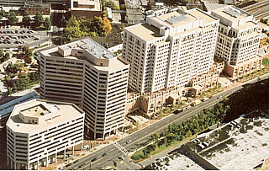
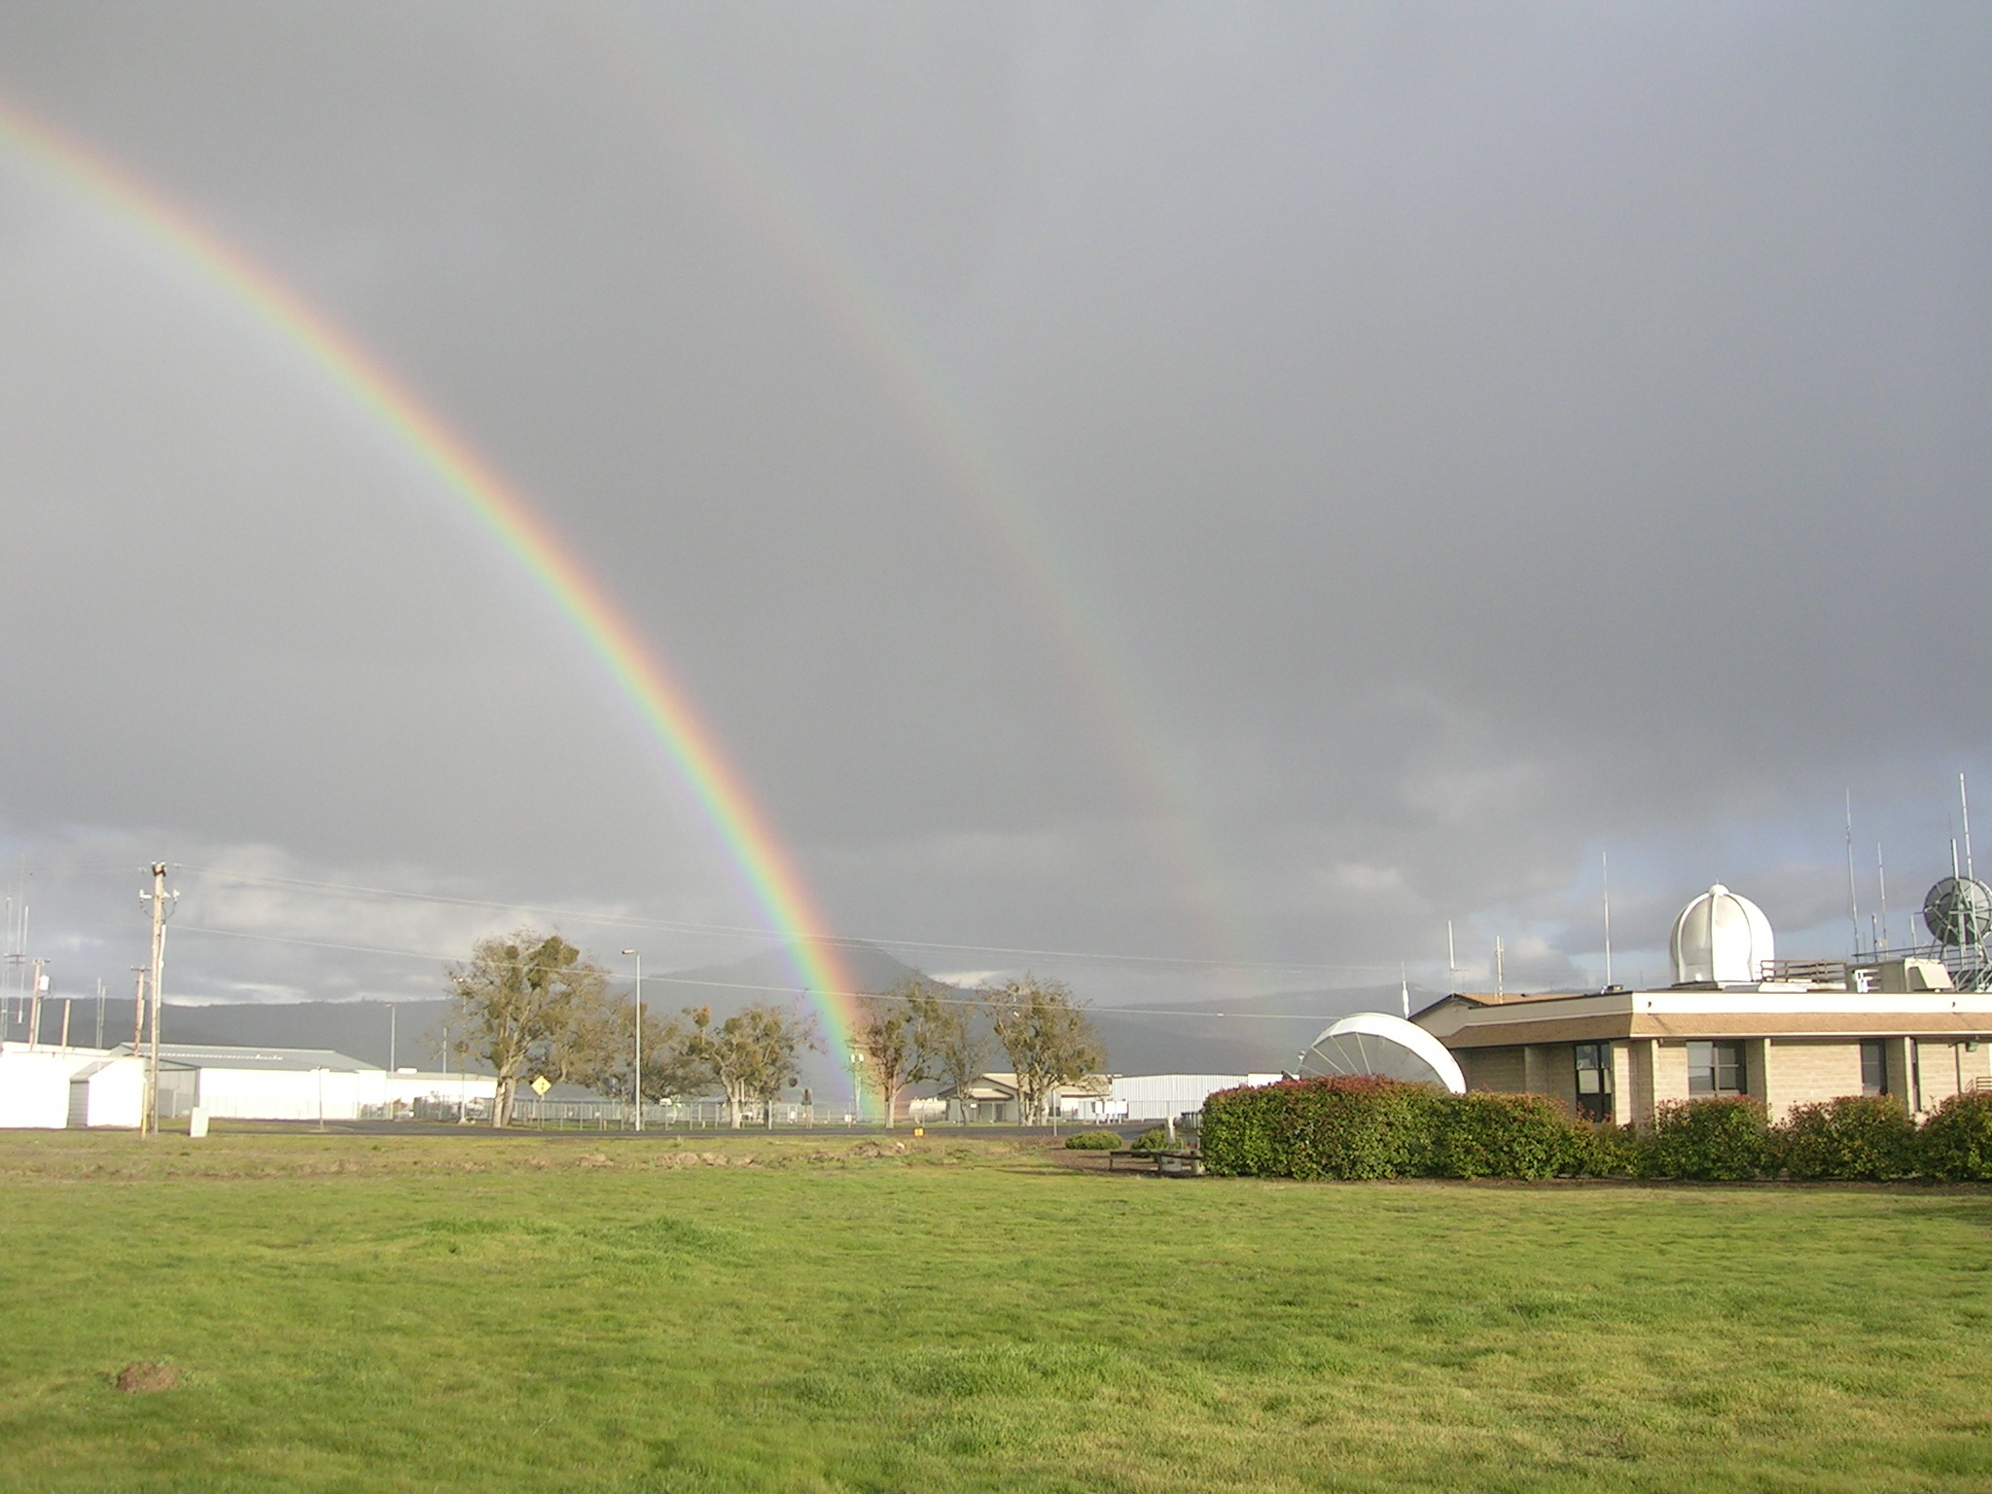
Beneficial HQ-Field Relationship
The Synthetic GOES-Ingest for WFOs is unique in scope
Enable future state ingest, imagery, curves, AWIPS menus
Practice distribution and display, gain feedback
Good process to gain feedback – daily calls

Slide 10
Setup Process
Silver Spring
RPM
Medford
Easy!
(Matt Comerford)
(Mike Stavish / Darren Dixon)

Slide 11
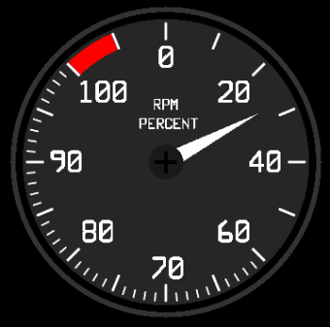
Setup Process
RPM (RPM Package Manager)
Utility for installing software on Linux
Get RPM file.
Build RPM for local WFO (linux box outside AWIPS, ITO or ESA)
Install file inside AWIPS: rpm -i file.rpm
Update file: 1-3, then rpm -U file.rpm
Notes:
Note – minor maintenance issue with ldmd and pqact on cpsbn1 after awips upgrades

Slide 12
Maintenance
Some outages occur after AWIPS build upgrades or after ldm localizations
GOES-R ldm settings get removed
ldmd.conf
pqact.conf
Quick fix by Matt Comerford or locally
Notes:
Note – minor maintenance issue with ldmd and pqact on cpsbn1 after awips upgrades

Slide 13
Original WFO Synthetic GOES-R Data Access
Products initially only available through AWIPS Product Browser under source “GOES-17”

Slide 14
New RPM Provides “GOES-R” Menu in D2d

Slide 15
GOES-R Menus
Synthetic Data Flowing Soon!
Notes:
Synthetic data will include real ancillary data

Slide 16
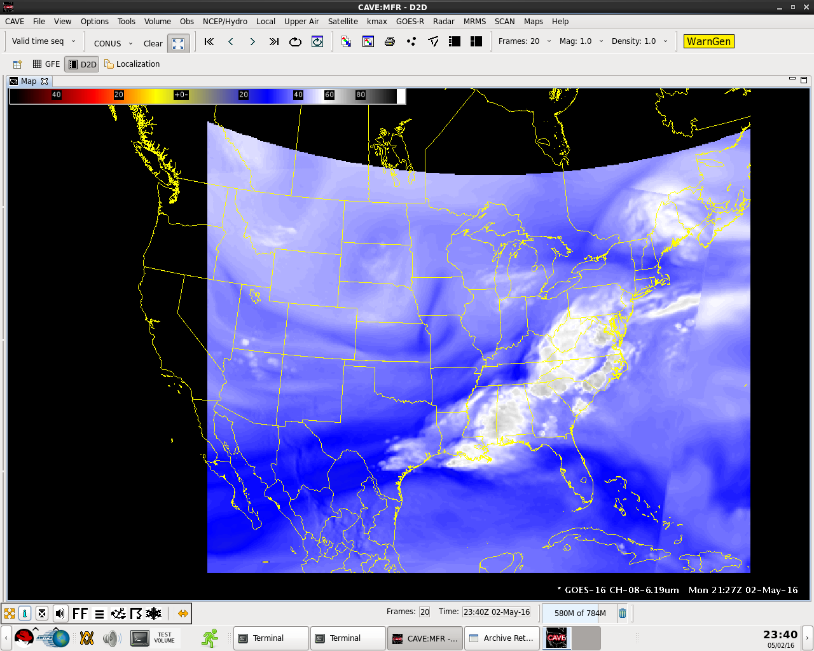
MFR CAVE display showing Synthetic GOES-R products
GOES East shown
Should come further west

Slide 17
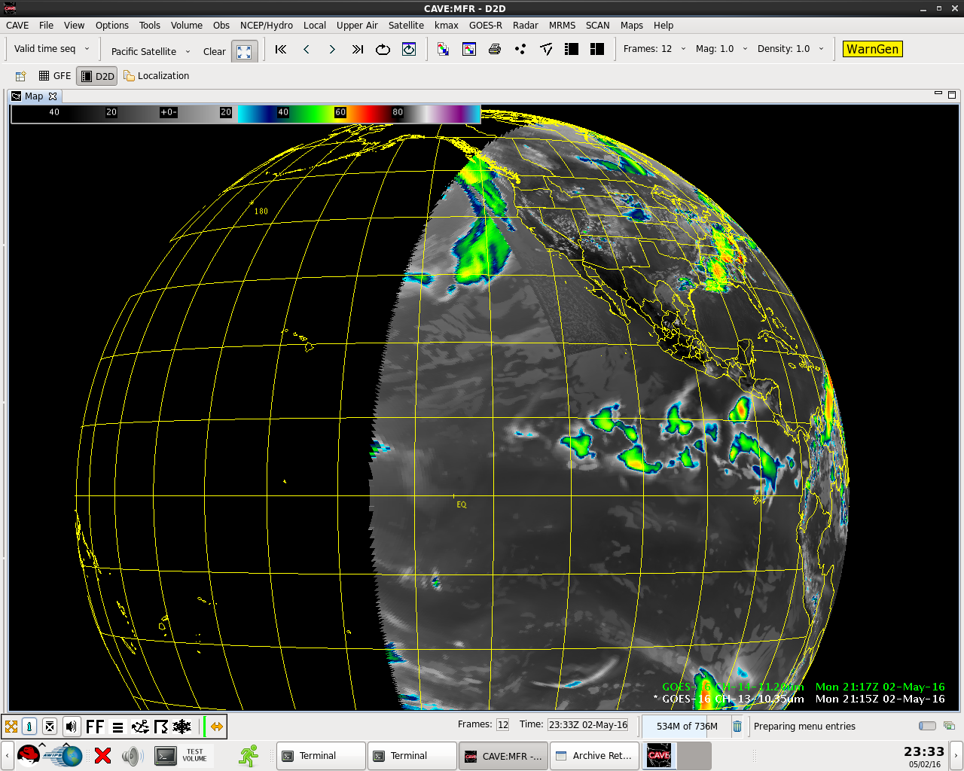
MFR CAVE display showing Synthetic GOES-R products
Goes East Full Disk

Slide 18
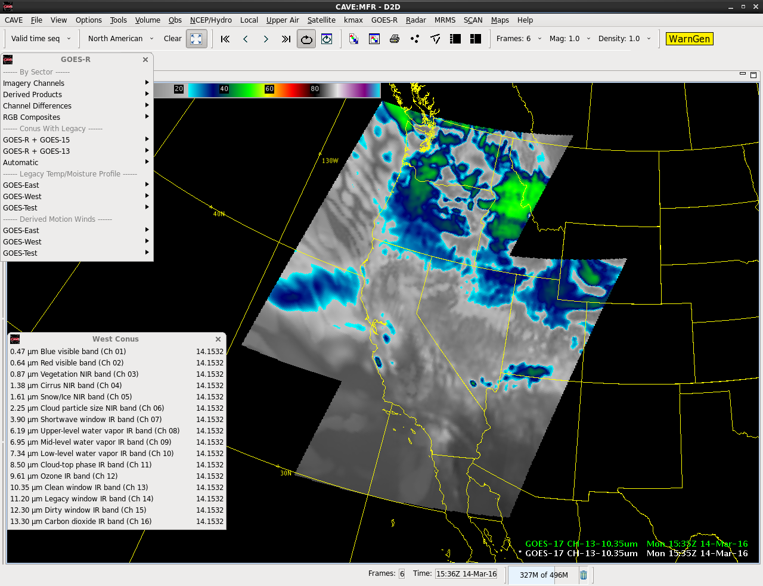
Ch. 13- 10.35um Mesoscale subsectors

Slide 19
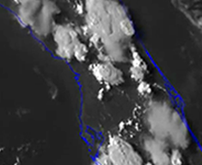
Looping and Frame Counts
Higher temporal resolution in satellite imagery necessitates:
Additional frame counts in looping
Higher speeds in looping

Slide 20
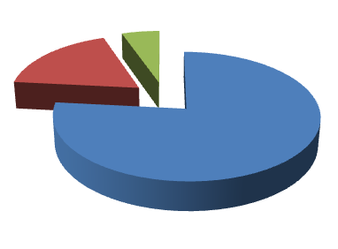
Raw Data Storage
“RAW” storage in “data_store/goes-r” was filling up.
Was consuming 650G of 2T
Not consistent among offices however

Slide 21
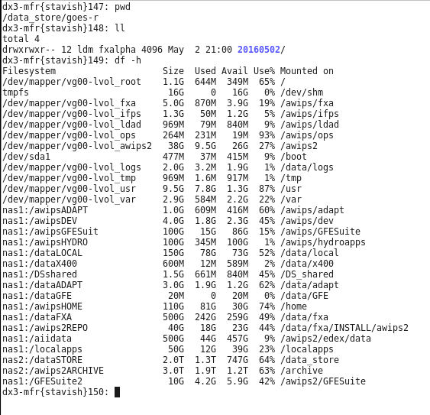
Data Storage
Was getting above 90%

Slide 22
Raw Data Storage
Archive Retention handles RAW data
Offices set # of archived hours (days)
Can add a section to purge the Synthetic Goes-R data with unique retention hours

Slide 23
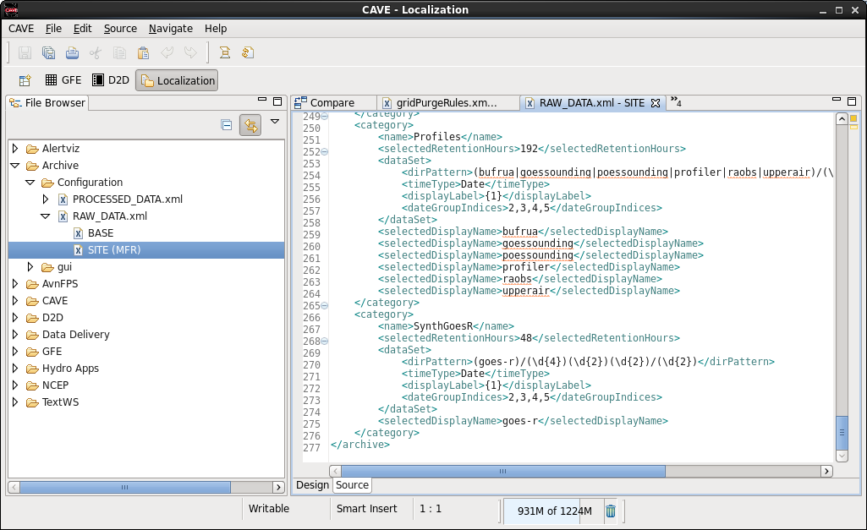
Modified “RAW_DATA.xml”
Added “SynthGOES-R”

Slide 24
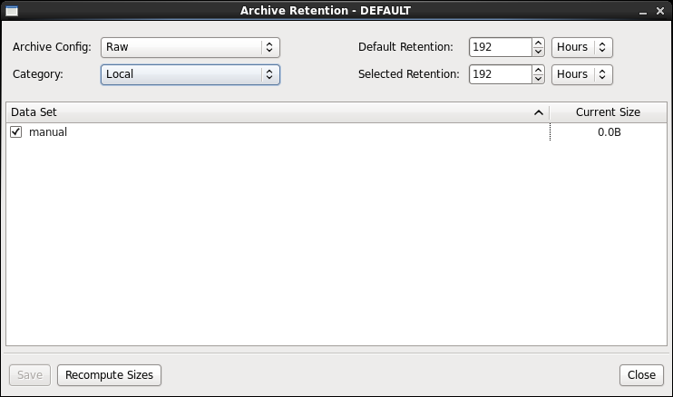
Raw Data Storage
8 days for this category
Selecting “Raw” shows you the /data_store

Slide 25
Raw Data Storage
Added a new category at MFR to purge GOES-R

Slide 26
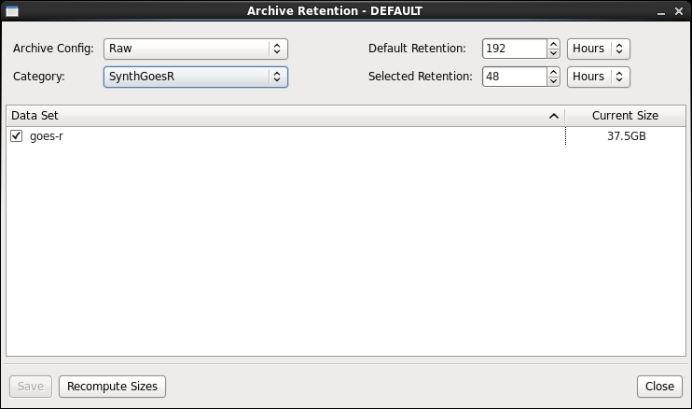
Raw Data Storage
Reduce retention time

Slide 27
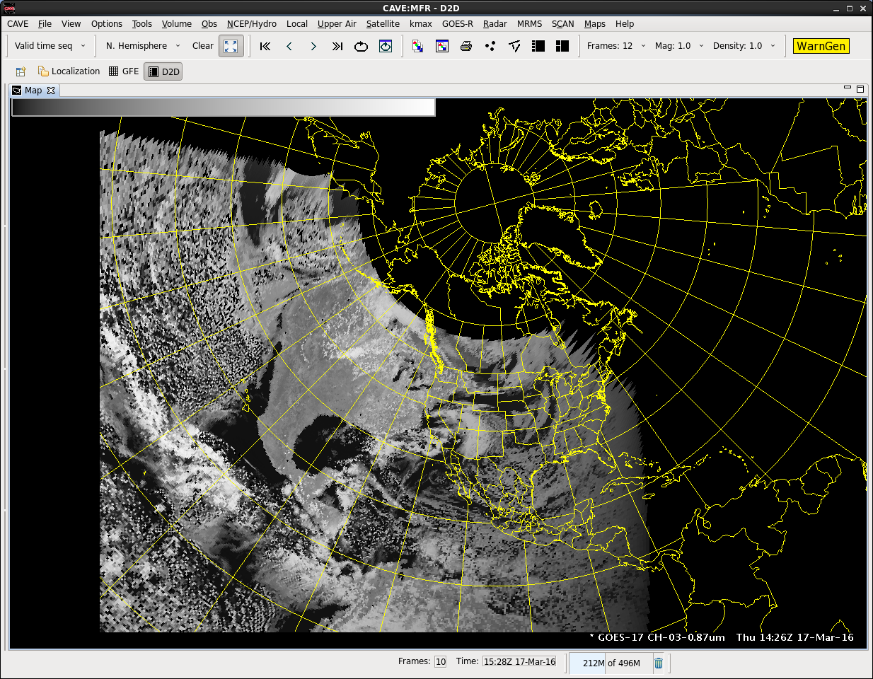
Synthetic Glitch
Notes:
The process was not without issues now and then…

Slide 28
Synthetic GOES-R at Medford Summary
Beneficial interactions with TOWR-S via routine conference calls which have lead to other avenues – overall GOES-R education
Fairly easy setup and upgrades
Raw data storage concerns depending on config for archiver retention
Additional looping configs may be necessary
Fun and educational to experience the “look and feel” of future GOES-R data
Fulfilling to contribute to the implementation - identifying issues and suggesting enhancements from a field perspective

