Slide 1
Pre-Launch Readiness: DOE/GRE Overview, Previous Activities, Plans for DOE-4, and L2 Algorithms
Wayne MacKenzie
GOES-R Product Area Lead and PRO Deputy
NESDIS/OSPO/SPSD
NOAA Satellite Proving Ground/User Readiness Meeting
Norman, OK
May 11, 2016
Notes:
Exciting preview of GOES-R-like capabilities. Shown here is the 1km, 1-minute Visible band imagery from GOES-14 when it was in the Super Rapid Scan Schedule. Another great example of how GOES-R will routinely (not just in Super Rapid Scan), be able to provide insight to how the weather IS developing, instead of how the weather WAS developing.
The GOES-R ABI will have sixteen spectral bands vice five (3 times more),
four times the spatial resolution, and
more than five times faster temporal coverage than the current system.
Mode 3 generates 3 times more files than Mode 4.
New Capabilities come with computational cost.
See Talks for GOES-R Data Volumes:
Schmit - ABI
Goodman - GLM
Denig - Space Wx
Metcalf - DCS
Seymour - GRB & HRIT/EMWIN
My Talk is going to focus on what Users should expect to see leading up to and during the Joint Operations of GOES-13/14/15 & GOES-R.

Slide 2
Outline
DOE/GRE Overview
Previous Activities to Date
Plans for DOE-4
Algorithm Change Process
Algorithm Trade Study
Level 2+ Status

Slide 3
DOE/GRE Activities

Slide 4
Data Operations Exercises (DOEs)
DOEs are mission rehearsals executed by the Data Operations team
DOEs provide incremental readiness to prepare systems, operators, processes, and teams to support mission operations
Conducted in a “rehearse like we fly” manner
Both nominal and anomalous conditions are exercised
Problems encountered are recorded and opened for investigation
Unscripted events are injected including failover scenarios
Some long duration DOEs are planned to satisfy consumers’ needs
Goal is to ultimately exercise the entire ground system by processing various data sets from end-to-end, from L0 through L2+, including PDA in DOE-3 and DOE-4
DOE-4 will include participation by the NWS TOWR-S (Total Operational Weather Readiness - Satellites) project which is incorporating distribution to elements of the AWIPS community
CBU: Consolidated Back-Up in Fairmont, WV
Notes:
Photo: CBU: Consolidated Back-Up in Fairmont, WV

Slide 5
Ground Readiness Exercises (GREs)
GREs are more flexible and less defined mission rehearsals executed by the Data Operations team
DOEs provide incremental readiness to prepare systems, operators, processes, and teams to support mission operations
Both nominal and anomalous conditions are exercised
Problems encountered are recorded and opened for investigation
Unscripted events are injected including failover scenarios
CBU: Consolidated Back-Up in Fairmont, WV
Notes:
Photo: CBU: Consolidated Back-Up in Fairmont, WV

Slide 6
DOE/GRE Activities
DOE/GREs use simulated ABI data as input data.
There are two types of simulated data used:
MVTDS – Mission Validation Test Dataset
MVTDS starts as Level 0 data in the ground system and processes through L2+
AAWDS – ABI AWG/UW Simulated Dataset
AAWDS starts as Level 1b in the ground system and processes through L2+
Output is sent out a terrestrial GRB link to NSOF to generate L2+ data
Output is also sent out via PDA to NWS via the Total Operational Weather Readiness Satellite Project (TOWR-S)
NWS sends data via the Satellite Broadcast Network (SBN) to select WFOs and NCEP Centers to ensure preparedness of their distribution systems.
Notes:
Photo: CBU: Consolidated Back-Up in Fairmont, WV

Slide 7
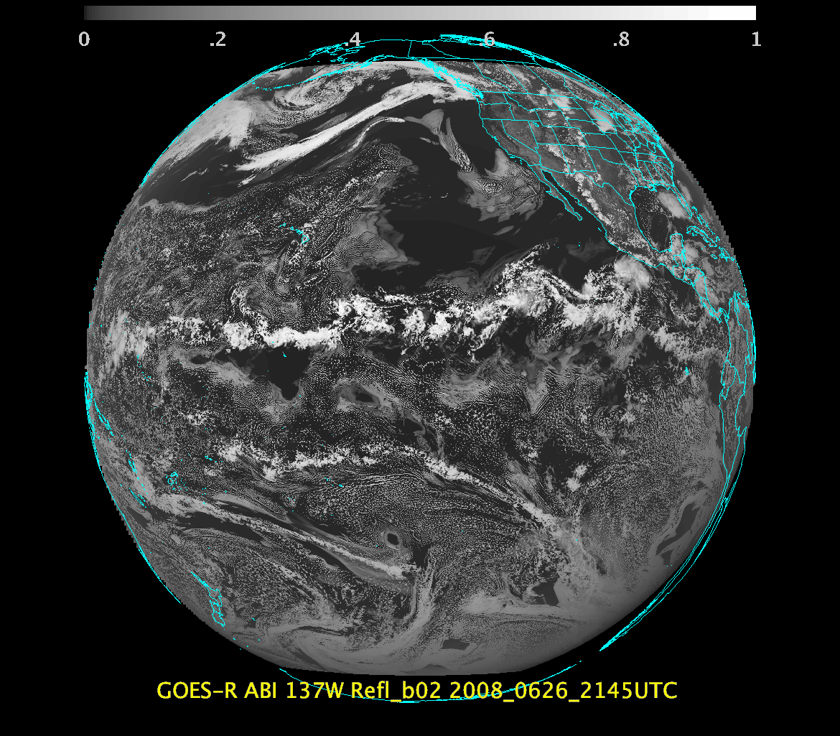
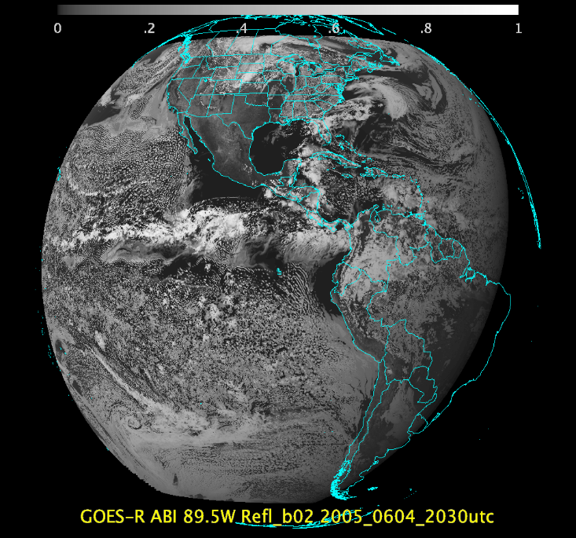
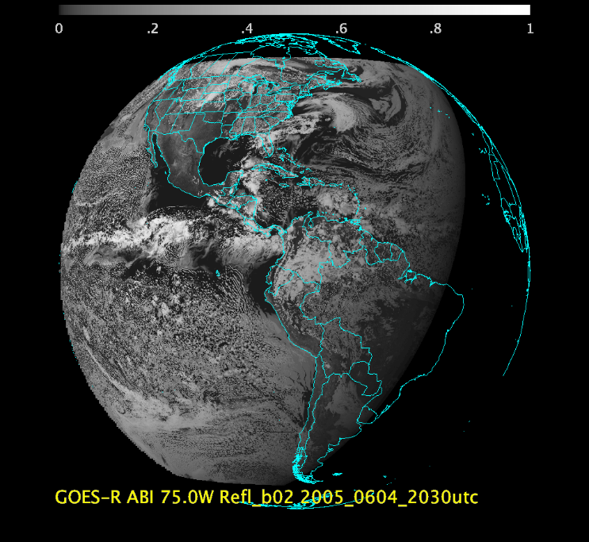
AWG Proxy Team ABI Image Triplet Test Datasets Delivered to the GOES-Program
ABI Image Triplet | 137W | 89.5W | 75W
Model | WRF | WRF | WRF
Number of times | 7 | 7 | 7
Time range | 20:00-20:30UTC | 20:00-20:30UTC | 20:00-20:30UTC
Day | 04-Jun-2005 | 04-Jun-2005 | 04-Jun-2005
Sectors | FD, CONUS, MESO | FD, CONUS, MESO | FD, CONUS, MESO
Types | GRB, VAL | GRB, VAL | GRB, VAL
Navigation | FGF | FGF | FGF

Slide 8
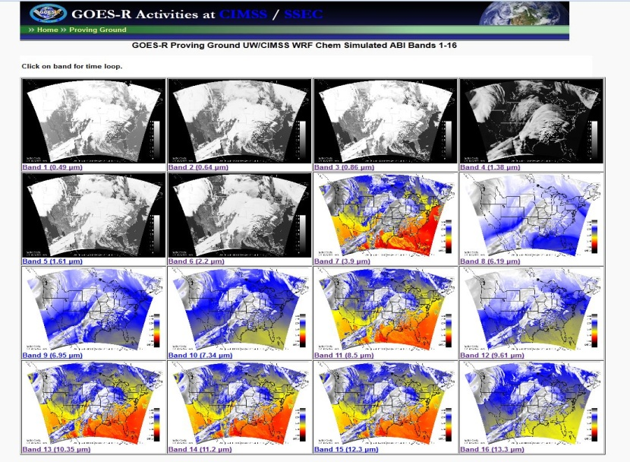
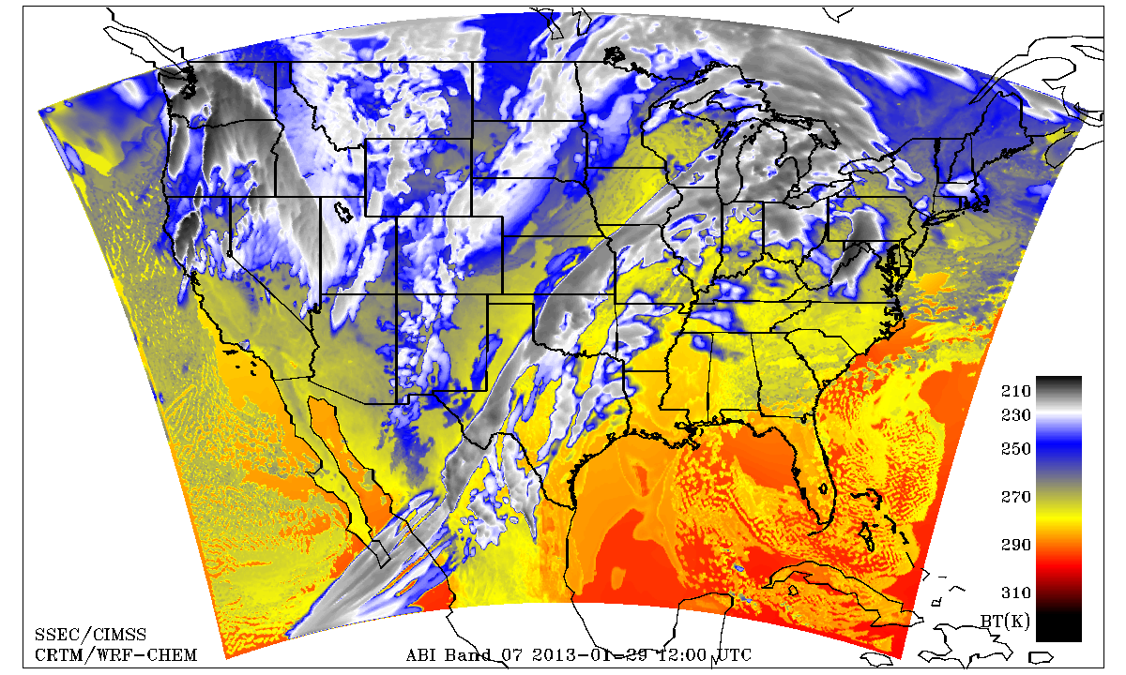
GOES-R ABI High Fidelity Simulated Datasets
Atmospherically realistic data generated via combination of high spatial resolution numerical model runs and advanced ‘forward’ radiative transfer models
All 16 bands, various coverages (FD, CONUS, Meso), spatial resolutions, and formats (GOES-R Fixed Grid Format, NetCDF)
Used by AWG product teams and in a number of GOES-R Proving Ground demonstrations
Used to support ABI waiver analyses
Planned use in GOES-R Ground System verification testing activities
AWG Proxy Team at CIMSS
Notes:
Successive Order of Interaction (SOI) forward radiative transfer model
These high fidelity simulated datasets are important for pre-launch algorithm development, testing, verification, and user readiness activities

Slide 9
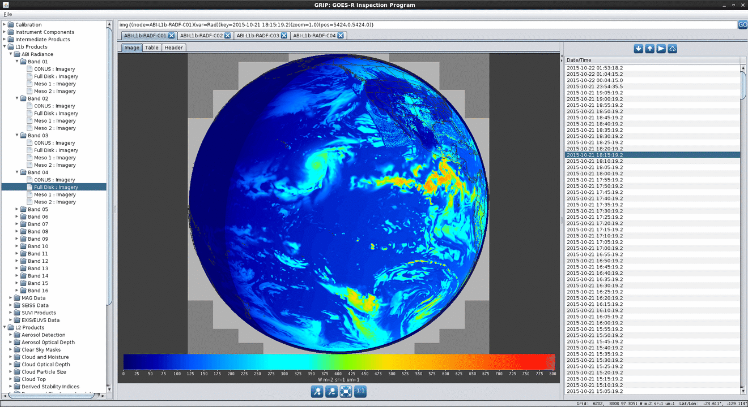
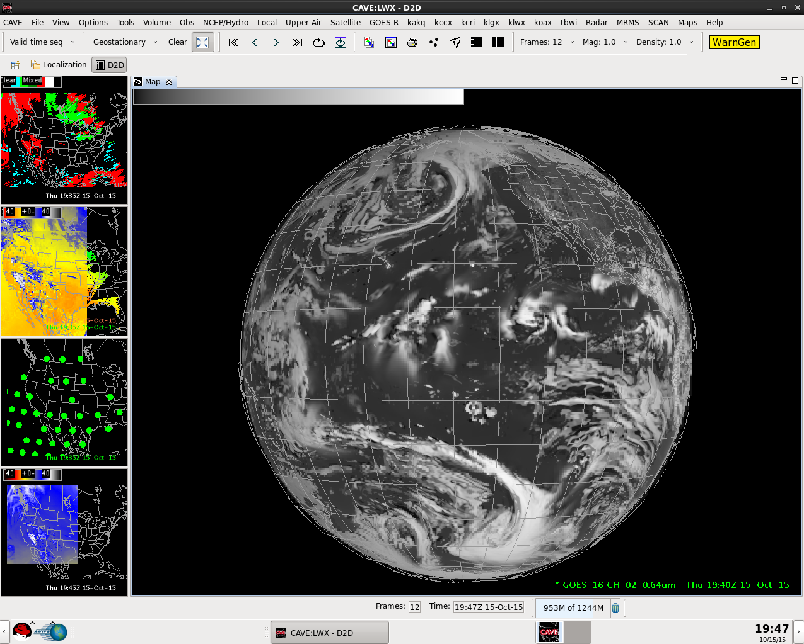
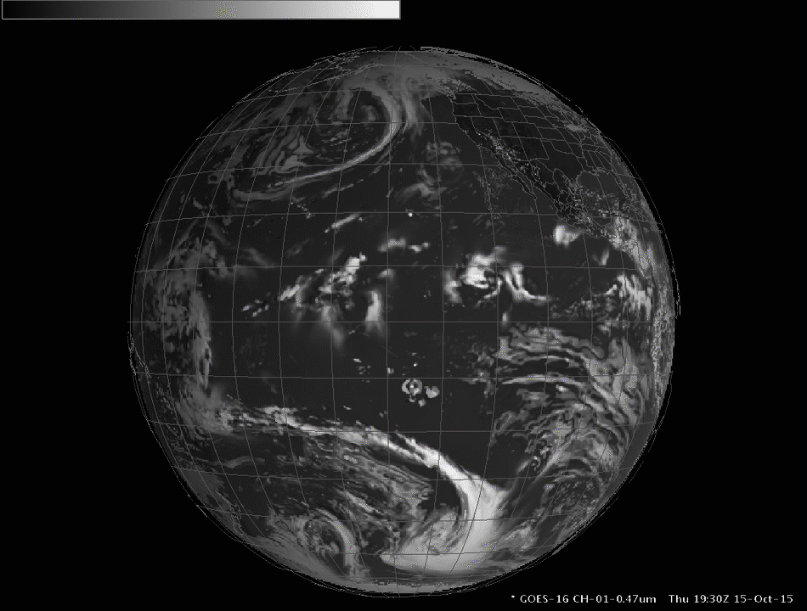
Simulated Cloud & Moisture Imagery (CMI) from the Ground Readiness Exercise GRE-DO1 (AAWDS)
GOES-R Inspection Program (GRIP)
NWS AWIPS 4-Panel Display
10/21/15
10/15/15
The GOES-R AWG Proxy Team at NESDIS/STAR’s Cooperative Institute for Meteorological Satellite Studies (CIMSS) creates 16 bands of real-time modeled data using WRF and GFS models, called AAWDS (ABI AWG/UW-Madison Data Set)
RaFTR software formats the data and interpolates to the GOES-R real-time cadence for sampling Earth then the data are injected to the GOES-R GS data fabric.
Finally, PD sends the NetCDF files to NWS which broadcasts the file over the SBN to AWIPS-II terminals at select WFOs
Forecasters then look at these simulated “GOES-R products” and can see the spatial/spectral/temporal benefits and make side-by-side comparisons against other tools
Notes:
Hurricane Patricia is along coast of Mexico (central pressure of 880mb is lowest of any storm in the Eastern Pacific or Atlantic in 30).
Hurricane Olaf is in center of Pacific.
Periodic uploads via manual data transfer each morning.

Slide 10
PREVIOUS Activities

Slide 11
DOE Activities
AWG and CWG participating in Ground Segment’s DOEs
DOE-0: NOV 2014
Input Data: Triplet Dataset (KPPs generated only for L2)
DOE-1-2: 15-30 JUN 2015
Algorithm change
Manually transfer data off of OE to DE (NSOF PPZ DE)
Input Data: Triplet Dataset (ABI and non-ABI Instruments)
DOE-3: AUG 2015
Analyze Space Wx Prototypes and Final Product Set updates (WCDAS DE)
Input Data: Triplet Dataset (ABI and non-ABI Instruments)

Slide 12
GRE Activities
GRE’s are less formal data flows.
AWG and CWG participating in Ground Segment’s GREs
Issues have been identified during GRE activities and allowed us to fix these issues pre-launch
We have flowed spacecraft data into the ground system as of May 9!

Slide 13
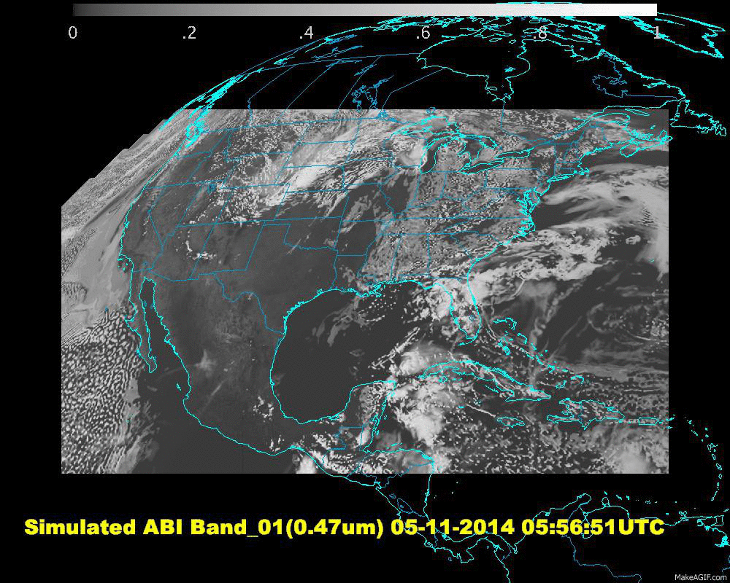
DOE/GRE Schedule
MVTDS (Mission Validation Test Dataset) contains the ABI Triplet Dataset from 04 June 2015.
AAWDS (ABI AWG/UW Data Set) is simulated L1b data from WRF in near real-time.
Test Event | Date | Input Dataset
DOE-0* | Nov 2014 | MVTDS
DOE-1&2 | Jun 2015 | MVTDS
DOE-3 | Aug 2015 | MVTDS
GRE DO 1 | October 2015 | AAWDS
GRE DO 2.1 | Jan 2016 | MVTDS (Errors)
GRE DO 2.2 | Jan/Feb 2016 | AAWDS
GRE DO 2.3 | Feb 2016 | AAWDS
GRE 3.1 - MVT | May 2016 | MVTDS/AAWDS
DOE-4 | July 2016 | AAWDS
Simulated Cloud & Moisture Imagery (CMI) from the First GOES-R Data Operations Exercise
* Only L2+ algorithm produced was Imagery during DOE-0

Slide 14
Plans for DOE-4

Slide 15
DOE-4 Information
DOE-4 Highlights
July 18th – August 26th
AAWDS for ABI
MVTDS for non-ABI
2 weeks each position West, Center and East position
Algorithm change (preparation for PLT)
Implementation and back-out
DOE-4 will include participation by the NWS TOWR-S (Total Operational Weather Readiness - Satellites)

Slide 16
DOE-4 Information
DOE-4 will occur after the DO.04 build
Issues identified during DOE-4, we will incorporate in a build post-launch
Algorithm fixes can be incorporated quickly after launch so that testing isn’t delayed
Eric Guillot will talk about NWS/TOWR-S involvement in DOE-4

Slide 17
Algorithm Change Process

Slide 18
Types of Changes
Non-Science Changes – Changes that do not affect the science algorithms. These go straight to the WR/DCRB process.
Look-up Tables (LUTs) – an array that replaces runtime computation with a simpler array indexing operation. This is used to save processing time when the values are known within sufficient precision.
Simple Code Changes – Any code change that does not affect to I/O, is under 200 lines of code, and is PG only.
Complex Code Changes – Any code change that does not meet the simple criteria.

Slide 19
System Testing
After code is installed on the DE, we will flow live data through the algorithms
All algorithm changes will flow data on the system before being promoted to operations
Length of time depends on the complexity of the changes
For simple code changes or LUT updates, we will follow a 3 week patch schedule.

Slide 20
2 Week Patch Overview
CM Merge/DE Prep
Test on Live Data
Stop Test/Send Data
Test Data Review/ Write WR
ARB Review/OCCR Review/Deployment
1.5 Days
2.5 Days
1 Days
3 Days
7 Days

Slide 21
Algorithm Implementation Improvement Study

Slide 22
Algorithm Maintenance & Sustainment Improvements Study
System written in C++ including science algorithms
Study will investigate simplifying the process to implement new algorithms
Centralizing configuration files
Simplifying data fabric interface
Improving metadata generation configuration
Investigate wrapping Fortran science algorithms using two algorithms
Cloud Mask
Parallax Correction
Study Completion September 2016

Slide 23
Level 2 Status

Slide 24
L2+ Algorithm Status
Algorithm | Status
ADP | Matches AWG Test Data Results
AOD | Matches AWG Test Data Results
CMI | Matches AWG Test Data Results
Vol Ash | Matches AWG Test Data Results
Clear Sky Mask | Matches AWG Test Data Results
CTP/CTT/CTH | Matches AWG Test Data Results
Soundings | Matches AWG Test Data Results
Cloud Phase | Matches AWG Test Data Results
DSR/RSR | Matches AWG Test Data Results
Snow Cover | - Deferred. Degraded performance due to lack of Albedo product. Albedo was removed from Baseline in 2012, but is being developed by AWG. To accomplish delivery in 2016 Q4 & implementation in 2017 Q4. - User impact is to NIC which uses for comparisons in development of IMS. Four downstream products depend on Snow Cover, but all 4 have switched to IMS polar product (2km resolution matches GOES-R).
DMW | Remaining issues are being worked. Held a TIM with AWG/Harris/AER on 4/28. Several issues were identified and will be examined. Should be resolved and deployed in early PLT.
LST | Matches AWG Test Data Results
Fire | Matches AWG Test Data Results
Rain Rate | Matches AWG Test Data Results – However, operational implementation is missing parallax correction which will impact operational implementation cal/val activities. Mitigation – implement parallax correction as one of the wrapped algorithm trade studies ASAP, which is likely after PLT.
Hurricane Intensity | Matches AWG Test Data Results
SST | Matches AWG Test Data Results
Notes:
Matching re-producability requirements, is criteria for turning rows green.
Snow cover runs but is degraded, needs albedo so we’re adding it to the baseline. Any other alg that needs snow cover is using the IMS snow mask, so there are no algorithm implications.
Final WR for winds in work, fix in DO.04.

Slide 25
New Algorithm Development
5 Pathfinder Algorithms
Cloud Cover Layers
Aerosol Particle Size
Sea & Lake Ice Cover/Concentration
Sea & Lake Ice Age/Thickness
Sea & Lake Ice Motion
Albedo Algorithm
Needed for Fractional Snow Cover Algorithm
Low Cloud/Fog
Science Development Complete 8/2017
Operational 12/2017

