Slide 1
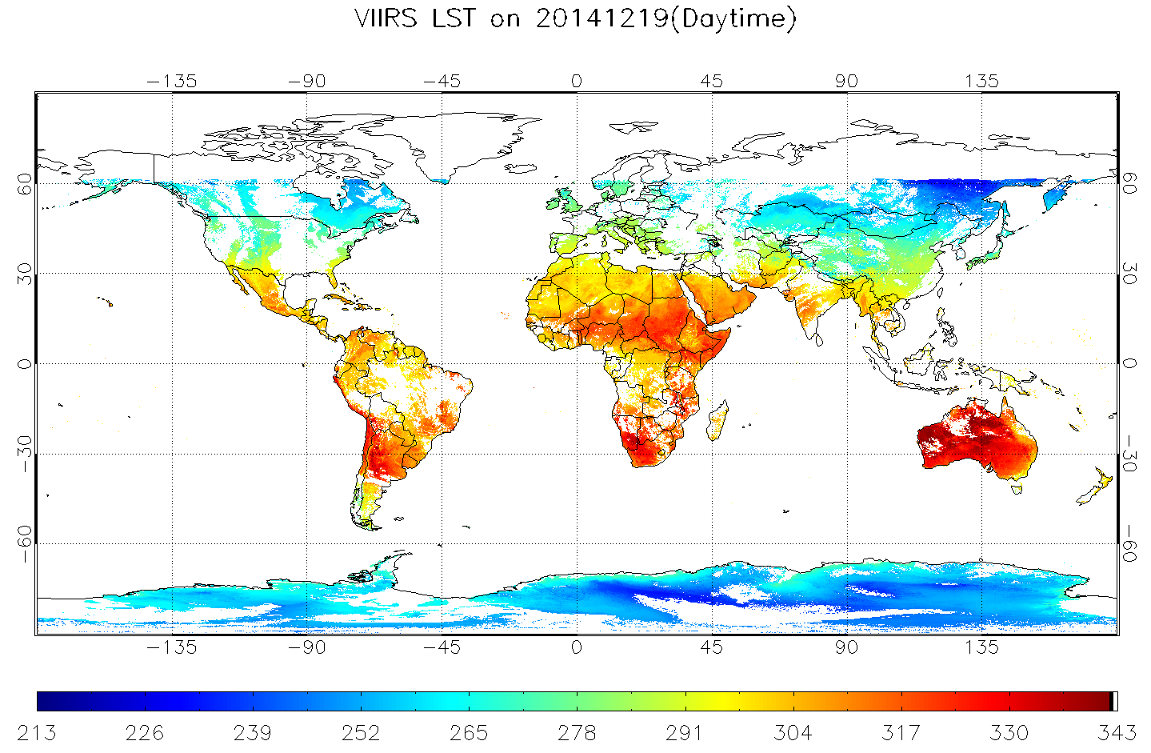
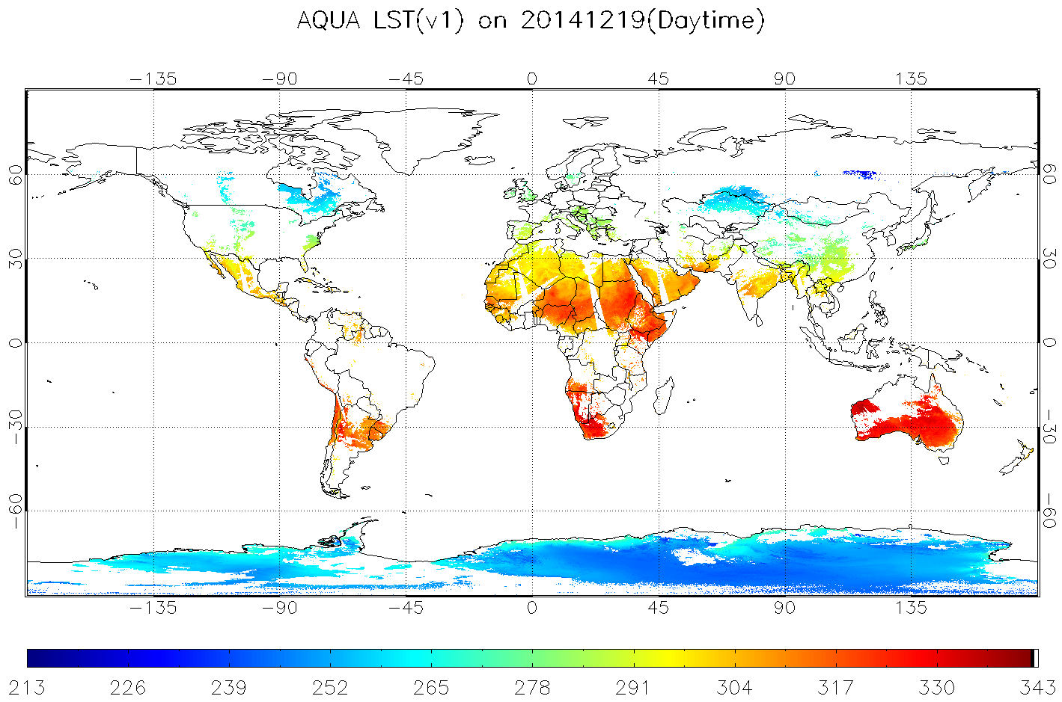
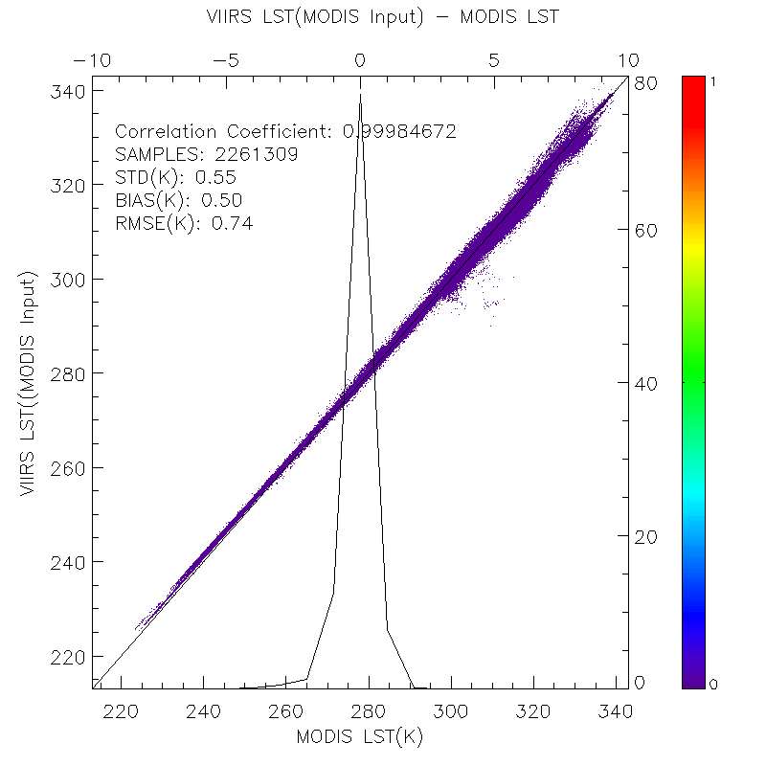
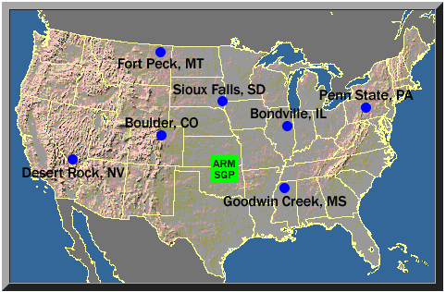
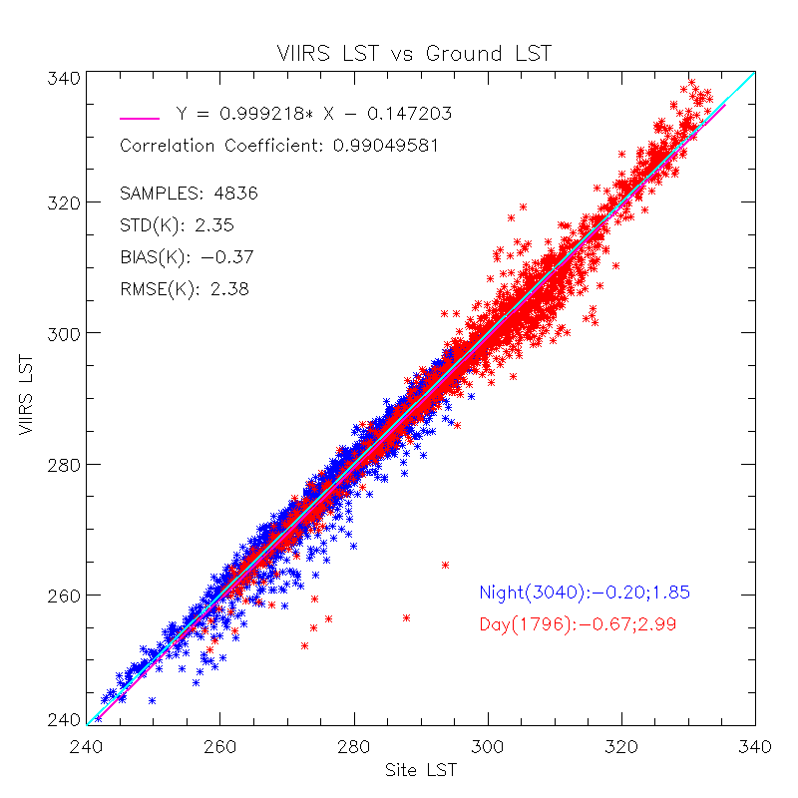
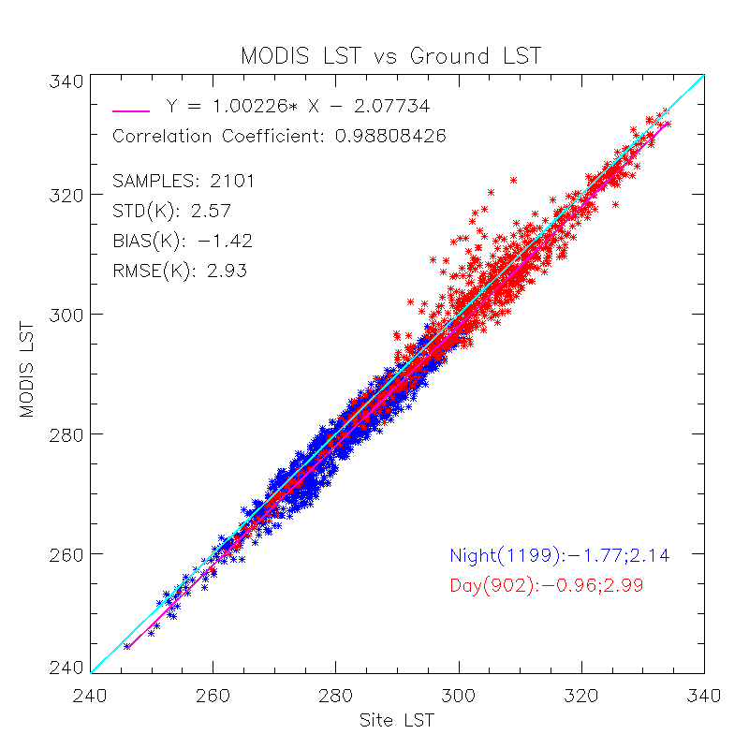
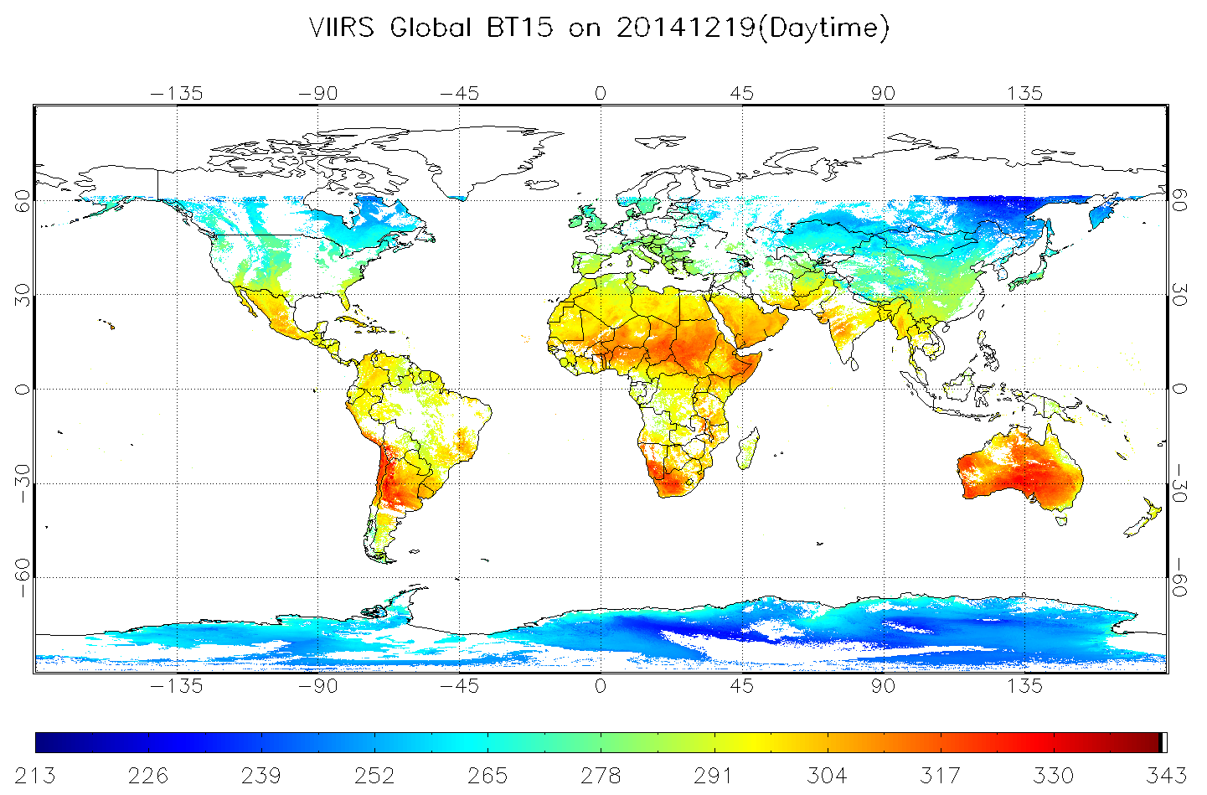
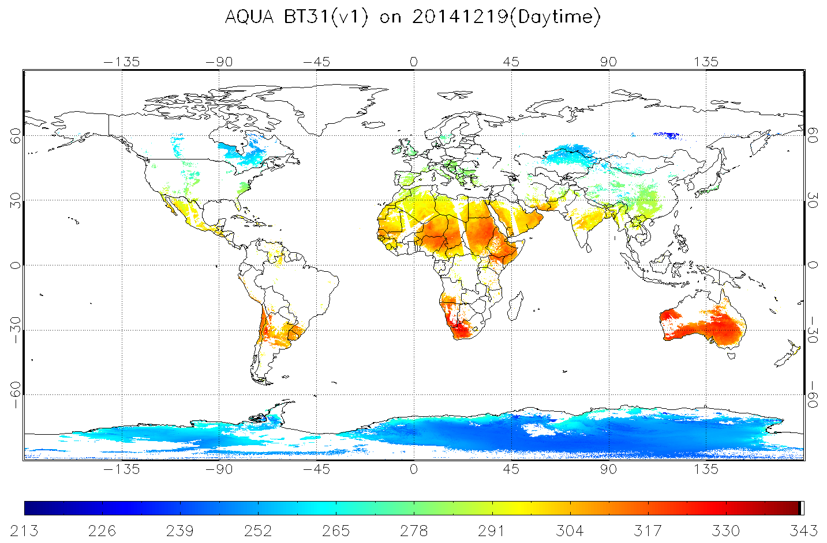
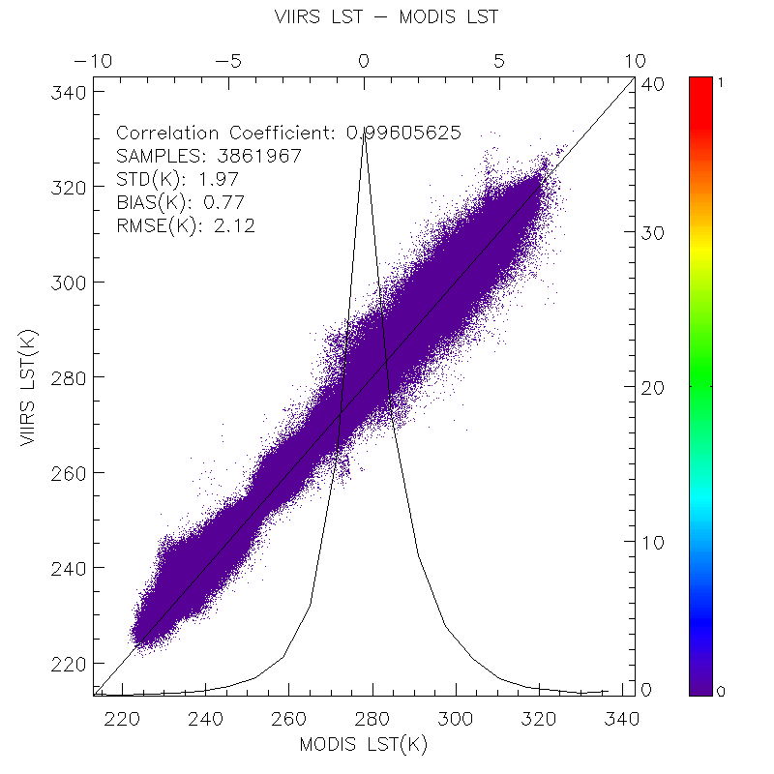
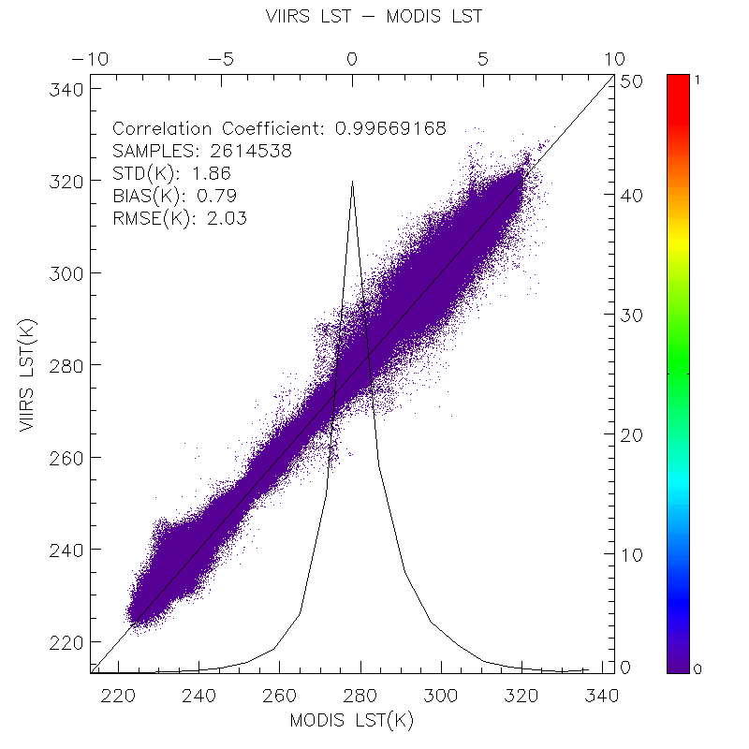
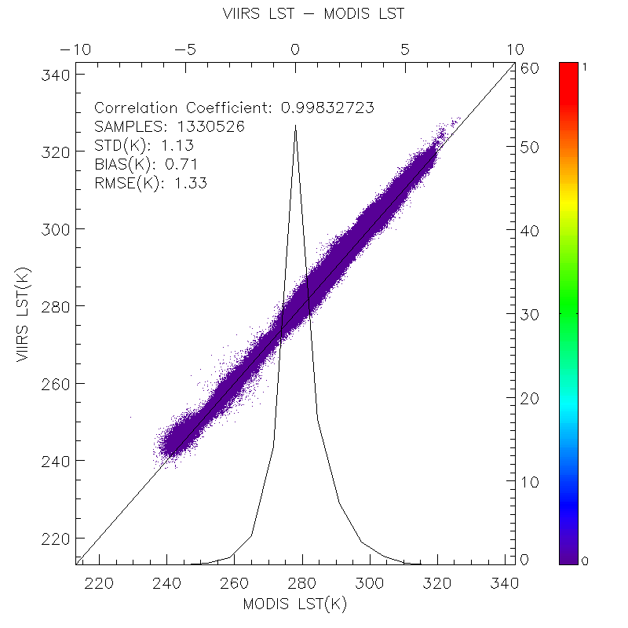
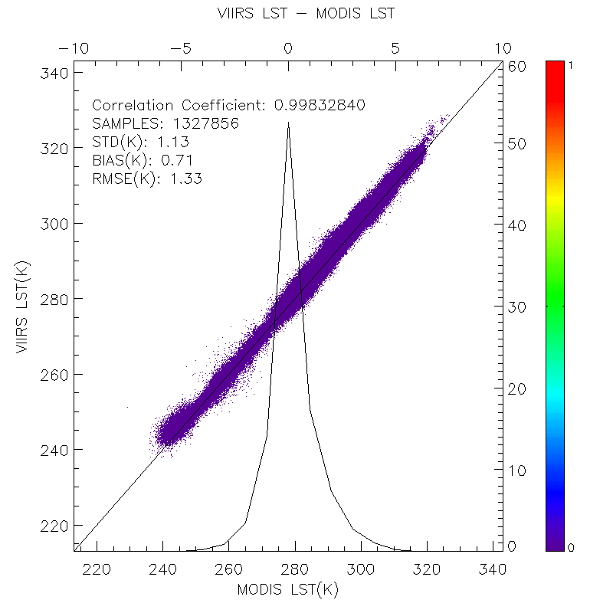
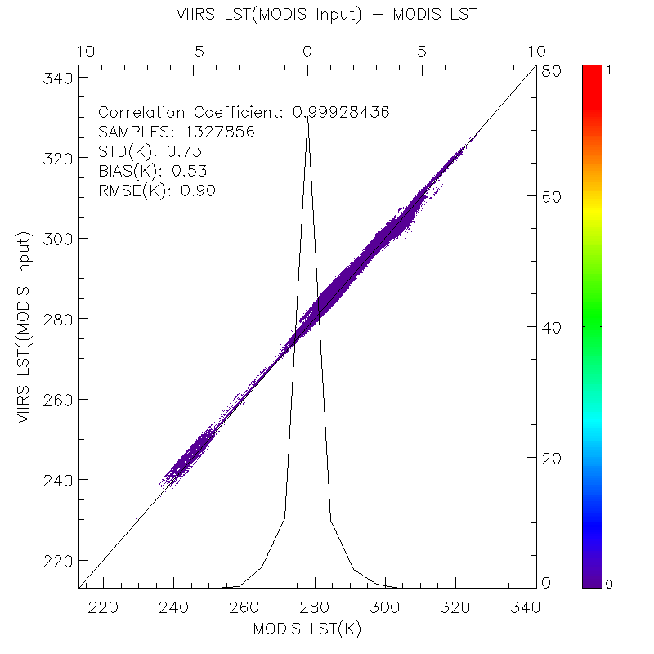
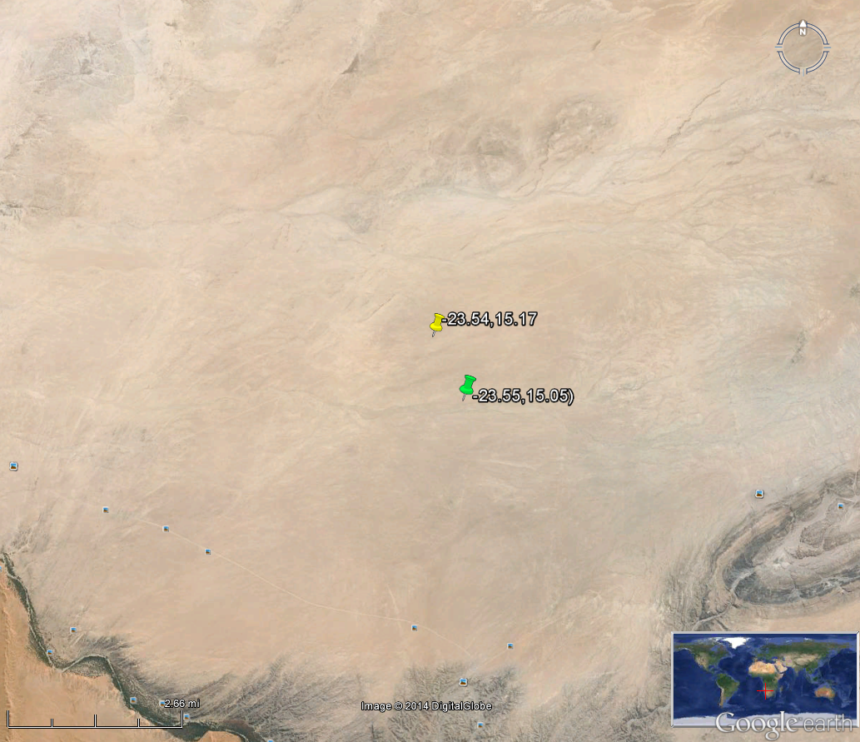
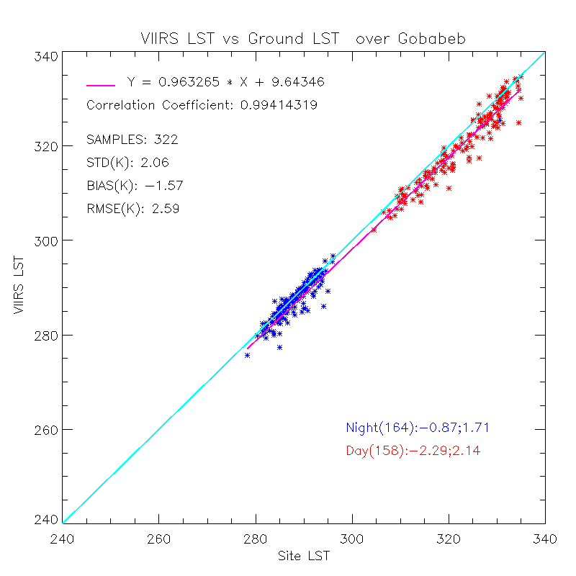
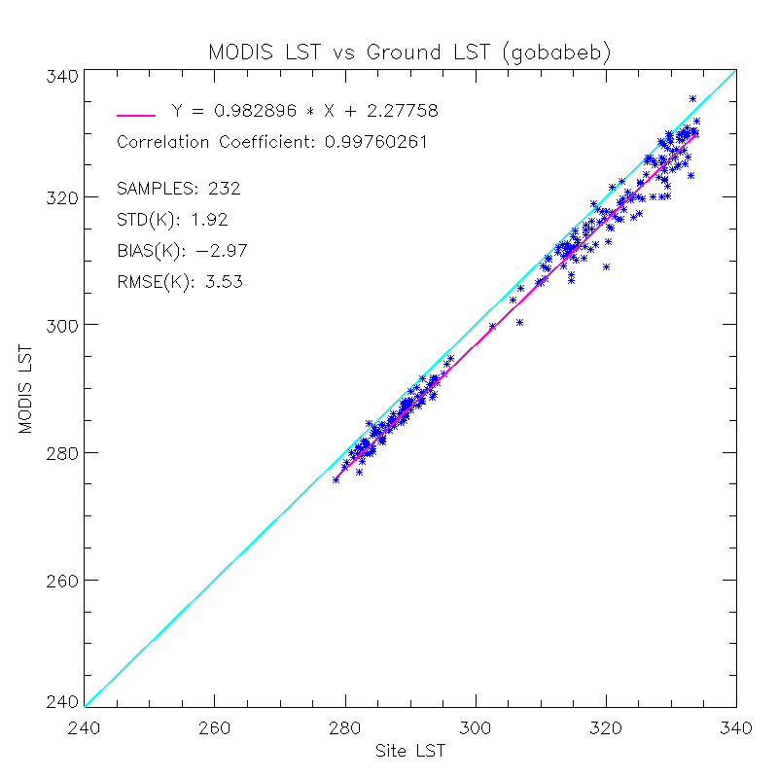
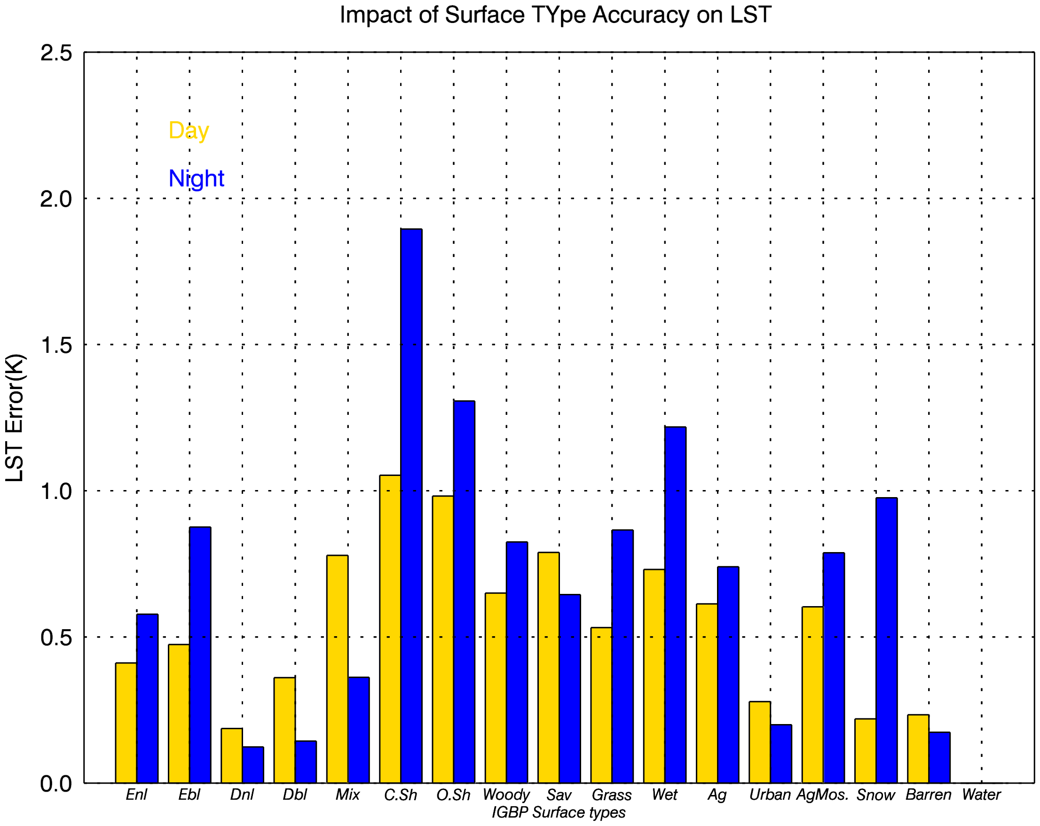
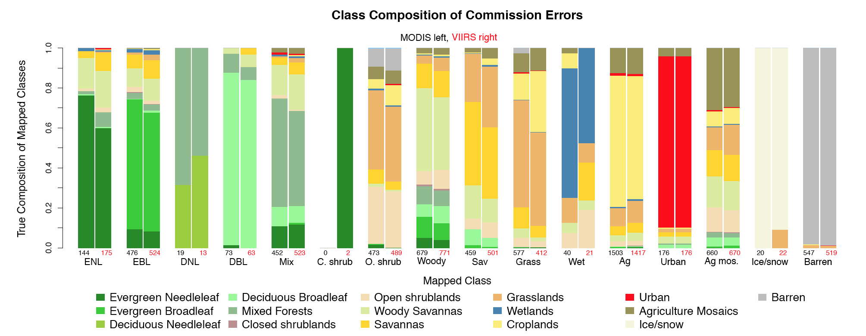
Quality Assessment of Suomi NPP VIIRS Land Surface Temperature Product
Yuling Liu¹², Yunyue Yu² , Peng Yu¹² , Zhuo Wang¹²
¹CICS, University of Maryland, College Park; ² STAR/NESDIS/NOAA
Introduction
Land Surface Temperature (LST) is one of Environmental Data Records (EDRs) provided by the Visible Infrared Imaging Radiometer Suite (VIIRS) onboard the Suomi NPP (S-NPP) satellite, with a spatial resolution of 750m at nadir. It is derived from a split-window regression algorithm in which the algorithm coefficients are surface type dependent as referred to 17 International Geosphere-Biosphere Programme (IGBP) types. The VIIRS LST EDR has gone through a maturity evolving process, completed validated V1 stage maturity review in December 2014. This presentation shows some validation results of the review including comparisons of the most recent VIIRS LST product with the ground in-situ observations and with heritage LST product from Moderate Resolution Imaging Spectroradiometer (MODIS) Aqua collection 5. Comparisons against the SURFRAD station (e.g. in-situ) observations indicate an overall accuracy of -0.37K and precision of 2.35 K, with a better accuracy achieved at nighttime compared to that at daytime. The result from the field measurements in Gobabeb, Namibia suggests that both VIIRS and MODIS underestimate the LST by 1.6K and 3K, respectively. Some issues can be summarized: (1) cloud contamination, particularly the cloud detection error over snow/ice surface, shows significant impact on LST validation quality; (2) performance of the VIIRS LST is strongly dependent on a correct classification of the surface type, e.g. the given surface type commission error causes 0.7K LST error using MODTRAN simulation data and 1.2K LST error using the real data; (3) the VIIRS LST can be degraded when very high brightness temperature difference between the split windows is observed; (4) surface type dependent algorithm exhibits inappropriate in overcoming the large emissivity variations within a surface type.
VIIRS LST Algorithm
Cross Satellite Comparison
Establish the 2-band 10.76µm(M15) and 12.01µm(M16) split window algorithm for both day and night based on regression equation for each of the 17 IGBP surface types.
Global Scale
Where (with k=0 to 4) are coefficients depending on surface type (with i =0 to 16 for 17 IGBP surface types) and day/night condition (with j=0 to 1), and θ is satellite viewing zenith angle.
a
b
e
Temperature based Validation
Daily LST and BT maps are generated for cross-satellite comparison.
VIIRS LST daytime;
AQUA LST daytime;
VIIRS BT11 daytime;
MODIS BT11
LST is calculated with MODIS sensor data and VIIRS algorithm.
c
d
SURFRAD data in US
Granule Scale
Corresponding matchups for VIIRS and MODIS Aqua:
Time span: Feb. 2012 – Aug. 2014 (VIIRS) Jan. 2012 – Jul. 2013(MODIS)
Suggested for matchup
a
b
c
d
e
Sensor Location
Comparison results from Simultaneous Nadir Overpass (SNO) between VIIRS and AQUA in 2012, 2013 and early 2014 over US, polar and low latitude areas. The matchups are quality controlled using the quality flags in each product.
a) all comparison results under cloud clear condition ; b) based on a, and the satellite zenith angle difference between VIIRS and MODIS is constrained within 10 degrees; c) based on a, and spatial variation tests are added ; d) based on c, and angle difference is added ; e) based on d, and VIIRS LST is calculated using MODIS data as input and then compare to MODIS LST.
Ground data in Gobabeb, Namibia
Corresponding matchups for VIIRS and MODIS Aqua:
Time span: Jan. 2012 – Dec. 2012
VIIRS LST Uncertainty Estimation
Surface Type Commission Error
And
Sensor Noise
Impact on LST using simulation data
is the probability of mis-classfication of surface type i (i=1,2…17) to be j (j=1,2…17)
is the LST difference between LST calculated with the equation for surface type i and with the equation for surface type j for each pixel with i surface type
represents the error for each IGBP type i under either day or night condition
represents the error for all IGBP types and all day/night conditions
represents the number of samples for surface type IGBP i
represents the total number of samples for all cases
Where
represents the error caused by sensor noise from both BT11 and BT12 for each IGBP type I under either day or night condition i (i=1,2…17) j(0:night,1:day)
represents the error caused by sensor noise from BT11
represents the error caused by sensor noise from BT12
represents noise requirements for emissive band at 11micron and 12micron, onboard the VIIRS, respectively
represents the overall error caused by sensor noise
represents the number of samples for surface type IGBP i
represents the total number of samples for all cases
and
Overall Uncertainty
Overall Statistics | Uncertainty by Surface Type Accuracy | Uncertainty by Sensor Noise | Algorithm Uncertainty | Overall LST product Uncertainty**
All | 0.73 | 0.198 | 0.46 | 0.88
All-Day | 0.61 | 0.197 | 0.42 | 0.77
All-Night | 0.83 | 0.199 | 0.51 | 0.99
Overall Statistics | Impact on LST
All | 0.73
represents the overall LST uncertainty
represents the uncertainty caused by surface type
represents the uncertainty caused by sensor noise
is the algorithm uncertainty, estimated in the coefficients regression procedure bases only on the simulation data.
Summary
Comparisons against SURFRAD observations indicate an overall accuracy of -0.37K and precision of 2.35K with a better accuracy at nighttime. The result over one field measurement dataset in Africa suggests that both VIIRS and MODIS underestimate the LST by 1.6K and 3K, respectively.
Cross comparison results at global scale and granule scale indicate an overall good agreement between VIIRS LST and MODIS LST. The discrepancy of the two satellite LSTs is much smaller when VIIRS LST is calculated using the MODIS sensor data as proxy. This suggests the algorithm difference is not the main cause for the large LST difference. However, there is a positive bias mostly less than 0.5K between VIIRS and MODIS LST.
Cloud contamination, particularly the cloud detection error over snow/ice surface, show significant impacts on LST validation quality therefore additional cloud filter is strongly recommended for LST validation and applications.
VIIRS LST quality is strongly dependent on a correct classification of the surface type. The given surface type commission error causes 0.7K LST error using MODTRAN simulation data and 1.2K LST error using the real data. The difference between the results from the theoretical analysis and real data analysis is likely caused by the emissivity characterization of surface types. The emissivity variability within a surface type could cause a large error over different regions.
The sensor noise, surface type accuracy as well as algorithm uncertainty causes an overall LST uncertainty of 0.9K.
VIIRS LST EDR is in validated V1 maturity, ready for scientific use of the data.
Overall Statistics | Impact on LST
All-Day | 1.5K
All-Night | 0.8K
All | 1.2K
Impact on LST using real orbit data on Oct. 22, 2014, daytime (top) and nighttime(bottom)
*Reference: Damien Sulla-Menashe, VIIRS ST V1 Quality Assessment April 02, 2014 EDR meeting

