Slide 1
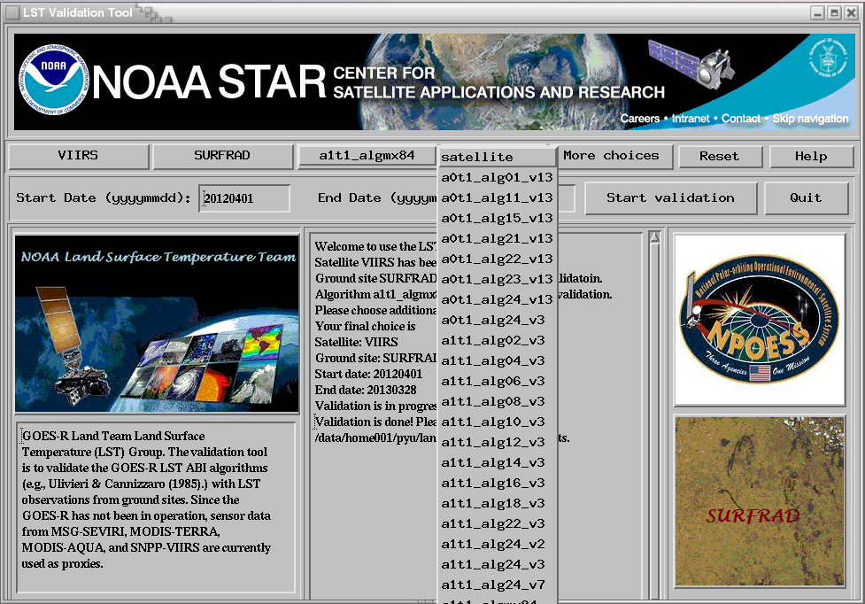
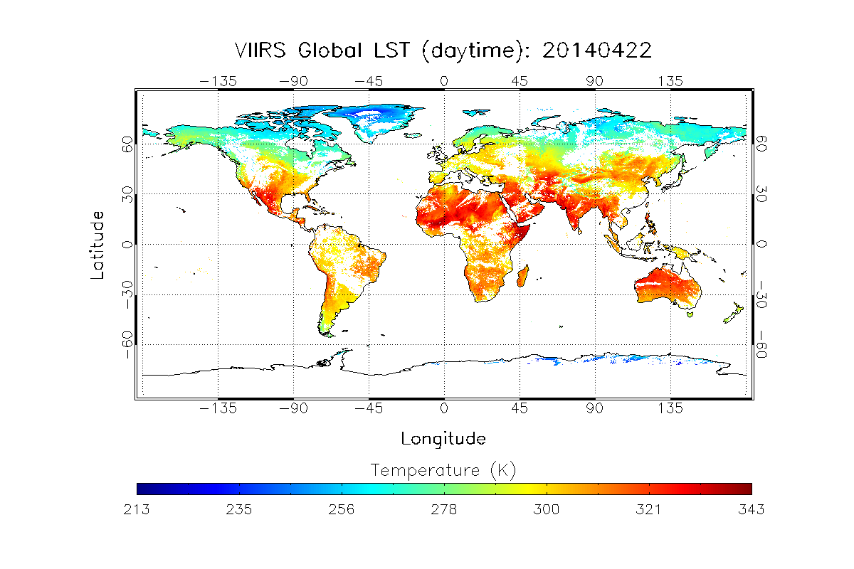
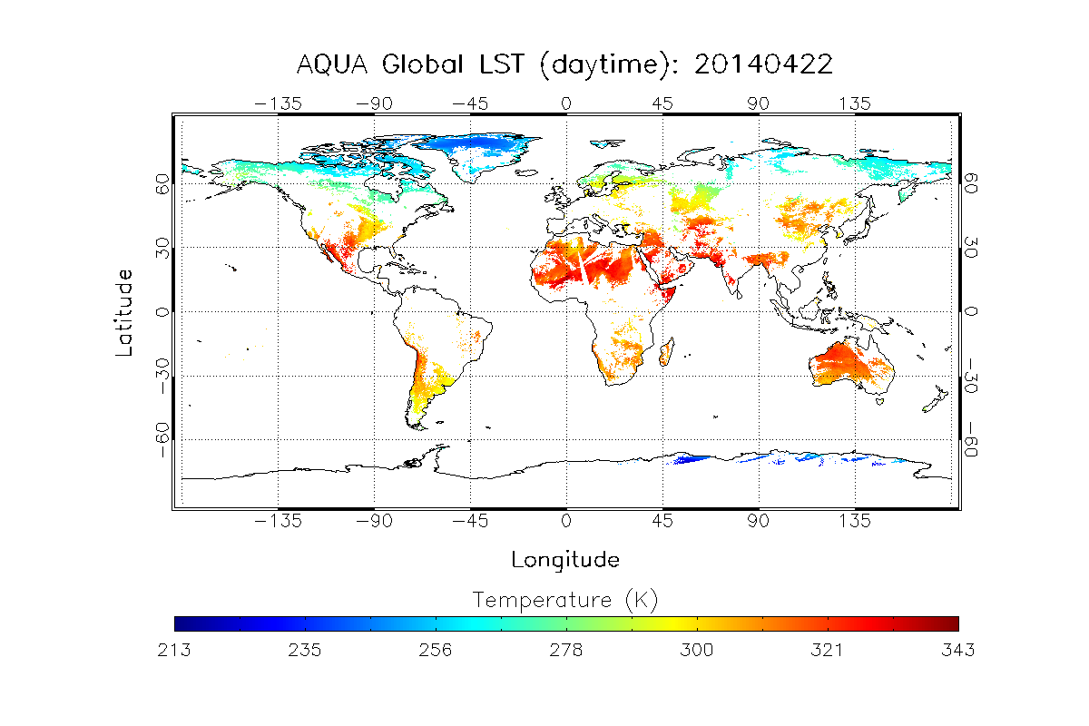
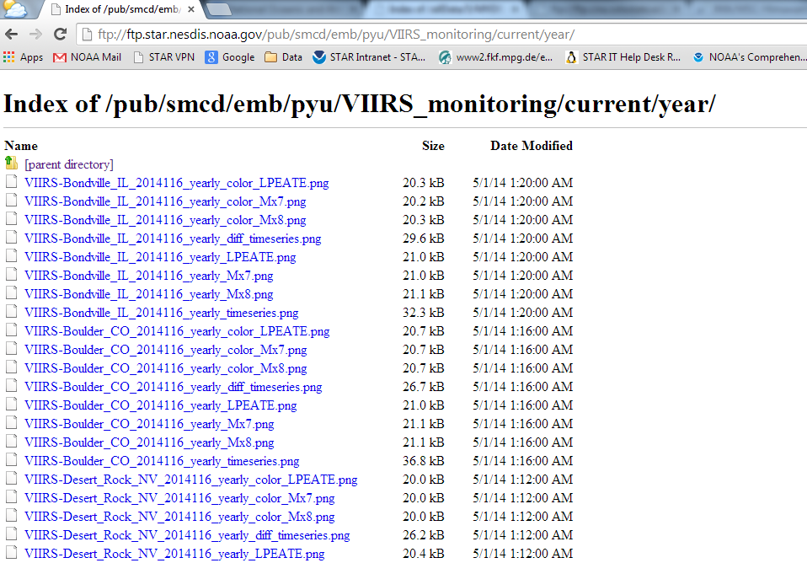
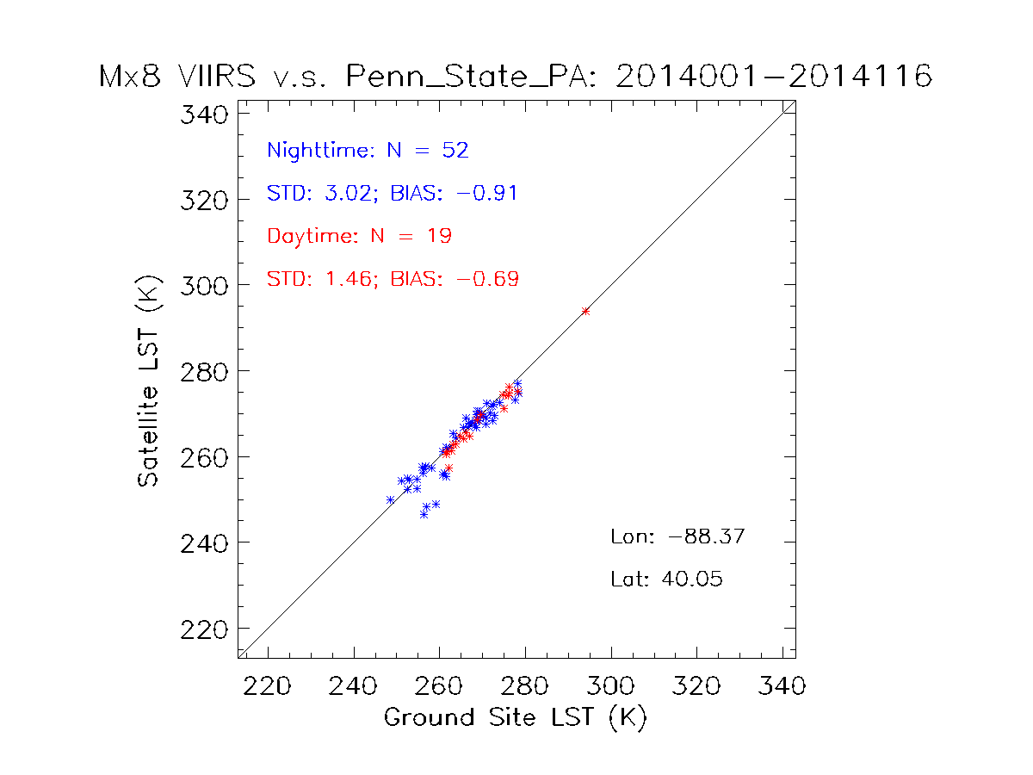
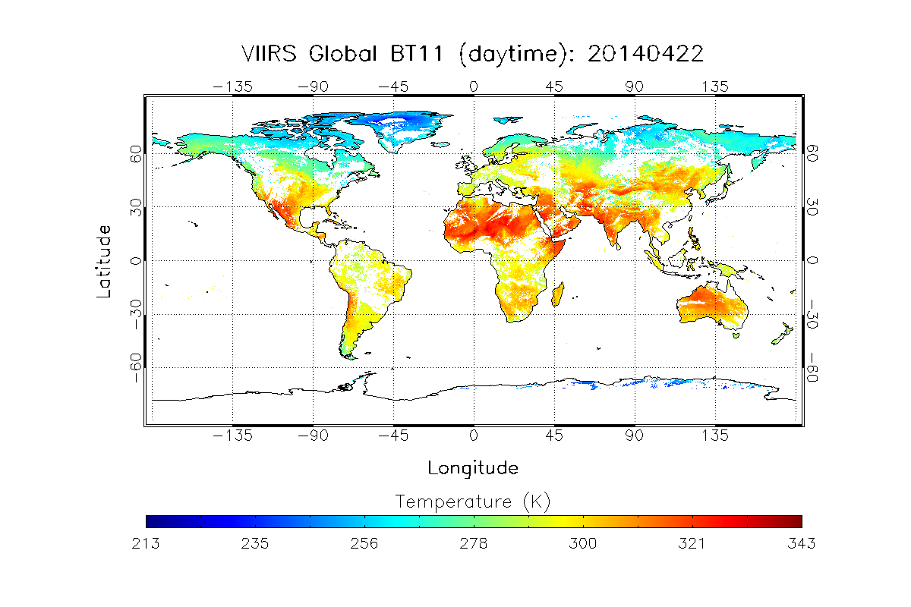
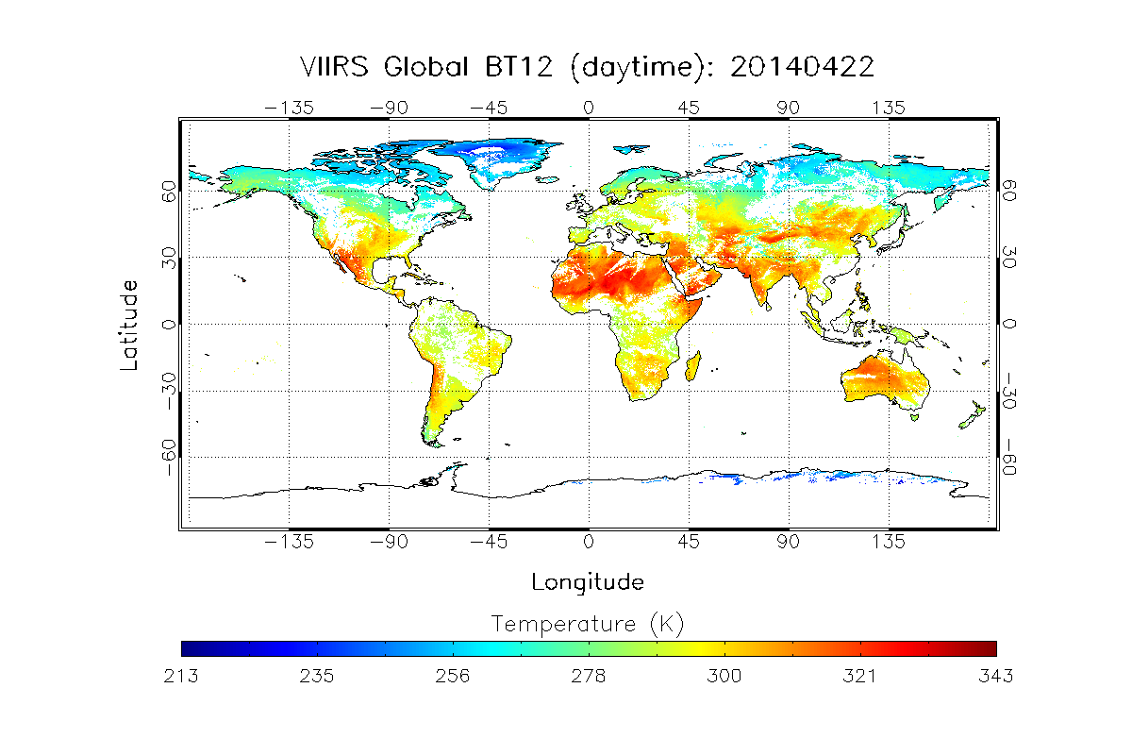
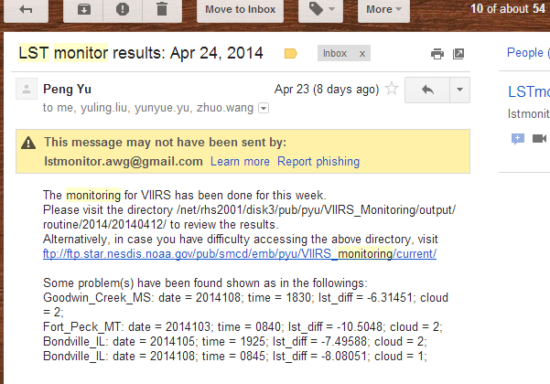
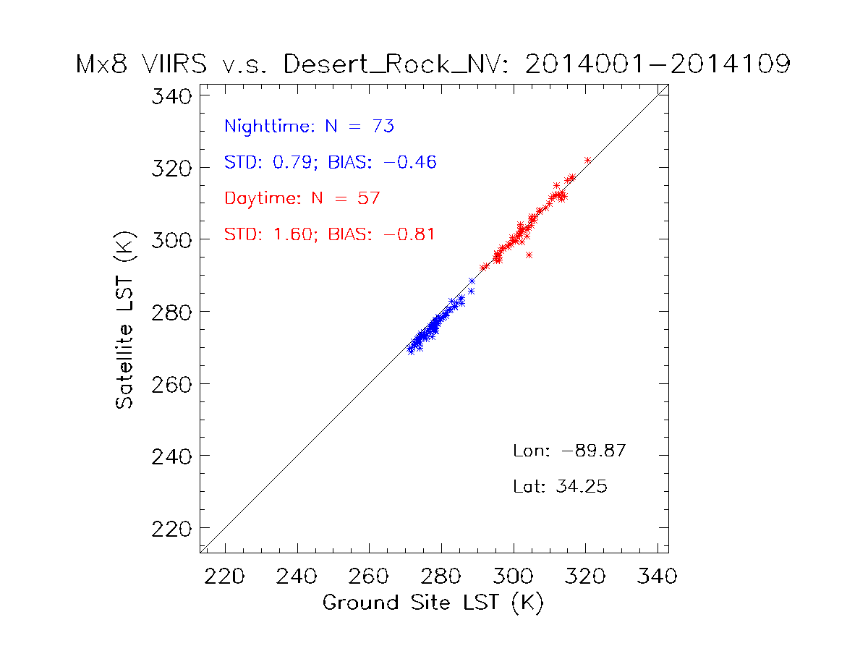
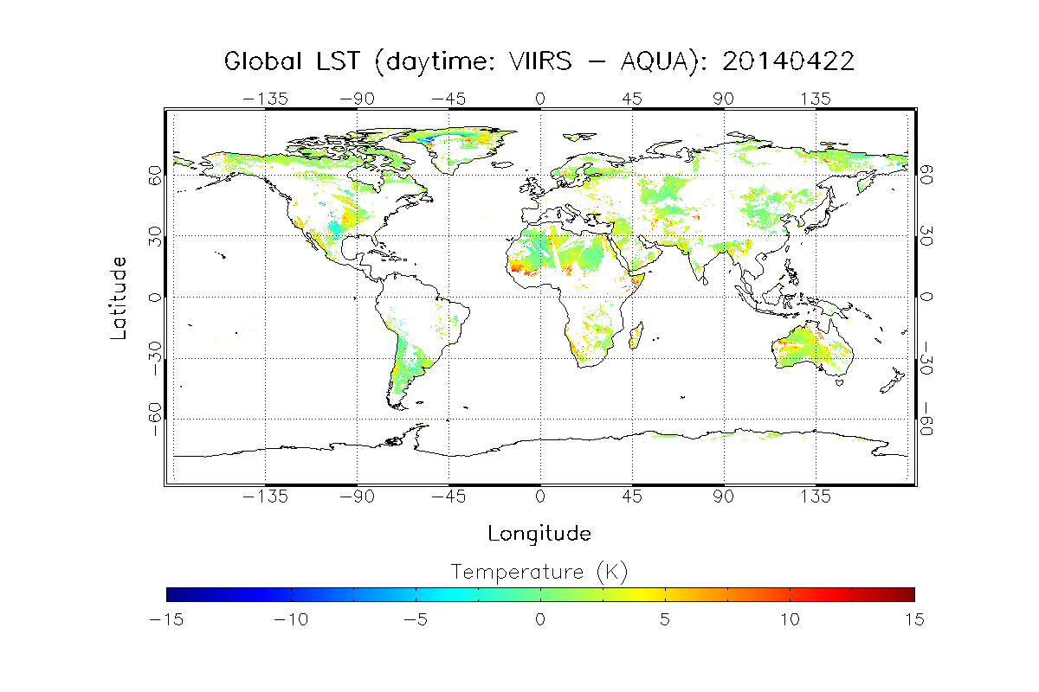
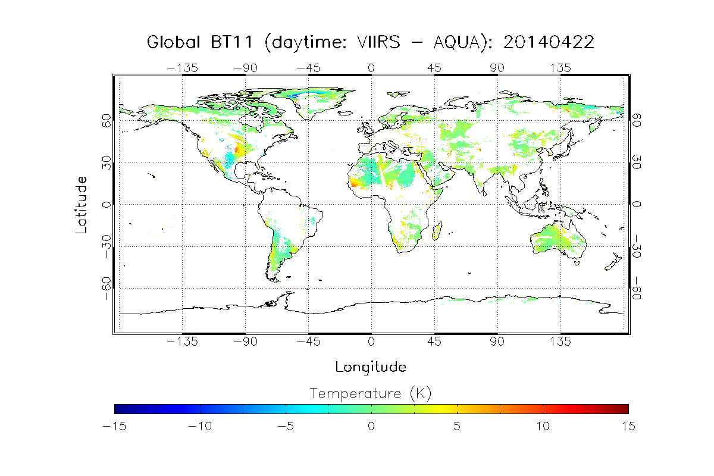
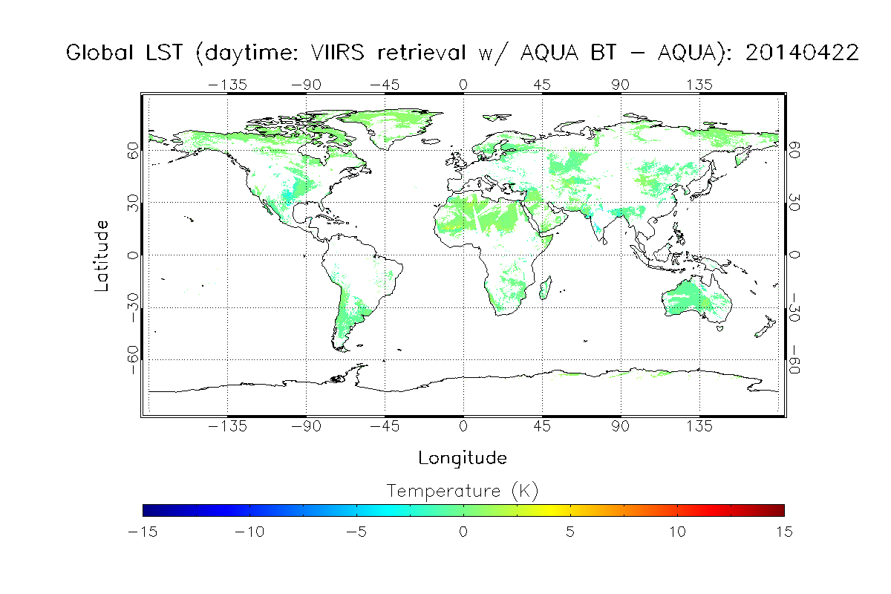
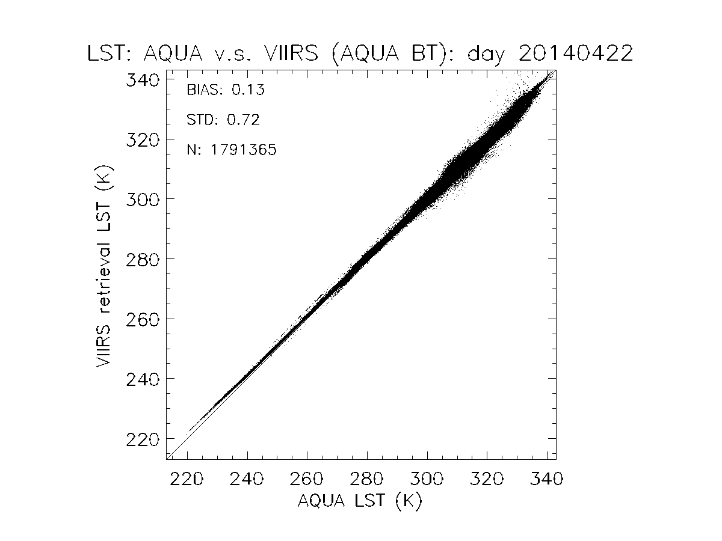
A system for satellite LST product monitoring and retrieval algorithm evaluation Peng Yu¹², Yunyue Yu², Zhuo Wang¹², and Yuling Liu¹² ¹ESSIC/CICS, UMD, College Park, MD ²STAR/NESDIS, NOAA, College Park, MD
Introduction
Land surface temperature (LST) is of fundamental importance to many aspects of the geosciences, e.g., the net radiation budget at the Earth surface and to monitoring the state of crops and vegetation, as well as an important indicator of both the greenhouse effect and the energy flux between the atmosphere and the land. As one of the key products in both JPSS and GOES-R missions, it is crucial to keep improving the retrieval algorithm and monitor the product once the LST production is in its operational mode.
The LST algorithm work group (AWG) has been focusing on developing multiple systems to facilitate the monitoring and improvement of the LST product, including the regression package for retrieval algorithm coefficient generation, the routine validation and deep-dive system, and a prototype long term monitoring (LTM) system for both GOES-R and JPSS. While each tool package is a stand-alone system and has its own application, a merged system combining the three will better and more efficiently serve the need of the LST retrieval. The regression package includes a comprehensive simulation database from MODTRAN and generates the coefficients for different algorithms, which will be evaluated by the validation tool software. The LTM system monitors LST production from multiple satellites in near real time, including GOES-E, GOES-W, SNPP-VIIRS, MODIS-AQUA, and will include more satellites, e.g., GOES-R, JPSS, and Sentinel, etc. Meanwhile, it produces the proxy data set from these satellite sensors, which will be used by the validation system for algorithm evaluation.
This study presents the most recent progress towards this goal and some preliminary results of a few case studies.
Monitoring system
Routine Validation Tool
Global cross-satellite comparison
SURFRAD Data
VIIRS Data
Validation w/ ground sites
MODIS Data
Inter-senser comparison at granule level
Daily data from SNPP-VIIRS and MODIS-AQUA are collected. Two global datasets based on different compositing procedure are generated for daytime/night and VIIRS/AQUA, allowing the cross-satellite comparison of the LST products. For dataset 1, satellite LST as well as data required for retrieval with other algorithm are stored. Different retrieval algorithms for VIIRS are tested for potential algorithm improvement.
Satellite Site matchup
NRT validation
Satellite matchup
Matchup Data
Global maps for LST and other variables for VIIRS and AQUA
START
Abnormal Events analysis
Web
Cross-sensor comparison granule
Model-data comparison
Output graphics, statistics, and warning messages
Validation Tool
a
b
Model-data comparison
Inter-sensor comparison at global level
Global map generation
Algorithm Evaluation
Model Data
Cross-sensor comparison global
Global Data
Validation with ground sites
Cron start
c
d
VIIRS SURFRAD
Online Data inquiry
FTP server
Geo-location & temporal matchup
Fig. 1Validation results are published via FTP server.
QC & Cloud Screening
Graphics, Data table, & log
Figure. 4. Daily LST and BT maps are generated for cross-satellite comparison. a) VIIRS LST daytime; b) AQUA LST daytime; c) VIIRS BT11 daytime; and d) VIIRS BT12 daytime
Email to users
A case study: the LST difference between VIIRS and AQUA
a
b
End
Figure. 3. VIIRS LST and LST calculated with other algorithm are validated with SURFRAD sites’ observations.
Figure. 2. A message with summary and/or warning will be sent to the users once the validation is done.
Algorithm Evaluation
Table 1. Fourteen candidates for algorithm evaluation
Matchup data from monitoring tool has been used to evaluate different retrieval algorithms. This experiment includes 12 different algorithms (Table 1), nine of which are listed as in the GOES-R LST ATBD. As a quality control procedure,, the following filters have been applied to the matchup data set, including satellite quality flag (cloud clear), QC for ground sites, and additional cloud filtering based on 3x3 neighboring brightness temperature standard deviation. The results are shown in the following table.
No | Formula# | Reference
1 |  | Wan & Dozier (1996); Becker & Li (1990).
2 |  | Prata & Platt (1991); modified by Caselles et al. (1997).
3 |  | Coll & Valor (1997).
4 |  | Vidal (1991).
5 |  | Price (1984).
6 |  | Ulivieri & Cannizzaro (1985).
7 |  | Sobrino et al. (1994).
8 |  | Ulivieri et al. (1992).
9 |  | Sobrino et al. (1993).
1’ |  | Wan & Dozier (1996); Becker & Li (1990).
6’ |  | Ulivieri & Cannizzaro (1985).
8’ |  | Ulivieri et al. (1992).
11 |  | Modified from Ulivieri & Cannizzaro (1985).
12 |  | Modified from Ulivieri & Cannizzaro (1985).
#Note: T₁₁ and T₁₂ represent the top-of-atmosphere brightness temperatures of channels 14 and 15, respectively; ε=( ε ₁₁+ ε ₁₂)/2 and Δ ε ( ε ₁₁- ε ₁₂), where ε ₁₁ and ε ₁₂ are the spectral emissivity values of the land surface at channels 14 and 15, respectively; θ is the satellite view zenith angle. C, A₁, A₂, A₃, A₄, and D are algorithm coefficients.
c
d
Table 2. Validation results with respect to SURFRAD ground sites.
Site | Record No. | Bias | STD | RMSE
VIIRS | 1802 | -0.61 | 2.31 | 2.39
1 | 1802 | -0.16 | 2.40 | 2.40
2 | 1802 | 0.18 | 2.59 | 2.60
3 | 1802 | -0.21 | 2.44 | 2.45
4 | 1802 | -0.19 | 2.43 | 2.44
5 | 1802 | -0.81 | 2.53 | 2.66
6 | 1802 | -0.19 | 2.45 | 2.45
7 | 1802 | -0.21 | 2.44 | 2.45
8 | 1802 | -0.22 | 2.44 | 2.45
9 | 1802 | -0.19 | 2.48 | 2.48
1’ | 1802 | -0.10 | 2.37 | 2.37
6’ | 1802 | -0.13 | 2.41 | 2.41
8’ | 1802 | -0.15 | 2.41 | 2.41
11 | 1802 | -0.16 | 2.33 | 2.35
12 | 1802 | -0.16 | 2.33 | 2.34
Figure.5. a) The LST difference between VIIRS and AQUA is shown. The difference can be as large as 10K in some areas. b) The BT (11 micron meter) difference between the two satellitesis consistent with the LST difference. c) LST is calculated with MODIS BT data and VIIRS algorithm, its difference with AQUA LST is much smaller than that shown in a. This indicates the algorithm difference is not the main reason for the large LST difference. d) The scatter plot of the LST shown in c. Possible cause of the large LST difference: observation time, satellite view angle, which will be further studied.
Summary and future work
The routine satellite LST monitoring tool has been developed and implemented. Part of its functionalities has been automated for the goal of routine validation. The tool has been also utilized as a basic research tool to solve problems in the algorithm improvement and product validation.
The monitoring tool is still in development and testing mode. The global cross-satellite comparison component will be automated and the component to compare LST from different satellite LSTs at granule level is being developed. Further testing of the tool with different case studies will be needed. After the developmental phase, it will be also extended to other satellites such as GOES-R, etc.

