Slide 1
NUCAPS Status and summary of evaluations from recent field campaigns Presented by: Chris Barnet Science and Technology Corporation With contributions from: Lori Borg (SSEC), Nick Nalli (STAR), Mitch Goldberg (JPSS), Antonia Gambacorta, Nadia Smith, Jonathan Smith, Jim Davies (SSEC), Tom King (STAR), Bill Sjoberg (JPSS), and many more
NOAA Satellite Proving Ground / User Readiness Meeting
Wednesday, May 11, 2016 (Session 6, 16:15)
Notes:
40 minutes total

Slide 2
What is NUCAPS?
NOAA-Unique Combined Atmospheric Sounding System (NUCAPS) uses both infrared and microwave sounders
We wrote original project plan in Sep. 2003 for Aqua, Metop, NPP/JPSS, (and GOES-R/HES processing)
Selected NASA AIRS ST algorithm as the most robust
NUCAPS is a distribution of both radiance and geophysical products
NUCAPS-Metop algorithm: Operational since 8/2008
Metop-A started with IASI/AMSU/MHS, AVHRR CCR (8/2012)
Metop-B operational on 11/2015 with AVHRR
Will continue to run both operationally (orbits interleaved)
NUCAPS-NPP algorithm: Operational since 4/2014
High resolution CrIS scheduled for fall 2016
Operational maintenance budget is very small
All upgrades have to be justified, prioritized, and scheduled

Slide 3
Availability of NUCAPS-NPP (with latency)
Apr. 18, 2014 NUCAPS operational at OSPO
Via DDS subscription in near real time (≤ 3h)
Via CLASS interactive webpage (~ 6h)
On-line/downloadable TAR files via CLASS ftp site (~48h)
Sep. 2014 AWIPS-II implementation begins at NWS/WFO’s
NUCAPS T(p) and H2O(p) products can be displayed as skew-T and manipulated within AWIPS (≤ 3h)
May 2016 testing of cross-section (plan view and volume browser)
May 2016 testing of NUCAPS-Metop (soundings 4x/day)
Feb. 24, 2015 NUCAPS operational at CSPP direct broadcast stations
CSPP = Community Satellite Processing Package
Support field campaigns and science evaluations
Network of DB will be used to reduce latency to NWP
Reprocessing of full mission CrIS+ATMS SDRs and NUCAPS at Univ. Wisconsin (JPSS funded)
V1.0 (2014 operational system) completed in Aug. 2015

Slide 4
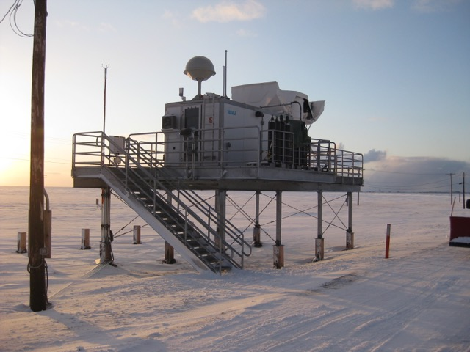
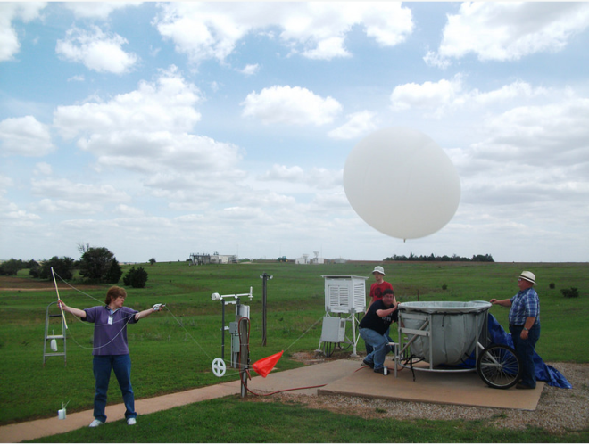
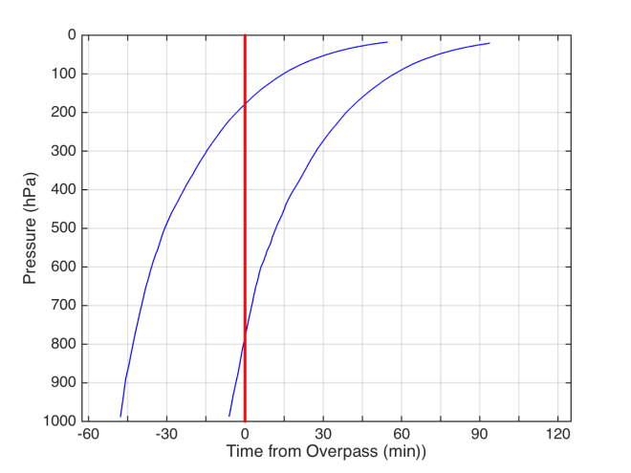
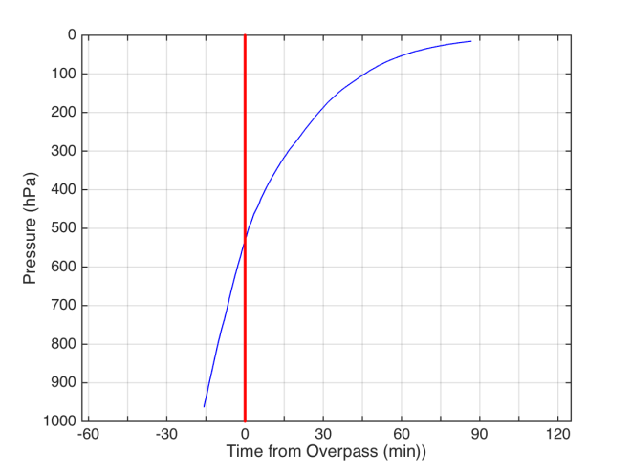
S-NPP EDR Validation: ARM Sites
Dedicated S-NPP Launches occurring once every ~4days
North Slope Alaska (NSA)
ENA
TWP
Dual & Single Dedicated Launch Strategies
Combined w/ancillary data -> Best Estimate (BE)
Southern Great Plains (SGP)
Dual Launch
OP-45min & -5min
Single Launch
OP-15min
overpass time
overpass time
Slide courtesy of Lori Borg

Slide 5
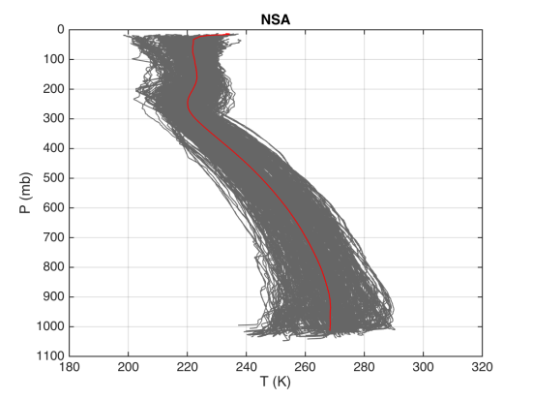
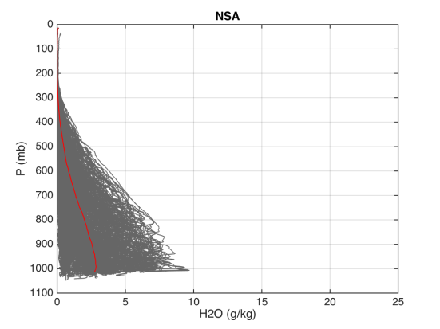
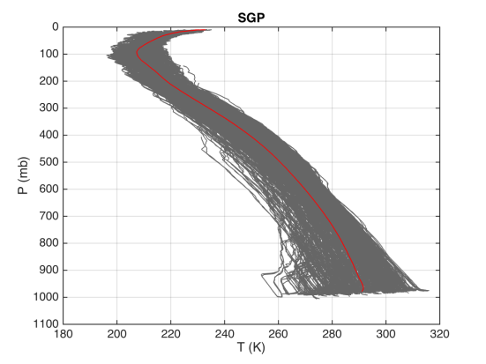
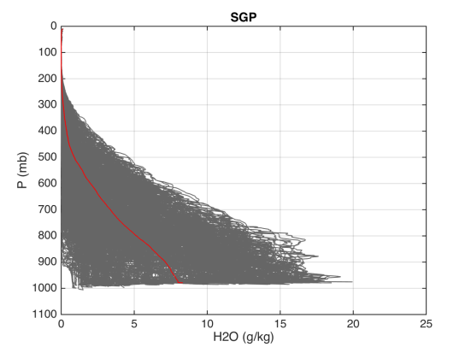
S-NPP EDR Validation: T & WV Profile Distributions
profiles consist of highly accurate measurements of wide range of conditions
Part of analysis is to measure the variability within dual-sonde ascent
≈0.75 K in T(p) and ≈5-30% in H₂O(p) is seen within 40 minutes
NSA
NSA
NSA
NSA
NSA
coastal site
cold & dry
variable surface
(ocean, sea ice, tundra)
low contrast between
clouds and surface
Temperature (K)
H2O (g/kg)
SGP
SGP
SGP
SGP
SGP
continental site
wide fluctuations in WV
complex sfc emission
Temperature (K)
H2O (g/kg)
Slide courtesy of Lori Borg

Slide 6
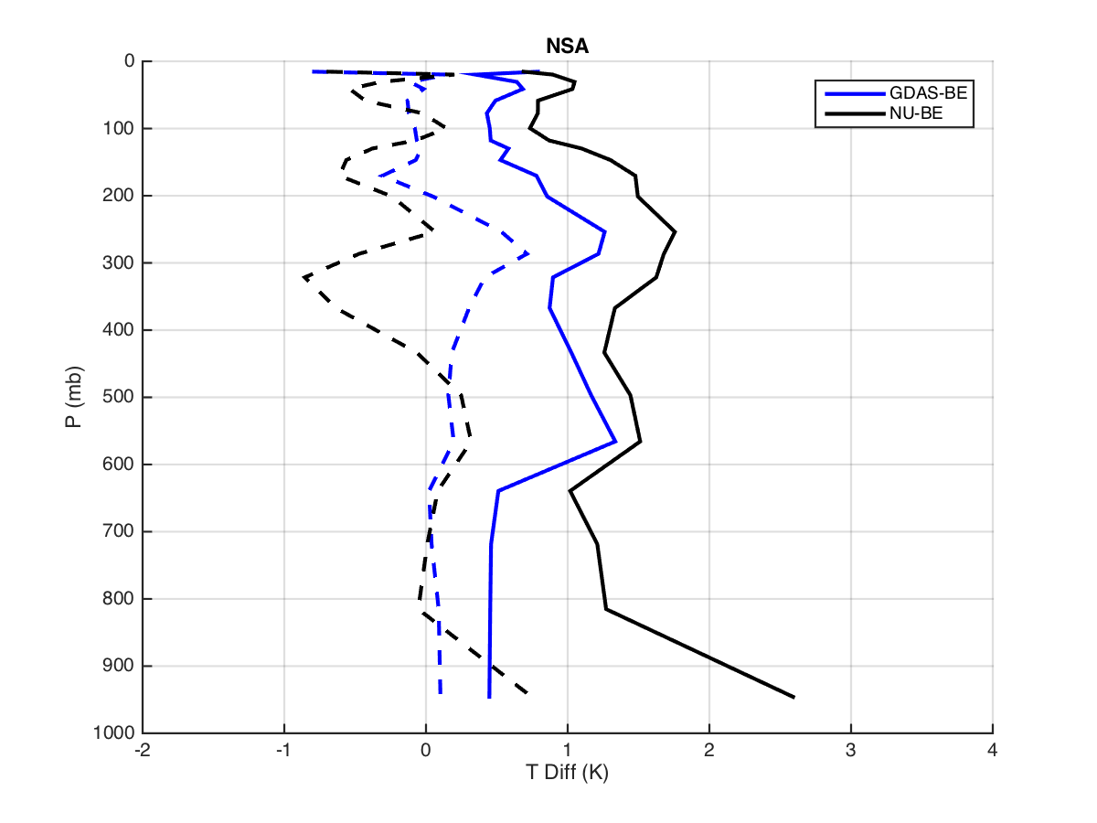
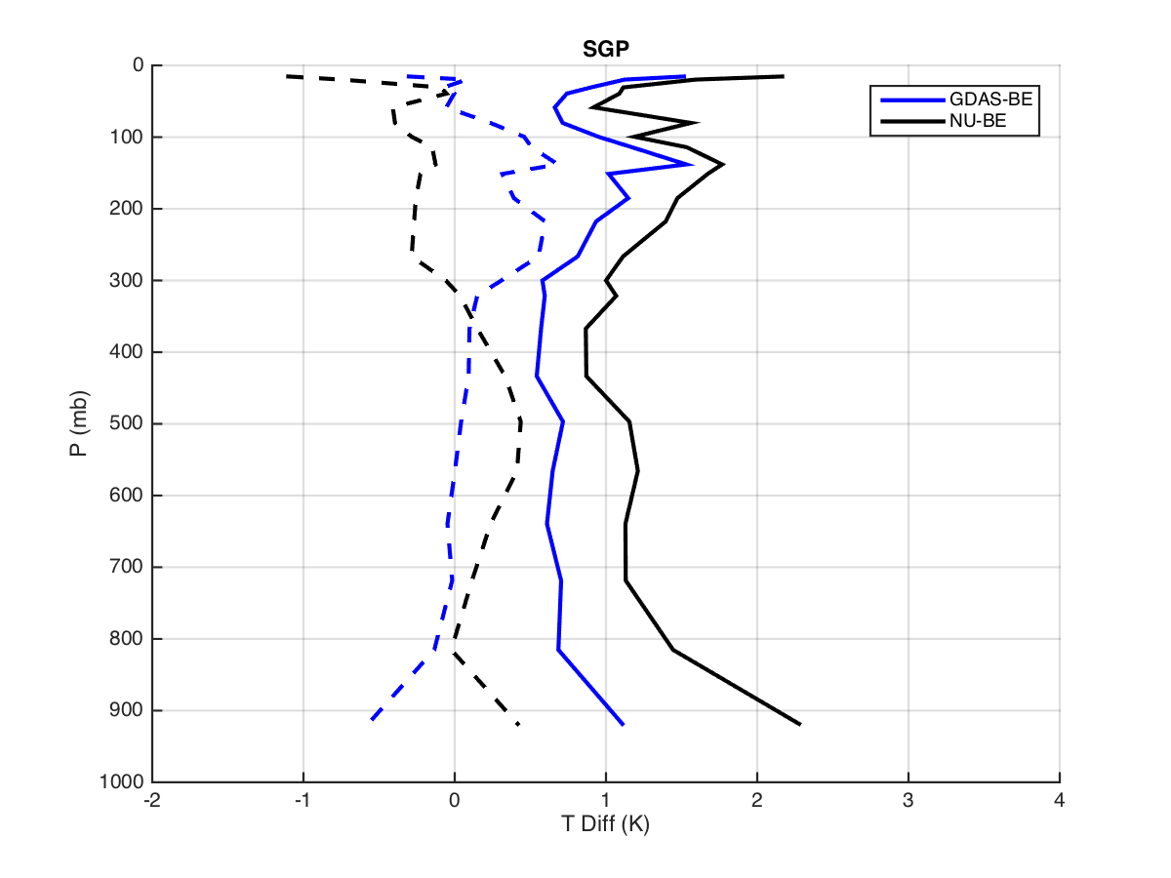
S-NPP EDR Validation: Comparisons of NUCAPS & BestEstimate (BE)
1km layer differences shown for ALLSky conditions
mean (dashed) & RMS (solid) differences shown
GDAS-BE
NUCAPS-BE
NSA
SGP
Temperature Difference (K)
Temperature Difference (K)
preliminary comparison of NUCAPS & BE look good
further effort is ongoing to assess what is happening near the surface
Slide courtesy of Lori Borg

Slide 7
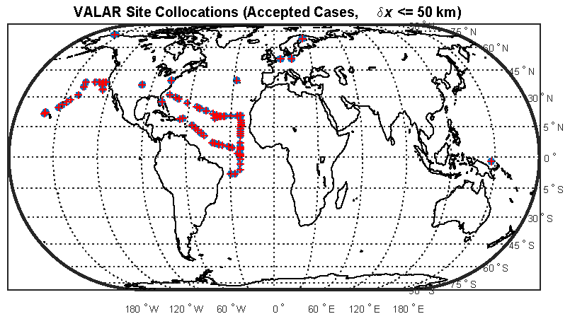
Validation of NUCAPS by NOAA/STAR (Nick Nalli)
Compared T(p) and q(p) to dedicated RS-92 launches
ARM SGP, NSA, ENA
Howard Univ. Beltsville USA (urban site)
R.H. Brown field campaigns (AEROSE and CalWater)
Compared to ozonesondes
AEROSE + CalWater
SHADOZ (not shown on map)
WOUDC (not shown on map)
Selected radiosondes within 50 km radius and -75 ≤ δ ≤to 0 minutes
δt = t(RAOB)-t(NNP)
Selected ozonesondes within 125 km and -250 ≤ δt ≤ +120 minutes

Slide 8
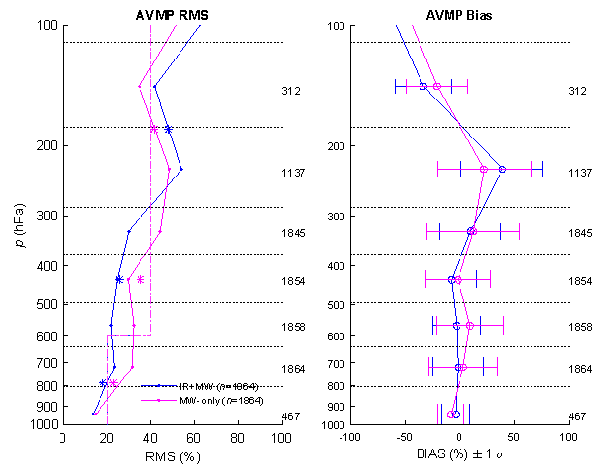
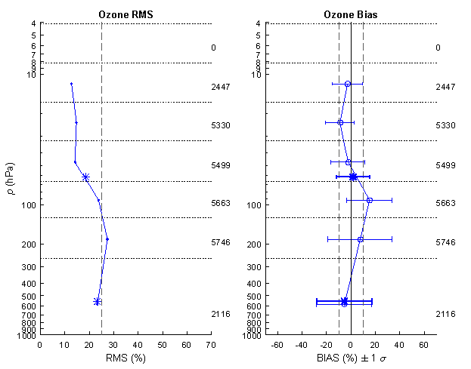
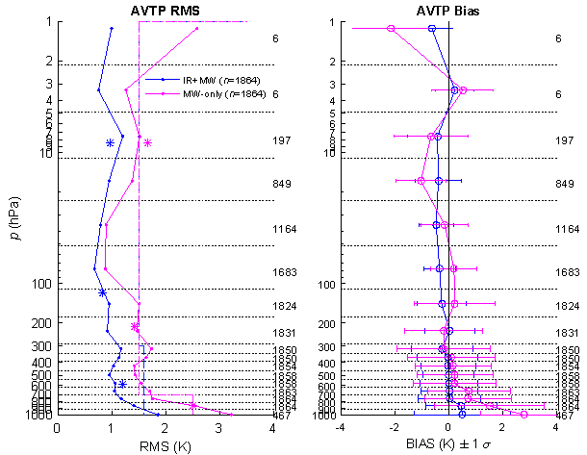
Results (AMS Paper #352, 2016 Annual meeting)
NUCAPS meets JPSS requirements for both ATMS-only (magenta) and CrIS+ATMS (blue) retrievals
CrIS+ATMS AVMP exceeds 100-300 RMS
Believed to be caused by a bias in the RAOBS
T(p) AVTP (K)
RMS BIAS
q(p) AVMP (%)
RMS BIAS
O₃(p) AVMP (%)
RMS BIAS

Slide 9
The JPSS initiatives: a recipe for validation and R₂O
Put yourself in the user’s environment
Listen to exactly how they interpret the data
This requires institutional knowledge of their application
e.g., words we use many not convey the same meaning
Tailor product to their syntax and visualization
Utilize the user’s metric of success
If you never leave your “cubicle”, you’ll have difficulty establishing your relevance
These concepts are adapted from Kloos 2016 Esri Arcuser newsletter “The ROI mindset for GIS Managers”

Slide 10
But … you need to ask the right questions
A question such as “Do you want high spatial resolution” will always be answered “yes”
Better to ask “Which is more important, spatial resolution or boundary layer sensitivity”
The answer will depend on application
The sounding community assumes retrievals would be useful for global or regional models
But are we listening to what they really need?
We do not have a stable a-priori.
Radiance assimilation has Gaussian shaped impact, with a mean slightly above zero.
We need to efficiently convey our vertical co-variance and minimize our biases

Slide 11
My focus: application dependent characterization of NUCAPS
NOAA is investing in a number of JPSS Sounding Initiatives
Goal is to demonstrate new applications with S-NPP
Focus is on applications with high societal value
These are not the “easy” applications
Secondary goal is to encourage interaction between developers and users to tailor soundings to applications
We currently have a number of active initiatives for sounding
NUCAPS in AWIPS-II: training module & improvements
Hazardous Weather Testbed (HWT): Convective Initiation
Hydrometeorology Testbed (HMT): Atmospheric Rivers and El Nino Rapid Response field campaigns
See Bill Sjoberg’s Session #4 (4:20 pm) for list/discussion of other initiatives
I will speak to item #3 today
Bill Line and Dan Nietfeld are speaking to items #1 and #2 in Sessions 4 (11:35 am), 6 (3:10 pm), and 8 (2:50 pm and 3:05 pm)

Slide 12
Hydrometeorology Testbed:
El Nino Rapid* Response Field Campaign
* Campaign went from white paper proposal to implementation in less than 2 months
POCs: Chris Barnet (JPSS) & Ryan Spackman (NOAA/ESRL/PSD)

Slide 13
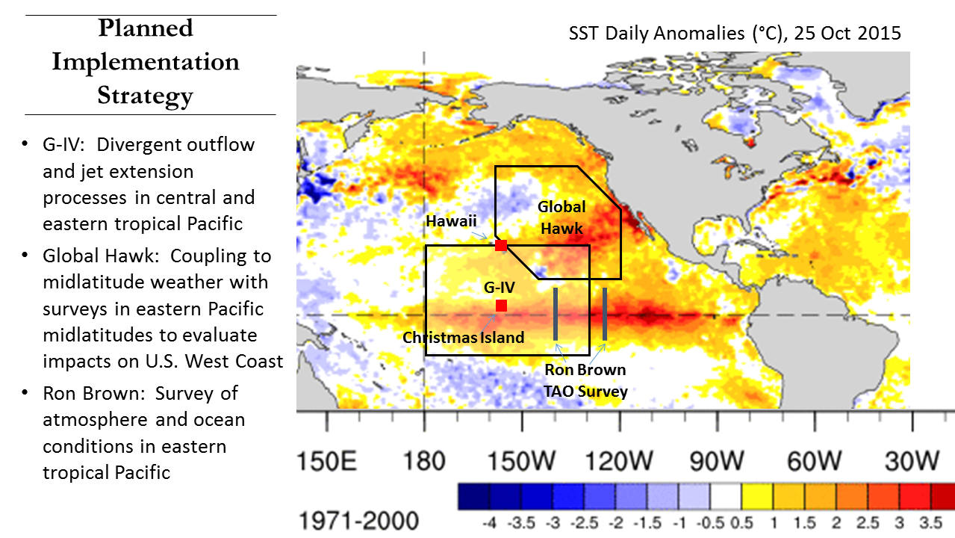
Planned Implementation Strategy
G-IV: Divergent outflow and jet extension processes in central and eastern tropical Pacific
GH: Coupling to mid-latitude weather with surveys in eastern Pacific mid-latitudes to evaluate impacts on US West Coast
R.H. Brown: Survey of atmosphere and ocean conditions in eastern tropical Pacific

Slide 14
Meridional Perspective on Flight Strategies
G-IV: Divergent flow aloft in central/eastern tropical Pacific should mostly be reachable by G-IV at altitude of 12-14 km and captured by dropsonde measurements
GH: Survey the subtropical jet and deep tropics where convection may extend above G-IV altitude.

Slide 15
Campaign ran from Jan. 19th through Mar. 10th, 2016
NOAA G-IV deployed from Honolulu International Airport
Twenty-two 8-hour flights, Jan. 21 through March 10th
41-45,000’, ~25-35 dropsondes/flight
Global Hawk (GH), part of SHOUT, deployed from NASA/AMES
Three 24-hour flights (2/15, 2/16 and 2/21)
55-63,000’, ~65 dropsondes/flight
radiosonde launches at Kiritimati Isl., Kiribati (2N, 157W)
first radiosonde 1/26, 2pm HT, will continued though mid-March
Close to S-NPP overpass time (0,12Z), 1340 miles south of Honolulu
NOAA Ron Brown departed Ford Island Tue. 2/16
6 to 8 RS-92 sonde launches per day, continued through mid-March
Two C-130’s, one at each end of AR (Hickam HI and Travis CA)
Two flights made (2/18 and 2/21)
Field campaign website: http://www.esrl.noaa.gov/psd/enso/rapid_response/

Slide 16
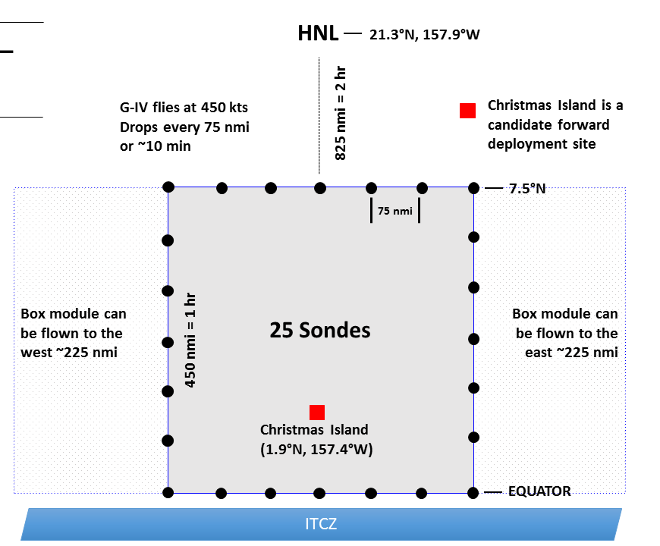
G-IV Flight Module Deep Tropics
Measure thermodynamics and wind field north of the ITCZ
sample organized tropical convection
poleward convective outflow
Box module is 450 nmi square with 75 nmi dropsonde spacing
G-IV performs box module in 4 hour at cruise altitude (41-45 kft)
Expected total flight duration for pattern shown in ~8 hour (3500 nmi)

Slide 17
What we provided
We performed the same kind of analysis we did for CalWater-2015 and CalWater-2014
Provided an overview document on satellite soundings and visualization methods to the campaign scientists
Selected pages (e.g., skew-T description) is at end of this document
Use both Honolulu HI & Corvallis OR direct broadcast sites
Process 1:30 am overpass (~12:30 UT, 2:30 HST, 7:30 EST)
Provide analysis to flight forecasters during the planning telecon
Process 1:30 pm overpass (~0:30 UT, 14:30 HST, 19:30 EST)
Provide scientists an in-flight quick look at proposed dropsonde locations
Use archive data (~24 hours later) to process entire Pacific domain and provide comparison between retrievals (MW-only and IR+MW), co-located GFS, and dropsondes
1st comparison of dropsondes and satellite to capture meta data for campaign archive

Slide 18
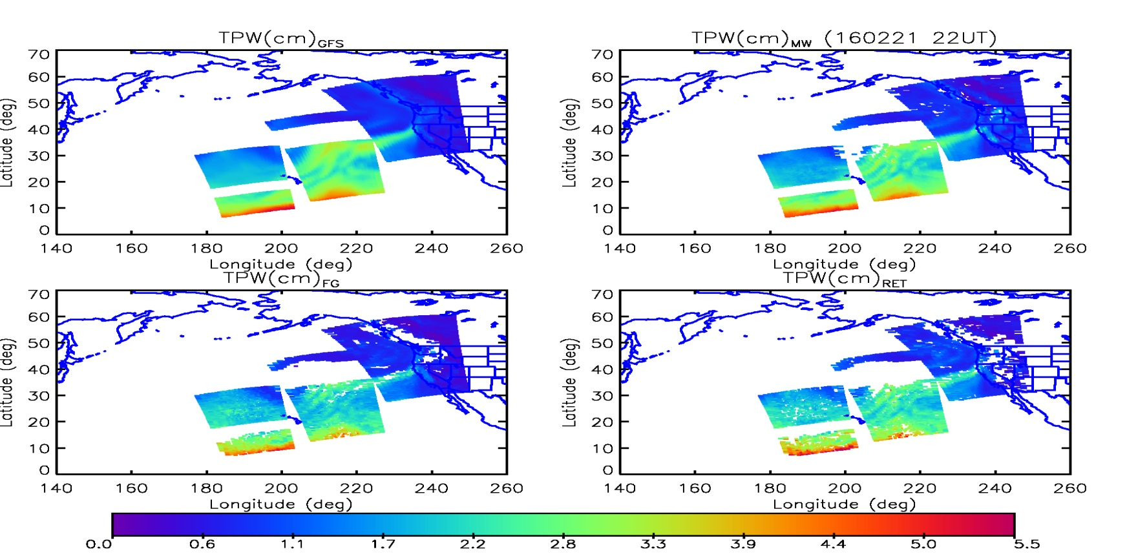
Example of DB coverage
Feb. 21, 2016 pm coverage from both Corvallis and Hawaii
Periodic problems with “antenna shadowing” on NPP
Also see missing granules due to ATMS GEO problems

Slide 19
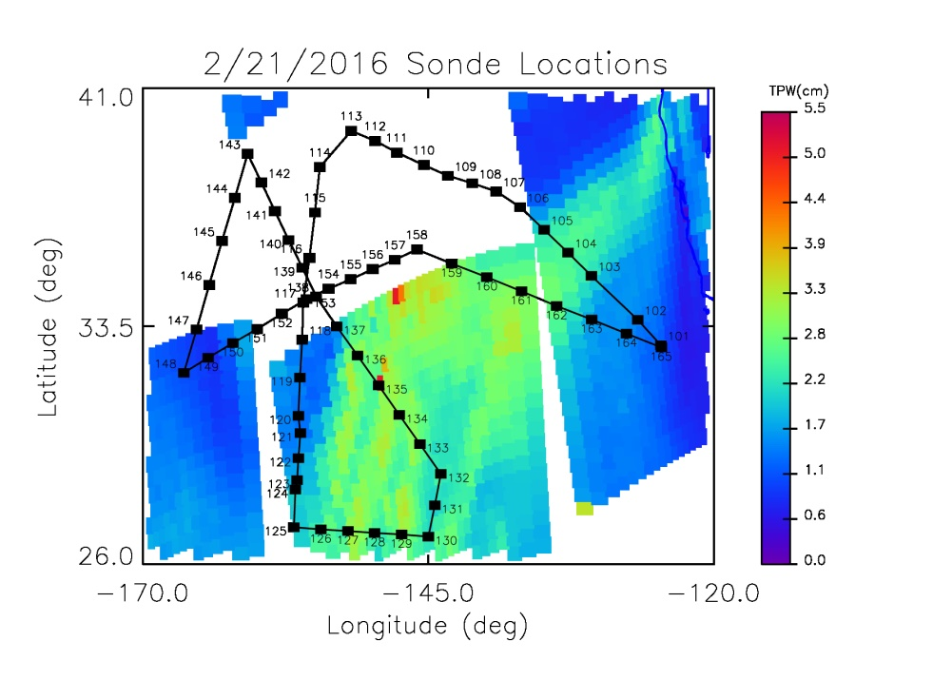
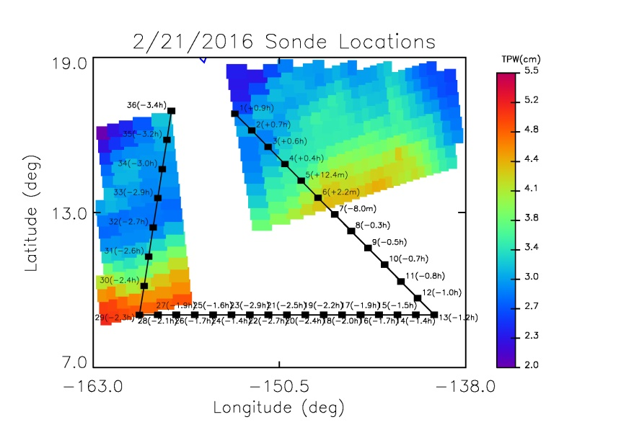
Fetch of DB antenna was a problem for this campaign
On most days the Hawaii antenna did not “see” far enough south to be useful for flight planning
Because CrIS requires data before/after for calibration
On most days Corvallis antenna didn’t “see” far enough west for Global Hawk

Slide 20
Some lessons learned for flight planning
We could routinely process direct broadcast NPP data with a total latency (satellite obs to skew-T plots) of 45 minutes
But for flight planning there is already a plethora of data
Real time T(p), q(p) can complement the other data
Mostly used to help to decide which forecast model was most representative of current conditions.
Towards the end of the mission, DB skew-T plots did help guide flight plan
But we need to be able to answer questions like “do you believe that dry layer aloft” on a case by case basis
Individual skew-T’s were more valuable than cross-section visualization
Morning orbit gave them a preview of the planned dropsonde data acquistion
Valuable insight into forecaster opinions of satellite soundings
They are aware and concerned with our a-priori assumptions
They assume we cannot handle outliers (stick to prior)
At the “grass roots” level, forecasters became aware of satellite capabilities and limitations.

Slide 21
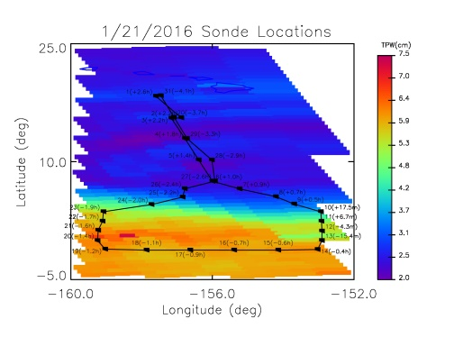
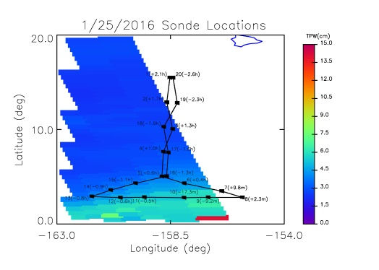
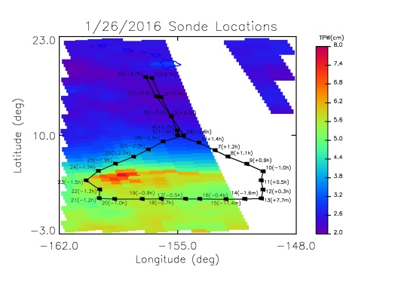
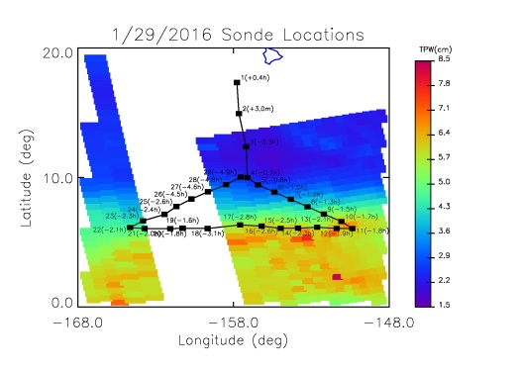
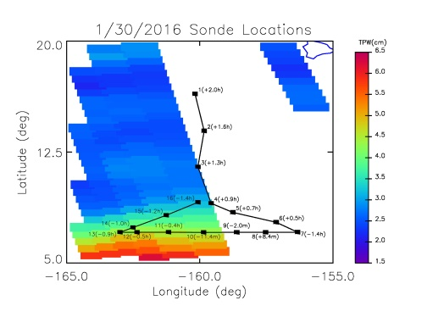
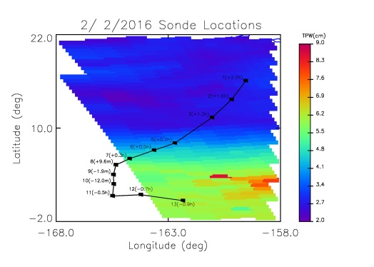
Post-processing from archive: Jan. 21 through Feb. 2

Slide 22
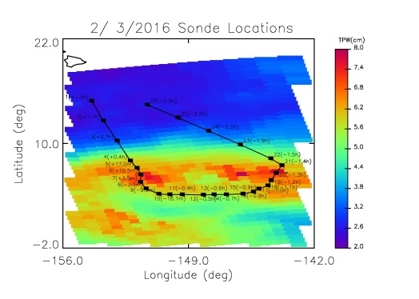
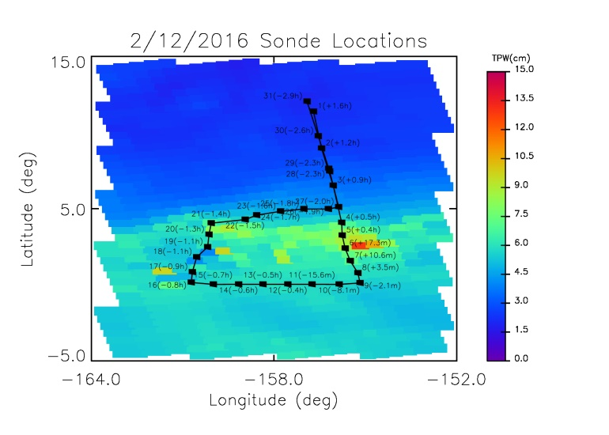
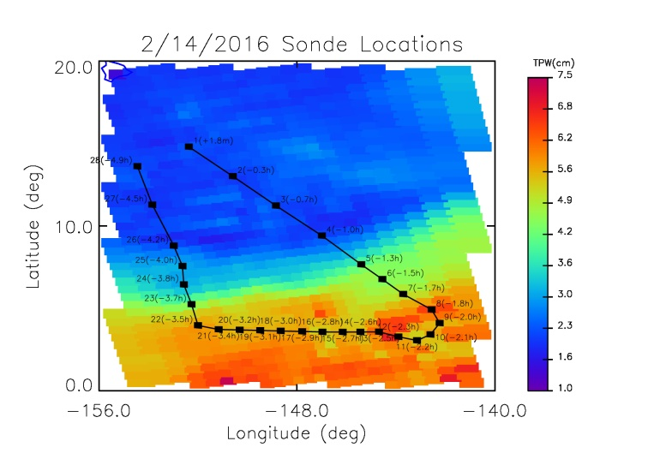
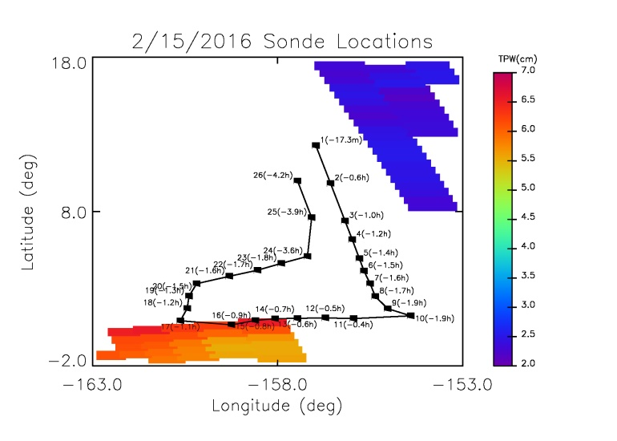
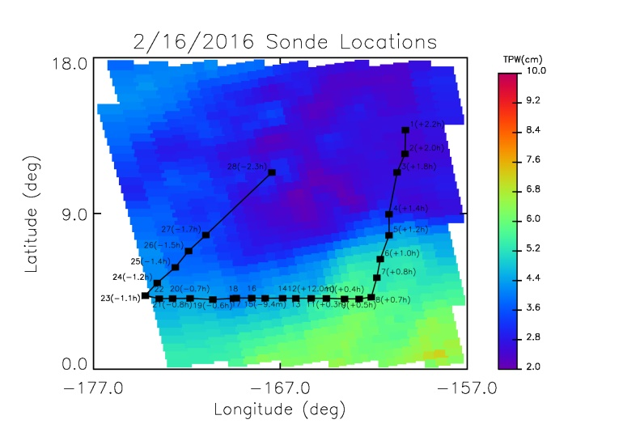
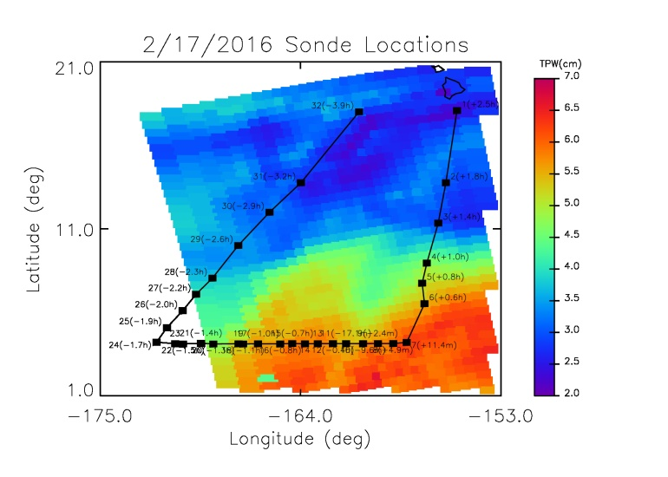
Feb. 3 through Feb. 17 post-processing

Slide 23
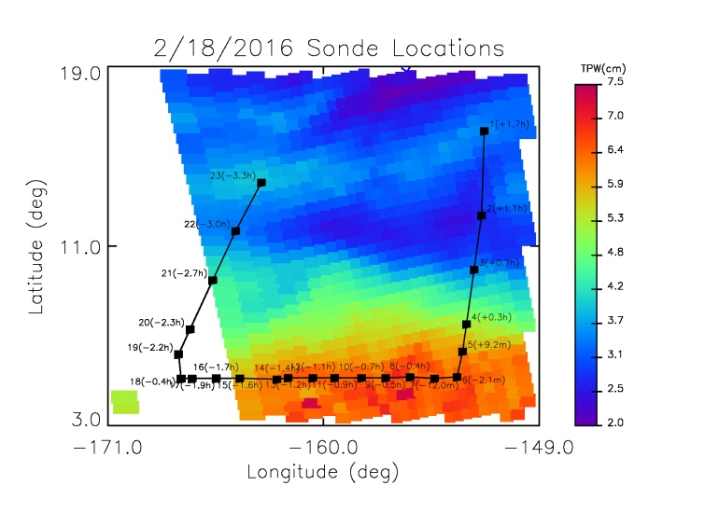
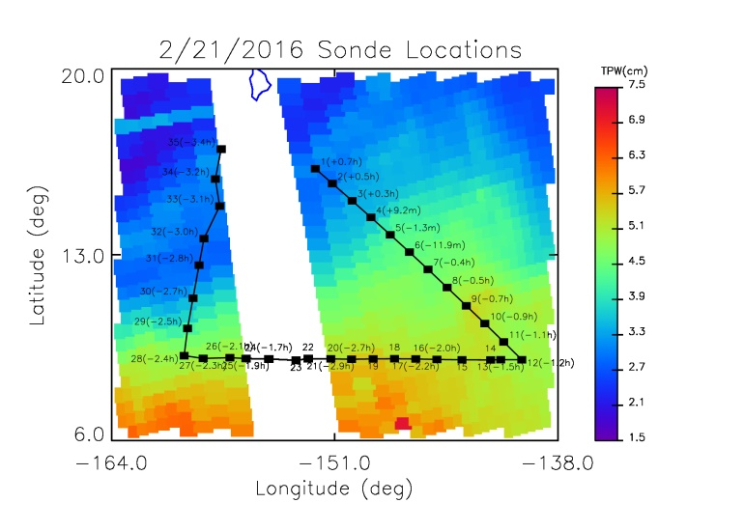
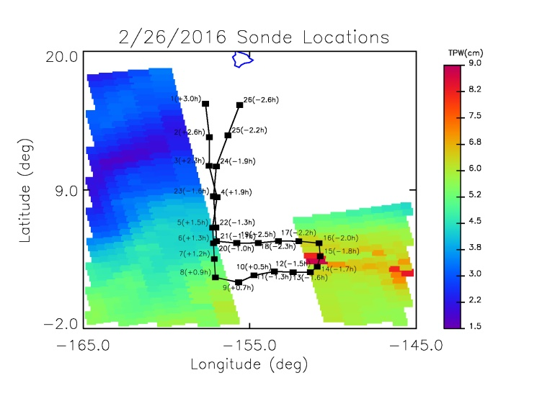
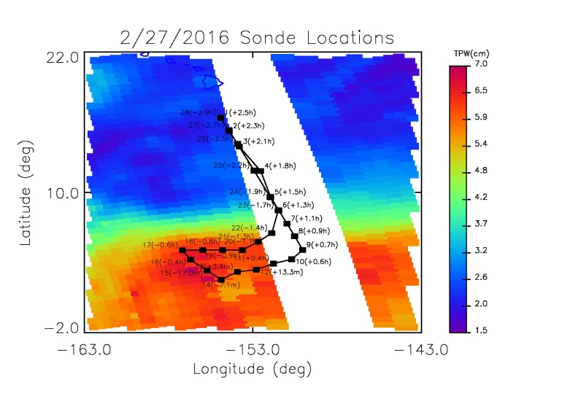
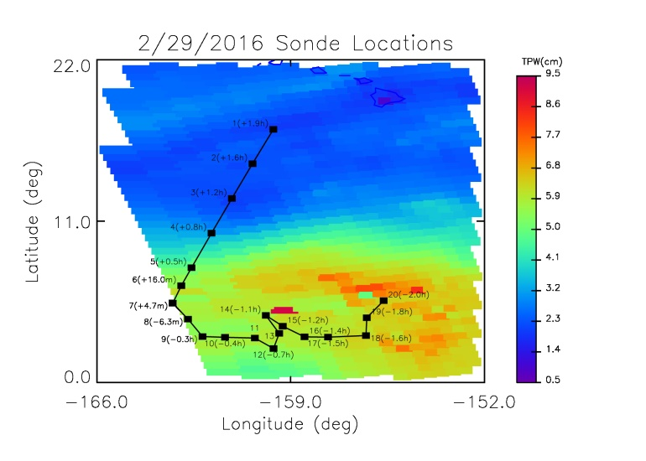
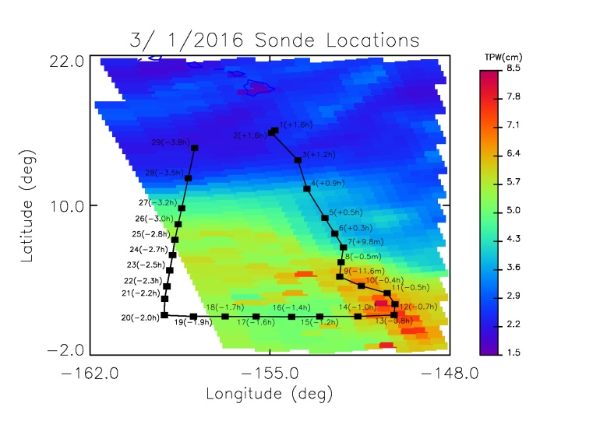
Feb. 18 through Mar. 1 post-processing

Slide 24
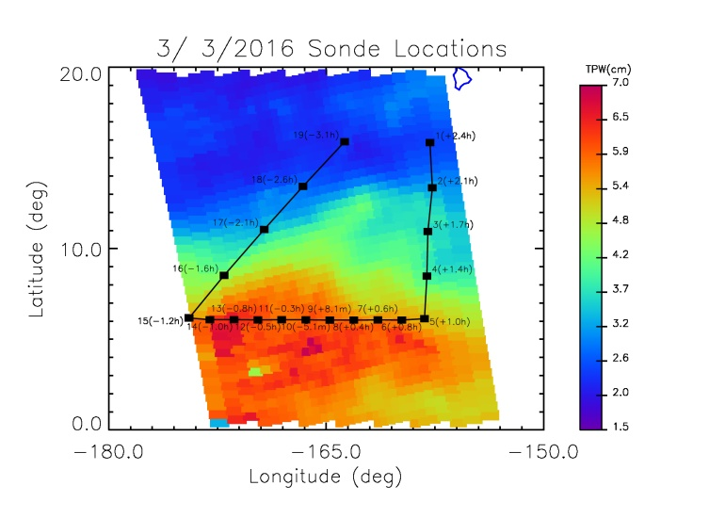
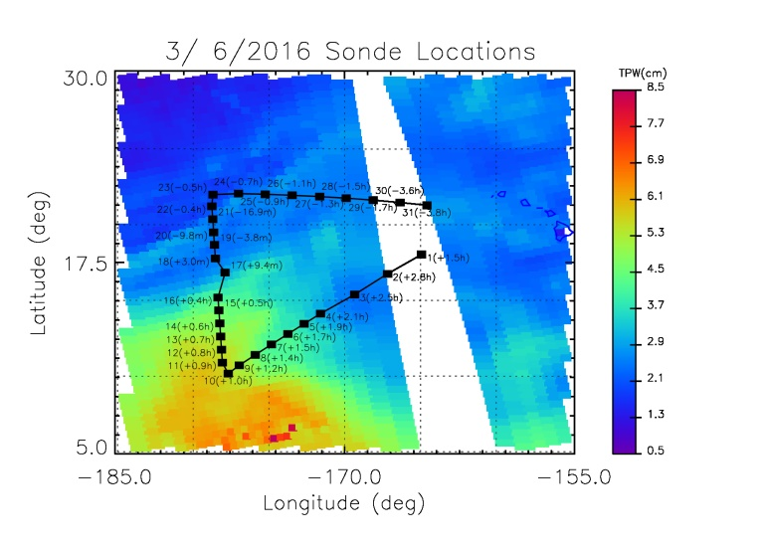
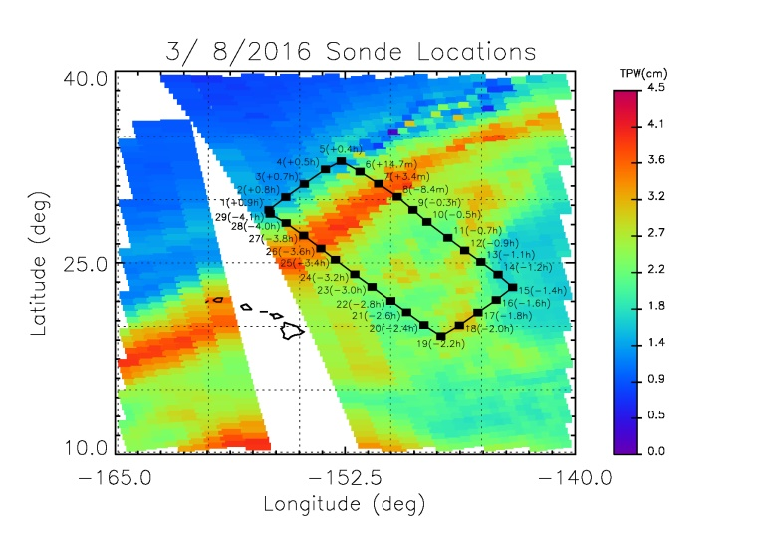
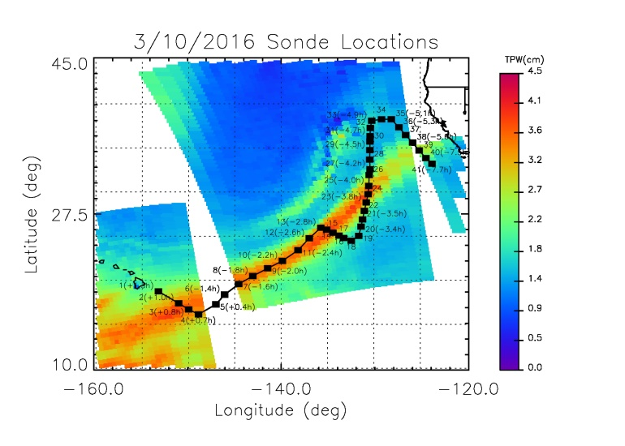
Mar. 3 through Mar. 10 post-processing

Slide 25
Summary of acquired datasets for validation
flight | DB |  | flight | total | match | overpass | useful | # of GH | # C130 | RHB | CXI
number | sites |  | date | # sondes | #skew | sondes | match | sondes | sondes | sondes | sondes
1 | HI | Thu | 1/21/2016 | 31 | 31 | 11/12 | -4.3 min
2 | HI | Mon | 1/25/2016 | 20 | 17 | 08/09 | -9.2 min
3 | HI | Tue | 1/26/2016 | 32 | 24 | 10/11 | -11.4 min |  |  |  | 6
4 | HI | Fri | 1/29/2016 | 29 | 22 | 02/03 | -0.3 hour |  |  |  | 2
5 | HI | Sat | 1/30/2016 | 16 | 9 | 08/09 | -11.4 min |  |  |  | 2
6 | HI | Tue | 2/2/2016 | 13 | 8 | 07/08 | +0.3 hour |  |  |  | 2
7 | HI | Wed | 2/3/2016 | 26 | 26 | 07/08 | + 3 min |  |  |  | 2
8 | HI + CO | Fri | 2/12/2016 | 31 | 31 | 08/09 | -2.1 min |  |  |  | 2
9 | HI | Sun | 2/14/2016 | 28 | 28 | 01/02 | -0.3 hour |  | 102 |  | 2
10 | HI + CO | Mon | 2/15/2016 | 26 | 4 | 01 | -17.3 min | 2 |  |  | 2
11 | HI + CO | Tue | 2/16/2016 | 28 | 27 | 14/15 | -9.4 min | 22 | 85 | 1 | 2
12 | HI | Wed | 2/17/2016 | 32 | 24 | 08/09 | -2.4 min |  |  | 5 | 2
13 | HI | Thu | 2/18/2016 | 23 | 18 | 05/06 | -2.1 min |  |  | 5 | 2
14 | HI + CO | Sun | 2/21/2016 | 35 | 32 | 05/06 | -1.3 min | 65 |  | 6 | 2
15 | HI | Fri | 2/26/2016 | 26 | 9 | 10/11 | +0.9 hour |  |  | 0 | 2
16 | HI | Sat | 2/27/2016 | 28 | 15 | 12/13 | +3.4 min |  |  | 1 | 2
17 | HI | Mon | 2/29/2016 | 20 | 20 | 07/08 | +4.7 min |  |  | 7 | 2
18 | HI | Tue | 3/1/2016 | 29 | 23 | 07/08 | 30 secs |  |  | 7 | 2
19 | HI | Thu | 3/3/2016 | 19 | 19 | 09/10 | -5.1 min |  |  | 6 | 2
20 | HI | Sun | 3/6/2016 | 31 | 29 | 18/19 | +3.0 min |  |  | 6 | 2
21 | HI | Tue | 3/8/2016 | 29 | 29 | 07/08 | +3.4 min |  |  | 8 | 2
22 | HI + CO | Thu | 3/10/2016 | 41 | 38 | 05/06 | +0.7 hour |  |  | 7 | 2
total acquired |  |  | 1102 | 593 |  |  |  | 89 | 187 | 144 | 89
total analysed |  |  | 483 |  | 483

Slide 26
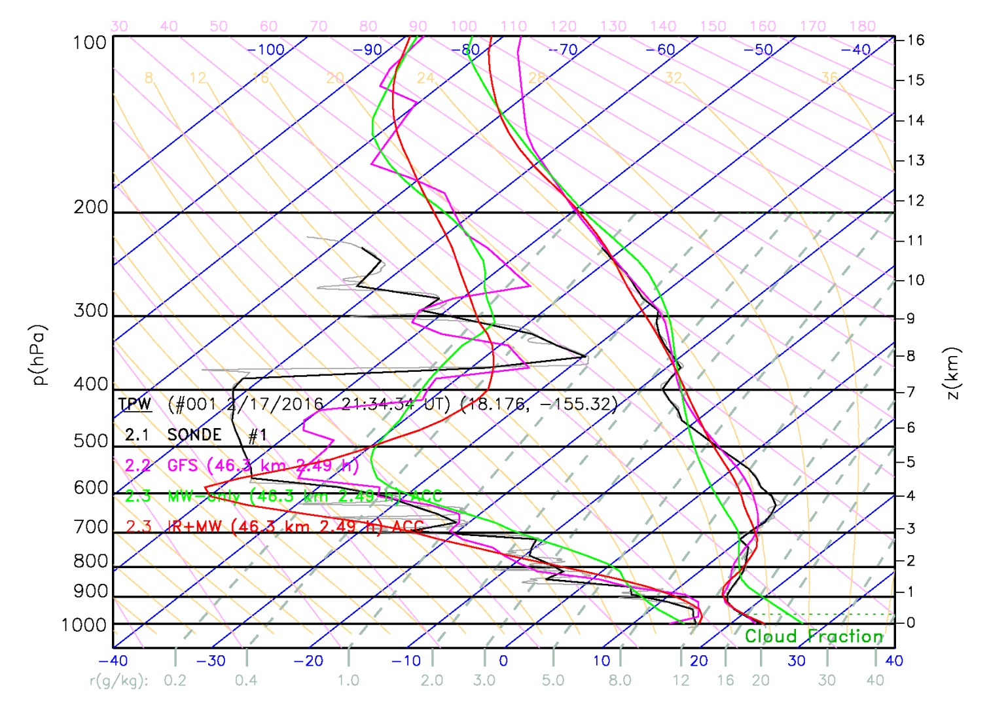
Feb. 17, Sonde #1: 2.5 hours before overpass time
IR+MW tends to capture vertical T(p) and q(p) structure better than MW

Slide 27
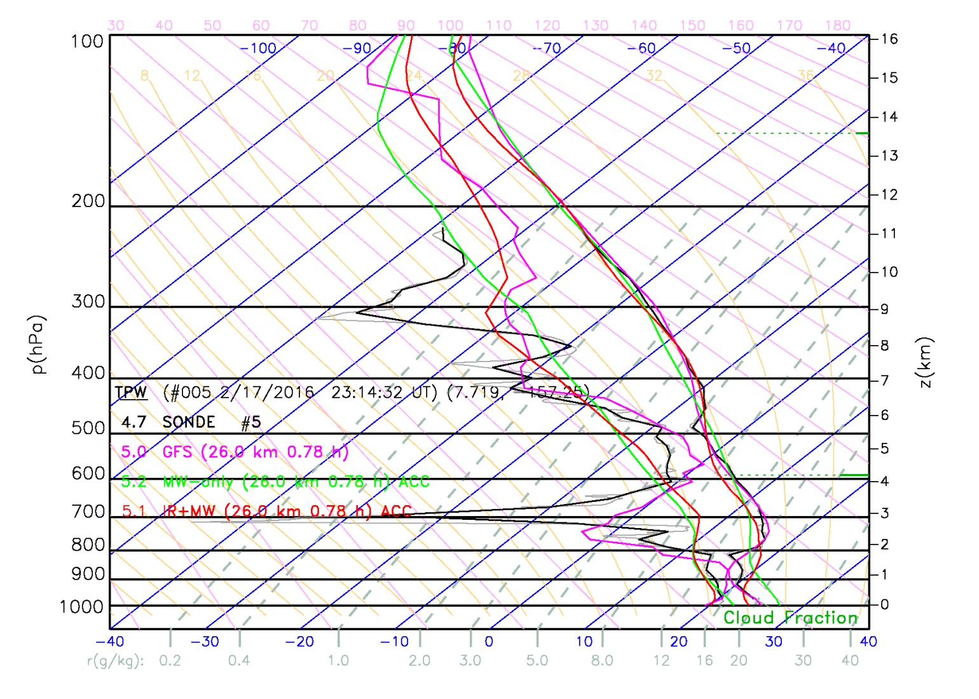
Feb. 17, Sonde #5: 0.8 hours before overpass time
But obviously doesn’t have the vertical resolution of a sonde or GFS

Slide 28
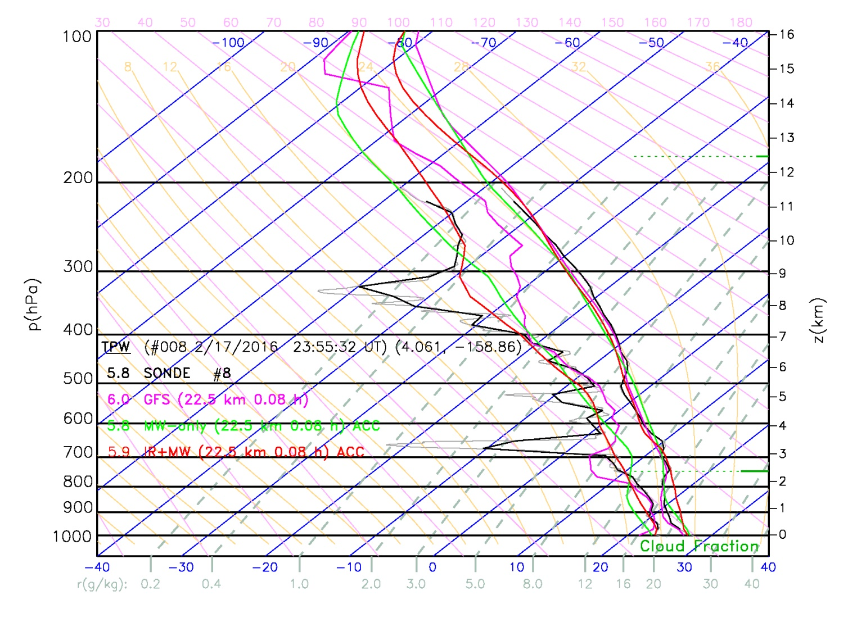
Feb. 17, Sonde #8: near overpass time
NUCAPS is capturing large scale vertical structures

Slide 29
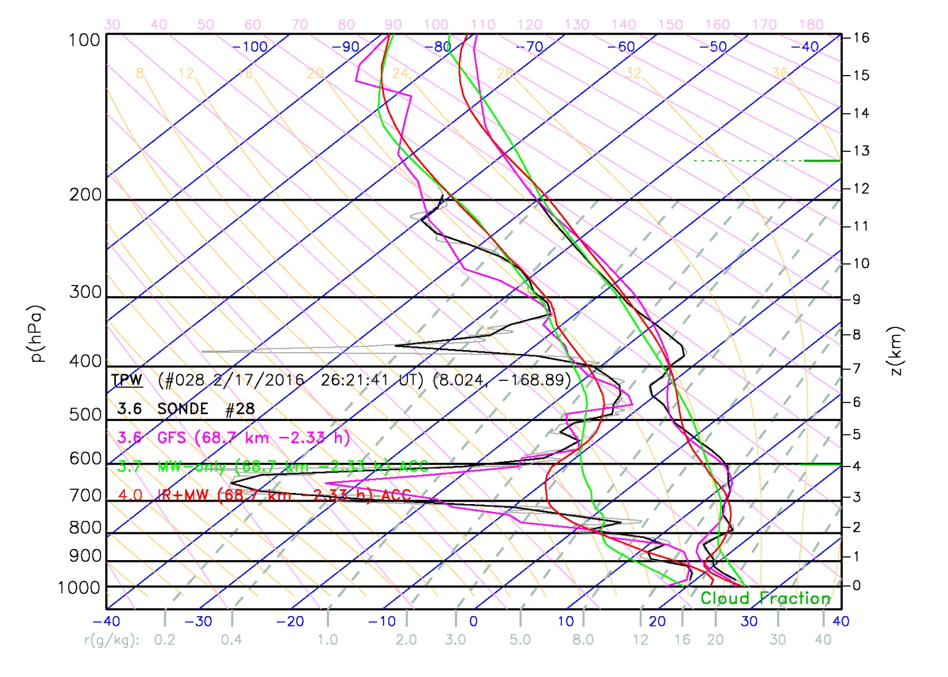
Feb. 17, Sonde #28: 2.3 hours after overpass time
thin layers can be used to estimate vertical response

Slide 30
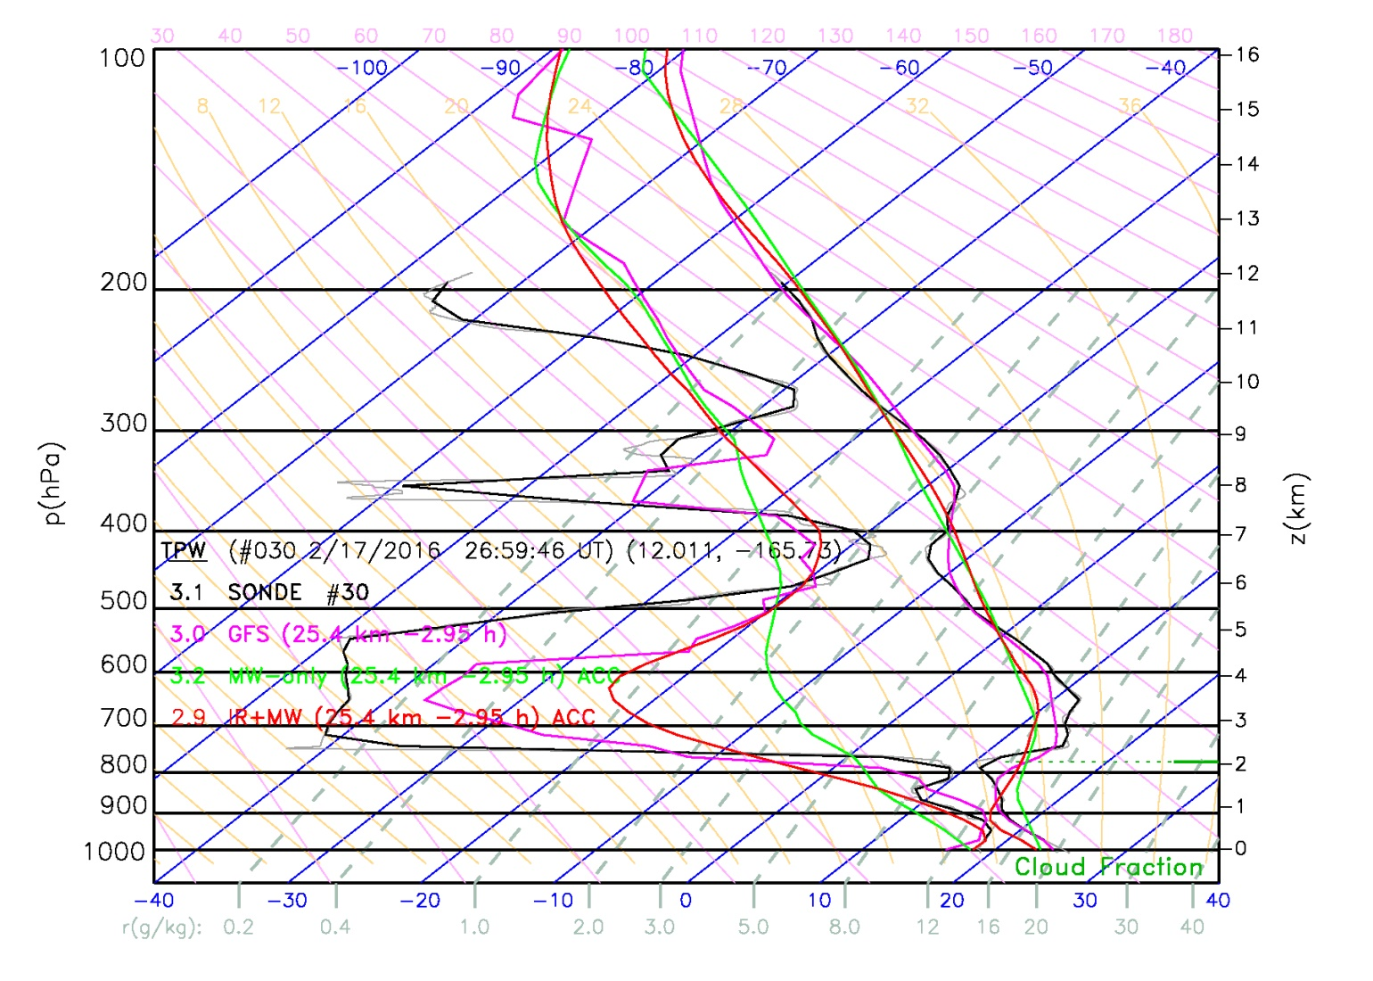
Feb. 17, Sonde #30: 3 hours after overpass time
Again, vertical resolution of IR+MW tends to be better than MW-only

Slide 31
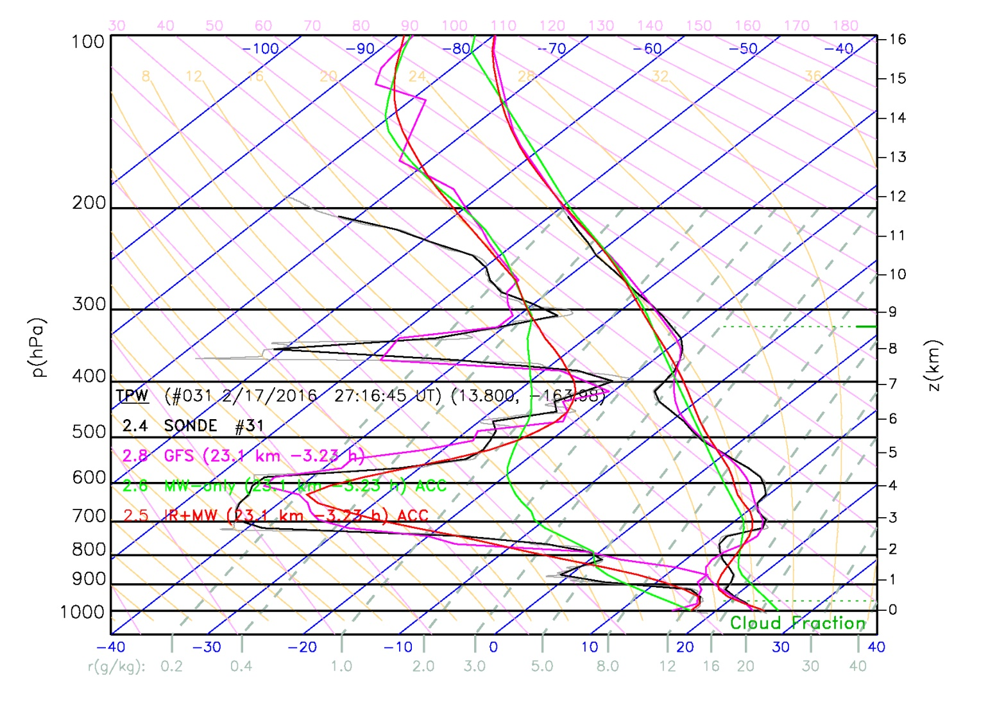
Feb. 17, Sonde #31: 3.2 hours after overpass time
But why did this case do so much better?

Slide 32
Specific research topics we will focus on
Characterize algorithms in ocean regimes
Assess satellite sounding vertical resolution
Ability to see marine inversions, moist areas aloft
Improve our training: do statistics in user units (dew point)
These data test our ability to see extremes
Moisture extremes along flight path
2015/16 El Nino outside of NUCAPS climatology training
Can test sensitivity to a-priori assumptions
Support the scientific goals of the field campaign
Use satellite data to test skill of GFS on flight versus non-flight days
Is USA forecast sensitive to specific regions (e.g., ITCZ outflow)
What datasets could enhance skill.
Add NUCAPS to datasets that document the thermodynamic environment of the 2015/16 El Nino
Complements the in-situ data investment of this field campaign

Slide 33
Feedback has led to potential improvements to NUCAPS
We need to improve our surface retrieval
We will employ the NASA MEaSURES MODIS/ASTER surface emissivity climatology (Borbas, SSEC)
Should improve NUCAPS lower tropospheric soundings over land
We need to improve our QC
Original QC was developed to demonstrate that we met requirements
We need application dependent QC
Forecasters need more information as to where to believe sounding
We will explore using a model (most likely RAP) a-priori
Would allow NUCAPS to “verify” the model in near-real time
If we have low information content our product relaxes to model (and we can convey that)
If we have high information content this informs the forecast to either have more confidence in the model or to estimate where the model is incorrect
Could bring in valuable surface information
Could minimize surface correction
Could ensure surface correction agrees with satellite measurements

Slide 34
Thank You! Questions?

Slide 35
Acronyms
AIRS = Atmospheric Infrared Sounder
AMSU = Advanced Microwave Sounding Unit
AR = Atmospheric River
ATMS = Advanced Technology Microwave Sounder
AVHRR = Advanced Very High Resolution Radiometer
AWIPS = Advanced Weather Interactive Processing System
AWT = Aviation Weather Testbed
CrIS = Cross-track Infrared Sounder
CIMMS = Cooperative Institute for Mesoscale Meteorological Studies
CIMSS = Cooperative Institute for Meteorological Satellite Studies
CSPP = (CIMSS) Community Satellite Processing Package
CWA = (NWS) County Warning Area
CWSU = (FAA) Center Weather Service Unit
EUMETSAT = EUropean organization for exploitation of METeorological SATellites
FOV/FOR = Field Of View/Regard
GFS = (NCEP) Global Forecast System
GSFC = (NASA) Goddard Space Flight Center
HMT = Hydrometeorology Testbed
HSB = Humidity Sounder Brazil
HWT = Hazardous Weather Testbed
IASI = Infrared Atmospheric Sounding Interferometer
JPSS = Joint Polar Satellite System
METOP = METeorological Observing Platform
MHS = Microwave Humidity Sensor
MODIS = MODerate resolution Imaging Spectroradiometer
NASA = National Aeronautics and Space Administration
NCEP = National Centers for Environmental Prediction
NESDIS = National Environmental Satellite, Data, and Information Service
NHC = (NCEP) National Hurricane Center
NOAA = National Oceanographic and Atmospheric Administration
NPP = National Polar-orbiting Partnership
NWP = Numerical Weather Prediction
NWS = National Weather Service
NUCAPS = NOAA Unique CrIS/ATMS Processing System
OPC = (NCEP) Ocean Prediction Center
OSPO = (NESDIS) Office of Satellite and Product Operations
SOO = Science Operations Officer
SPC = (NCEP) Storm Prediction Center
SPoRT = (NASA) Short-term Prediction and Research Transition Center
STAR = (NESDIS) SaTellite Applications and Research
STC = Science and Technology Corporation
UMBC = University of Maryland, Baltimore County
VIIRS = Visible Infrared Imaging Radiometer Suite
WFO = (NWS) Weather Forecast Office
WPC = (NCEP) Weather Prediction Center

