Slide 1
International Coordination of Space Weather Observations and Products
Terry Onsager¹ and Juan Rodriguez²
¹NOAA Space Weather Prediction Center
²CIRES University of Colorado and NOAA National Geophysical Data Center

Slide 2
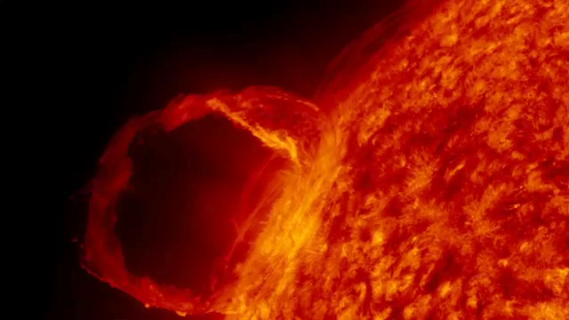
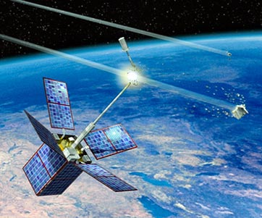
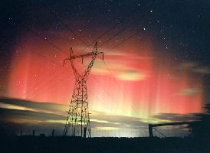
Main Topics
• Energetic particle environment impacts
• GOES-R enhancements
• International coordination activities

Slide 3
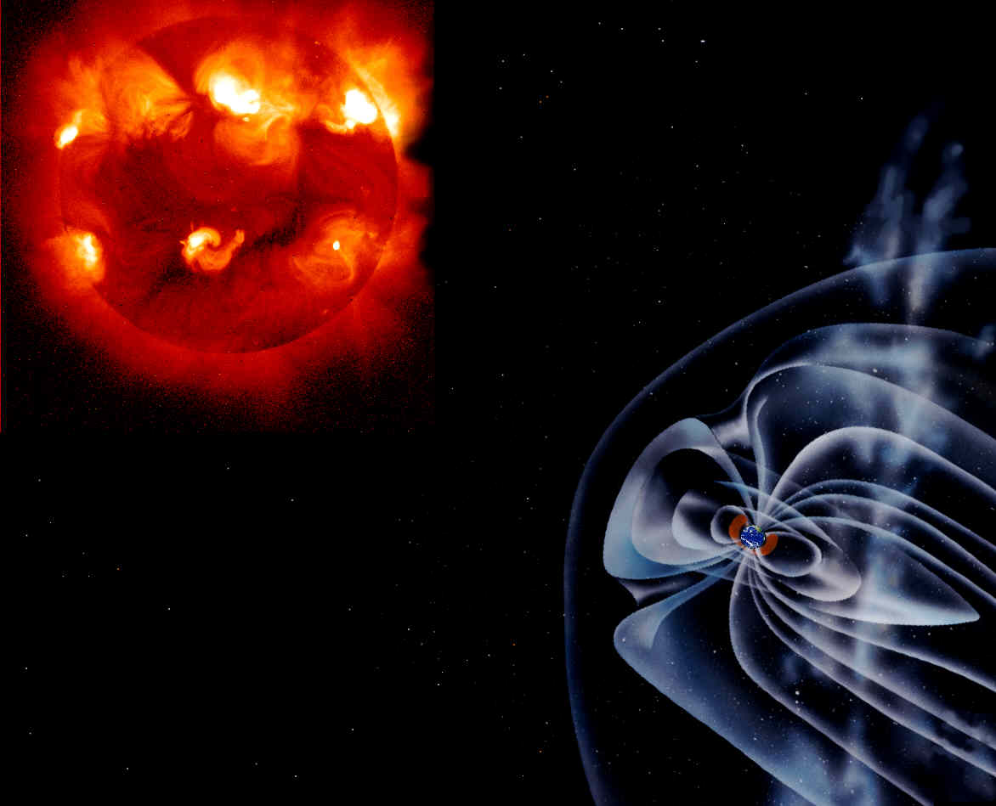
GOES measures particle sources external to the magnetosphere:
- Galactic Cosmic Rays
- Solar Energetic Particles
GOES measures particle sources internal to the magnetosphere:
- Radiation Belts
- Ring current/plasma sheet

Slide 4
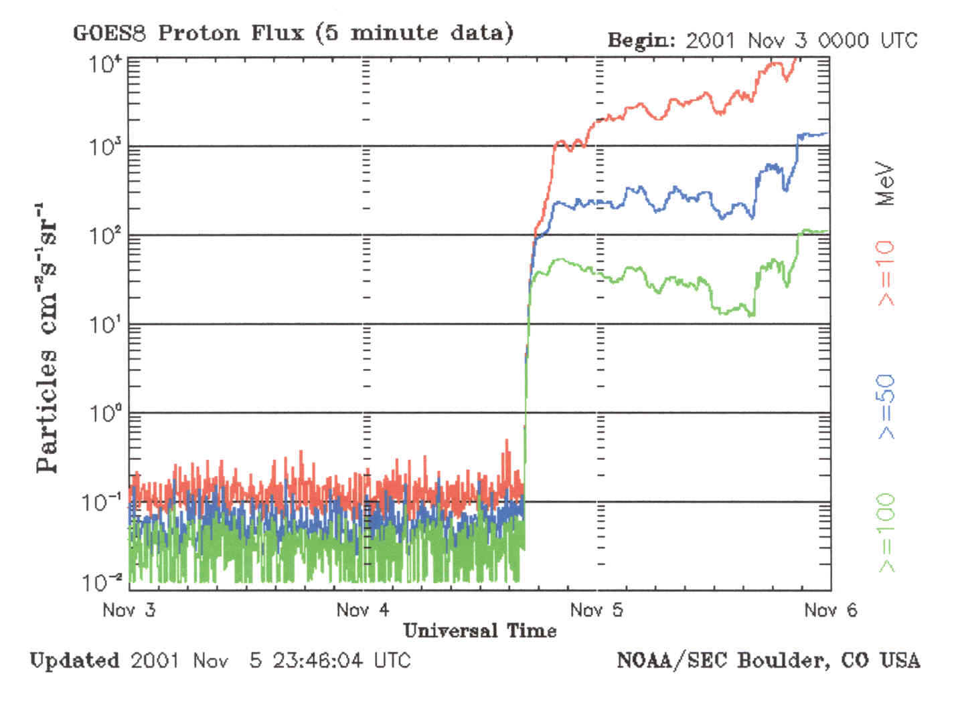
S4
>10 MeV
S3
>50 MeV
Solar Radiation Storm
in Geostationary Orbit
S2
S1
>100 MeV
Satellite Electronics Impacts
- Single event upsets (protons, heavy ions)
- Deep dielectric charging (energetic electrons)
- Surface charging (low energy electrons)
Geosynchronous Orbit

Slide 5
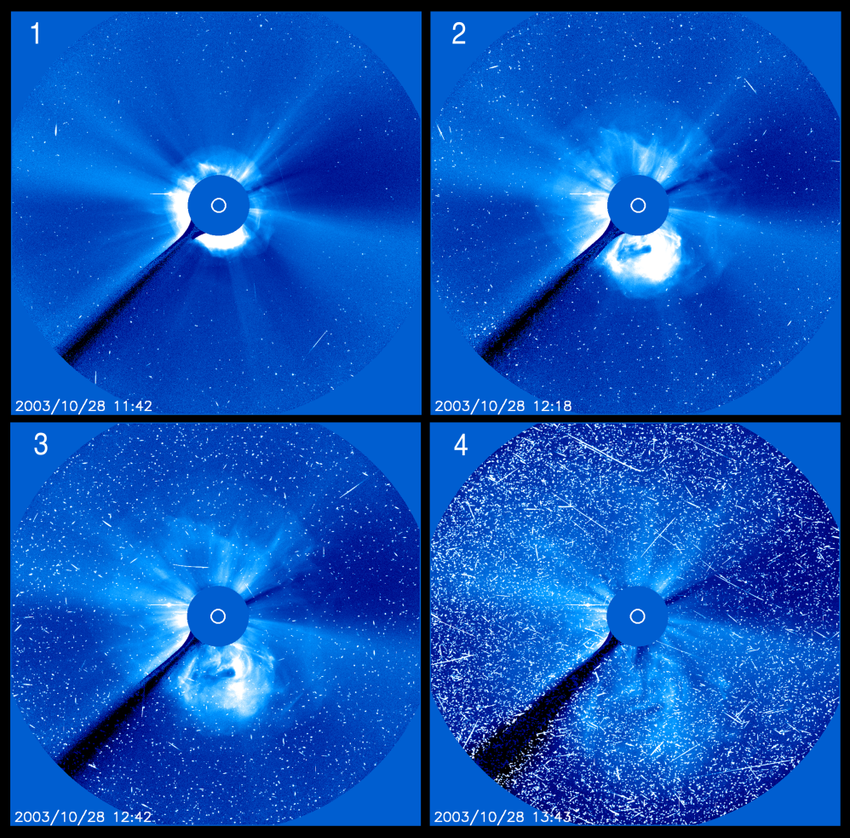
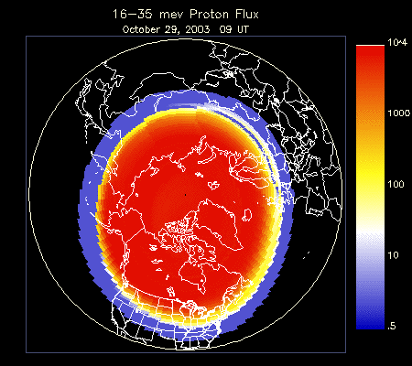
Interplanetary Space
Polar Ionosphere
- Star tracker anomalies (energetic protons)
- HF communication outages (energetic protons)
- Human radiation (energetic protons and electrons)

Slide 6
Satellite Impacts During Storm Period:
October 19 – November 7, 2003
Approximately 53% of Earth and Space science missions were impacted (NASA/GSFC)
Examples include:
Mars Odyssey Probe : Spacecraft entered safe mode; MARIE instrument failed
Stardust Mission: Spacecraft entered safe mode
SMART-1: Three auto shut-downs of engines in lunar transfer orbit
Mars Explorer Rover: Entered idle mode due to excessive star tracker events
Microwave Anisotropy Probe: Star tracker resets
Mars Express: Star tracker unusable – relied on gyroscopes
ADEOS-2: Total loss

Slide 7
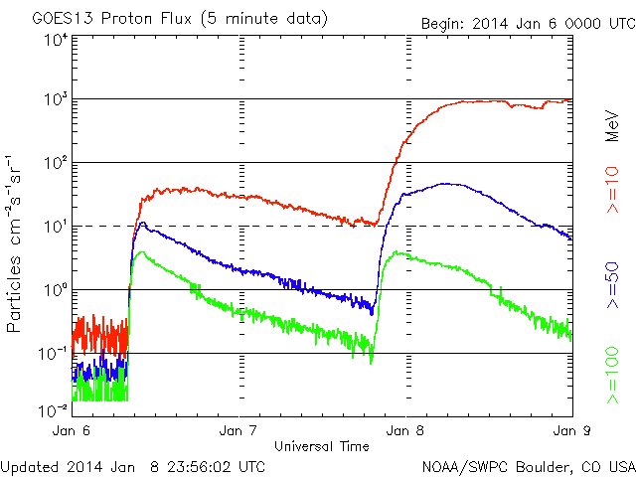
Spacecraft Operations and Aviation Impacts January 8, 2014
NBCnews.com
Polar Airline Flights Re-routed
Orbital Sciences cargo delivery to ISS
Energetic Proton Flux
Geostationary Orbit

Slide 8
Evolution of GOES Charged Particle and Magnetometer Coverage
Satellite Series | Electrons >800 keV | Electrons 30-600 keV | Electrons 0.03-30 keV | Protons >740 keV | Protons 80-800 keV | Protons 0.03-30 keV | Solar Heavy Ions, >10 MeV/n | Magneto-meter
GOES 8-12 | √ |  |  | √ |  |  | He | √
GOES 13-15 | √ | √ |  | √ | √ |  | He | √
GOES R | √ | √ | √ | √ | √ | √ | He, Z=4-29 (Be-Cu) | √
Radiation effects application | Interior charging, human radiation | Surface and interior charging | Surface charging and charging signatures | Single event effects, HF comm., human radiation | Surface damage (e.g., solar arrays) | Surface charging signatures | Single event effects | Charging, calculation of n and T, orientation anomalies
• Daily Forecasts (1-3 day):
- Solar x-rays and energetic protons
- Geomagnetic activity
- 10.7 cm radio flux
• Event-Driven Warnings and Alerts:
- Warnings: geomagnetic storms, proton events
- Alerts: solar flares, proton events, geomagnetic storms, electron events, solar radio bursts
• Also: Continuous real-time data and input for numerical models

Slide 9
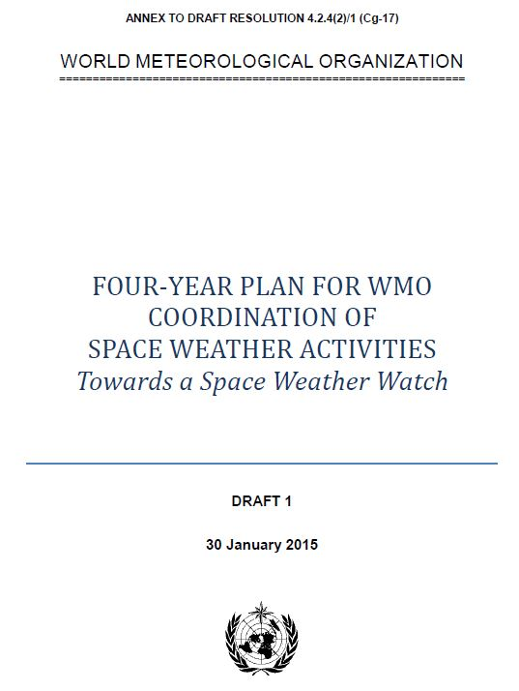
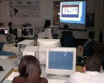
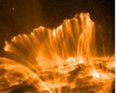
World Meteorological Organization
Specialized Agency of the United Nations with 191 Members
• Promote sustained observations essential for space weather services
• Improve exchange of data and information utilizing the WMO Information System
• Support emergence of services in coordination with aviation and other major application sectors
• Improve emergency warning and global preparedness
• Promote synergy with meteorology/climate
Space-based
Observing System
Access to Satellite
Data and Products
Awareness and
Training
Space Weather
Coordination
WMO Space Programme Elements:

Slide 10
Space Weather Service Requirements for International Civil Aviation
ICAO is developing provisions for space weather information to international air navigation, including:
• Requirements for space weather services
• Selection criteria for designation of global and regional centers
• Governance and cost recovery arrangements
• Considerations of space weather impacts and service uses
GOES data and SWPC services will be essential for addressing the emerging needs of civil aviation for space weather information.

Slide 11
Coordination Group for Meteorological Satellites
• Focus on operational spacecraft and instrument issues
• Host space weather instruments
• Routinely report on satellite anomalies
• Can facilitate integration of observing capabilities
Near-term Actions:
1. Develop Terms of Reference for space weather activities
2. Work with WMO space weather team to develop procedures for collection and use of anomaly information

Slide 12
Solar Energetic Particle Measurement Intercalibration Workshop,
Boulder, Colorado, 11 April 2014
International participation: Europe, Japan, China, Russia, USA
Many missions represented: scientific vs. operational, new vs. historical
Interoperability of multiple national space-weather observations demands cross-comparisons
Intercalibration (quantitative adjustment of observations to some standard) may not be needed if observations agree to within some error bar
Workshop recommendations:
Develop guidelines for the on-orbit cross-comparison of solar energetic particle measurements
Similar in intent to optical calibration guidelines for the WMO/CGMS Global Space-based Inter-Calibration System (GSICS), which was developed for satellite-borne imagers and sounders
Workshop report lists questions that need to be addressed by these guidelines
Use January 2014 SEP event as a recent cross-comparison opportunity
Initial results show good agreement between NOAA GOES and NASA Van Allen Probes Relativistic Electron Proton Telescope (REPT)
J. V. Rodriguez, T. G. Onsager, D. Heynderickx, and P. T. A. Jiggens (2014), Meeting Report: Solar Energetic Particle Measurements Intercalibration Workshop, 11 April 2014, Boulder, Colorado, Space Weather, 12, 613-615.

Slide 13
United Nations Committee on the Peaceful Uses of Outer Space (COPUOS)
COPUOS Scientific and Technology Subcommittee (STSC):
• Space Weather is a new agenda item for STSC (2013)
• Space weather guidelines and recommended practices for space actors will soon be released (2015)
• COPUOS actions cover the full range of issues – basic research, applications, capacity building – with high-level government and space agency participation
COPUOS is well positioned to facilitate communication from basic science to operational services, including the continuity and interoperability of space weather data

Slide 14
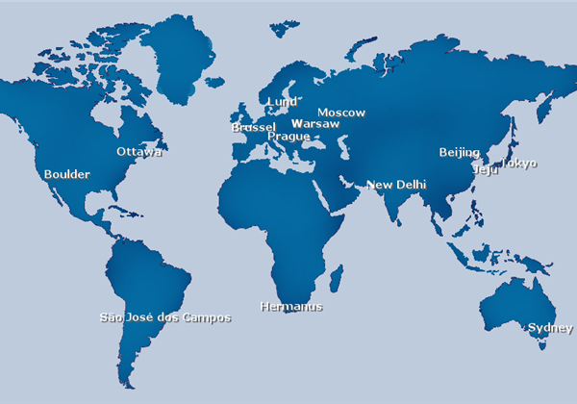
International Space Environment Service
Coordinating space weather services since 1962
• Improved service coordination is a priority
• Endorsed by national governments as space weather service providers
• Provide local users with targeted services
• Promote exchange of data and information
• Close collaboration with WMO
16 Regional Warning Centers
4 Associate Warning Centers
1 Collaborative Expert Center
UK
Graz
www.spaceweather.org

Slide 15
Summary
• The GOES space weather data are essential for many of NOAA’s operational space weather forecasts, warnings, alerts, and models
• Forecasts and specification of energetic particles support the satellite industry, commercial aviation, manned space flight, and launch ops.
• GOES-R includes improved capabilities to address the diverse service needs
• International coordination on observations and research will contribute to improve services and global resilience
• WMO, ICAO, COPUOS, CGMS and ISES are engaged in complementary efforts to advance data and service capabilities

