Slide 1
GOES-R and JPSS EPDT
Andrew Molthan¹ (for Jason Burks²)
NASA Marshall Space Flight Center/SPoRT¹
NWS / Meteorological Development Lab / CIRA²

Slide 2
GOES-R EPDT course
Spring 2016 course
April 26-28th, 2016
Held at SPoRT in Huntsville, AL
Group D
Included members of AWIPS Software Development Team (ASDT), Unidata, Department of Energy, NWS, SPoRT.

Slide 3
What is a code sprint?
EPDT Participants further learning and fulfill needs of GOES-R or JPSS.
Focused development activity over 3 days
Code in the end either ends up in the baseline or on VLab for future development

Slide 4
GOES-R code sprint Fall 2015
GOES-R toggle of display when section of data unavailable
Image Loop Tools
Integration of more products

Slide 5
GOES-R Toggle of display
Since imagery is delivered in patches
Need ability of the display to remove frames that have missing data
Have to add data back when missing imagery is delivered.

Slide 6
Image Loop Tools
Added loop scrubber
Allows quick interrogation of loop-able data
Very useful for GOES-R high temporal frequency data
Added ability to display visible frame controls
Visual indicator of frames displayed, and quick way to turn of frames.

Slide 7
Integration of more GOES-R products
TOWR-S and TOWR documentation work
Ingest, menu structure, and colormaps configurations developed for several GOES-R products
TOWR-S integration handled by Joe Zajic, et. al

Slide 8
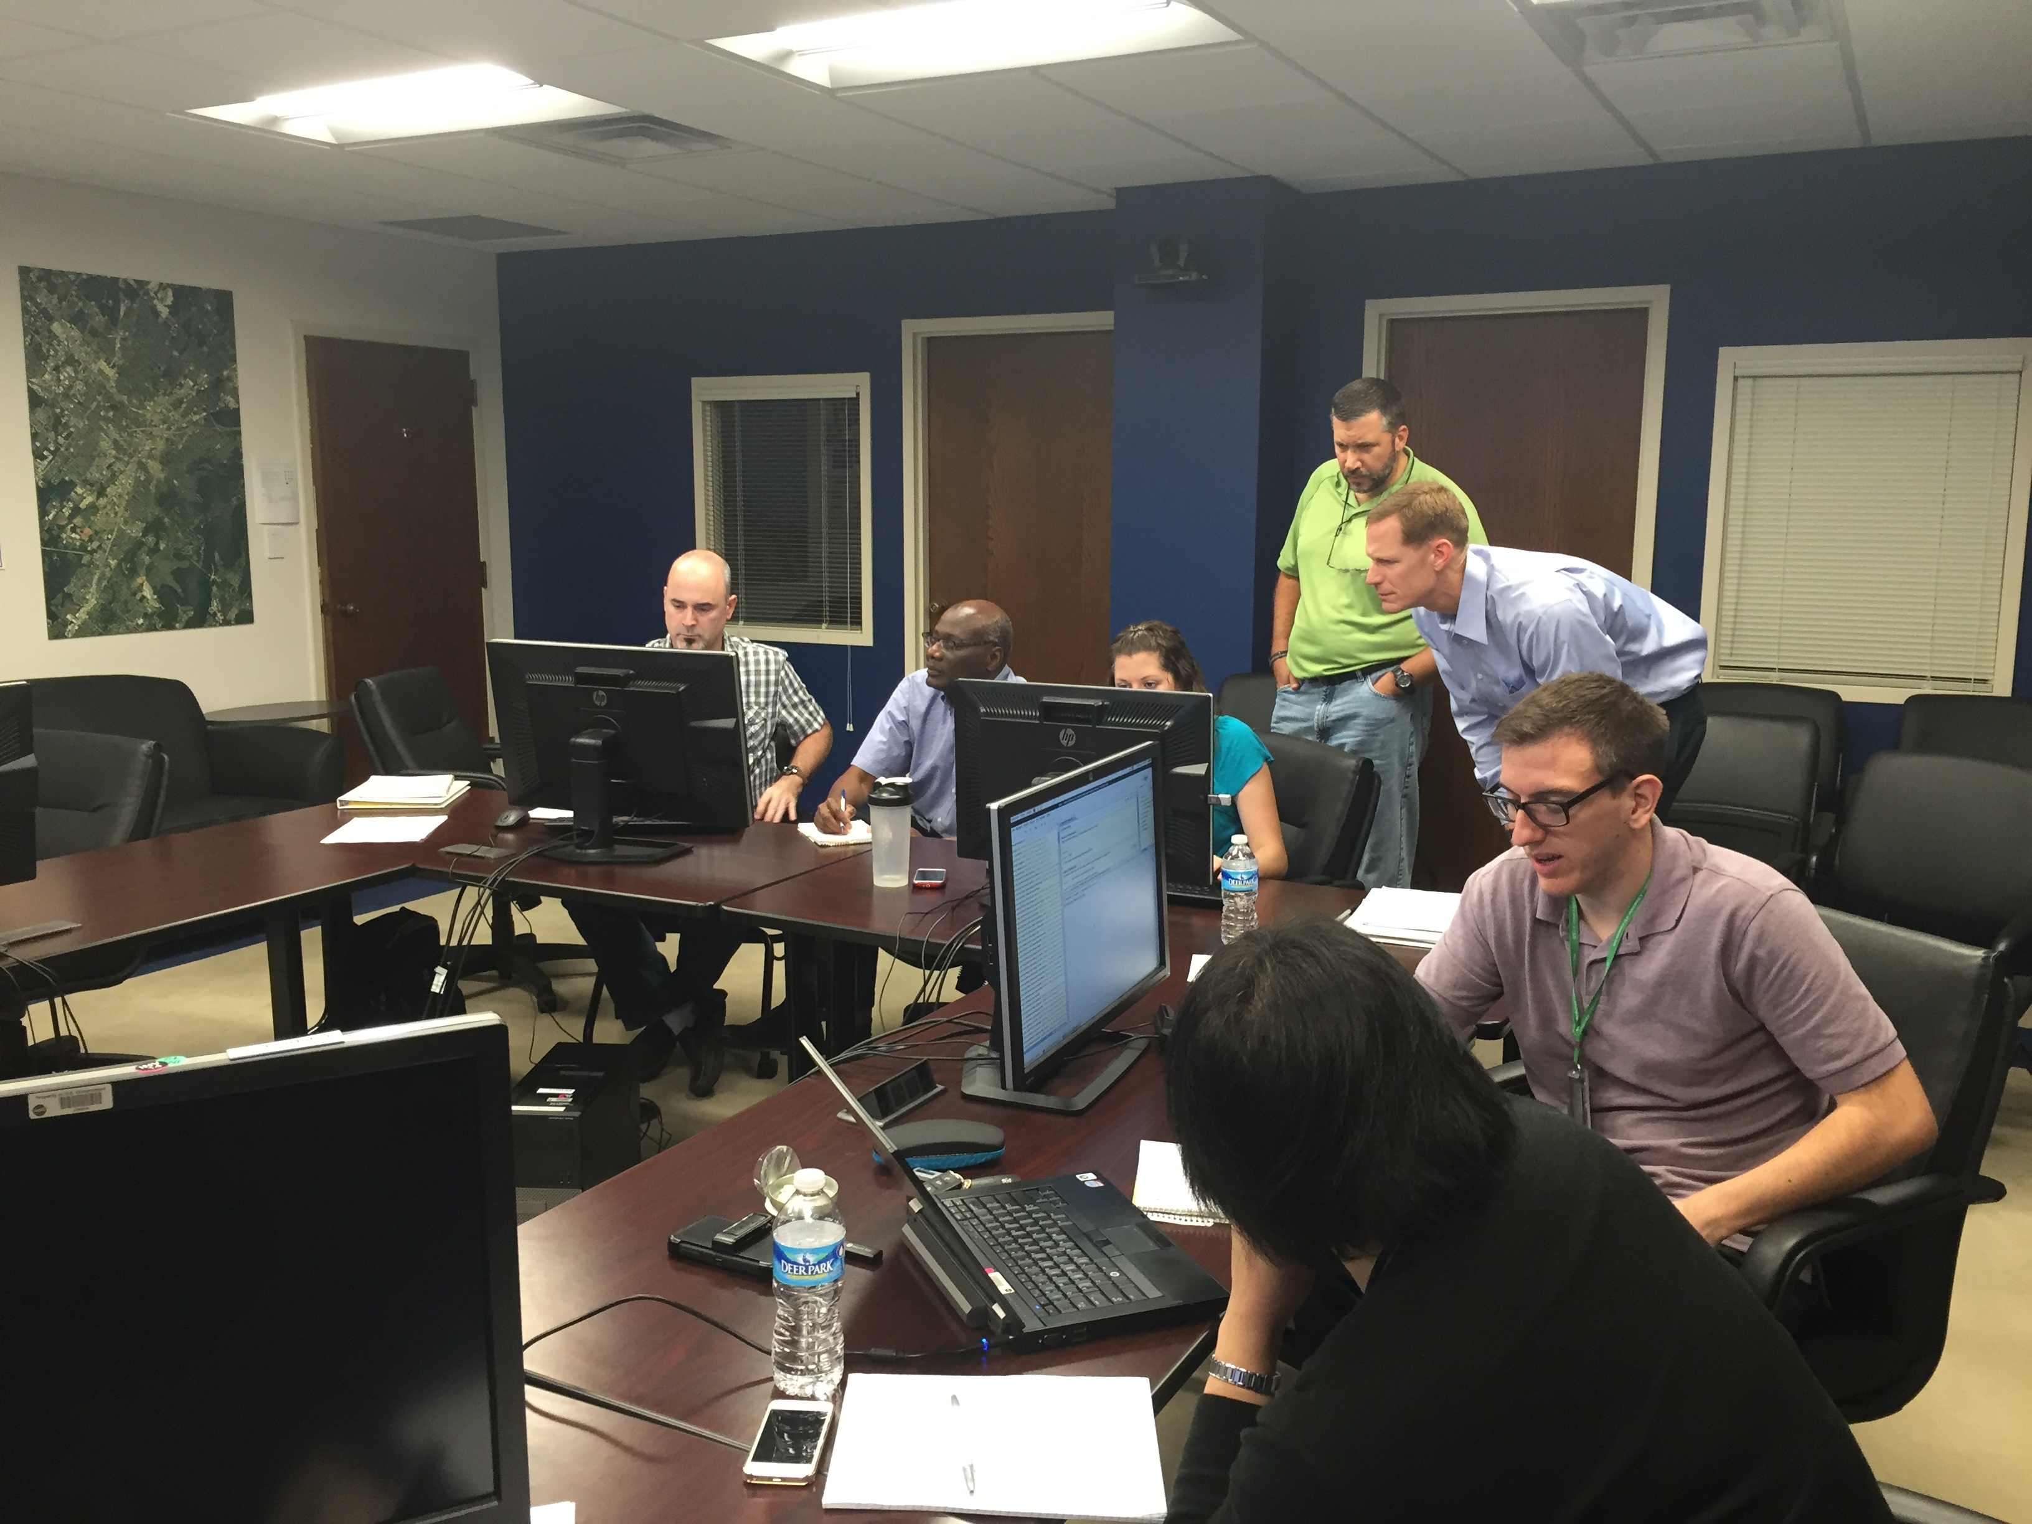
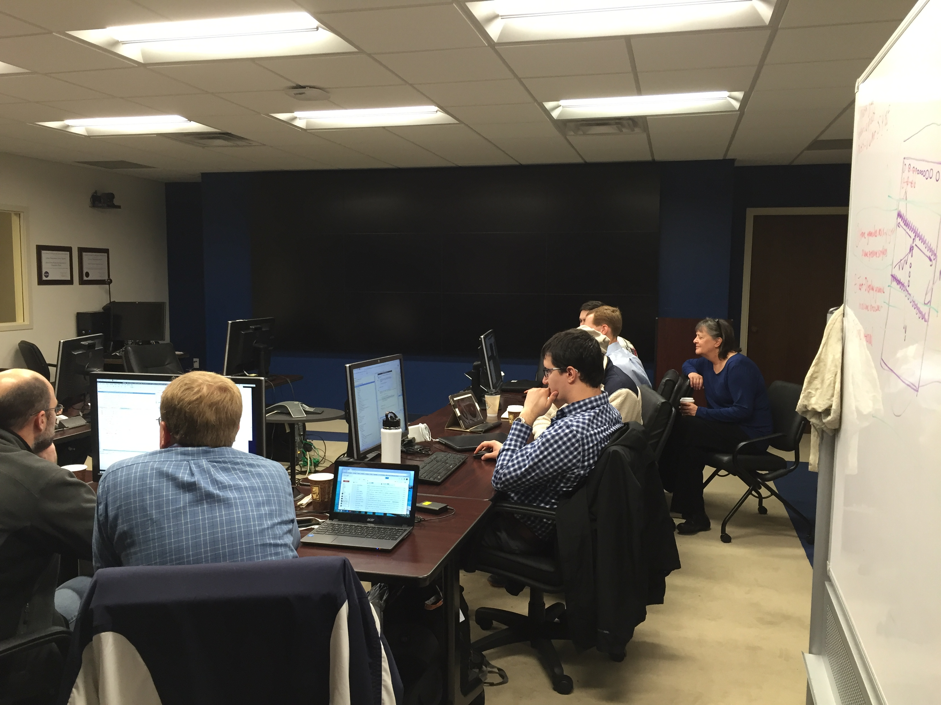
JPSS Code Sprint Fall/Winter 2015
VIIRS Active Fires
JPSS Product Ingest and Display
Document the new pointset plugins
NUCAPS Gridded Display

Slide 9
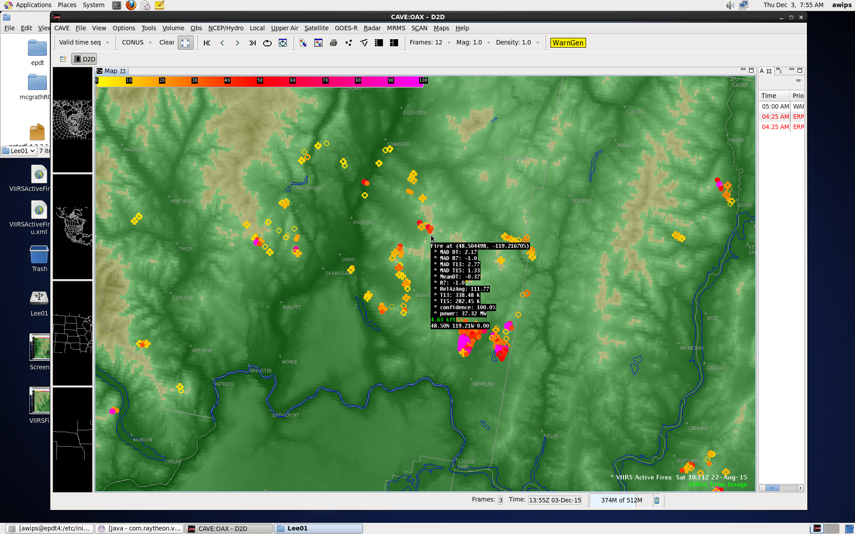
VIIRS Active Fires

Slide 10
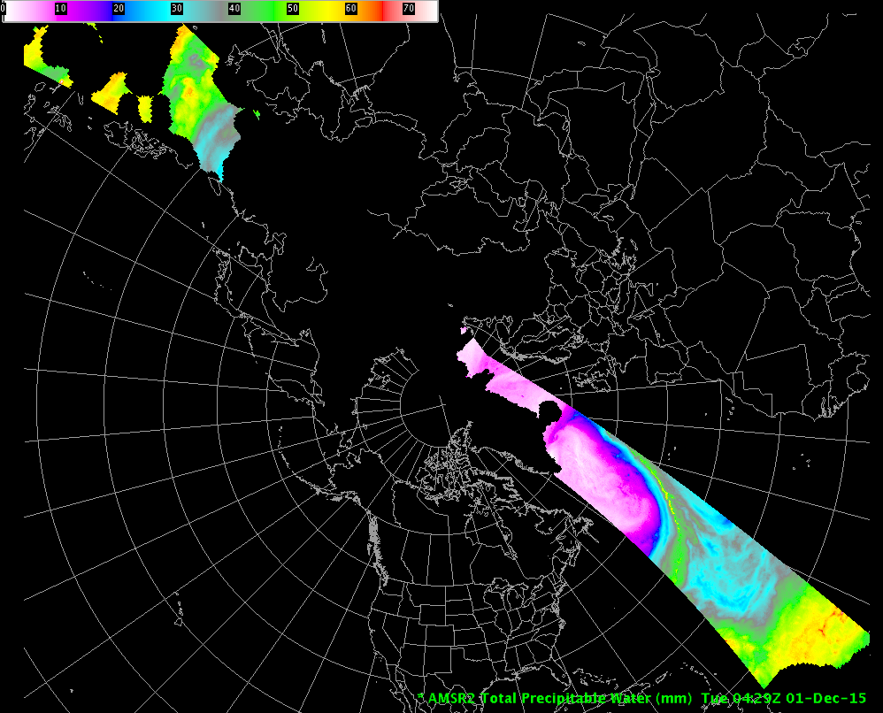
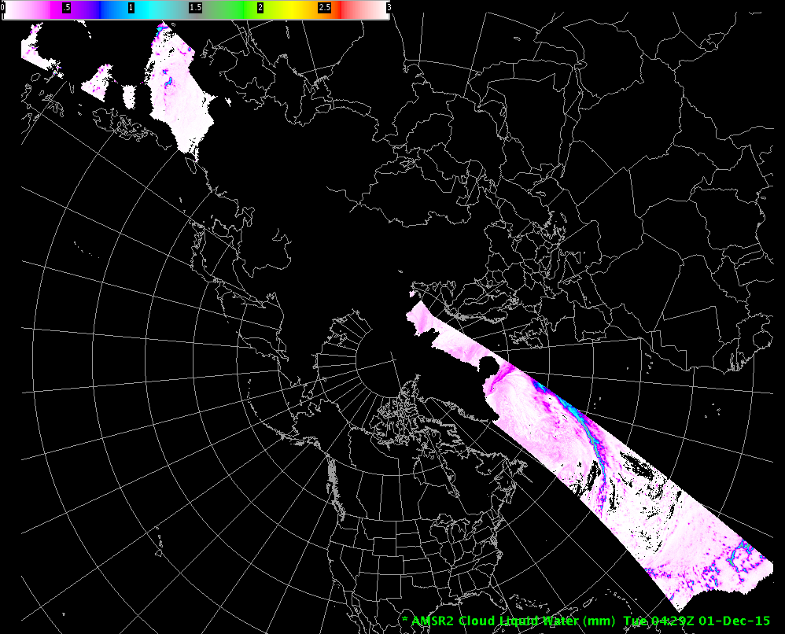
JPSS Product Ingest and Display
AMSR-2 L1B products:
GCOM Ocean Products
Cloud Liquid Water (CLW)
Sea Surface Temperature (SST)
Total Perceptible Water (TPW)
GCOM Precipitation Product
Rain Rate (Rain_Rate/RR)
ATMS MIRS Imagery:
ATMS MIRS Sea Ice Concentration (SIce)
ATMS MIRS Snow Water Equivalent (SWE)

Slide 11
Document the new pointset plugins
Documentation for the pointset plugin was generated so that other groups in the code sprint could utilize the plugin to display JPSS data and to ensure future displays of JPSS data can use this plugin.
The pointset plugin is very new to AWIPS and represents a new ingest and visualization
Several deficiencies were noted with the pointset plugin:
The pointset plugin uses optimized graphics card methods to display the data. It was found during the code sprint that the graphics optimization was found to have a limitation on ATI graphics cards.
This was reported to the Prime AWIPS contractor and they verified through their software testers that it was actually a more widespread fault, and it was fixed shortly after the end of the code sprint.
That fix has already been added to the baseline of AWIPS II.
The pointset plugin cannot ingest short or integer type arrays.
This limitation was reported to Prime Contractor and is currently being worked.
A training document was developed and provided to the NWS for future configurations

Slide 12
NUCAPS Grid Display
Develop a gridded interpolated view of the NUCAPS sounding data on the standard atmospheric pressure levels.
The NUCAPS soundings are already being ingested into the AWIPS II platform and are viewable through a display plugin.
The project is to connect into the ingest and collect the NUCAPS soundings after ingest and grid the soundings into planar 2D fields at standard pressure levels.
The group made significant progress and next code sprint will be able to carry on the development to possible finish the plugin.
Currently the new plugin can be connected to the normal ingest of NUCAPS and take the soundings and grid one single level and return it out as a grid data object. This grid data object gets displayed in CAVE like other grid data
The code developed so far has been pushed to the VLab repository. Before the next code

Slide 13
Future EPDT Efforts
SPoRT will continue to facilitate travel and other logistical aspects of EPDT as needed, in collaboration with EPDT Co-Is at CIRA.
Jason will remain engaged in overall AWIPS development activities in his new role with the Meteorological Development Lab / CIRA

Slide 14
Questions?

