Slide 1
Space Weather Products in AWIPS2
Steven Hill, NOAA/SWPC
SWPC: Chris Lauer, Ratina Dodani, Kelvin Fedrick, Mike Carpenter, Ann Newman, Chris Balch, Bob Rutledge, Rob Steenburgh, Brent Gordon
NCO: Shova Gurung, David Plummer, Stephen Gilbert, Jason Travis
NGDC: Johnathan Darnel, Janet Machol, Bill Denig, Pau Loto’aniu, Rob Redmon

Slide 2
Space Weather Products in AWIPS2
Integrating space weather (including GOES) data into AWIPS2
GOES-R space weather instrumentation and products
Data fusion
Data path from IDP GOES-R product generation to SWPC to AWIPS2
Test operations with GOES 13-15 data

Slide 3
Not Exactly a Science Issue, but…
GOES Space Weather Data have previously been developed and managed exclusively by SWPC
For GOES-R
GOES-R program is developing the L1B products
NGDC is developing the L2+ algorithms and processing system
NWS IDP will host operational L2+ processing
AWIPS2 will replace many custom SWPC systems, not just for GOES SWx data, but also for all other SWx data

Slide 4
AWIPS2 Context
SWPC provides data pipeline
NCO provides AWIPS2 applications
AWIPS2 Functions include:
Image ingest, rendering, animation and analysis
Time series data (GOES, ACE, STEREO, DSCOVR)
Coded messages, events, regions, other text I/O
Ground magnetometer data
General forecaster applications (Products, Alerts…)
Enlil applications: SPI, CMENT, CAT
Model ingest, rendering and animation

Slide 5
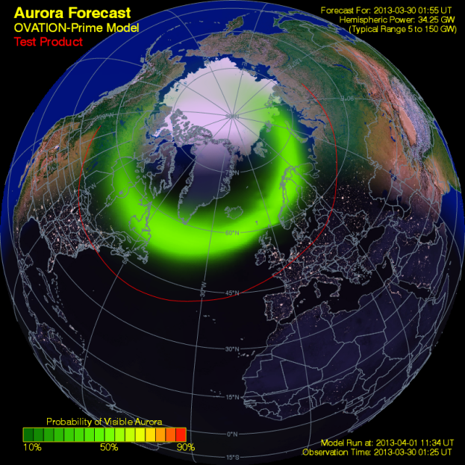
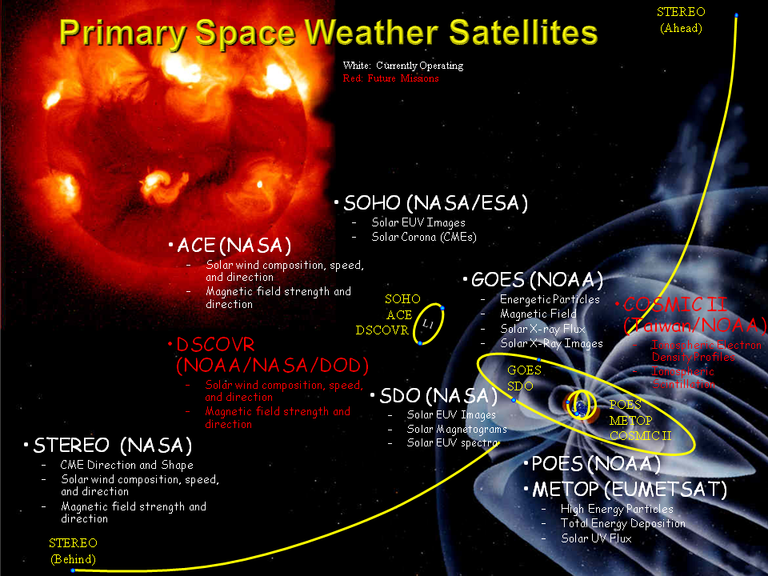
SWPC Reliance on Satellites
Aurora Location and Intensity Model: Driven by solar wind data measured at the L1 point (1% of the distance between Earth and sun
Most Products Require Satellite Data
95% of SWPC products use satellite data
Only 10% of products can be produced without satellite data
Two of the Three Space Weather Scales are Derived solely from Satellite Observations
Future Satellite Missions are Critical
DSCOVR: Continuity of observations from L1
GOES-R: Continuity of observations from GEO
COSMIC II: Expanding real-time observations on a global scale

Slide 6
GOES R Instruments
EXIS - Ultraviolet and X-ray Irradiance Sensors (EXIS): X-ray sensor, expanded dynamic range and flare location
SUVI – Full-disk extreme ultraviolet imager: Active region characterization, filament eruption, and flare detection
SEISS – Electrons, protons, heavy ions – Surface charging, internal charging, single-event upsets
MAG - Detection of geomagnetic storms and magnetopause crossing, energetic particle products, model validation

Slide 7
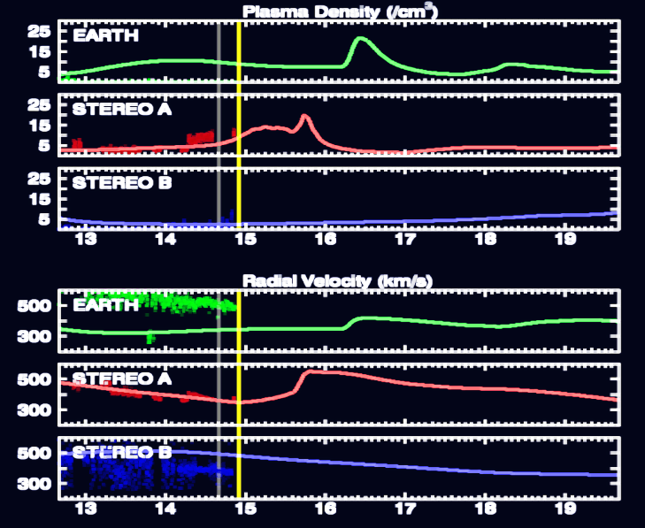
Data Integration and Fusion
Data fusion for forecaster interpretation
Solar Image overlays for situational awareness
Over-plots of solar wind measurements vs. models
Notes:
Enlil run from 2012-03-14

Slide 8
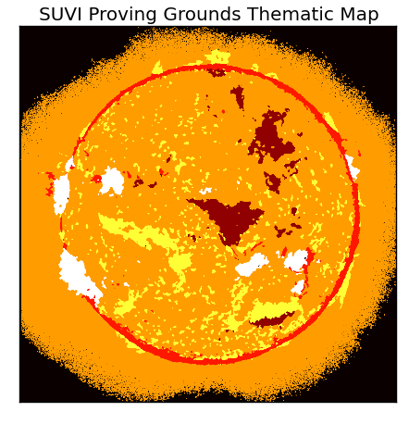
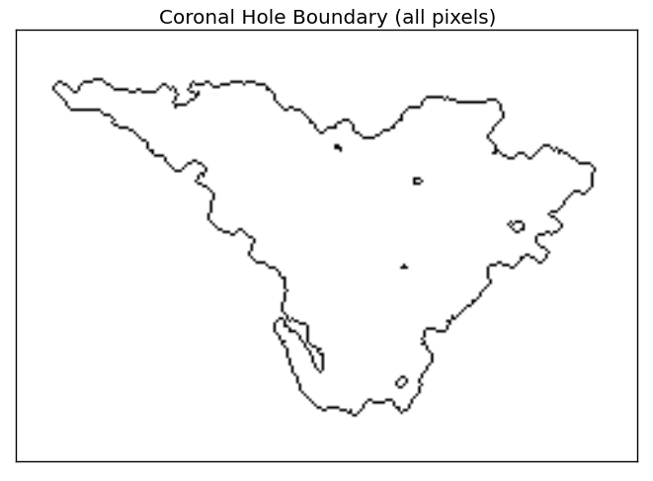
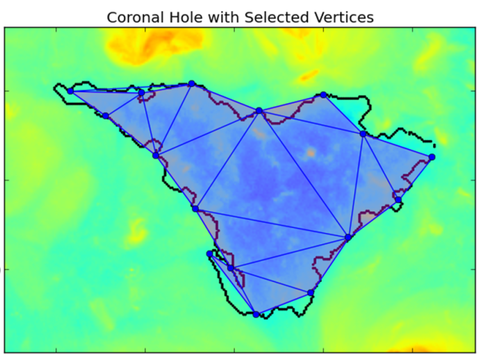
Example New/Improved Products
SUVI
Thematic maps (multispectral pixel classifier) improvements
Bright regions – associated with solar active regions
Flare location – Solar eruptions seen as hottest & brightest of bright regions
Coronal Hole Boundaries – dark areas of strong, outflowing solar wind
SEISS and Magmetometer
Electron and Proton Densities and Temperatures (Moments)
Magnetopause crossing

Slide 9
Demonstration(s)
Proxy data
GOES 13-15
ACE
SDO
Requirements and Specifications
Latency: < 15 sec for time series; < 1 min for images
Formats: XML for time series; FITS for images
Reliability
File type must be easily and quickly validated, self-describing, etc.
System elements must be robust against interruption and corrupt data
Other Guiding Principles:
Minimize technical debt
Minimize maintenance
Maximize extensibility (easy to add new data sets)

Slide 10
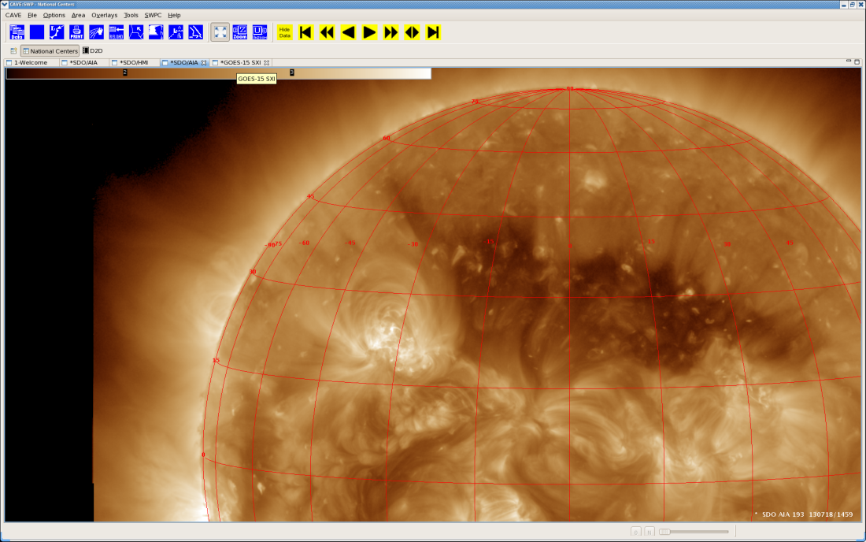
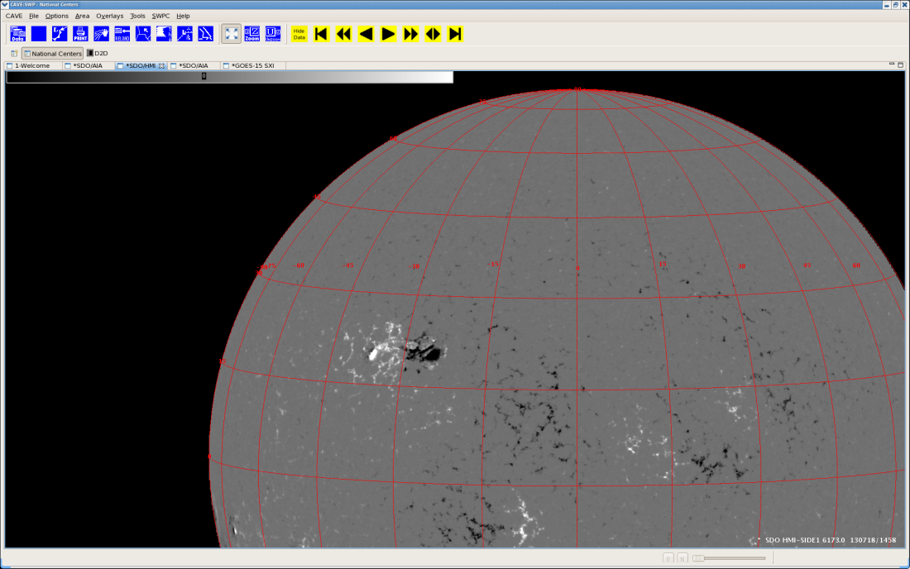
Solar Imagery on AWIPS2
SDO 19.3nm and HMI magnetogram data
Science level data now accessible to forecasters via FITS format
Quantitative images with accurate navigation

Slide 11
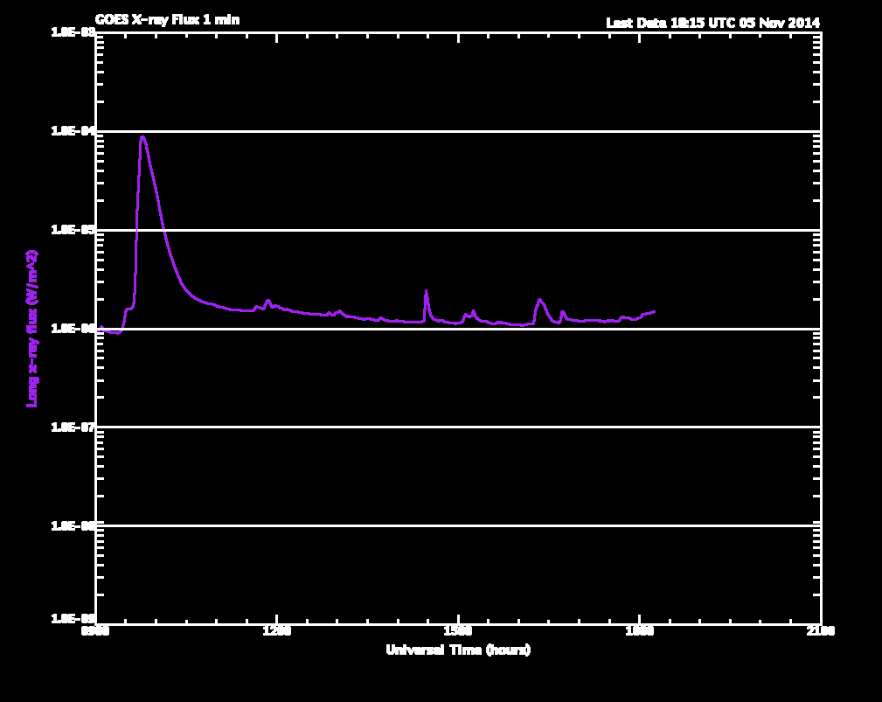
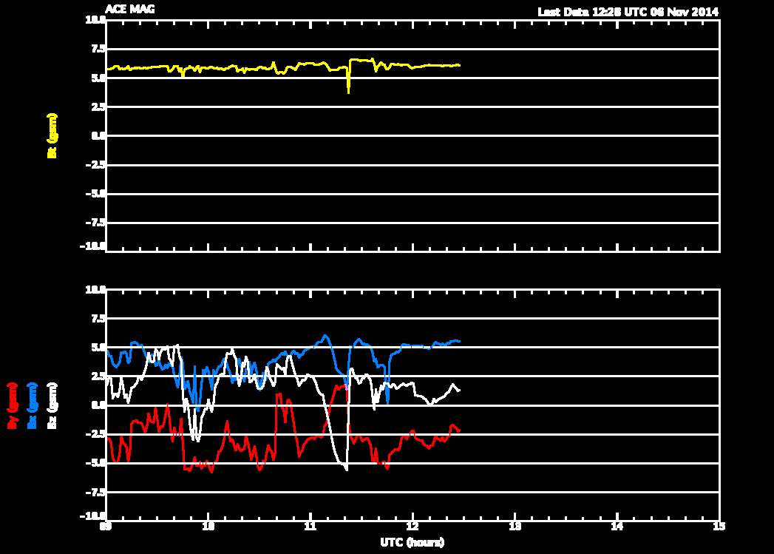
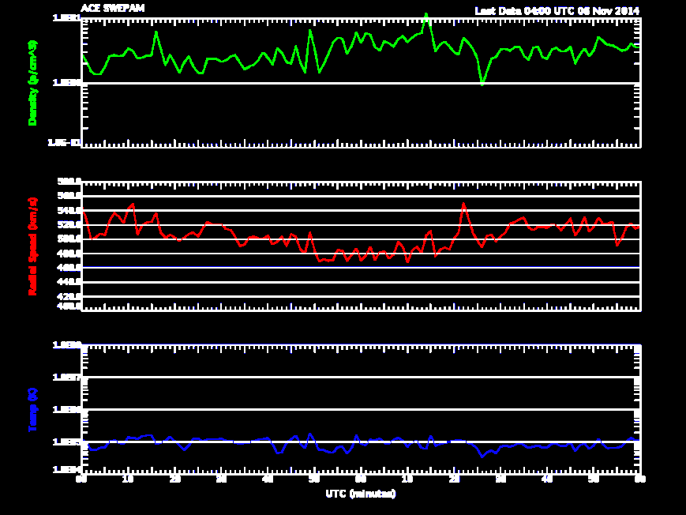
Time Series data on AWIPS2
ACE and GOES data
Data formats and samples generated
Encoders and decoders written
Prototype pipeline developed
Preparing for operational deployment of the data pipeline

Slide 12
Conclusion
Substantial progress toward highly reliable system
Integrating a system very unlike prior GOES space weather data systems
Components developed across organizations (GOES-R, NGDC, NCO, NWS, and SWPC)
AWIPS2 image and time series data will soon be available to forecasters in real-time

