Slide 1
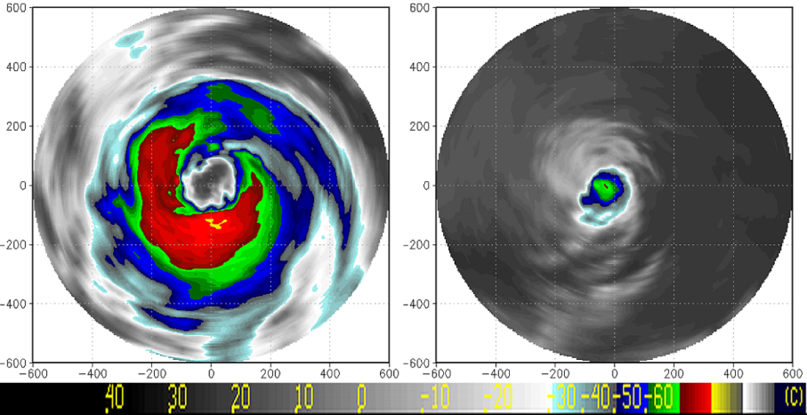
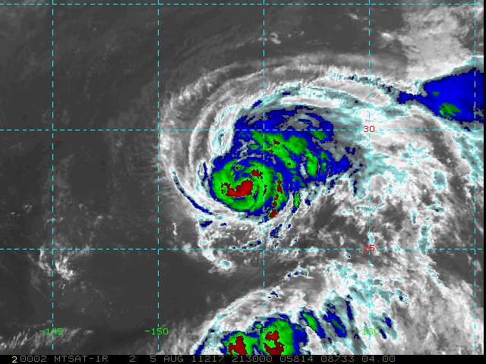
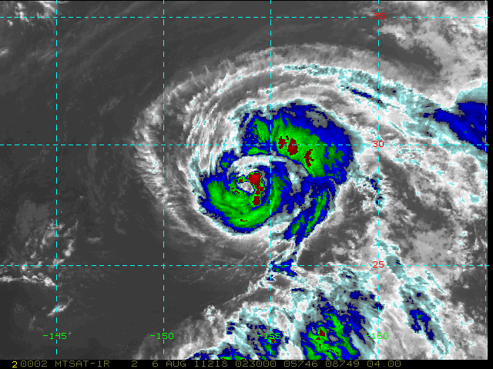
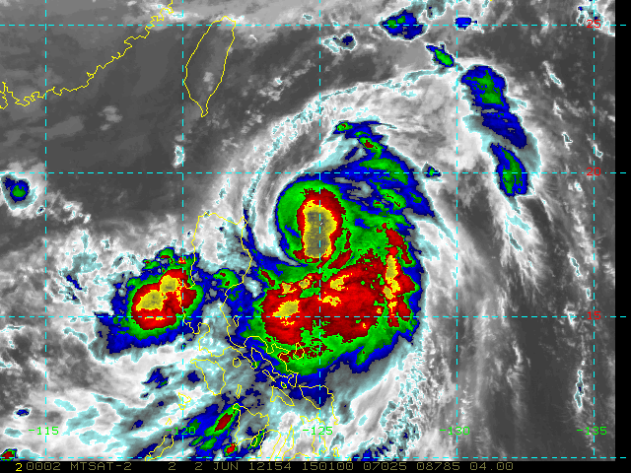
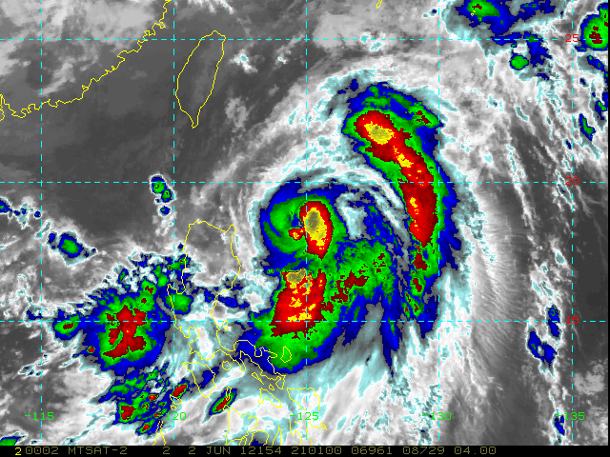
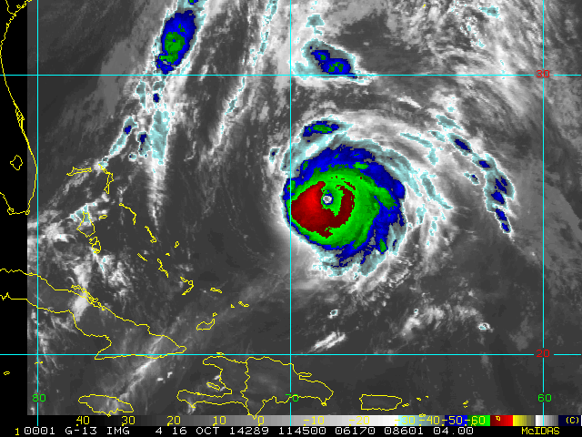
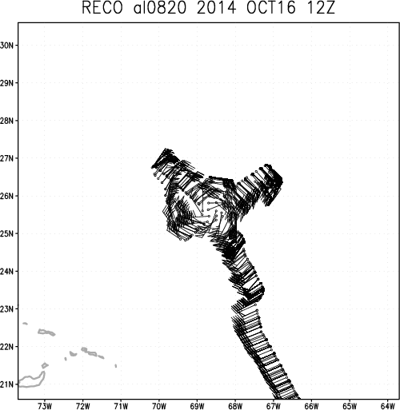
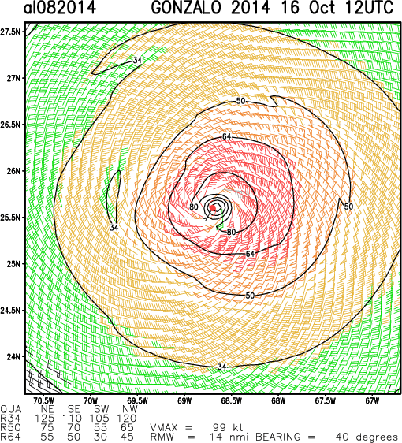
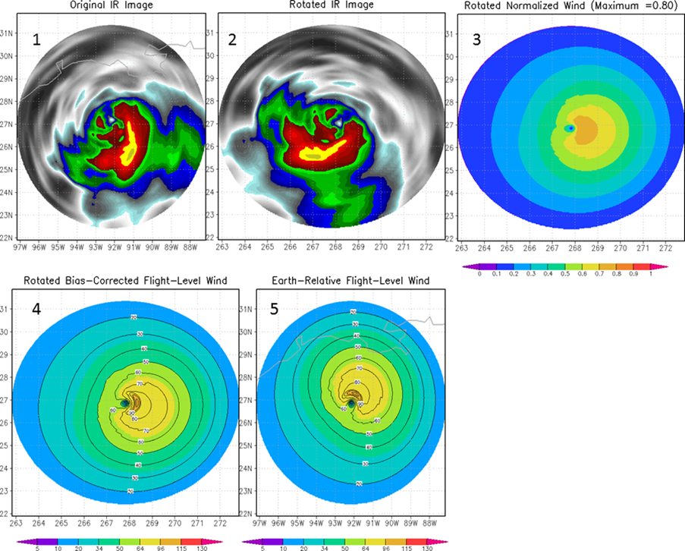
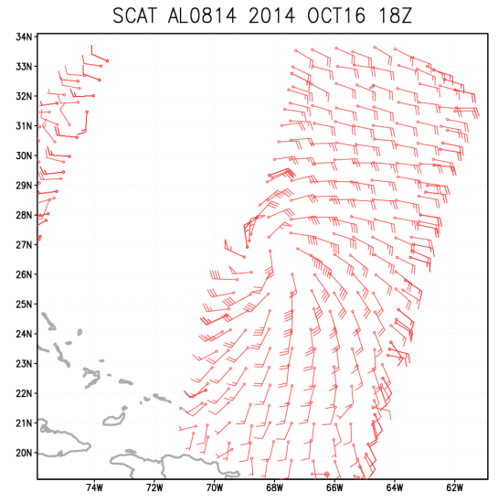
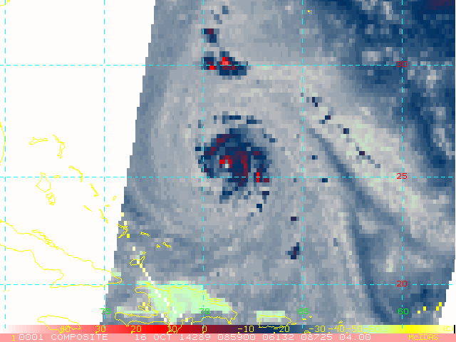
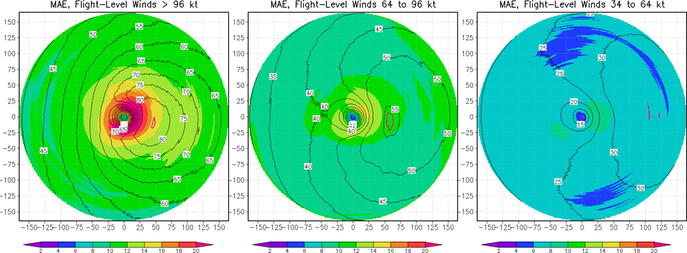
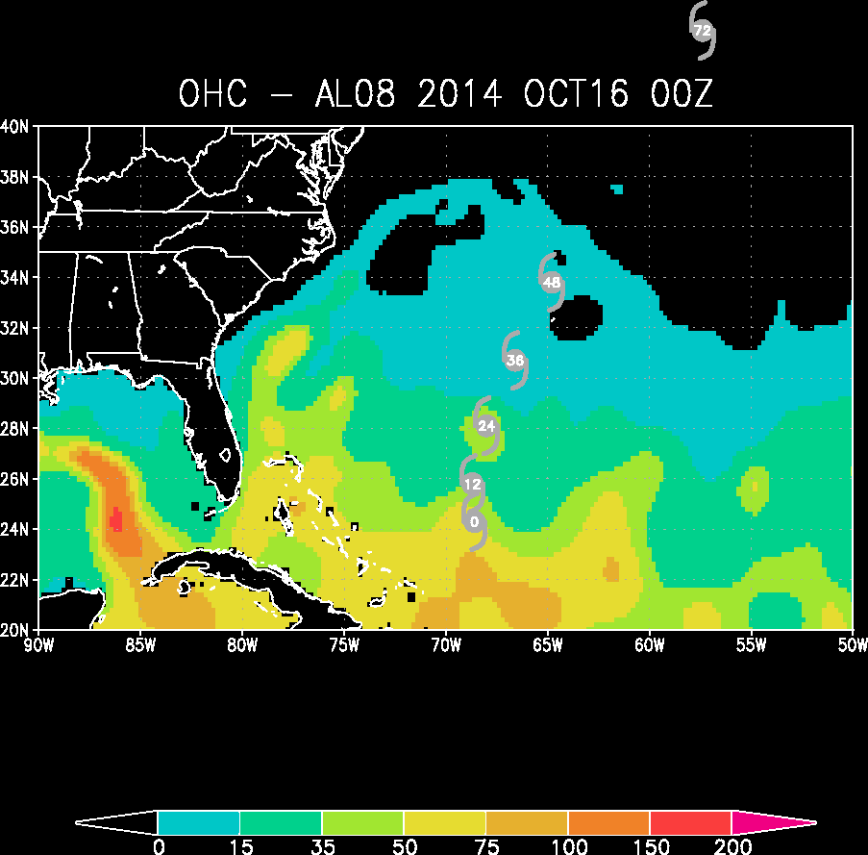
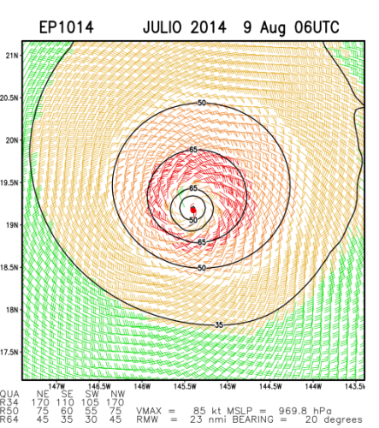
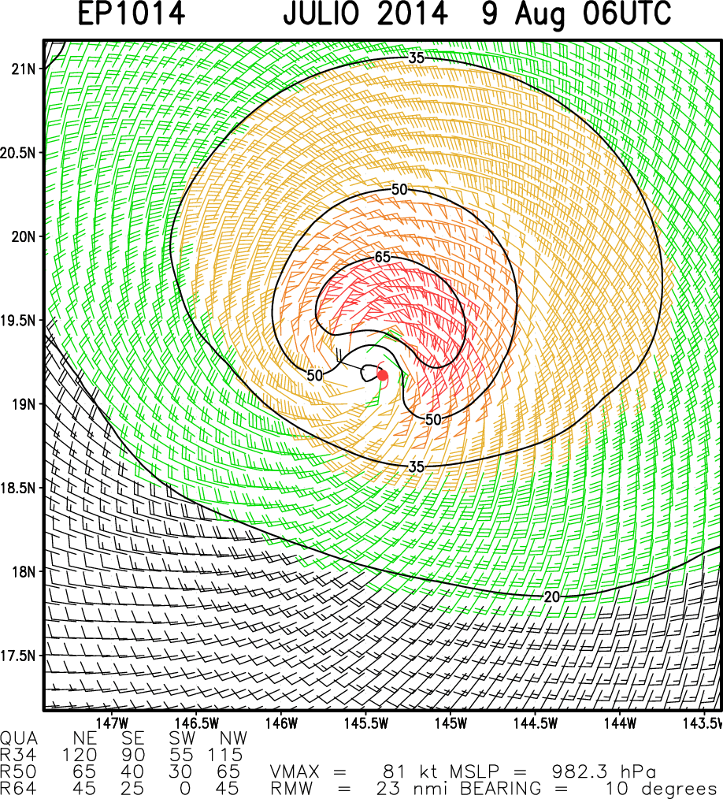
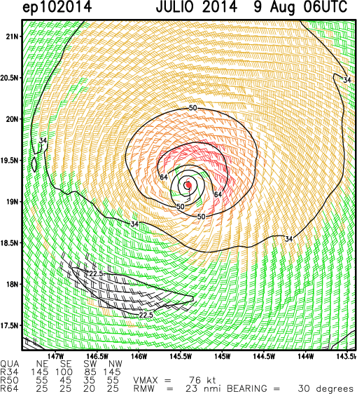
Preparing for GOES-R and JPSS: New Tropical Cyclone Tools Based on 30 Years of Continuous GOES IR Imagery John A. Knaff¹, Robert T. DeMaria², Scott P. Longmore², Debra A. Molenar¹, Kate D. Musgrave² ¹NOAA Center for Satellite Applications and Research/RAMMB, Fort Collins, Colorado ²The Cooperative Institute for Research in the Atmosphere, Fort Collins, Colorado
Scientific Premise: As JPSS/SNPP and GOES-R platforms become available, the focus of the satellite community’s funding, research, and product development often gravitates toward their new capabilities. This is sometimes justified, especially when the information content of older datasets has been exhausted. However this is sometimes not the case.
Here we argue that tropical cyclone (TC) research and product development is a case where there is untapped potential in the information contained in older satellite data. The reasons are many. The observation of tropical cyclones has dramatically improved in the last 20 years. Some significant observational improvements are based on satellite platforms (e.g., scatterometry, microwave imagery, water vapor imagery) while others (e.g., aircraft reconnaissance instrumentation, improved dropwindsondes) are not. Statistical techniques, data storage, data availability, and computational speed have also all improved. In sum, the availability of improved observations, analysis techniques, computing, and physical understanding of TCs has improved so much that new capabilities can be developed using older geostationary and polar data.
Example Applications Developed with These Data
Eye Detection/Eye Size/Radius of Maximum Wind
Dvorak fixes (ATCF) are used to develop eye no-eye training set (n=2677)
based on six-hourly Atlantic and East Pacific tropical cyclones.
Machine learning algorithms used to train an objective eye detection scheme (under JPSS funding, see Robert DeMaria’s poster)
Preliminary results suggest that this scheme can detect 75% of the eye cases with false detections of ~20% when using a 50 knot intensity threshold
IR-based TC Size Estimates (Knaff et al. 2014)
Based on the 1D (azimuthally average) Principle components and latitude (no intensity)
V500 is the tangential wind at 500 km radius.
Satellite & Lat. information is trained on model analyses
No eye, 65 knots
Eye, 65 knots
Leading modes of variability or Empirical Orthogonal Functions (EOFs) of the 6-hourly mean azimuthally averaged profiles of IR BT. The percent of the variance explained by each EOF is shown in parentheses.
IR images of Typhoon Abe (left, 25.2ºN, 124.8ºE, 90 kt, 30 Aug 1990, 00 UTC) and Hurricane Kay (right,16.0ºN, 123.8ºW, 65 kt on 13 Oct 1998 18 UTC). These images also had PC1 values of -1.1 and 1.0, PC2 values of 2.8 and -2.3 and PC3 values of 2.1 and -2.6 for Abe and Kay, respectively. These are the largest and smallest hurricanes in a 30-yr global dataset.
No eye, 70 knots
Eye, 83 knots
Data Available for TC Application Development
IR Imagery
CIRA/RAMMB TC IR Image Archive (1990-pres)
HURSAT (1978-2009)
TC Information
ATCF (Best tracks w/ wind radii, fixes, guidance, real time)
HURDAT2 (Best tracks w/ wind radii)
IBTrACS (all agencies)
Aircraft Reconnaissance
Air Force/NOAA (10 & 1 Hz; 1995-pres)
HDOBS (real-time access)
Dropwindsondes (real-time access)
Other Satellite
Passive Microwave Imagery/Sounder
Scatterometry
CloudSat
Ocean Analyses
Navy Coupled Ocean Data Assimilation (NCODA)
NESDIS operational products
Model analysis/forecasts (HWRF/GFS)
Fields
Synthetic Imagery
Potential Forecast/Diagnostic Applications
Surface wind structure
TC size (vortex size as inferred from outer winds)
Diagnoses of the 2-D wind field using imagery and intensity
Relating TC size and intensity to wind radii
Statistical-dynamical wind radii prediction
Eye/radius of maximum winds
Objective eye detection and/or probability of existence
Forecasting eye development/eye diameter
Intensity
Rapid Intensification Forecasts (probabilistic)
Statistical Dynamical Forecasts (deterministic)
Additional Applications Derived from TC Size estimates
Application | Use
1. Wind Radii given intensity, motion vector and TC size | Can be applied to intensity fix(es) (e.g. Dvorak) Provides a distribution for Monti-Carlo/stochastically generated storms for climate risk modeling
2. TC size as the basis for statistical-dynamical size/wind radii forecasts | Can potential provide wind radii estimates consistent with SHIPS/LGEM
3. TC size can be used to scale observational data | Any application requiring size normalization for average quantities(e.g., rainfall, core/rainband separation, lightning)
4. Model diagnosis | Can quantify sizes from synthetic imagery, assess TC growth etc.
Two West Pacific cases, WP122011 MERBOK (top, 65 knots) and WP042012 MAWAR (bottom, 70-83 knots). Images on the left show the no-eye image 6 hours prior to the images on the right which were subjectively determined to have an eye.
Next Steps
Refine algorithm with different intensity thresholds/data subsets
Develop probabilistic eye/no-eye algorithm
Run the algorithm on all images in the CIRA/RAMMB TC archive (~500,000 unique times)
2-D wind field (Knaff et al. 2015)
Based on intensity estimate, 2-D storm relative IR principle components
Trained on aircraft-based flight-level data decomposed into azimuthal wavenumbers 0-1 and their phases
Produces an estimate of the 2-D wind field
Uses a method called single field principle component analysis that relates wind amplitudes and phases to the IR principle components.
Additional Applications Eye Detection/Eye Size/Radius of Maximum winds
Application | Use
1. Intensity forecasting | The probability of eye formation provides vital information as to the short-term intensification rate
2. Climatology of eye size, eye formation | Detailed climatology of eye size and eye formation is of general interest. Eye diameter is related to RMW
3. Eye anticipation, eye size product | This would aid short-term forecasts and forecasters
4. Model diagnosis | Methods could compare model eye formation to climatological aspects of eye formation (2)
Hurricane Ike (2008) Sept 12 at 1145 UTC
Summary
The increased availability of improved observations, new analysis techniques, computing efficiency, and physical understanding of TCs has improved so much that new capabilities can be developed using older geostationary and polar data. Such capabilities can easily be transitioned to future operational and analysis techniques that make use of JPSS and GOES-R imagery and products.
Work to develop new tropical cyclone capabilities using legacy GOES and POES imagery will continue at CIRA/RAMMB and is the basis for much of our GOES-R product development effort.
References:
Knaff, J.A., S.P. Longmore, D.A. Molenar, 2014: An Objective Satellite-Based Tropical Cyclone Size Climatology. J. Climate, 27, 455-476.
Knaff, J.A., S.P. Longmore, R.T DeMaria, D.A. Molenar, 2015: Improved tropical cyclone flight-level wind estimates using routine infrared satellite reconnaissance. Accepted to J. App. Meteor. Climate.
DeMaria, R.T., G. Chirokova, J. A. Knaff, and J. F. Dostalek 2015: Machine Learning Algorithms for Tropical Cyclone Center Fixing and Eye Detection. 20th Conference on Satellite Meteorology and Oceanography.
Dependent mean wind field (contours) and absolute errors (MAE, shaded) stratified by flight-level analysis winds with cases with winds greater than 96 kt (left), winds 64 to 95 kt (middle) and winds 34 to 64 kt (right). Note motion is toward the top of the page. The magenta contour on each panel shows where the average RMW of flight-level wind is located in each composite. The scale is the same for all figures.
An illustration of the steps taken to estimate the wind field. Imagery are mapped to a polar grid (1) and then rotated with respect to direction (2). Rotated imagery, translation speed, latitude and intensity are used to estimate the normalized wind field (3). The observed intensity is then applied to create a wind speed field (4). Finally the wind field is rotated back to its earth-relative directional component (5).
Additional Applications Derived from 2-D Wind Fields
Application | Use
1. NESDIS Multi-Platform Tropical Cyclone Surface Wind Analysis | Improve the inner core flight-level wind estimates
2. Vortex Data assimilation | Can be used to specify the wind distribution including RMW
3. Input for aircraft-based analyses. | First guess
NESDIS
New IR Winds
Aircraft + NESDIS
Acknowledgments: This work was supported under the Hurricane Forecast Improvement Program (HFIP )and the GOES-R/JPSS Risk Reduction Program.
Disclaimer: The views, opinions, and findings contained in this article are those of the authors and should not be construed as an official National Oceanic and Atmospheric Administration (NOAA) or U.S. Government position, policy, or decision.

