Slide 1
TOWR-S Coordination with NWS Operations and Training
Eric Guillot, Mike Johnson, & the TOWR-S Team
11 May 2016

Slide 2
What is the GOES-R Simulated Imagery?
RaFTR: Resample and Format: Timed Release system creates simulated GOES-R data
All 16 GOES-R channels derived from CIMSS model output
Hourly WRF-CHEM over CONUS
GFS over rest of world
RaFTR interpolates model output to correct GOES-R imagery cadence
Flex Mode: 15 min FD, 5 min CONUS, two 1 min mesoscale areas
Scan Mode: 5 min FD & CONUS
Data is processed through the GOES-R Ground Segment and sent over the GOES-R East and West SBN channels via the NCF
As far as AWIPS-II is concerned, this is the real GOES-R imagery!

Slide 3
What are the GOES-R Simulated Products?
Simulated GOES-R imagery flows into GOES-R GS
Baseline product algorithms process the data:
Simulated imagery
Real-time ancillary data (models, observations, etc.)
Baseline products are created in real-time and hosted on the PDA system
Baseline products are sent to sites over EXP channel of SBN via NCF and terrestrially via PDA
As far as AWIPS-II is concerned, these are the real GOES-R baseline products!

Slide 4
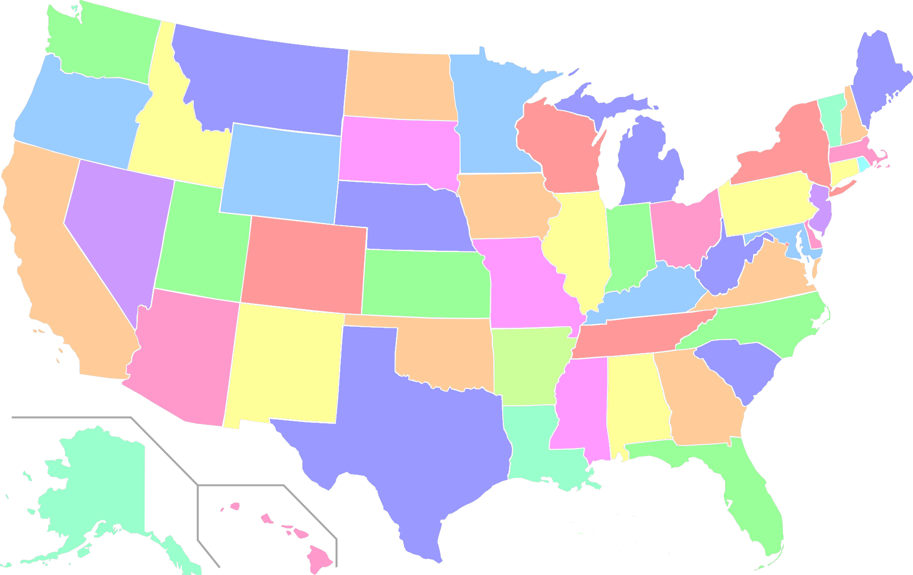
User Readiness Partners
MSO
PQR
FGF
MFR
APX
RIW
CIMSS
EKA
CYS
OAX
HNX
CIRA
WPC
OPC
UCAR
CRHQ
RLX
VAAC
OPG
AWC
PAH
LOX
MRX
ABQ
PSR
HWT
OUN
CAE
WDTD
SPC
CHS
TWC
FWR
ARH
PRHQ
NHC
= WFO/RFC/National Center
BRO
= Support Site
Notes:
22 WFOs
1 RFC
All 5 National Centers
1 NESDIS center
2 Regional HQs

Slide 5
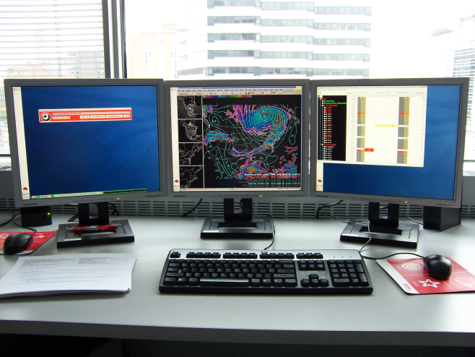
Necessary Site Modifications to Receive Imagery & Products
Modifications to the AWIPS pqact & ldmd files:
Read the GOES-R East and GOES-R West SBN channels
Read the SBN EXP channel
Read the WMO headers for GOES-R Sectorized Cloud and Moisture Imagery, derived products, and polar products
Restart LDM as root
Note: pqact.conf file changes are overwritten in each AWIPS build
5

Slide 6
Daily Satellite Scan Strategy Tag-Up
Standing optional meeting daily at 2pm EDT
Opportunity for user community to:
Report any dataflow issues at their site
Decide to put the “satellite” in E or W position for next day
Decide to put the “satellite” in Flex or Continuous Full Disk mode for next day
Decide on position of Mesoscale sectors if in Flex mode
Plan for following day will go into effect at 12z that day
6

Slide 7
AWIPS Freeze & TOWRpro RPM Development
AWIPS freeze is imminent
AWIPS v16.4.1 is currently final release (~Oct 2016)
Satellite AWIPS development will continue beyond freeze date
Non-baseline “localization” changes to continue during freeze via TOWRpro RPM
RPM = Red Hat Package Manager
A collection of .xml AWIPS configuration files installed at the “site” level
GOES-R RPM collection called “goes-r wfo”
Polar RPM collection called “polar-wfo”
7

Slide 8
GOES-R TOWRpro RPM
GOES-R TOWRpro RPM has been deployed at nearly all participating sites. It contains:
Improved GOES-R CAVE menu
GOES-R 11-bit color tables
Derived product WMO headers
Purge rules to 6 hours
Other config files required to receive products
Users can provide feedback to TOWR-S for recommended changes to menu, color tables, etc.
Derived products are becoming available over SBN this month
8

Slide 9
Polar TOWRpro RPM Development
Polar TOWRpro RPM is under development and not yet deployed. It will contain:
Polar imagery/products (listed by satellite source) in existing “Satellite” CAVE menu
WMO headers for all polar imagery/products
Polar products are becoming available over SBN this month
Beginning to flow over EXP SBN channel
First product will be AMSR-2 Sea Surface Wind Speed
Eventually these products will be migrated to their operational paths
Requires AWIPS v16.2.1 to display them (point-set plugin, netcdfGrid plugin)
9

Slide 10
TOWRpro AWIPS Installation
Performed by site ITO or SOO
Detailed directions provided on Vlab
Takes ~20-30 minutes for initial install
Takes ~5 minutes for install of updated version
Matt Comerford (TOWR-S) wrote TOWRpro RPM & installation instruction (supports every site install)
Installation guide located at: https://vlab.ncep.noaa.gov/group/goes-r-end-user-mission-readiness-project/rpm-installation-guide
10

Slide 11
Participants Presenting Today
Following three talks this session are from various TOWR-S participants:
Mike Stavish: SOO @ WFO Medford
Chris Gibson / Lance Vandenboogart: SOO / Intern @ WFO Missoula
Paul Iniguez: SOO @ WFO Phoenix
11

Slide 12
Summary
NWS participation with simulated imagery dataflow has been outstanding
TOWRpro RPM has become a primary way to advance AWIPS satellite configuration changes
GOES-R SCMI will continue to be sent over SBN until real GOES-R data is available after launch
Simulated GOES-R derived products and real polar product dataflows are beginning very soon
12

