Slide 1
Activities of the Hydrology Initiative of the JPSS PGRR Program
Ralph Ferraro
NOAA/NESDIS/STAR
Ralph.R.Ferraro@noaa.gov

Slide 2
Hydrology – Very Diverse!

Slide 3
Hydrology Initiative Overview & Objectives
Goal(s):
Create a forum for Hydrology-related project teams to interact regularly
Coordinate activities of its stakeholder projects to include:
Algorithms/techniques/software that is mutually beneficial
Link derived products (surface, atmosphere) where possible
Develop potential products intercomparisons
Engage users, including WFO, National Centers, Proving Grounds, Testbeds
Identify newsworthy ‘events’ to apply project capabilities & evaluate value
Develop linkages to other initiatives under JPSS & GOES-R PGRR. Additionally, linkages to NESDIS/STAR and OSPO activities related to operational product monitoring (through JPSS ADP and GOES-R AWG)
Satellite (sensors) used:
Primary - S-NPP (ATMS, VIIRS; CrIS); GCOM (AMSR-2);
Secondary - NOAA POES & MetOp (AMSU/MHS; AVHRR); DMSP (SSMIS)
We meet “virtually”, approximately every 2 months
Held our kick off meeting on July 21, 2015
Five meetings since then, most recently April 27, 2016

Slide 4
Initiative Projects/Participants Project details provided in backup slides
Project PI | Project Title | Status
Dave Gochis (NCAR) | Applying Snow Products from S-NPP JPSS and SNODAS to Seasonal Streamflow Forecasting at the NWS National Water Center | FY16 New Start
Huan Meng (NESDIS/STAR) | Continued expansion, enhancement and evolution of the NESDIS snowfall rate product to support weather forecasting | Continuation
Pingping Xie (NWS/NCEP) | Reprocessing of JPSS precipitation and OLR products for improved operational climate applications | Continuation FY16 New Start?
Isaac Moradi (UMD/CICS) | Extending AMSU/MHS FCDR's and TCDR's to S-NPP ATMS | FY16 New Start?
John Forsythe (CSU/CIRA) | Using JPSS Retrievals to Implement a Multisensor, Synoptic, Layered Water Vapor Product for Forecasters | FY16 New Start
Tony Wimmers (UW/CIMSS) | Strengthening TPW visualization in the OCONUS domain with JPSS data products | FY16 New Start
Tarendra Lakhankar (CUNY/CREST) | Validation and Application of JPSS/GCOM-W Soil Moisture Data Product for operational flood monitoring in Puerto Rico | FY16 New Start
Jerry Zhan (NESDIS/STAR) | Enhance Agricultural Drought Monitoring using NPP/JPSS Land EDRs for NIDIS | Continuation?
Andi Walther (UM/CIMSS) | Further development of the VIIRS Nighttime Lunar Reflectance-derived Cloud Properties and the Demonstration for their use for Precipitation and Icing Applications | FY16 New Start?

Slide 5
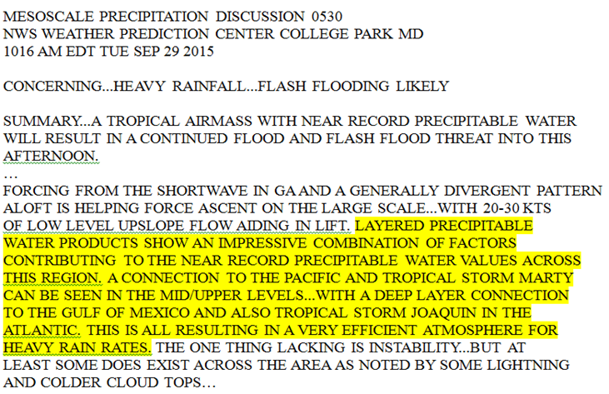
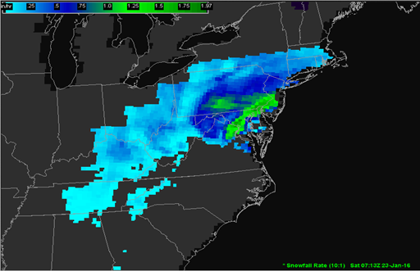
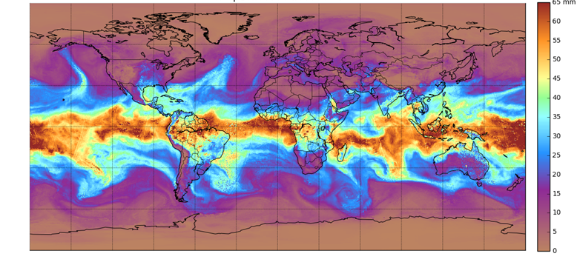
Examples of NWS User Engagement (In some projects, they are the downstream user of products from other projects)
Layer TPW
WPC, NHC, SPC, OPC, + WFO’s (e.g. Tucson AZ) with data routed via NASA SPoRT
Looked at closely during SC floods in Sept. 2015
TPW Visualizations
Honolulu, Anchorage, Key West WFOs
Snowfall Rates
Exploiting DB over CONUS to reduce latency to 30 minutes or less!
Product assessment in winter 2015-2016 at six WFOs (via NASA/SPoRT), WPC, SPC, SAB
NCEP/CPC, NWC

Slide 6
Collaborative Case Studies
Hydrology → El Nino of 2015-16 good opportunity to examine various products
Note not all of these projects are ripe for this type of study
CIRA hosting FTP site/data depository
Initially start with imagery, but ultimately, data in native resolution with decoders, etc.
List of case studies:
CA Atmospheric River – January 5, 2016 (See Backup)
East Coast Snowstorm – January 22-23, 2016 (See Backup)
Central U.S. Flooding – early March 2016
CO Front Range snowstorm – March 23, 2016 (J. Forsythe)
Texas Flooding – Late April 2016 (A. Heidinger)

Slide 7
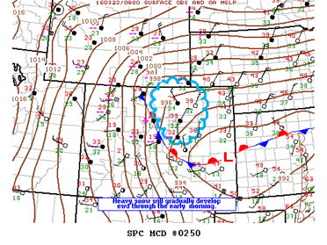
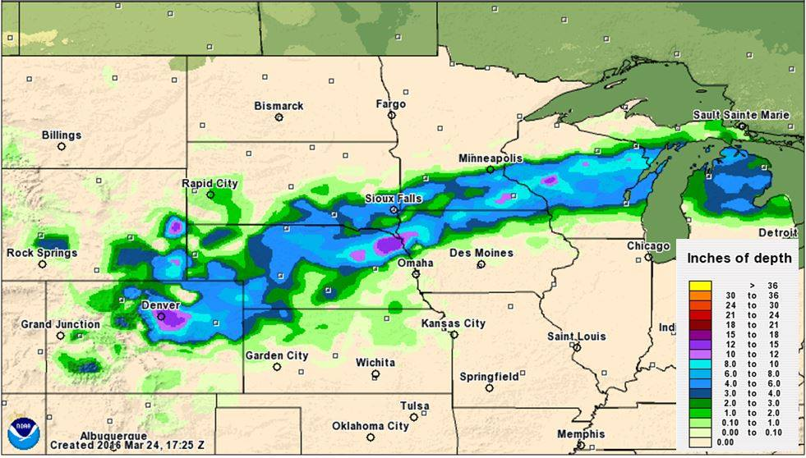
March 23-24 Front Range Blizzard
Interesting synoptic event “typical” of transition season snowfall in Front Range
Mesoscale features were “atypical” and lead to forecast “bust”
Snowfall rates 2-3”/hr occurred
Wetness of snow and strong winds caused extensive power outages

Slide 8
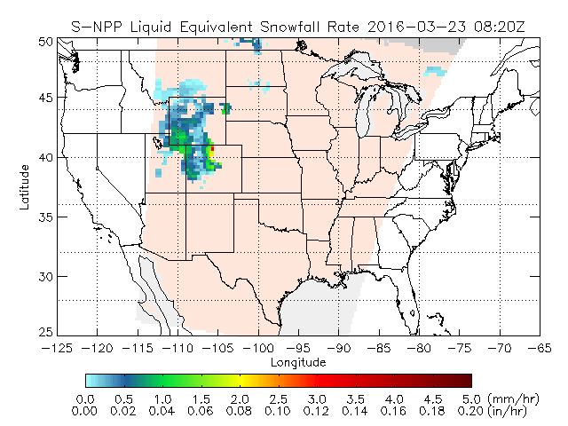
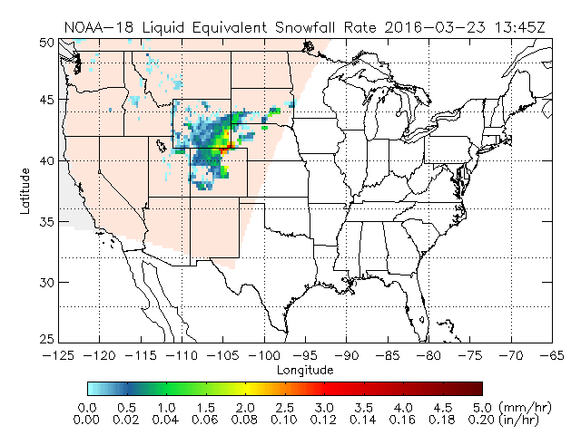
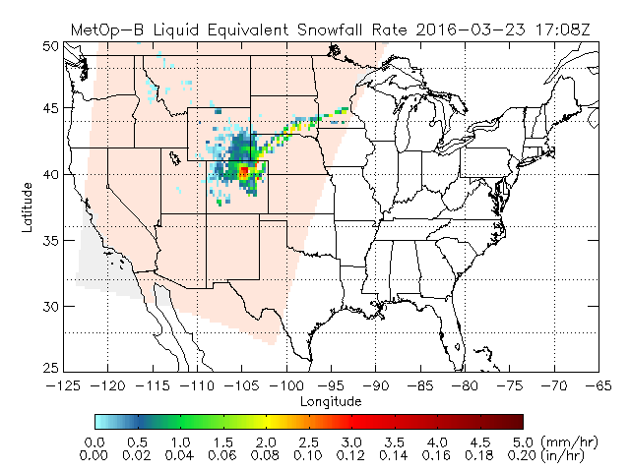
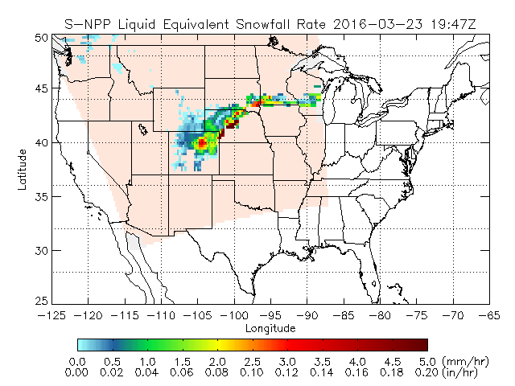
Snowfall Rate Product
Diane Cooper/Sheldon Kusselson
0820 UTC 23 March 2016 1345 UTC
S-NPP
ATMS
N18
MHS
1708 UTC 23 March 2016 1947 UTC
MOB
MHS
S-NPP
ATMS

Slide 9
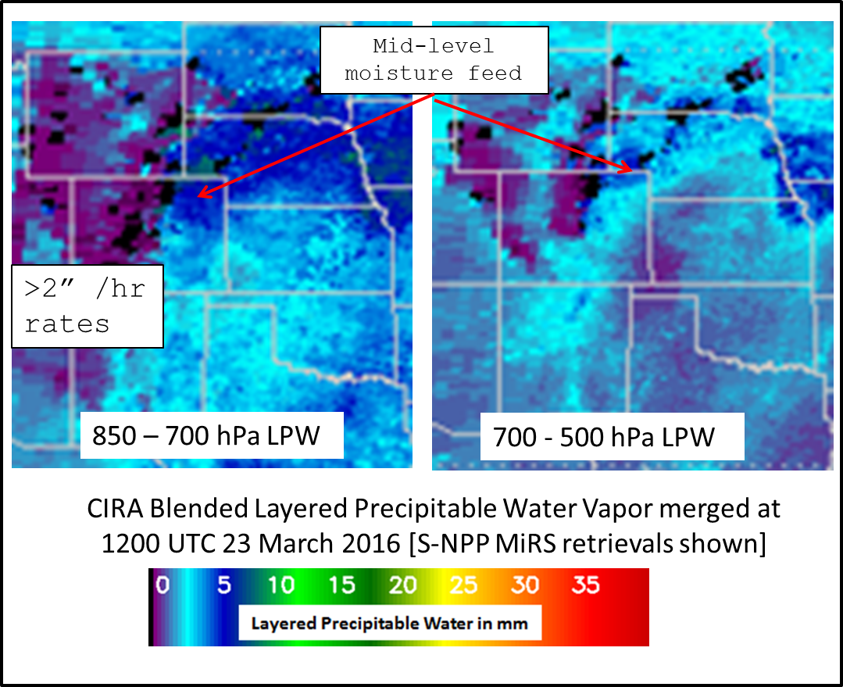
Water Vapor Products

Slide 10
Summary and Take Away Points
JPSS is funding a variety of projects related to Hydrology
Water vapor, snowfall rates, precipitation, hydrological models, soil moisture, climate data records
Some projects are on their second cycle of funding
Some projects are well engaged with NWS users while others are just starting
Engaged with NWSFO’s and national centers
Have detailed training materials, generally working with NASA/SPoRT and satellite liaisons.
Some projects are in fact downstream users of some of the hydro. products
As a way of promoting more end to end use of the products, we are having the PI’s collaborate on case studies of interest
If anyone wants to see us focus on a particular case, please let me know!
We hope to develop a publication within 1-year
As the case studies mature, we will also engage with other JPSS PGRR initiatives
Down the road, we hope to engage with similar types of activities under the GOES-R3 program

Slide 11
Backup Slides
Hydrology Project Details

Slide 12
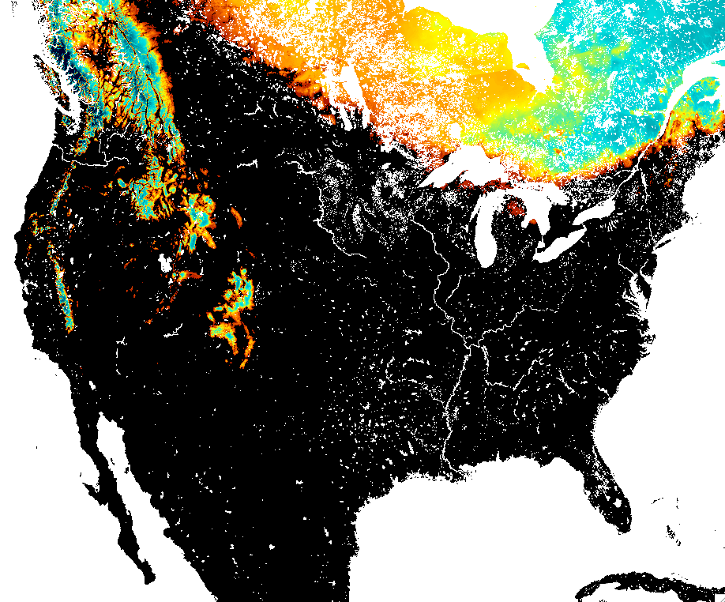
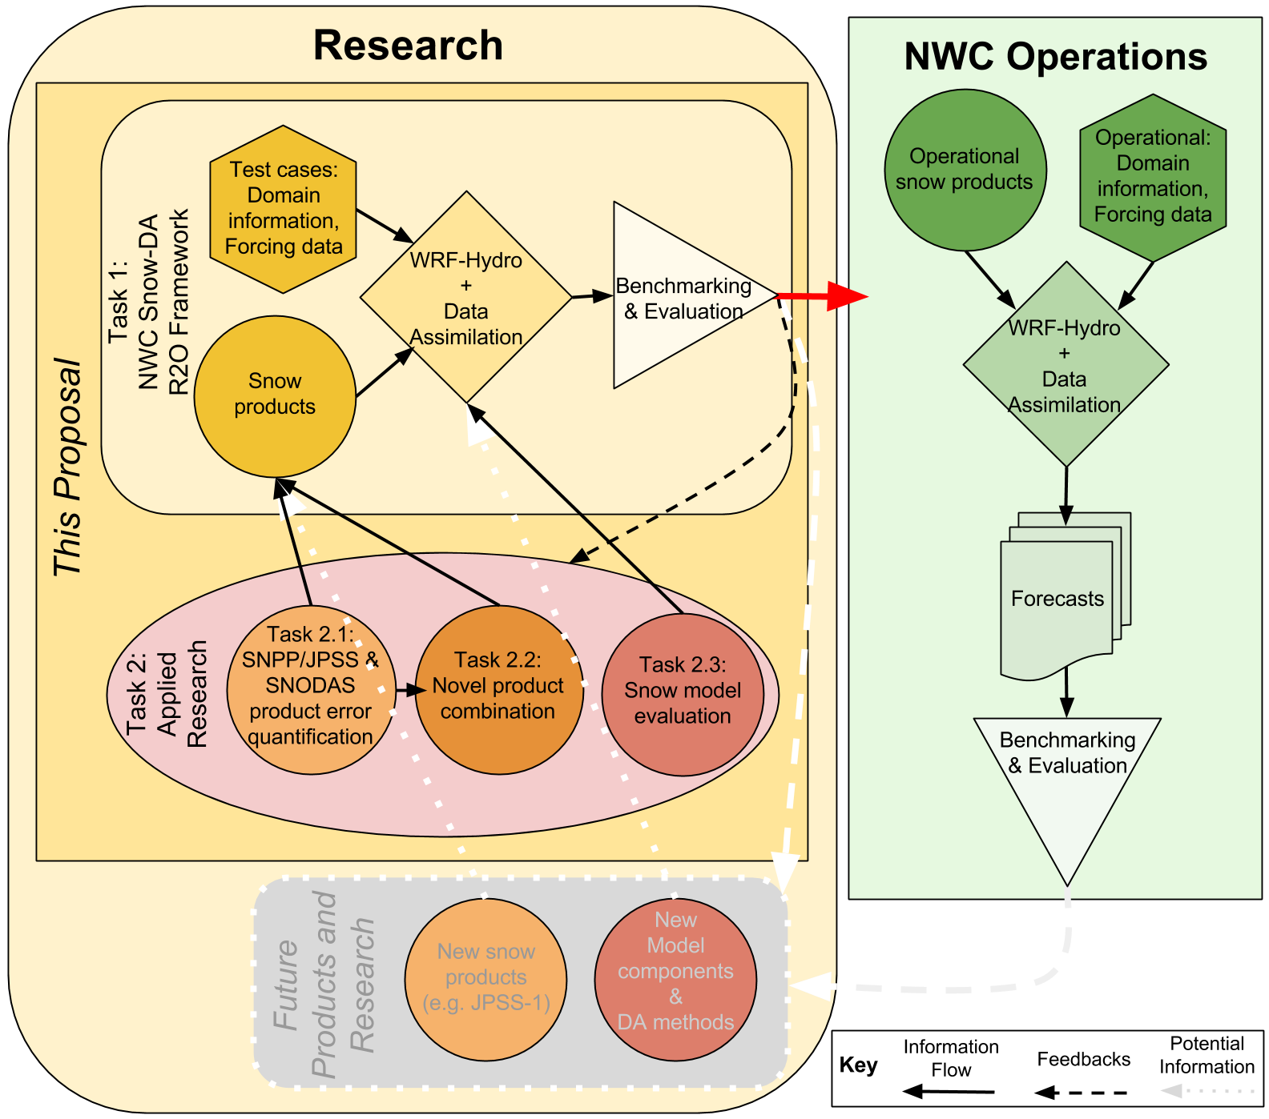
S-NPP/JPSS and SNODAS Applications to the National Water Model NCAR (Gochis) – NWC (Cosgrove) NOAA CREST (Romanov) – NCEP (Ek)
Risk Reduction/Proving Ground – Hydrology Initiative
Objectives
Improvement of seasonal streamflow forecasts
Assimilation snow observations and SNODAS.
Develop error chars of satellite snow obs
Combine satellite snow observations
Establish and R2O evaluation framework for operational snow products
Primary sensors involved
SNPP satellite:
VIIRS snow cover fraction
ATMS snow depth and snow water equivalent
GCOM-W satellite:
AMSR2 snow depth and snow water equivalent
Primary ground data / ancillary products
The SNODAS product & its observations
Airborne Gamma
Vast point observation data base including SNOTEL, etc.
NASA Airborne Snow Observatory
LiDAR
Hyperspectral (Albedo)
Targeted end users
NWC’s National Water Model (NWM)

Slide 13
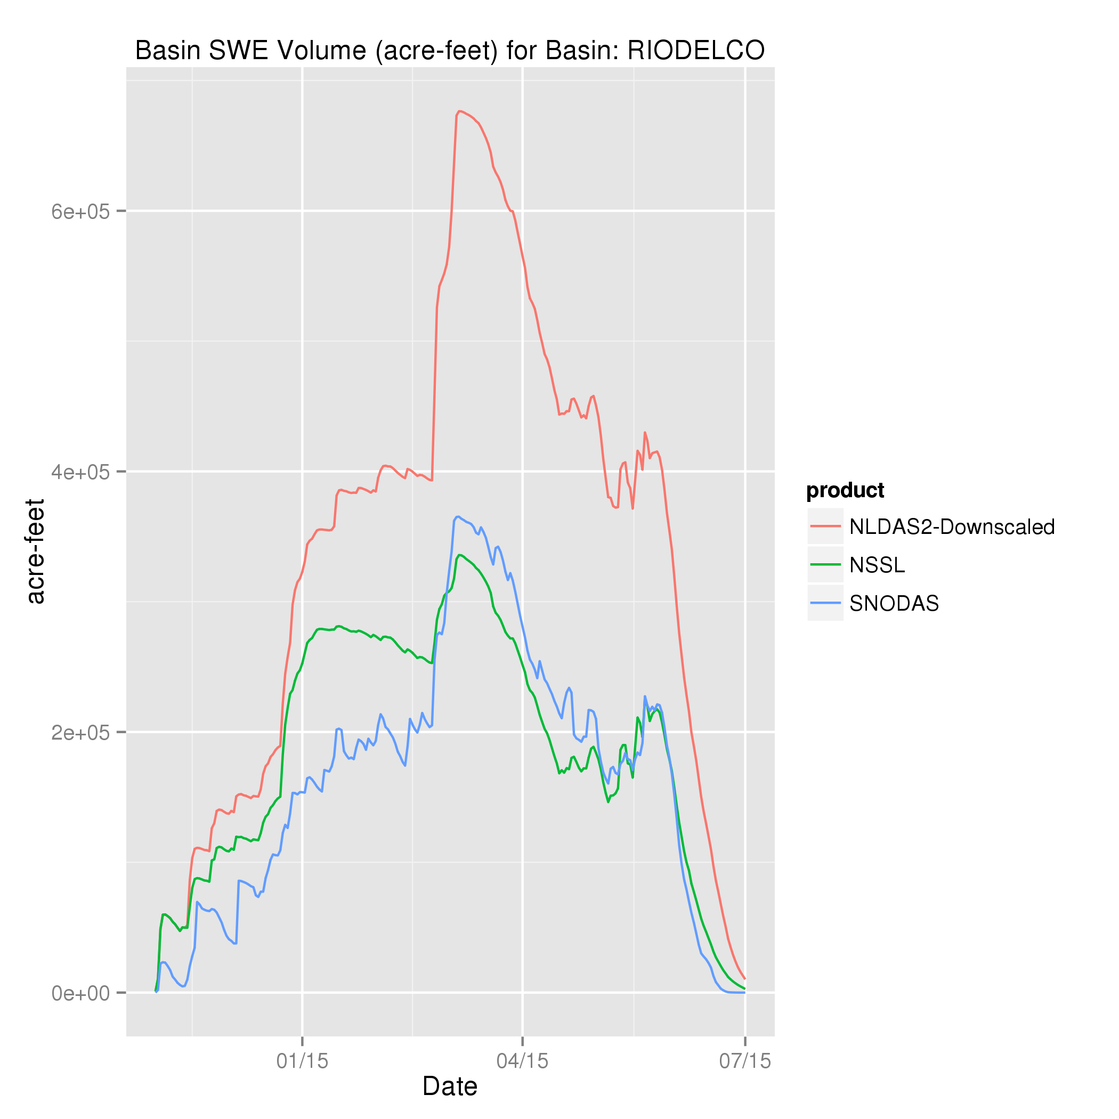
Project Status/Update
Risk Reduction/Proving Ground – Hydrology Initiative
Accomplishments to date
(Not yet funded)
Participation in group goals
Users Engaged to date
NWC
Colorado Water Conservation Board
Colorado Division of Natural Resources
Near term plans/milestones
Compare our forcing product with others in group: development of snow QPE (see figure on right for backgrnd)
Establish snow database
One really interesting result (images on right)
Upper Rio Grande Basin Basin SWE volume uncertainty as a function of forcing product: In-situ-RADAR-based NSSL product improved simulation over NLDAS2 and agreed more with SNODAS.

Slide 14
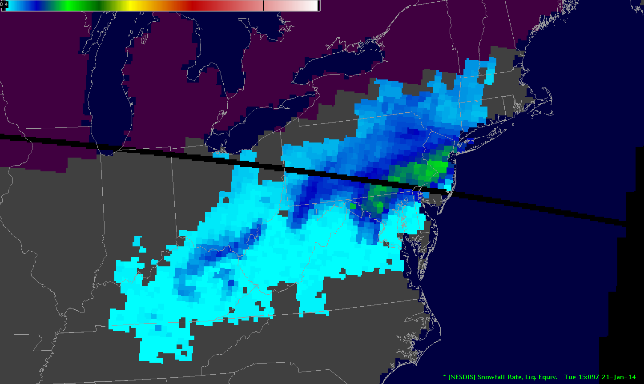
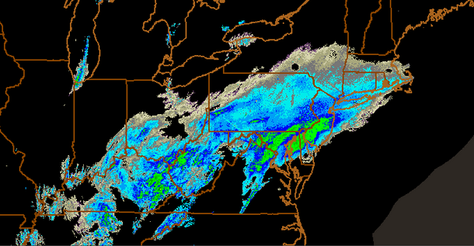
Continued Expansion, Enhancement and Evolution of the NESDIS Snowfall Rate Product to Support Weather Forecasting H. Meng, J. Dong, C. Kongoli, R. Ferraro, B. Yan, S. Rudlosky, B. Zavodsky
Risk Reduction/Proving Ground – Hydrology Initiative
Objectives
An ATMS snowfall rate (SFR) algorithm was developed previously with the support of JPSS PGRR
Improve the SFR algorithm for snowfall associated with low cloud and with dominating emission effect
Develop SFR algorithms for SSMIS and GMI sensors
Develop prototype over ocean SFR algorithm
Primary sensors involved
ATMS (S-NPP, JPSS)
MHS and AMSU pair (POES, Metop)
SSMIS (DMSP)
GMI (NASA GPM)
Primary ground data
NSSL MRMS radar precipitation
NCEI QCLCD gauge
Targeted end users
NWS Weather Forecast Offices (WFOs)
National Centers (WPC, SPC)
Hydrology community (CMORPH, NWC)
Retrieved Snowfall Rate
Composite NEXRAD Reflectivity

Slide 15
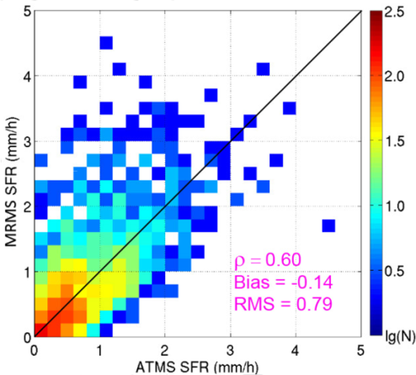
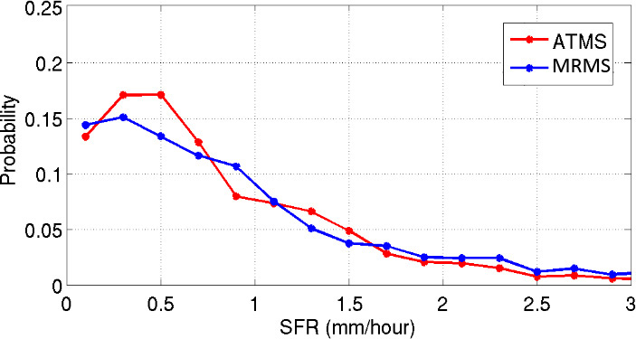
Project Status/Update
Risk Reduction/Proving Ground – Hydrology Initiative
ATMS SFR from the East Coast Blizzard Jan 22-23, 2016
Accomplishments to date
Developed a new framework for snowfall detection that can significantly improve probability of detection
Completed formulation to incorporate cloud liquid water in the forward radiative transfer model; coding is close to completion
Users Engaged to date
Product assessment in winter 2015-2016 at six WFOs, WPC, SPC, SAB
NCEP/CPC, NWC
Near term plans/milestones
Complete development of shallow snowfall detection algorithm
Calibrate snowfall rate algorithm after RTM coding is complete
Start development of SSMIS snowfall detection algorithm
One really interesting result (images on right)
SFR performed well for the 2016 East Coast Blizzard
ATMS SFR converted to solid amount with 10:1 snow:water ratio

Slide 16
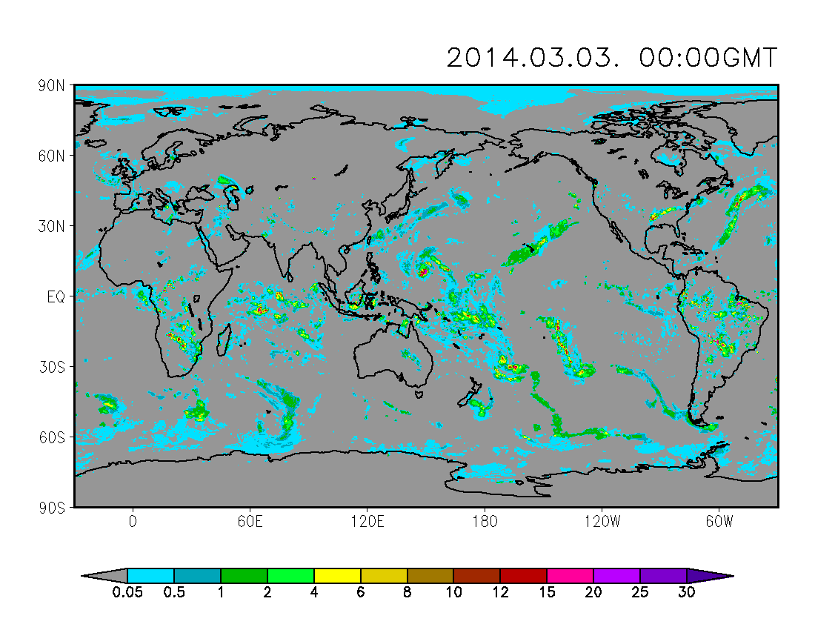
Infusing JPSS PMW Retrievals to CMORPH Precipitation Estimates for Improved Weather, Climate, and Water Applications P. Xie, R. Joyce, S. Wu and collaborators
Risk Reduction/Proving Ground – Hydrology Initiative
Objectives
To improve CMORPH integrated precipitation estimates through infusing retrievals from JPSS sensors
Pole-to-pole coverage
Snowfall rate representation
Improved accuracy / reduced latency
Primary sensors involved
ATMS, VIIRS
Primary ground data
Gauge measurements of precipitation
Targeted end users
NHC, WPC, EMC, CPC and field offices
National / international centers, research institutes, universities, governments, private industries (>100s)

Slide 17
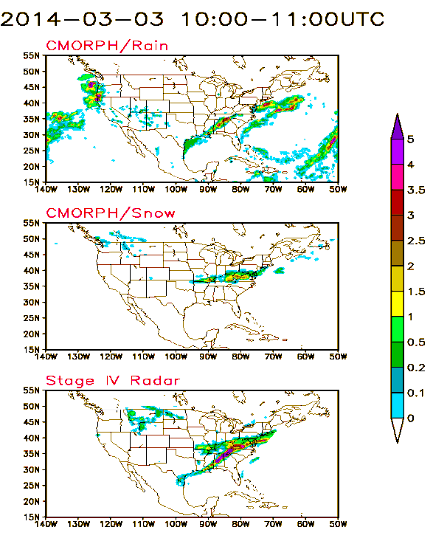
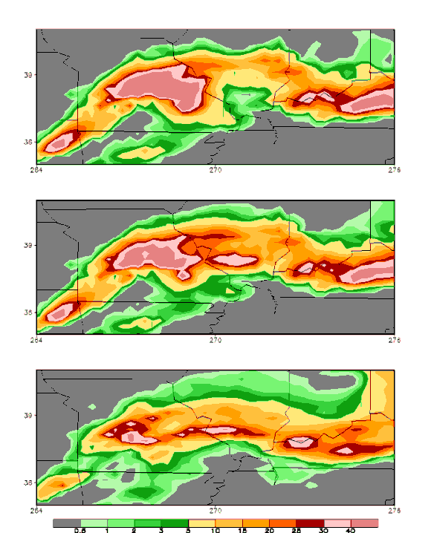
Project Status/Update
Risk Reduction/Proving Ground – Hydrology Initiative
Accomplishments to date
Component techniques developed; Test system established
Users Engaged to date
We have been communicating with our users in several key areas (CPC, EMC, NHC, et al) with regard to their users requirements
Near term plans/milestones
Real-time production of the pole-to-pole CMORPH (this coming summer)
Reprocessing the new CMORPH for the JPSS era (?)
One really interesting result (images on right)
Improved capacity in detecting snowfall rate (left figure) and quantification for storm rainfall (right figure)
CMORPH w/o
SFR retrievals
CMORPH
w/o SNPP
CMORPH with
SFR retrievals
CMORPH
with SNPP
Stage IV
Radar Est
Stage IV
Radar Est

Slide 18
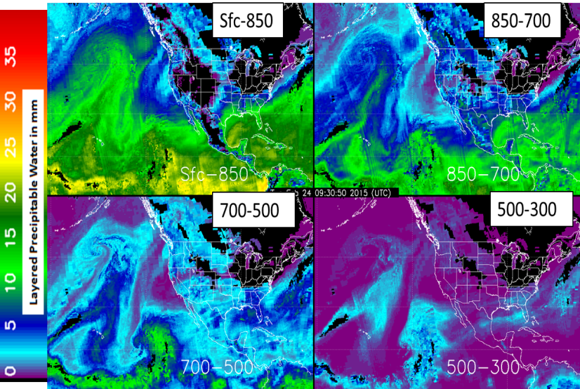
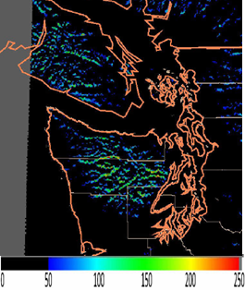
Using JPSS Retrievals to Implement a Multisensor, Synoptic, Layered Water Vapor Product for Forecasters John Forsythe, Andy Jones, Stan Kidder, Dan Bikos, Ed Szoke Cooperative Institute for Research in Atmosphere (CIRA),Colorado State University
Risk Reduction/Proving Ground – Hydrology Initiative
Objectives
Blend multiple polar soundings of layer precipitable water (LPW) and advect through time to benefit forecasters
Update the orographic rain index (ORI)
Obtain feedback and develop training materials
Primary sensors involved
S-NPP (ATMS), DMSP F18/19 (SSMIS), NOAA-18/19 (AMSU-A/MHS), Metop-A/B 9(MHS); all via NOAA MiRS retrieval system.
NASA Aqua (AIRS); NUCAPS products
Primary ground data
Radiosondes
GFS 0-6 hour forecasts
Targeted end users
National centers (WPC, NHC, SPC, OPC, AWC)
Put a few graphics
Example of 4-layer blended LPW product produced in near-realtime at CIRA at 0900 UTC 24 February 2015.
ORI product at 00 UTC 14 Feb. 2010. Units are mm * m/s.

Slide 19
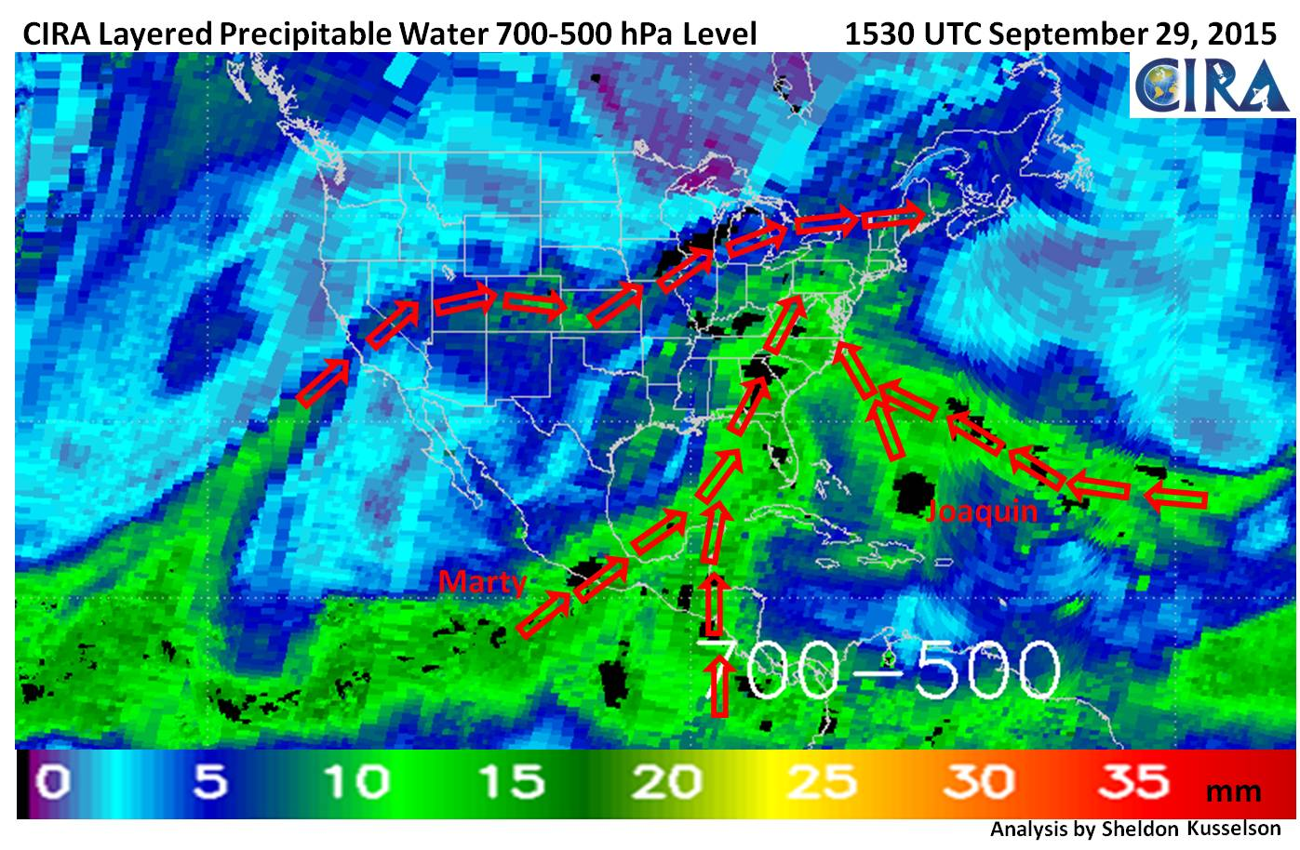
Project Status/Update
Risk Reduction/Proving Ground – Hydrology Initiative
Accomplishments to date
Product served in near-realtime to national centers.
S-NPP MiRS V11 (high resolution (~15 km)) retrievals now included in product
Users Engaged to date
WPC, NHC, SPC, OPC, + WFO’s (e.g. Tucson AZ) with data routed via NASA SPoRT
Near term plans/milestones
Develop the advection component by combining GFS winds with the layered water vapor
Continue to receive forecaster feedback
One really interesting result (images on right)
Played a key role in understanding the many sources of moisture for record flooding in South Carolina in late September. 12 SOO’s briefed via VISIT chat.

Slide 20
Strengthening TPW visualization in the OCONUS domain with JPSS data products Tony Wimmers, Chris Velden, Jordan Gerth, Bill Ward, Carven Scott, Kennard Kasper, Xiwu Zhan
Risk Reduction/Proving Ground – Hydrology Initiative
Objectives
1) Add SNPP ATMS and AMSU/MHS to the hourly, morphed-composite MIMIC-TPW product and ready the system for JPSS
2) Streamline the algorithm and extend the product domain to 70°N-70°S
3) Direct all development toward a future merger with the Blended TPW product
Primary sensors involved
SNPP ATMS, AMSU/MHS, SSMIS
Targeted end users
1) Operational NWS forecasters in the OCONUS domain
2) Tropical weather and tropical cyclone forecasters (NHC, JTWC) and global partners
Example of improved data advection scheme
Red: GFS surface winds,
Black: 10-hour Runge-Kutta trajectories used for image morphing of TPW

Slide 21
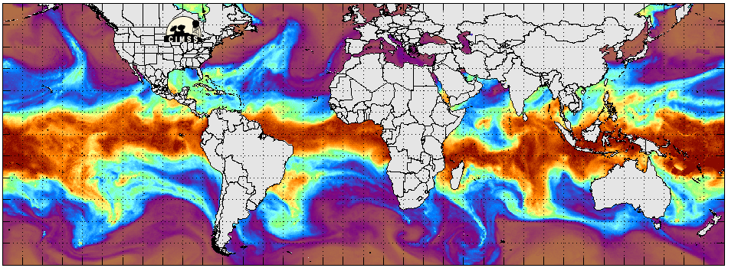
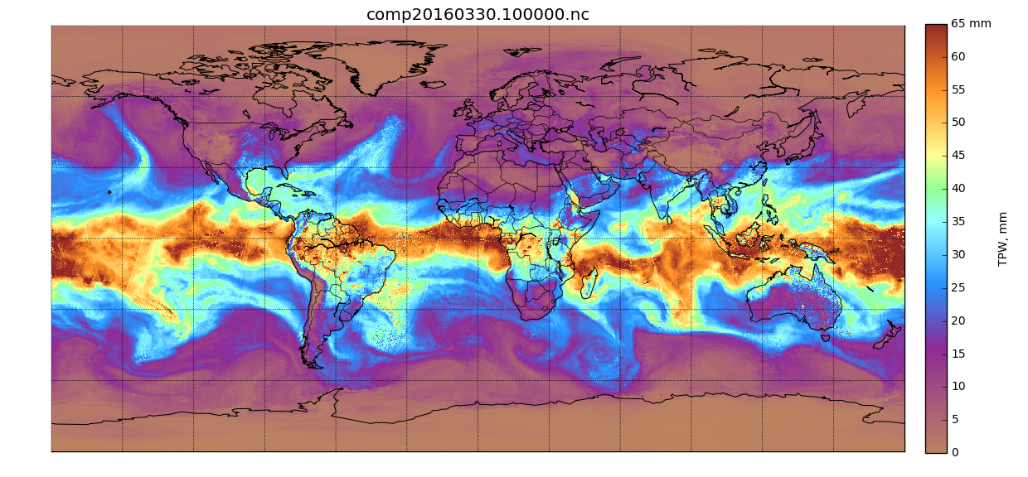
Project Status/Update
Risk Reduction/Proving Ground – Hydrology Initiative
Accomplishments to date
1) Rewrote the algorithm for full portability (Python language, DDS input, NetCDF/AWIPS output)
2) Producing full-globe retrievals (beyond original proposal of 70°N-70°S over water)
3) New algorithm has improved accuracy and 10x improvement in speed
Users Engaged to date
Honolulu, Anchorage, Key West WFOs
Near term plans/milestones
1) Bring MIMIC-TPW ver 2 online in real-time
2) Engage users with in-person consultation and online materials
One really interesting result (images on right)
Using MIRS ver11.2 retrieval of TPW provides a composite with good intercalibration, 3x higher resolution than MIRS ver9, and no gaps in data.
MIMIC-TPW ver 1 (existing product)
MIMIC-TPW ver 2 (ready in summer 2016)

Slide 22
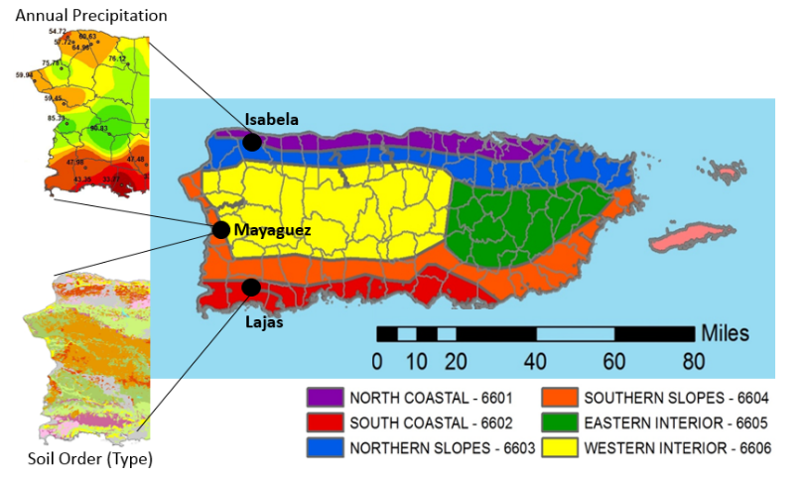
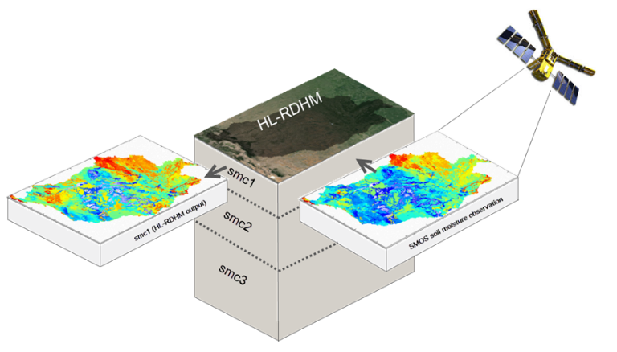
Validation and Application of JPSS/GCOM-W Soil Moisture Data Product for operational flood monitoring in Puerto Rico Tarendra Lakhankar, Jonathan Munoz, Reza Khanbilvardi, and Nir Krakauer Xiwu Zhan, Jorge Rivera-Santos, and Reggina Cabrera (Collaborators)
Risk Reduction/Proving Ground – Hydrology Initiative
Objectives
Validation of GCOM-W Soil Moisture Data Product using field measurements
Field Experiment using L-band Radiometer for GCOM-W soil moisture
Development of framework for GCOM-W soil moisture in Flash Flood Guidance System in Puerto Rico
Primary sensors involved
GCOM-W1/AMSR2
SMOS and SMAP
Primary ground data
L-Band dual polarized microwave radiometer
Soil moisture, vegetation and ancillary data
Targeted end users
WFO/NWS (San Juan)
NESDIS/STAR (Cal/Val)

Slide 23
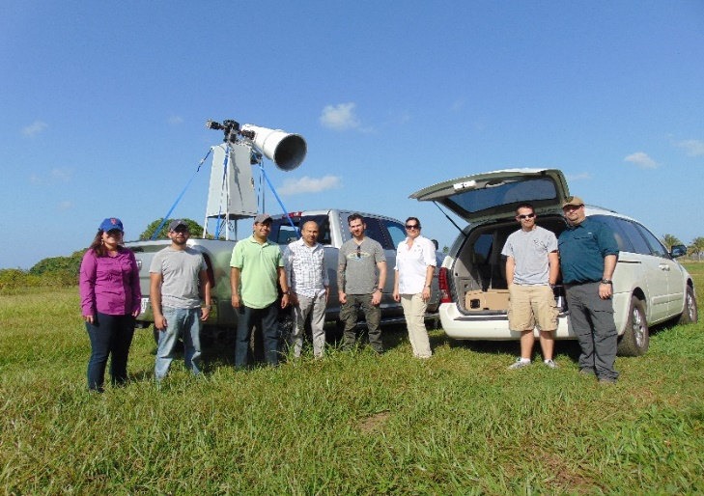
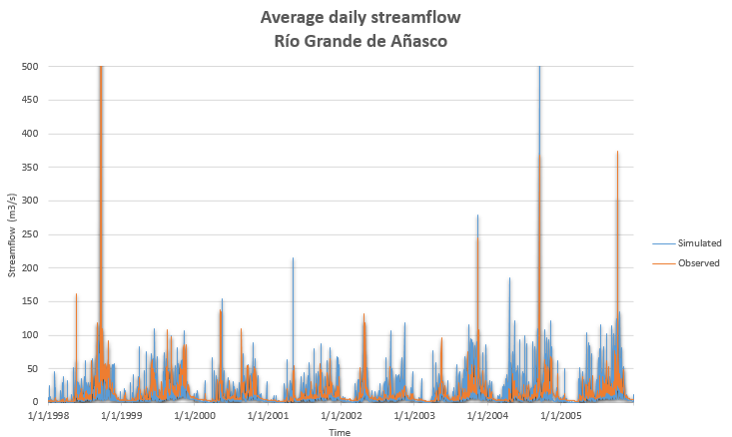
Project Status/Update
Risk Reduction/Proving Ground – Hydrology Initiative
Accomplishments to date
Soil moisture field experiment carried out during Feb 2016 at Western part of Puerto Rico
Data acquisition and processing of GCOM-W, SMOS, and SMAP microwave sensors and in-situ soil moisture and ancillary data
Users Engaged to date
NWS/WFO San Juan
NESDIS/STAR
Near term plans/milestones
Cross-comparison and validation of GCOM-W1/AMSR2, SMOS, and SMAP soil moisture data using in-situ soil moisture data in Puerto Rico
Identification of framework for GCOM-W1/AMSR2 soil moisture in Flash Flood Guidance System in Puerto Rico
Second round of field experiment for quantification of the effect of land cover heterogeneity in summer 2016
One really interesting result (images on right)
None
Simulation of streamflow using a conceptual empirical model for the Río Grande de Añasco watershed, PR

Slide 24
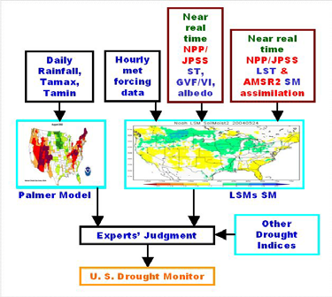
Enhance Agricultural Drought Monitoring Using SNPP/JPSS Land EDRs for NIDIS X. Zhan, C. Hain, J. Yin, J. Liu, L. Fang, M. Ek, J. Huang, M. Anderson, M. Svoboda
Risk Reduction/Proving Ground – Hydrology Initiative
Objectives
Improve current US and global drought monitoring via using near real time SNPP/JPSS land data products
Primary sensors involved
S-NPP/VIIRS
GCOM-W1/AMSR2
Primary ground data
Palmer Drought Severity Index
In situ soil moisture measurements from USDA SCAN/NOAA CRN ground networks
Targeted end users
NIDIS of USDA, NOAA and USGS
NWS-NCEP
Data flow of Weekly US Drought Monitor (USDM) Generation

Slide 25
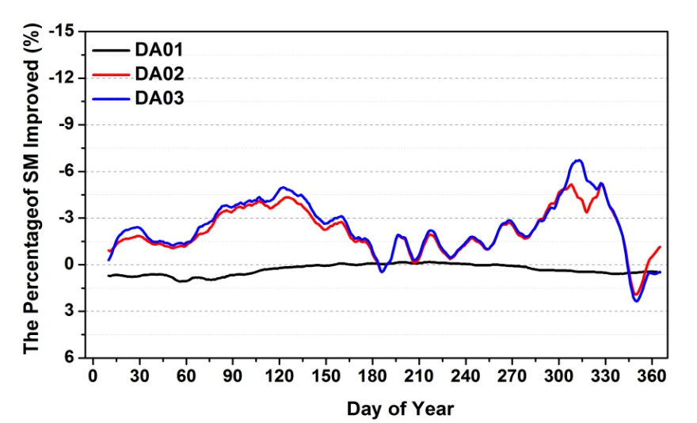
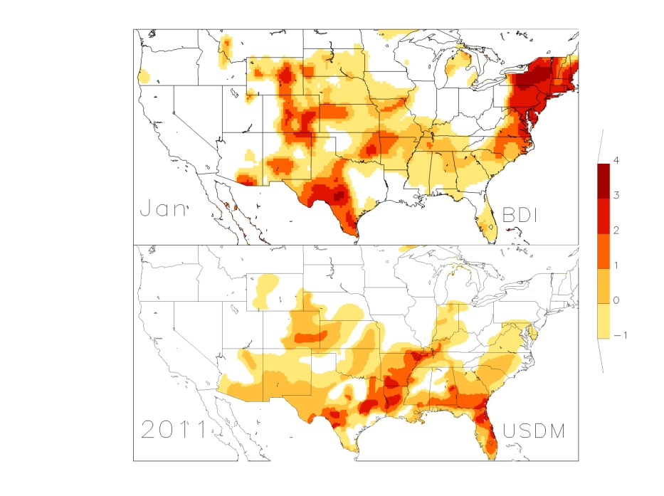
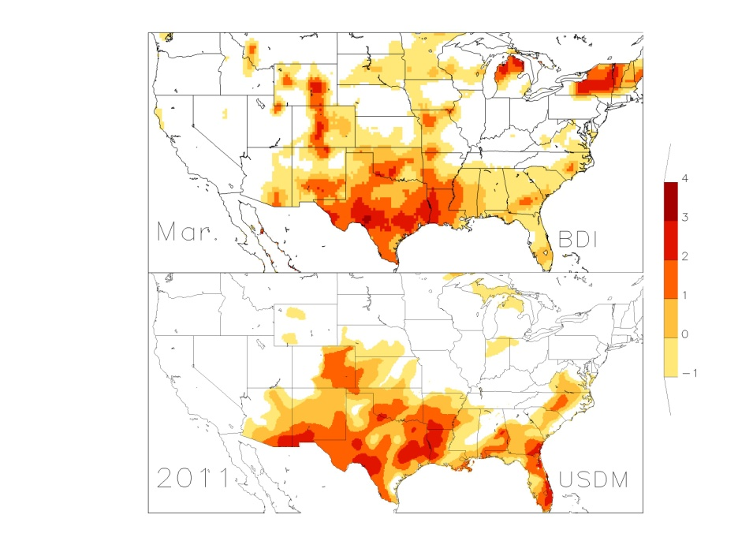
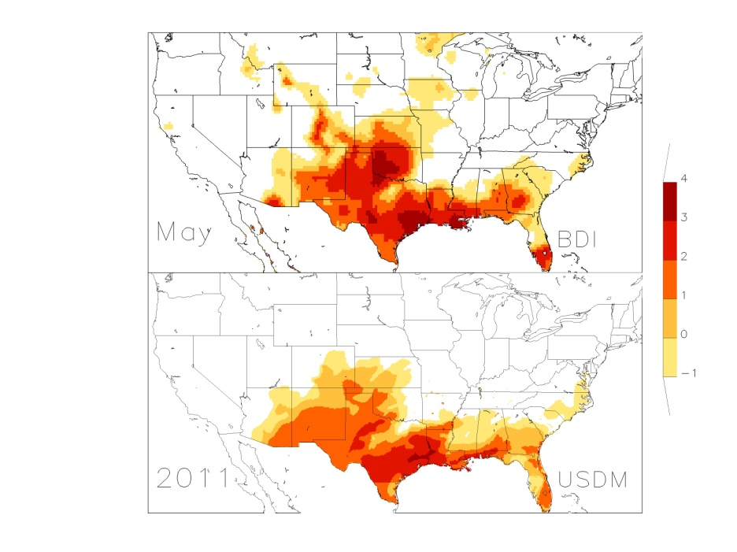
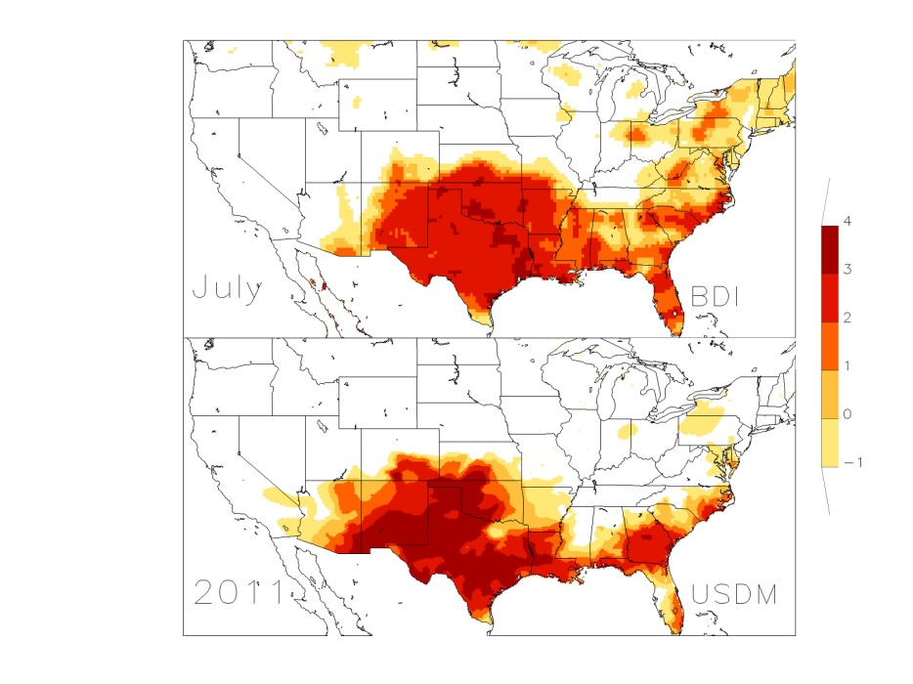
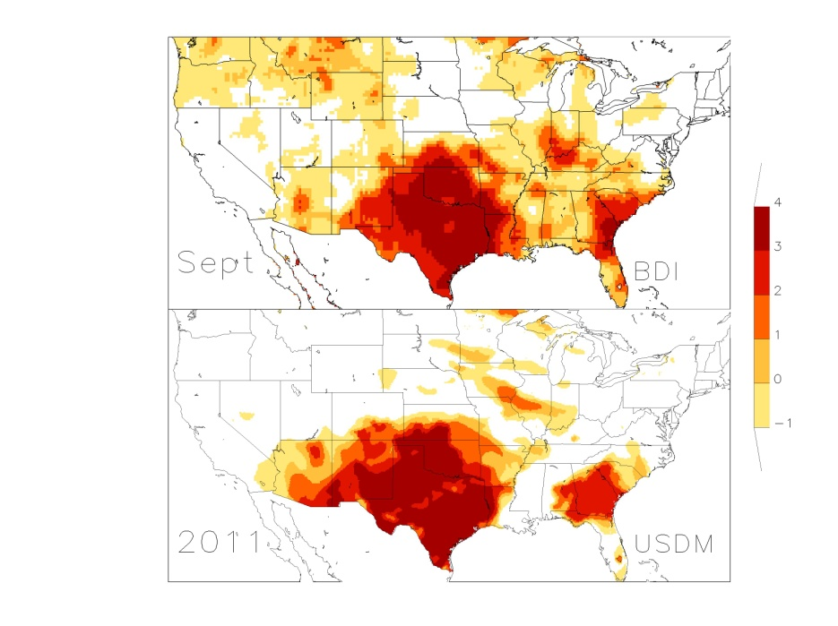
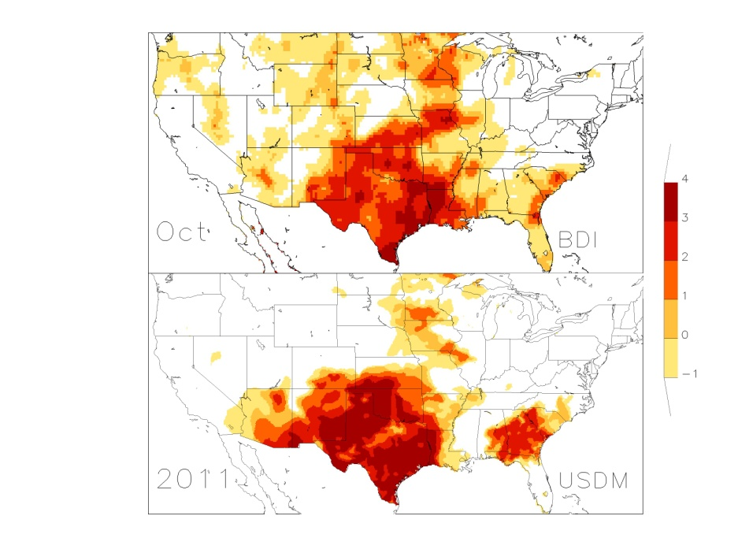
Project Status/Update
Risk Reduction/Proving Ground – Hydrology Initiative
Accomplishments to date
The most recent surface type data improves Noah model soil moisture simulations
Results indicated that NRT JPSS/GCOM land data of GVF and SM may improve Noah model soil moisture estimates and in turn enhances drought monitoring
Blending various soil moisture estimates or satellite retrievals generates better drought index (BDI)
Four refereed journal papers appeared and two more will be forthcoming
Users Engaged to date
NCEP EMC/CPC drought related research/operations
NIDIS of USDA, NOAA and USGS
Near term plans/milestones
Give a talk to national NLDAS monthly telecon on results from this project before project ends in May 2016
Further validate the BDI for longer time periods (e.g. 1980-current year) and submit two more journal papers
One really interesting result (images on right)
BDI compared with US drought Monitor (see lower right comparing images)
Near real time weekly (DA02) and monthly (DA03) GVF data improved Noah LSM soil moisture simulations while NRT albedo (DA01) did not for 2012 data.
Blended Drought Index (BDI) Compared with USDM

Slide 26
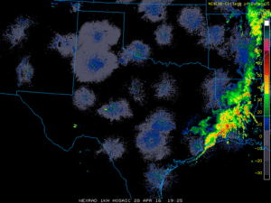
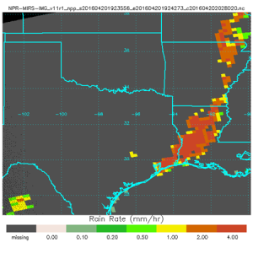
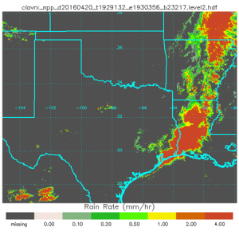
Hydrologic Applications of the VIIRS Cloud Products Andi Walther, Andrew Heidinger and Samantha Tushaus
Risk Reduction/Proving Ground – Hydrology Initiative
Objectives
Verify the skill in deriving precipitation from VIIRS cloud products and study how they complement other sources (microwave, IR).
Explore the accuracy of the cloud water path product from VIIRS and how it can complement that from ATMS (which lacks coverage over land)
Demonstrate skill with lunar-reflectance to provided unique nighttime ability.
Primary sensors involved
VIIRS including DNB (primary)
ATMS (for reference)
Primary ground data
NWS Radar Data
Targeted end users
NWS forecast offices – we think precipitation and water path are better suited for AWIPS displays than the standard cloud optical depth and particle size.
Rain-rates on April 20, 2016 19:30 UTC
NWS Radar
MIRS ATMS
VIIRS Cloud

Slide 27
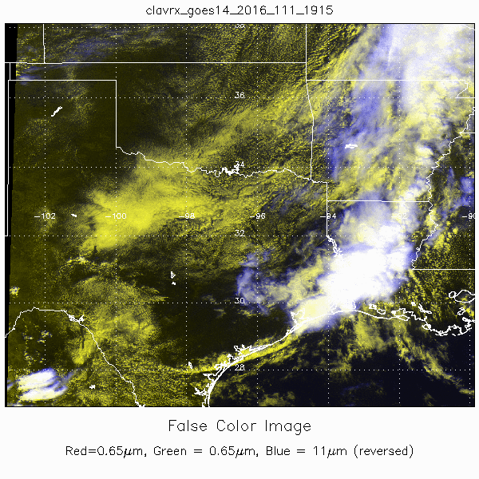
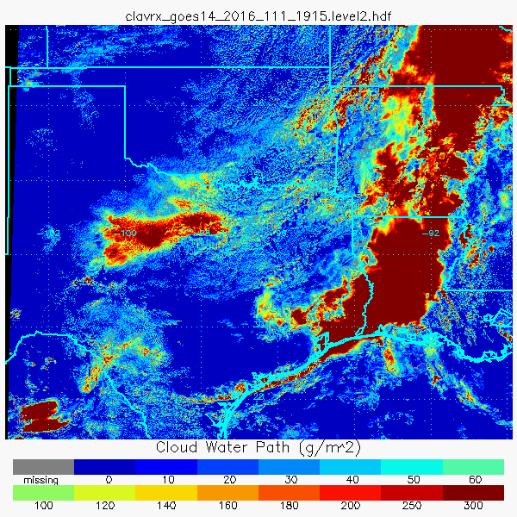
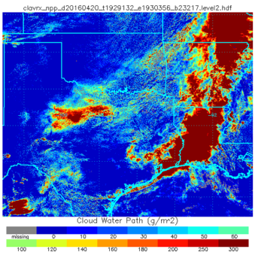
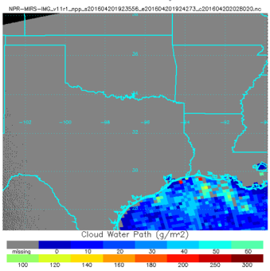
Project Status/Update
Risk Reduction/Proving Ground – Hydrology Initiative
Cloud Water Path for April 20, 2016
19-20 UTC
GOES-14 1-min
Accomplishments to date
The KNMI (Dutch Met Agency’s) cloud product precipitation implemented on VIIRS in CLAVR-x.
Rain rate and water path generated from VIIRS Lunar reflectance.
Generated data for 2 JPSS Hydro test cases
Users Engaged to date
None yet, cloud-derived hydro products are still being tested.
Near term plans/milestones
Analyze April 20,2016 case (Houston Floods)
Explore remaining issues with VIIRS lunar products.
One really interesting result (images on right)
April 20, 2016 had GOES-14 1-minute data.
We are exploring the synergy of the high temporal GOES and high spatial VIIRS for this significant hydrological event.
GOES-14
VIIRS
MIRS ATMS

Slide 28
Case 1: Atmospheric River, California, January 5 2016

Slide 29
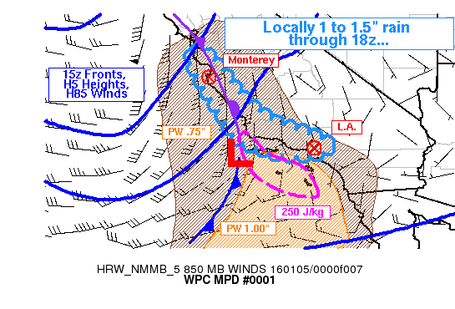
MESOSCALE PRECIPITATION DISCUSSION 0001
NWS WEATHER PREDICTION CENTER COLLEGE PARK MD
544 AM EST TUE JAN 05 2016
AREAS AFFECTED...CENTRAL CA COAST...SRN CA
CONCERNING...HEAVY RAINFALL...FLASH FLOODING POSSIBLE
VALID 051043Z - 051643Z
SUMMARY...RAIN RATES WILL INCREASE ALONG THE CENTRAL AND SOUTHERN
CALIFORNIA COAST EARLY THIS MORNING...AND HEAVIER RAIN WILL BEGIN
TO SPREAD INTO THE L.A. BASIN AROUND 15Z. FLASH FLOODING IS
POSSIBLE.
DISCUSSION...STRONG ASCENT WILL ACCOMPANY AN OCCLUDED FRONT COMING
ONSHORE ALONG THE LENGTH OF THE CA COAST...AND ASSOCIATED POSITIVE
TILT UPPER TROUGH...WITH LATER EMPHASIS FOR HEIGHT FALLS IN THE
BASE OF THE TROUGH ALONG THE SOUTHERN CALIFORNIA COAST. ALTHOUGH
LIGHTNING HAD NOT BEEN DETECTED AS OF 1030Z...RADAR AND SATELLITE
PRESENTATION WAS IMPRESSIVE NEAR AND OFFSHORE OF MONTEREY...WHERE
CLOUD TOPS HAD COOLED TO -40C...AND CONVECTIVE RADAR ELEMENTS WERE
TRACKABLE...NOT SIMPLY HIGH REFLECTIVITY DUE TO BRIGHT BANDING.
SURFACE OBSERVATIONS HAD BEGUN TO SAMPLE HEAVY RAIN AND
ACCUMULATIONS EXCEEDING A HALF INCH PER HOUR IN THE BAY AREA.
A FRONTAL PRECIPITATION BAND WILL PROGRESS STEADILY
EASTWARD...WITH THE BACK EDGE COMING SOUTH ALONG THE COAST THIS
MORNING. EXPECTATIONS PER THE HIGH RESOLUTION MODELS ARE FAIRLY
UNIFORM...WITH AREAL AVERAGE 0.50 TO 1.0 INCHES OF RAIN THROUGH
18Z...BUT LOCALLY GREATER THAN 1.5. TOTALS MAY BE ESPECIALLY
ENHANCED IN THE SOUTHWARD FACING MOUNTAINS OF SOUTHERN
CALIFORNIA...OWING TO S/SW LOW LEVEL FLOW...LONGER DURATION OF
BROAD HEIGHT FALLS...AND PROXIMITY TO GREATER PW VALUES NEAR 1.00
INCH ALONG WITH ENOUGH INSTABILITY FOR THE HRRR TO PICK UP ON 250
J/KG. THE HEAVIER RAIN RATES SHOULD REACH LOS ANGELES BY
15-17Z...AND THE EVENT IS EXPECTED TO CONTINUE INTO THE AFTERNOON
FROM THERE SOUTHWARD...WITH MAXIMUM HOURLY RATES APPROACHING 0.75
INCHES. THIS WOULD BE VERY CLOSE TO FLASH FLOOD GUIDANCE
VALUES...AND WOULD BE MORE THAN ENOUGH TO CAUSE FLASH FLOODING IN
THE MORE SUSCEPTIBLE BURN SCAR AREAS.
BURKE
ATTN...WFO...HNX...LOX...MTR...SGX.

Slide 30
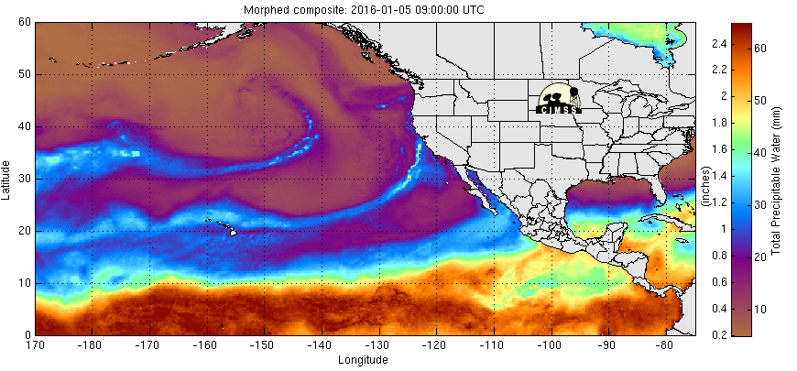
MIMIC TPW
2016 Jan 05 0900 UTC: Approach of the atmospheric river
1500 UTC: Peak rainfall
2100 UTC: Weakening
Jan 06 0300 UTC

Slide 31
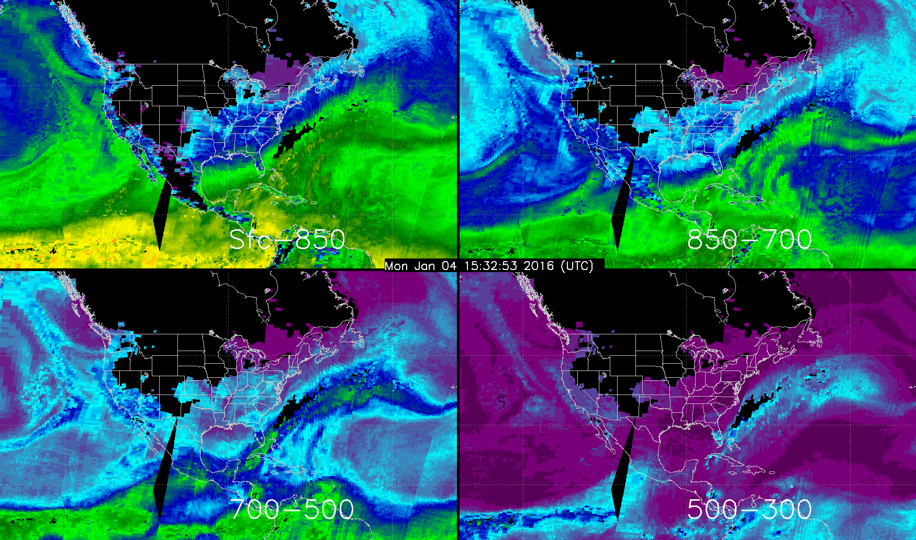
Broad moisture signature at lower layers, small signal above 500 mb

Slide 32
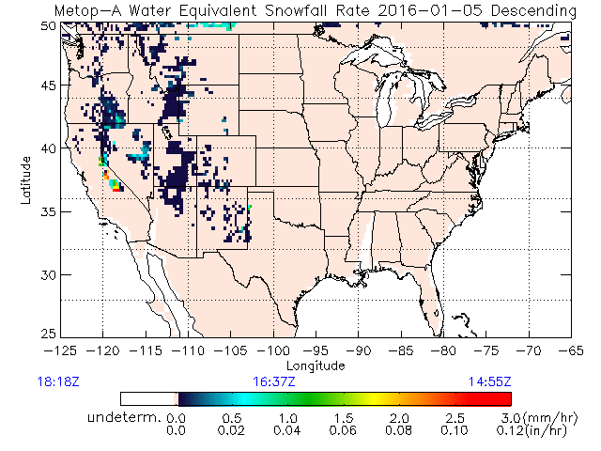
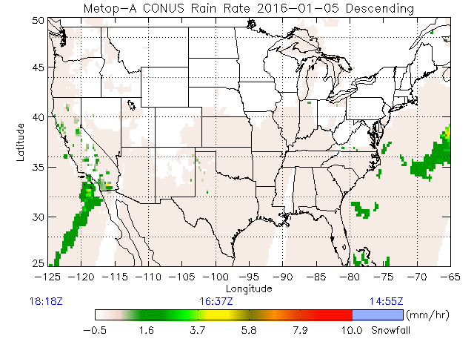
http://www.star.nesdis.noaa.gov/corp/scsb/mspps_backup/sfr_realtime.html

Slide 33
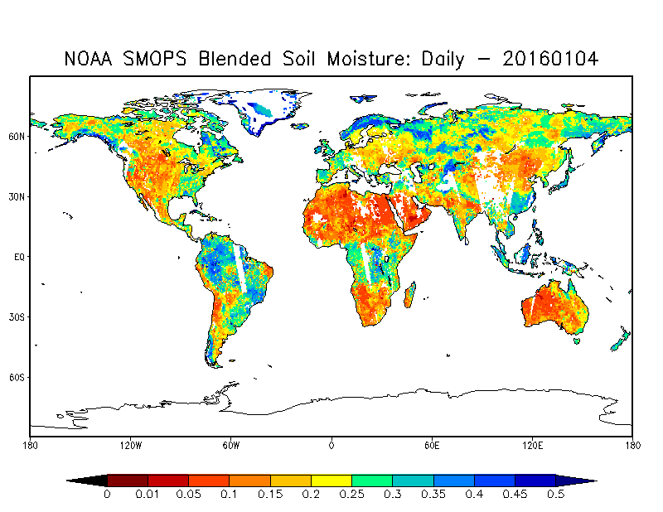

Slide 34
Case 2: East Coast Blizzard of 2016. January 22-23 2016
See also:
http://www.star.nesdis.noaa.gov/jpss/Blizzard2016.php

Slide 35
East Coast Snowstorm: Layered water vapor: Jan. 23 07 UTC (coastal low was forming at this time)
Suomi-NPP MIRS High Resolution (~ 15 km) LPW retrievals, from the new Version 11 algorithm running at NESDIS. Not yet in CIRA blended product (but will be soon…).

Slide 36
East Coast Snowstorm: Layered water vapor Jan 22, 09 UTC to Jan. 23 18 UTC (NOAA-18/19; Metop-A, -B, DMSP F18) using MIRS V8 (old version). SNPP to be added soon.

