Slide 1
Improved high-impact weather HRRR/RAP forecast accuracy from assimilation of satellite-based cloud, lightning, convection, AMVs, fire, and radiance data
Stan Benjamin, Steve Weygandt, Haidao Lin,
Curtis Alexander, Ming Hu, Tracy Lorraine Smith
NOAA/ESRL/GSD, Boulder, CO
Rapid Refresh reflectivity - 0h valid 02z 26 Jan 2012
Outline
HRRR (3km)/ RAP (13km) are the hourly updated models for NOAA. Focus – situational awareness, decision making for severe weather, transportation, energy, all-season high-impact weather.
HRRR/RAP are only NOAA models that currently assimilate satellite-based cloud and radar reflectivity data.
2015 HRRR/RAP additions at NCEP: lightning, radial wind, mesonet
HRRR/RAP assimilation at ESRL – 2014-2015:
Cloud-top cooling from GOES
Fire data from ABBA, MODIS for HRRR-chem-smoke, RAPchem
Direct readout radiance data from JPSS
Initial testing of global cloud analysis (in progress)
Results from RAP OSEs (obs sensitivity experiments) from radiances and observations
With lightning assim
No
lightning assim
NOAA Satellite Science Week – 24 Feb 2015

Slide 2
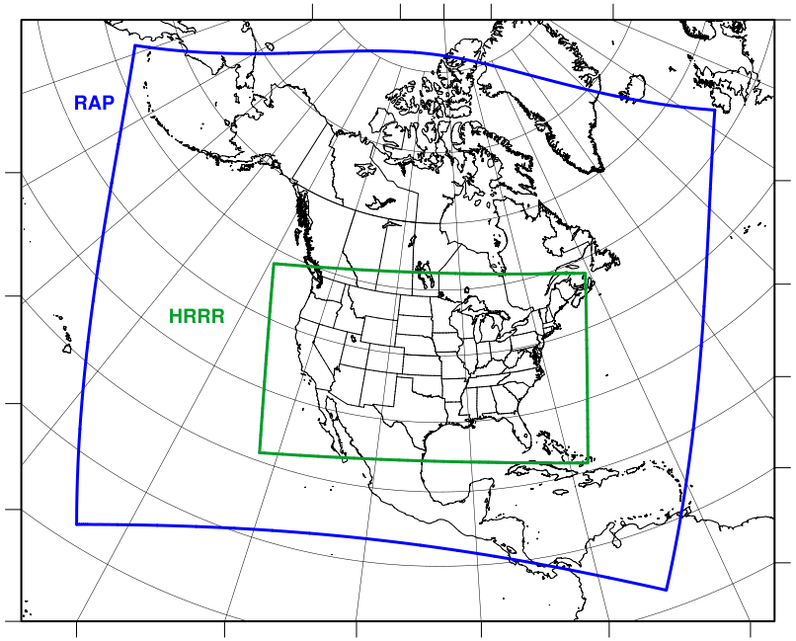
Rapid Refresh and HRRR
NOAA hourly updated models
(situational awareness for energy, aviation, severe weather, etc.)
13km Rapid Refresh (RAP) (mesoscale)
Version 2 -- NCEP implement 25 Feb 2014
Version 3 – GSD
Planned NCEP –June 2015
RAP
3km High Resolution Rapid Refresh (HRRR) (storm-scale)
HRRR
Initial -- NCEP
implement 30 Sept 2014
Version 2 – GSD
Planned NCEP –June 2015
Sat Science Week
HRRR/RAP sat assim – high-impact wx
February 2015

Slide 3
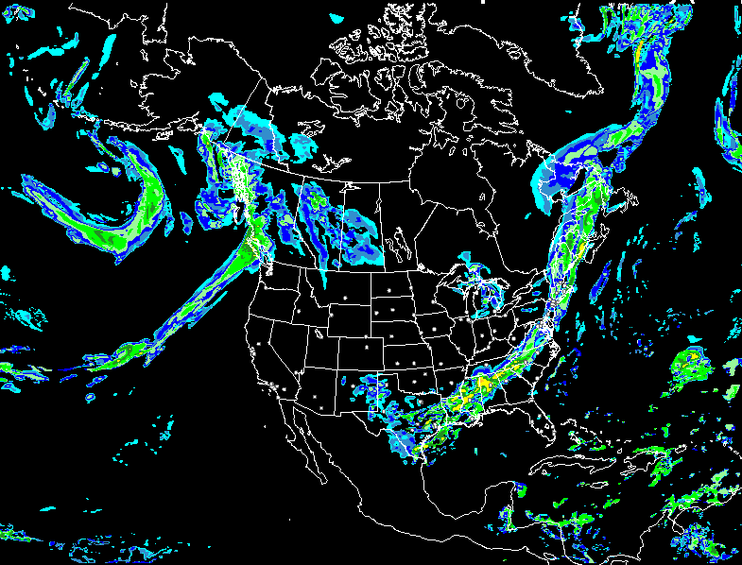
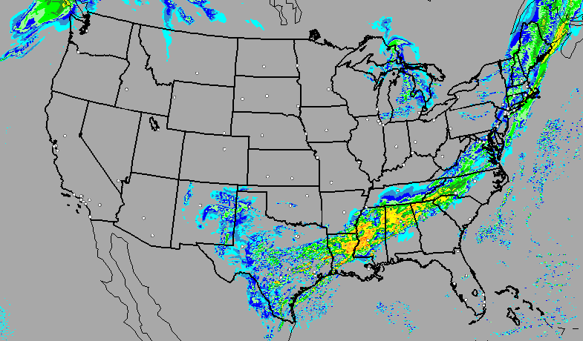
Data assimilation for RAP and HRRR
Hourly cycling model
RAP
EnKF-
hybrid,
Radar and
Cloud anx
Data Assimilation cycle
Observations
HRRR

Slide 4
RAPv3: Observations used (Sat-based)
HRRRv2 – all except radiances into 3km GSI assimilation
Hourly Observation Type | Variables Observed | Observation Count
Rawinsonde | Temperature, Humidity, Wind, Pressure | 120
Profiler – 915 MHz | Wind, Virtual Temperature | 20-30
Radar – VAD | Wind | 125
Radar | Radial Velocity | 125 radars
Radar reflectivity – CONUS | 3-d refl ➔Rain, Snow, Graupel | 1,500,000
Lightning | (proxy reflectivity) GOE | GOES-R, ground
Aircraft | Wind, Temperature | 2,000 -15,000
Aircraft - WVSS | Humidity | 0 - 800
Surface/METAR | Temperature, Moisture, Wind, Pressure, Clouds, Visibility, Weather | 2200 - 2500
Surface/Mesonet | Temperature, Moisture, Wind | ~5K-12K
Buoys/ships | Wind, Pressure | 200 - 400
GOES AMVs | Wind | 2000 - 4000
AMSU/HIRS/MHS (RARS) | Radiances | 1K-10K
GOES | Radiances | large
GOES cloud-top press/temp | Cloud Top Height | 100,000
GPS – Precipitable water | Humidity | 260
WindSat Scatterometer | Winds | 2,000 – 10,000
Notes:
Observations of the earth system critical to prediction…the more the better with high-density radar and stat obs

Slide 5
RAPv3: Observations used (new 2015)
HRRRv2 – all except radiances into 3km GSI assimilation
Hourly Observation Type | Variables Observed | Observation Count
Rawinsonde | Temperature, Humidity, Wind, Pressure | 120
Profiler – 915 MHz | Wind, Virtual Temperature | 20-30
Radar – VAD | Wind | 125
Radar | Radial Velocity | 125 radars
Radar reflectivity – CONUS | 3-d refl ➔Rain, Snow, Graupel | 1,500,000
Lightning | (proxy reflectivity) | NLDN
Aircraft | Wind, Temperature | 2,000 -15,000
Aircraft - WVSS | Humidity | 0 - 800
Surface/METAR | Temperature, Moisture, Wind, Pressure, Clouds, Visibility, Weather | 2200 - 2500
Surface/Mesonet | Temperature, Moisture, Wind | ~5K-12K
Buoys/ships | Wind, Pressure | 200 - 400
GOES AMVs | Wind | 2000 - 4000
AMSU/HIRS/MHS (RARS) | Radiances | 1K-10K
GOES | Radiances | large
GOES cloud-top press/temp | Cloud Top Height | 100,000
GPS – Precipitable water | Humidity | 260
WindSat Scatterometer | Winds | 2,000 – 10,000
Notes:
Observations of the earth system critical to prediction…the more the better with high-density radar and stat obs

Slide 6
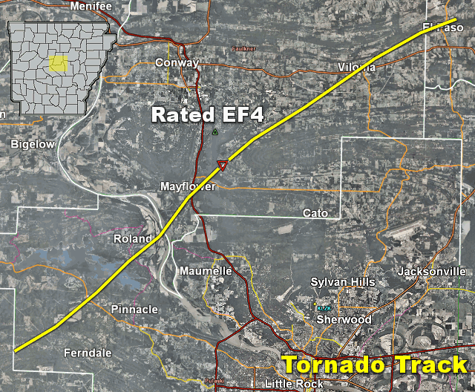
Arkansas Tornadoes Background
HRRR (and RAP) Future Milestones
HRRR Milestones
Arkansas tornadoes – Sunday 27 April 2014
✖
8 fatalities
✖
3 fatalities
Sat Science Week
HRRR/RAP sat assim – high-impact wx
Notes:
Very recent case of tornadic thunderstorm in Arkansas producing fatalities northwest of Little Rock

Slide 7
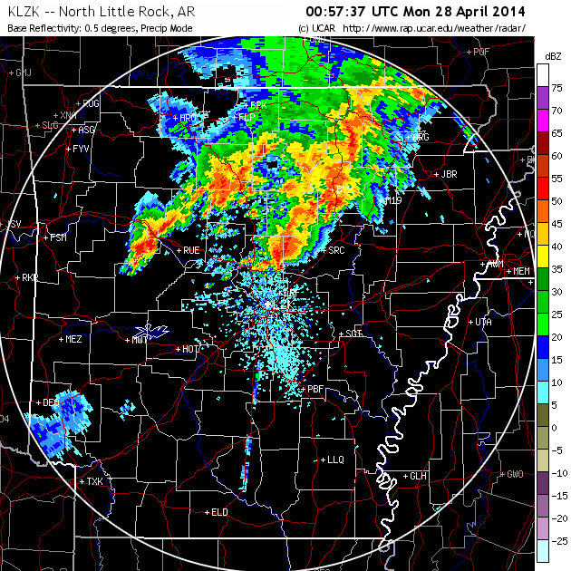
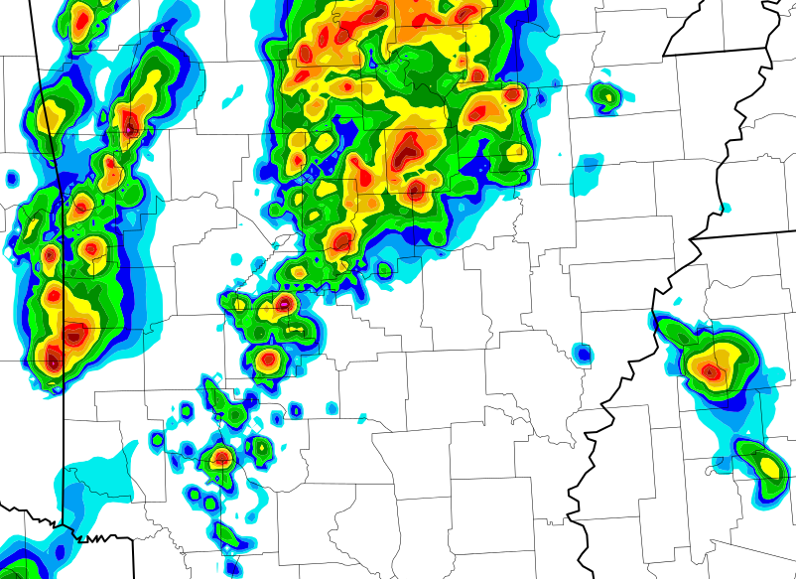
HRRR Supercell Forecast Arkansas
HRRR (and RAP) Future Milestones
HRRR Milestones
HRRR
6-hr fcst
made
at 2 PM
for 8 PM
27 April
Observed radar
HRRR
Tornadic
thunderstorm
✖
✖
Actual
tornado path
HRRR forecast
rotation track
✖
Fatalities
Notes:
HRRR captures location of parent thunderstorm very well in both time and location with indication of strong thunderstorm rotation within half-county six hours ahead

Slide 8
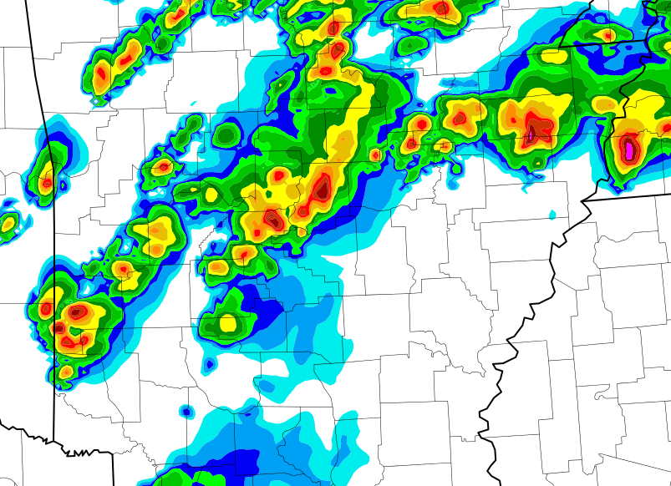
HRRR Supercell Forecast Arkansas
HRRR (and RAP) Future Milestones
HRRR Milestones
HRRR
10-hr fcst
made
at 10 AM
for 8 PM
27 April
Observed radar
HRRR
Tornadic
thunderstorm
✖
✖
Actual
tornado path
HRRR forecast
rotation track
✖
Fatalities
Notes:
HRRR captures the exact location of parent thunderstorm 10 hours in advance and forecasts and nearly identical track to the tornado

Slide 9
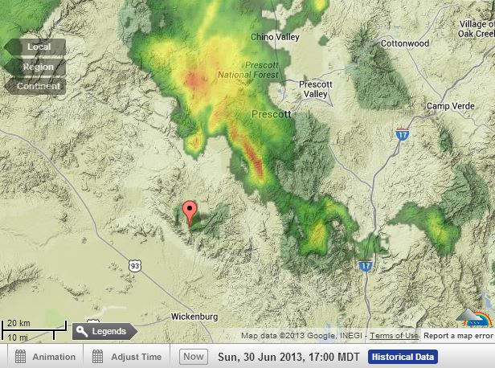
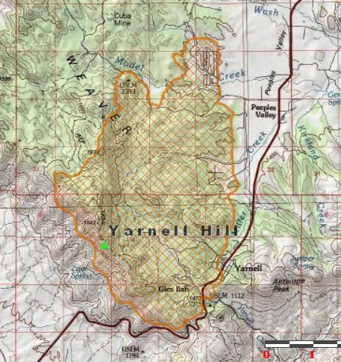
Yarnell, AZ Wildfire Background
Wildfire Driven by thunderstorm
outflow , 30 June 2013
Radar Reflectivity
4 PM MST June 30, 2013
July 2, 2013 Yarnell, AZ
Wildfire Perimeter
Yarnell, AZ
Last contact with fire crew
~ 4:30 PM MST
(2330 UTC) Sun. 30 June, 2013

Slide 10
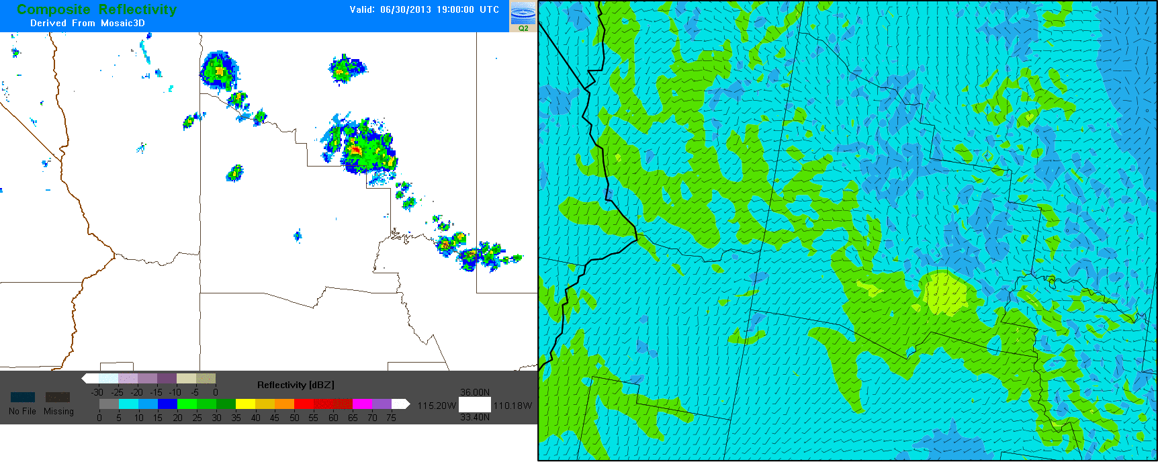
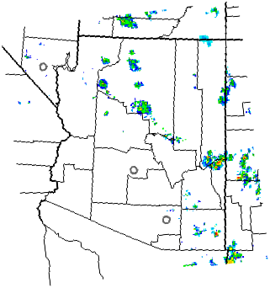
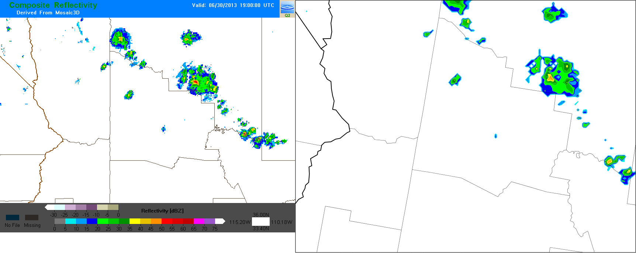
HRRR Wind Forecast Yarnell, AZ
HRRR (and RAP) Future Milestones
HRRR Milestones
HRRR run at
12 pm MST
Available by
2 pm MST
HRRR Fcst 80m Wind (kts)
Yarnell
Observed Radar (dBZ)
HRRR Fcst Radar (dBZ)
Yarnell
Yarnell
Notes:
HRRR captured the scenario of the outflow winds impacting the fire from the northeast with 2-3 hour lead time

Slide 11
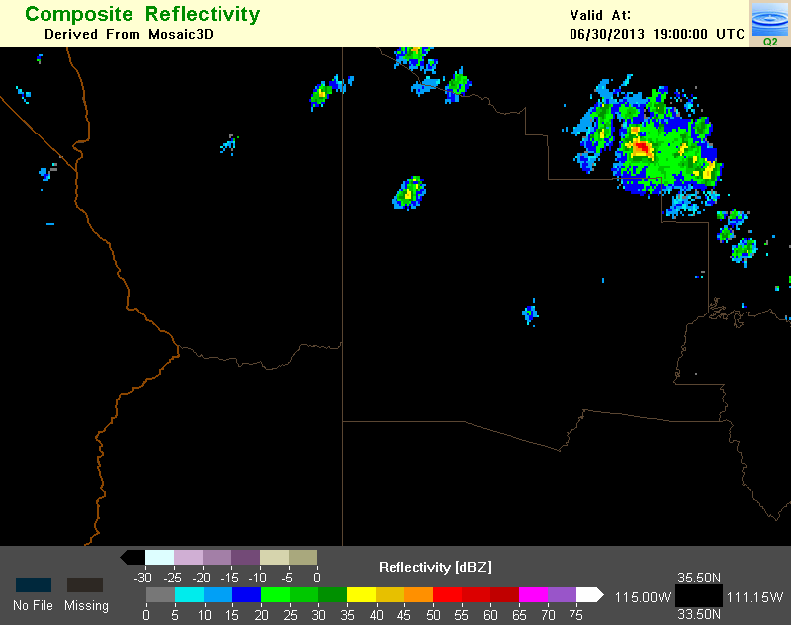
Observed
Radar
HRRR forecast from
1900 UTC (noon MST)
model run, which is
available by 2 PM MST
Yarnell
1900 z
1200 PM MST
1900
0-h HRRR forecast
80 m AGL wind speed (kts)
and direction (barbs)
HRRR forecast radar reflectivity
Yarnell
Yarnell
HRRR
HRRR
0-h fcst
0-h fcst

Slide 12
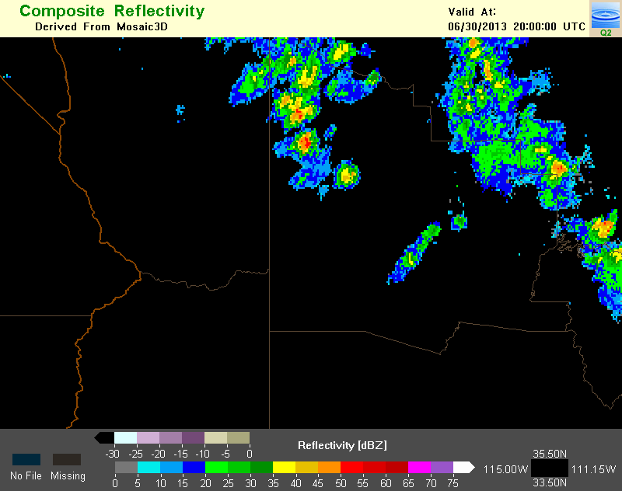
Observed
Radar
HRRR forecast from
1900 UTC (noon MST)
model run, which is
available by 2 PM MST
Yarnell
100 PM MST
2000 z
1-h HRRR forecast for 1 PM
80 m AGL wind speed (kts)
and direction (barbs)
HRRR forecast radar reflectivity
Yarnell
Yarnell
HRRR
HRRR
1-h fcst
1-h fcst

Slide 13
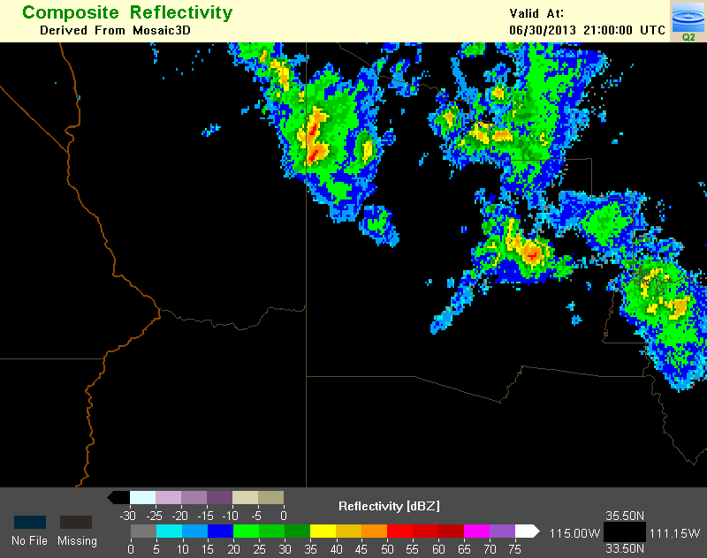
Observed
Radar
HRRR forecast from
1900 UTC (noon MST)
model run, which is
available by 2 PM MST
Yarnell
200 PM MST
2100 z
2-h HRRR forecast for 2 PM
80 m AGL wind speed (kts)
and direction (barbs)
HRRR forecast radar reflectivity
Gust
Front
Edge
Yarnell
Yarnell
HRRR
HRRR
2-h fcst
2-h fcst

Slide 14
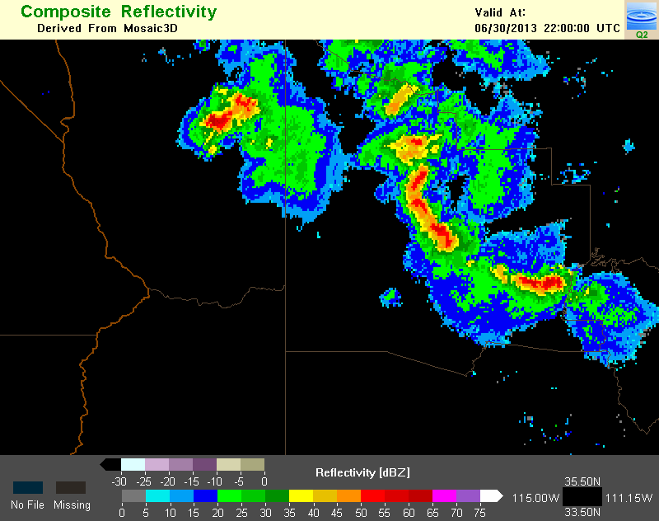
HRRR forecast from
1900 UTC (noon MST)
model run, which is
available by 2 PM MST
Observed
Radar
Yarnell
300 PM MST
2200 z
3-h HRRR forecast for 3 PM
80 m AGL wind speed (kts)
and direction (barbs)
HRRR forecast radar reflectivity
Gust
Front
Edge
Yarnell
Yarnell
HRRR
HRRR
3-h fcst
3-h fcst
SW winds

Slide 15
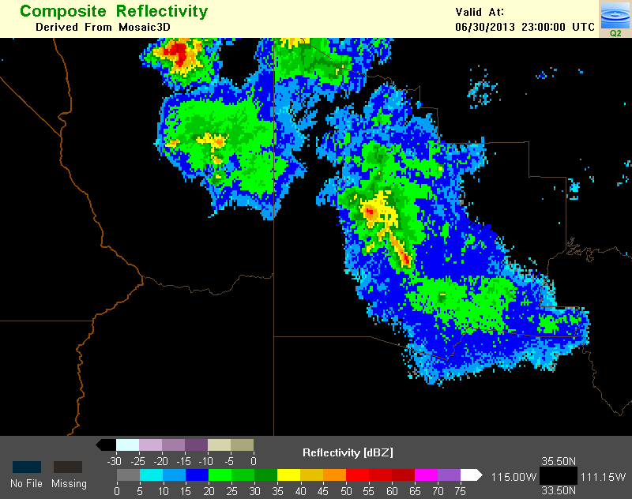
HRRR forecast from
1900 UTC (noon MST)
model run, which is
available by 2 PM MST
Observed
Radar
Yarnell
400 PM MST
2300 z
4-h HRRR forecast for 4 PM
80 m AGL wind speed (kts)
and direction (barbs)
HRRR forecast radar reflectivity
Yarnell
Yarnell
HRRR
4-h fcst
Gust
Front
Edge
HRRR
4-h fcst

Slide 16
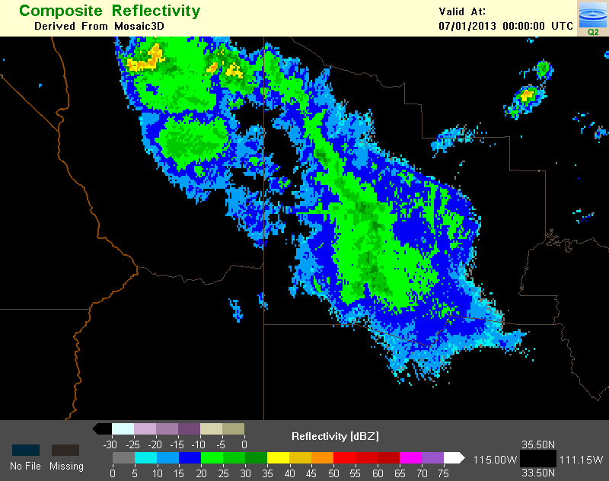
Observed
Radar
HRRR forecast from
1900 UTC (noon MST)
model run, which is
available by 2 PM MST
Yarnell
500 PM MST
0000 z
5-h HRRR forecast for 5 PM
80 m AGL wind speed (kts)
and direction (barbs)
HRRR forecast radar reflectivity
Yarnell
Yarnell
HRRR
HRRR
5-h fcst
Gust
Front
Edge
NE winds
5-h fcst

Slide 17
Outline
HRRR (3km)/ RAP (13km) are the hourly updated models for NOAA. Focus – situational awareness, decision making for severe weather, transportation, energy, all-season high-impact weather.
HRRR/RAP are only NOAA models that currently assimilate satellite-based cloud and radar reflectivity data.
2015 HRRR/RAP additions at NCEP: lightning, radial wind, mesonet
HRRR/RAP assimilation at ESRL – 2014-2015:
Cloud-top cooling from GOES
Fire data from ABBA, MODIS for HRRR-chem-smoke, RAPchem
Direct readout radiance data from JPSS
Initial testing of global cloud analysis (in progress)
Results from RAP OSEs (obs sensitivity experiments) from radiances and observations (including AMVs)
Sat Science Week
HRRR/RAP sat assim – high-impact wx
17

Slide 18
Radiance DA updates for RAPv3 (mid-2015 NCEP implementation)
Includes new sensors/data
GOES sounding data from GOES-15
AMSUA/MHS from NOAA-19 and METOP-B；
Includes the direct readout (RARS) data
Removes some high-peaking channels to fit the model top of RAP, removes O₃ channels
Implemented the enhanced variational bias correction scheme with cycling

Slide 19
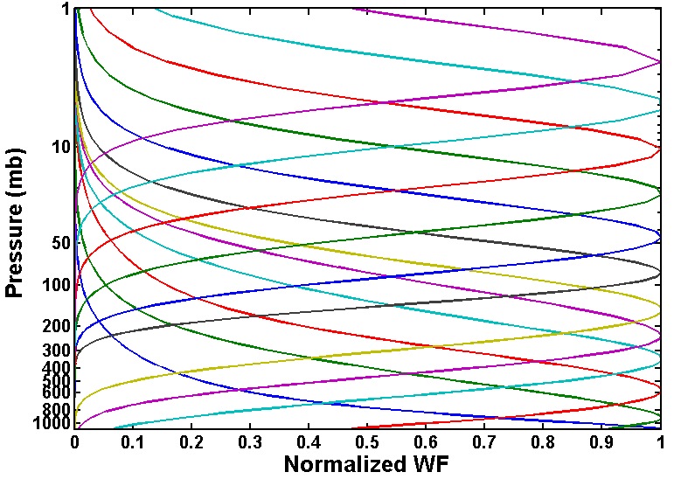
Radiance channels selected for RAP V2
AMSU-A (remove high-peaking channels)
NOAA-15: channels 1-10, 15;
NOAA-18: channels 1-8, 10,15;
METOP-A: channels 1-6, 8-10,15 (removed channel 8 on 26 Sep. 2014 per NCEP note) ;
HIRS4 (remove high-peaking and O₃ channels)
METOP-A: channels: 4-8, 10-15;
MHS
NOAA-18, METOP-A : channels 1-5;

Slide 20
Radiance channels selected for RAPv3 (2015)
AMSU-A (remove high-peaking channels)
NOAA-15: channels 1-10, 15;
NOAA-18: channels 1-8, 10,15;
NOAA-19: channels 1-7, 9-10, 15;
METOP-A: channels 1-6, 8-10,15 (removed channel 8 on 26 Sep. 2014 per NCEP note) ;
METOP-B: channels 1-10, 15;
HIRS4 (remove high-peaking and O₃ channels)
METOP-A: channels: 4-8, 10-15;
MHS
NOAA-18/19, METOP-A/B : channels 1-5;
GOES (remove high-peaking and ozone channels)
GOES-15 (sndrD1,sndrD2,sndrD3,sndrD4): channels 3-8, 10-15.
RARS - NOAA-15/18/19, METOP-A/B

Slide 21
Retrospective Experiments (RAPv2)
Extensive retro run for bias coefficients spin up
Control run (CNTL) – (conventional data only)
1-h cycling run, 8-day retro run (May 28 – June 4 2012)
RAP Hybrid EnKF system (RAP V2)
Real-time radiance (limited availability)
CNTL + RAP real time radiance data (amsua/mhs/hirs4/goes)
Use updated bias coefficients from the extensive retro run
RARS + Real-time radiance (better availability)
(RARS = Regional ATOVS Retransmission Services)
Full coverage radiance (perfect availability)
Using full data for AMSUA/MHS/HIRS4 (no data latency)

Slide 22
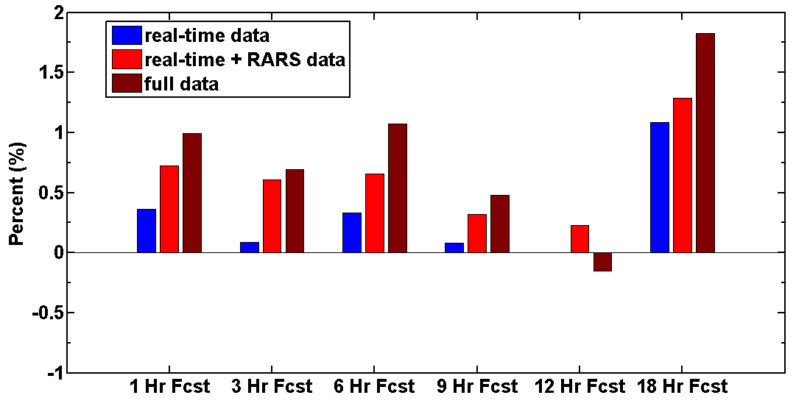
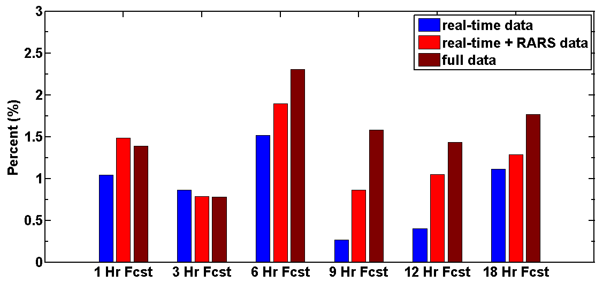
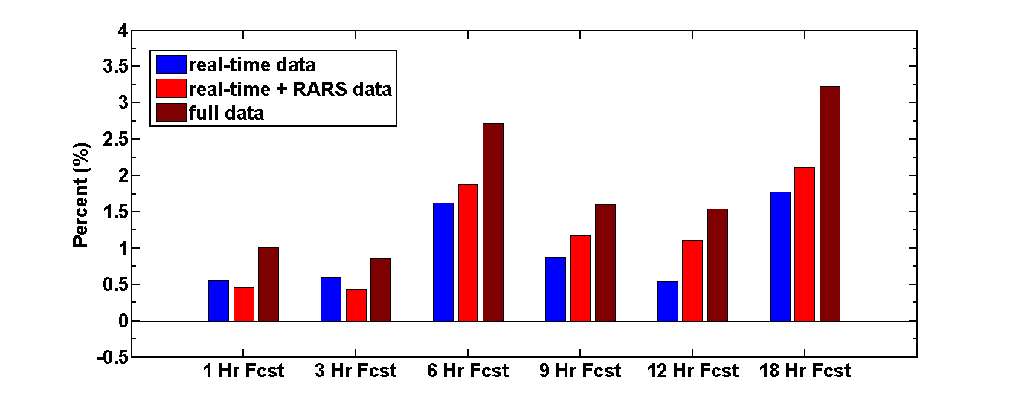
Impact from no/RARS/full data sets
Temperature
Relative Humidity
+1.5%
+2.5%
Better
Better
Worse
18 Hr Fcst
18 Hr Fcst
Real-time data
+3.5%
RARS included
Wind
Full data
Normalize Errors
E_{N} = (CNTL – EXP)
CNTL
Better
100-1000 hPa RMS mean
18 Hr Fcst
Full data helps, esp. with wind fcsts, but also T and RH (over RARS)
May28-June04 2012 retro runs

Slide 23
6-h Forecast RMS Error improvements - Observation impact: radiance vs. raob
Temperature
Relative
Humidity
Wind
Worse
Worse
Better
Worse
Better
Better
upper-air verification
raob impact
Radiance impact
Retro run (05/15/2013-05/22/2013)
Pairwise comparison

Slide 24
RAP-radiance assimilation summary
Direct-readout data especially important to hourly RAP
Reduces data latency (necessary for RAP/HRRR)
RAP system will get much more real-time radiance data by using RARS data
Could still double radiance impact with zero latency
4-month data-impact RAP experiments with and without RARS direct readout data,
1-4% positive impact has been seen for temperature, moisture, and wind
Much less than aircraft, slightly less than raob impact
Direct readout will likely have more impact on 1h-12h forecasts with Global Rapid Refresh
http://rapidrefresh.noaa.gov

Slide 25
Wind RMS (m/s) [1000-1000 hPa]
RAP 2013 obs impact
-20%
RAP data impact
-- North America
-- GSI/ensemble/hybrid DA
-- May 2013 experiments
-- 12z and 00z combined
+3h +6h +9h +12h
Relative Humidity RMS (%) [1000-400 hPa]
-20%
Normalize: 6h Fcst – 0h Anx
V – 1.8 m/s, RH – 6%, T – 0.5K
+3h +6h +9h +12h
Aircraft – largest impact wind/RH/temp – all have up to 20% reduction forecast error, especially 6h-9h fcsts
Following in importance:
Raob, Surface,
GPS-Met, AMVs
Temperature RMS (K) [1000-100 hPa]
Airc
AMV
Raob
Sfc
GPS
-20%
+3h +6h +9h +12h
Notes:
Std atm height of 400mb is 23574 feet.

Slide 26
Outline
HRRR (3km)/ RAP (13km) are the hourly updated models for NOAA. Focus – situational awareness, decision making for severe weather, transportation, energy, all-season high-impact weather.
HRRR/RAP are only NOAA models that currently assimilate satellite-based cloud and radar reflectivity data.
2015 HRRR/RAP additions at NCEP: lightning, radial wind, mesonet
HRRR/RAP assimilation at ESRL – 2014-2015:
Cloud-top cooling from GOES
Fire data from ABBA, MODIS for HRRR-chem-smoke, RAPchem
Direct readout radiance data from JPSS
Initial testing of global cloud analysis (in progress)
Results from RAP OSEs (obs sensitivity experiments) from radiances and observations (including AMVs)
Sat Science Week
HRRR/RAP sat assim – high-impact wx
26

Slide 27
What is the cloud and precipitation hydrometeor (HM) analysis?
Observations
Map to HM field
Merge HM field
Update hydrometeors in the model state based on the cloud field.
ceilometeors
No cloud
Cloud
Unknown
Notes:
Last opportunity for corrections from observations
Adjustments are limited currently… If high clouds are observed they are built into the model fields.

Slide 28
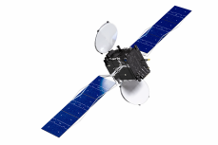
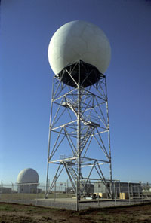
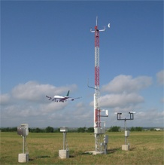
What is the cloud and precipitation hydrometeor (HM) analysis?
The 3 km model hydrometeors are updated based on cloud and precipitation observations to provide a high-resolution 3-d cloud (qr, qi) analysis.
GOES cloud top pressure
ceilometeors
WSR-88D Reflectivity
Notes:
Cartoon can be updated… Main points are:
3 types of obs (sat,radar,METAR)
Obs are used to help clear regions with no clouds and build low level clouds
Obs are used used to help clear precip and build (limited) precip

Slide 29
More details about the cloud and precipitation hydrometeor (HM) analysis
3-d variables updated | Add HM to 3-d model grid? | Remove from 3-d model? | Which observations are used?
cloud water, cloud ice, temperature, water vapor | Yes, below 1.2 km AGL | Yes. Cloud trimming at night to ground added in 2015 | Sat (GOES) cloud- top pressure/temp, METAR ceilometers
Rain water, snow water | Yes, for Zr < 28 dBZ for all temperatures. If 2m T < 5°C: add to full column, Else: add at observed maximum reflectivity level | Yes | Radar reflectivity
Sat Science Week
HRRR/RAP sat assim – high-impact wx
Notes:
New development to improve model bias and improve cloud forecasts is on-going.
The hydrometeor analysis is simple and does not make changes throughout the full column.

Slide 30
Outline
HRRR (3km)/ RAP (13km) are the hourly updated models for NOAA. Focus – situational awareness, decision making for severe weather, transportation, energy, all-season high-impact weather.
HRRR/RAP are only NOAA models that currently assimilate satellite-based cloud and radar reflectivity data.
2015 HRRR/RAP additions at NCEP: lightning, radial wind, mesonet
HRRR/RAP assimilation at ESRL – 2014-2015:
Cloud-top cooling from GOES
Fire data from ABBA, MODIS for HRRR-chem-smoke, RAPchem
Direct readout radiance data from JPSS
Initial testing of global cloud analysis (in progress)
Results from RAP OSEs (obs sensitivity experiments) from radiances and observations
Sat Science Week
HRRR/RAP sat assim – high-impact wx
30

Slide 31
Radar/lightning digital filter assimilation
HRRR (and RAP) Future Milestones
HRRR Milestones
Reflectivity
Digital filter-based assimilation initializes ongoing / developing convection / precipitation regions
Use for following obs types:
Radar reflectivity
➔ Lightning (GOES-R or ground)
Satellite cloud-top cooling rate
-20 min -10 min Initial +10 min + 20 min
Backwards integration,
no physics
Forward integration,full physics with obs-based latent heating
Initial fields with improved balance, storm-scale circulation
RAP / HRRR model forecast

Slide 32
Outline
HRRR (3km)/ RAP (13km) are the hourly updated models for NOAA. Focus – situational awareness, decision making for severe weather, transportation, energy, all-season high-impact weather.
HRRR/RAP are only NOAA models that currently assimilate satellite-based cloud and radar reflectivity data.
2015 HRRR/RAP additions at NCEP: lightning, radial wind, mesonet
HRRR/RAP assimilation at ESRL – 2014-2015:
Cloud-top cooling from GOES
Fire data from ABBA, MODIS for HRRR-chem-smoke, RAPchem
Direct readout radiance data from JPSS
Initial testing of global cloud analysis (in progress)
Results from RAP OSEs (obs sensitivity experiments) from radiances and observations

Slide 33
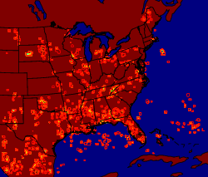
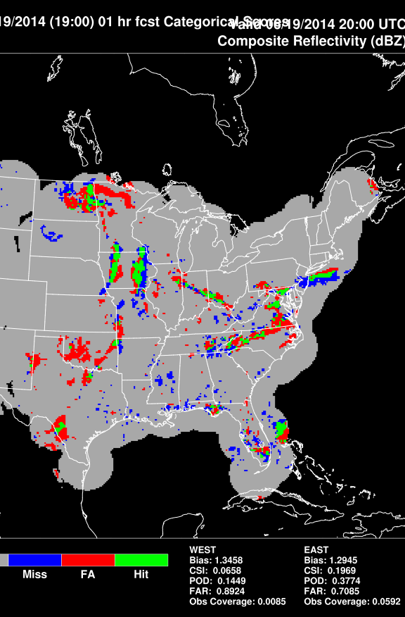
Cloud-top cooling (CTC) assimilation NOAA/ESRL/GSD and UAH Tracy Lorraine Smith, Steve Weygandt // John Mecikalski
Cloud-top cooling data from
U.Alabama-Huntsville.
Assimilation of larger cooling than -3K/15min.
RAP experiment: Analysis For 00h 25dBz 19z 19 June 2014.
Improved CSI, POD, FAR with CTC
Next step:
CTC assimilation at 3km in HRRR.
RAP1h Forecast
valid 20z 19 June 2014
CSI, POD same with CTC.

Slide 34
Outline
HRRR (3km)/ RAP (13km) are the hourly updated models for NOAA. Focus – situational awareness, decision making for severe weather, transportation, energy, all-season high-impact weather.
HRRR/RAP are only NOAA models that currently assimilate satellite-based cloud and radar reflectivity data.
2015 HRRR/RAP additions at NCEP: lightning, radial wind, mesonet
HRRR/RAP assimilation at ESRL – 2014-2015:
Cloud-top cooling from GOES
Fire data from ABBA, MODIS for HRRR-chem-smoke, RAPchem
Direct readout radiance data from JPSS
Initial testing of global cloud analysis (in progress)
Results from RAP OSEs (obs sensitivity experiments) from radiances and observations
Sat Science Week
HRRR/RAP sat assim – high-impact wx
34

Slide 35
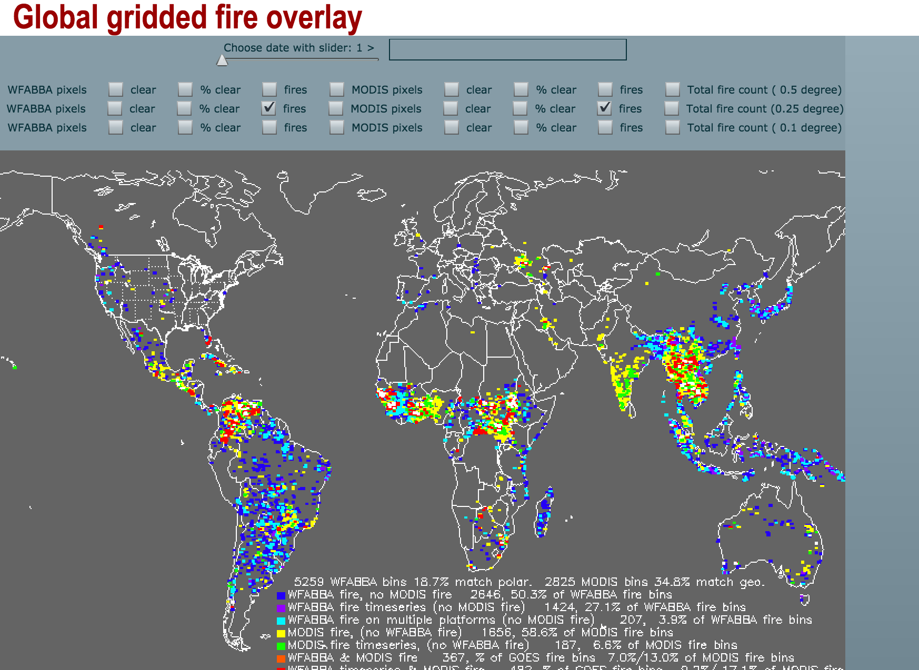
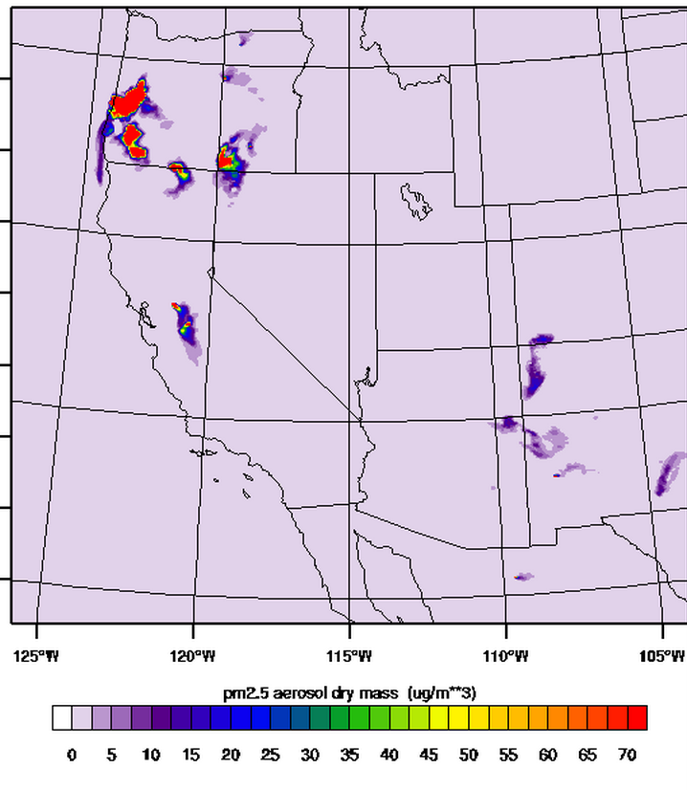
HRRR-chem – assimilation of WFABBA
HRRR-chem-3km
PM25- surface
11h fcst valid 17z 24 Feb 2015

Slide 36
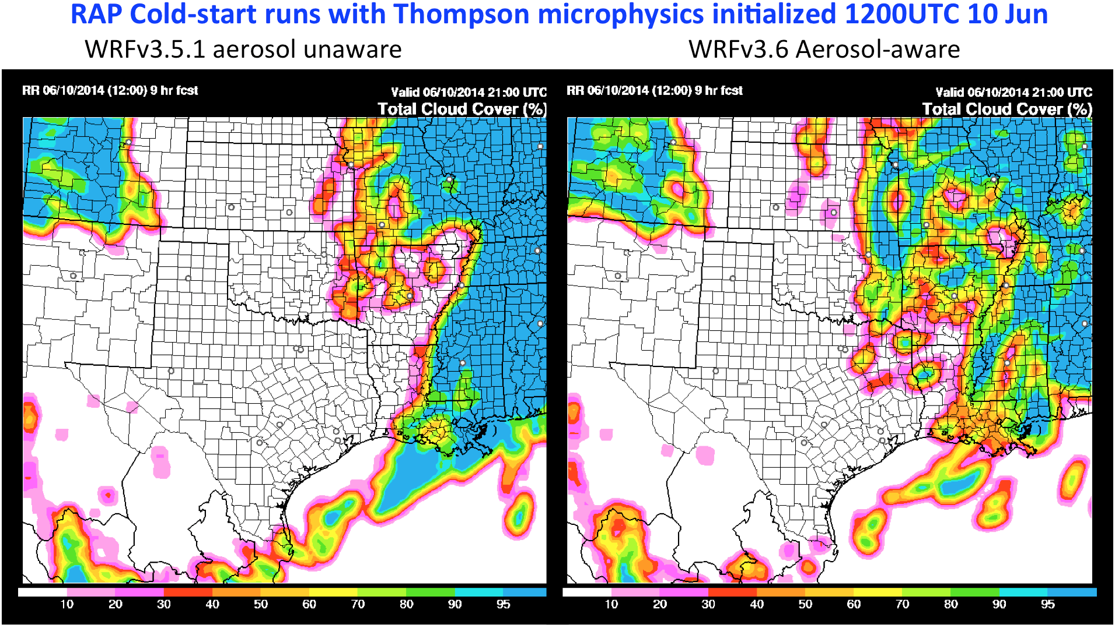
NCEP RAPv3/HRRRv2-2015 Changes
Use of forecast aerosol fields to have prognostic cloud-condensation nuclei (CCN).
Example: RAP cold-start tests without/with aerosol-aware cloud microphysics.
More small-scale cloud with more CCN over land.

Slide 37
RAP/HRRR Implementation Map
HRRR (and RAP) Future Milestones
HRRR Milestones
ESRL – experimental version
NWS-NCEP - operational –
Planned dates
RAPv3 – GSD testing in 2014
Final RAP-primary impl - 1/1/2015
Will initialize 2014 ESRL-HRRR(v2)
Improved PBL, LSM, cu-parm, DA
WRFv3.6.1 w/ Thompson/NCAR aerosol-aware microphysics
HRRRv2 – GSD testing in 2014
Final HRRR-primary impl - 1/1/2015
Initialized by 2014 RAP (v3)
Improved radar assimilation, hybrid assimilation, PBL/cloud physics
RAPv4 – GSD testing in 2015
Hourly RAP ensemble data assimilation
HRRRv3 – GSD testing in 2015
Target: Improved 3km physics + improved data assimilation.
Implement June 2015
(domain expansion to NAM domain)
Implement June 2015
(extension to 24h)
Implement 2016
Implement 2016

Slide 38
Improved high-impact weather HRRR/RAP forecast accuracy from assimilation of satellite-based cloud, lightning, convection, AMVs, fire, and radiance data
HRRR (3km)/ RAP (13km) are the hourly updated models for NOAA. Focus – situational awareness, decision making for severe weather, transportation, energy, all-season high-impact weather.
HRRR/RAP are only NOAA models that currently assimilate satellite-based cloud and radar reflectivity data.
2015 HRRR/RAP additions at NCEP: lightning, radial wind, mesonet
HRRR/RAP assimilation at ESRL – 2014-2015:
Cloud-top cooling from GOES
Fire data from ABBA, MODIS for HRRR-chem-smoke, RAPchem
Direct readout radiance data from JPSS
Initial testing of global cloud analysis (in progress)
Rapid Refresh reflectivity - 0h valid 02z 26 Jan 2012
With lightning assim
No
lightning assim
2015-17 – storm-scale ens assimilation – GSI – 4dEnVar
HRRR ensemble, toward 15-min update cycle (5 min)
Satellite data – GOES-R+, JPSS/SNPP – critical to improve HRRR as primary short-range prediction of high-impact wx

Slide 39
Future work–RAP/GRR - direct-readout
Include more direct readout data in real-time RAP and continue to test and evaluate their impact in real-time RAP
Plan to include the AIRS direct readout data in RAP if available
Plan to include direct readout data in RAP from SNPP and possible future JPSS
Include the direct readout radiance data from NPP/JPSS for future hourly GSD Global Rapid Refresh
http://rapidrefresh.noaa.gov

