Slide 1
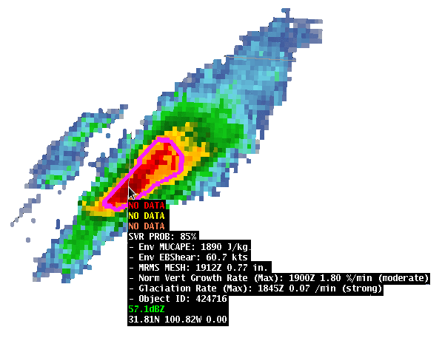
An Evaluation of the ProbSevere Model at
NWS Central and Eastern Regions
During the Spring and Summer of 2016
Chad M. Gravelle, PhD GOES-R Satellite Liaison NWS Operations Proving Ground University of Wisconsin - CIMSS Kansas City, MO
2016 Satellite User Readiness Meeting
Norman, Oklahoma
11 May 2016

Slide 2
2014 and 2015 Hazardous Weather Testbed Evaluation
2014 (12 participants)
When participants were asked if the ProbSevere model helped to increase their confidence in issuing severe thunderstorm (tornado) warnings, 78% of respondents answered “yes”.
Additionally, 47% of the respondents answered that the model increased lead-time to warning issuance.
2015 (25 participants)
On 95% of days, forecasters said the ProbSevere model helped to increase their confidence in issuing (or not issuing) severe thunderstorm or tornado warnings.
Forecasters answered ProbSevere helped increase lead time to severe thunderstorm and tornado warning issuance on 76% of days.
By the final day of each week, all 25 participants answered that they would use the ProbSevere model output if available during warning operations at their WFO.

Slide 3
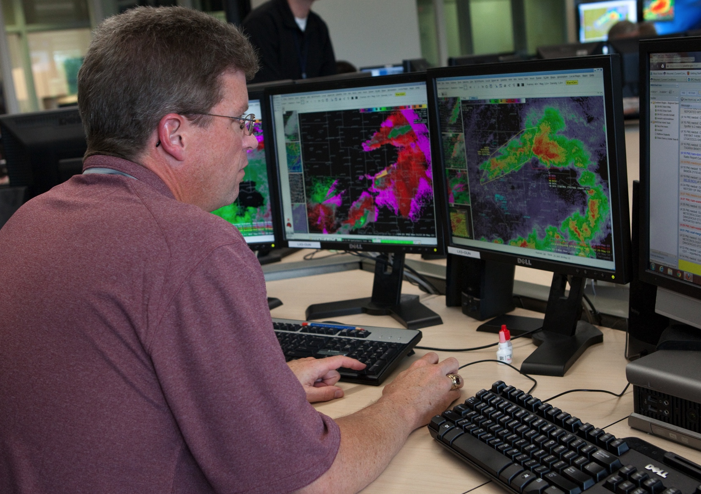
Why Evaluate ProbSevere at NWS Forecast Offices?

Slide 4
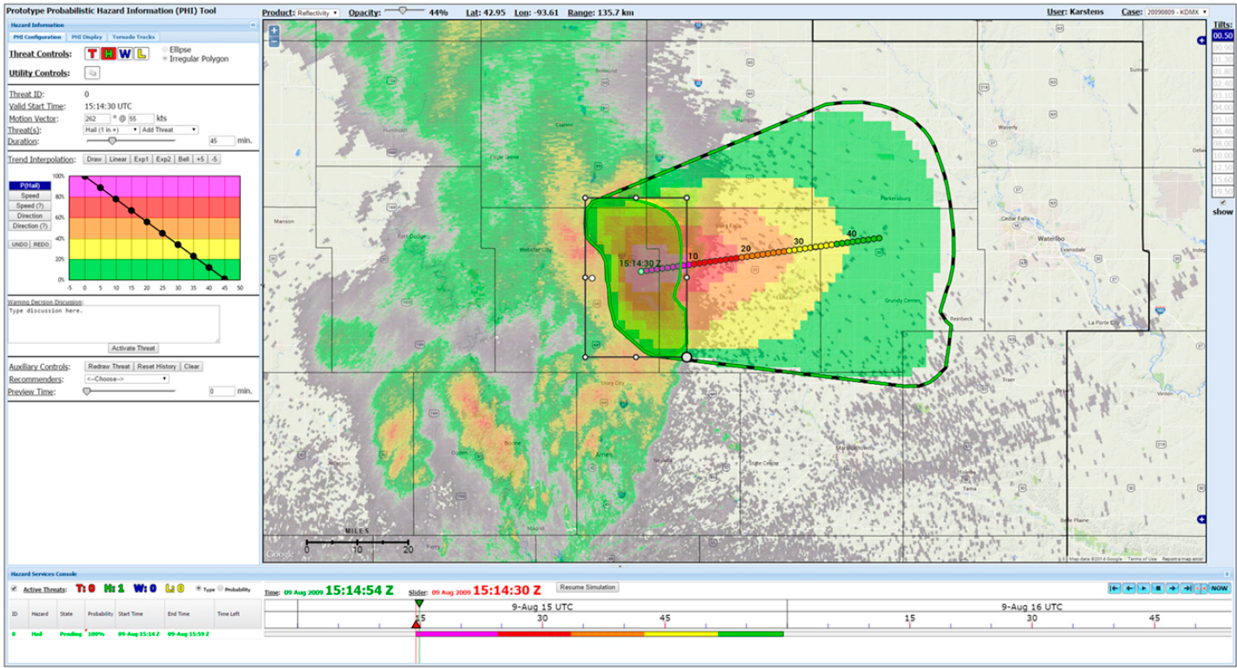
Why Evaluate ProbSevere at NWS Forecast Offices?
FACETS - 2014 Prototype Probabilistic Hazard Information (PHI)
Karstens (2015)

Slide 5
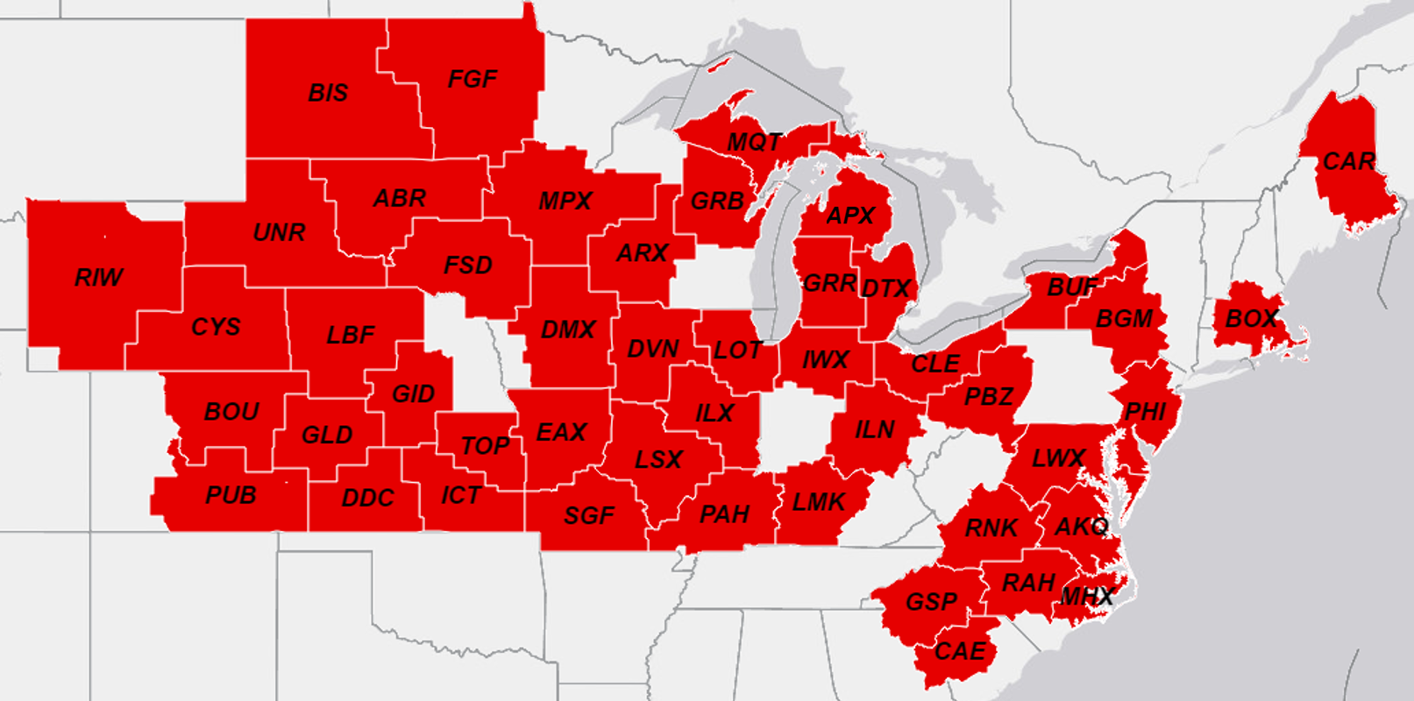
Spring/Summer 2016 Central and Eastern Region Evaluation
Participating Forecast Offices…
Eastern Region: 15
Central Region: 33
48 offices…18 forecasters…potentially 864 sets of eyes.
Notes:
18 meteorologists…48WFOs...864total

Slide 6
Spring/Summer 2016 Central and Eastern Region Evaluation
Evaluation: 1 April through 1 October 2016
Two live webinars on ProbSevere were scheduled with participating WFOs the last week in March.
WFO points of contact were given recorded Articulate Module on ProbSevere to distribute to forecasters that could not attend live webinars.
Feedback…
- Short online survey, seven questions
- Email exchanges with the field
- Bimonthly conference calls

Slide 7
1 April - 1 May Feedback: Forecaster Surveys
Forecaster Surveys Submitted: 23 (20 in Central Region)
How useful did you find the ProbSevere Model for providing confidence in issuing or not issuing convective warnings on thunderstorms?
10 (Extremely Useful)
9
8
7
6
5
4
3
2
1 (Not Useful)

Slide 8
1 April - 1 May Feedback: Forecaster Surveys
Forecaster Surveys Submitted: 23 (20 in Central Region)
How useful did you find the ProbSevere Model for providing confidence in issuing or not issuing convective warnings on thunderstorms?
10 (Extremely Useful)
9
8
7
6
5
4
3
2
1 (Not Useful)
- comments discussed using with dense cirrus and linear convection
- “false alarms”…forecaster needs to think probabilistically
Average (6.6)
Range
Mode

Slide 9
1 April - 1 May Feedback: Forecaster Surveys
“Overall, the ProbSevere Model resulted in a high false alarm rate for only marginal severe pulse convection.”
“We had several tornado touch downs with Prob Severe numbers of 10-25, if I recall. As event shifted toward large hail, ProbSevere numbers helped greatly.”
“I like the model and idea. However, for this marginal low-end event, the False Alarm Rate was very high.”
“It appears ProbSevere is too quick to suggest the storms are severe. This is my first time using it and from what I have seen while working radar is that the trends were more useful than following just numbers.”

Slide 10
1 April - 1 May Feedback: Probability “Jumps”
Forecaster comment in submitted survey…
“To me the probability jumps were absolutely the key in this event. So much so that I really would like to have a ‘rate of change’ of the ProbSevere output. The reason for this is that in some cases the actual values of ProbSevere were not high but when these storms produced a high rate of change of ProbSevere probabilities they actually became severe in some cases.

Slide 11
1 April - 1 May Feedback: Probability “Jumps”
Forecaster comment in submitted survey…
“To me the probability jumps were absolutely the key in this event. So much so that I really would like to have a ‘rate of change’ of the ProbSevere output. The reason for this is that in some cases the actual values of ProbSevere were not high but when these storms produced a high rate of change of ProbSevere probabilities they actually became severe in some cases.
One other observation I had was that in some cases storms that I did not believe to be severe on radar had a high value of ProbSevere. This actually decreased my confidence in the warning process.”

Slide 12
1 April - 1 May Feedback: Probability “Jumps”
Email sent by a CR ProbSevere POC to Office Staff…
All,
We had a good taste of severe weather Sunday and Monday and this was one of the first times we have had a good chance to take a closer look at Prob Severe and MRMS.
Below I took a few captures from one storm from Monday. ProbSevere probabilities with this storm went from 32% at 1758z to 70% at 1800z and we issued a warning at 1806z. At the 70% probability you would have had 6 additional minutes of lead time. This storm reached as high as 98% and remained elevated through much of the life cycle of the storm. It comes as no surprise to anyone that the ProbSevere threshold needed for a severe storm on a given day will be highly dependent on the kinematic and thermodynamic environment as well as the cloud cover of course.

Slide 13
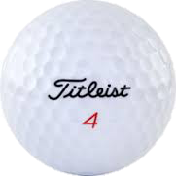
1 April - 1 May Feedback: Probability “Jumps”
Email sent by a CR ProbSevere POC to Office Staff…
All,
We had a good taste of severe weather Sunday and Monday and this was one of the first times we have had a good chance to take a closer look at Prob Severe and MRMS.
Below I took a few captures from one storm from Monday. ProbSevere probabilities with this storm went from 32% at 1758z to 70% at 1800z and we issued a warning at 1806z. At the 70% probability you would have had 6 additional minutes of lead time. This storm reached as high as 98% and remained elevated through much of the life cycle of the storm. It comes as no surprise to anyone that the ProbSevere threshold needed for a severe storm on a given day will be highly dependent on the kinematic and thermodynamic environment as well as the cloud cover of course.
1756: 27% 0.63" 10 fl/min
1758: 32% 0.63" 18 fl/min
1800: 70% 1.13" 18 fl/min
1802: 70% 1.13" 18 fl/min
1804: 85% 1.13" 32 fl/min
1806: 90% 1.13" 45 fl/min <---- svr issued
1808: 95% 1.50" 50 fl/min <----

Slide 14
1 April - 1 May Feedback: ProbSevere Near CWA Boundaries
H/T: Jim Sieveking (LSX SOO)
Storm Moving NE at 45 mph
~16 miles from CWA Border
DVN
DVN
LSX
2152 UTC
2.25” hail reported at 2253 UTC in DVN CWA

Slide 15
1 April - 1 May Feedback: ProbSevere Near CWA Boundaries
H/T: Jim Sieveking (LSX SOO)
Storm Moving NE at 45 mph
~16 miles from CWA Border
Storm Moving NE at 45 mph
~13 miles from CWA Border
DVN
DVN
LSX
LSX
2152 UTC
2.25” hail reported at 2253 UTC in DVN CWA
2200 UTC
1.00” hail reported at 2211 UTC in LSX CWA

Slide 16
1 April - 1 May Feedback: ProbSevere Near CWA Boundaries
Jim to his staff…
“Warning forecasters must remember that the ProbSevere algorithm was trained to predict the probability of severe weather occurring with a thunderstorm within the next 60 minutes.
When storms are developing near CWA boundaries, warning forecasters must pay special attention to…
- storm motion to determine the amount of time that the storm will be in the CWA.
- trends in ProbSevere probabilities and its components to anticipate if there is a higher probability the storm will produce severe weather.”
H/T: Jim Sieveking (LSX SOO)

Slide 17
1 April - 1 May Feedback: Forecaster Surveys
Forecaster Surveys Submitted: 23 (20 in Central Region)
How likely are you to use the ProbSevere Model for an upcoming convective event?
10 (Extremely Likely)
9
8
7
6
5
4
3
2
1 (Not Likely)

Slide 18
1 April - 1 May Feedback: Forecaster Surveys
Forecaster Surveys Submitted: 23 (20 in Central Region)
How likely are you to use the ProbSevere Model for an upcoming convective event?
10 (Extremely Likely)
9
8
7
6
5
4
3
2
1 (Not Likely)
Mode
Average (9.1)
Range

Slide 19
“ProbSevere is a highly valued tool, one that forecasters are becoming more reliant on as its credibility continues to increase. I'm/we're impressed so far.”

