Slide 1
How WES2 can facilitate satellite user readiness
Michael Bowlan (OU/CIMMS/WDTD),
James LaDue (WDTD)

Slide 2
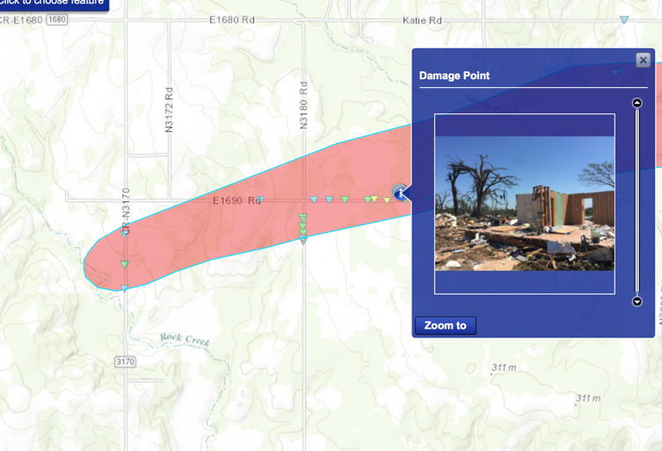
How to train to be user ready: case study
How can we give this resident better lead time?
Tor – 6 hr
Tor –120 min
Tor – 25 min
Tor – 5 min

Slide 3
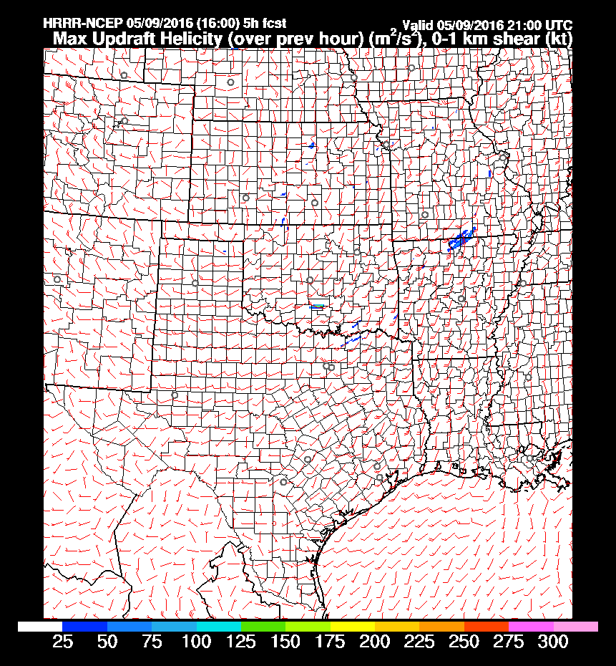
How to train to be user ready: case study
SA begins hours in advance and our training begins here
Tor – 6 hr

Slide 4
How to train to be user ready: case study
SA begins hours in advance and our training begins here with satellite foundational
Tor – 6 hr

Slide 5
How to train to be user ready: case study
Old outflow boundary seen in SRSO with post dryline cumulus line. CI likely at triple point
Tor – 6 hr
Tor –120 min

Slide 6
How to train to be user ready: case study
Significant tornado parameter high in region of potential CI
Tor – 6 hr
Tor –120 min

Slide 7
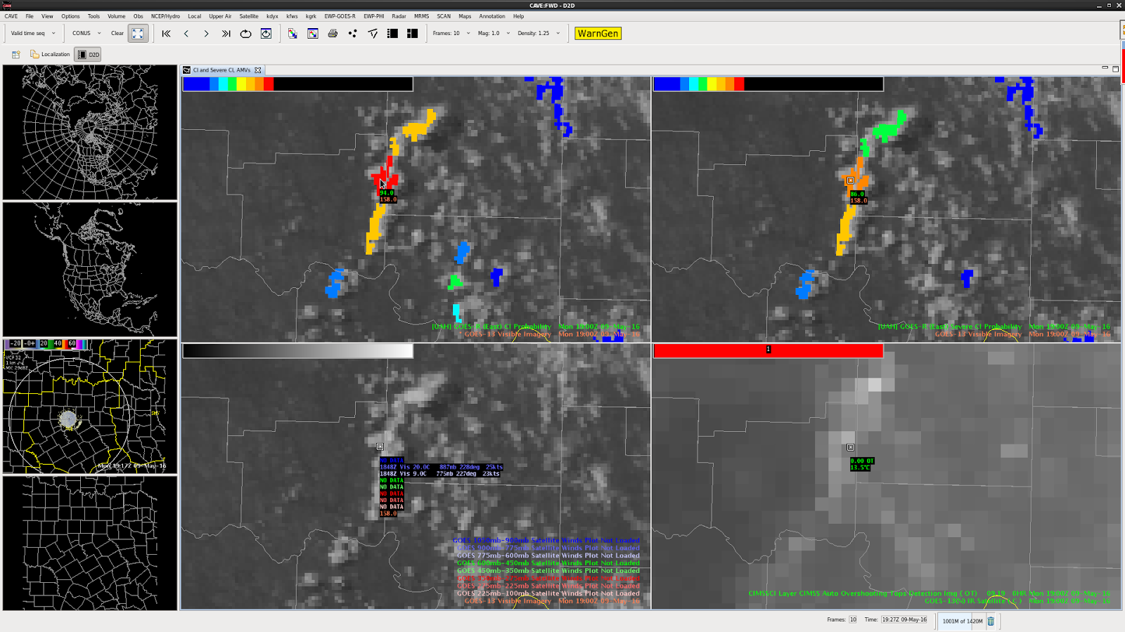
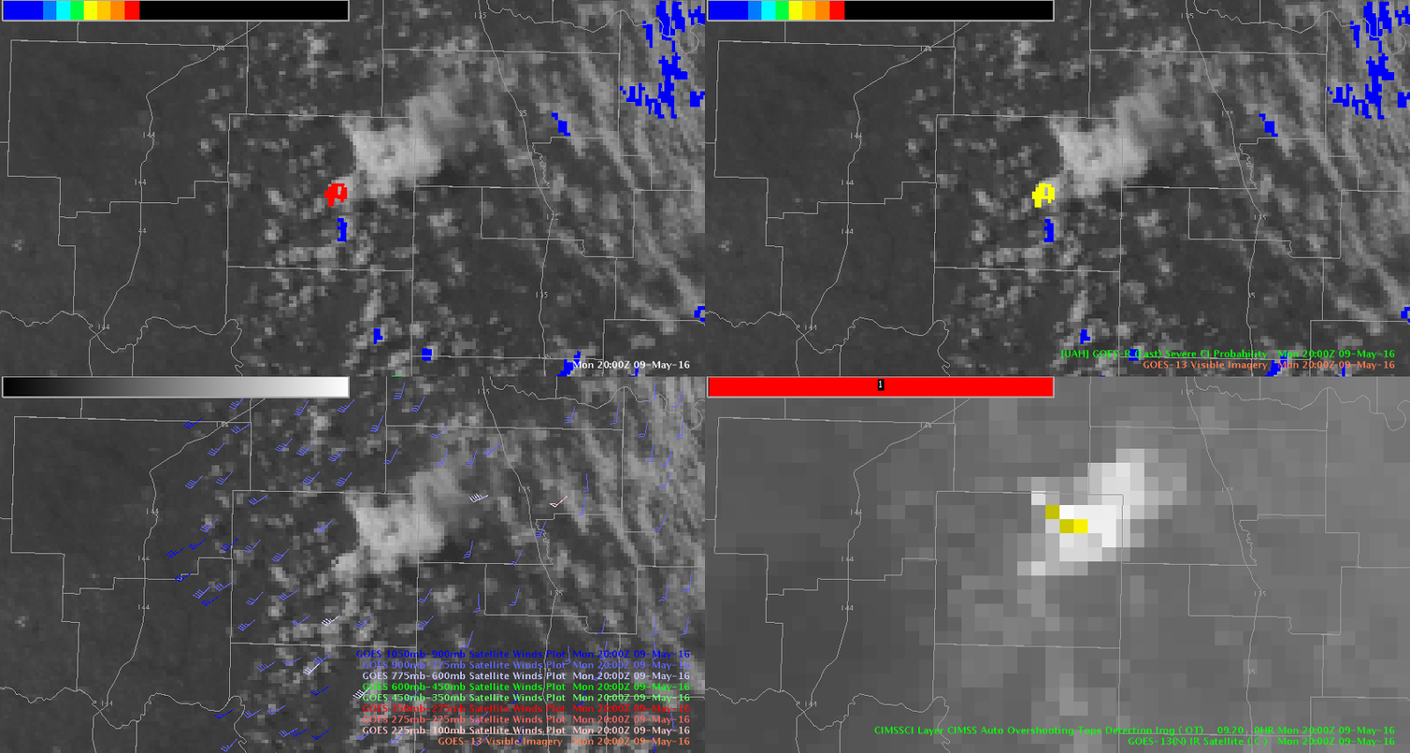
How to train to be user ready: case study
potential CI
Tor – 6 hr
Tor –120 min

Slide 8
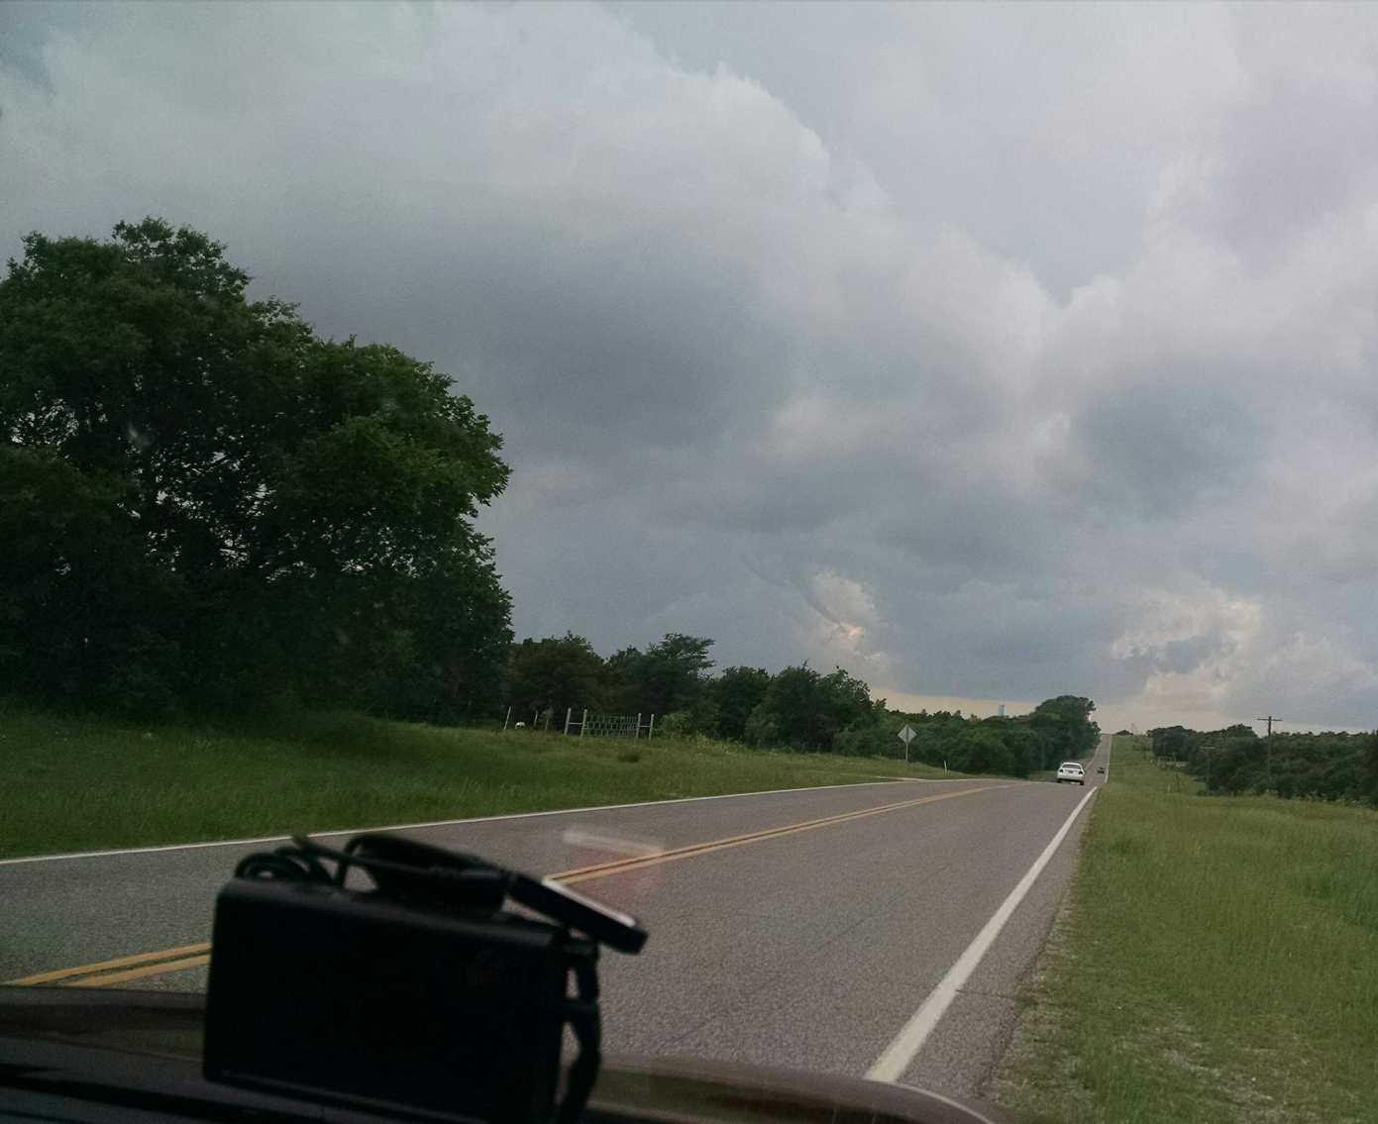
How to train to be user ready: case study
Funnel already sent via Twitter
WES2 can emulate injects of any imagery and information
Tor – 6 hr
Tor –120 min
Tor – 25 min

Slide 9
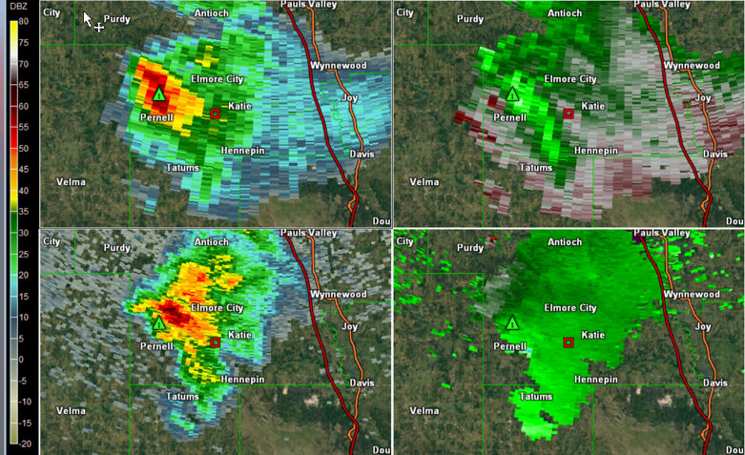
How to train to be user ready: case study
Already mesocyclone is visible aloft in immature convection. These concepts taught in Radar course foundational
Tor – 6 hr
Tor –120 min
Tor – 25 min

Slide 10
How to train to be user ready: case study
Nascent supercell with midlevel funnel right at intersection of three boundaries. These are covered in Satellite foundational and reinforced in WES2 exercises.
Tor – 6 hr
Tor –120 min
Tor – 25 min

Slide 11
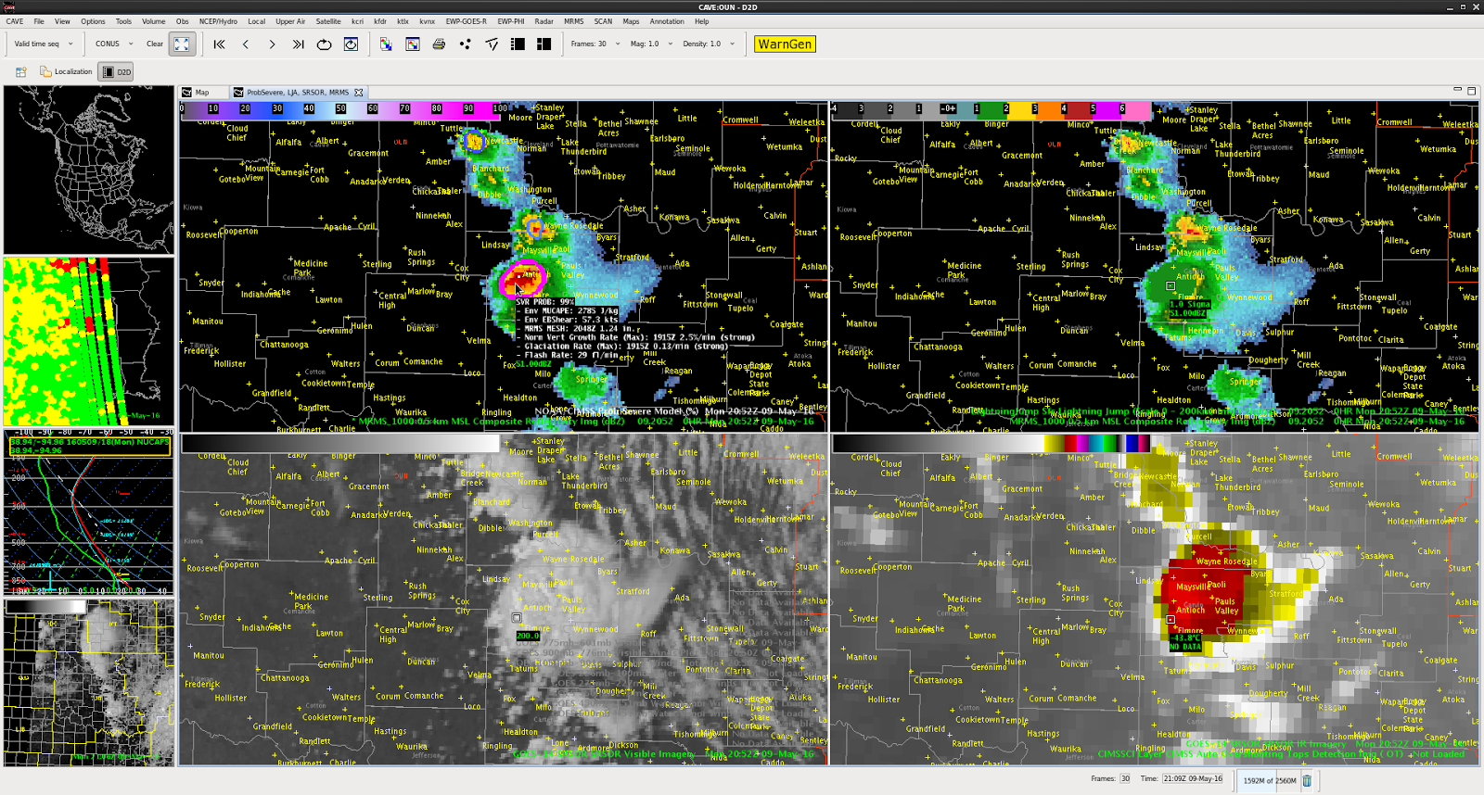
How to train to be user ready: case study
Probsevere jumps to 90% with strong satellite-based growth rate helping to influence. WES2 can display any product AWIPS2 can.
Tor – 6 hr
Tor –120 min
Tor – 25 min

Slide 12
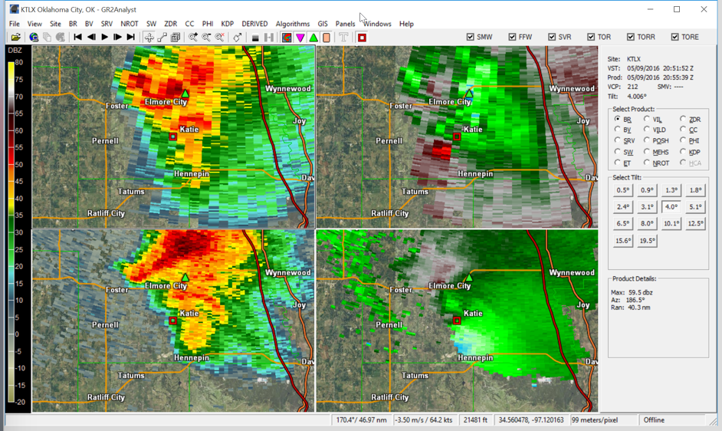
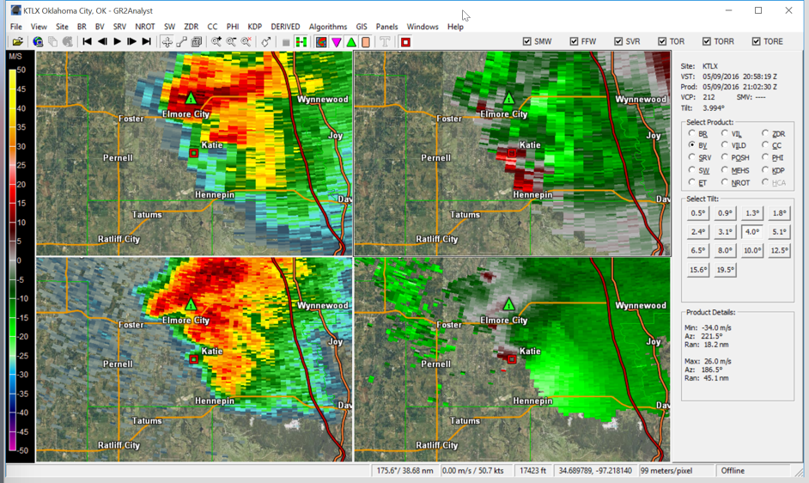
How to train to be user ready: case study
1
2
How can we give this resident better lead time?
Tor – 6 hr
Tor –120 min
Tor – 25 min
Tor – 5 min

Slide 13
How to train to be user ready: case study
Five images are available for every 88D volumetric scan
Tor – 6 hr
Tor –120 min
Tor – 25 min
Tor – 5 min

Slide 14
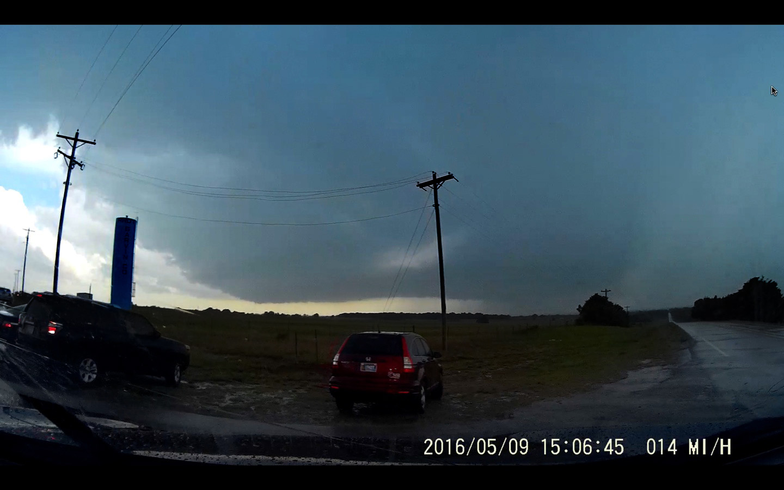
How to train to be user ready: case study
2
1
Another live image available to WFO can also be made available in WES2
Tor – 6 hr
Tor –120 min
Tor – 25 min
Tor – 5 min

Slide 15
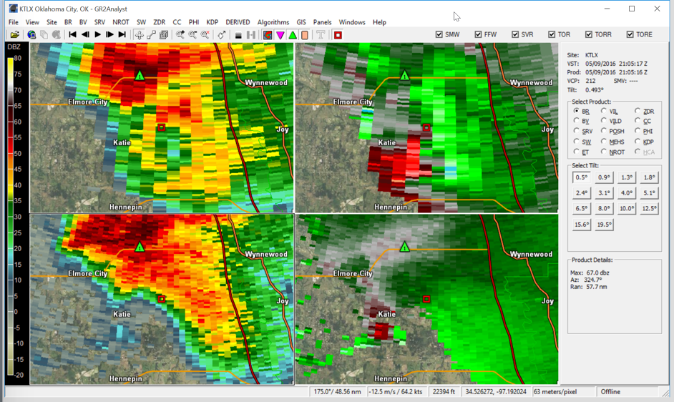
How to train to be user ready: case study
Tornado begins
Tor – 6 hr
Tor –120 min
Tor – 25 min
Tor – 5 min
Tor

Slide 16
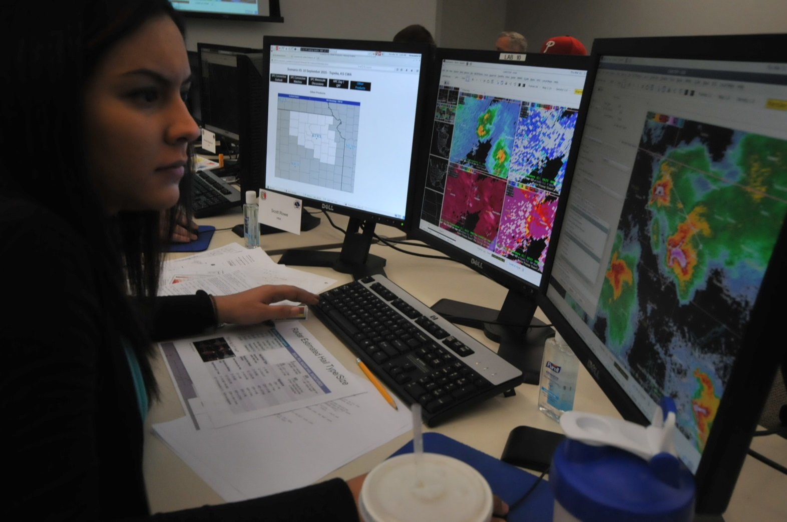
“Train As You Fight” with AWIPS
WES
Scripting
Dual-Pol
Radar
Analysis
Warngen

Slide 17
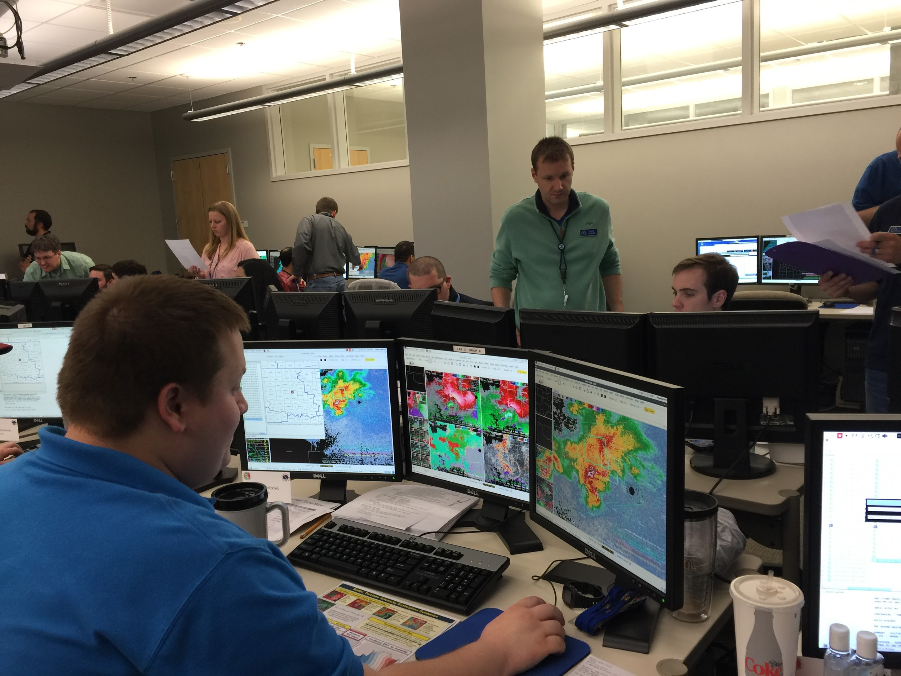
WES2 capabilities
Manage time in software
Case Review
Simulation
Exchanging Cases & Localizations

Slide 18
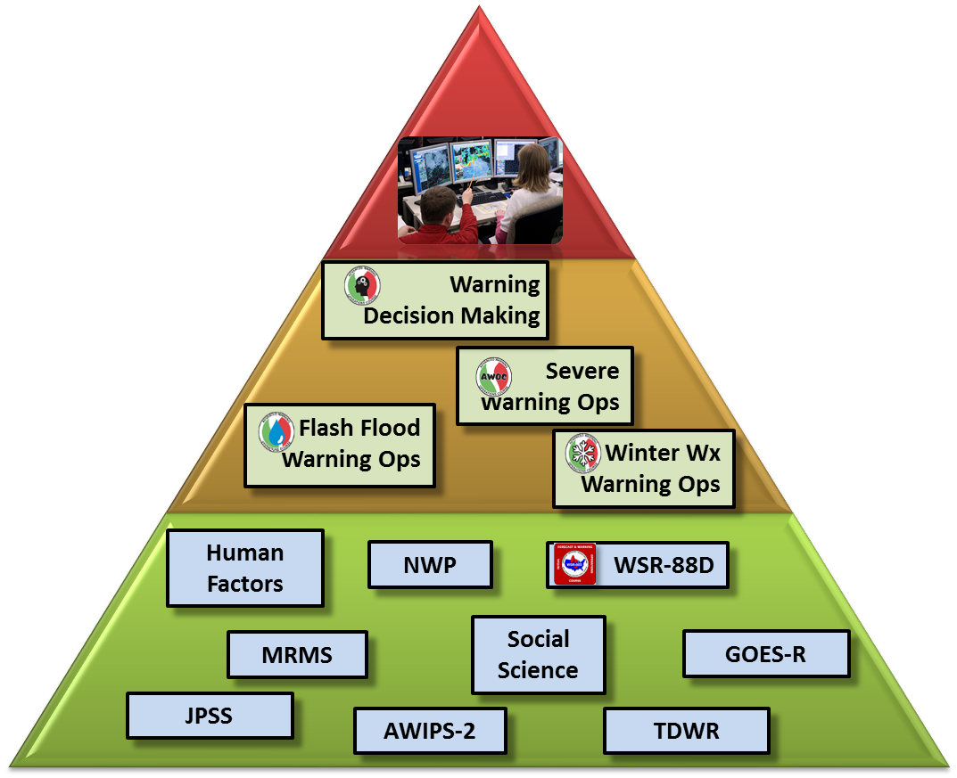
types of WES2 interaction follows stage of learning
What does it take to do a task (e.g., issue a warning)?
Job-oriented:
IDSS Simulation:
.
Job-oriented:
Simulation, miniscenario,
Foundational and focused applications:
Jobsheets,

Slide 19
Demonstration
Foundational
Job-task CI
Job-task Warning
Job-task DSS

Slide 20
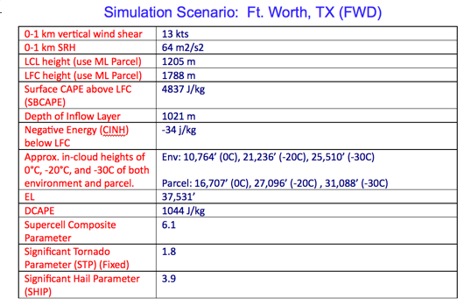
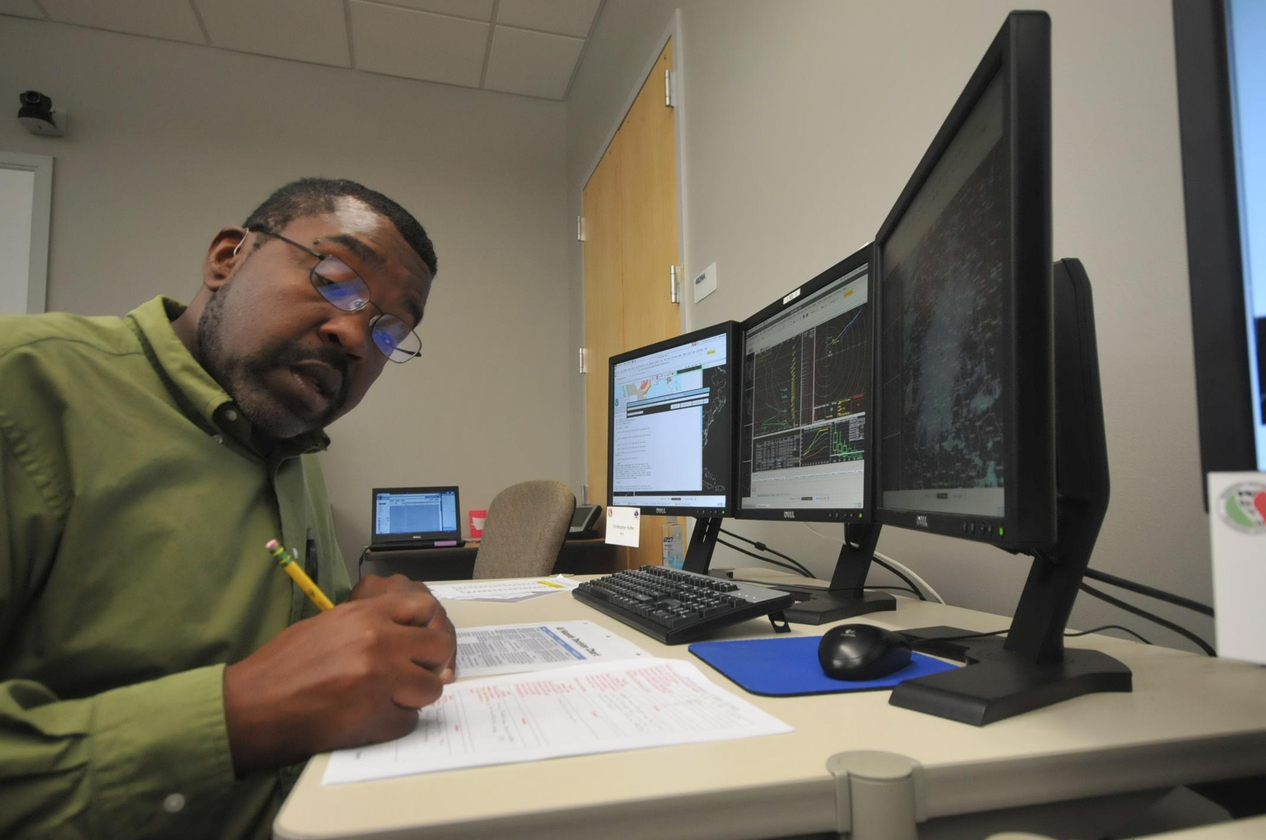
Foundational tasks - demonstrate you know the basics

Slide 21
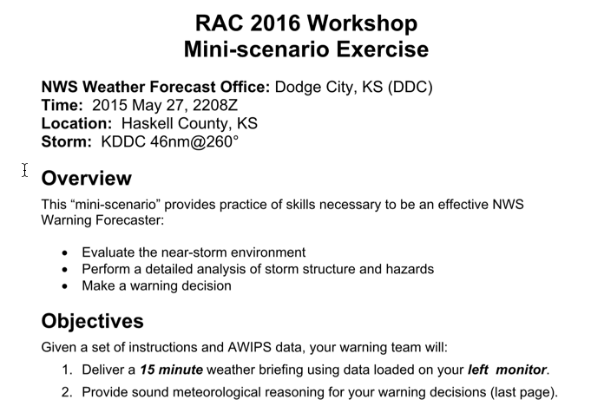
Job oriented decision tasks
Limited data source
Full data fusion

Slide 22
Full simulation
Replicate job environment
All data sources available
individual or in small teams
Objectives task-oriented or conceptual
Experiment, take chances

Slide 23
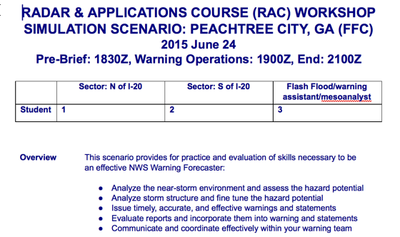
Full simulation
Reference sheets available for practice

Slide 24
sample GOES-R lesson candidates for foundational job sheets
Pre-convective environment. (20 min.)
Pre-convective cloud features.
Boundary-forced convection.
Mountain waves and orographic enhancement.
Fog / low cloud formation and dissipation.
Mesolows.
Convective evolution mini-modules:
Cumulus congestus / growth.
Discrete storms. (20 min.)
Mesoscale convective systems.

Slide 25
Example - miniscenario exercise

