Slide 1
Using GOES-R Probabilities of IFR Visibility and Ceiling for Decision Support at the FAA - Air Traffic Control System Command Center (ATCSCC)
Nat’l Aviation Meteorologist (NAM)
Michael Eckert
Notes:
Intro Slide

Slide 2
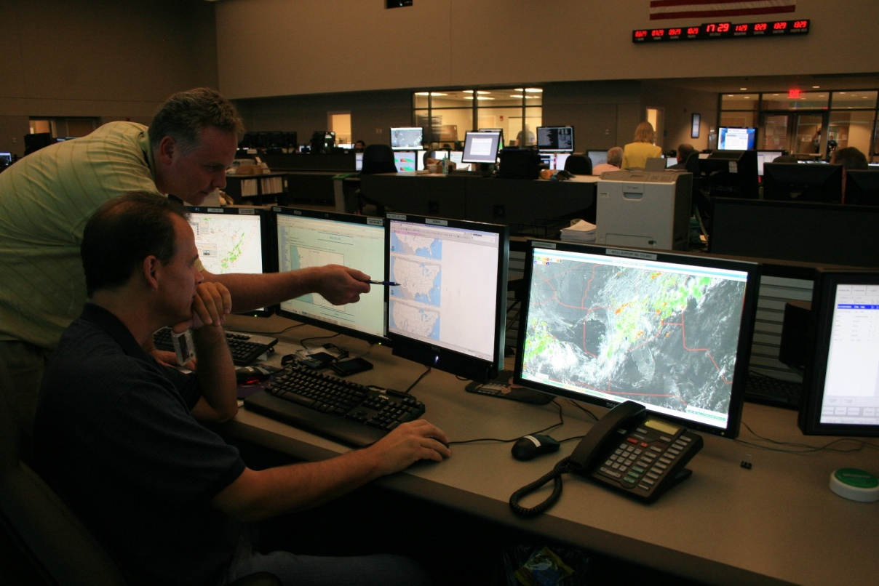
Role/Mission of the NAM
Orchestrate weather support to the ATCSCC through coordination/collaboration with partners
Maximize efficiency/safety in the NAS
Minimize delays in the NAS
Tools
CCFP
CAWS
Impromptu Briefings
Telcons
Notes:
NAM Role/Mission

Slide 3
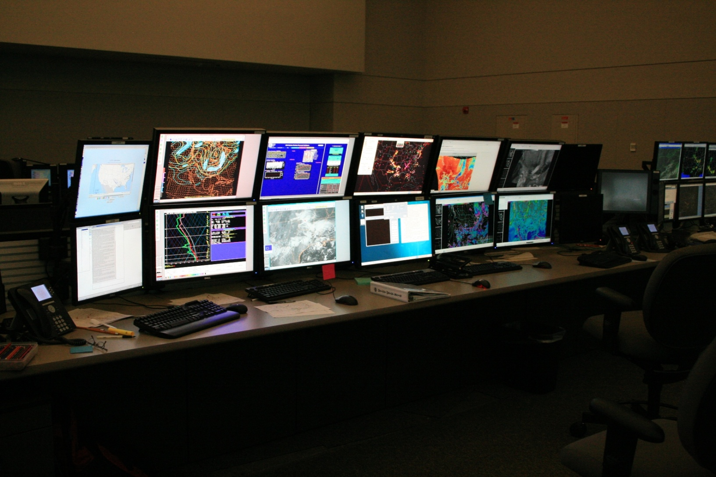
Wall of Weather
PC N-AWIPs TFMS AWIPs PC
Notes:
Tools…Hardware/software

Slide 4
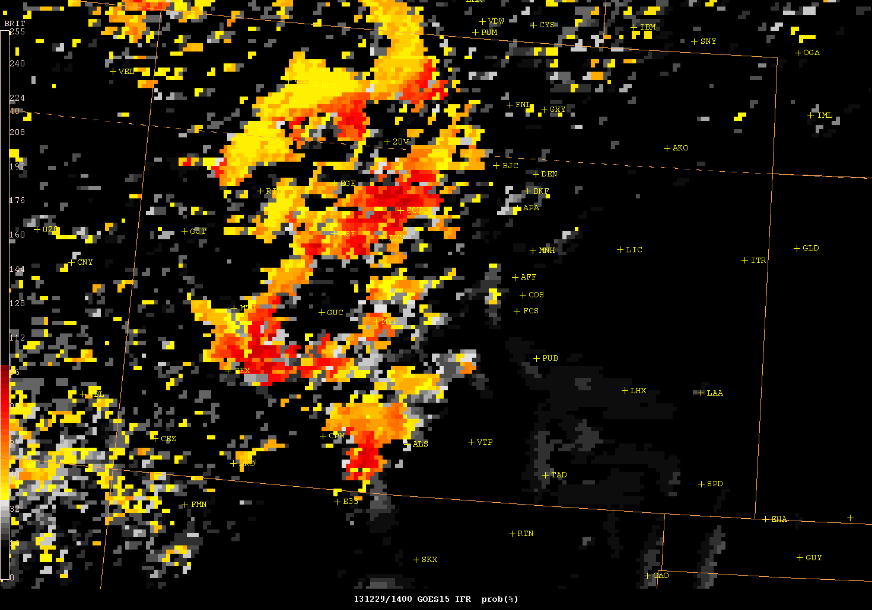
Eagle, CO
Fog Event
12/29/13

Slide 5
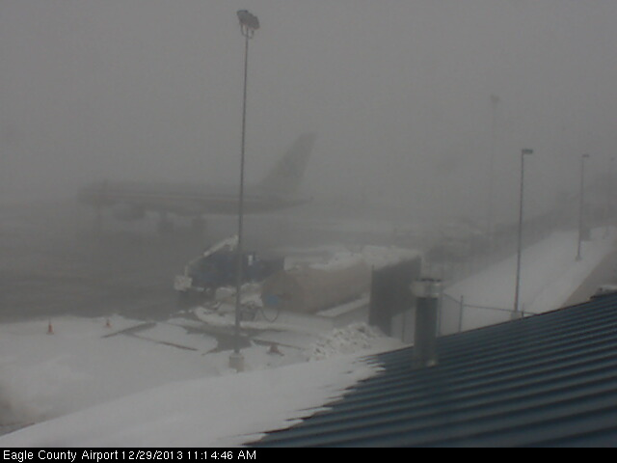
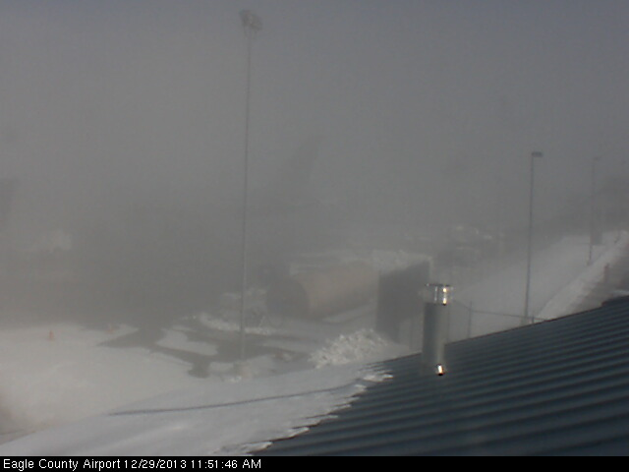
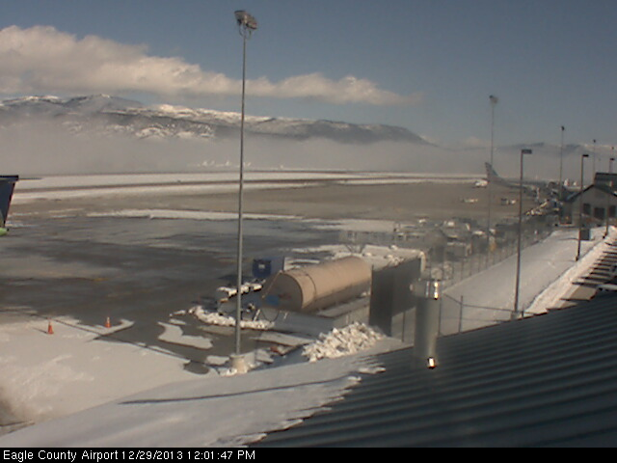
EGE Fog Event 12/29/13
15 Min before GOES-R probability indicated clearing
20 minutes after GOES-R probability indicated clearing
30 minutes after GOES-R indicated clearing

Slide 6
EGE Fog Event 12/29/13
KEGE 291450Z 00000KT 1/4SM FZFG OVC002 M11/M11 A3022
KEGE 291550Z 00000KT 1/2SM FZFG OVC002 M09/M10 A3024
KEGE 291650Z 00000KT 1/2SM FZFG OVC003 M07/M08 A3025
KEGE 291750Z 00000KT 1/4SM FZFG OVC002 M04/M05 A3025
KEGE 291859Z 00000KT 10SM FEW030 M01/M03 A3021 RMK VIS E 3/4 FG BANK E
NWS Met monitored GOES-R probability of IFR conditions. Coordination with ZDV throughout the event due to high volume of Holiday Travel to Ski Resorts.
Once Satellite lost the “one” pixel of 70% probability, we notified Terminal Specialist/Supervisor/ZDV that clearing was imminent.
Normal flight operations commenced ahead of schedule (~60 min), thereby saving time and $$ to the customers and airlines.
Delay cost → $76.00/min × 60 min × 50 aircraft
Savings ~ $228,000.00

Slide 7
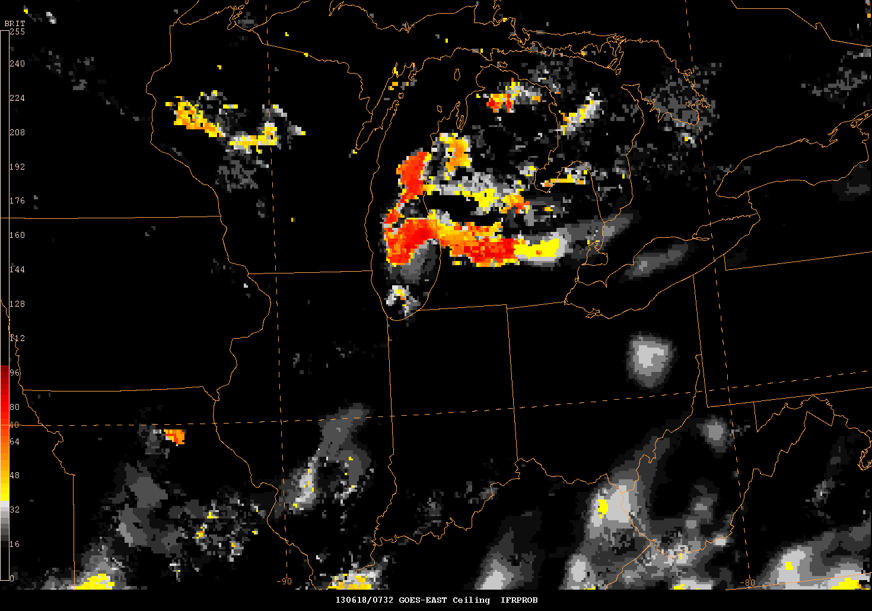
ORD Stratus Event 06/18/13
Notes:
Using GOES-R Probability IFR CIGs

Slide 8
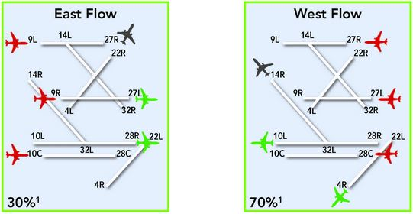
ORD Fog/Stratus Event 06/18/13
NAM arrives 4:30am
TAF had VFR Forecast
GOES-R IFR showing ↑area high probability IFR over Lake MI
Coordination with WFO LOT
TAF updated…FAA notified of major changes
ORD/Airlines ready for IFR/LIFR (extra fuel for holding??)
Airport operations changes made to accommodate the IFR conditions
Notes:
Using GOES-R Probability IFR CIGs

Slide 9
ORD Fog/Stratus Event 06/18/13
ORD TAF 180532Z 03008KT P6SM SCT060 BKN250
FM181300 04012G18KT P6SM SCT060 BKN150
ORD TAF 180907Z 03008KT P6SM SCT100 BKN250
FM181000 03007KT P6SM BKN007
ORD TAF 181125Z 03010KT 3SM BR OVC005
TEMPO 1812/1816 1SM BR
ORD 181004Z … 10SM OVC008…
ORD 181034Z … 4SM BR OVC004…
ORD 181051Z … 1 3/4SM R10L/5500VP6000FT BR OVC004…
ORD 181055Z … 1/4SM R10L/4500VP6000FT BR OVC004…
Flights 10Z - 12Z = 60
Diversion cost ~$10,000/Flight…”NO DIVERSIONS”
SAVINGS ~$600,000 – EXTRA FUEL
Notes:
Using GOES-R Probability IFR CIGs

Slide 10
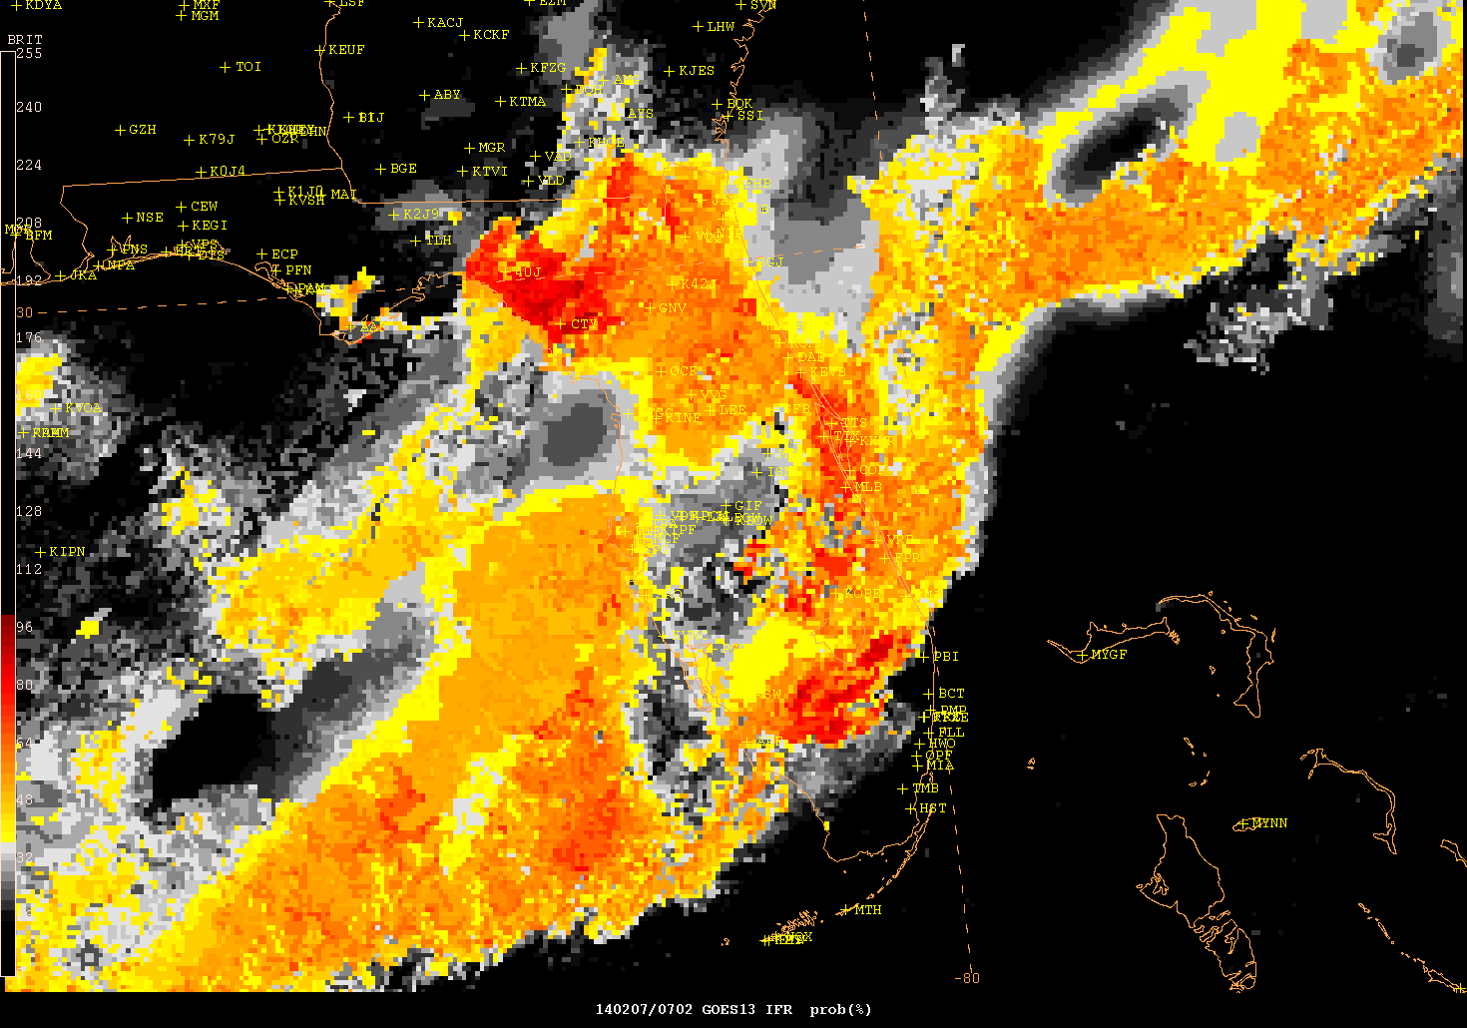
MIA FOG EVENT 02/07/14

Slide 11
MIA Fog/Stratus Event 03/07/14
GOES-R showed high probability IFR Conditions expanding SE
Coordinated w/ZMA and ATCSCC
Nothing in TAF (no observations over much of interior central Florida)
TAF KMIA 071120Z 0712/0812 00000KT P6SM FEW020 SCT250
FM071500 11006KT P6SM SCT030 SCT050=
TAF AMD KMIA 071133Z 0712/0812 34003KT 1/4SM FG VV001
FM071500 11006KT P6SM SCT030 SCT050=
MIA 071053Z 33006KT 10SM FEW020 SCT050…
MIA 071101Z 33005KT 9SM SCT003 SCT020 BKN050…
MIA 071110Z 34005KT 3/4SM BR VV002 21/20 A3008 RMK AO2 TWR VIS 5=
MIA 071127Z 34003KT 1/4SM FG VV001…
MIA 071153Z 33005KT 0SM FG VV001 21/20 A3010 RMK AO2 SFC VIS 1/4…

Slide 12
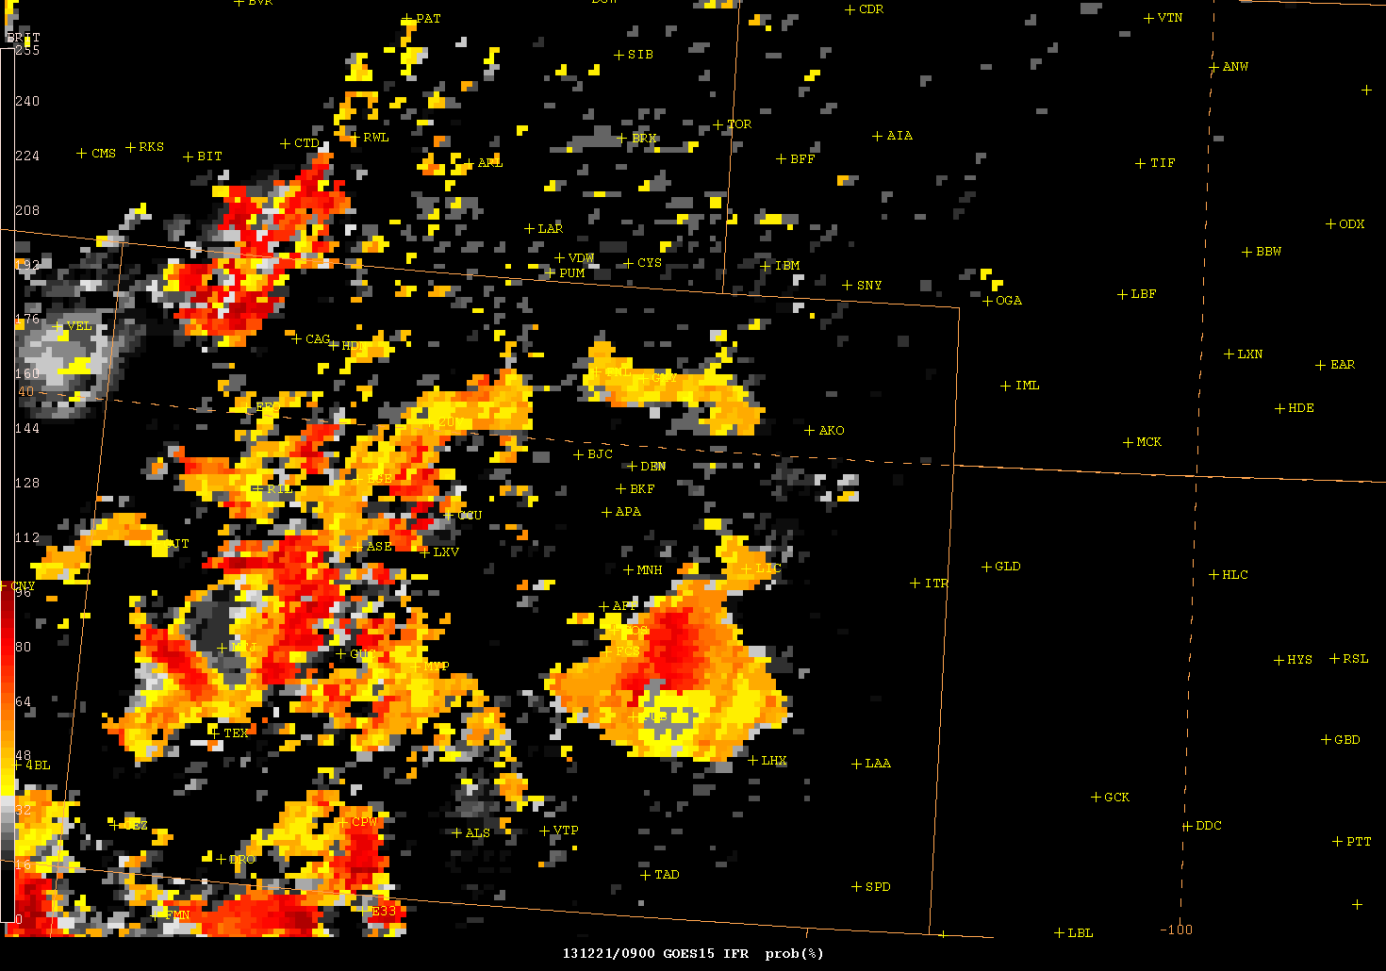
DIA Fog Event 12/21/13

Slide 13
DIA Fog Event 12/21/13
DEN 210854Z 2109/2212 15007KT P6SM FEW100 SCT200
FM211300 25008KT P6SM FEW140 BKN200
FM211600 33007KT P6SM SCT140 BKN200
ACTSCC WX LOG:
1055Z – GOES-R SHOWG IFR CIG DVLPG N OF DEN & EXPNDG S…THINK IT WL GET INTO DEN ~12Z AND LAST 2-3 HRS. SOME FZ FOG PSBL.
DEN 211120Z 2112/2218 30007KT 1SM BR BKN003
TEMPO 2112/2116 1/4SM FZFG VV001
FM211600 24006KT P6SM SCT140 BKN200
DEN 211509Z 2115/2218 27005KT 1/4SM FZFG VV001
FM211600 27005KT 1/2SM FZFG VV002
FM211630 28005KT 2SM BR BKN004
DEN 210753Z 23005KT 8SM CLR M08/M10 A2958
DEN 210853Z 16010KT 9SM CLR M09/M12 A2956
DEN 210953Z 15007KT 10SM FEW002 M11/M13 A2953
DEN 211053Z 30009KT 9SM VCFG FEW000 M09/M11 A2952 RMK AO2 SLP031 FG FEW000 VIS LWR E AND NW-N
DEN 211059Z 29009KT 8SM BCFG FEW000 SCT003 M09/M11 A2952 RMK AO2 FG FEW000 VIS LWR S AND NW-NE
DEN 211112Z 29009KT 1 1/2SM BR BCFG FEW001 BKN003 M09/M11 A2952 RMK AO2 CIG THN TWR IN CLDS
DEN 211119Z 30007KT 1/2SM R35L/P6000FT FZFG BKN000 OVC003 M09/M11 A2951
DEN 211127Z 31008KT 1/8SM R35L/P6000FT FZFG VV001 M09/M11 A2951
DEN 211153Z 34003KT 1/16SM R35L/P6000FT FZFG VV001 M09/M11 A2952
DEN 211222Z 00000KT 1/16SM R35L/1000V1200FT FZFG VV001 M10/M11 A2953

Slide 14
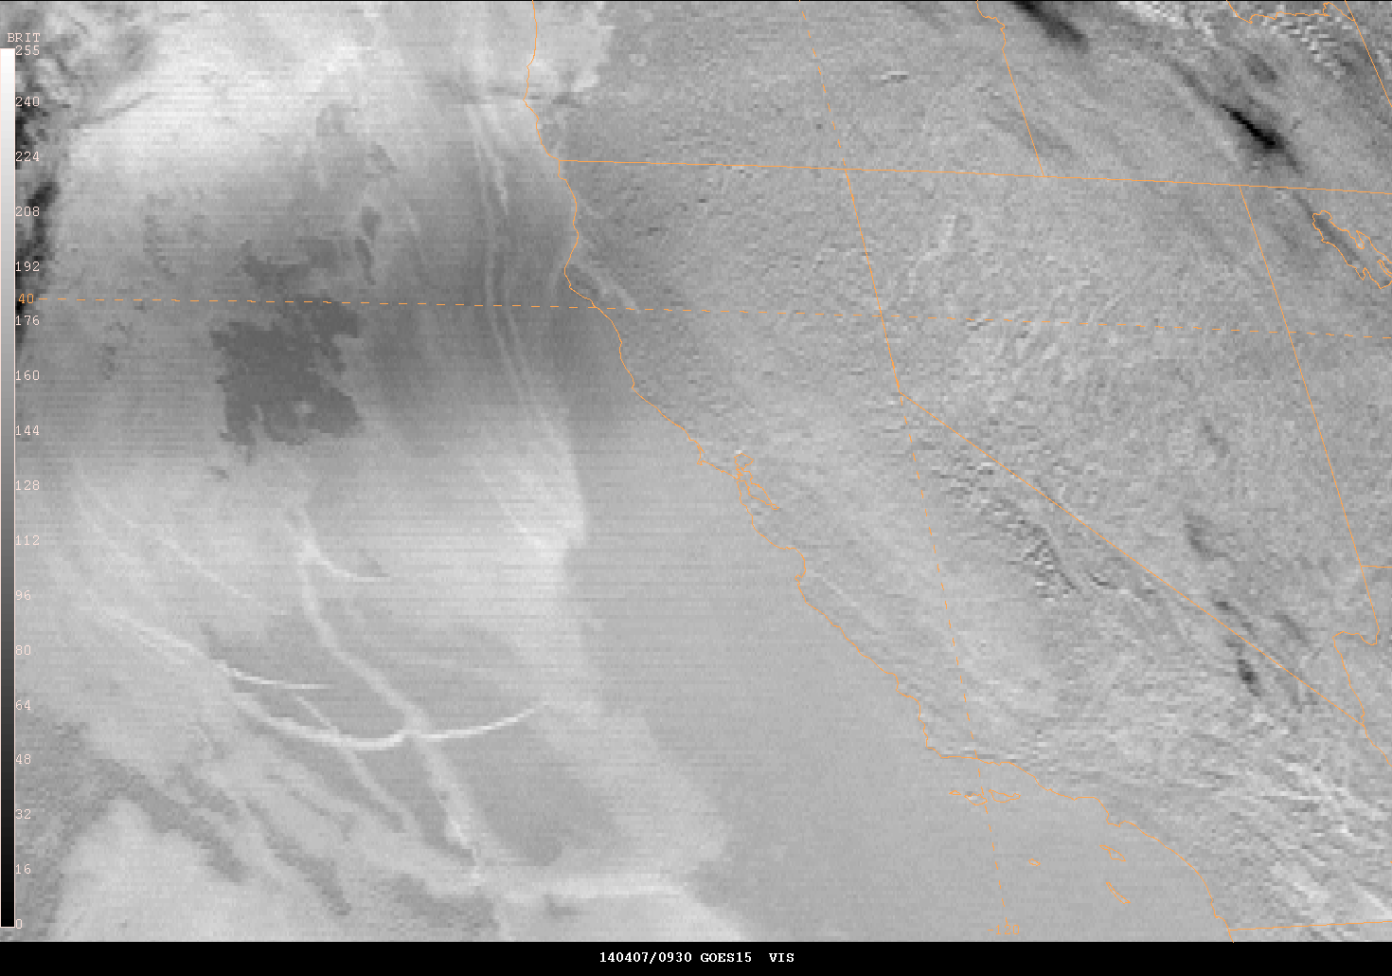
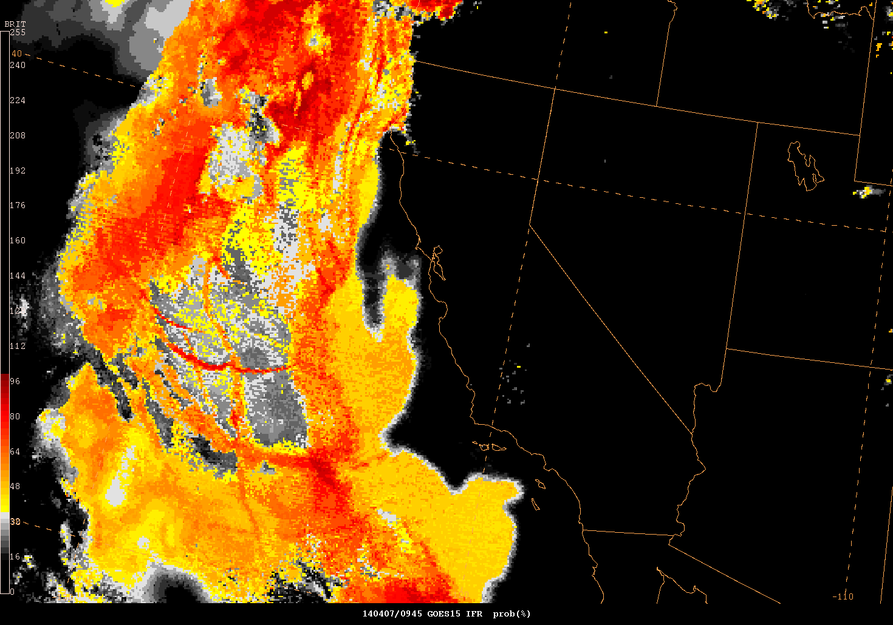
SFO Negative Case 04/07/14
GOES-R showed med probability IFR conditions
Coordinated w/ZOA
GOES-R incorrectly showed potential IFR
Notes:
Using GOES-R Probability IFR CIGs

Slide 15
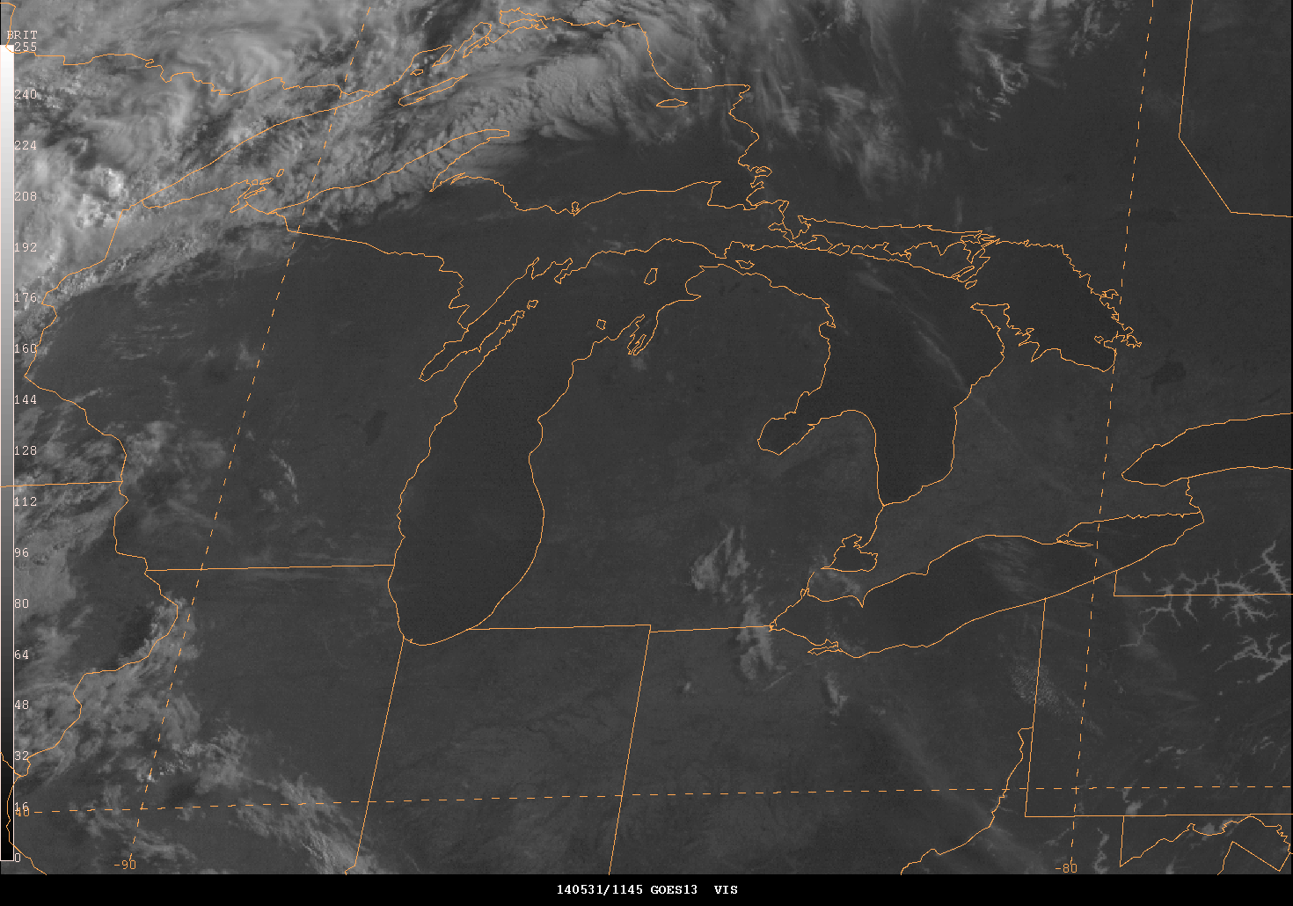
Great Lakes Negative Case 05/31/14
GOES-R showed high probability IFR Conditions
Coordinated w/ZAU …ZAU MET saw nothing over Lake MI
Vsbl pics showed CLR conditions

Slide 16
SUMMARY
Good heads up with nocturnal events
Good source in data-void (SFC Obs) areas
Need further evaluation for areas with large pockets cold water
Use of GOES-R Probability IFR conditions has been positive for Decision Support Services @ ATCSCC between NAMs/CWSU & WFO METs
Likely saved Millions of $ for the Aviation Industry

Slide 17
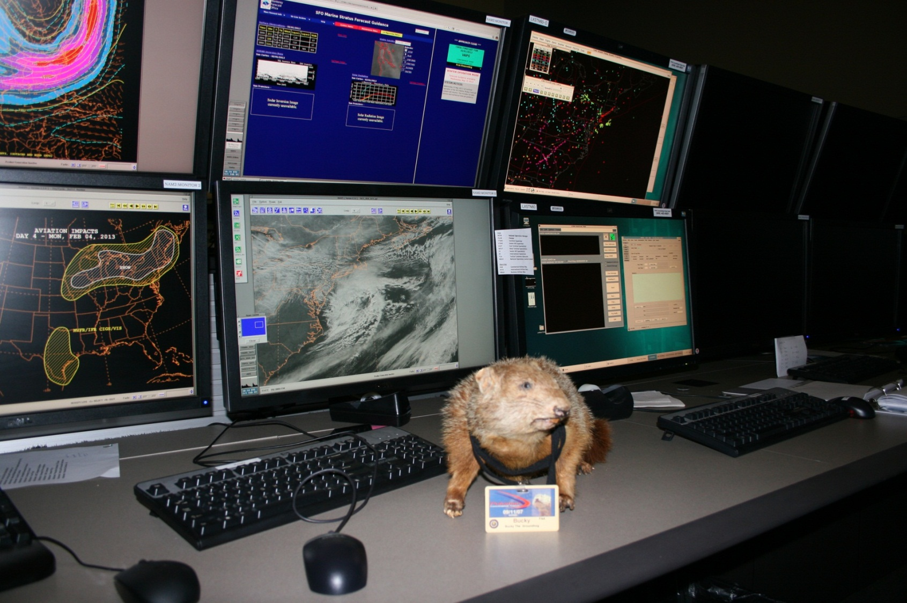
QUESTIONS????

