Slide 1
Use of Satellite Observations in RTMA/URMA
Steve Levine, Manuel Pondeca, Jacob Carley, Runhua Yang
2016 Satellite Proving Ground/User-Readiness Meeting
11 May 2016

Slide 2
Overview
Description of RTMA/URMA
Ob ingest/quality issues
More info about RTMA and URMA in this NOAA Google drive folder
Satellite Winds in RTMA/URMA
Satellites used
Example plots
Fit-to-analysis and fit-to-background stats
Cloud cover analysis
Jordan Gerth’s GOES-R work (originated at this meeting!)

Slide 3
Real Time Mesoscale Analysis (RTMA)
Gridded (NDFD resolution) hourly near real time surface fields for situational awareness, verification, ‘analysis of record’
Used for tuning National Blend, initial forecast grid population, now verification in CR
Use all available surface obs and near-surface satellite obs (winds over water only)
Mesonet (MADIS Integrated mesonet feed)
METAR
Surface Synoptic
Surface Ship
Buoy
ASCAT winds
Satellite winds over water and below 850 hPa
Assimilate obs with background field (short-term forecast, RAP/NAM/HRRR)
Un-Restricted mesoscale analysis (URMA) runs 6 hours later to pick up latent data (also includes min/maxT)
Notes:
Added near-surface satellite winds, and ASCAT winds

Slide 4
Data Processing at NCEP
BUFR
Tanks
/dcom
Different tanks/dumps for different types - not cross checked
GTS
NCO/PMB
NCO/SIB
tranjb
Gather data
decode
dumpjb
NWSTG/
TOC/
“Gateway”
Satellite ingest scripts
“Katz” scripts/EMC
Dump Files
LDM
tranjb
TNC
Conventional data
Non-conventional Data
MADIS
LDM
PREPDATA
Prevents
SYNDATA
CQCBUFR
PROFCQC
CQCVAD
PREPACQC
ACARSQC
PREPBUFR
SMS job queries NESDIS servers for new data
Analysis
(GSI QC happens here)
Parm cards
Radar
ROC
BUFR mnemonic table
Global (not RTMA) Guess (perhaps relocated)
NESDIS
FTP
tcvitals
Outside NCEP
Inside NCEP
*original slide from Dennis Keyser

Slide 5
Satellite/Remote Sensing Derived Winds used in RTMA/URMA
Assimilate Low-level Cloud drift winds over ocean at or below 850 hPa.
JMA visible and IR
EUMET SAT visible
NESDIS GOES IR*
NESDIS GOES WV cloud top
EUMETSAT IR
EUMETSATWV deep layer winds
MOIDS IR, WV clould top. WV deep layer
ASCAT scatterometer winds thinned to 50 km
*Most commonly seen in typical analysis (except in Guam domain)
MODIS IR winds often seen in Alaska
JMA Himawari obs typically seen in Guam and AK domains also
Use pressure-dependent 10 m wind speed reduction factor

Slide 6
Example Impact of Satellite Observations in URMA
All plot values in kts
ASCAT Winds
NESDIS GOES IR

Slide 7
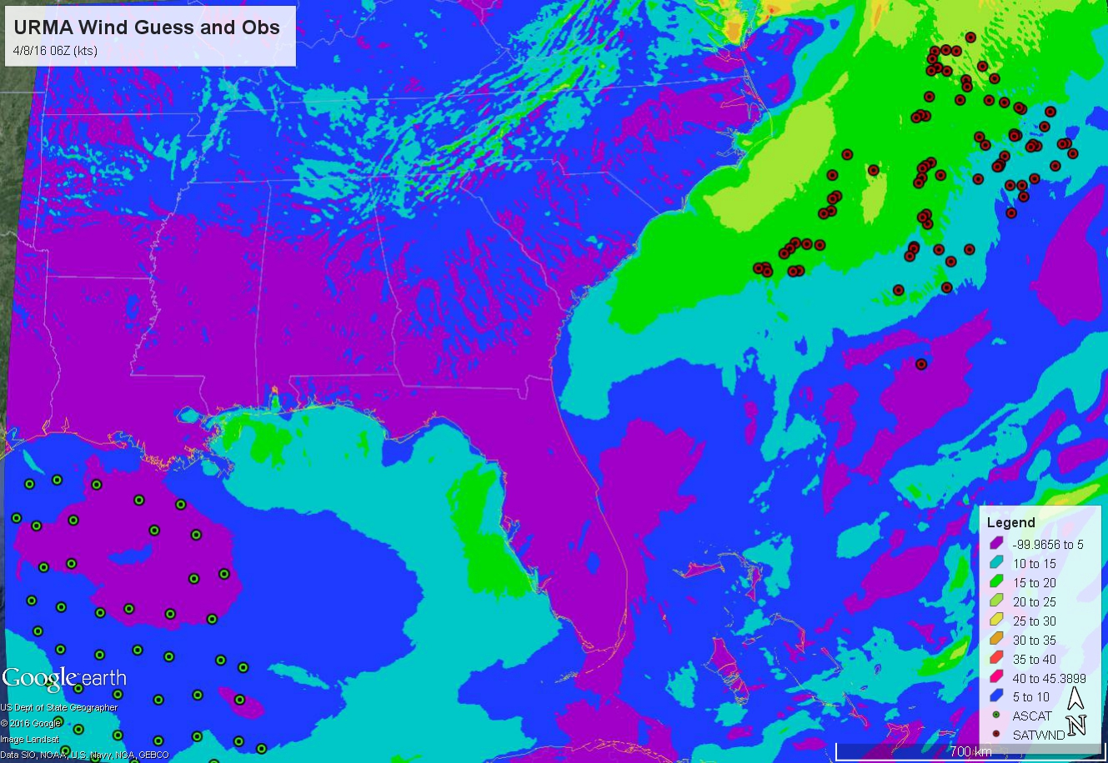

Slide 8
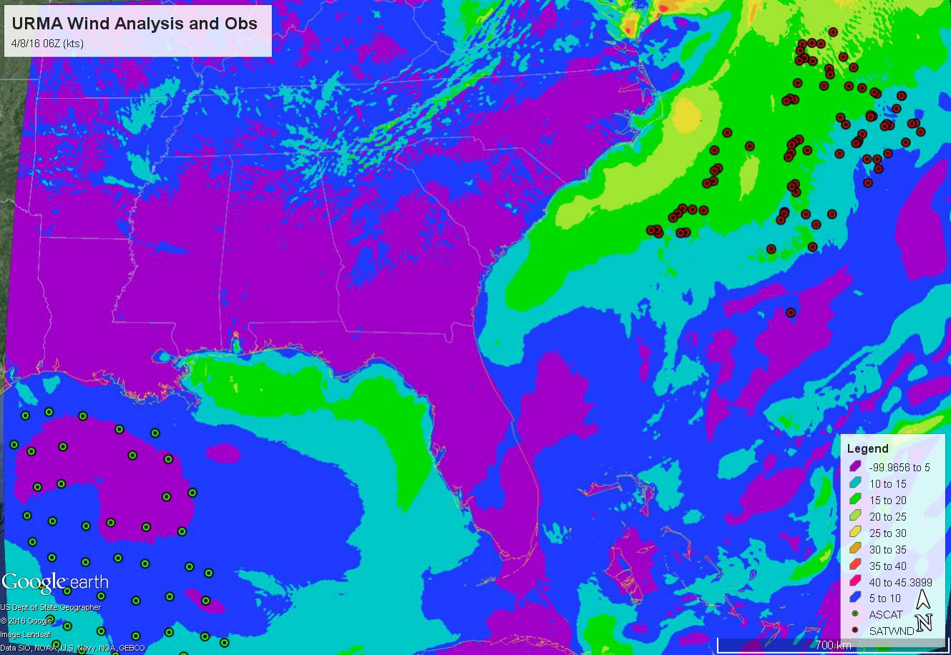

Slide 9
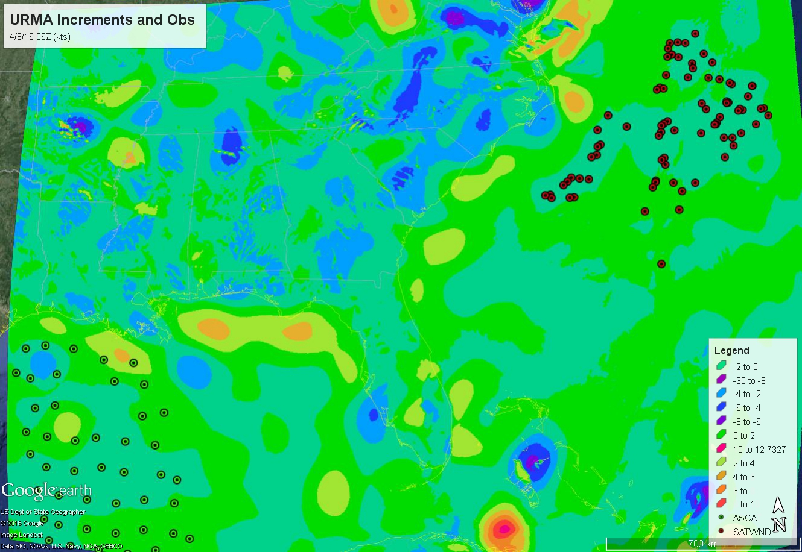

Slide 10
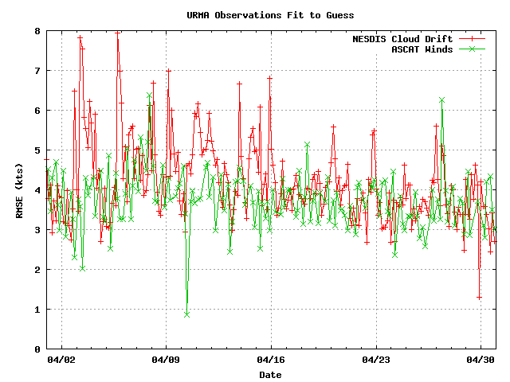

Slide 11
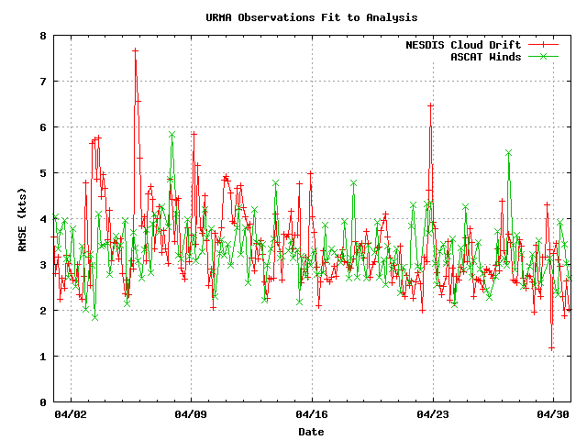

Slide 12
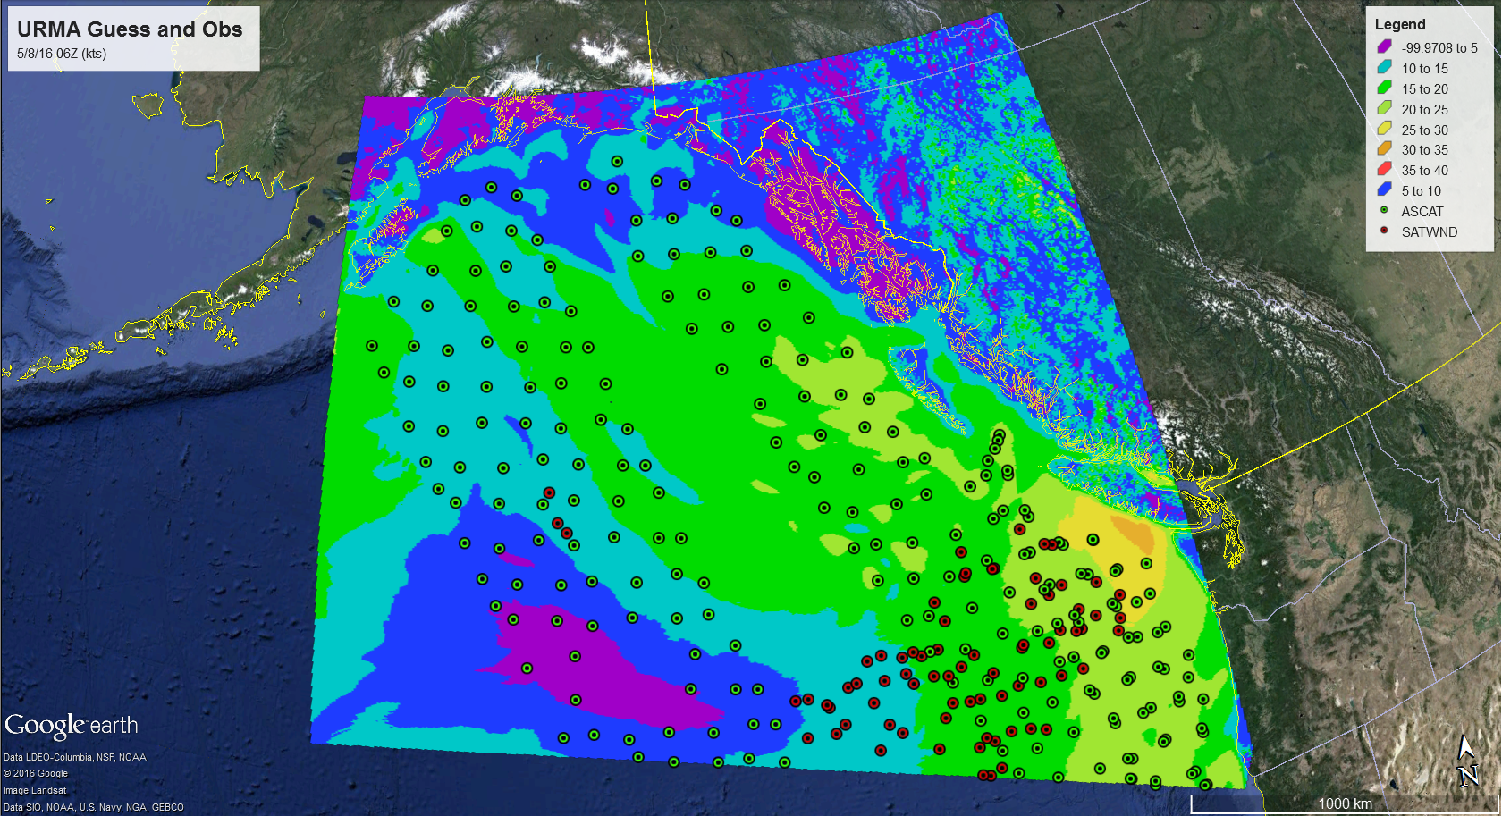

Slide 13
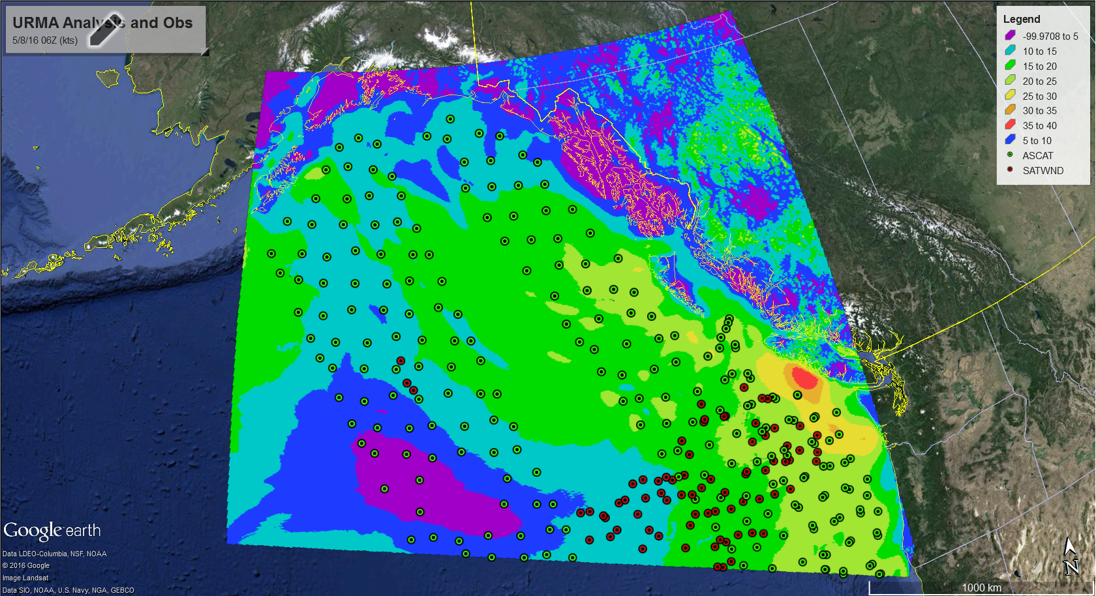

Slide 14
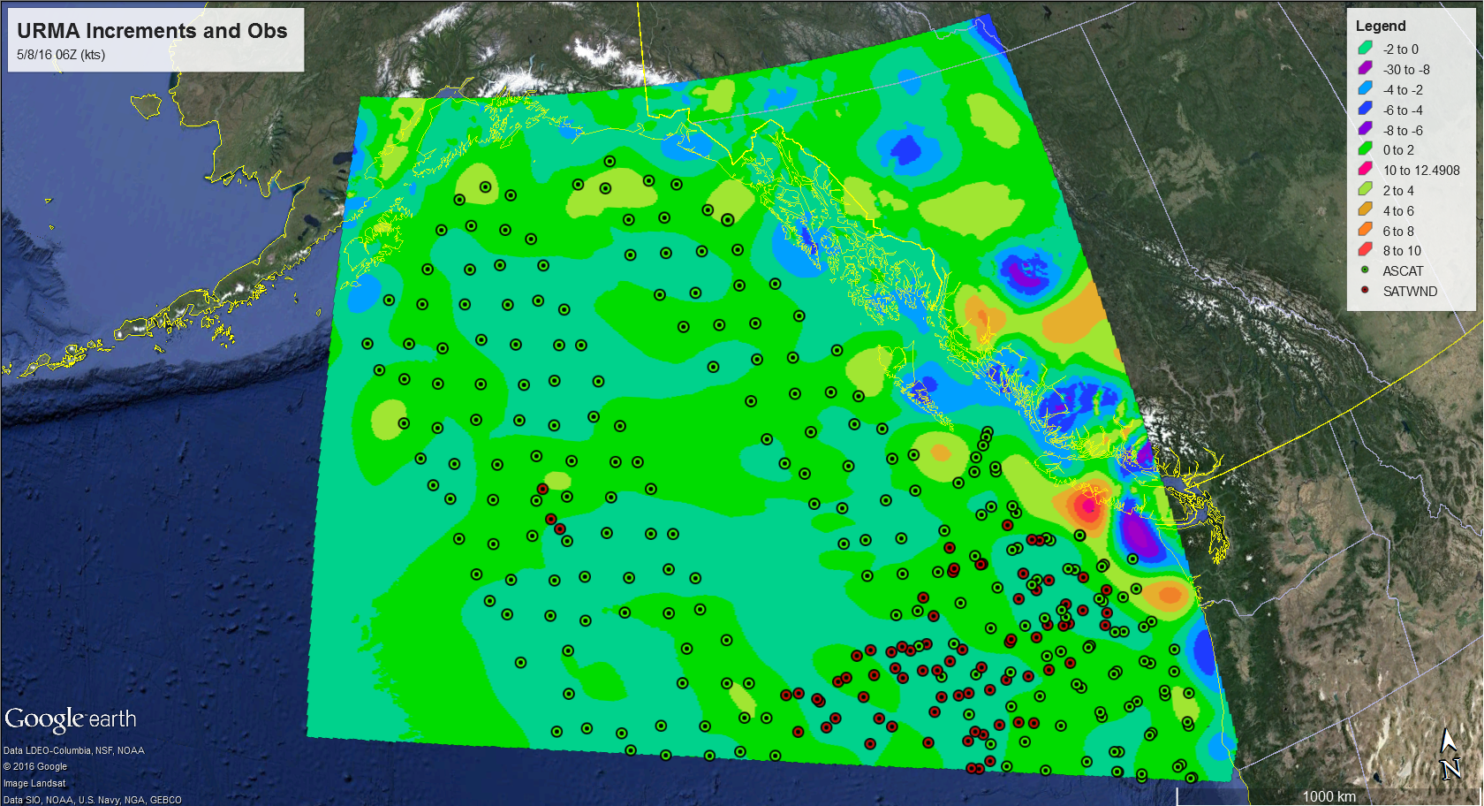

Slide 15
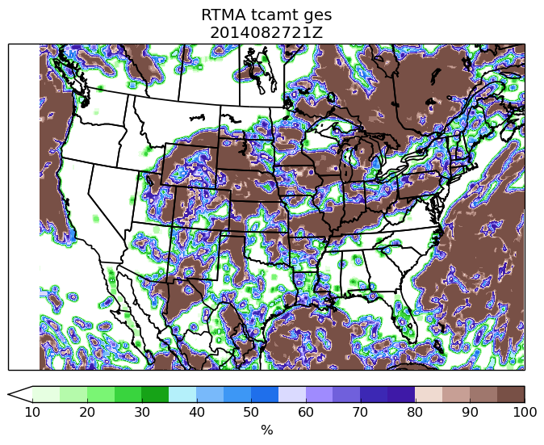
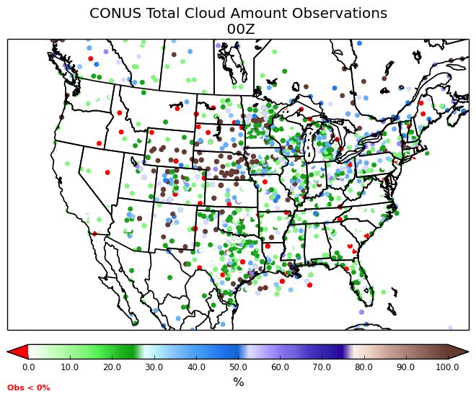
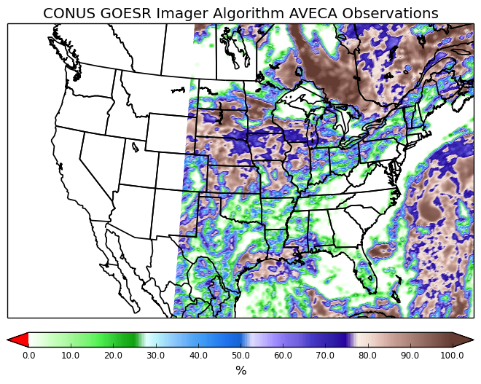
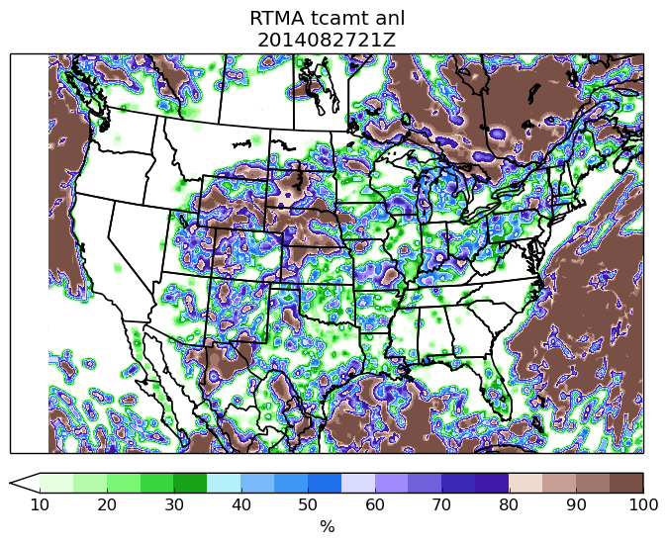
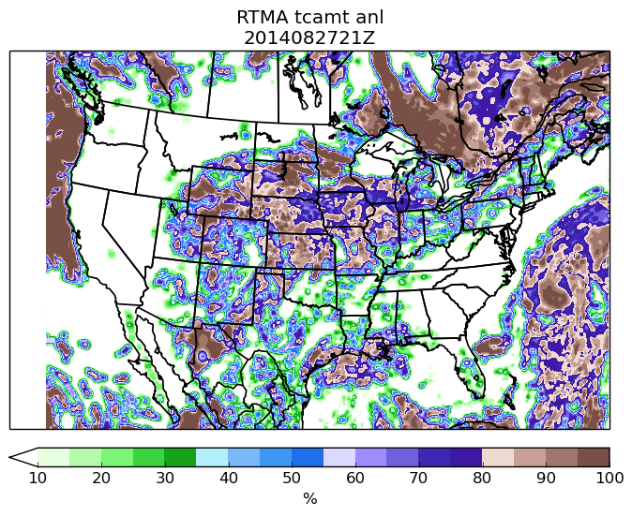
RTMA/URMA - Sky Cover Analysis Development
Collaboration with J. Gerth of Univ. Wisconsin/CIMSS
Establishing NCEP data feed for GOES Imager Sky Cover data produced via GOESR algorithms for use in RTMA/URMA
RTMA Background
GOES Imager Obs
Surface-based Obs
RTMA Analysis with ONLY Surface Obs
RTMA Analysis with NEW GOES Imager obs and Surface Obs
Sky Cover better matches GOES Imager data when assimilated → more realistic/plausible analysis
Large reduction in sky cover over central US

Slide 16
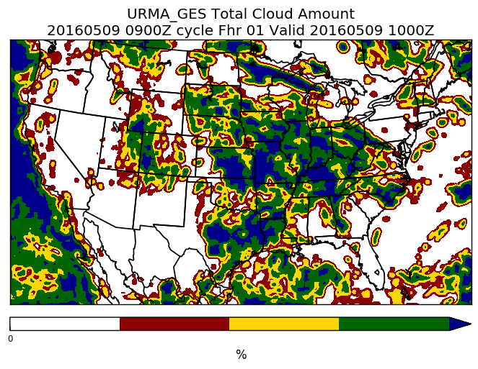

Slide 17
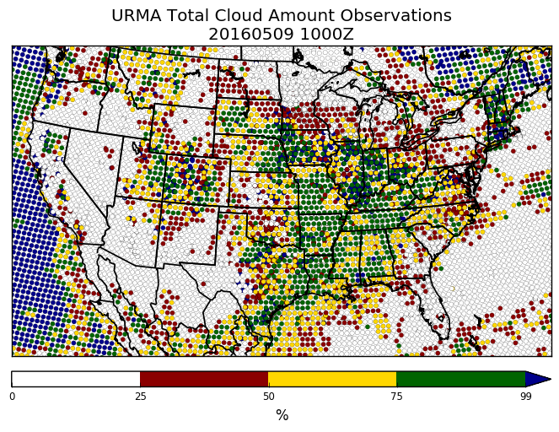

Slide 18
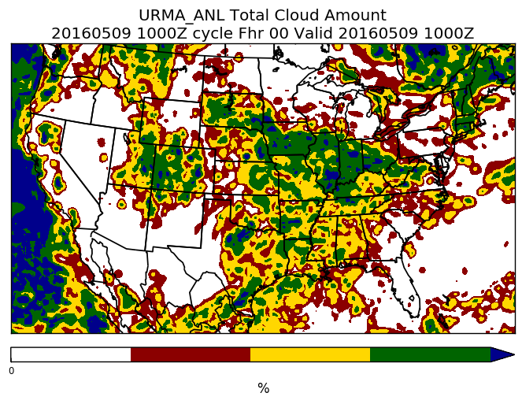

Slide 19
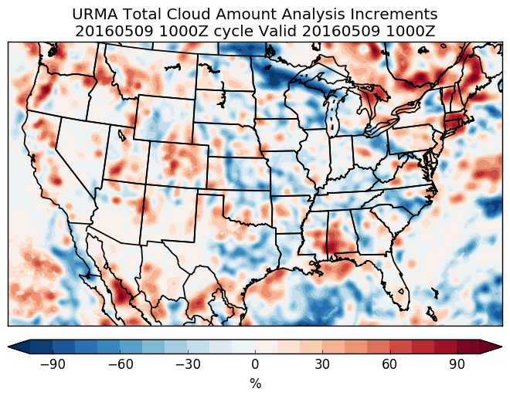

Slide 20
Want more RTMA/URMA info?
VLab Page
Google Drive Folders
Listserver
aor-rtma@infolist.nws.noaa.gov or rtma.feedback.vlab@noaa.gov
SOO/DOH evaluation group
Monthly-ish conference calls
Early access to development versions
Field feedback and suggestions always appreciated
Thank you!

